Slide 1
What Do I Do with All These Reports? Integrative Planning, Data-Informed Decision Making and Continuous Quality Improvement
Dr. Cynthia Napoli-Abella Reiss, West Valley College
Dr. Sarah Harris, College of the Sequoias
Dr. Jennifer Vega La Serna, College of the Sequoias

Slide 2
Session Description
The 2024 ACCJC Standards take data out of the introductory silo and ask colleges to report on it in context and in practice. Throughout these standards, institutions are challenged to leverage their institutional processes and practices toward meaningful outcomes and provide evidence of integrated planning and the use of data in the pursuit of continuous quality improvement. In this session, presenters will focus on how an intentionally designed integrative planning process can help colleges use data to direct their resource planning toward meeting the college mission. Presenters will share some best practices for making data accessible and meaningful for planning, and discuss how colleges can evaluate and reflect on planning processes as they work toward continuous quality improvement, whether they are reviewing institutional effectiveness during lean times or during periods of growth.

Slide 3
Introductions and Discussion Poll :
What is your role at your college?
How clear and transparent is your college’s decision-making process?
How accurately could you describe or diagram your college’s decision-making process?
Your Planning Process

Slide 4
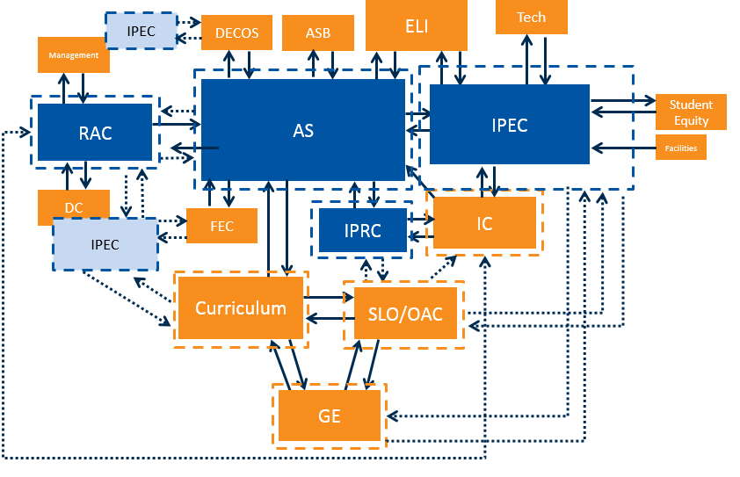
Clear Decision-Making?

Slide 5
Standard 1: Institutional Mission and Effectiveness
The institution has a clearly defined mission that reflects its character, values, organizational structure, and unique student population. The mission outlines the institution’s explicit commitment to equitable student achievement and serves as a guiding principle for institutional planning, action, evaluation, improvement, and innovation.

Slide 6
Data in the ACCJC Standards
Have Data: 2014 Standards
Use Data: 2024 Standards
Full ISER Data Chapter
4 Standards, 127 Substandards
“Data” mentioned in 7 substandards: 18%
Data often isolated in beginning chapter – meant to inform later writing, but may not do so explicitly.
Data Chapter requirement removed
4 Standards, 30 Substandards
“Data” mentioned in 2 substandards: 15%
Data appears throughout the review criteria & possible evidence
Data expected to be integrated throughout the ISER – colleges should show how it is used to inform improvements in student outcomes

Slide 7
Discussion: Standard 1
Review Criteria:
The institution has established and published standards for student achievement (i.e., institution-set standards) in accordance with Commission policy.
The institution regularly reviews and discusses qualitative and quantitative data to evaluate its progress toward achieving the mission, enhancing understanding of students’ experience, informing short and long term planning, and implementing improvements as needed.
The institution regularly reviews meaningfully-disaggregated data, identifies equity gaps, and engages in planning and improvement to close these gaps.
Possible Sources of Evidence Could Include:
Documentation of how institution-set standards and assessment of student learning are used to support the institution as it evaluates progress towards its mission
Examples of improvements and/or innovations implemented as a result of discussions of progress toward the mission
Minutes or other documentation of meaningful discussion of disaggregated data, equity gaps, and action plans in response to the data
In Breakout Rooms: Give one example from your institution to respond to bullet #2 .
1.3. The institution holds itself accountable for achieving its mission and goals and regularly reviews relevant, meaningfully disaggregated data to evaluate its progress and inform plans for continued improvement and innovation.

Slide 8
COS Example
Program Review Data Dashboard

Slide 9
Program Review Elements
Program Summary –
Strengths of the unit; includes course success; productivity, FTES, FTEF
Areas of improvement; data driven
SLO assessments/SAO assessments: timeline and progress to completion
Changes based on SLO/SAO assessments
Actions – one year
Resource requests if needed to fund actions: linked to District Objections and SLO/SAO

Slide 10
Program Review – Culture of Data
Four data metrics are displayed:
Success
Productivity
FTES (Full-time Equivalent Students)
FTEF (Full-time Equivalent Faculty)
Three years of data are displayed (Fall and Spring)
Unit totals are shown
Top 5 enrolled courses in the unit are shown
Each data category can be disaggregated

Slide 11
Scoring Rubric
Criteria | 3 | 2 | 1 | 0
Funding request is linked to District Objectives through its associated action | Demonstrates significant link to District Objectives | Demonstrates moderate link to District Objectives | Demonstrates poor connection to District Objectives | Demonstrates no connection to District Objectives
The action linked to the funding request is related to course/program/ department outcomes. | Demonstrates significant link to multiple course/program/ department outcomes | Demonstrates clear link to a course/program/ department outcome | Demonstrates weak link to course/program/ department outcome | Demonstrates no link to course/program/ department outcome
Resource request is connected to achieving the action | Demonstrates significant need for the achievement of the action | Demonstrates moderate need for the achievement of the action | Demonstrates minimal need for the achievement of the action | Demonstrates no need for the achievement of the action
Data supports the rationale for the action and need for resource request | Data significantly supports rationale for the action and need for resource request | Data moderately supports rationale for the action and need for resource request | Minimal data present with no clear connection to rationale for the action and need for resource request | No connection to rationale for the action or need for resource request
Funding request has been ranked by Service Area | Demonstrates a high ranking in the top quartile by specific Service Area | Demonstrates a ranking in the second quartile by specific Service Area | Demonstrates a ranking in the third quartile by specific Service Area | Demonstrates a ranking in the bottom quartile by specific Service Area
COS Budget Committee Resource Request Ranking Process

Slide 12
Peralta CCD

Slide 13
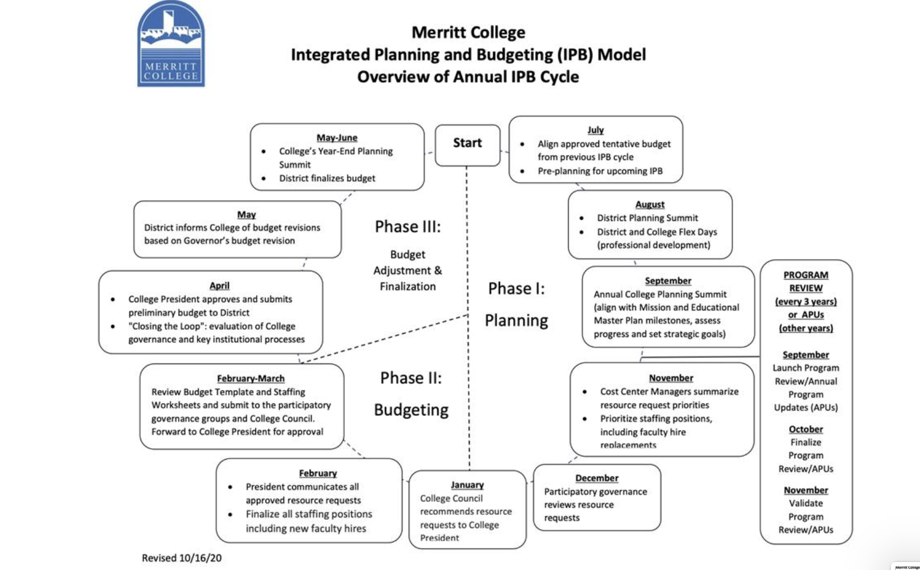
Planning Example: Merritt College

Slide 14
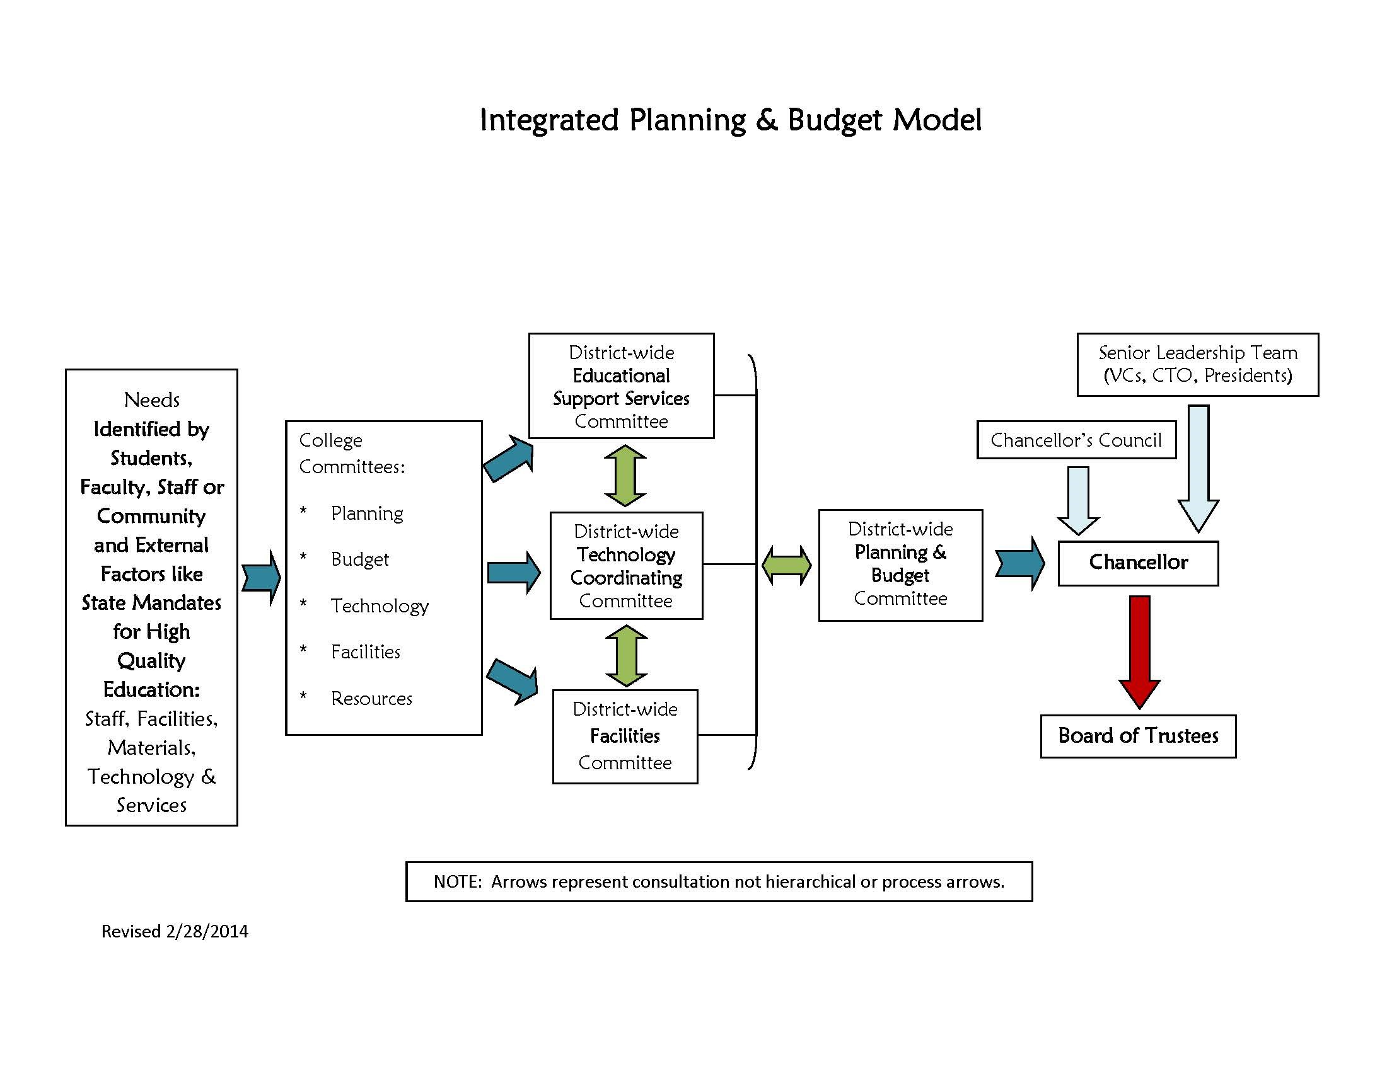
Peralta CCD Example: Planning and Budget

Slide 15
Planning Roles and Perspectives
Faculty
Staff
Administration
Board Members
Commissioners
ACCJC Focus on Outcomes

Slide 16
Plan to Plan!
Manuals describe the processes for Governance, Resource Allocation, and Planning
Each is reviewed and updated annually
Planning manual provides timelines for development of 10-year Master and 3-year Strategic Plans
Ensures ongoing, shared understanding of processes

Slide 17
Questions?
Questions? Contact: info@asccc.org
ACCJC Accreditation Handbook
2024 ACCJC Standards
COS Governance, Integrated Planning, and Resource Allocation Manuals
References and Resources

