Slide 1
Finding Our Way: Navigating Difficult Conversations
Juan Arzola, ASCCC At-Large Representative
Dr. Kimberley H. Stiemke, ASCCC South Representative
Eric Wada, ASCCC North Representative

Slide 2
Session Description
Learning how to effectively navigate difficult conversations is a necessary component of leadership. This skill becomes even more important when such conversations involve IDEAA. Join us for this interactive session as we convene a community of leader-learners to discuss potential ways to handle micro/macroaggressions in supportive and culturally affirming ways.

Slide 3
Trigger Warning
This session is intended to spark a critical conversation.
Some individuals may find some content uncomfortable and/or have strong reactions to some of the material.

Slide 4
Session Goals and Objectives
The goals for this presentation are to offer an opportunity for thoughtful reflection, dialogue, and suggestions for strengthening working relationships by learning how to engage in difficult conversations.
Identify ways to eradicate micro/macroaggressions while recognizing the toll micro/macroaggressions may have taken on you and your colleagues.
New(er) leaders will be prepared if micro/macroaggressions come up in meetings or other academic/professional spaces to identify the problem and respond accordingly.

Slide 5
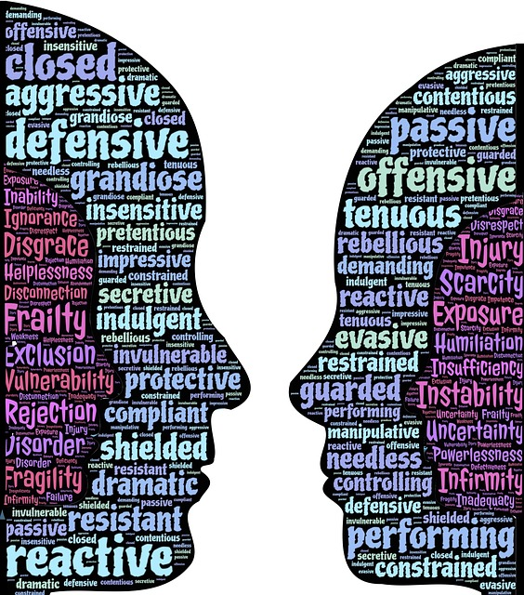
Defining a Difficult Conversation
Difficult conversations are often conversations that
are emotionally charged
involve discomfort
possess an element of vulnerability
people often avoid
are centered around IDEAA
Notes:
Conversations where IDEAA is centered can lead to challenging emotions
May result in micro/macroaggressions
Involves discomfort – ignorant, defensive, disagreements, language, priority (IDEAA)

Slide 6
But why are these conversations difficult?
are emotionally charged
often stem from micro/macroaggressions
involve discomfort
fear of rejection, being found out, fear of being wrong, fear of being called out
possess an element of vulnerability
fear of being judged, put a target on your back, fear of not meeting expectations
people often avoid
dislike conflict, hold onto their world view
are centered around IDEAA
active resistance to IDEAA, disconnect (What does this have to do with me?)

Slide 7
Introduction Video
How are microaggressions like mosquitoes?
Notes:
Eric

Slide 8
What is a micro/macroaggression?
“Microaggressions are brief every day exchanges that send denigrating messages to certain individuals.”
“Macroaggressions are large-scale systematic oppression of a target group by society’s institutions, such as government, education, and culture, which can all contribute or reinforce the oppression of marginalized social groups while elevating dominant social groups.”
Notes:
Comments pertaining to microaggressions are also applicable to macroaggressions.

Slide 9
Types of Microaggressions
Microassault – overt discrimination, intentional acts (verbal and nonverbal)
ex. calling someone a derogatory name, mocking hand gestures
Microinsult – communicates the demographic group is not respected, slight exception to the stereotype, may be masked as a compliment, dismissive, invisibility
ex. calling male doctors, “Dr.” and female doctors “Mrs.”
Microinvalidation – a comment or action that dismisses the experiences of historically disadvantaged group members
ex. color blindness, “I don’t see color.”

Slide 10
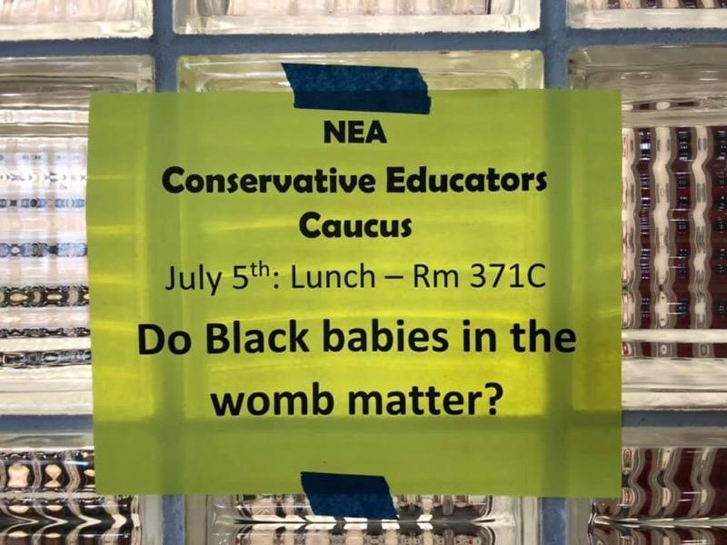
Critical Perspectives for Thought

Slide 11
What are your Critical Thoughts?
What message is the question communicating?
Who is communicating the message?
What power and/or influence does the messenger/and messaging have?
How does the question make you feel?
Who is being impacted by the question/message?
Notes:
This is just an example. Can be applicable to why SEA funds are being used to …

Slide 12
Impact of Micro/macroaggressions
Emotional and mental toll
Increased stress
Burnout
Frustration
Racial battle fatigue
Confronting resistance
Targeted backlash
Racelighting
Disillusionment
Lack of support
Lack of resources
Lack of intentionality
Notes:
Juan

Slide 13
Responding to Microaggressions
Inquire – Ask for clarification
Reframe – Give a different perspective
Identify – Directly state how what was said was offensive
Diffuse – Take a step away and process the situation
Revisit – Reflect on what was said and if you missed an opportunity to address a microaggression, go back and address a microaggression if you missed the opportunity

Slide 14
Culturally Responsive Leadership
Encourage equity-focused professional development broadly
Expect equity-centered discussions.
Setting the foundation for culturally responsive dialog in your meetings
Community agreements
Statements about faculty and equity, ethics, professionalism, etc…?
Recruit faculty with diverse backgrounds to lead
Recognize when someone might be overtaxed
Pros and cons of term limits
Be prepared for when a meeting goes sideways
Recognize microaggressions and address them appropriately
It’s tough - consider practicing or role playing.
Check-in with members of your Senate periodically
Practice cultural humility
Notes:
Eric

Slide 15
Cultural Humility as a Form of
Culturally Responsive Leadership
Self-reflection & Cultural humility:
ASCCC Cultural Humility Toolkit
Individual and institutional self-assessment/self-reflection prompts
Resources from ASCCC and Vision Resource Center
Decision tree and action plan to begin self-reflection and cultural humility
ASCCC’s Cultural Humility Training: Four Principles
Lifelong learning, self-reflection, compassionate self-critique
Investment in interconnectedness and interdependence
Mitigate or redress power imbalances
Advocate for institutional consistency

Slide 16
IDEAA-centered Faculty Conversations on Academic and Professional Matters
Revisiting IDEAA movement
Embraced by the ASCCC (as directed by the field at Spring 2022 and Fall 2022 Plenary Resolutions here)
Current Academic and Professional matters through an IDEAA lens
Academic freedom
Curriculum and Course Outline of Record
Equivalency
Faculty evaluation
Faculty hiring procedures
Faculty professional development/learning
Faculty service areas
Tenure review
Notes:
Juan

Slide 17
Partner Share
Describe a time when you had to navigate a difficult conversation.
What were the circumstances?
What was the resolution?
How did the resolution come about?
What strategies did you use?
Is there a take-away from this session that would be helpful?

Slide 18
Self-care and Affirmations
How do you practice self-care?
2 Minute Grounding Meditation

Slide 19
Takeaways
Please share a thought that has resonated with you during this presentation.

Slide 20
References/Resources
ASCCC Cultural humility toolkit
01.01 2022 Fall Adopt the Academic Senate for California Community Colleges Mission, Vision, and Values Statements that Include Anti-Racism
03.01 2022 Fall Advancing IDEAA in Guided Pathways
07.05 2022 Fall Incorporating Inclusion, Diversity, Equity, Anti-racism, and Accessibility (IDEAA) Principles Explicitly into Title 5, §53200
01.02 2022 Spring Adding Anti-Racism to the Academic Senate for California Community Colleges’ Vision Statement
03.01 2022 Spring Develop and Publish an Inclusion, Diversity, Equity, Anti-Racism, and Accessibility (IDEAA) Liaison Handbook
03.02 2022 Spring Adopt the DEI in Curriculum Model Principles and Practices Framework

Slide 21
References/Resources 2
17.03 2022 Spring Faculty Participation in the Creation of Course Enrollment Maximums for Community College Departments and Courses
19.01 2022 Spring Cultural Humility Driving Inclusion, Diversity, Equity, Anti-Racism, and Accessibility (IDEAA) Work
Woods, L. and Harris III, F. (2021). Racelighting the normal realities of Black, Indigenous, and People of Color: A scholarly brief
Smith, W. A., Allen, W.R., & Danley, L. L. (2007). ''Assume the Position . . . You Fit the Description'' : Psychosocial Experiences and Racial Battle Fatigue Among African American Male College Students”. American Behavioral Scientist, 51, pgs. 551 - 578.

