Slide 1
What Should I Do When…?
Dr. Karen Chow, ASCCC Area B Representative
Dr. Maria Jose Zeledon Perez, ASCCC Area D Representative
Dr. Kimberley H. Stiemke, ASCCC South Representative

Slide 2
Session Description
Join us for an interactive session where we will look at leadership scenarios for issues that come up for local Senate leaders. As a community of learners, we will discuss potential approaches to handling conflict in culturally affirming ways.

Slide 3
Session Goals
The goals of this presentation are to:
Clarify shared governance
Review 10+1
Destigmatize conflict
Provide culturally responsive leadership strategies

Slide 4
What is Shared Governance?
“Shared governance” is not a term that appears in law or regulation. Education Code §70902(b)(7) calls on the California Community Colleges Board of Governors to enact regulations to “ensure faculty, staff, and students...the right to participate effectively in district and college governance” and, further, to ensure “the right of academic senates to assume primary responsibility for making recommendations in the areas of curriculum and academic standards.”
“Participating Effectively in District and College Governance The Academic Senate for California Community Colleges and The Community College League of California” (updated 2020) p. 2

Slide 5
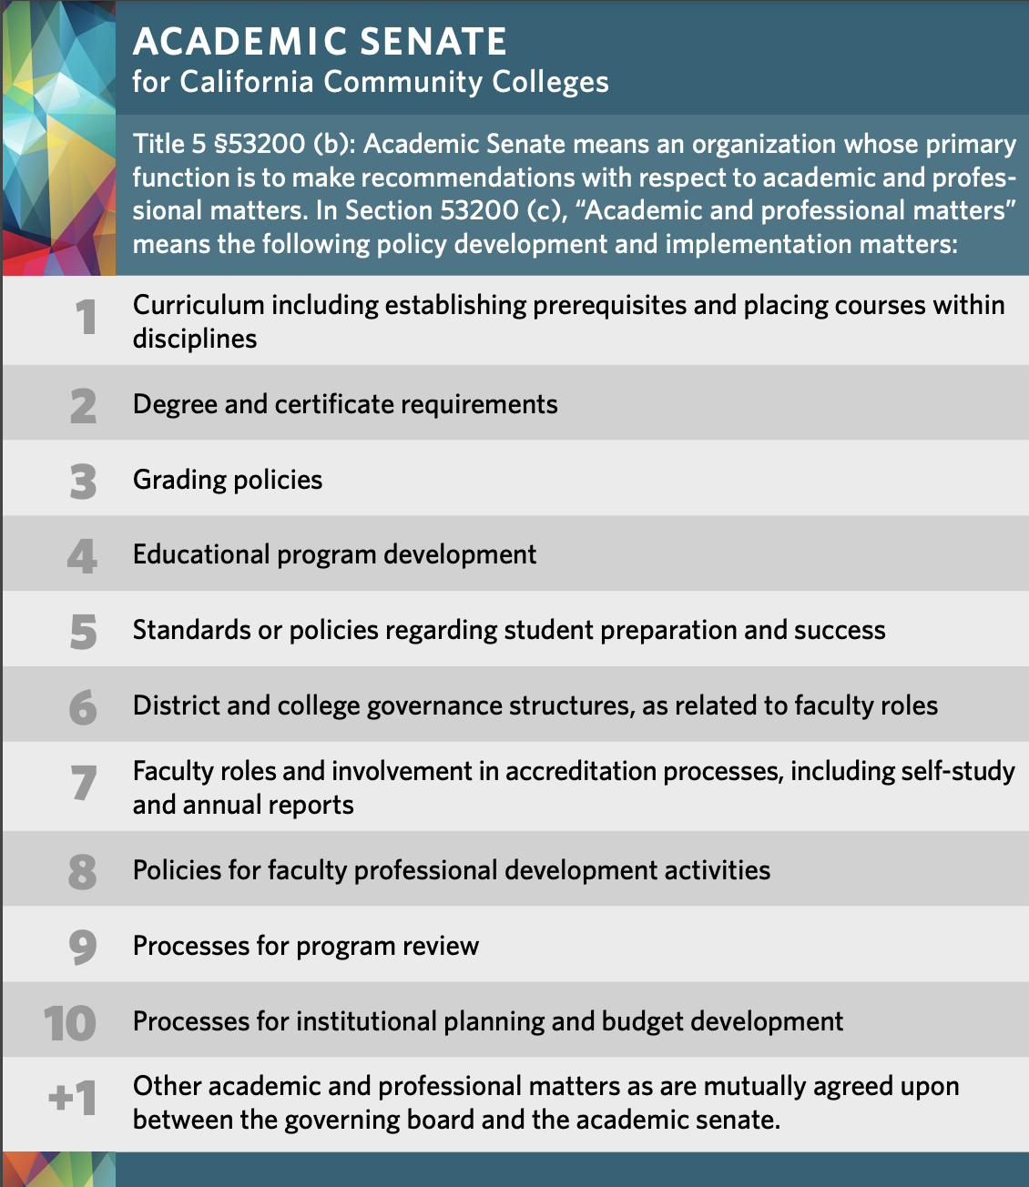
ASCCC 10+1
Title 5 § 53200 (b): Academic Senate means an organization whose primary function is to make recommendations with respect to academic and professional matters. In Sections 53200 (c), "Academic and professional matters" mean the following policy development and implementation matters
Curriculum including establishing prerequisites and placing courses within disciplines
Degree and certificate requirements
Grading policies
Educational program development
Standards or policies regarding student preparation and success
District and college governance structures, as related to faculty roles
Faculty roles and involvement in accreditation processes, including self-study and annual reports
Policies for faculty professional development activities
Processes for program review
Processes for institutional planning and budget development
Other academic and professional matters as are mutually agreed upon between the governing board and the academic senate.
Notes:
PDF https://www.asccc.org/sites/default/files/asccc_10%2B1_graphic_2020_0.pdf

Slide 6
The Truth About Leadership
1. Individuals make a difference.
2. Credibility is the foundation of leadership.
3. Values drive commitment.
4. Focusing on the future sets' leaders apart.
5. Leaders cannot do it alone.
6. Trust rules.
7. Challenge is the crucible for greatness.
8. Leaders either lead by example or they do not lead at all.
9. The best leaders are the best learners.
10. Leadership is an affair of the heart.
Truth About Leadership, James M. Kouzes and Barry Z. Posner, 2010

Slide 7
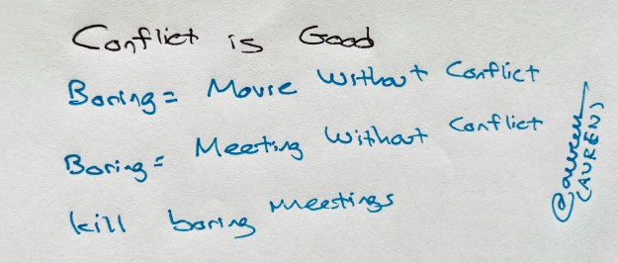
Destigmatizing Conflict
Conflict has the potential to
strengthen emotional intelligence
trigger a mindset change
develop more vital trust within the team
sharpen your leadership skills
prepare you for conflict
Notes:
https://trainingmag.com/5-tips-to-use-conflict-to-develop-your-leadership-and-team/#:~:text=Conflict%20strengthens%20emotional%20intelligence.&text=Research%20shows%20leaders%20who%20encounter,them%20across%20various%20conflict%20situations.

Slide 8
Liberatory Design Mindset as a Culturally Responsive Leadership Practice
Build relational trust
Practice self-awareness
Recognize oppression
Embrace complexity
Focus on human values
Seek liberatory collaboration
Work with fear and discomfort
Attend to healing
Work to transform power
Exercise creative courage
Take action to learn
Share, don’t sell (transparency and non-attachment in sharing ideas)
Notes:
Liberatory Design Slidedeck in English: https://static1.squarespace.com/static/60380011d63f16013f7cc4c2/t/60b698f388fe142f91f6b345/1622579446226/Liberatory+Design+Deck_June_2021.pdf
Liberatory Design Deck links for both English and Spanish: https://www.liberatorydesign.com/

Slide 9
Scenario #1: Curriculum
The college’s History Department has decided to modify the writing prerequisites for several of its courses and has taken the proposal to the college curriculum committee, where the change has been approved. The English Department faculty are unhappy with the change and protest to the academic senate, stating that the senate, with the final authority over curriculum, should overturn and prevent the change before it is presented to the governing board. Also, Ethnic Studies Department is unhappy with History Department’s request to have this course be submitted to CSU for meeting the CSU Area F Ethnic Studies graduation requirement.

Slide 10
Scenario #1 Issue
The issue is whether final authority for curriculum recommendations rests with academic senate or with the curriculum committee, and what the academic senate’s role is when there is faculty conflict around curriculum committee approvals.

Slide 11
Scenario #1 Citation
Education Code §70901(b)(1)(E) guarantees “the right of academic senates to assume primary responsibility for making recommendations in the areas of curriculum and academic standards.” In addition, Title 5 §53200(c) lists the areas of academic and professional matters on which districts must consult with academic senates, and curriculum is number one on the list. These citations of law and regulation would seem to put the authority for curriculum directly under the academic senate. However, Title 5 §55002(a) reads as follows: “A degree-applicable credit course is a course which has been designated as appropriate to the associate degree in accordance with the requirements of section 55062, and which has been recommended by the college and/or district curriculum committee and approved by the district governing board as a collegiate course meeting the needs of the students.” Similar language is included in Title 5 §55002(b) and (c) for non-degree-applicable credit courses and for noncredit courses.

Slide 12
Scenario #1 Process
Academic senates generally operate at the policy and oversight level regarding curriculum, not at the operational level. Therefore, one could properly argue that the senate has oversight over curriculum but leaves the details and implementation to the curriculum committee. For example, the senate could rightly claim purview over decisions regarding any changes to the structure or membership of the curriculum committee. However, the situation in this scenario is at an operational or implementation level. If the English faculty and Ethnic Studies faculty were to argue that proper processes had not been followed in making this change, then the senate would be justified in investigating the claim about process, and if it found the processes had not been followed, then it could ask the curriculum committee to reconsider the question and make certain that proper processes were followed. However, if the curriculum committee has followed the approved process, the senate should generally trust in the committee’s judgement rather than micro-managing.

Slide 13
Scenario #1 Suggestion
If the question is whether the academic senate has the final authority on individual matters of curriculum implementation and operation, the answer is arguably that yes, it does, since Education Code supersedes Title 5 and Education Code gives the senate primary responsibility for curriculum recommendations. However, if the academic senate micromanages the curriculum committee in that way, the curriculum committee will lose all credibility and few faculty will want to serve on it. A wise senate will trust its committees and respect their work. The curriculum committee should be trained to make curriculum decisions, while the senate often is not. Overruling the curriculum committee on a matter such as the one in this scenario would at the least be very bad practice by the senate and could ultimately cause considerable damage to the relationships between and credibility of both bodies. See “Participating Effectively” questions 19 and 32.
Notes:
Scenarios to Illustrate Effective Participation in District and College Governance A Joint Publication of the Community College League of California and the Academic Senate for California Community Colleges, Scenario 2 (modified)

Slide 14
Scenario #2: Policy for Faculty Professional Development Activities
The college’s faculty and staff development committee has approved a particular flex day activity for faculty. A group of faculty object to this activity, have gotten no satisfaction through complaints to the faculty and staff development committee, and now have brought a resolution to the academic senate to stop that particular activity. Issue: The issue is whether or not individual faculty development activities are subject to collegial consultation with the academic senate.

Slide 15
Scenario #2 Issue
The issue is whether or not individual faculty development activities are
subject to collegial consultation with the academic senate

Slide 16
Scenario #2 Citation
Title 5 §53200(c)(8) lists “Policies for faculty professional development
activities” as an academic and professional matter. If an action has been
taken contrary to policy, then the academic senate is within its rights to seek
corrective action. If the faculty development activity and the process by which
it was approved do follow adopted policy, then the academic senate may
comment, but it holds no authority to require action.

Slide 17
Scenario #2 Process
The academic senate should examine the existing policy on faculty and staff
development. The senate should communicate with the faculty and staff
development committee to ascertain the facts of the case. If the activity or
the way it was approved are not in accord with the policy, the academic
senate should state so explicitly and take steps to ensure that the staff
development committee follows the policy. If no policy violations are evident,
the academic senate should consider the merits of the complaint 18 raised
by the faculty. If the senate feels that a problem exists, it should state the
substance of the disagreement and request the faculty and staff
development committee to reconsider whether or not to offer the activity, but
the senate should not attempt to direct the decision of the committee. This
example points out that when consulting collegially on policy matters, the
academic senate needs to follow explicit standards and procedures and that
the senate’s authority rests at the policy level rather than in implementation.

Slide 18
Scenario #2 Suggestion
In this case, the problem was brought to the attention of the academic
senate before any violations occurred and any irreconcilable disputes
developed. Note that the academic senate should clearly distinguish its
roles of policy or procedure oversight and of mediation between
groups having a dispute on an implementation matter. See
“Participating Effectively” question 19.

Slide 19
Scenario #3: Academic Senate-Union Relations
Prior to the latest round of contract bargaining, the faculty union’s negotiation team met with academic senate representatives to discuss possible changes to the tenure track faculty evaluation process. Later, in an update on the status of negotiations, the union reveals a proposal for changes to the evaluation process that is significantly different from that discussed with the senate in pre-negotiation meetings. The senate protests that the union is required under Education Code to consult with the academic senate regarding faculty evaluation and has not honored that requirement. The union responds that once negotiations begin, consultation with the senate is no longer required and the union is not bound by any previous discussions.

Slide 20
Scenario #3 Issue
The issue is the degree to which bargaining units are required to consult with academic senates regarding the negotiation of faculty evaluation processes.

Slide 21
Scenario #3 Citation
Education Code §87610.1(a) states, “In those districts where tenure evaluation procedures are collectively bargained pursuant to Section 3543 of the Government Code, the faculty’s exclusive representative shall consult with the academic senate prior to engaging in collective bargaining on these procedures.” Similar language exists in Education Code regarding evaluation processes for tenured faculty and parttime faculty (§87663(f)). Education Code does not make any statement regarding communication between the bargaining unit and the academic senate after bargaining has begun.

Slide 22
Scenario #3 Process
The wording of the applicable code section states only that bargaining units must 38 consult local academic senates regarding evaluation processes before bargaining begins. The spirit of the section might be taken to indicate that academic senates have an interest in faculty evaluation procedures and should be consulted to the degree possible on the negotiation of these procedures. Faculty bargaining teams should meet with their academic senates before bargaining begins to develop a mutual understanding regarding goals, priorities, and acceptable concessions on evaluation procedures. After negotiations begin, the bargaining team should keep the senate informed to the degree possible regarding proposals and developments in the negotiation process. However, academic senates must understand that the bargaining team must be free to negotiate and cannot be bound to confer with the senate on all proposals and possibilities that arise in the negotiation process.

Slide 23
Scenario #3 Suggestion
Local senates and faculty bargaining units should develop an ongoing and consistent system of communication between the two bodies, such as liaison reports at each other’s meetings or a group of representatives from the two bodies that meets at regular intervals. Such a system can help senates and unions understand each other’s perspectives and priorities and might therefore assist in avoiding conflicts such as the one in the above scenario. Another possibility is to have the negotiations teams agree to the establishment of a joint task force with members from both sides of negotiations and representatives from the academic senate to meet and bring forward a proposal for changes to the evaluation process. Though the work product from the task force would still only be advisory to the negotiations process, it would increase the chance that both sides could agree when the item is finalized at the negotiations table.

Slide 24
Discussion
What issues are happening at your college?

Slide 25
Resources
Participating Effectively in District and College Governance The Academic Senate for California Community Colleges and The Community College League of California
The Truth About Leadership: The No-Fads, Heart-of-the Matter Facts You Need to Know
5 Tips to Use Conflict to Develop Your Leadership and Team
Liberatory Design Slide deck in English
Liberatory Design Deck links for both English and Spanish

Slide 26
Q&A
Thank you for participating in this session!
For more information, contact: info@asccc.org

