Slide 1
Legislation and Advocacy: The 411 on the 10+1 Wednesday, June 16 | 3:45-5:00

Slide 2
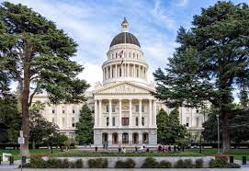
Presenters
Christopher Howerton, ASCCC North Representative
Ginni May, ASCCC Vice President
Welcome!
Who are you?
In the chat, tell us who you are…

Slide 3
Description
Significant changes to the California community colleges are often made through the legislative process (both at the state and federal level). Some recent examples include associate degrees for transfer, assessment and placement, graduation requirements, general education patterns, course numbering to and distance education. The involvement of the legislature in academic and professional matters (a.k.a. the 10+1) creates opportunities and challenges. Join this interactive session to get the 411 on legislative and budget development processes, past and currently proposed legislation, the role of academic senate leaders in advocacy, and ways for you to stay informed.

Slide 4
Overview
Legislative and budget development processes
Notable legislation or trailer bill language
Associate degrees for transfer
Assessment and placement
Graduation requirements
General education patterns
Common course numbering
Distance education
and more…
The role of academic senate leaders in advocacy,
Staying informed

Slide 5
Legislative and Budget Development Processes
Terms and Acronyms
The Assembly – the lower house of the CA Legislative Branch, 80 members
The Senate – the upper house of the CA Legislative Branch, 40 members
Assembly Bill (AB)
Senate Bill (SB)
Department of Finance
Legislative Analyst’s Office
Trailer Bill Language
Legislative Two-Year Cycle
Resource: Glossary of other Legislative Terms

Slide 6
Legislative and Budget Development Processes
The Legislative Cycle
The Legislative Branch of the California State Government is composed of the State Assembly, the State Senate, and several other departments.
This branch of government holds the principal lawmaking powers of the state.
On average, the Legislature will propose, analyze, and debate over 6,000 bills in a two-year session.
Assembly Members and Senators are limited to introducing fifty and forty bills (each, respectively) per two-year session.
Possible 5,600 bills per two-year cycle (80x50+40x40=5600) and there are always exceptions…

Slide 7
Legislative and Budget Development Processes Assembly and Senate Chambers

Slide 8
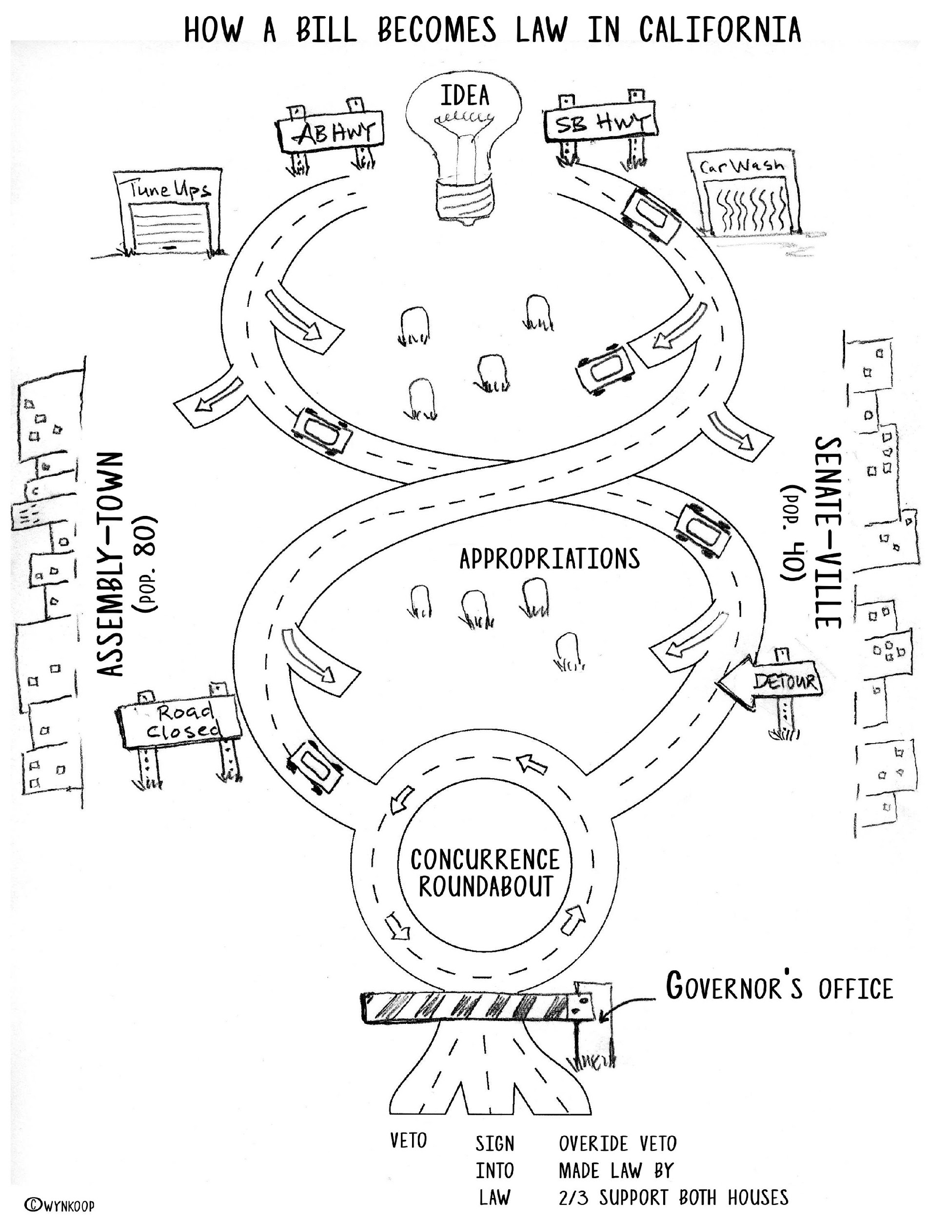
Legislative and Budget Development Processes
Graphic created by: Wendy Brill-Wynkoop

Slide 9
Legislative and Budget Development Processes Legislative Cycle Timeline
January – February
Bills are introduced
March – May (House of Origin)
Amendments
Committee Hearings
Education, Appropriations (fiscal)
Last week of May
Bills that make it go to the floor of the house for a vote
June – August
Same process is repeated in the other house
September
Concurrence
If both houses pass, then bill goes to the Governor
Governor
Veto – reject the bill
Sign – makes the bill law, chaptered
House over-ride of veto – 2/3 majority in both houses

Slide 10
Budget Development Processes
Release of Governor’s Budget
Legislative Analyst’s Analysis
Budget Subcommittee Hearings
Governor’s Revisions
Budget Subcommittee Actions
Conference Committee
Legislative Actions
Governor’s Consideration

Slide 11
Budget Development Timeline
STEP 1: Governor submit proposed budget to each house of legislature (on or before Jan. 10th)
STEP2: A budget bill is introduced in each house and referred to both the Assembly Budget Committee, Senate Budget & Fiscal Review Committee
STEP 3: The LAO provides an analysis of the proposed budget at the end of Feb. “The Analysis of the Budget Bill”
STEP 4: The budget committees from both houses develops its own version of the budget (Feb.-April)
STEP 5: Governor submits a revision (aka “the May Revise”)

Slide 12
Budget Development Timeline
STEP 6: A Conference Committee is formed consisting of:
3 members of the Senate (2 from the majority party)
3 members of the Assembly (2 from the majority party) (May- early June)
Step 7: After deliberations, a budget is submitted to both houses for a vote (passage requires a two-thirds vote) (early June)
Step 8: Once approved it is sent to the Governor for signature (must be approved by June 15).
Possible line-item veto power “blue penciling”
Any item vetoed can be reconsidered separately or overridden in the same manner as other bills (two-thirds vote)
The budget goes into effect upon the Governor’s approval of the budget bill.

Slide 13
Formal ASCCC Positions on Proposed Legislation and/or Trailer Bill Language
When does the ASCCC take a position?
How does the ASCCC take position*?
Why doesn’t the ASCCC take a position on every bill?
*ASCCC Policy: 10.09 ASCCC Advocacy – https://asccc.org/policies/advocacy

Slide 14
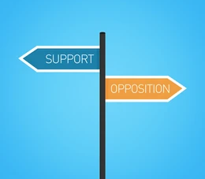
Past and Recent ASCCC Positions on Legislation
Recent Positions taken at Spring Plenary Session 2021:
6.02 – Support AB 417 (McCarty) as of March 8, 2021: Rising Scholars Network
6.03 – Support AB 421 (Ward) as of March 8, 2021: Career Development College Preparation Course Funding
6.06 – Support AB 927 (Medina) as of April 9, 2021: Baccalaureate Degree Program
6.07 – Oppose AB 928 (Berman) as of April 9, 2021: Student Transfer Achievement Reform Act
6.08 – Oppose AB 1111 (Berman) as of April 9, 2021: Common Course Numbering
Past Positions on the ASCCC website here: https://asccc.org/legislative-positions

Slide 15
Notable Legislation and/or Trailer Bill Language
Associate Degrees for Transfer
AB 440 (Beall, 2009) – Transfer Degree
SB 1440 (Padilla, 2010) – Transfer Degree: ADT
SB 440 (Padilla, 2013) – Transfer Degree: ADT
AB 928 (Berman, 2021) – Student Transfer Achievement Reform Act of 2021: Associate Degree for Transfer Intersegmental Implementation Committee.

Slide 16
Notable Legislation and/or Trailer Bill Language
Assessment and Placement
AB 705 (Irwin, 2017) – English, Mathematics, ESL placement
Notes:
Over 30 resolutions in response to AB 705

Slide 17
Notable Legislation and/or Trailer Bill Language
Graduation Requirements
AB 1460 (Weber, 2019) – CSU Ethnic Studies Requirement
AB 3310 (Muratsuchi, 2020) – CCC Ethnic Studies Requirement
AB 1040 (Muratsuchi, 2021) – CCC Ethnic Studies Requirement

Slide 18
Notable Legislation and/or Trailer Bill Language
General Education Patterns
AB 928 (Berman, 2021) – Student Transfer Achievement Reform Act of 2021: Associate Degree for Transfer Intersegmental Implementation Committee.
California State University General Education (CSU GE) Breadth
or
Intersegmental General Education Transfer Curriculum (IGETC)

Slide 19
Notable Legislation and/or Trailer Bill Language
Common Course Numbering
AB 1111 (Berman, 2021) – Postsecondary education: common course numbering system.
Trailer Bill Language
Recovery with Equity: A Roadmap for Higher Education after the Pandemic Report – Recommendation 6 is Common Course Numbering

Slide 20
Notable Legislation and/or Trailer Bill Language
Distance Education or more…
Distance Education – Trailer Bill Language
AB 927 (Medina, 2021) – Public postsecondary education: community colleges: statewide baccalaureate degree pilot program.
Zero-Textbook-Cost Programs – Trailer Bill Language

Slide 21
The Role of Academic Senate Leaders in Advocacy
Be familiar with processes
Meet with local legislators and others involved with budget
Discuss legislative priorities with your Board of Trustees
Make sure your academic senate has a Legislative Liaison
Sign up for the ASCCC legislative liaison listserv by emailing info@asccc.org
Volunteer to serve on the Legislative and Advocacy Committee and other committees!
Center inclusion, diversity, equity and antiracism in all advocacy endeavors, ensuring we are not perpetuating inequities is vital to every effort.

Slide 22
How You Can Stay Informed
ASCCC January 2021 Letter to Legislative Liaisons: https://www.asccc.org/sites/default/files/ASCCC%20Letter%20to%20Legislative%20Liaisons%201-28-2021.pdf
Floor Report of the 2021-22 Budget: https://abgt.assembly.ca.gov/sites/abgt.assembly.ca.gov/files/Floor%20Report%20of%20the%202021-22%20Budget%20-%20%28June%2011%2C%202021%20Version%29.pdf
Overview of the Legislative Process: http://www.leginfo.ca.gov/bil2lawx.html
California Legislative Information: https://leginfo.legislature.ca.gov/faces/home.xhtml
Legislative Analyst’s Office (LAO): https://lao.ca.gov
California Department of Finance: http://www.dof.ca.gov
Glossary of Terms: https://leginfo.legislature.ca.gov/faces/glossaryTemplate.xhtml
Assembly Daily History: https://clerk.assembly.ca.gov/content/daily-history
Senate History: https://www.senate.ca.gov/content/senate-histories
Department of Finance Trailer Bill Language: https://esd.dof.ca.gov/dofpublic/trailerBill.html

Slide 23
Questions and Comments

