Slide 1
General Education Webinar Series
General Education Requirements of the Associate Degree, Baccalaureate Degree, and Associate Degree for Transfer

Slide 2
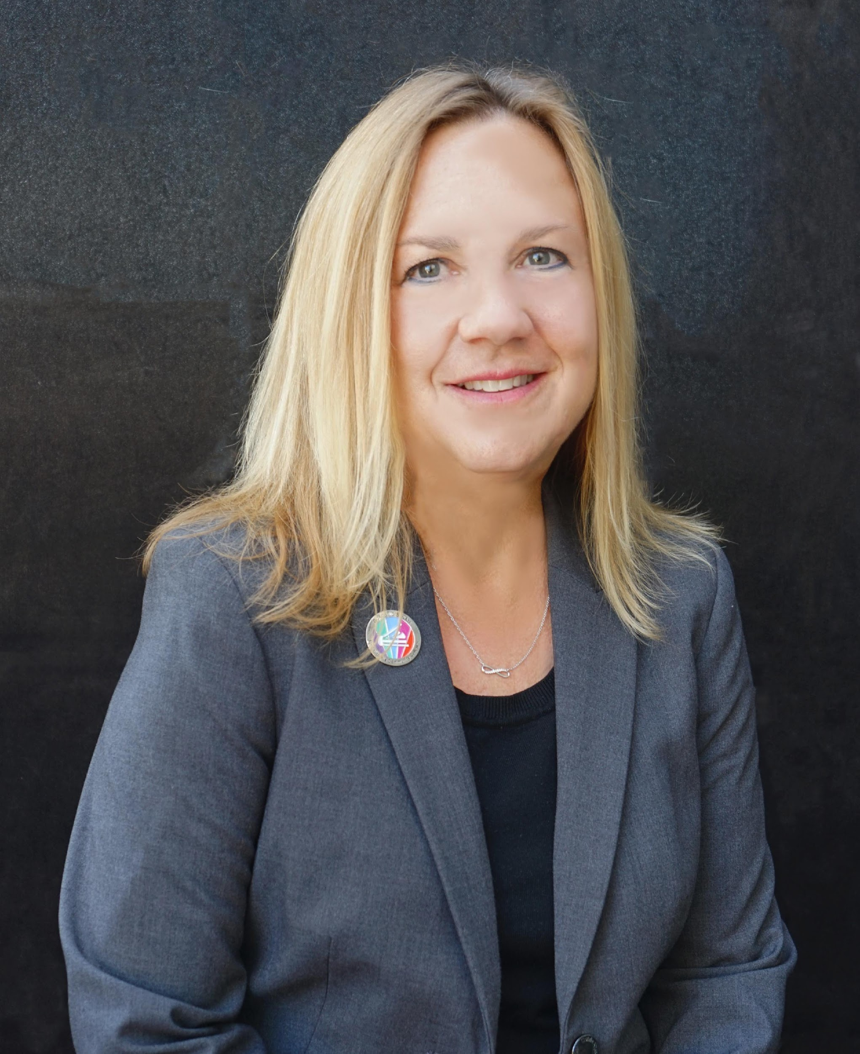
Presenters
Stephanie Curry, ASCCC Area A Representative, Transfer, Articulation, and Student Services (TASSC) Committee Chair
Ginni May, ASCCC President
LaTonya Parker, ASCCC Secretary, Curriculum Committee Chair
Notes:
Start with Stephanie and work our way through

Slide 3
Breakout Description
If you missed the 2022 Curriculum Institute presentation here is another opportunity to learn about Transfer and General Education updates and proposed changes. Join us for a discussion of General Education (GE) at the community colleges which includes local, baccalaureate and transfer GE patterns The legislation, regulation, and transfer policies that guide these patterns have undergone and continue to undergo numerous changes and updates
Most recently, AB 928 (Berman, 2021) calls for the implementation of a singular lower division general education pathway that meets transfer requirements for both the CSU and UC systems; and work to develop this new joint GE pattern is underway.
Join us in this webinar to learn about General Education at the community colleges, the impact of GE on transfer and student success, the ongoing work of the Intersegmental Committee of Academic Senates or ICAS on AB 928, discussion of an associate degree GE pattern and how to engage with faculty on your campus about the potential impacts of changes to GE.

Slide 4
History
Why General Education?
Why are we reconsidering it?
We are looking for a green light to move forward with aligning GE Pathways.

Slide 5
General Education at the Community Colleges
§ 55061. Philosophy and Criteria for Associate Degree and General Education.
The governing board of a community college district shall adopt a policy which states its specific philosophy on General Education. In developing this policy governing boards shall consider the following policy of the Board of Governors:
The awarding of an Associate Degree is intended to represent more than an accumulation of units. It is to symbolize a successful attempt on the part of the college to lead students through patterns of learning experiences designed to develop certain capabilities and insights. Among these are the ability to think and to communicate clearly and effectively both orally and in writing; to use mathematics; to understand the modes of inquiry of the major disciplines; to be aware of other cultures and times; to achieve insights gained through experience in thinking about ethical problems; and to develop the capacity for self-understanding. In addition to these accomplishments, the student shall possess sufficient depth in some field of knowledge to contribute to lifetime interest.
(b) The governing board of a community college district shall also establish criteria to determine which courses may be used in implementing its philosophy on the associate degree and general education.
(c) The governing board of a community college district shall, on a regular basis, review the policy and criteria established pursuant to subdivisions (a) and (b) of this section.

Slide 6
General Education – Accreditation Requirements (ACCJC)
ER 12. General Education
The institution defines and incorporates into all of its degree programs a substantial component of general education designed to ensure breadth of knowledge and promote intellectual inquiry. The general education component includes an introduction to some of the major areas of knowledge. General education courses are selected to ensure students achieve comprehensive learning outcomes in the degree program. Degree credit for the general education component must be consistent with levels of quality and rigor appropriate to higher education. (Standard II.A.12 and II.A.5)

Slide 7
General Education – Accreditation Requirements (ACCJC)
II.A.5. The institution’s degrees and programs follow practices common to American higher education, including appropriate length, breadth, depth, rigor, course sequencing, time to completion, and synthesis of learning. The institution ensures that minimum degree requirements are 60 semester credits or equivalent at the associate level, and 120 credits or equivalent at the baccalaureate level. (ER 12)

Slide 8
General Education – Accreditation Requirements (ACCJC)
II.A.12. The institution requires of all of its degree programs a component of general education based on a carefully considered philosophy for both associate and baccalaureate degrees that is clearly stated in its catalog. The institution, relying on faculty expertise, determines the appropriateness of each course for inclusion in the general education curriculum, based upon student learning outcomes and competencies appropriate to the degree level. The learning outcomes include a student’s preparation for and acceptance of responsible participation in civil society, skills for lifelong learning and application of learning, and a broad comprehension of the development of knowledge, practice, and interpretive approaches in the arts and humanities, the sciences, mathematics, and social sciences. (ER 12)

Slide 9
General Education – Title 5
Title 5, §55061 describes the completion of GE, one component of the degree, as a learning experience that demonstrates:
“…the ability to think and to communicate clearly and effectively both orally and in writing; to use mathematics; to understand the modes of inquiry of the major disciplines; to be aware of other cultures and times; to achieve insights gained through experience in thinking about ethical problems; and to develop the capacity for self-understanding.”

Slide 10
General Education – Title 5: Local Patterns
Title 5, §55063(c) requires that students receiving an associate degree shall complete a minimum of 18 semester or 27 quarter units of GE coursework that includes a minimum of 3 semester or 4 quarter units in each of the following areas:
Natural Sciences
Social and Behavioral Sciences
Humanities
Language and Rationality
English Composition
Communication and Analytical Thinking
Notes:
I think this should be done quickly - we will get into in more depth later

Slide 11
General Education – Title 5: Additional requirements
General Education areas based on Title 5, § 55063
Additional requirements in written expression, mathematics, and Ethnic Studies
Colleges may locally determine additional requirements and competency in reading
Colleges may also allow completion of a GE pattern for an articulated transfer institution, such as an out-of-state school

Slide 12
General Education – Transfer Patterns SB 1440 (Padilla, 2010)/SB 440 (Padilla, 2013)
Transfer (ADT) options:
CSU GE Breadth
When certified by the community college, meets lower-division GE requirements for all CSU campuses
Additional U.S. History and American Institutions requirement may be completed at the CC
Intersegmental General Education Transfer Curriculum (IGETC)
When certified by the Community College, meets lower-division GE requirements for all CSU campuses and most UC’s, with some exceptions.
IGETC and CSU GE for STEM
Permitted for some STEM ADT’s, these delay one Arts/Humanities and one Social/Behavioral Science course

Slide 13
AB 928 (Berman, 2021)
Single lower division general education pathway agreement by December 31, 2023 and implementation by 2025-2026.
Only lower division GE pathway to determine transfer eligibility to both the CSU and UC systems
GE pathway to include no more units that those required under the current IGETC pattern as of 7/2/21. This equals 34 units.
The Intersegmental Committee of the Academic Senates (ICAS) shall establish GE pathway by May 31, 2023,
IF NOT… administrative bodies of the CCC, CSU, and UC systems shall establish the GE pathway by December 31, 2023.

Slide 14
Recent Changes – Ethnic Studies
Ethnic Studies is a General Education Requirement for the CSU General Education Breadth and the UC IGETC Pattern
CSU currently has Ethnic Studies under Area F – AB 1460 (Weber, 2020)
IGETC currently has Ethnic Studies under Area 7 – UC
Ethnic Studies in the Community College System
Graduation Requirement for all Associate Degrees – Title 5 § 55063; resolution of ASCCC – approved by BoG in July 2021 - must be met by taking a 3-unit transfer-level course
Estimated implementation in fall 2024
Students can take an ethnic studies course and fulfill both the graduation requirement and the General Education requirements with the same course

Slide 15
Proposed CalGETC
What is the process?
What is the proposal?

Slide 16
Intersegmental Committee of Academic Senates (ICAS)
5 members each from:
Academic Senate for California Community Colleges Executive Committee
Academic Senate of the California State University
University of California Academic Senate
ICAS Special Committee on AB 928
Three faculty from each segment – CCC, CSU, UC
Advisory members: articulation officer, student, administrators, and academic senate executive director from each segment

Slide 17
Intersegmental Committee of Academic Senates (ICAS)
The Special Committee on AB 928
Spring 2022 - met three times to discuss the singular general education (GE) transfer pathway
Several options and patterns considered
Consensus reached on a pattern to recommend to ICAS
Students recommended pathway name - CalGETC
ICAS voted unanimously on April 25, 2022 to approve the proposed framework for vetting during fall 2022

Slide 18
Proposed CalGETC
Singular lower division general education pathway for transfer to both CSU and UC
GE requirements for the Associate Degree for Transfer (ADT)
34 semester/45 quarter units

Slide 19
Proposed GE Pathway – CalGETC
CalGETC Area | Subject | Courses/Units
1 – English Communication | English Composition Critical Thinking and Composition Oral Communication | 1 course (3 units) 1 course (3 units) 1 course (3 units)
2 | Mathematical Concepts and Quantitative Reasoning | 1 course (3 units)
3 – Arts and Humanities | Arts Humanities | 1 course (3 units) 1 course (3 units)
4 | Social and Behavioral Sciences | 2 courses (6 units)
5 | Physical Science Biological Science Laboratory (for Phys/Bio course) | 1 course (3 units) 1 course (3 units) (1 unit)
N/A | Lifelong Learning and Self Development (CSU upper division GE)
6 | Language other than English (LOTE) (Currently UC only, carries no units)
7 | Ethnic Studies | 1 course (3 units)
 |  | 11 courses (34 units)

Slide 20
Proposed GE Pathway – CalGETC Differences
Area 1 – English Communication
UC will accept Oral Communication as a new (third) course
The CCC will revise and strengthen (if needed) courses fulfilling the Oral Communication subject requirement to meet new core competencies
Area 3 – Arts and Humanities
Decreases from three courses to two courses
one in Arts
one in Humanities

Slide 21
Proposed GE Pathway – CalGETC Differences
Area 4 – Social and Behavioral Sciences
Recently approved due to Ethnic Studies
Reduced from three to two courses
N/A
CSU will remove Lifelong Learning and Self-Development course from IGETC and treat as upper-division GE requirement
Area 6 – LOTE
UC will remove its Language Other than English proficiency requirement from IGETC and treat it as a graduation requirement
Area 7 – Ethnic Studies

Slide 22
Potential Impacts of New GE Pathway
Consequences of reduction in units from the CSU GE Breadth pattern:
Less 1 course/3 units in Arts and Humanities and
Less 1 course/3 units in Social and Behavioral Sciences
Upper division Lifelong learning requirement
Not met at CCC
Impact on counseling, heath, and other programs at CCC
UC accepts fewer courses for GE than CSU
Reduced student options at CCC: CSU may have more options than CCC
Providing enough Ethnic Studies courses in CCC

Slide 23
Next Steps to Approving a Singular Lower Division GE Pathway
Academic senates of each system will vet the proposed pathway – CalGETC in fall 2022
After vetting, recommendations from each system academic senate will be forwarded to ICAS - December 2022
Special Committee on AB 928 will consider recommendations and augment the proposed CalGETC pathway as needed and recommend to ICAS - February 2023
ICAS to consider recommendations and determine a final Singular Lower Division GE Pathway (CalGETC) by May 31, 2023

Slide 24
Next Steps to Approving a Singular Lower Division GE Pathway
ASCCC:
Comments due by October 1, 2022 in ASCCC portal
Comments will be reviewed and a resolution will be drafted for dissemination to Area meetings
Discussion at Area meetings and sharing with local academic senates
Resolution will be debated and voted on at the 2022 fall plenary session
Notes:
https://asccc.org/content/submit-input-ab-928

Slide 25
Proposing a GE Pathway for the Associate Degree
What are the current requirements?
Why would we consider this?

Slide 26
Current General Education Requirements for the Associate Degree
Title 5, §55063(c) requires that students receiving an associate degree shall complete a minimum of 18 semester or 27 quarter units of GE coursework that includes a minimum of 3 semester or 4 quarter units in each of the following areas:
(1) Natural Sciences
(2) Social and Behavioral Sciences
(3) Humanities
(4) Language and Rationality
English Composition
Communication and Analytical Thinking

Slide 27
Current Title 5 §55063 Requirements
(1) Natural Sciences. Courses in the natural sciences examine the physical universe, its life forms, and its natural phenomena. Such courses help students appreciate and understand the scientific method, and understand the relationships between science and other human activities. This category includes introductory or integrative courses in astronomy, biology, chemistry, general physical science, geology, meteorology, oceanography, physical geography, physical anthropology, physics, and other scientific disciplines. A minimum of three semester or four quarter units must be completed in this area.

Slide 28
Current Title 5 §55063 Requirements
(2) Social and Behavioral Sciences. Courses in the social and behavioral sciences focus on people as members of society. Such courses develop awareness of the method of inquiry used by the social and behavioral sciences. They stimulate critical thinking about the ways people act and have acted in response to their societies, and promote appreciation of how societies and social subgroups operate. This category includes introductory or integrative survey courses in cultural anthropology, cultural geography, economics, history, political science, psychology, sociology, and related disciplines. A minimum of three semester or four quarter units must be completed in this area.

Slide 29
Current Title 5 §55063 Requirements
(3) Humanities. Courses in the humanities study the cultural activities and artistic expressions of human beings. Such courses develop awareness of the ways in which people throughout the ages, and in different cultures, respond to themselves and the world around them in artistic and cultural creation, and develop aesthetic understanding and an ability to make value judgments. Such courses include introductory or integrative courses in the arts, foreign languages, literature, philosophy, and religion. A minimum of three semester or four quarter units must be completed in this area.

Slide 30
Current Title 5 §55063 Requirements
(4) Language and Rationality. Courses in language and rationality develop the principles and applications of language toward logical thought, clear and precise expression, and critical evaluation of communication in whatever symbol system the student uses. This includes courses in both English Composition, and Communication and Analytical Thinking as follows…

Slide 31
Current Title 5 §55063 Requirements
(A) English Composition. Courses fulfilling the written composition requirement include both expository and argumentative writing, and may be taught in disciplines including, but not limited to, English and English as a Second Language. A minimum of three semester or four quarter units must be completed in this area.

Slide 32
Current Title 5 §55063 Requirements
(B) Communication and Analytical Thinking. Courses fulfilling the communication and analytical thinking requirement include, but are not limited to, oral communication, mathematics, and quantitative reasoning courses such as logic, statistics, computer languages, programming, and related disciplines. A minimum of three semester or four quarter units must be completed in this area.

Slide 33
Current Additional Requirements for the Associate Degree
Title 5, §55063(d)… The associate degree also requires demonstrated competence in reading, written expression, and mathematics, and satisfactory completion of a course in ethnic studies:
(1) Satisfactory completion of a course in English at the level of the course typically known as Freshman Composition. This requirement may also be met by satisfactory completion of an English course taught in another department or discipline that requires entrance skills at the a level equivalent to those for Freshman Composition, or by demonstrating competency that is comparable to satisfactory completion of a specified English course. The equivalence of English coursework, and the methods of demonstrating comparable competency in written expression and reading is determined by the college/district.

Slide 34
Current Additional Requirements for the Associate Degree
Title 5, §55063(d)… The associate degree also requires demonstrated competence in reading, written expression, and mathematics, and satisfactory completion of a course in ethnic studies:
(2) Satisfactory completion of a course in mathematics at or above the level of the course typically known as Intermediate Algebra (either Intermediate Algebra or another mathematics course at or above the same level, with the same rigor, and with Elementary Algebra as a prerequisite, approved locally). This requirement may also be met by satisfactory completion of a mathematics course taught in another department or discipline that requires entrance skills at a level equivalent to Intermediate Algebra, or by demonstrating competency that is comparable to satisfactory completion of a mathematics course at or above the level of the course typically known as Intermediate Algebra. The equivalence of mathematics coursework, and the method of demonstrating comparable competency in mathematics is determined by the college/district.

Slide 35
Current Additional Requirements for the Associate Degree
Title 5, §55063(d)… The associate degree also requires demonstrated competence in reading, written expression, and mathematics, and satisfactory completion of a course in ethnic studies:
(3) Satisfactory completion of a transfer-level course (minimum of three semester units or four quarter units) in ethnic studies. This requirement may be satisfied by obtaining a satisfactory grade in a course in ethnic studies taught in or on behalf of other departments and disciplines.

Slide 36
Proposing a GE Pathway for the Associate Degree
Minimum requirements for the local associate degree - colleges would still be able to add requirements
Consistent with requirements for Associate Degree for Transfer
ADT has additional requirements (proposed CalGETC?)
Consistent with current Title 5 regulations
Does not raise or add requirements - transfer-level mathematics NOT required
Unit requirement from 18 to 21
Requirements could still be met by using Credit for Prior Learning or Credit by Exam
Area descriptions could include competencies like what is done for Ethnic Studies

Slide 37
Proposing an Associate Degree GE Pathway
1 | English Composition Oral Communication and Critical Thinking | 3 semester/4 quarter units* 3 semester/4 quarter units* | Title 5 §55063(c)(4)(A) and (d)(1) Title 5 §55063(c)(4)(B)
2 | Mathematical Concepts and Quantitative Reasoning | 3 semester/4 quarter units+ | Title 5 §55063(c)(4)(B) and (d)(2)
3 | Arts and Humanities | 3 semester/4 quarter units* | Title 5 §55063(c)(3)
4 | Social and Behavioral Sciences | 3 semester/4 quarter units* | Title 5 §55063(c)(2)
5 | Natural Sciences | 3 semester/4 quarter units* | Title 5 §55063(c)(1)
 | Lifelong Learning and Self Development | optional
6 | Language other than English (LOTE) | optional
7 | Ethnic Studies | 3 semester/4 quarter units* | Title 5 §55063(d)(3)
* indicates transfer-level course required
+ indicates college-level course required

Slide 38
A Closer Look…
1 | English Composition Oral Communication and Critical Thinking | 3 semester/4 quarter units* 3 semester/4 quarter units* | Title 5 §55063(c)(4)(A) and (d)(1) Meets English/Reading Competency Requirements and intent of AB 705 Title 5 §55063(c)(4)(B) The current title 5 regulations only require one course in Communication and Analytical Thinking
2 | Mathematical Concepts and Quantitative Reasoning | 3 semester/4 quarter units+ | Title 5 §55063(c)(4)(B) and (d)(2) The current title 5 regulations only require one course in Communication and Analytical Thinking Meets math competency requirement and intent of AB 705
* indicates transfer-level course required
+ indicates college-level course required

Slide 39
A Closer Look…
3 | Arts and Humanities | 3 semester/4 quarter units* | Title 5 §55063(c)(3) The current title 5 language does not name Arts in heading, but includes it in examples.
4 | Social and Behavioral Sciences | 3 semester/4 quarter units* | Title 5 §55063(c)(2)
5 | Natural Sciences | 3 semester/4 quarter units* | Title 5 §55063(c)(1)
* indicates transfer-level course required
+ indicates college-level course required

Slide 40
A Closer Look…
 | Lifelong Learning and Self Development | optional | Currently, not required in title 5 CCCs could require it for local associate and baccalaureate degrees
6 | Language other than English (LOTE) | optional | Currently, not required in title 5
7 | Ethnic Studies | 3 semester/4 quarter units* | Title 5 §55063(d)(3)
* indicates transfer-level course required
+ indicates college-level course required

Slide 41
Benefits
Aligns with proposed CalGETC
Consistent with current associate degree requirements
transfer-level math not required
Eliminates the “competency” requirement ambiguities
Defining each area could be done with competencies like what has been done for the Ethnic Studies area
Easier for all to understand and navigate: students, faculty, administrators, staff, legislators, special interest groups, and the community

Slide 42
Next Steps to Proposing an Associate Degree GE Pathway
ASCCC:
Comments due by September 30, 2022 in Proposing a GE Pattern
Comments will be reviewed and a resolution will be drafted for dissemination to Area meetings
Discussion at Area meetings and sharing with local academic senates
Resolution will be debated and voted on at the 2022 fall plenary session
Notes:
https://asccc.org/content/submit-input-ab-928

Slide 43
Proposing a GE Pathway for the CCC Baccalaureate Degree
What are the current requirements?
Why would we consider this?

Slide 44
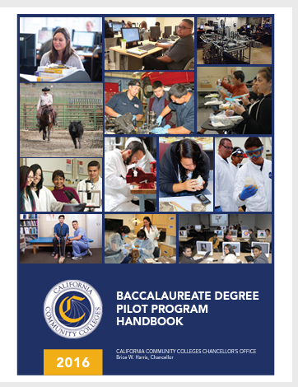
CCC Baccalaureate Degrees and General Education
Currently, students in a California community college baccalaureate degree program must complete the CSU General Education Breadth pattern or Intersegmental General Education Transfer Curriculum (will become obsolete)
Current information on General Education for Baccalaureate Degree Programs can be found in the CCC Baccalaureate Degree Pilot Program Handbook (2016) which is under revision.
A new GE pattern or pathway is being discussed to potentially align with the proposed CalGETC pathway.

Slide 45
Resolution on Baccalaureate General Education
9.03 S22 Develop Lower Division GE Pathway for CCC Baccalaureate Degree Programs
Whereas, AB 927 (Medina, 2021) expands baccalaureate degree programs in the California Community Colleges;
Whereas, Applicants to California community college baccalaureate degree programs currently must complete the CSU General Education Breadth pattern or Intersegmental General Education Transfer Curriculum, both of which may soon be obsolete given the AB 928 (Berman, 2021) mandate to “establish a singular lower division general education pathway that meets the academic requirements necessary for admission to the California State University and the University of California” for implementation by fall 2025 and that the pathway “be the only lower division general education pathway used to determine eligibility and sufficient academic preparation for transfer into both segments”; and
Whereas, The scope and purpose of baccalaureate degrees differ between the California Community Colleges, the California State University, and the University of California, and specifics for lower division general education preparation differs based on those scopes and purposes;
Resolved, That the Academic Senate for California Community Colleges work with the California Community Colleges Chancellor’s Office to develop a lower division general education pathway specific to California community college baccalaureate degree programs for approval by Spring 2023 and system-wide implementation by fall 2024.

Slide 46
Proposed Lower Division GE Pathway for CCC Baccalaureate Degree
1 | English Composition Oral Communication and Critical Thinking | 3 semester/4 quarter units* 3 semester/4 quarter units* | Title 5 §55063(c)(4)(A) and (d)(1) Title 5 §55063(c)(4)(B)
2 | Mathematical Concepts and Quantitative Reasoning | 3 semester/4 quarter units+ | Title 5 §55063(c)(4)(B) and (d)(2)
3 | Arts and Humanities | 3 semester/4 quarter units* | Title 5 §55063(c)(3)
4 | Social and Behavioral Sciences | 3 semester/4 quarter units* | Title 5 §55063(c)(2)
5 | Natural Sciences | 3 semester/4 quarter units* | Title 5 §55063(c)(1)
 | Lifelong Learning and Self Development | optional
6 | Language other than English (LOTE) | optional
7 | Ethnic Studies | 3 semester/4 quarter units* | Title 5 §55063(d)(3)
 | Additional units from any of the above areas | 6 semester/8 quarter units
* indicates transfer-level course required
+ indicates college-level course required

Slide 47
Next Steps to Proposing a Lower Division GE Pathway for the CCC Baccalaureate Degree
ASCCC:
Comments received for the proposed CalGETC pathway, the proposing an Associate Degree pathway, and Baccalaureate Degree workgroup will be considered
A resolution will be drafted for dissemination to Area meetings
Discussion at Area meetings and sharing with local academic senates
Resolution will be debated and voted on at the 2022 fall plenary session
Notes:
https://asccc.org/content/submit-input-ab-928

Slide 48
The Three Proposed Pathways Together…
CCC Associate Degree GE and CCC Baccalaureate Degree GE likely to have more courses approved than CalGETC
Students that are undecided can start with courses approved for CalGETC and will still meet CCC Associate Degree GE and CCC Baccalaureate Degree GE requirements
All three pathways are aligned and clear

Slide 49
Area | Proposed CalGETC Pathway | Proposed CCC Associate Degree GE Pathway | Proposed CCC Baccalaureate Degree GE Pathway (Lower Division)
1 | English Composition (3/4) Critical Thinking and Composition (3/4) Oral Communication (3/4) | English Composition (3/4) Oral Communication and Critical Thinking (3/4) | English Composition (3/4) Oral Communication and Critical Thinking (3/4)
2 | Mathematical Concepts and Quantitative Reasoning (3/4) Transfer Level | Mathematical Concepts or Quantitative Reasoning (3/4) Transfer or College Level | Mathematical Concepts or Quantitative Reasoning (3/4) Transfer or College Level
3 | Arts (3/4) Humanities (3/4) | Arts and Humanities (3/4) | Arts and Humanities (3/4)
4 | Social and Behavioral Sciences (6/8) | Social and Behavioral Sciences (3/4) | Social and Behavioral Sciences (3/4)
5 | Physical Science (3/4) Biological Science (3/4) Laboratory (for Phys/Bio Science) (1/1) | Natural Sciences (3/4) | Natural Sciences (3/4)
 | Life Long Learning and Self Development Not required (CSU Upper Division GE) | Life Long Learning and Self Development Not required in current title 5 regulations | Life Long Learning and Self Development Not required in current title 5 regulations
6 | Language other than English (LOTE) (Currently UC only, carries no units) | Language other than English (LOTE) Not required in current title 5 regulations | Language other than English (LOTE) Not required in current title 5 regulations
7 | Ethnic Studies (3/4) | Ethnic Studies (3/4) | Ethnic Studies (3/4)
 |  |  | Additional units from above areas (6/8)
Total | 11 courses (34 semester/45 quarter units) | 21 semester/28 quarter units | 27 semester/39 quarter units

Slide 50
What’s Next…
If you haven’t already, respond to surveys…
go to https://www.asccc.org
They are on the home page
Looking for a green light to continue the process for GE alignment….not a done deal. We want your input.

Slide 51
Webinar Series (sign up at www.asccc.org)
Monday, Sept 12, 2022 (9-10:a30am) | General Education Requirements of the Associate Degree, Baccalaureate Degree, and Associate Degree for Transfer
Tuesday, Sept 13 (3-4:30pm) | General Education Requirements of the Associate Degree, Baccalaureate Degree, and Associate Degree for Transfer
Tuesday, Sept 27 (12-1:30pm) | Role of local Academic Senates and Curriculum Committees in regard to general education
Wednesday, Sept 28 (2-3:30pm) | Role of Articulation in Transfer in regard to general education
Monday Oct 3, 2022 (9-10:30am) | Addressing the impact of CalGETC, as proposed on local colleges, programs and course and students
Thursday Oct 6, 2022 (2-3:30) | Addressing the impact of CalGETC, as proposed on local colleges, programs, courses and students

Slide 52
Got Questions?

Slide 53
Resources
ASCCC Website: https://www.asccc.org
ICAS Website: https://icas-ca.org – update in progress
Questions? Email info@asccc.org
5C: https://www.cccco.edu/About-Us/Chancellors-Office/Divisions/Educational-Services-and-Support/What-we-do/Curriculum-and-Instruction-Unit/California-Community-College-Curriculum-Committee
CIAC: https://www.csusb.edu/ciac (articulation officers website)
Feedback for Proposing a General Education Pattern for the Associate Degree: https://www.surveymonkey.com/r/GE_Pattern_Survey_2022
Feedback on proposed CalGETC pathway: https://www.surveymonkey.com/r/AB928_GE_Survey

