Slide 1

Legislative Cycle and the Need for Advocacy:
Political Landscape and Power Dynamics of Sacramento

Slide 2
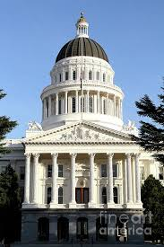
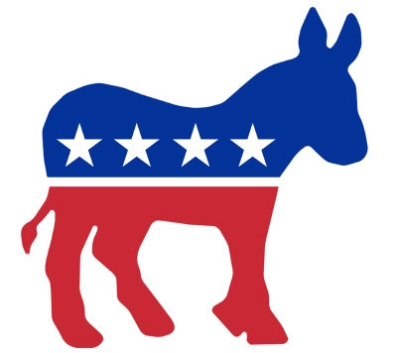

Policy
Politics

Slide 3
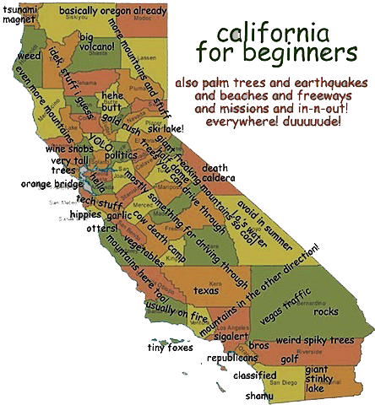

Slide 4
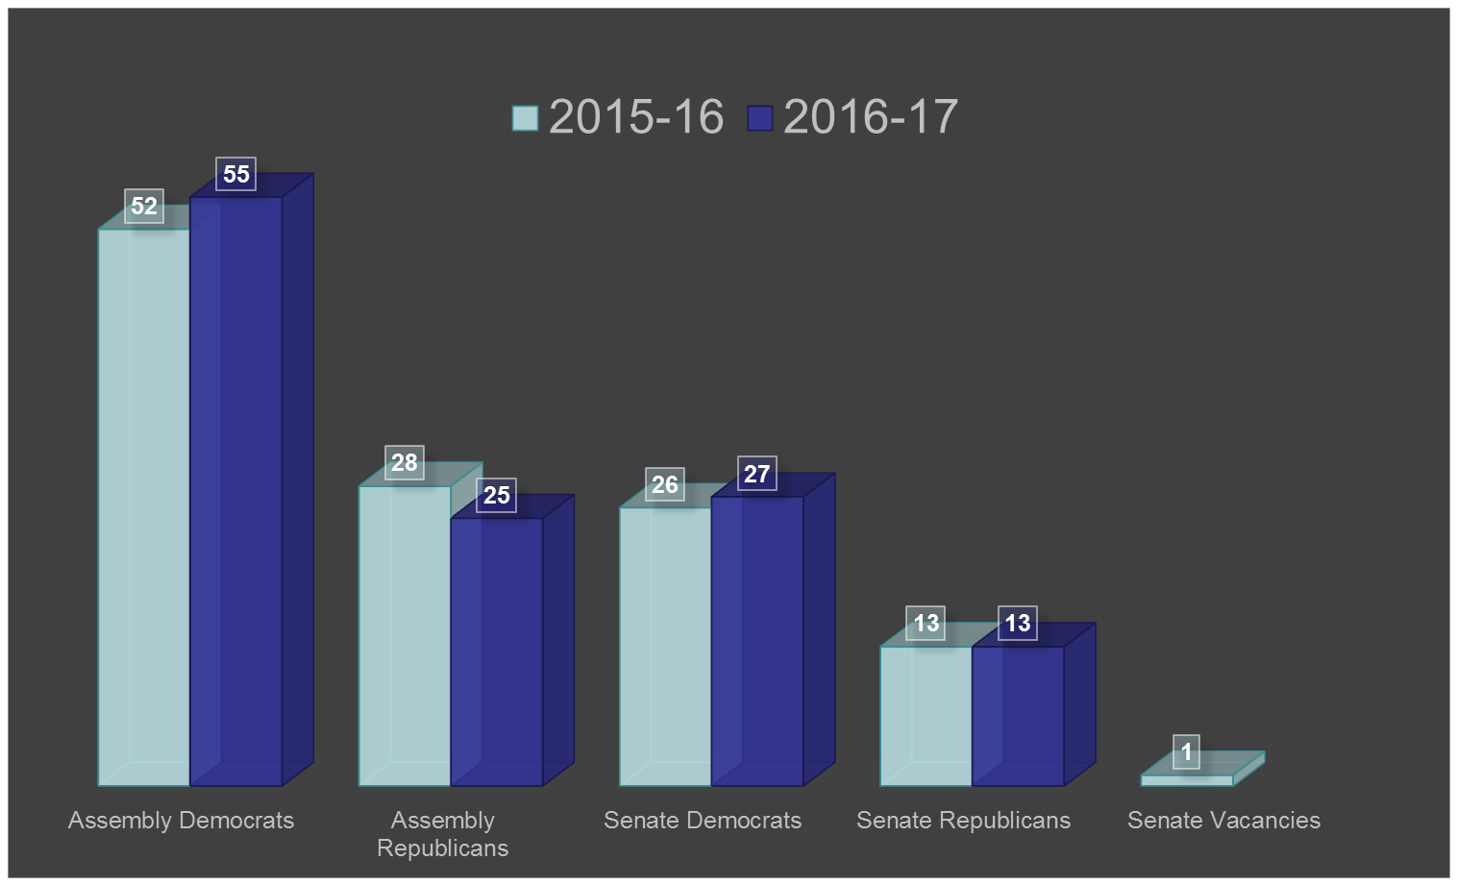
Partisan Composition of Legislature

Slide 5
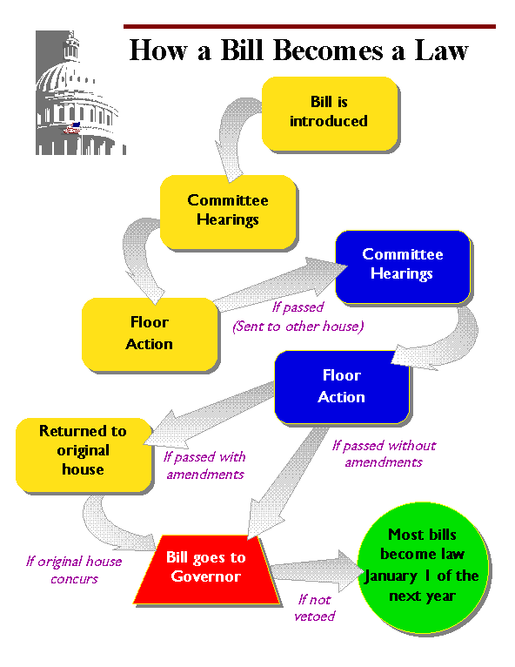

Slide 6
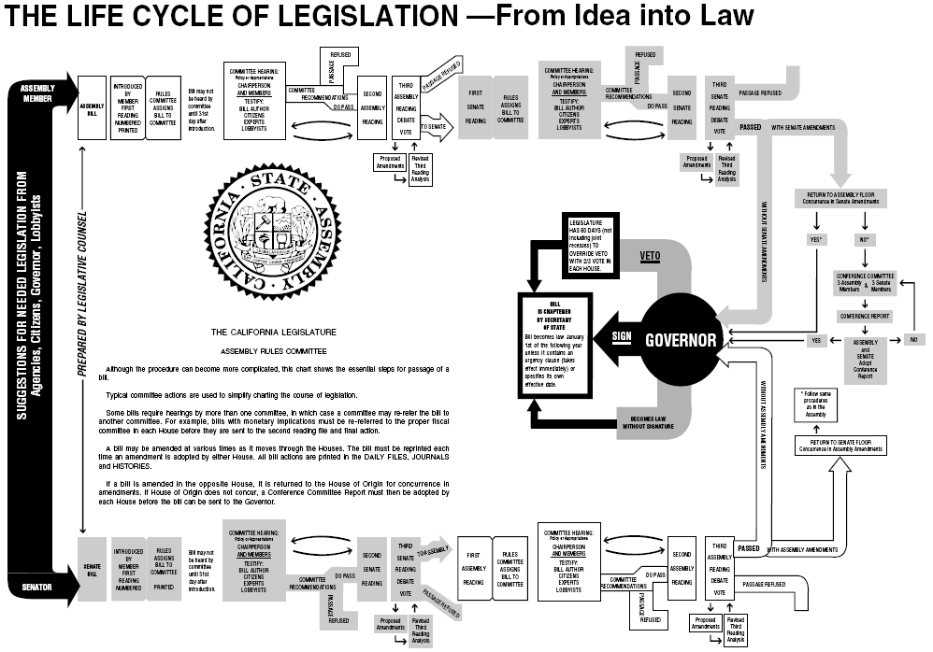

Slide 7
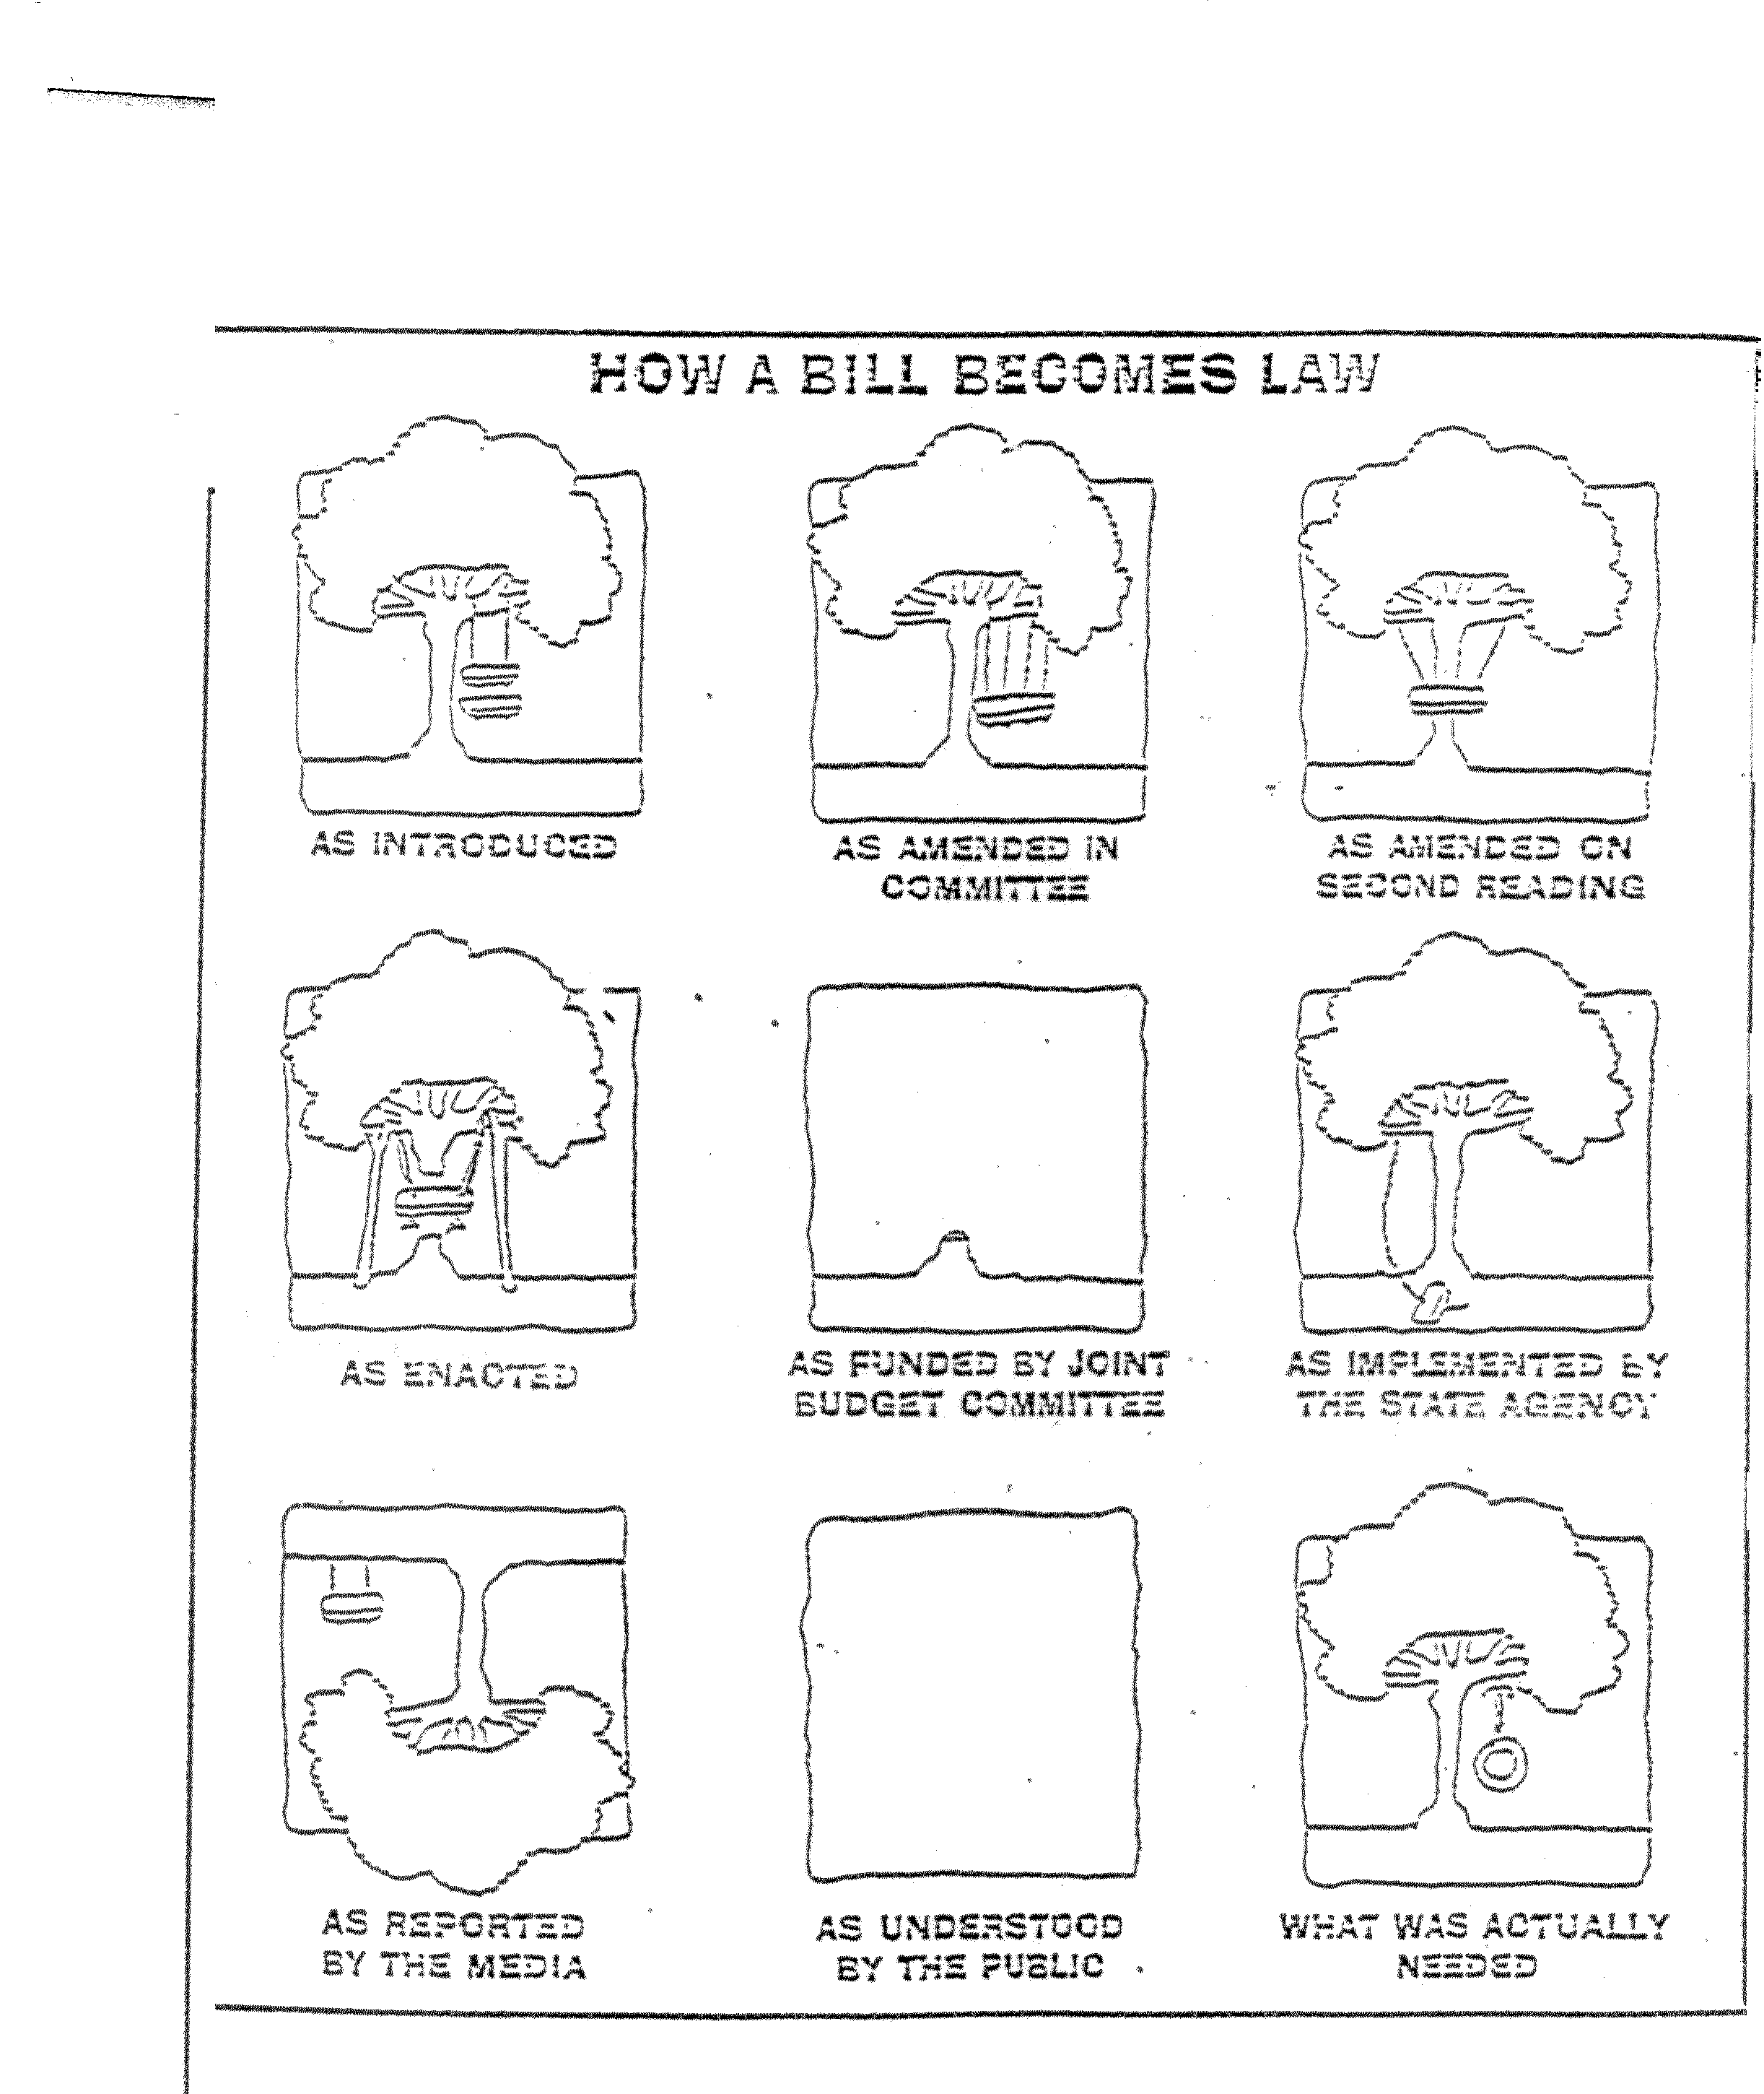

Slide 8
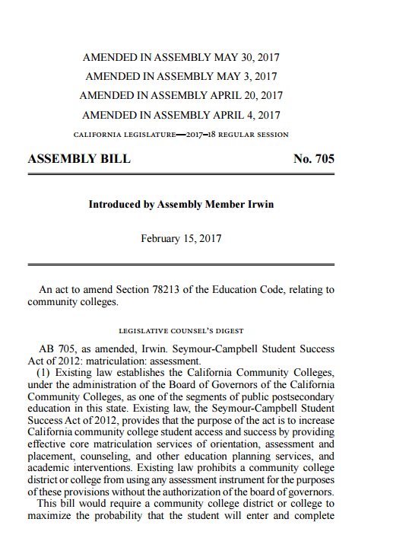
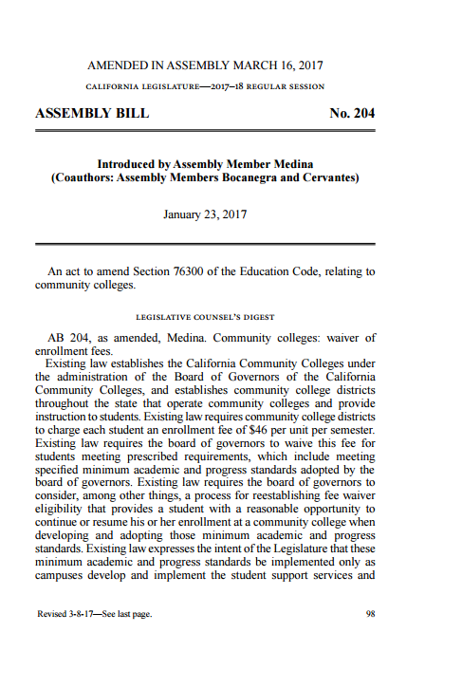
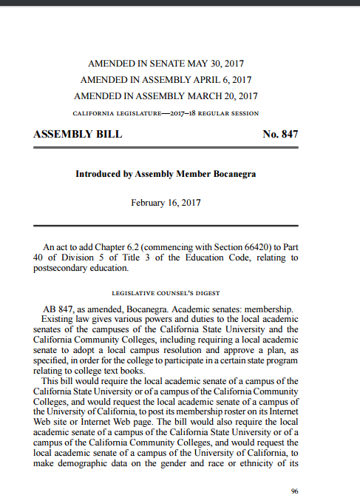
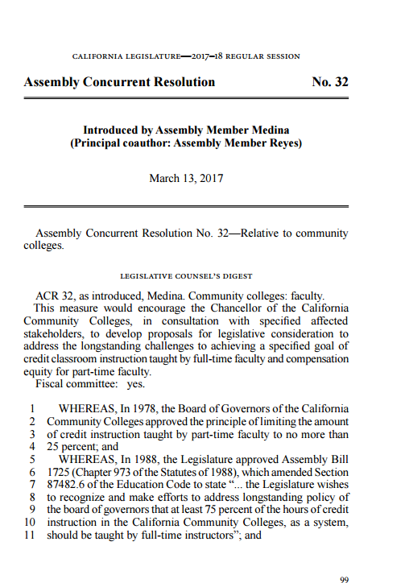

Slide 9
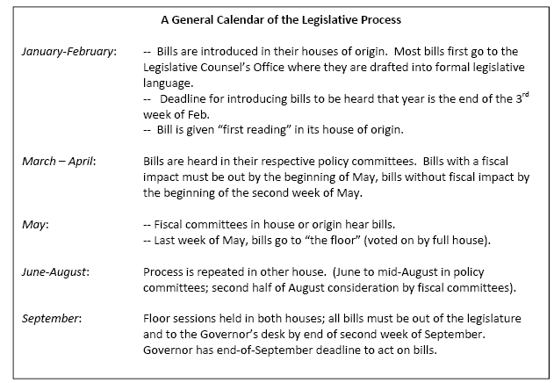

Slide 10
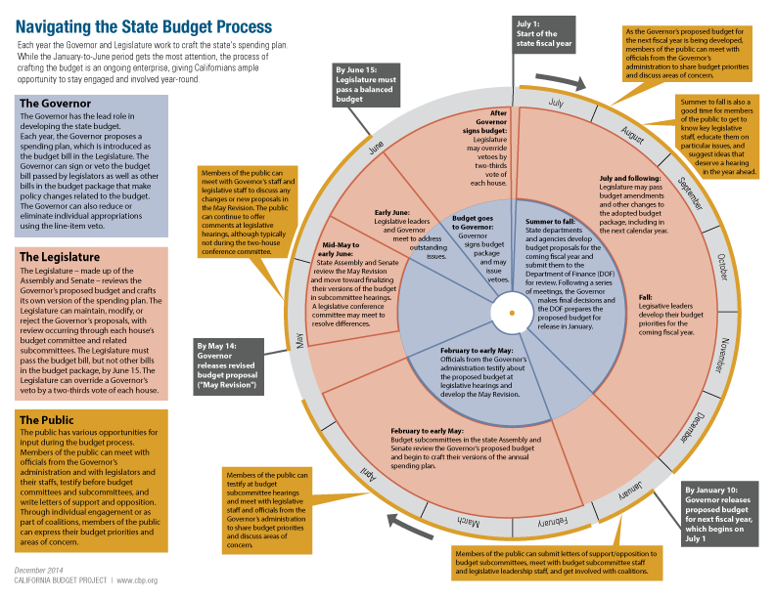

Slide 11
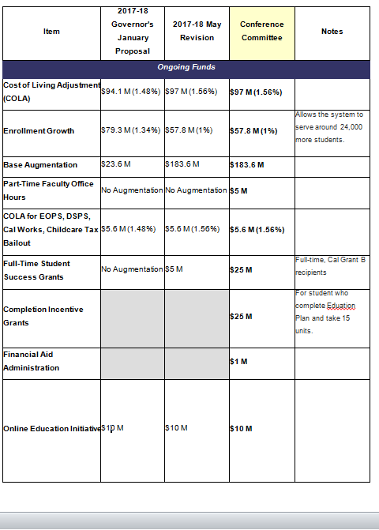
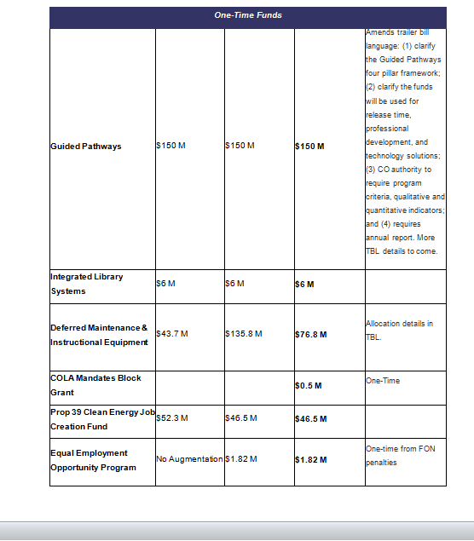
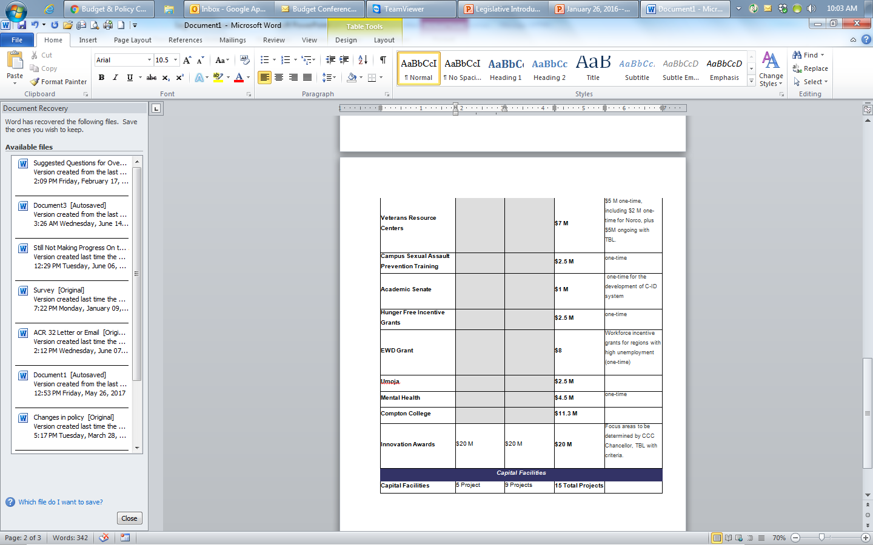

Slide 12
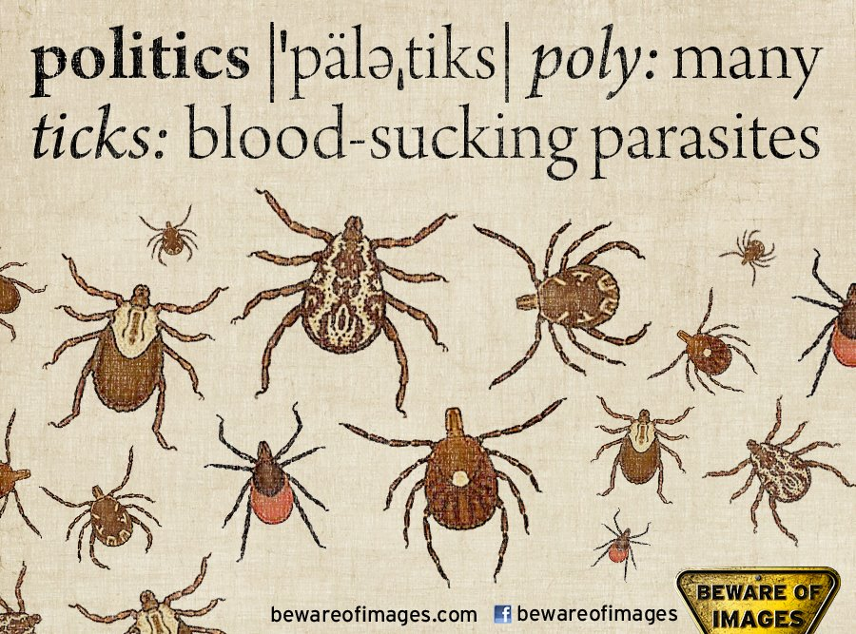
Why Americans hate politics
Hate Politics

Slide 13
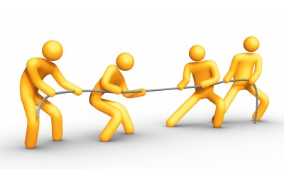
Tug and pull
sacramento
Washington, DC

Slide 14
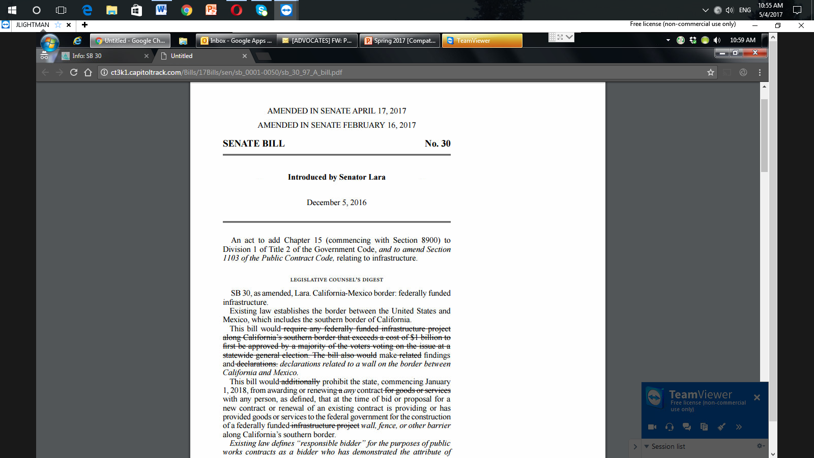
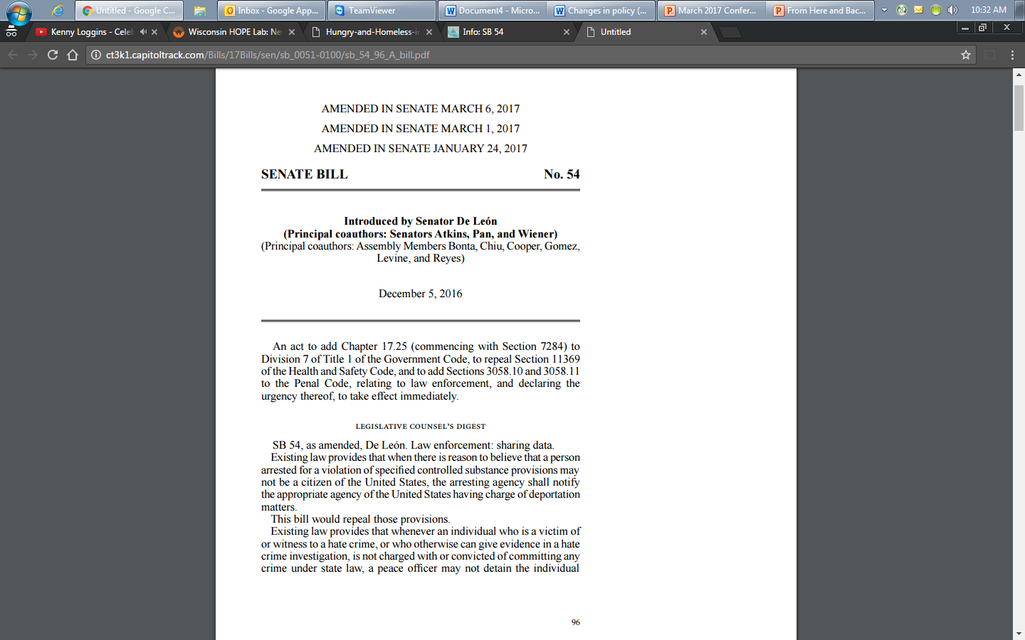
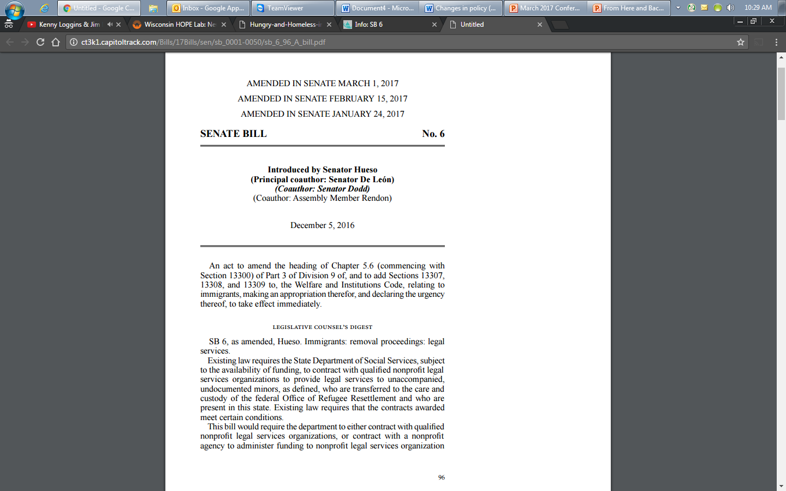
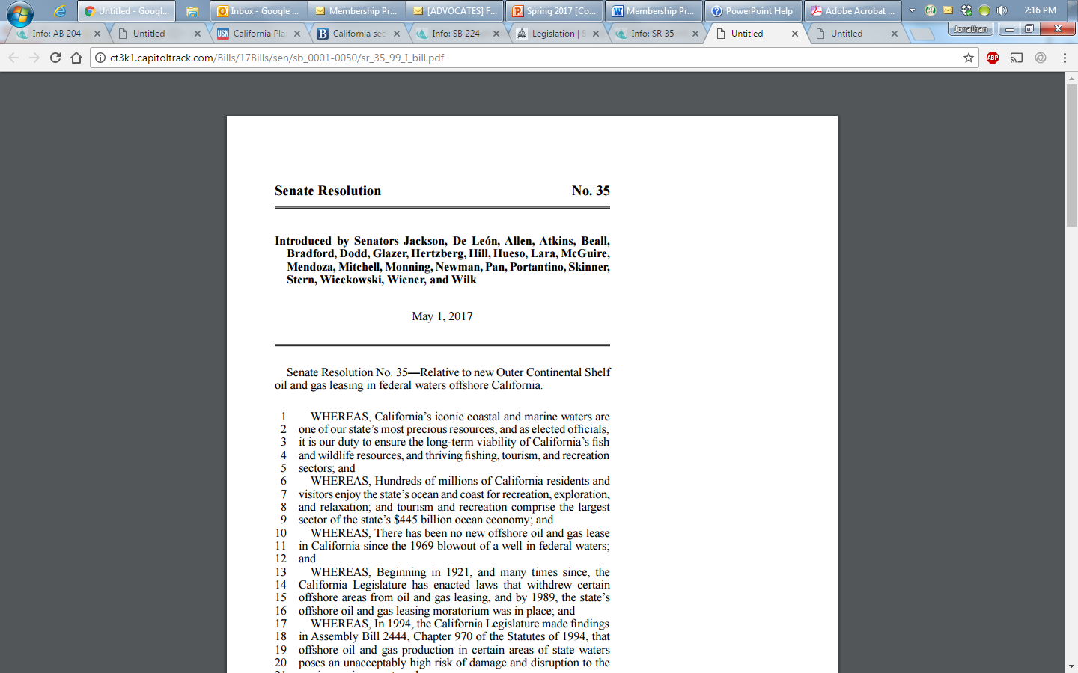
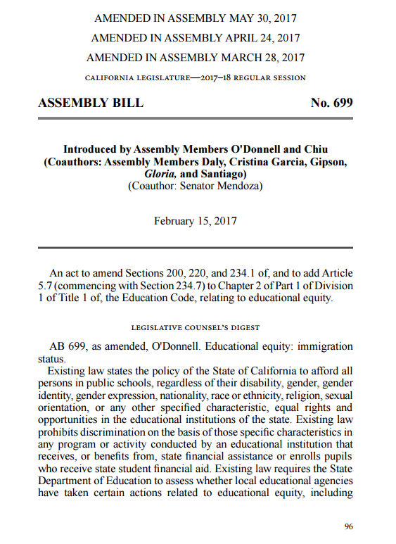
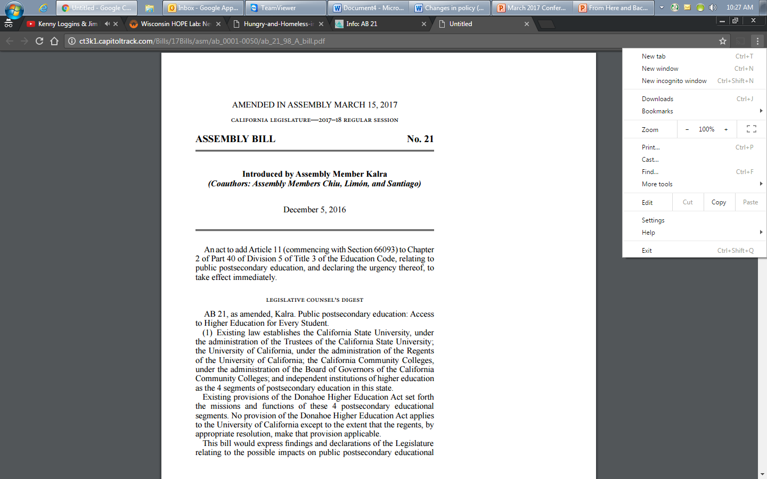
Words Into Action

Slide 15
What Type of Problem do we Need to Solve?
Legislative
Budgetary
Regulatory
Political
Perception
Other

Slide 16
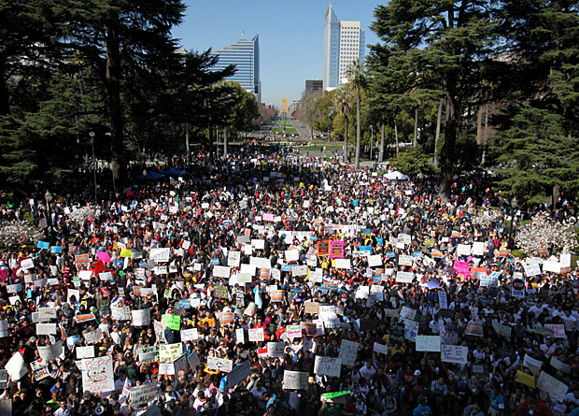
Powerful Visual but Not Always the Best Strategy

Slide 17
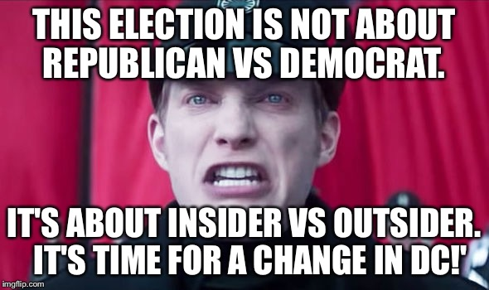

Slide 18
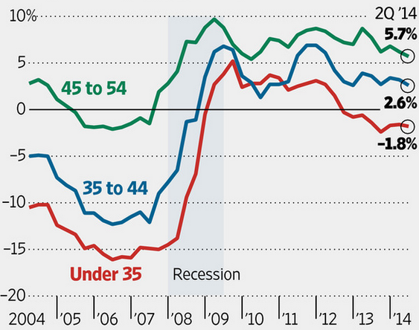
Savings Rates by Age, 2004-14

Slide 19
Understanding the Millennials
(Born After 1980)
Distrust
Trust
Institution of Marriage
Friends
Organized Religion
Friends
Friends
Politics

Slide 20
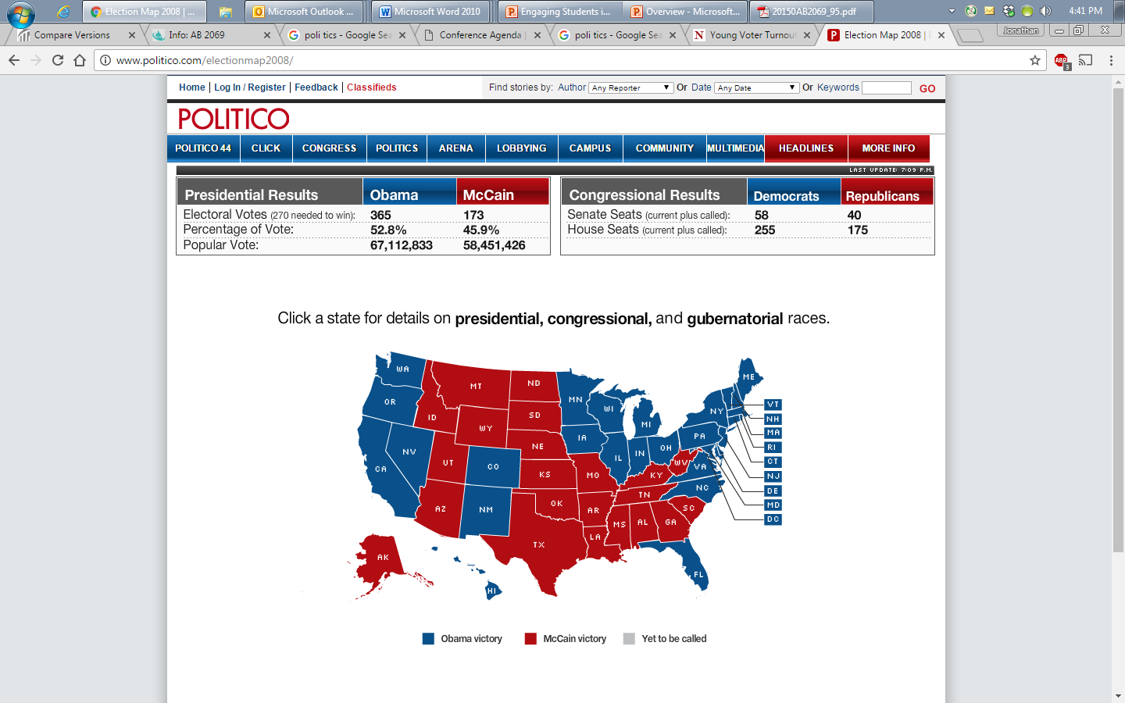
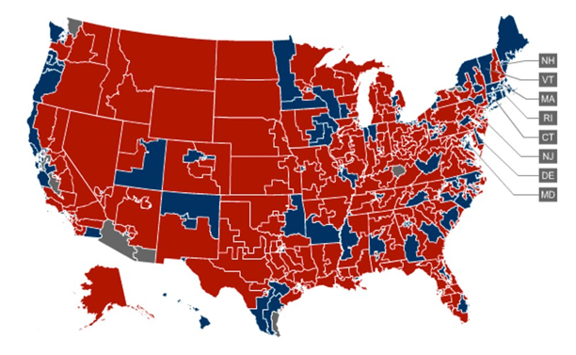
Comparing Elections
2008
2010
Congress: Dems +23
Senate: Dems +8
Congress: Reps +63
Senate: Reps +6

Slide 21
Sixty Percent Decline

Slide 22
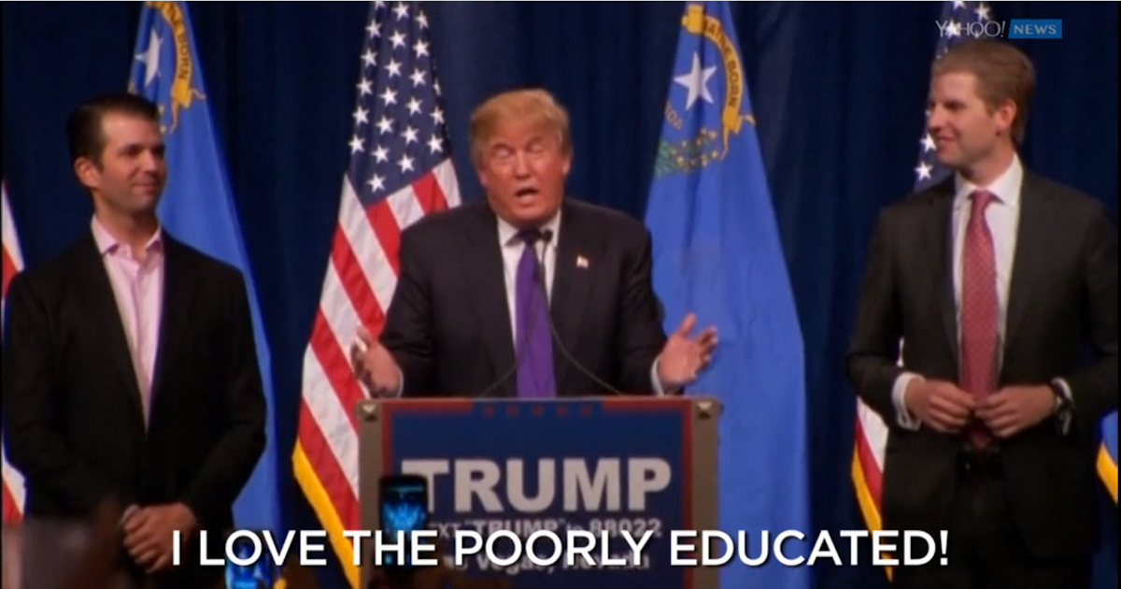

Slide 23
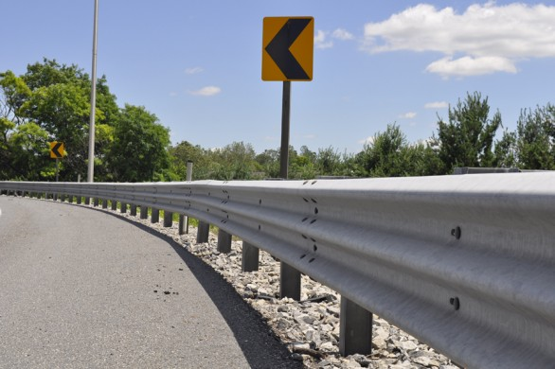
Beyond anything else, we must rebuild the guard rails of a compassionate, diverse, and democratic society that values and cherishes everyone.
Notes:
David Frum, The Atlantic, How Donald Trump exploited the seven broken guard rails of democracy

Slide 24

Simple Concepts
To whom
With whom

Slide 25
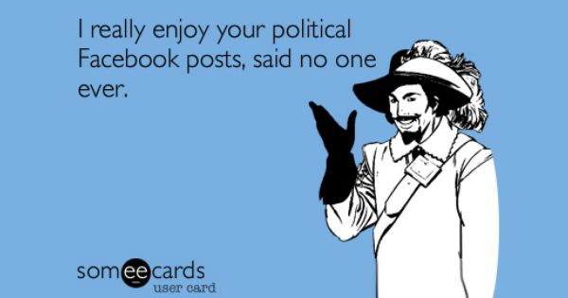

Slide 26
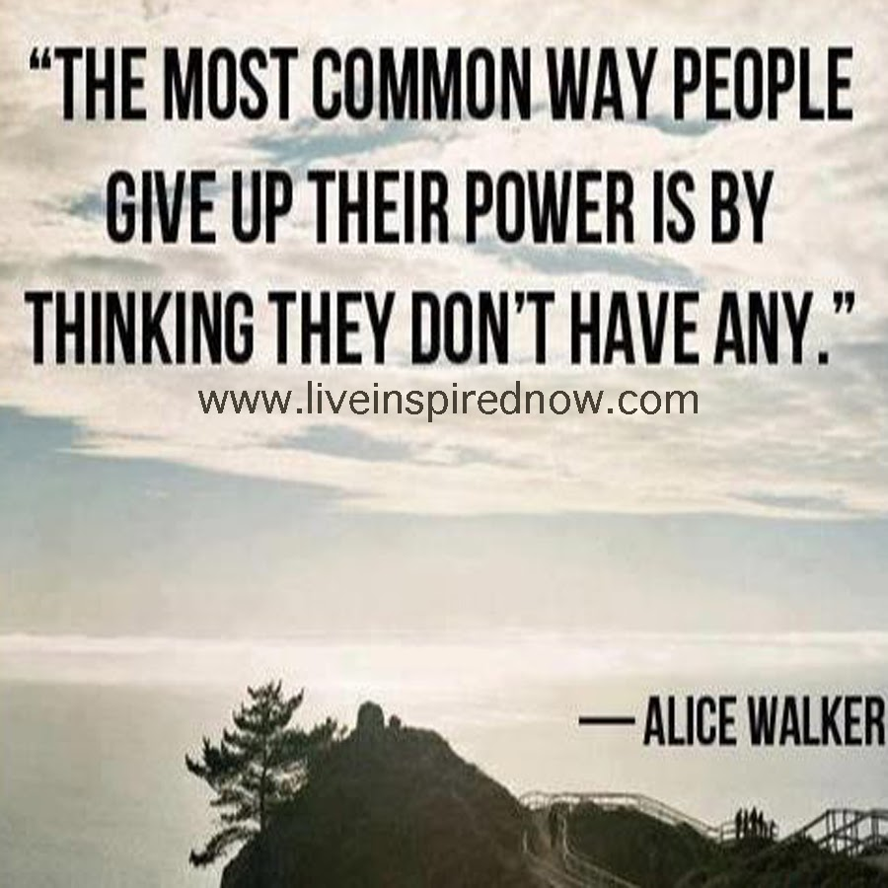
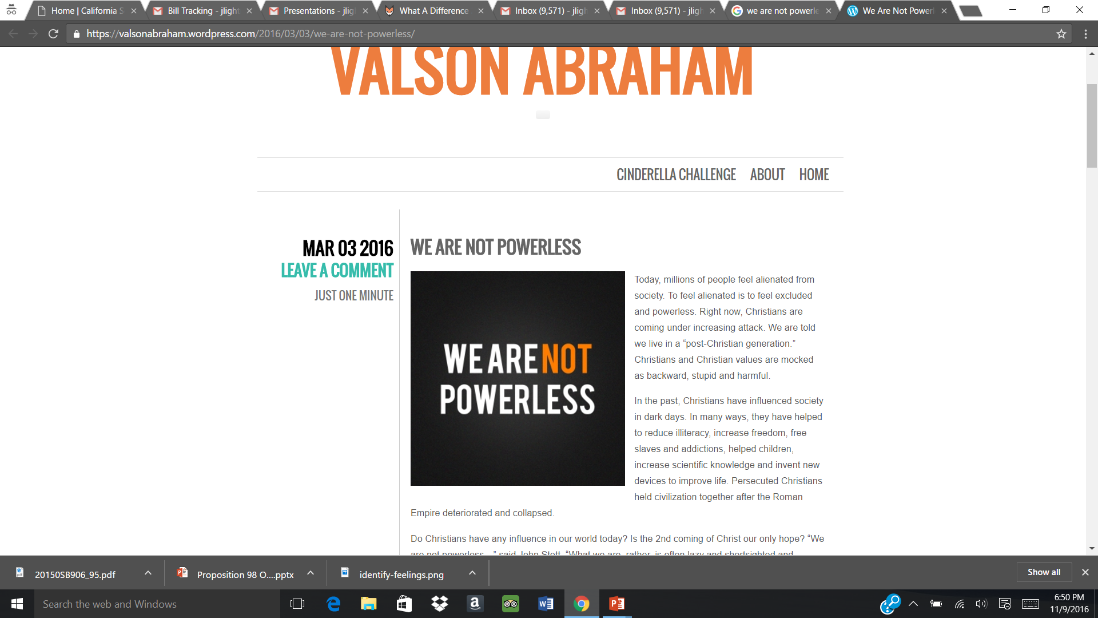

Slide 27
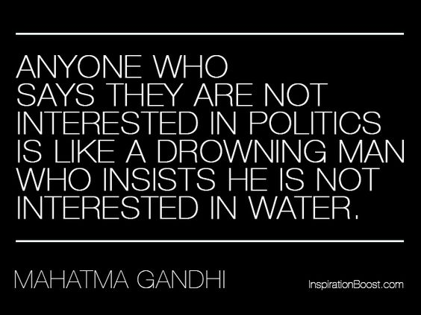

Slide 28
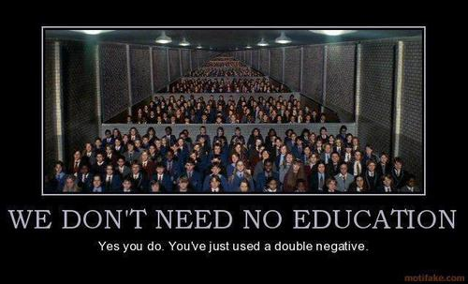

Slide 29
“…best political voice for community college faculty in the state.”
~ Sacramento News & Review

