Slide 1
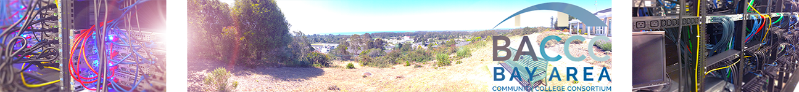
Colleges Share 24x7
ICT Remote Lab Systems
Bay-area Project: Gerlinde brady and Richard grotegut

Slide 2

What is Information Communication Technology?
ICT is an umbrella term, widely used outside the U.S., to encompass all rapidly emerging, evolving and converging computer, software, networking, telecommunications, Internet, programming and information systems technologies.
Notes:
2
Constance

Slide 3
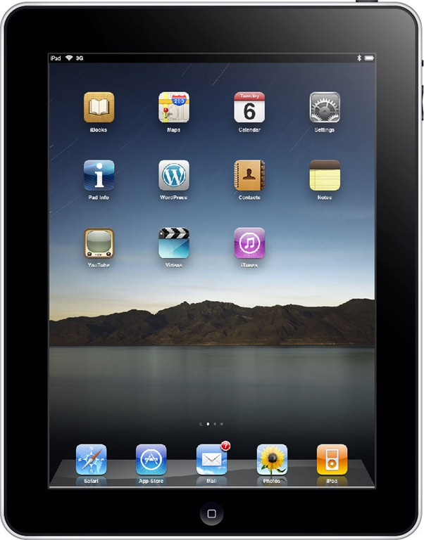
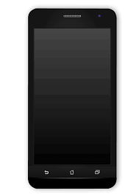
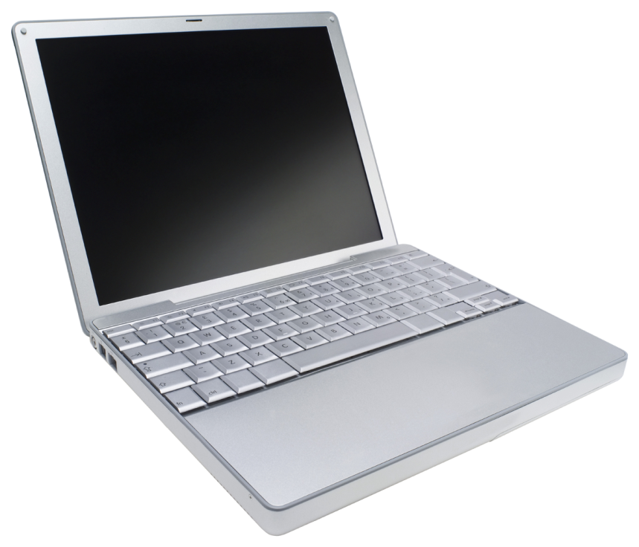
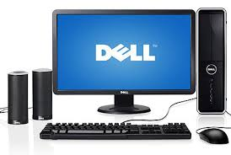
Instruction in Information Technology
We teach our students what they need to know so you can use one of these devices – whenever, wherever

Slide 4
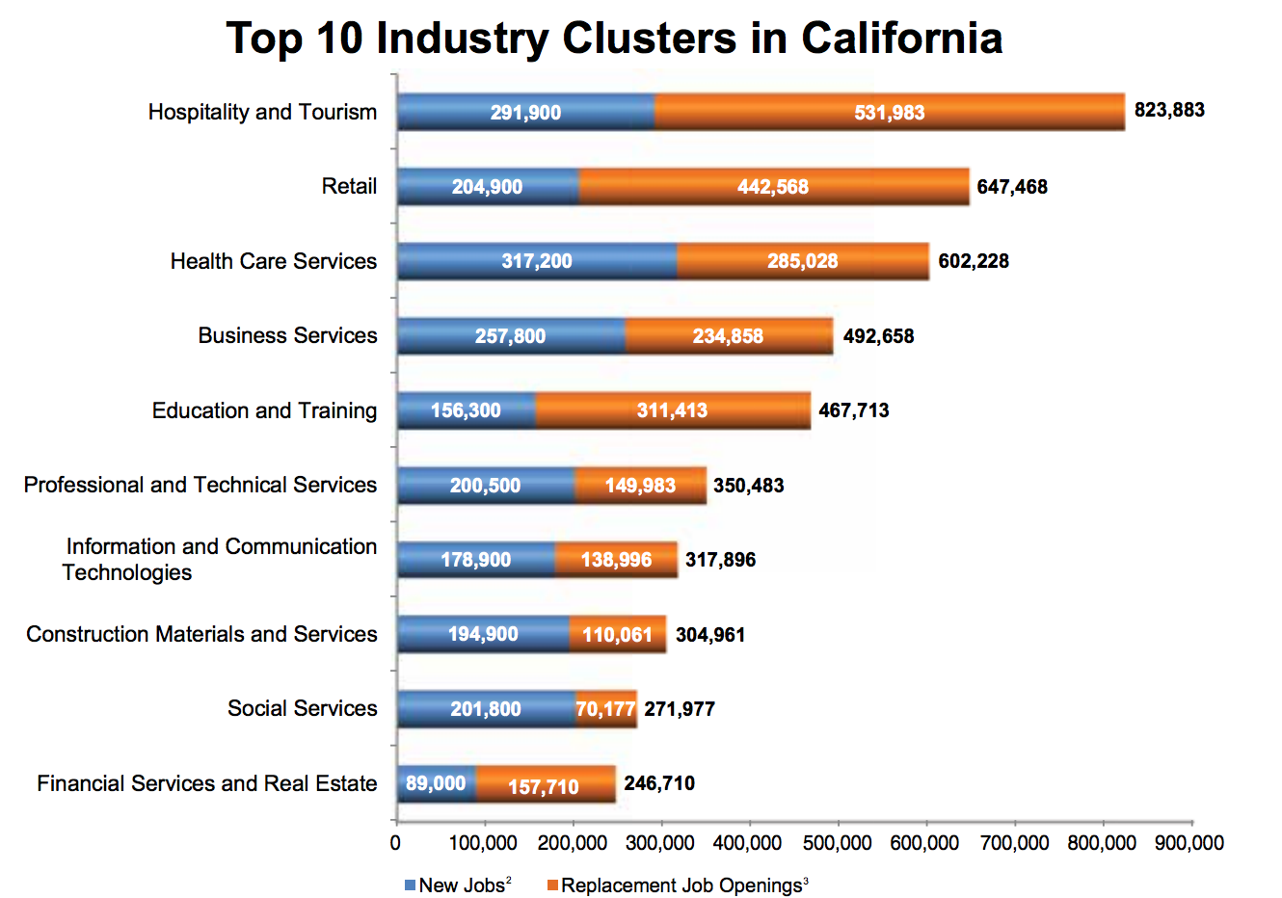
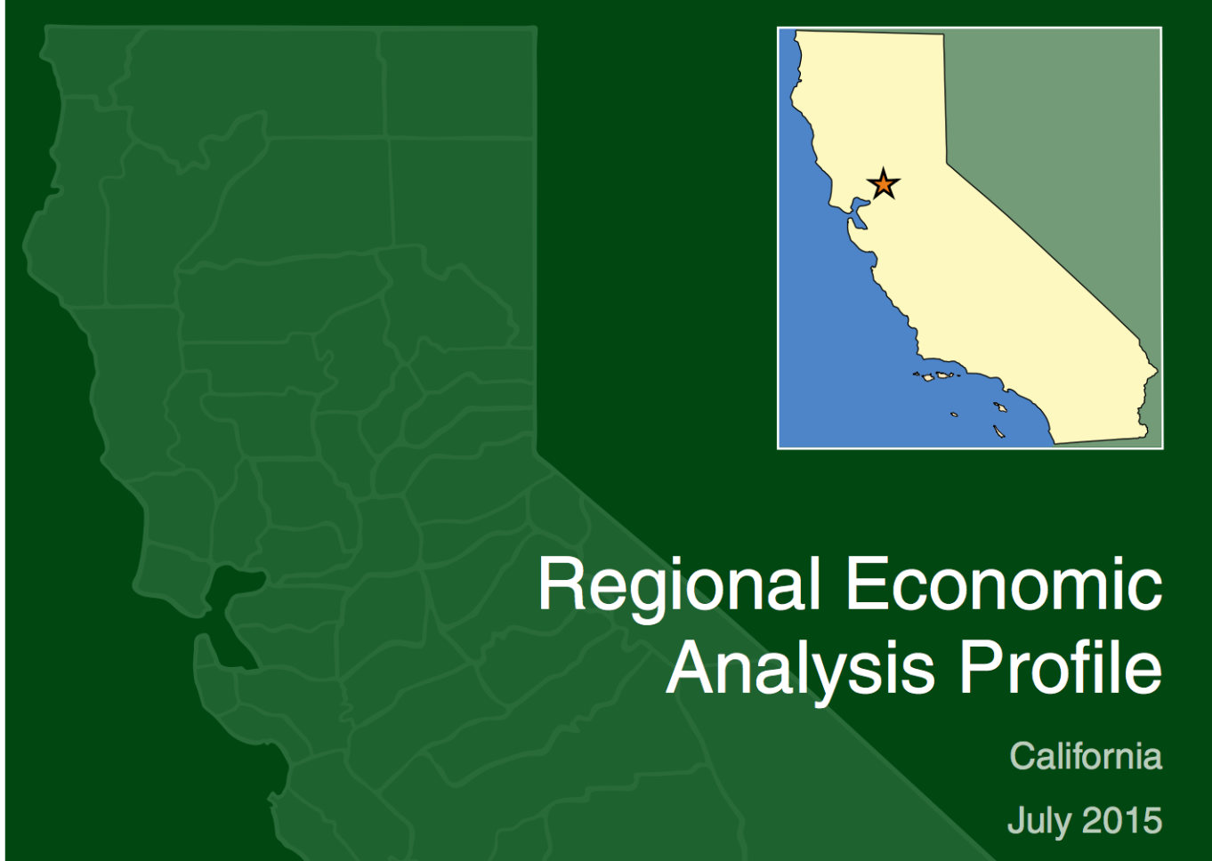
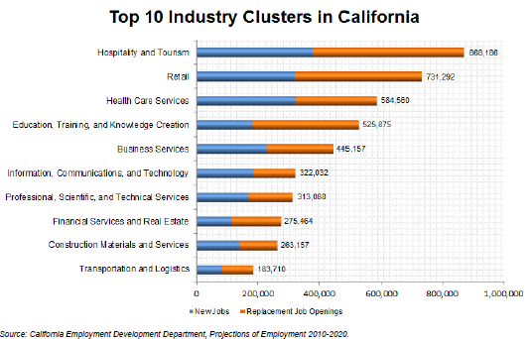
#7

Slide 5
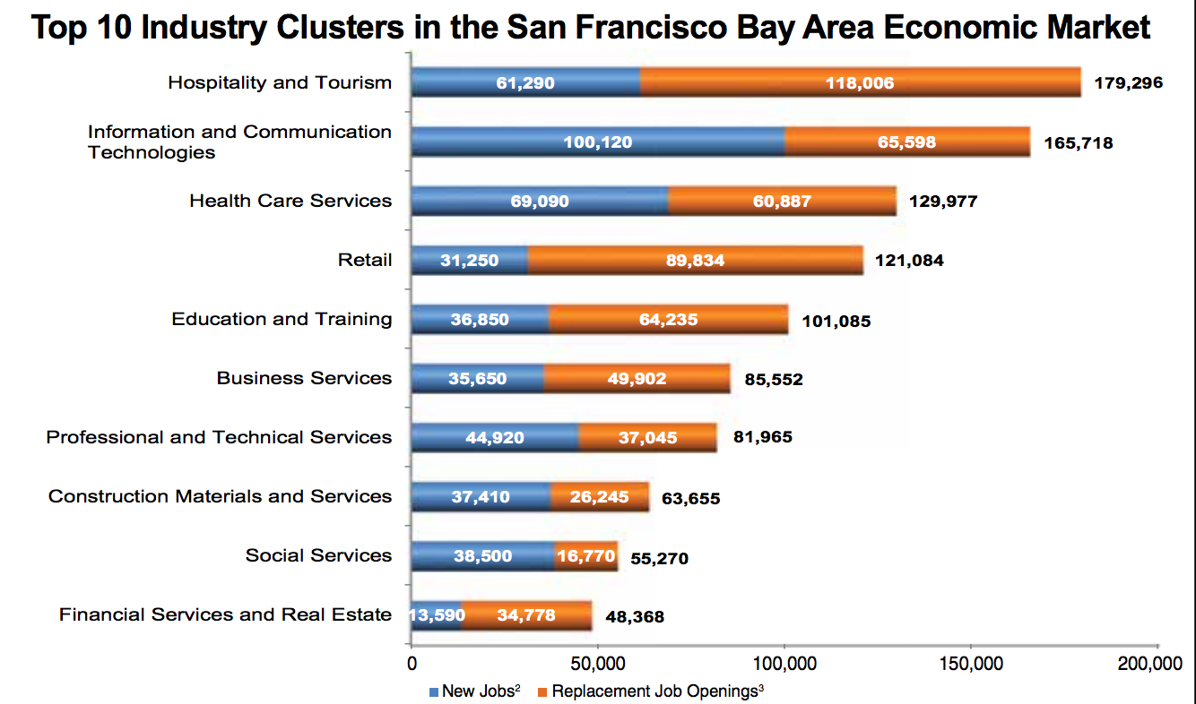

#2
Source: http://www.labormarketinfo.edd.ca.gov/Regional_Economic_Analysis_Profiles.html

Slide 6
Problem Statement
Employers demand real-world experience
Students need hands-on skills development
Equipment and software are expensive
Quick obsolescence, because ICT evolves so quickly
Installation, maintenance, management & support
License agreement challenges
Technical support for students and faculty
Students need access to labs according to their schedules
Notes:
6

Slide 7
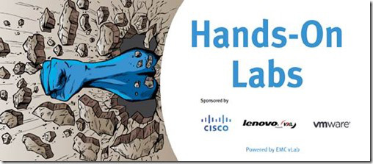
Importance of Learning by Doing
On-campus lab facilities are expensive and limited

Slide 8
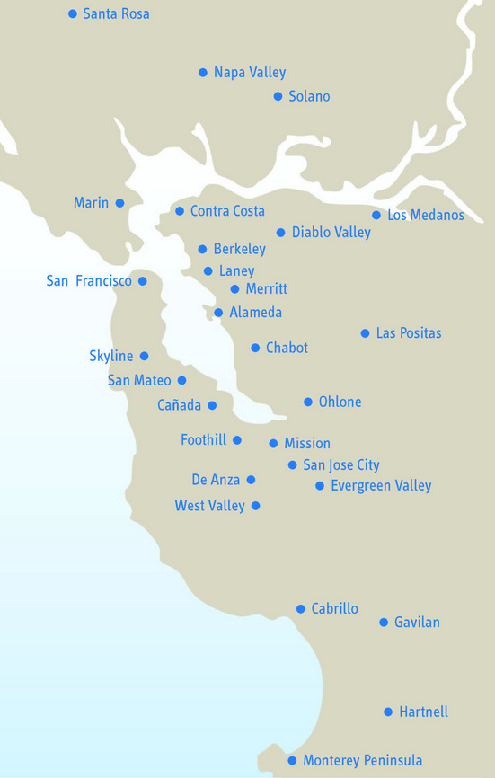
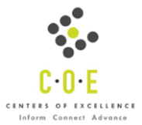

San Francisco Bay Area ICT Industry and Employment Training Options
Documented CCC ICT Supply by 28 CCCs:
    81 Departments
    1,345 Faculty
    140K Student Enrollments
    180 Degrees
    405 Academic Certificates
    7,398 sections of 2,366 courses
    Faculty and enrollment demographics
Notes:
8

Slide 9

Notes:
9

Slide 10
NETLAB+
NETLAB+ is a system that:
Provides access to real lab equipment remotely over the Internet
Provides 24/7 access
Provides hands-on training

Slide 11
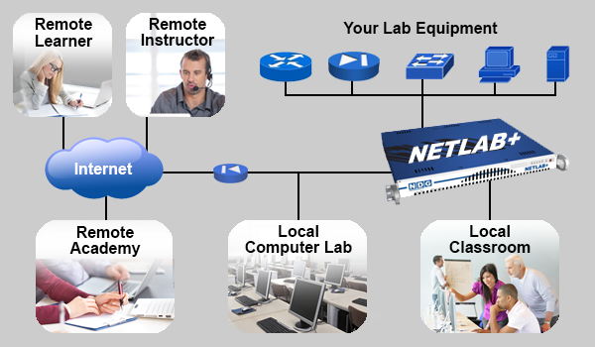
NETLAB+ supplements or replaces you local hands-on lab facility

Slide 12
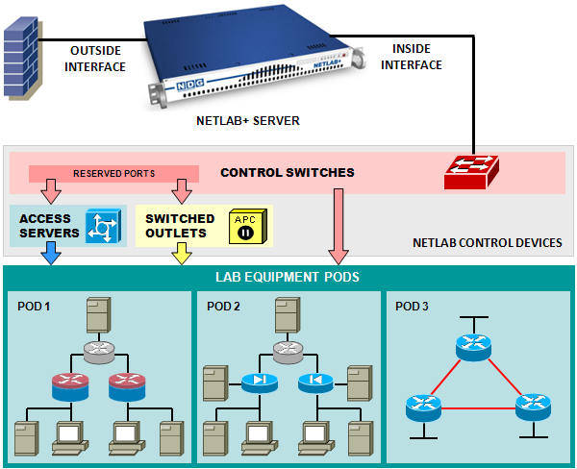
NETLAB+ - Over 500 Labs
Cisco Networking Academy
  >250 labs , certifications
VMware IT Academy
  Virtualization, certifications
EMC Academic Alliance
  Data storage, industry certifications
Linux Professional Institute
  low-cost, high value open source OS, certifications
CompTIA
  vendor neutral certifications
Cybersecurity labs
General IT labs
  Microsoft MCSA and other Microsoft Academy content
Custom Topologies and Labs
Palo Alto Networks and Red Hat Labs
No other solution has this
Notes:
12

Slide 13
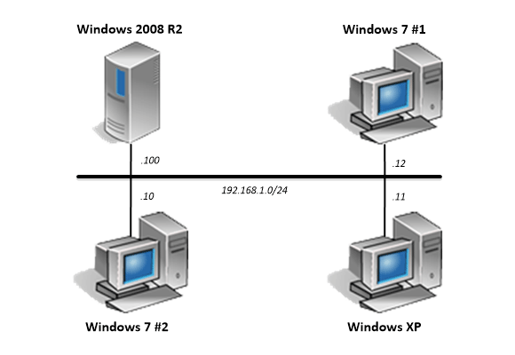
CompTIA A+ Labs

Slide 14
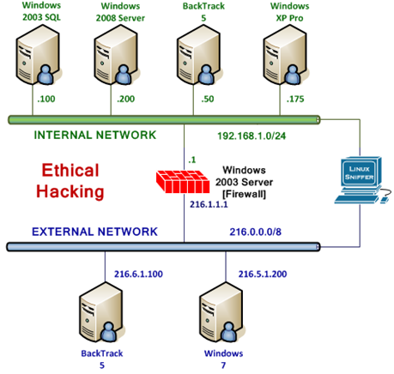
Ethical Hacking

Slide 15
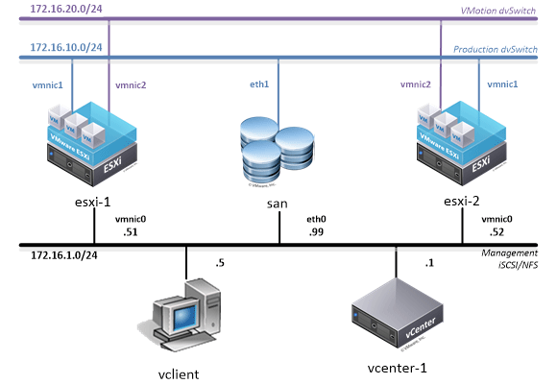
Virtualization Courses - VMware

Slide 16
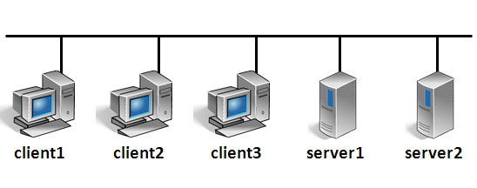
General IT Classes

Slide 17

Custom Classes

Slide 18
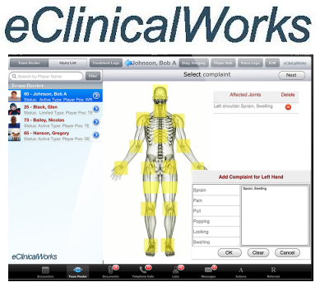
Custom Classes

Slide 19
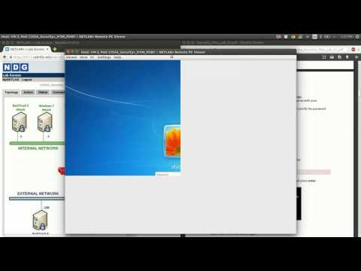
How Does it Help us Teach?
Demo on YouTube:
https://www.youtube.com/watch?v=4r9XFcSMlNg&feature=youtu.be

Slide 20
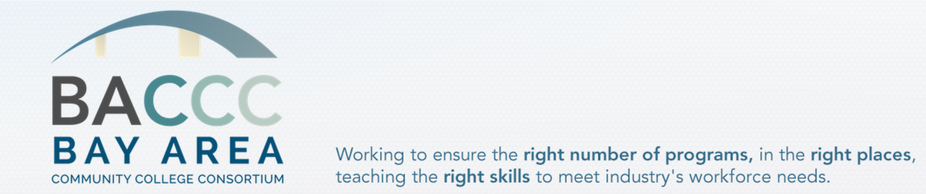
CTE Enhancement Funding: $980,000
In-Kind Contribution: $600,000+
DSN Contribution: 2 x $25,000
Notes:
20

Slide 21
Accessible 24 x 7
From school, home
Students can sign-up for 1-4 hour blocks, individually or in teams
Expensive Hardware & Software Shared by All
Servers
Switches
Software Simulations
Full-time Dedicated Network Technician Shared by All
Only supports NETLAB. Deep expertise

Slide 22
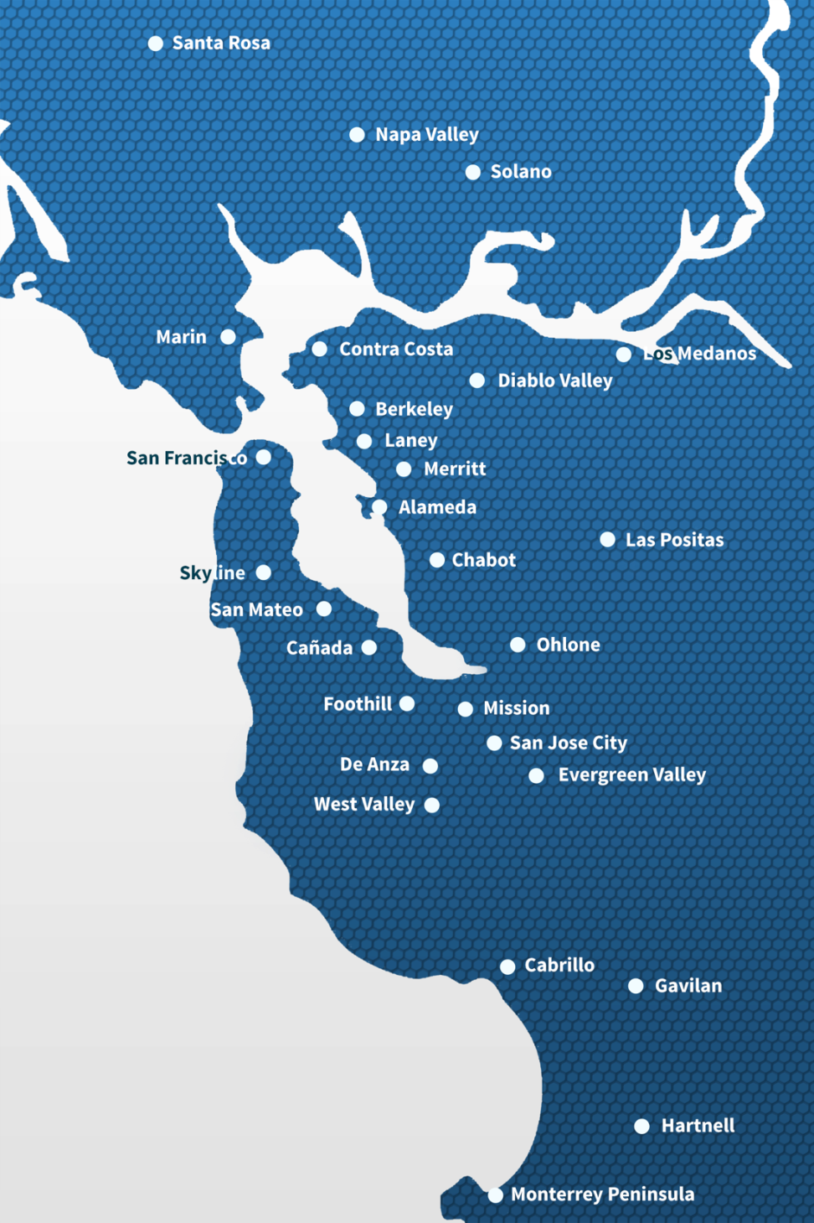
20 Participating Colleges
Initial pilot year participation:
20 of 28 BACCC colleges
Cabrillo College
Chabot College
City College of San Francisco
College of Alameda
Contra Costa College
Diablo Valley College
DeAnza College
Evergreen College
Gavilan College
Hartnell College
Las Positas College
Los Medanos College
Merritt College
Monterey Peninsula College
Ohlone College
San Jose City College
Santa Rosa College
Skyline College
Mission College
Solano College
Notes:
22

Slide 23

Memorandum of Understanding
40% CTE Enhancement Fund Contribution - $3,400
Participate in the Shared Lab Community
Teach at least 1 class with the BACCC system in Year 1
Agree to find ongoing funding
Service agreement
Notes:
23

Slide 24
Planning and Implementation
Building a shared lab facility is a major IT procurement project
  Team Effort
  Stakeholders
  Budget
  Project management and timelines
  Communication

Slide 25
What Had To Be Done
Electrical system upgrade
Cooling system fine tuning
Rack and equipment installation
Internet access installation
Security system installation

Slide 26
The Team
IT Department
Administration
Facilities
Purchasing
Business Office
Grants Office

Slide 27
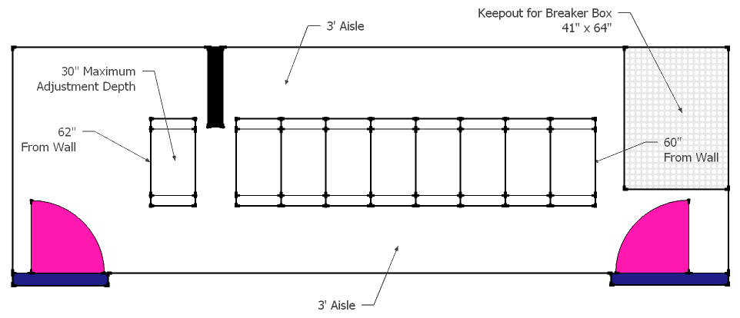
SPACE
Former CIS datacenter chosen for existing cooling
It’s a very small space

Slide 28
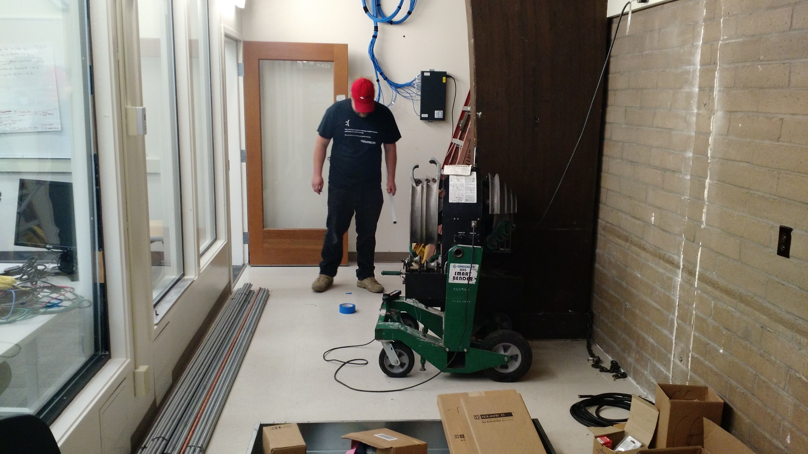
STARTING FROM SCRATCH

Slide 29
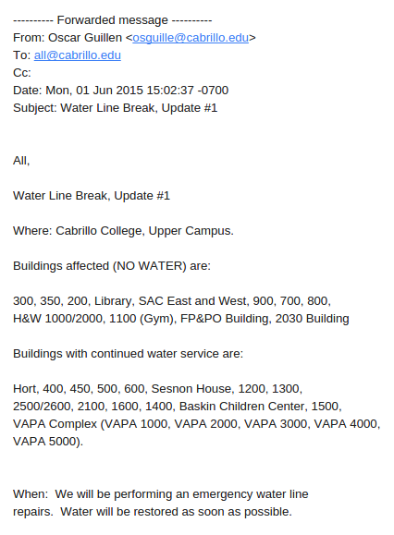
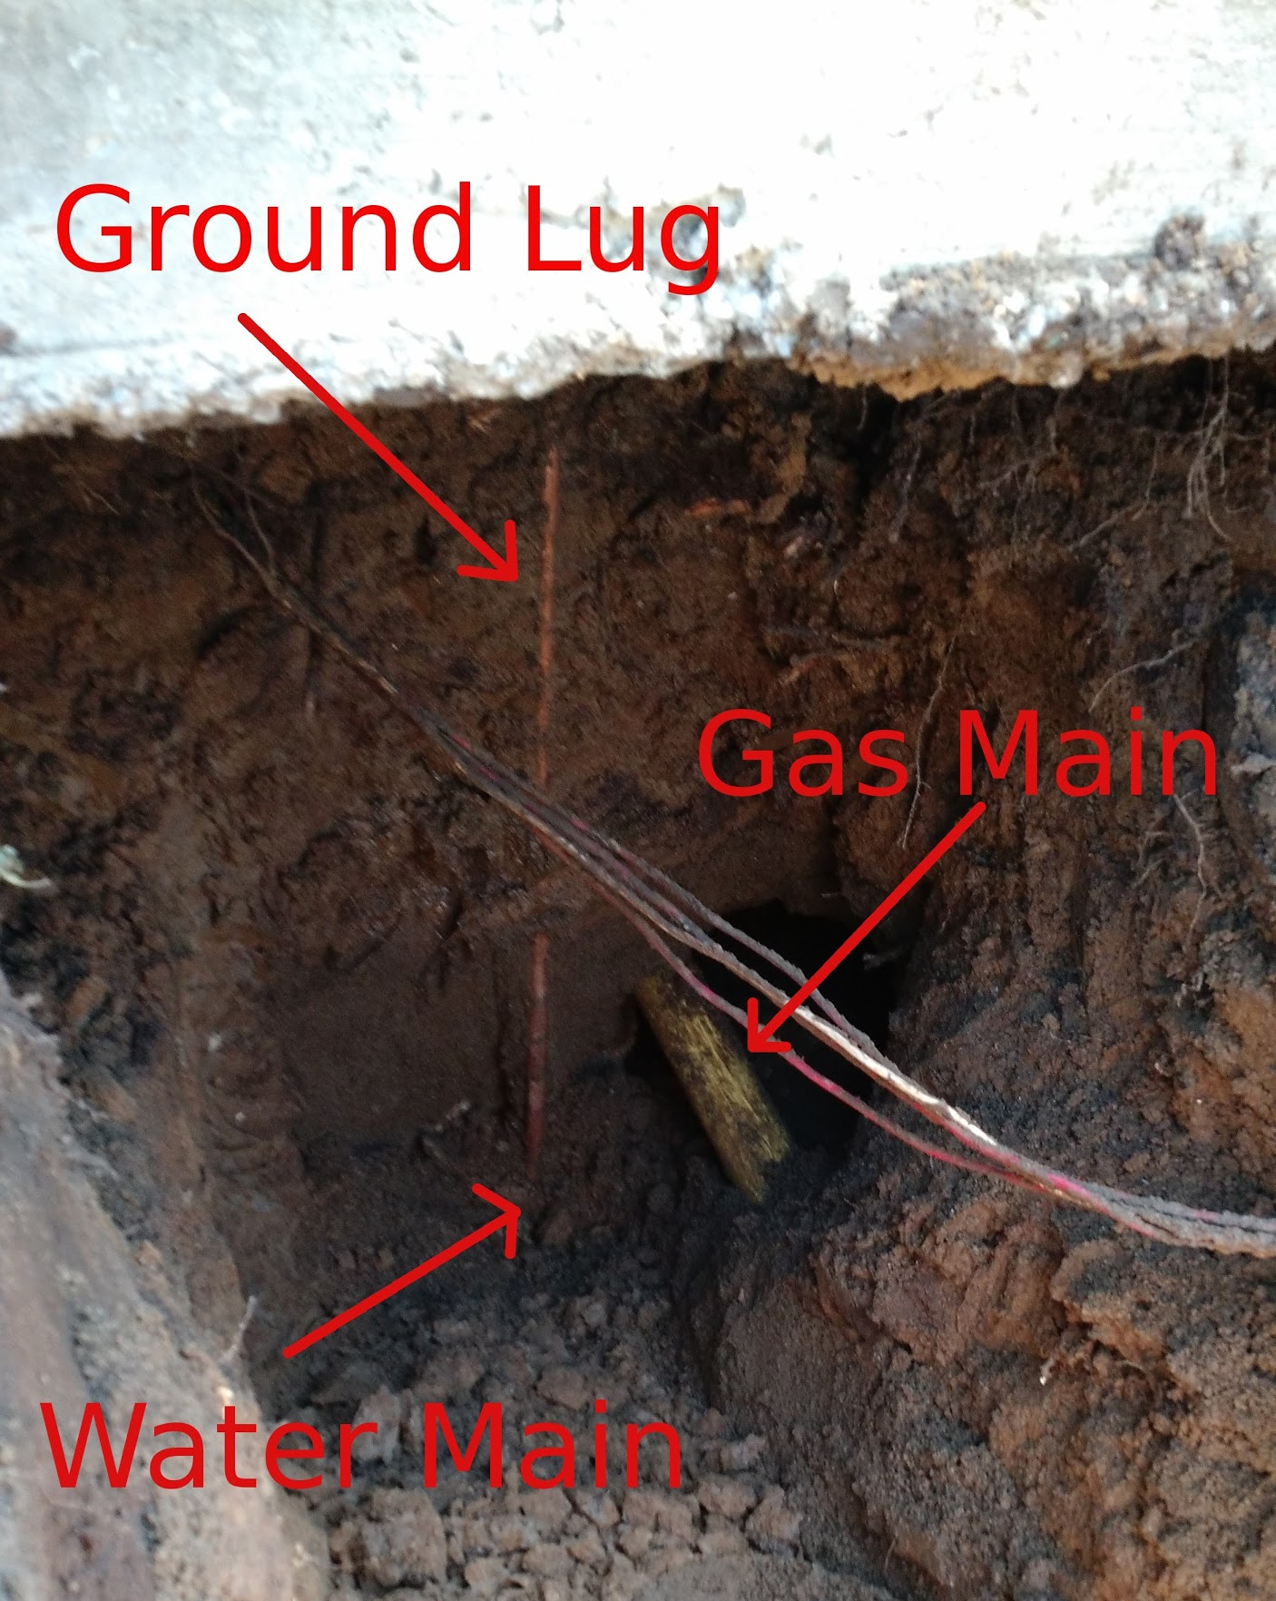
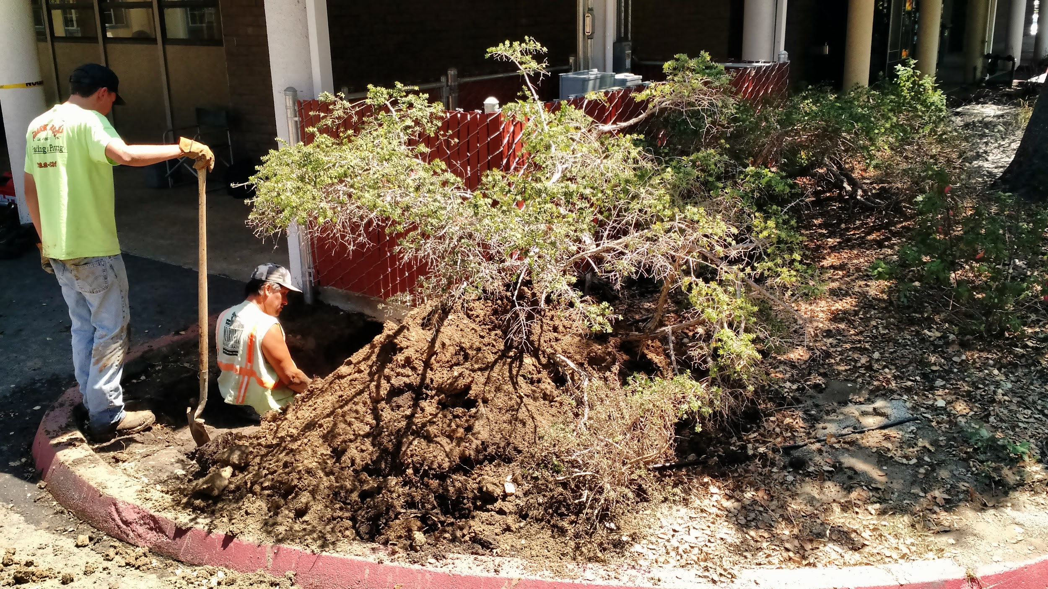
We Did Run Into ...

Slide 30
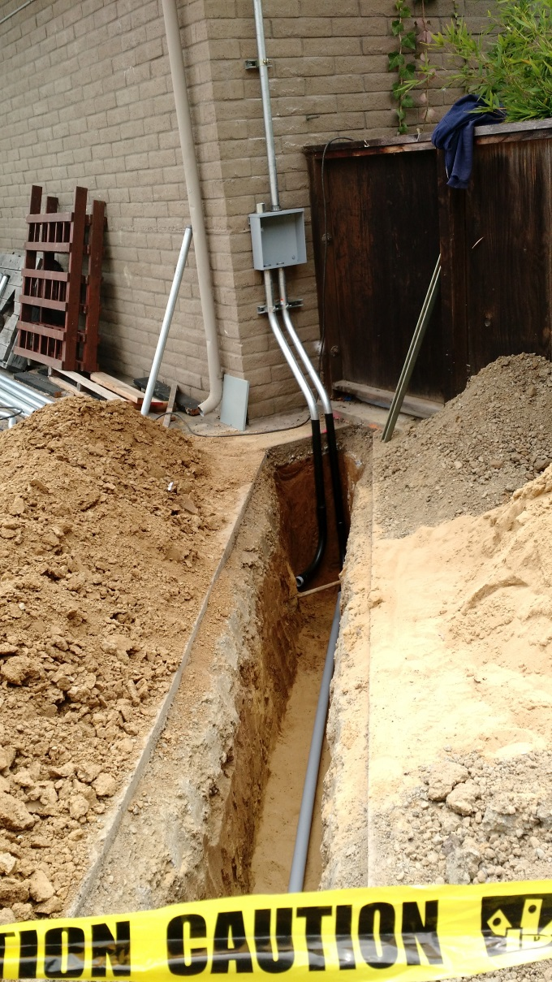
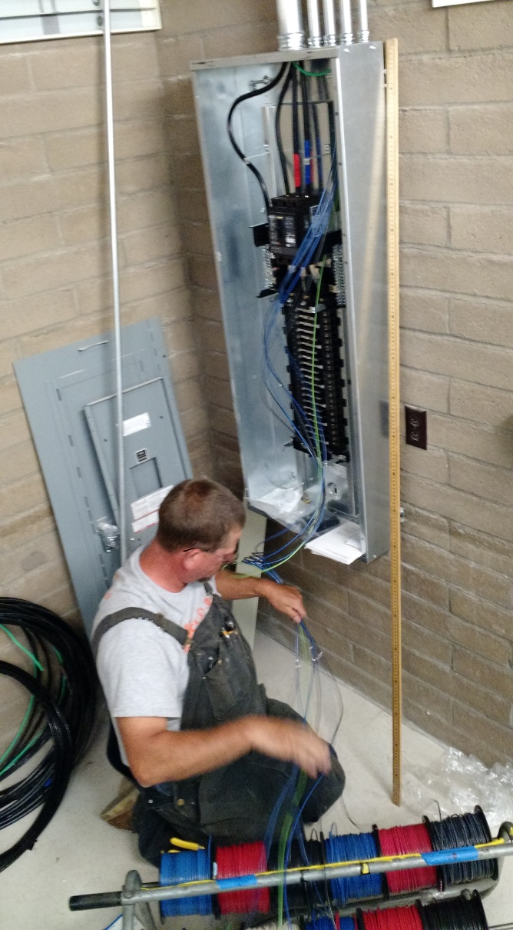
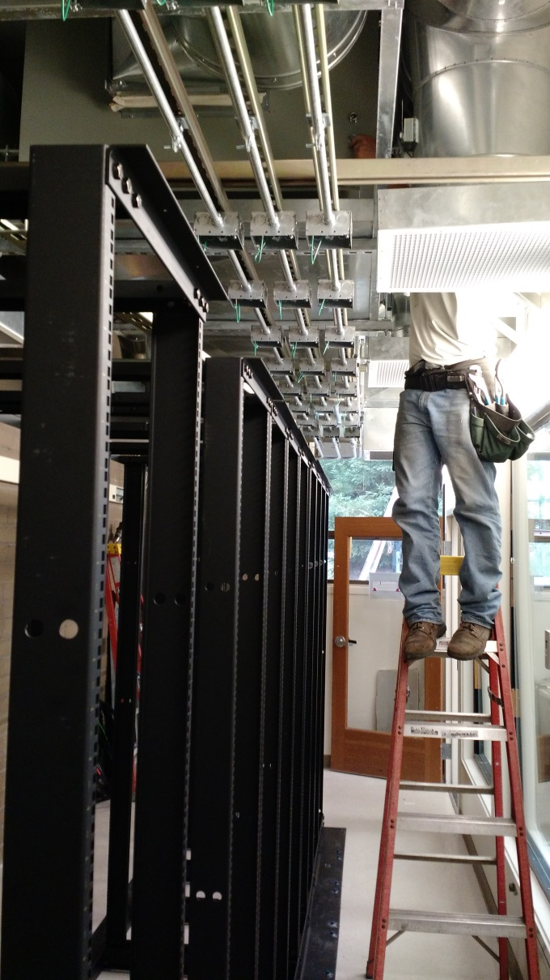
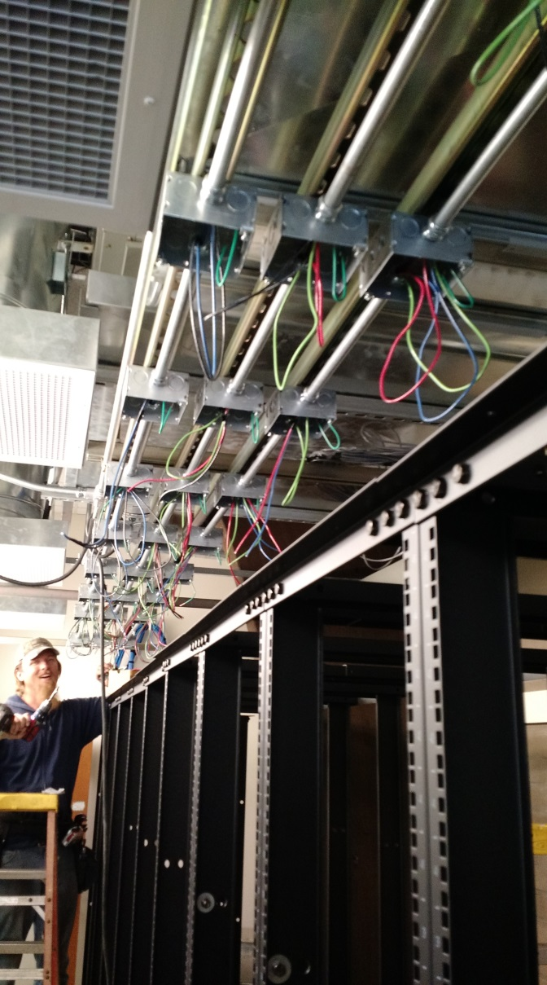
Making Progress

Slide 31
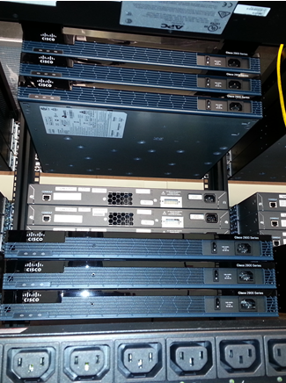
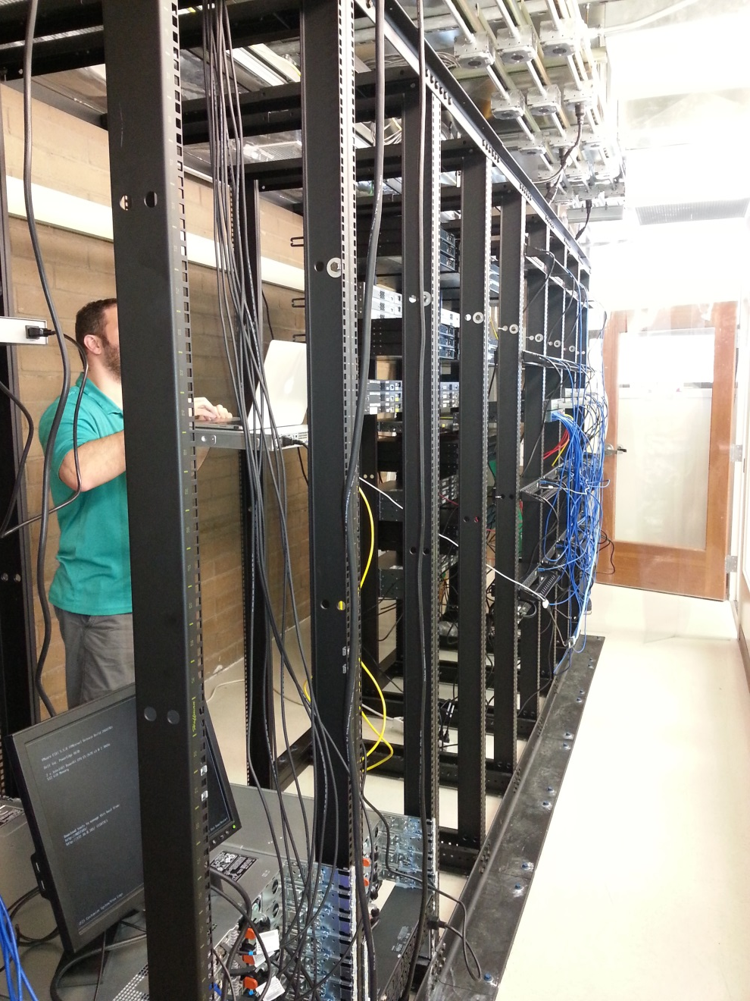
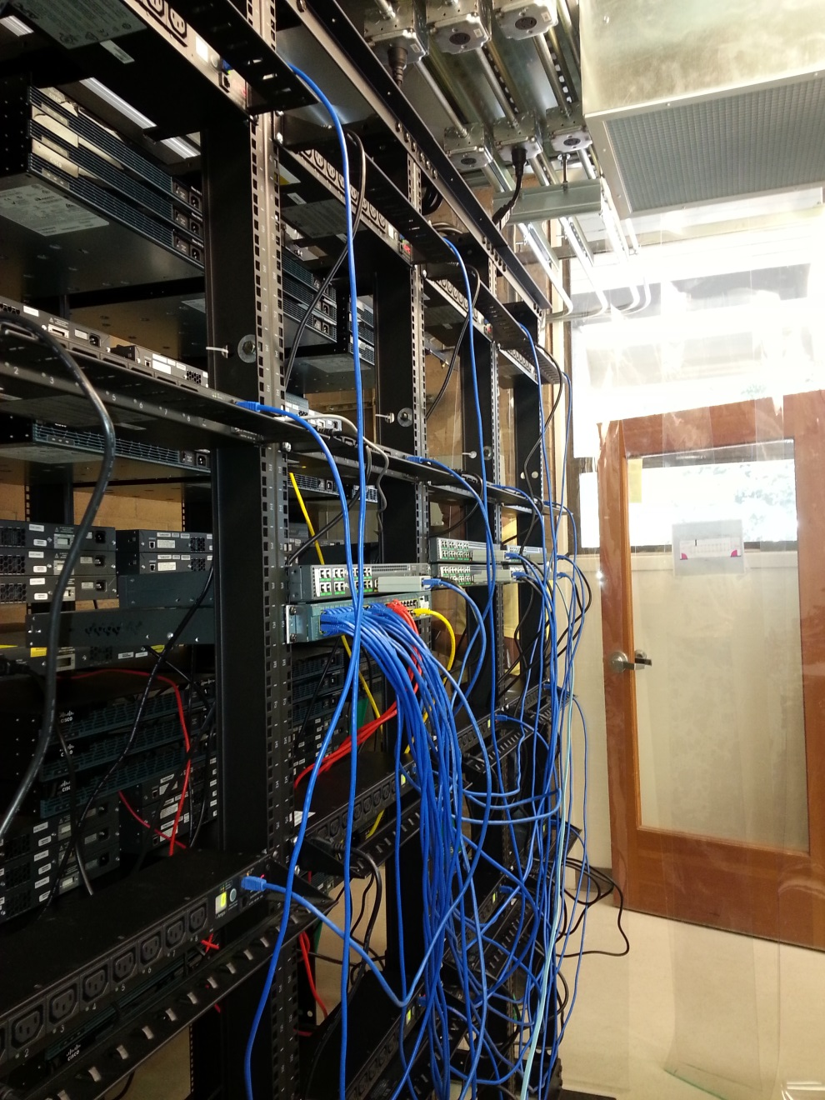

Slide 32

BACCC System Capacity
Purchased and donated equipment supports:
at least 288 simultaneous reservations
more than 16,000 three-hour lab reservations in a 24x7 week
Faculty pedagogy changes:
Hybrid Opportunity - Labs are Online
Students self-schedule lab access
Students do not have to travel to campus
Notes:
32

Slide 33
Cost and Cost Saving
cost of setting up an individual college system ~ $150,000
annual licensing and support cost ~$3,000
technical support person ~ $100,000 (including benefits)
  1 instead of 20
  20 x (150000+3000+100,000) = $4,060,000

Slide 34
Operational August 31, 2015
The date that classes started at most schools.
Contra Costa District classes began two weeks earlier – Used CSSIA’s (in Illinois) Remote Lab for the first two weeks.
Conducted orientation sessions in July, August and October. About 70 instructors attended.
123 Classes currently supported at 14 different schools. Total of 800+ unduplicated students in the system.
7959 lab hours completed by students in Fall 2015.

Slide 35
Testimonials
“We have used NETLAB at my college for over 12 years and I am very glad to have it hosted and managed elsewhere. The system is updated more regularly and the VM Images are current OSs. And the connection response time is better than when on my local campus! The additional capacity and new labs afford my students additional opportunities they would not have had were I to keep the server local. More of my colleagues will be able to integrate NETLAB into their courses and I can create additional courses without having to worry about lab facilities.
David, our technical manager, is a wonder. He is very responsive to my inquiries and change needs. We are fortunate to have him with us.
Thank you Richard and Gerlinde for making this happen in the SF Bay Area!”
- Michael McKeever, Santa Rosa JC

Slide 36
2016 Instructional Design and Innovation
This new institute will focus on strategies to improve student success and build more effective college programs.
cultivating partnerships to create new opportunities for students,
improving the collaboration between instruction and student services on our campuses,
discovering different strategies in curricular design,
integrating instructional technology into the classroom to enhance teaching,
and effectively institutionalizing innovative programs to ensure they do not disappear.

Slide 37
Partnerships to Create New Opportunities for Students
Increasing regional collaborations.
Cost savings provides more access.
Flexibility for student training need – taking the commute out of the loop.
Ability to offer more advanced, hard-to-fill, specialized advanced courses.
Faster deployment and updating for more timely delivery of hands-on content.

Slide 38
Discovering Strategies in Curricular Design
Regional approach to curriculum design.
VILT – Virtual Instructor-Led Training - train a growing and more dispersed population at a controllable cost.
Hybrid Synchronous/Asynchronous courses with hands-on practice available 24x7.
Development tools for easy sharing of lab content among schools, regions and states.

Slide 39
Enhance Teaching by Integrating Instructional Technology into the Classroom
Lab work can be done during scheduled class times and seamlessly continued outside of class.
VCT (Virtual Classroom Training) NETLAB with CCC-Confer provide powerful technology.
NETLAB can work seamlessly with Learning Management Systems (Canvas, Blackboard, Moodle, etc.)

Slide 40
Institutionalizing Innovative Programs
That is what we are working on right now
NETLAB (like CCC-Confer) could be a state-wide service
There is interest in this system statewide

Slide 41
Improving Collaboration Between Instruction and Student Services on our Campuses
?????????

Slide 42
NETLAB+ supplements or replaces you local hands-on lab facility

Slide 43
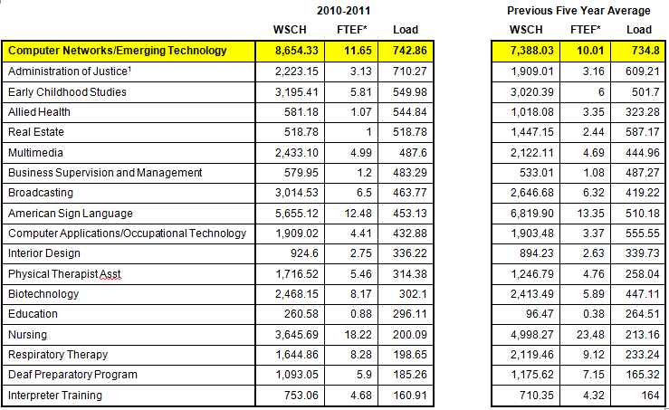
Value of a Remote Lab Facility
Ohlone College CNET Program began using NETLAB+ in 2003

Slide 44
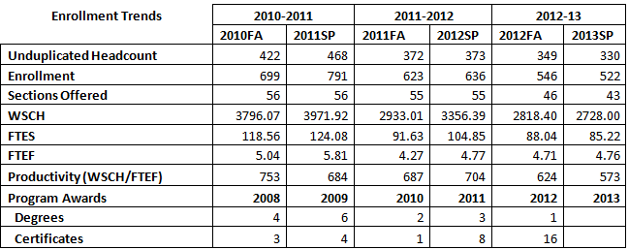
Value of a Remote Lab Facility

Slide 45
Value of the Shared Lab Facility
data center administrator
community of users
shared curriculum
outreach to high schools
regional alignment
(8000 Lab Hours / 525 = 15.2 FTES *$6,557 = $99,916)

Slide 46
Other Regional Collaborations
Regional Grant Proposal and Project Efforts
Regional ICT Faculty Professional Development
Regional ICT Industry and Employer Advisory Groups
Regional Harmonization of Curriculum and Credentials
Regional Coordination of Industry Academy Programs
Regional Curriculum, Resource and Subject Matter Expert Clearinghouse
Regional Marketing and Public Relations Efforts
Regional Development and Delivery of Distance Education Solutions
Regional K-12 Pathways Development and Coordination

Slide 47
Sustainability – Potential Strategies
Grants
  NSF - ATE grant
  Dept of Labor - TAACT
  CPT grants
  *NEW* CTE Incentive Grant funds
Sales of Service to other organizations that need
  Provide access to institutions outside of the collaborative for a fee
  Provide professional development for college IT departments
  Consider contract ED model - look for someone or a college that would like to try to generate income.

Slide 48
Sustainability – Potential Strategies
Chancellor’s Office Support
  Research other system-wide infrastructure investments - CCCConfer, DE, Canvas
  Consider what it would take to expand capacity to serve state
  Regional labs - supports focus on unique regional needs
College Membership
  Fee for participation (range $5 – 15K per year)
  General Fund – Colleges collect apportionment for student’s lab hours.
  Expand Membership

Slide 49
Q & A

Slide 50
Contact Information:
Gerlinde Brady - gebrady@cabrillo.edu
Richard Grotegut – RGROTEGUT@DVC.EDU

