Slide 1
HELP! An Introduction to ASCCC Resources to Support Your Senate Work
General Session 7
Thursday June 15, 2023 ǀ 1:15pm – 2:00pm

Slide 2
Welcome and Introductions
Carlos R. Guerrero, ASCCC South Representative
Christopher Howerton, ASCCC At-Large Representative
Eric Wada, ASCCC North Representative

Slide 3
General Session Description
As a response to identified needs and common questions, the ASCCC Executive Committee (and standing committees) regularly develop and update resources to support local senate work. Have questions about curriculum? Confused about open meeting requirements? Need support on advancing IDEAA locally? We got you! This session will provide an overview of some of the resources and services that ASCCC provides to support local senates

Slide 4
ASCCC Mission and Vision
MISSION
As the official voice of California community college faculty in academic and professional matters, the Academic Senate for California Community Colleges (ASCCC) is committed to equity, student learning and student success. The Academic Senate for California Community Colleges acts to:
Empower faculty to engage in local and statewide dialog and take action for continued improvement of teaching, learning, and faculty participation in governance
Lead and advocate proactively for the development of policies, processes, and practices
Include diverse faculty, perspectives, and experiences that represent our student populations
Develop faculty as local and statewide leaders through personal and professional development
Engage faculty and system partners through collegial consultation
VISION
Faculty leading change, serving students, and embracing inclusion

Slide 5
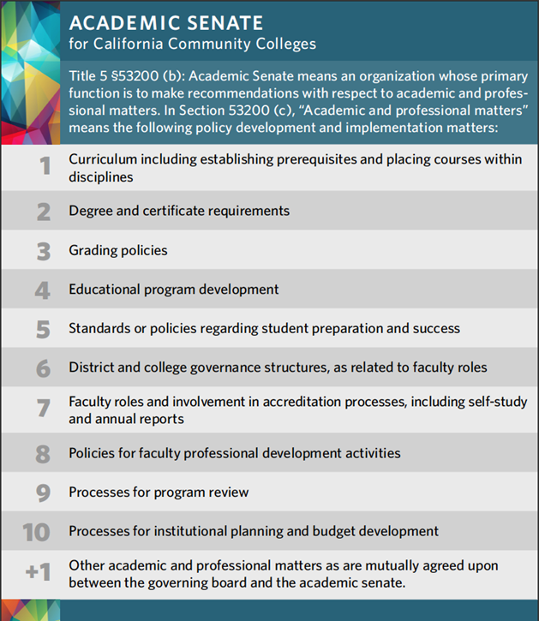
10+1 and New Member Card

Slide 6
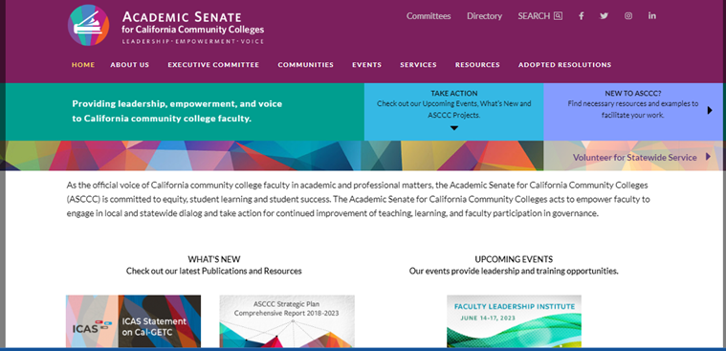
ASCCC Website asccc.org

Slide 7
New to ASCCC? https://asccc.org/local-senates
Notes:
CJH: Link here includes numerous resources
Resources:
Program and Course Approval Handbook (PCAH 8th Edition)
Minimum Qualifications/Disciplines List
The Brown Act
Area Map and College Listing
Board Policies
Request Technical Visits
Trying to figure out all the acronyms? Here is a list of the Commonly Used Acronyms.
If you need more information please Contact Us: Use the Form or email to info@asccc.org

Slide 8
ASCCC Website – Useful Links
ASCCC: Subscribe to Newsletter
ASCCC Request for Services
ASCCC Resolutions
ASCCC Legislative Positions
ASCCC Volunteer for Service
ASCCC Events
ASCCC Awards
Commonly Used Acronyms
Notes:
CRG: May want to discuss the difference between official and unofficial listservs. All on the list are hyperlinks
ASCCC: Subscribe to Newsletter: https://asccc.org/signup-newsletters
ASCCC Request for Services: https://asccc.org/content/request-services
ASCCC Resolutions: https://asccc.org/resources/resolutions
ASCCC Legislative Positions: https://asccc.org/legislative-positions
ASCCC Volunteer for Service: https://asccc.org/volunteer-serve-committee – will discuss more on slide 12
ASCCC Events: https://asccc.org/calendar/list/events
ASCCC Awards: https://asccc.org/awards
Commonly Used Acronyms

Slide 9
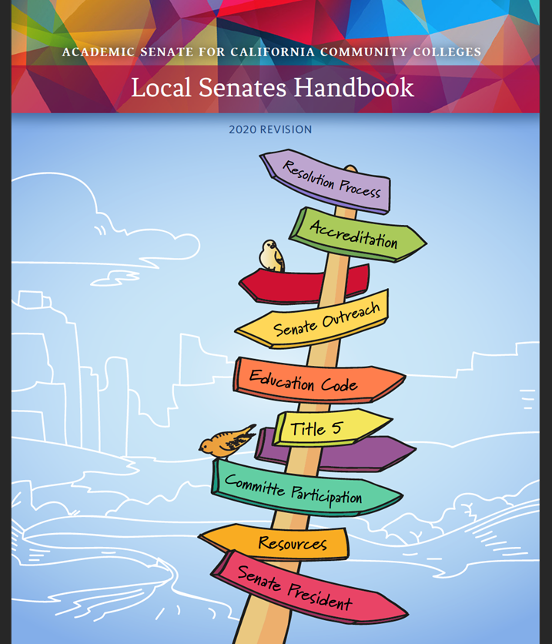
Local Senates Handbook
Part I: The Academic Senate for California Community Colleges: A Brief History
Part II: Roles and Responsibilities of an Academic Senate
Part III: Duties as a Local Academic Senate President
Part IV: Ensuring the Effectiveness of the Local Academic Senate
Part V: Linking Local Academic Senates to the ASCCC

Slide 10
Other ASCCC Publications
Academic Senate Papers
Senate Rostrum
ASCCC President’s Updates

Slide 11
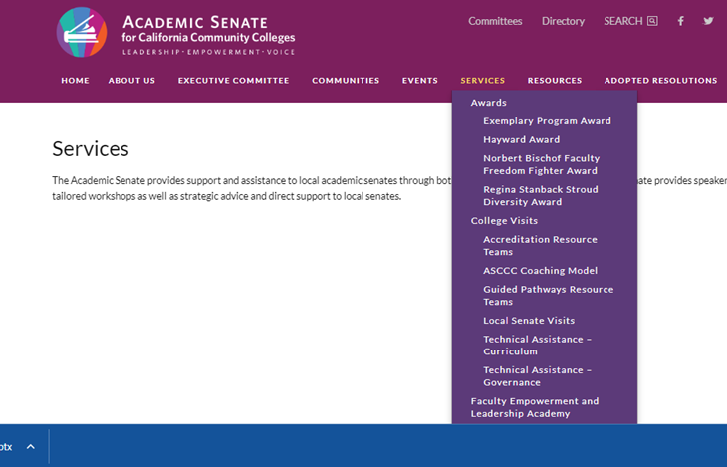
ASCCC Services
Accreditation Resource Teams
ASCCC Coaching Model
Guided Pathways Resource Teams
Local Senate Visits
Technical Assistance-Curriculum
Technical Assistance-Governance (Collegiality in Action)

Slide 12
Volunteer To Serve
ASCCC appoints almost 1,000 faculty members to work on statewide committees, workgroups, and task forces. Applying to serve provides you the opportunity to:
Create change within the California Community Colleges system
Network with other faculty from all over California
Gain experience serving on a committee
Access professional development
Increase your knowledge on issues within the California Community Colleges system
Apply here to volunteer to serve.

Slide 13
FELA (Faculty Empowerment Leadership Academy)
PROGRAM MISSION
TO CONNECT: Providing one-on-one mentoring to diverse faculty for personal and professional development with mentors who are campus leaders and/or administrators.
TO EMPOWER: Creating safe and brave spaces for courageous conversations to investigate equity, diversity, and inclusion; to share personal and collective experiences on race, privilege, and oppression; and to embolden new faculty leaders to advocate for transformative change on their campuses.
TO GUIDE: Providing networking opportunities and sharing guidance for navigating the systems of higher education. The focus of the mentoring will be to address the specific goals of the mentee.
23-24 Mentee Applications open June 12th and are due by August 18, 2023 (5pm)
Notes:
CJH: In addition to the mission some of the outcomes of the program includes:
OUTCOMES
Demonstrate a clear understanding of the faculty purview as outlined in the 10 + 1
Articulate the framework of inclusion, diversity, equity, anti-racism, and accessibility (IDEAA) in their professional development and leadership
Identify various ASCCC resources for local leaders
Consider their own personal leadership style(s)
Discuss various structural or systemic challenges for faculty leadership emergence
Relate their experience to impact their local academic senate work and future leadership

Slide 14
Additional Resources (more links!)
Model Hiring Principles and Practices
DEI Curriculum Model Principles and Practices
Cultural Humility Toolkit
Professional Development College
ASCCC Open Educational Resources Initiative
C-ID (Course Identification Numbering System)
California Community Colleges Chancellor’s Office (CCCCO or CO)
California Legislative Information
Find your legislators
Community College League of California (CCLC)
Accrediting Commission of Community and Junior Colleges (ACCJC)

Slide 15
Need Help?
Need to ask a question related to the 10+1?
Submit it through info@asccc.org.

