Slide 1
Student Engagement: Early Alert Supports an Engaged Classroom
ASCCC Instructional Design and Innovation Institute
Cynthia Rico, Sabra Sabio, Robyn Tornay
January 21, 2016

Slide 2
Summary
CCCTC went out for RFP on an education planning tool in late 2014
Hobsons acquired Starfish in February 2015
CCCTC and Hobsons signed contracts and are implementing the Starfish Enterprise Success Platform in colleges currently throughout the state
Three products come with the platform: Degree Planner, Early Alert and Connect

Slide 3
8 Pilot Districts (13 Colleges)

Slide 4
Video
Short video highlight

Slide 5
Before Starfish
Need to improve Retention, Success, and Completion
No existing all-student Early Alert/Progress Survey; Paper surveys for specific programs
High student-counselor ratio; No case management in General Population
Decentralized academic support
Student Success and Support Program and Student Equity Goals
Existing systems and processes (Scheduling, Tracking, Reporting)

Slide 6
Questions EPTDAS Asked
Data to show changes in retention, persistence, and use of campus support services?
Is Sierra satisfied with the level of reporting Starfish offers?
How did Sierra acquire faculty buy-in?
What system did Sierra use prior to Starfish?
Does Sierra have any videos on how to use Starfish at the college?

Slide 7
Faculty Usage & Student Response:
68% of faculty (adjunct and full-time) have created profiles in Starfish
85% of faculty who opened a survey completed the survey.
Thank you . . . I am struggling this semester. I am a full time high school volleyball coach. The book quizzes are what is killing me. I also wanted to see if I can watch the clips from the film for the campus paper because their is no way I can attend an event. I have a lot of things going on, which isn't an excuse but it's killing me. Thank you for your concern, means a lot that an instructor cares.

Slide 8
Fall 2014- Spring 2015
Total Items Manually Raised Survey Raised
14,422 | 2,489 | 11,480
The total number of flags and Kudos raised during the Fall 2014 – Spring 2015 academic year indicates that faculty are more likely to raise flags as a result of the survey rather than accessing the system and manually raising alerts.
Total Unique Students With a Flag or Kudos | 7392
Average Number of Flags Per Student | 1.88
Average Number of Kudos Per Student | 1.60

Slide 9
Influence on Student Behavior:
Flags are raised to indicate to students that a response or a change in behavior is needed.
For example, a faculty may raise an attendance concern for a student.
This concern is communicated to the student, encouraging students to meet with/talk with his/her faculty to discuss the concern and possible solutions.
The student may also change their behavior as a result of the flag and begin attending class regularly.

Slide 10
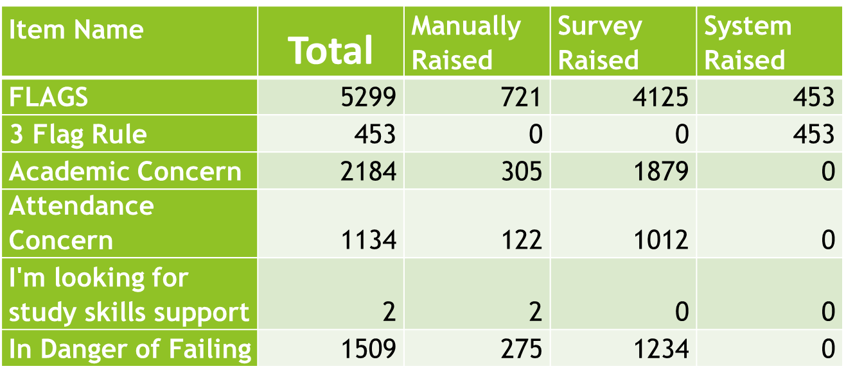
Student Behavior:
The majority of flags raised alerts students to an academic concern the faculty has for this student. Flags like In Danger of Failing result in intervention from Early Alert Counselor. Students responded favorably to this response.

Slide 11
Student Behavior:
Flagged students are engaging more with faculty
Early Alert is changing the way we look at instructor feedback – grades and directive comments
This term: Tutoring Referral To-Do

Slide 12
Influence on Instruction:
Surveys timed to meet instructor needs (testing, grading cycles)
Flags & Kudos were designed to allow for specific kinds of feedback at different times
Professors became more directive and clear in their comments to students. This helped students to understand the response/behavior change needed and take action to improve success.
KUDOS | 8595 | 1240 | 7355
Great Job | 463 | 34 | 429
Great Start Kudo | 1768 | 373 | 1395
Keep Up the Good Work | 6220 | 759 | 5461
Tutor Candidate | 144 | 74 | 70

Slide 13
Early Alert Implementation: Features
Creation of flags, Kudos, Help Me (student-raised flags), To-Do’s and Referrals
Design surveys: content & timing
Development of student communication
Design services: Kiosk & remote check-in
Effective practices: development and evaluation

Slide 14
Early Alert Implementation: Faculty and Students
Outreach to faculty, staff, and students
Provide faculty, staff, & student training
Develop and implement Starfish Advisory Team
Create website resources
Design & evaluate workflow – Faculty, Students, & Early Alert Counselors

Slide 15
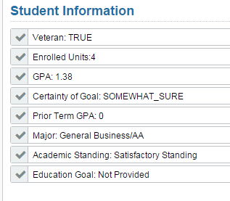
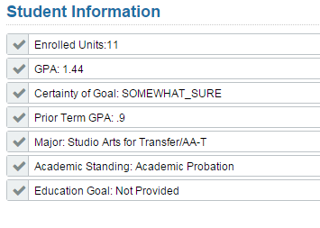
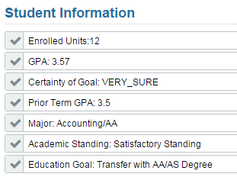
Acquiring Faculty Buy-In
Instructor: making the survey easy to access & easy to complete
Academic Senate approval for emails to students
Make emails accessible to faculty for review
Counselors: make accessing student information easier

Slide 16
Videos on Using Starfish
Starfish videos made available on website
http://www.sierracollege.edu/student-services/hub/faculty-videos/index.php
Faculty and Staff training provided
Reference materials provided to staff as needed
Sierra plans to create how-to videos for staff for various features:
Scheduling Office Hours
Managing other people’s schedules
Running the tutor center
Batch loading existing users to roles
Managing a Kiosk

Slide 17
Features of the System
Student Success Network
Online Appointment Scheduling
Calendar Manager
Kiosk Screen/Waiting Room
Counselor Management of Appointment

Slide 18
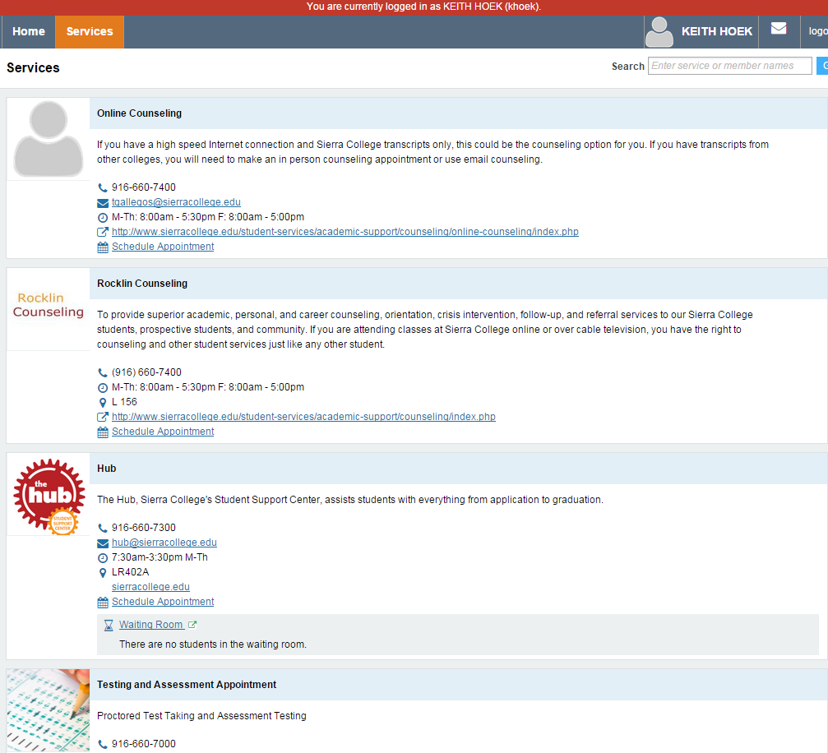
Student Success Network

Slide 19
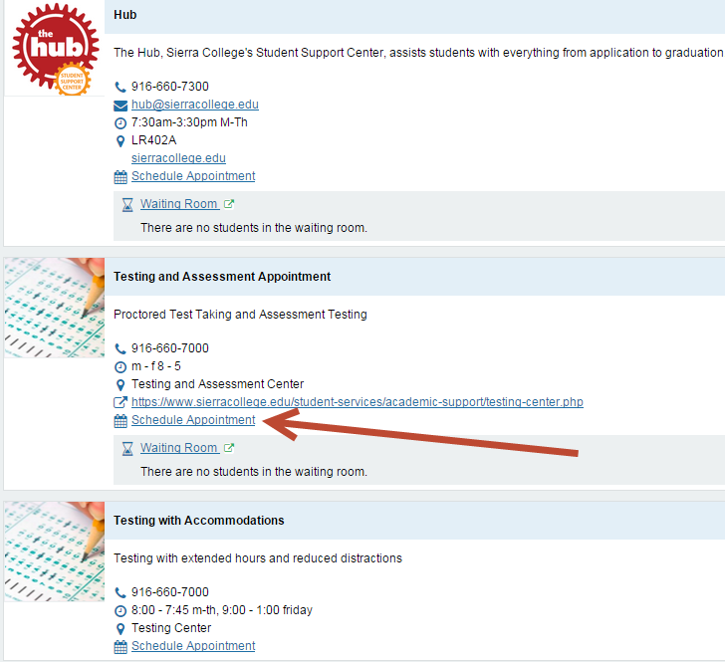
Select “Schedule Appointment”

Slide 20
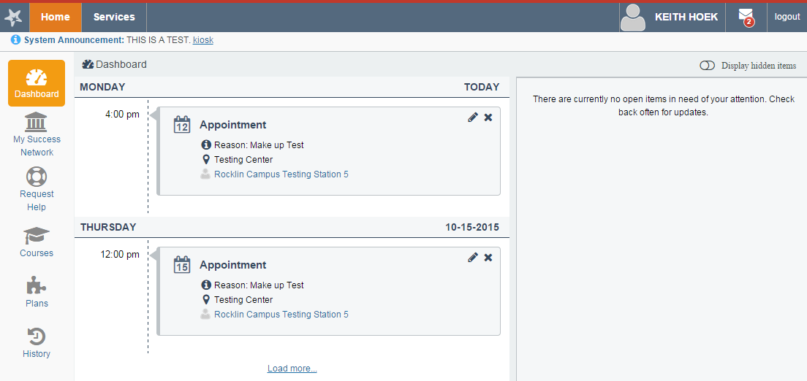
Next time student logs in, they see their scheduled appointments from the home tab.

Slide 21
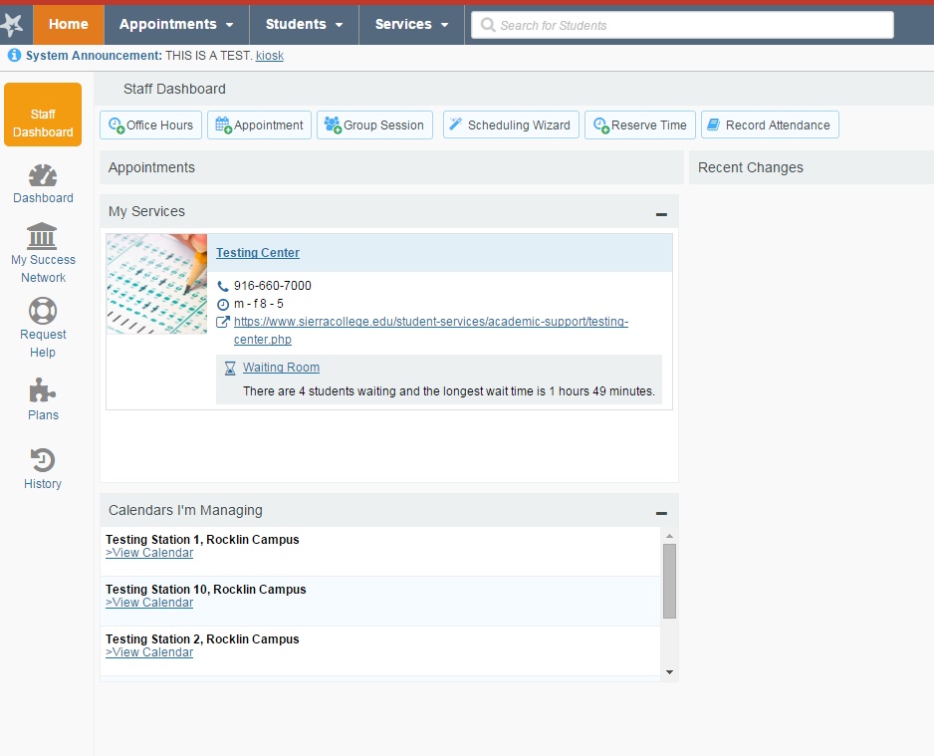
From the Home tab in Starfish, click on Waiting Room for the Service

Slide 22
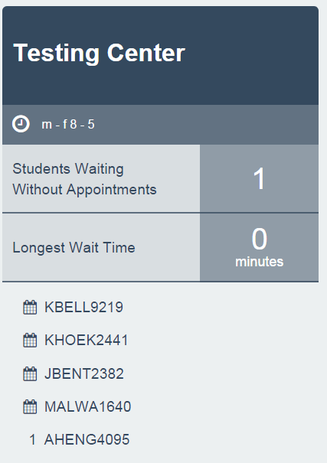
Those with appointments are visible and can be seen on the screen. The student who is in the waiting room with no appointment is also visible.

Slide 23
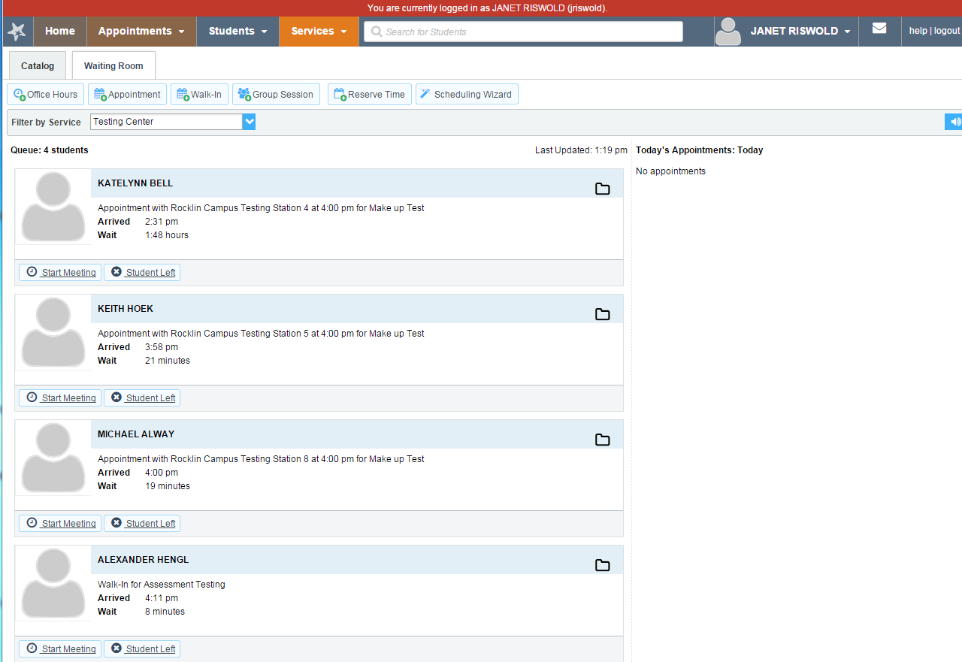
Students appear in the order they arrived. Staff can see who has appointments, and who “walked in”

Slide 24
“Start Meeting” to check the student in.

Slide 25
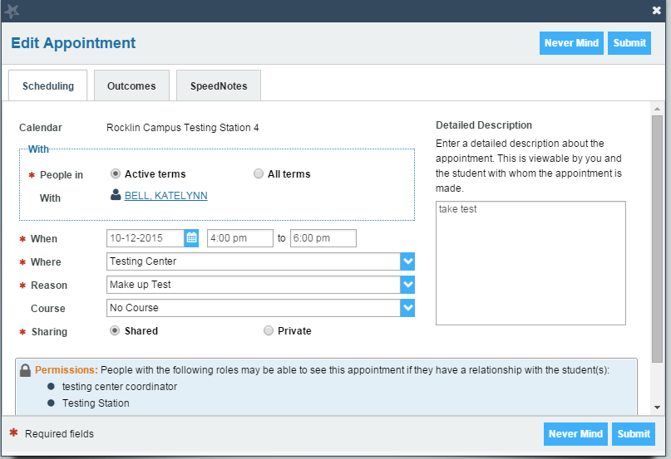
Staff member can alter “start time” here.

Slide 26
For automatic time entry, click the Outcomes tab

Slide 27
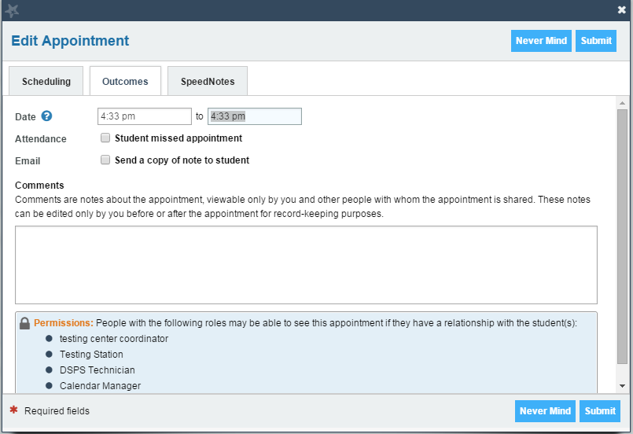
Must enter an end time, which can be changed later

Slide 28
El Camino College Implementation
Pre-Planning Meeting – July 2015
Discover documents to Hobsons – Summer 2015
District Kick-Off – August 2015
Weekly Team meetings with Hobsons
Bi-weekly technical meetings with Hobson

Slide 29
Team Structure
Team consists of:
Executive Sponsor
Project Lead
Functional Lead (2)
Technical Lead (2)
Faculty Liaison
Project Coordinator
Institutional Research and Planning
Public Relations and Marketing
Scribe

Slide 30
Where we are right now
Setting up attributes for the college
Establishing roles and relationships
Defining permissions
Determining flags
Notes:
Sabra: When you are on this slide, could you also mention about the conversations that you are having with the faculty( counselors and instructional)…. what are their thoughts about the Early Alert, what are their assumptions and what are you hoping to achieve. What other conversations have been important to have and do you have students in this process of implementation, what are their thoughts.

Slide 31
Questions and Closing
Additional information can be found at:
www.cccedplan.org
Additional questions may be asked at:
www.ccctechnology.info

