Slide 1
Accelerated Time to Completion A Path to Quantitative Reasoning
Gina Abbiate – Assistant Math Professor
Toni Parsons – Math Department Chair
San Diego Mesa College

Slide 2
Introductions
Get into small groups (less than 4 people)
Find commonalities among all of you within these categories:
Leisure activities
Your life as a student (yes….when YOU were in college)
Your life as a professional
Write the three items you have in common on the poster board

Slide 3
Introductions
Setting the tone
Finding common ground
Non-traditional structure to class meetings
Establish trust early
Rethinking “group projects”

Slide 4
What were the numbers saying?
Students placing into Math classes below Transfer-Level
 | 4 levels below | 3 levels below | 2 levels below | 1 level below | TOTAL
White | 8% | 26% | 26% | 15% | 76%
Asian | 6% | 15% | 16% | 14% | 51%
Filipino | 10% | 26% | 17% | 17% | 71%
Latino | 16% | 31% | 19% | 15% | 82%
African American | 27% | 39% | 14% | 10% | 90%
First-time students with placement levels; 3-cohort average (2011/12, 2012/13, and 2013/14); Source: SDCCD Information System

Slide 5
Huge Obstacles Require Huge Changes
Unacceptably low success rates
High repeat rates in Intermediate Algebra
Disproportionate impact on historically underrepresented
Response to Statway and California Acceleration Project
Committed to algebra skills as a graduation requirement
Keep options open for “non-STEM” majors

Slide 6
Math 92 - A typical day in class: Hiding the broccoli in mac n’ cheese
Throw them into the pool before giving them “floaties”
Focus on collaboration & problem solving
4 units course: 3 hours lecture, 3 hours lab
Two, three and four day per week options
Classroom Tutors with extra office hours
Application problems using calculators
Math Appreciation

Slide 7
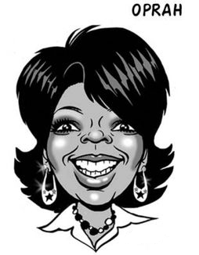
Sample: People Proportions

Slide 8
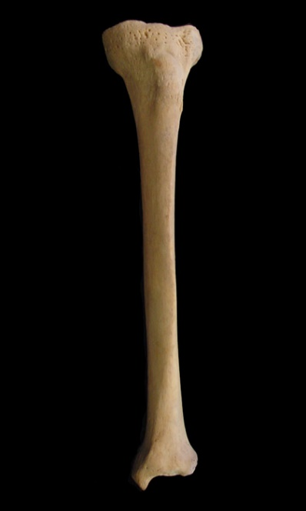
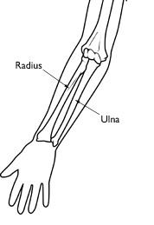
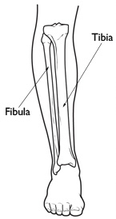
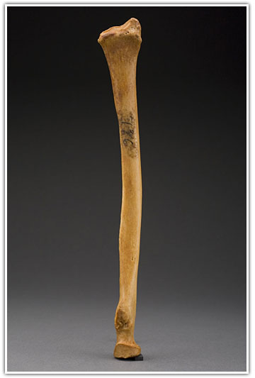
Sample: People Proportions How tall were these people?
Length 34.8 cm Length 24.8 cm

Slide 9
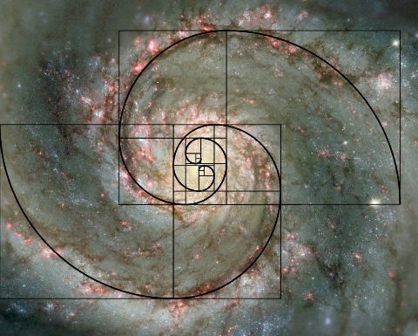
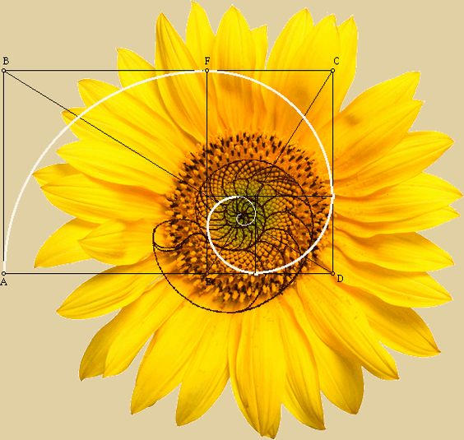
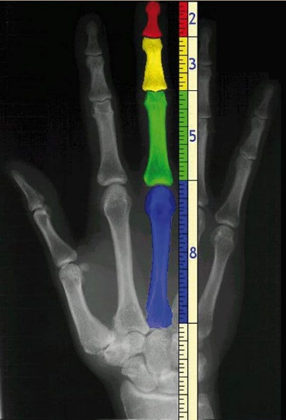
People Proportions: Phi (Φ), Fi, Fo, FUN!
The Golden Ratio
Φ$≈1.6180339$
=
Art
Architecture
Plants
Solar System
Music
Human Body
Weather
Population growth
Φ $=5^{.5}∗.5+.5$

Slide 10
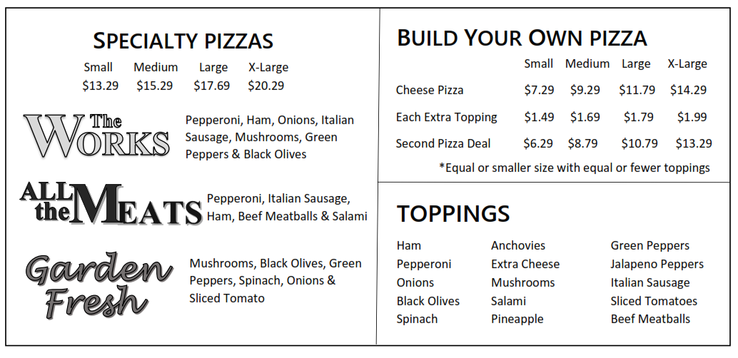
Sample: Pizzeria – Analyzing Area

Slide 11
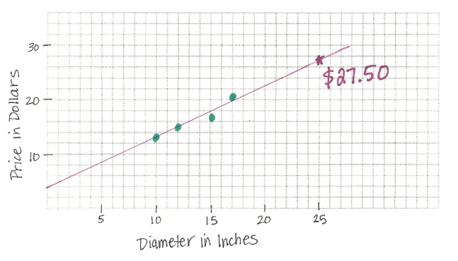
Sample: Pizzeria – Analyzing Area

Slide 12
Curriculum Implications
ELM Standards
Title 5 requirements for meeting AA requirement
Prerequisite for classes in other disciplines
Quantitative Reasoning Requirement
Easy path back to STEM

Slide 13
STEM Path vs. Non-STEM Path Comparison
31% Completed Basic Skills Math
73% Complete Transfer Level Math
STEM
PATH
Increased from 17%
69% Completed Basic Skills Math
70% Complete Transfer Level Math
Accelerated PATH
Source: CCCCO Basic Skills Cohort Tracker, Fall 2013 – Fall 2014 cohorts;
Students tracked for 3 terms after their initial course enrollment

Slide 14
Completion Percentages by Ethnicity
36%
38%
29%
24%
Source: CCCCO Basic Skills Cohort Tracker, Fall 2013 – Fall 2014 cohorts;
Students tracked for 3 terms after their initial course enrollment

Slide 15
Completion Percentages by Ethnicity
36%
70%
38%
71%
29%
71%
24%
64%
Source: CCCCO Basic Skills Cohort Tracker, Fall 2013 – Fall 2014 cohorts;
Students tracked for 3 terms after their initial course enrollment

Slide 16
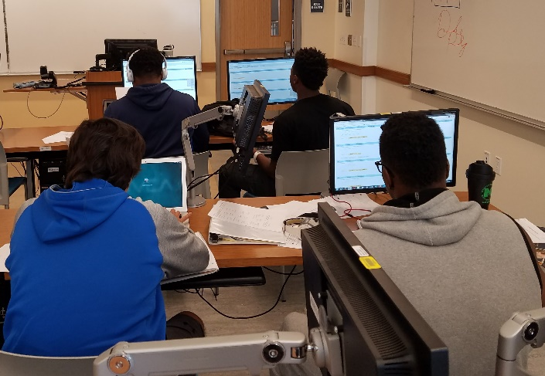
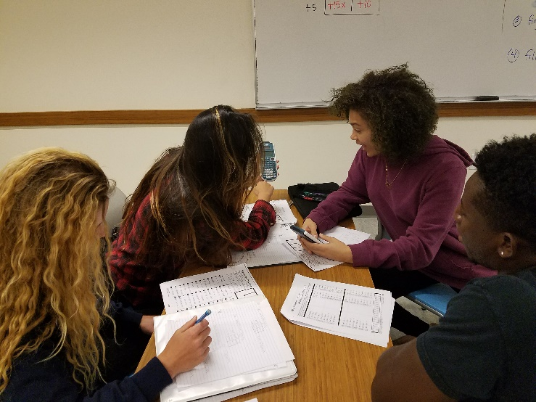
Looking to the future
Professional Development
Weekly discussions covering best practices
Retreat focused on use of technology
Reach More Students
BSSOT Grant goal to increase number of sections
Strengthen communication with counseling dept
Prerequisite Changes
Boot Camp for PreAlgebra Skills
Enrichment for equity based teaching methods
Drop the prerequisite completely?
Just in time support to refresh concepts
Demystify who is eligible for accelerated math

Slide 17
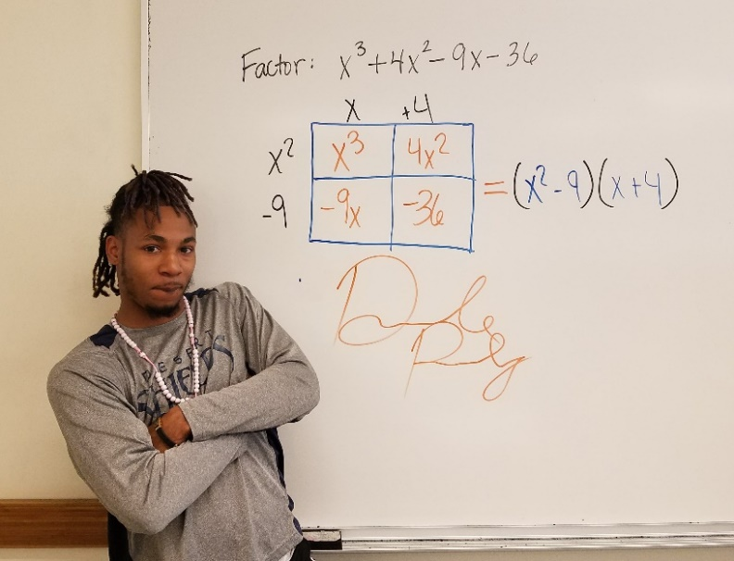
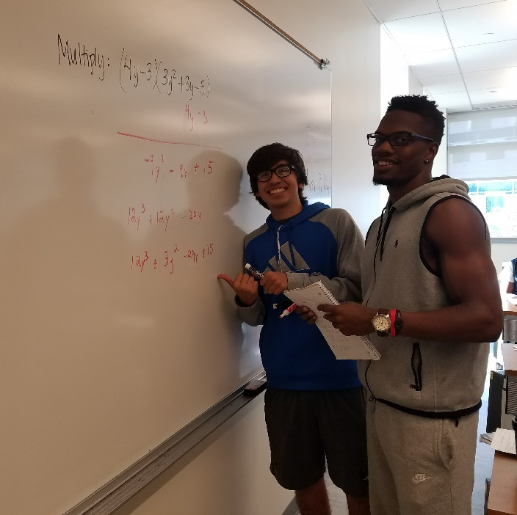
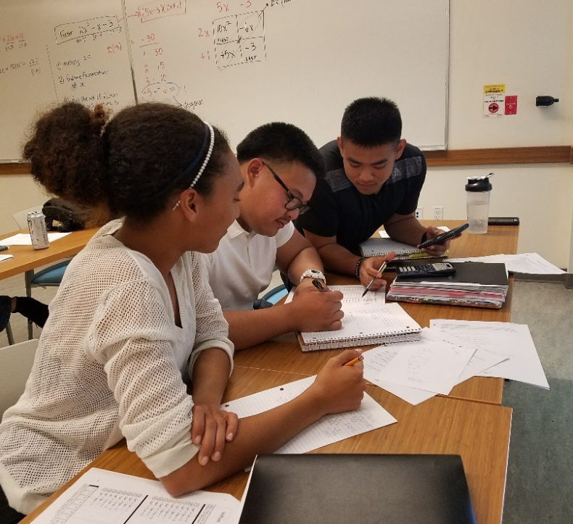
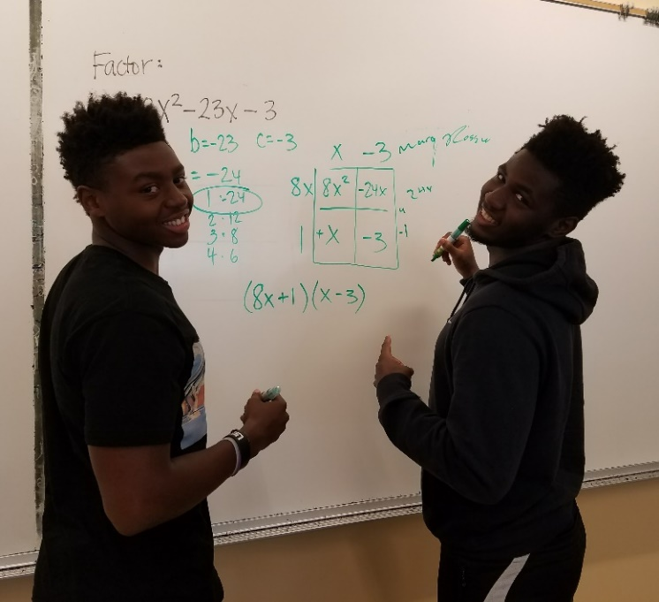
Student comments
“ I used to hate math, but now I
like it a little more.” -Edwin
“I wish I could have used a
calculator in my last class.
I think I would have passed.”
-Sophie
“I can’t believe I got an A on a
math test for the first time in
my life. I gotta call my mom!”
-Dejon
“Now I am feeling confident that
I can get though trig. I am
changing my major to
kinesiology.” -Jenna

