Slide 1
What's COVID Got To Do With Students’ Transfer Trajectories?
Research made possible with generous funding from:
Notes:
Darla

Slide 2
www.rpgroup.org
The RP Group
Mission: As the representative organization for Institutional Research, Planning, and Effectiveness (IRPE) professionals in the California Community Colleges (CCC) system, the RP Group strengthens the ability of CCC to discover and undertake high-quality research, planning, and assessments that improve evidence-based decision-making, institutional effectiveness, and success for all students.
Services: Research, evaluation, planning, professional development, and technical assistance—designed and conducted by CCC practitioners
Organization: 501(c)3 with roots as membership organization
Notes:
Darla
Our Vision
The RP Group strives to build a community college culture that views planning, evidence-based decision-making, and institutional effectiveness as integral, collaborative strategies that work together to promote student success, increase equitable outcomes, improve college operations, and inform policymakers.

Slide 3
Through
the Gate
An Overview
Notes:
Darla

Slide 4
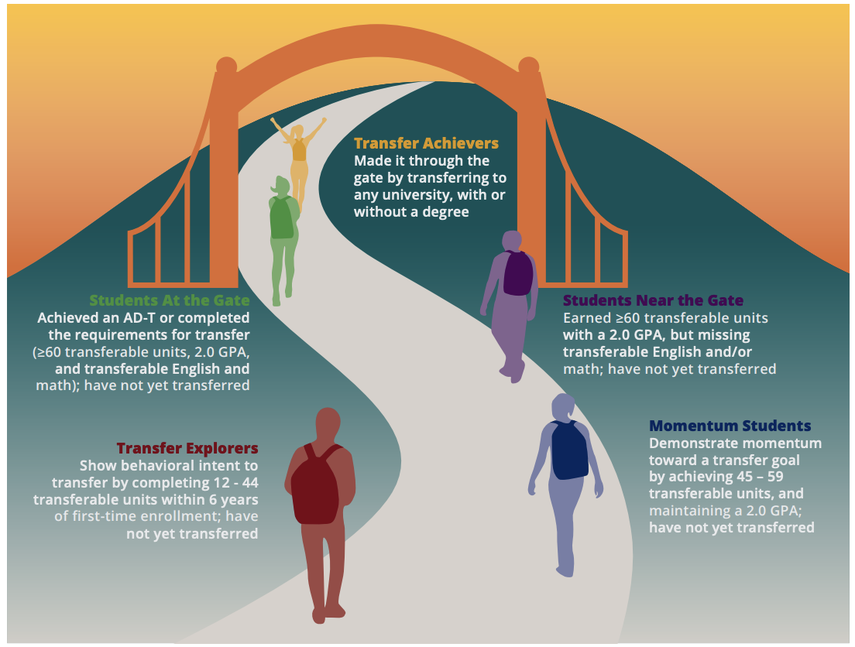
Through the Gate: Phase 1
Mapped California’s transfer landscape, identifying a continuum of milestones for the student transfer journey and quantifying how many students were “near” or “at” the transfer gate
4
Notes:
Darla

Slide 5
Through the Gate: Phase 1
More than half exit without credentials
Math is a barrier
Time is the enemy
Once African Americans reach key milestones, they are most likely to transfer…but too few get this far
Latinx students more likely to be At or Near the Gate than to have transferred
Notes:
Darla
Exit without credentials
Transfer Achievers: 69%
Students At the Gate: 54%
Students Near the Gate: 49%
92% of Near the Gate students need to complete math transfer requirement
African Americans are least likely to complete transfer-level math
Students who do not transfer within a year of becoming transfer ready (at the gate) are less likely to transfer
75% African-American students who make it near or at the gate ultimately transfer -- highest among any ethnic group
Yet, many African Americans do not make it past 30 units in six years
Latino students are 1.41 times more likely to remain at the gate than transfer
Latino students are 1.30 times more likely to remain near the gate than transfer

Slide 6
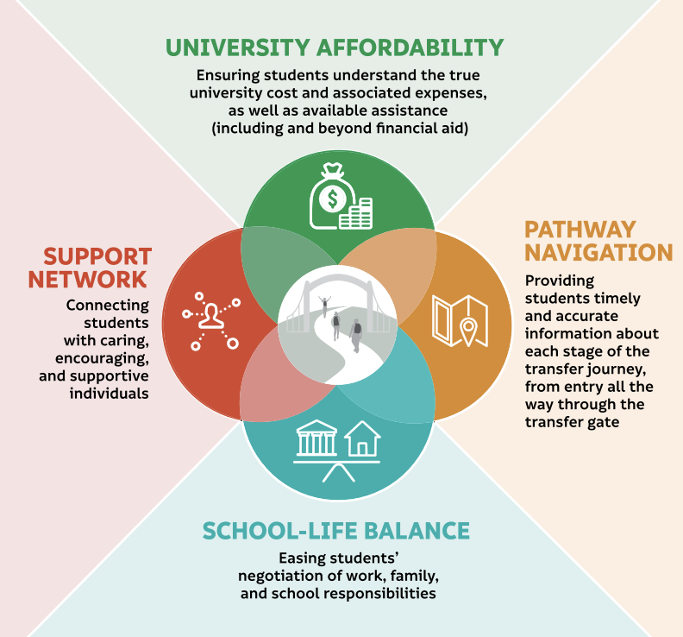
Through the Gate: Phase 2
Student Transfer Capacity-Building Framework
Developed a framework for building students’ transfer capacity, highlighting four issues community college students grapple with as they work toward their goal of a bachelor’s degree
6
Notes:
Darla

Slide 7
Through the Gate: Phase 2
Students say finances are the biggest hurdle to transfer
Students are juggling numerous and often competing school, work, and family responsibilities
Students are missing accurate, timely information about pursuing a baccalaureate throughout their transfer journey—from both community colleges and universities
Students say the absence of social support negatively impacts their transfer decision- making and compromises their capacity for pursuing a bachelor’s degree
7
Notes:
Darla

Slide 8
Through the Gate: Phase 2
Hispanic and Latina/o/x students are more likely than Asian and White students to report that having universities they can attend near their home is highly motivating
Hispanic/Latina/o/x students more likely than Asian and White students to indicate that the cost of university tuition is very challenging when considering transfer
African-American/Black students more likely than White students to indicate use and helpfulness of a wide variety of transfer-related resources
Notes:
Darla

Slide 9
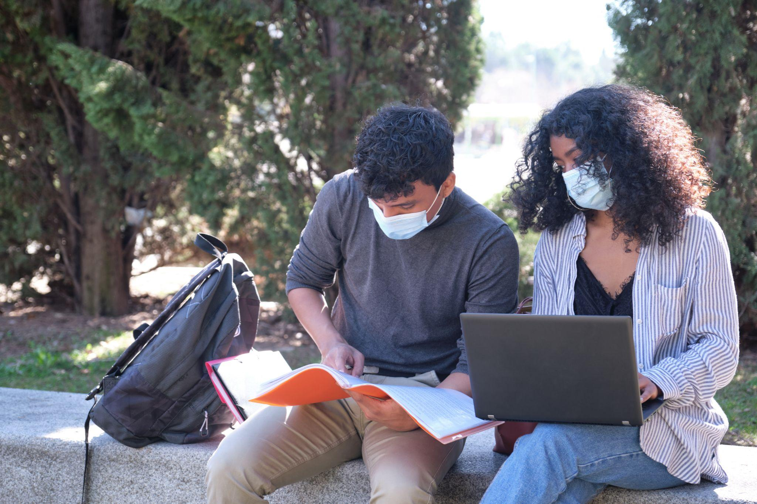
The Current Study...
Notes:
Katie

Slide 10
Long-Term
Questions
How will the pandemic impact the educational trajectories of transfer- motivated students?
What new or different supports will they need to attain their academic goals?
Notes:
Katie

Slide 11
Immediate
Questions
How were students’ transfer plans affected by the pandemic?
What issues did students who were close to transfer face during the pandemic?
Notes:
Katie

Slide 12
Immediate
Questions
What did students know about changes in the CCC and university segments designed to support their transfer journey, and how did they leverage these changes?
How are the four factors from the Transfer Capacity-Building Framework currently impacting students’ transfer experience?
Notes:
Katie

Slide 13
Research Overview
Study participants:
7,894 high-leverage students
67 CCC (58%)
Study activities:
Statewide survey
2 focus groups with students:
- experiencing transfer success
- with impacted transfer plans
13
Notes:
Katie
In spring 2021, we surveyed nearly 8,000
“high-leverage” students who had completed at least 45
transferable units as of fall 2020
at a CCC — those who were close to transfer but had not yet made it to university — exploring the near-
term impact of the COVID-19 pandemic on their transfer experience
Our research examined:
• COVID-19’s effect on students’ transfer plans
• Issues faced by transfer students during the pandemic
• Student awareness and use of relaxed requirements
made by California’s higher education segments,
designed to support their transfer success
• Influence of key factors on students’ transfer capacity
(identified by our original Through the Gate transfer
study1) during the pandemic and in the coming year

Slide 14
2 out of 5 students’ transfer plans were impacted by the pandemic
Highest among non-binary, Native American, and Native Hawaiian
Even among students who had been accepted for transfer, nearly one in 10 had either deferred or decided not to go
Notes:
Katie
Many students surveyed indicated that the pandemic negatively affected their transfer plans — despite their considerable progress toward a bachelor’s degree.
Impacts varied from changing pathways to delaying plans to cancelling transfer plans all together.
Many deferrals due to not wanting to pay university tuition online and / or waiting for life to settle back down
Some students reported that COVID-19 derailed their plans altogether, even after they had been admitted to university.

Slide 15
2 out of 5 students found it harder to access counselors/advisors during the pandemic
In focus groups, students noted concern that they won’t be prepared for the rigor of university-level work given the leniency of the present year
Especially true of majors involving a lot of hands-on coursework
Notes:
Katie
Many students reported having difficulty accessing transfer-related sources during the pandemic at both the CCC and university
40% of students found it harder to access counselors and advisors while 33% of students found it difficult to access both
community college and university transfer
center staff
Additionally, when asking about the issues they experienced during the pandemic, FGs shared concerns about their university readiness due to questions about the rigor of their online community college courses.

Slide 16
More than two-thirds of students not aware of changes to CCC, UC, and CSU transfer requirements
Even among those who did know of these changes, fewer than one in five indicated that the changes improved their transfer experience
Nice to know they exist as a safety net even if they don’t use
Notes:
Katie
68% of students were unaware of changes made by CCC
75% of students were unfamiliar with changes made by their prospective university
Student Groups Least Likely to Know
about Relaxed Requirements
• White
• Native American/Alaska Native
• Ages 25+
In focus groups and open-ended survey questions,
students voiced that while they did not leverage these
options, the availability of these options served as a sort
of safety net.

Slide 17
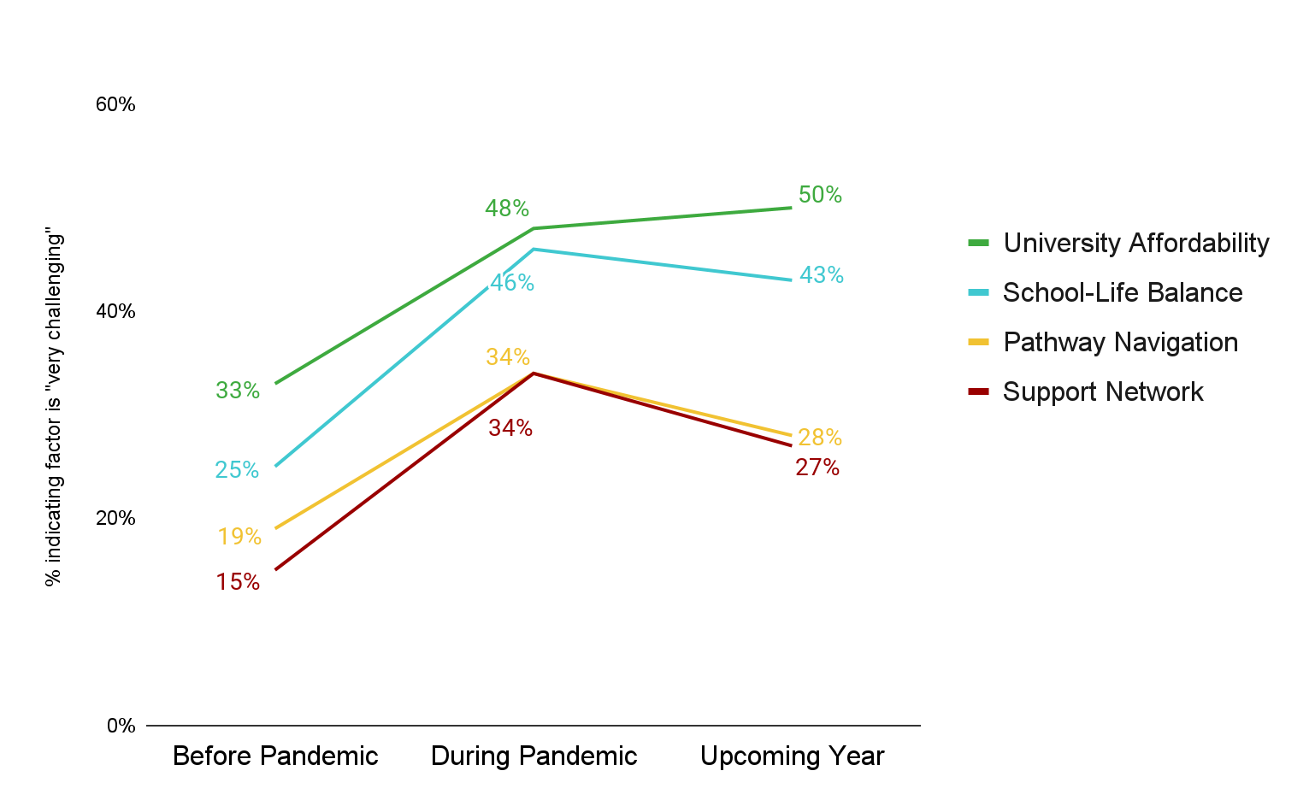
The challenge of each of the four factors is substantially higher than before the pandemic, most notably University Affordability
Notes:
Katie
University affordability most important, most challenging, and saw rise in challenge during pandemic
Concerns about school-life balance greatly intensified during the pandemic (now abating somewhat, but still much higher than pre-pandemic
Challenges associated with pathway navigation and support network grew substantially from before to during the pandemic, yet appear to be trending back downwards more quickly than university affordability or school-life balance
Issues with both areas centered around communication with both the community college and university. While many of the issues associated with these factors will likely be reduced by the availability of in-person education, these two factors are still substantially higher than they were before the pandemic.

Slide 18
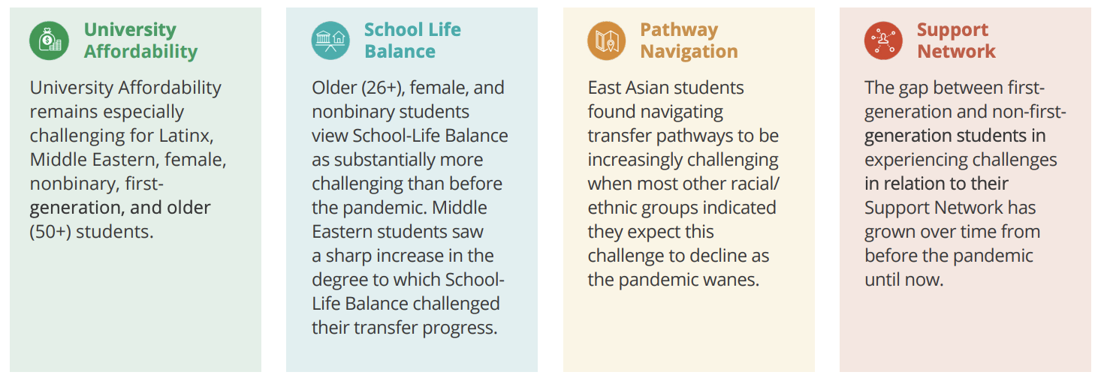
Changes in the factors impacting students’ transfer capacity varied among different student groups
Notes:
Katie

Slide 19
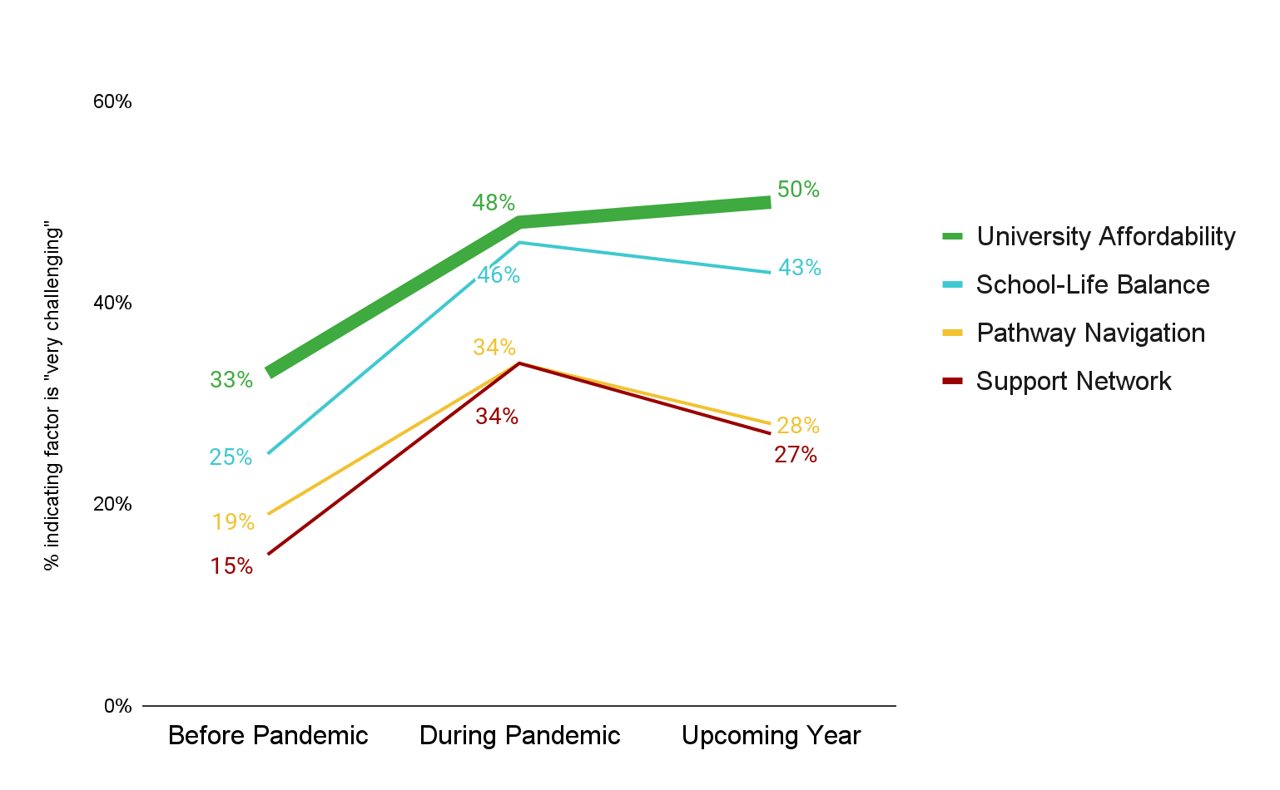
The challenge of University Affordability is higher than ever before
The uncertainty as to how next year will be is what is causing the most stress, I am currently working at a warehouse to afford food and pay bills but I work graveyard shift, not knowing if school will be back in person really stresses me out because I am unsure on whether to find a new job that will fit my future schedule or keep the one I have at the moment.
Notes:
Katie
For ASCC Pause to discuss - What can faculty do? How can faculty help? See Faculty Guide / Encourage students to get more info
https://rpgroup.org/Portals/0/Documents/Projects/ThroughtheGate/TTG-StudentSupportProfessionalsResource.pdf?ver=2021-09-16-150205-103

Slide 20
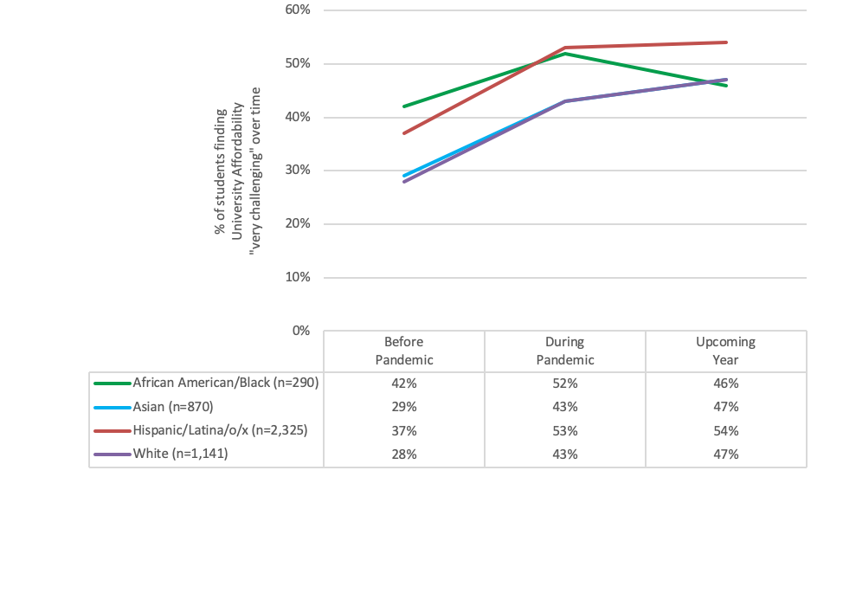
Hispanic/Latina/o/x students are most likely to indicate the challenge of University Affordability
Changes in the Challenge of University Affordability by Race/Ethnicity
Notes:
Katie

Slide 21
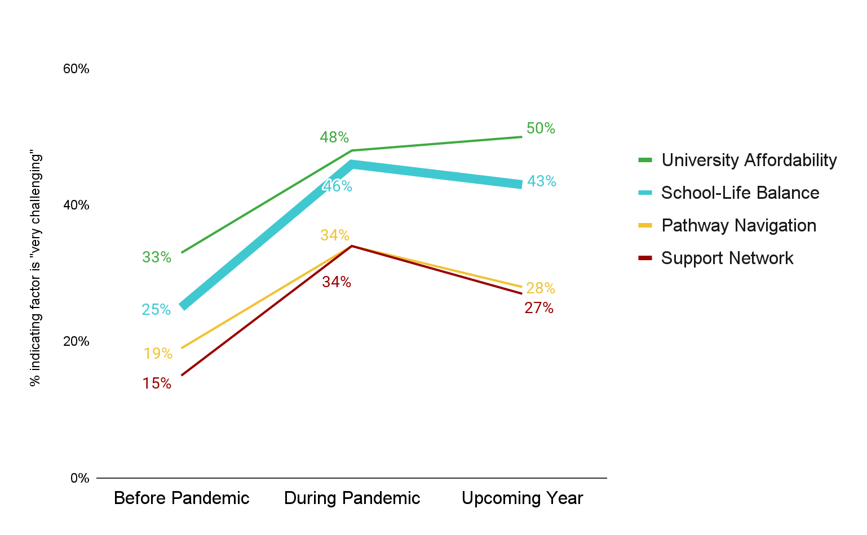
The challenge of School-Life Balance rose substantially during the pandemic
If everything will be closed my son will not be able to go to school, I will not be able to work and it will affect deeply my financial situation. Also, I will have problems studying because my son (who wants my attention all day long) will be always around me, and I will have to teach him myself when in fact I am not a teacher and don't know how to teach.
Notes:
Katie

Slide 22
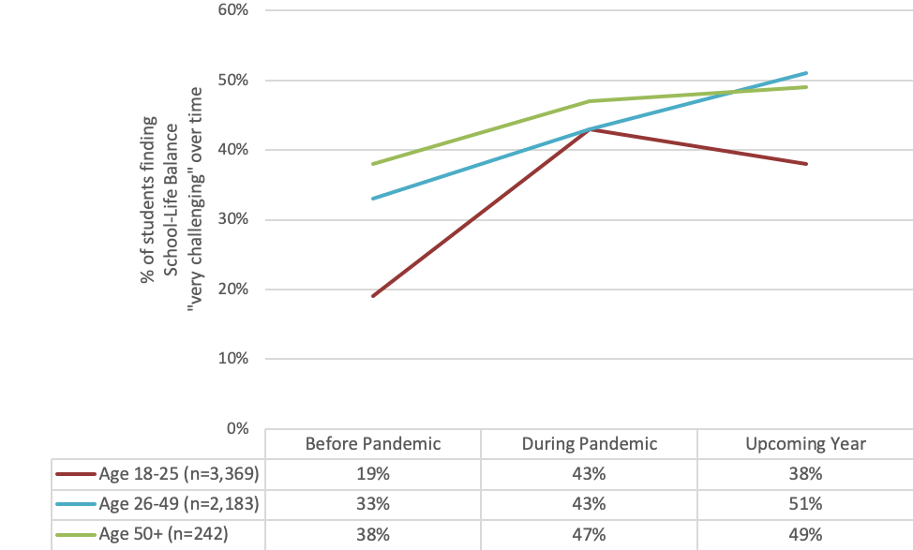
Students ages 26-49 continue to see an increase in the challenge of School-Life Balance
Changes in the Challenge of School-Life Balance
by Age
Notes:
Katie
for ASCC pause to discuss
join us tomorrow where we will talk more about what faculty can do individually and within their department to help students in this area

Slide 23
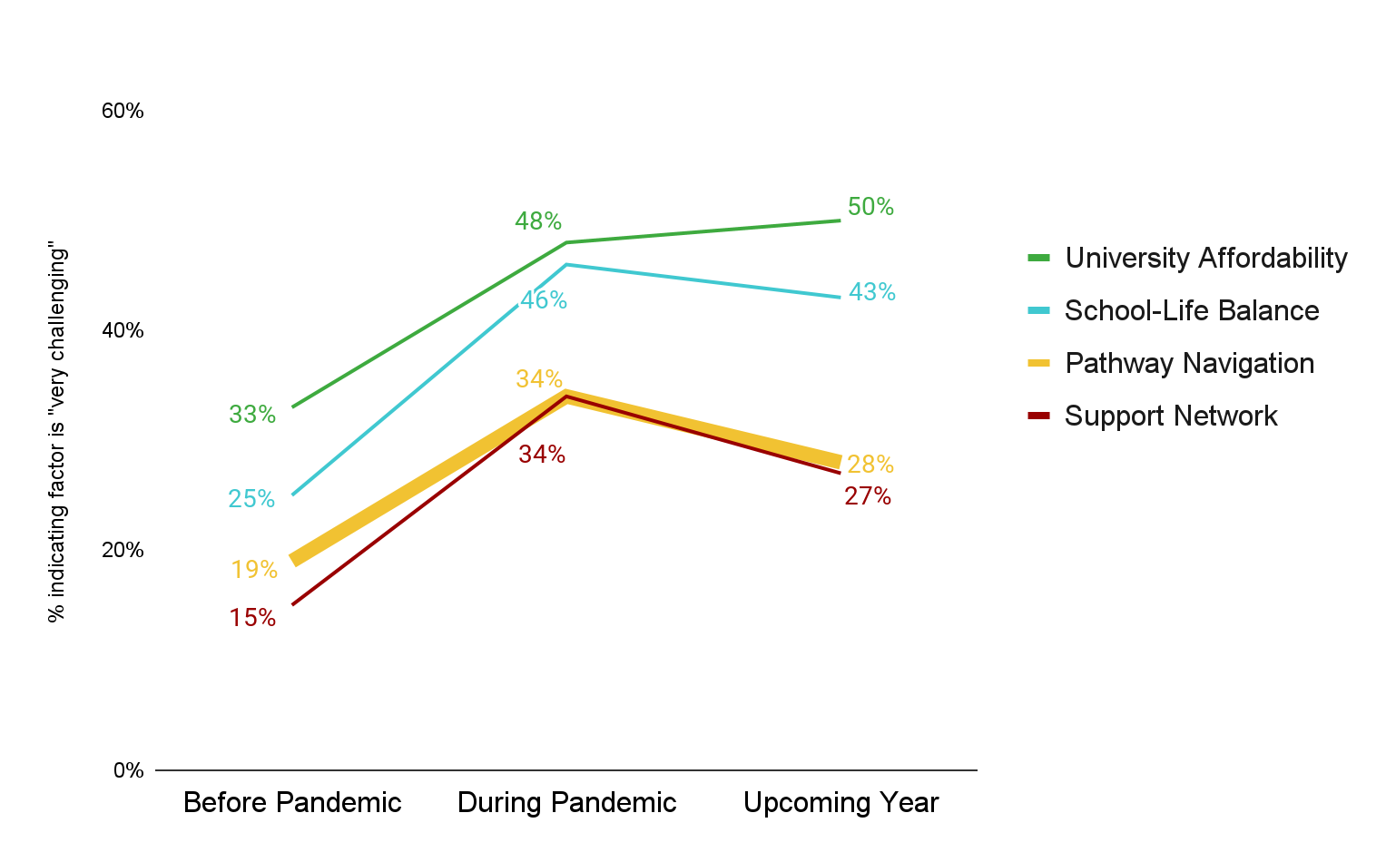
The challenge of Pathway Navigation rose during the pandemic, but is now trending back downwards
I was admitted to (a UC) for the Fall of 2020 but (the UC) withdrew my admission on the day of class registration saying I had to complete one more subject. I was communicating with them and had informed them because of COVID.... Office visits were not allowed, phones were off, and could not get a counselor to help me register for the class. I could not take that class. I had explained this scenario to (the UC) and they were okay until the day I needed to register for my classes they had me withdrew my application. My dream was crushed into million pieces...
Notes:
Katie

Slide 24
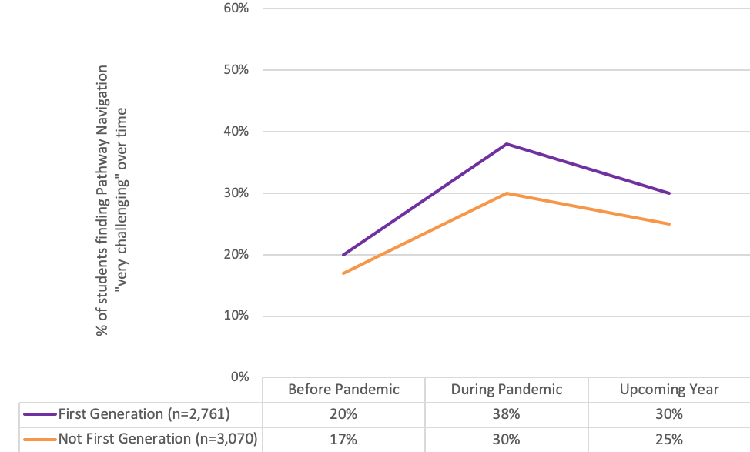
First generations students are more likely to indicate the challenge of Pathway Navigation than Non-First-Generation students
Changes in the Challenge of Pathway Navigation
by First Generation Status
Notes:
Katie
For ASCC Pause to discuss - even though it’s going back down, the gap is widening/wider than before - join us tomorrow where we will talk more about what faculty can do individually and within their department to help students in this area

Slide 25
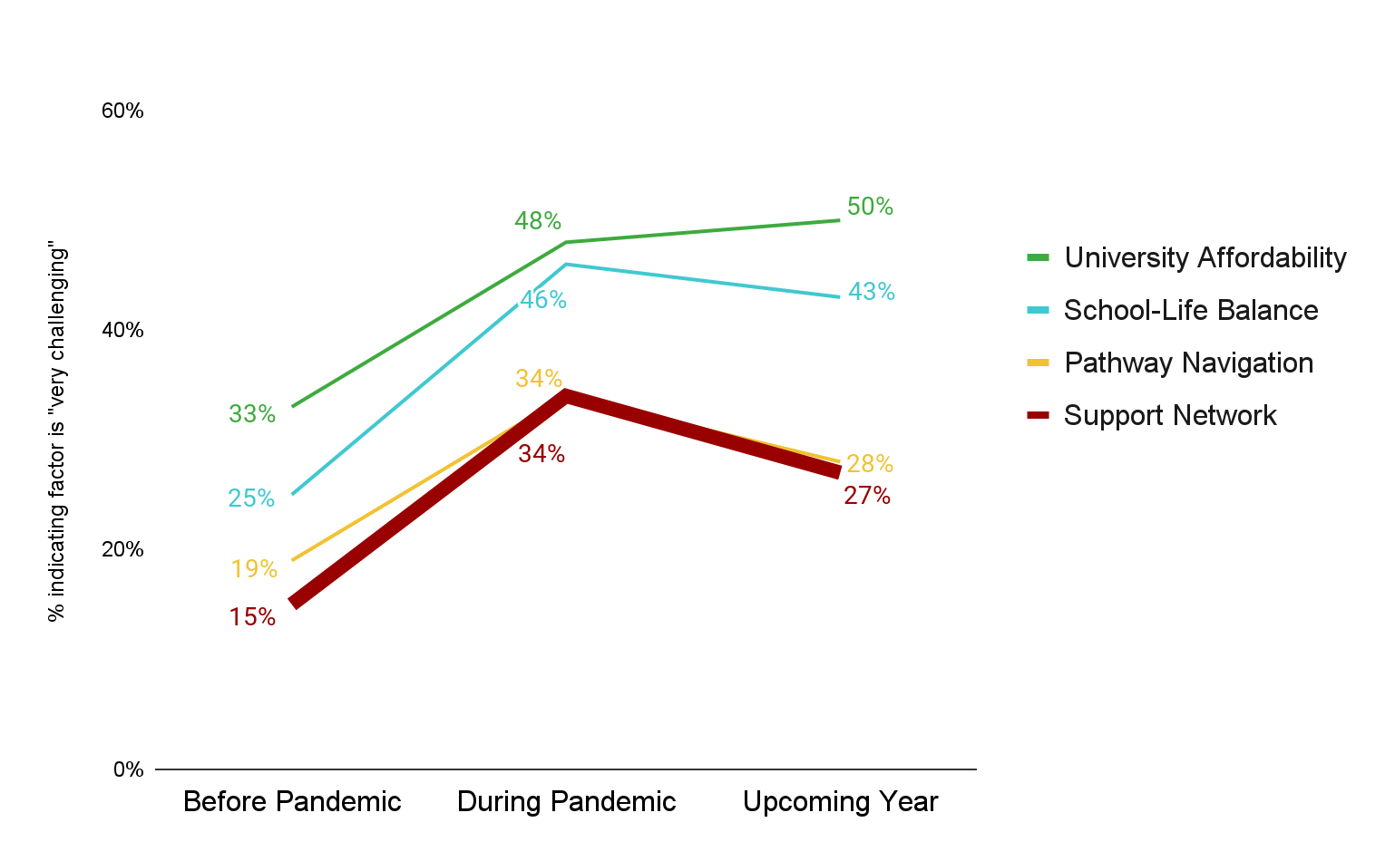
The challenge of accessing a Support Network rose during the pandemic, but is now trending back downwards
It has become harder to find support from friends and family to keep going. It seems more reasonable to stop trying to go back to school to pursue my interests and to find reasonable full-time work instead. Especially with myself and everyone having struggled with the pandemic, there is little support for doing something like school when working is so important right now.
Notes:
Katie

Slide 26
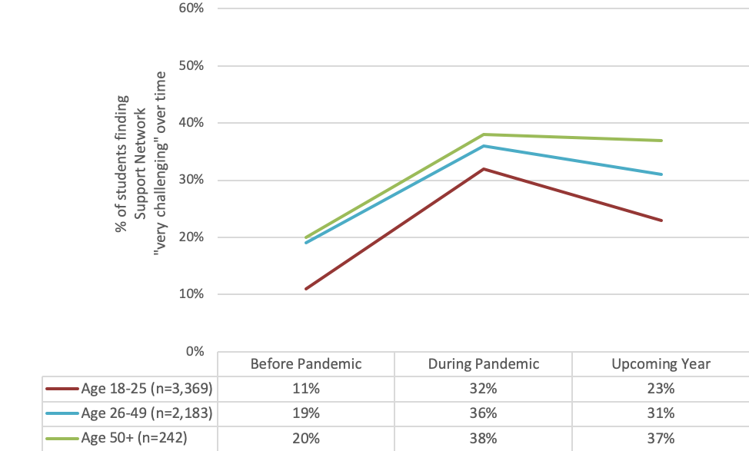
Students ages 50+ are most likely to indicate the challenge of accessing a Support Network
Changes in the Challenge of Access to Support Network
by Age
Notes:
Katie

Slide 27
Now What?
Get students back on their transfer path
Increase access to transfer resources
Track learning outcomes
Maintain student access to and awareness of relaxed transfer requirements
Provide holistic and integrated transfer support across students’ community college journey
Notes:
Darla

Slide 28
What does holistic and integrated transfer support look like?
Notes:
Darla

Slide 29
There is no precedence for this type of ordeal that we are going through so no one has the authority nor answers on how life will continue or go back to 'normal' after this and because of it, every day will be a continuous unknown and could possibly be another hindrance to progression. -Student Survey Participant
Notes:
Darla

Slide 30
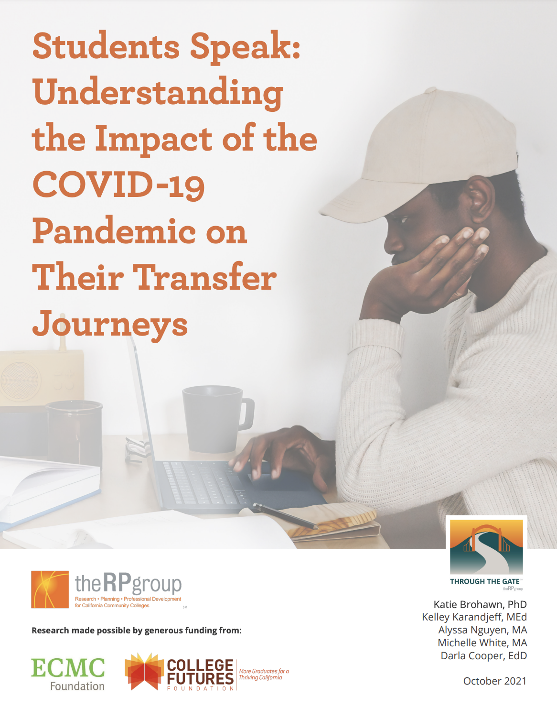
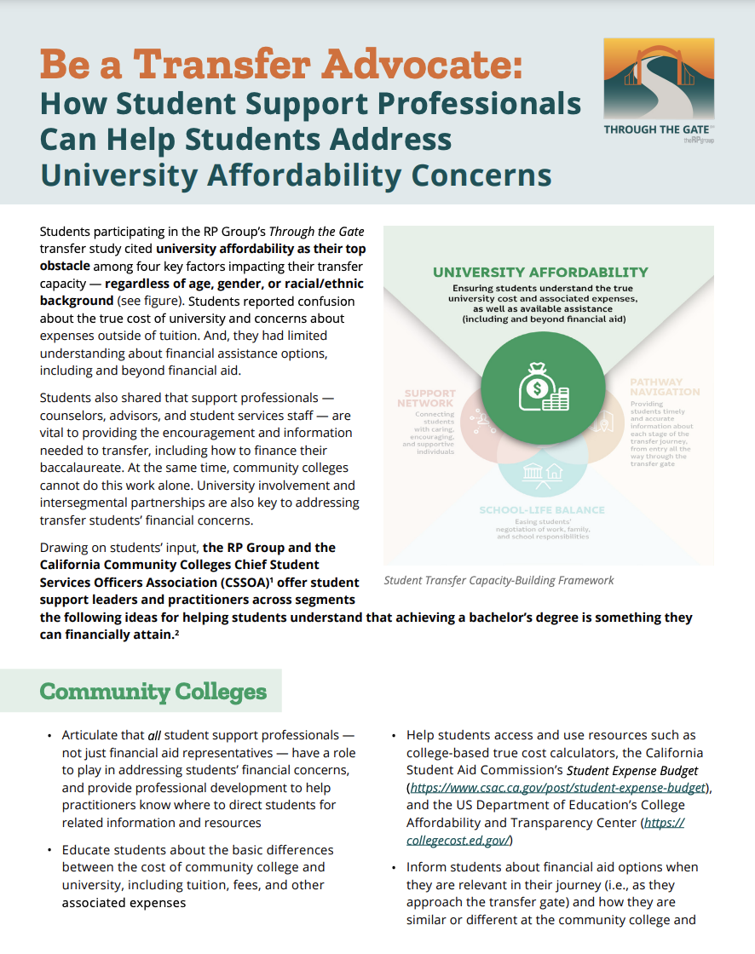
Notes:
Darla

Slide 31
Q & A
Notes:
Darla

Slide 32
Thank You and Join Us On October 20th!
Dr. Katie Brohawn
Director of Research, Evaluation, and Development
kbrohawn@rpgroup.org
Dr. Darla Cooper
Executive Director
dcooper@rpgroup.org
Notes:
Darla

