Slide 1
Be a Transfer Advocate:
Resources and Practices to Advocate for Your Transfer Students
Academic Academy October 2021
Notes:
Katie

Slide 2
The RP Group www.rpgroup.org
Mission
As the representative organization for Institutional Research, Planning, and Effectiveness (IRPE) professionals in the California Community Colleges (CCC) system, the RP Group strengthens the ability of CCC to discover and undertake high-quality research, planning, and assessments that improve evidence-based decision-making, institutional effectiveness, and success for all students.
Services
Research, evaluation, planning, professional development, and technical assistance—designed and conducted by CCC practitioners
Organization
501(c)3 with roots as membership organization
Notes:
Katie

Slide 3
Goals for Today
Provide an overview of the RP Group’s Through the Gate transfer initiative
Share strategies for supporting transfer students in your classroom and program
Group discussion about ways faculty are advocating for transfer student success at the classroom, program,and statewide level
Preview future research on how to support “high-leverage” transfer students -- those who are close to transfer but who have not yet made it to university
Notes:
Katie
Transfer success requires that all faculty, instructional and non-instructional, provide emotional and tactical support to build students’ capacity to successfully transfer. Today you’ll hear about what students say they need to successfully transfer and strategies how faculty specifically can support transfer, inside and outside of the classroom.

Slide 4
A Fresh Take on Transfer: Through the Gate Transfer Initiative
Determine strategies for increasing transfer, boosting baccalaureate production, and enhancing students’ social and economic mobility, especially for underrepresented populations
Identify individuals who have completed all or most of their transfer requirements, but who do not make it “through the gate” to university
Notes:
Katie
Research shows an impending shortage of baccalaureate holders in California, and the Vision for Success includes goals for dramatically improving students’ transfer outcomes. This study aims to identify strategies for increasing transfer among “high-leverage learners” in California Community Colleges — individuals who have completed all or most of their transfer requirements, but who do not make it “through the gate” to a university.

Slide 5
Original Research Approach
Phase 2:
Getting Better Directions
Phase 3:
Engaging for Action
Phase 1:
Mapping the Transfer Landscape
Quantitative research to better understand the transfer landscape for “high-leverage” learners: students who met all or most of their requirements but have not transferred
Mixed-methods research to understand what factors impact these students’ journeys and how policy and practice might change to propel them through the gate
Convenings with postsecondary leaders, educators, researchers, and advocacy groups to identify strategic opportunities to strengthen transfer success based on findings
Notes:
Katie

Slide 6
Nearly 300K out of 875K CCC students did not make it through the transfer gate between 2010 and 2015
Phase 1:
Mapping the Transfer Landscape
＞50% of these students exited without credentials
Math was a barrier
Time was the enemy
Once African Americans reached key milestones, they were most likely to transfer…but too few get this far
Latino students were more likely to be At or Near the Gate than to have transferred
6
Notes:
Katie
Research Question:
How many students get get close to but do not make it through the transfer gate?
Population:
875,630 CCC students
Enrolled b/w 2010-2011 and 2014-2015
Outcomes through spring 2016
Subgroups:
67% Transfer Achievers (583,074)
16% Students At the Gate (135,557)
18% Students Near the Gate (156,999)
92% of Near the Gate students need to complete math transfer requirement
African Americans are least likely to complete transfer-level math
Students who do not transfer within a year of becoming transfer ready (at the gate) are less likely to transfer
75% African-American students who make it near or at the gate ultimately transfer -- highest among any ethnic group
Yet, many African Americans do not make it past 30 units in six years
Latino students are 1.41 times more likely to remain at the gate than transfer
Latino students are 1.30 times more likely to remain near the gate than transfer

Slide 7
Framework for Building Students’ Transfer Capacity
Phase 2:
Getting Better Directions
From surveys and interviews with over 800 students across 31 CCC:
Students are motivated to transfer to have a better life, for themselves and their families.
Students need a more holistic and integrated approach to ensure progress toward their educational goal: a bachelor’s degree.
Community colleges can’t do this work alone; intersegmental collaboration and university involvement is critical.
Notes:
Darla
Why do so many students who are close to achieving their transfer goal stop short of making this transition?
What can we do to help students who are close to transfer make it through the gate to university?
What is holding back different student groups, and how can we help them continue their journey?
92% reported they are pursuing a bachelor’s degree to increase their career options and make more money (86%)

Slide 8
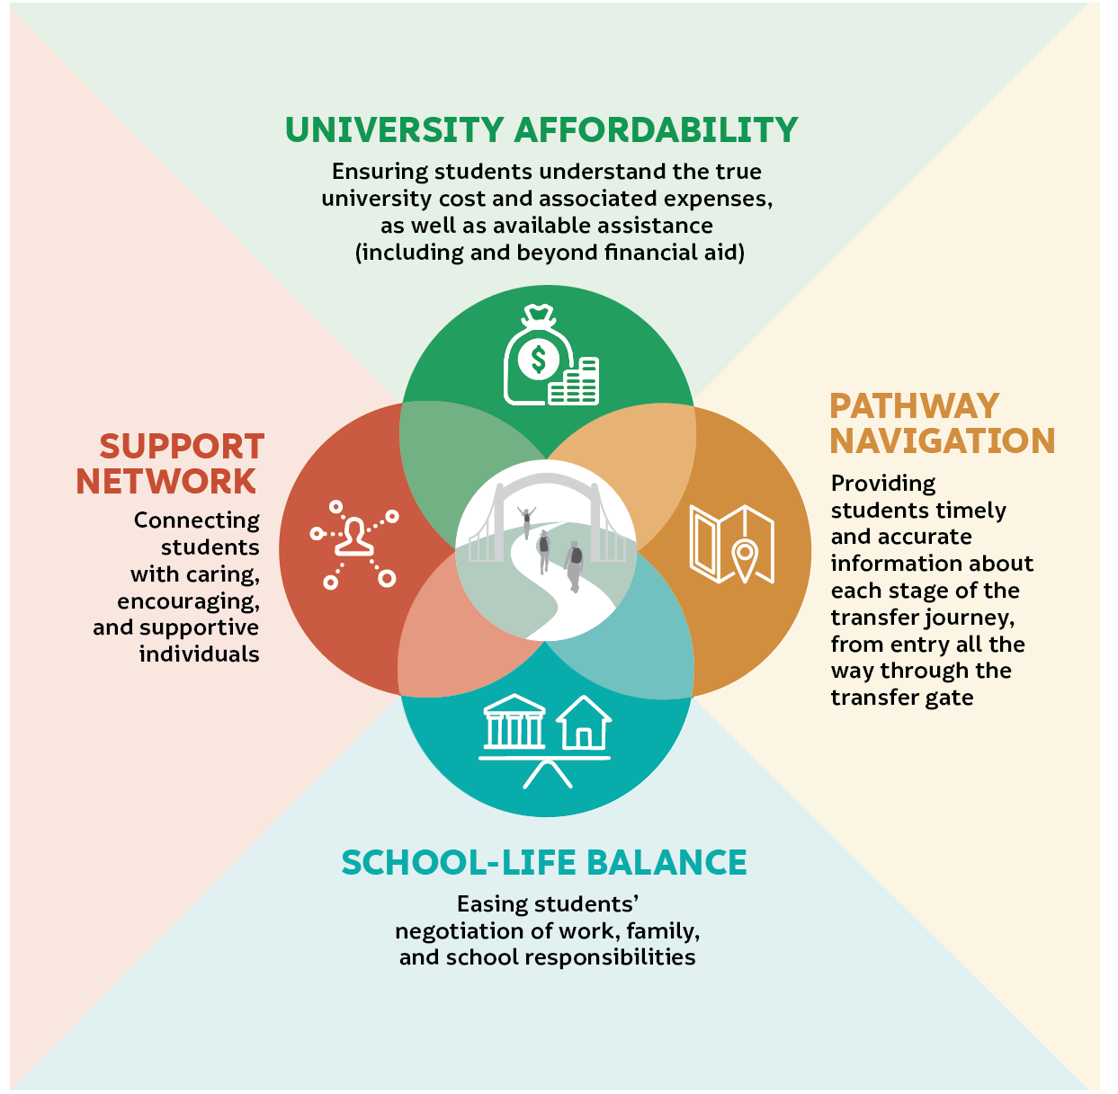
Framework for Building Students’ Transfer Capacity
Phase 2:
Getting Better Directions
Notes:
Darla
Finances are the biggest hurdle students cite
Students are juggling numerous and often competing school, work, and family responsibilities
Students are often missing accurate and timely information about pursuing a bachelor’s degree throughout their transfer journey—from both their community colleges and prospective universities
Students say the absence of social support negatively impacts their transfer decision-making and compromises their capacity for pursuing a bachelor’s degree

Slide 9
Students say finances are the biggest hurdle to transfer
One really big thing that’s scaring me is the money…. I mean, it's almost unimaginable that I have to spend the amount that one would pay for a very big house in California simply on education.
Notes:
Darla
Finances are the biggest hurdle students cite regarding transfer regardless of age, gender, or racial/ethnic background.·
Students often do not know the true cost of university compared to what it costs to attend community college
75% of students describe the cost of the university tuition as “very challenging,” with nearly half listing it as the biggest challenge they face when considering transfer
Over four out of five of students (82%) indicate that getting enough financial aid to pay for their education is very motivating to their transfer effort
Help students understand all costs associated with attending a university and the full complement of financial assistance options

Slide 10
Students are juggling numerous—and often competing—school, work, and family responsibilities
I have to take calculus for business….
The problem is [my college] doesn’t offer [it] at night or on the weekends. It’s a morning class at [the main campus]…. That may work for a millennial, but not for someone with a full-time job.
Notes:
Darla
Students are juggling numerous and often competing school, work, and family responsibilities in an effort to address financial hurdles.
58% find balancing school and work responsibilities “very challenging”
42% find balancing school and family responsibilities “very challenging”
schools are rarely organized to address many students’ complex realities.
Actively recognize the complexity of students’ lives in how educational services and supports are delivered, for example, consider mor student-centered course scheduling and coordinate with university partners to identify options for impacted programs for placebound students

Slide 11
Students are missing accurate and timely information about pursuing a bachelor’s throughout their transfer journey—from both community colleges and universities
A lot of people are left confused in what they’re doing…there’s all kinds of figuring out on their own…kind of teetering on the edge of, “Am I doing this right? Am I taking the right classes?” I think the ones who have it real lucky are the ones that consistently go and ask a bunch of questions and don’t stop until [they] get answers. And that kind of isn’t really good.
Notes:
Darla
Students describe challenges getting on the right transfer path from the get-go and knowing what to do along the way
Students generally highlight the significant self-reliance needed to navigate often confusing transfer pathways
Students describe triangulating information from a variety of resources to sus out and verify what to study, what courses to take, where to transfer, what practical steps to take to apply to those destinations and when, what it might cost, and how to get financial assistance.
What students need are for colleges and universities to provide clear and accurate information about transfer processes and requirements, strategically conveyed across students’ entire community college journey. Examples of these include Develop technology solutions that help students access updated info and real-time pathway advice and facilitating meetings between college and university faculty by academic department to align expectations for transfer students

Slide 12
Students say the absence of social support negatively impacts their transfer decision-making and compromises their capacity for pursuing a bachelor’s degree
A lot of times, it feels like people are fighting their own battles [at my college]…. It just doesn’t really feel like everyone’s connected…like they’re fighting together. A lot of times, it feels like a lot of people are on their personal journeys by themselves.
Notes:
Darla
Students highlighted the importance that support (both from inside and outside the college) can significantly impact motivation
Having a solid support network can be the key to addressing the other three factors impacting their transfer experience—boosting their financial awareness, fostering school-life balance, helping them navigate the transfer path
What students shared about this factor underscores that this network is not a “nice to have.”
Intentionally connect students to a network of supporters who demonstrate an active investment in their transfer success
Colleges play an essential role in activating this network, especially in the absence of support at home or in students’ off-campus communities
Students often feel alone

Slide 13
Students say…
Professors and academic programs play an essential role in holistically addressing these factors as they work toward their bachelor’s degree.
Notes:
Alyssa
Students turn to classroom faculty to help them feel connected and to get the encouragement and information they need to make it through the gate
Students perspectives underscore the important role academic programs play in structuring support for transfer into the student journey so they can successfully transition to university

Slide 14
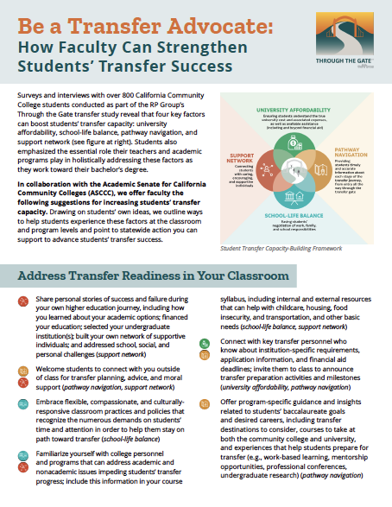
Notes:
Alyssa
Discuss collaboration between RP Group and ASCCC to develop ideas at the classroom and program levels and articulate opportunities to advocate for students’ transfer success at the system level

Slide 15
Ideas for Addressing Transfer Readiness in Your Classroom
Share personal stories of success and failure during your own higher education journey
Welcome students to connect with you outside of class for transfer planning, advice, and encouragement
Embrace flexible and compassionate classroom practices and policies—recognizing the numerous demands on students
Notes:
Alyssa

Slide 16
Ideas for Addressing Transfer Readiness in Your Classroom
Refer students to personnel/programs that can address academic and nonacademic issues impeding their transfer progress
When teaching advanced courses in a program of study/major, know the CSU and UC application process and financial aid deadlines; incorporate this info into activities and announcements
Offer program-specific guidance and insights related to students’ baccalaureate goals and desired careers
Notes:
Alyssa
Pause - -
Chatterbox style –
What formal strategies or informal approaches are you using to foster students’ transfer success - in your classroom and/or as an academic program?

Slide 17
Ways to Foster Transfer Success as an Academic Program
Know your program’s transfer data
Engage with faculty from top receiving universities to discuss expectations for transfer students in your program area
Promote pathways to transfer in your program area (i.e., CSU Associate Degree for Transfer (ADT), UC Transfer Agreement (TAG))
Notes:
Alyssa

Slide 18
Ways to Foster Transfer Success as an Academic Program
Assess/communicate the value of GE coursework to students’ transfer pathways; ensure the whole curricular picture makes sense to students
Embed holistic support in a way that strategically integrates with the student experience and the point in their educational journey
Notes:
Alyssa
Chatterbox style –
What formal strategies or informal approaches are you using to foster students’ transfer success - in your classroom and/or as an academic program?

Slide 19
Advocate at the System Level
Encourage financial aid reform (i.e., expanding Pell Grant and Cal Grant eligibility, increasing funding to reflect the true cost of education)
Support the expansion of ADTs and the adoption by university partners
Participate in the ASCCC’s Course Identification Numbering System (C-ID) and ADT workgroups
Align local curriculum to C-ID and ADT models
Notes:
Alyssa
Chatterbox style –
What formal strategies or informal approaches are you using to foster students’ transfer success - in your classroom and/or as an academic program?

Slide 20
Through the Gate: Looking Ahead
Recent publications:
Students Speak: Understanding the Impact of the Pandemic on their Transfer Journeys
Transfer Leaders Speak: Keeping Students on the Transfer Path, during the Pandemic and Beyond
Upcoming resource:
Take Charge of Your Transfer Success
Upcoming research study:
African American Transfer Tipping Point Study
Upcoming webinar:
National Transfer Student Week Webinar, 10/20/21, 12:00 - 1:30 PST Featuring Student Senate for California Community Colleges Leaders, Berkeley City College and Cuesta College Transfer Practitioners
Notes:
Alyssa
Reinforce that we can do this work alone! We need our university partners to help us with this work.

Slide 21
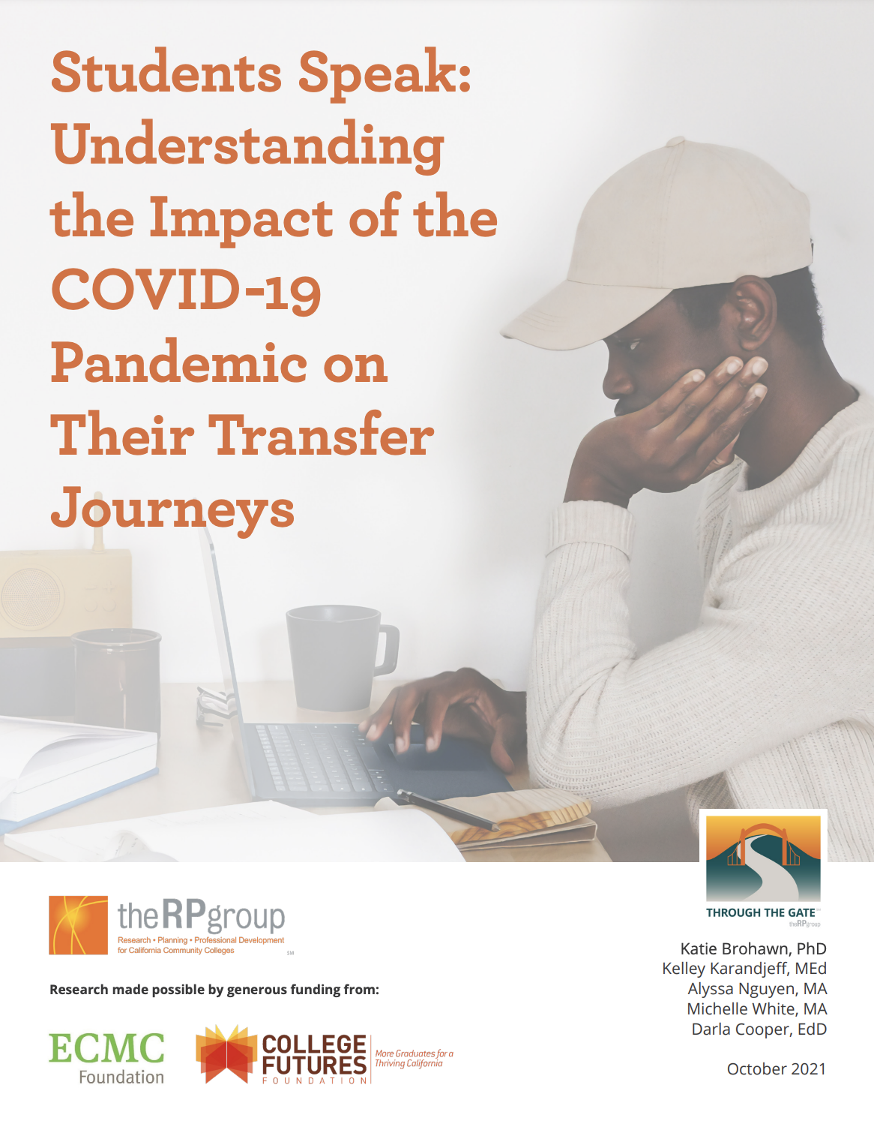
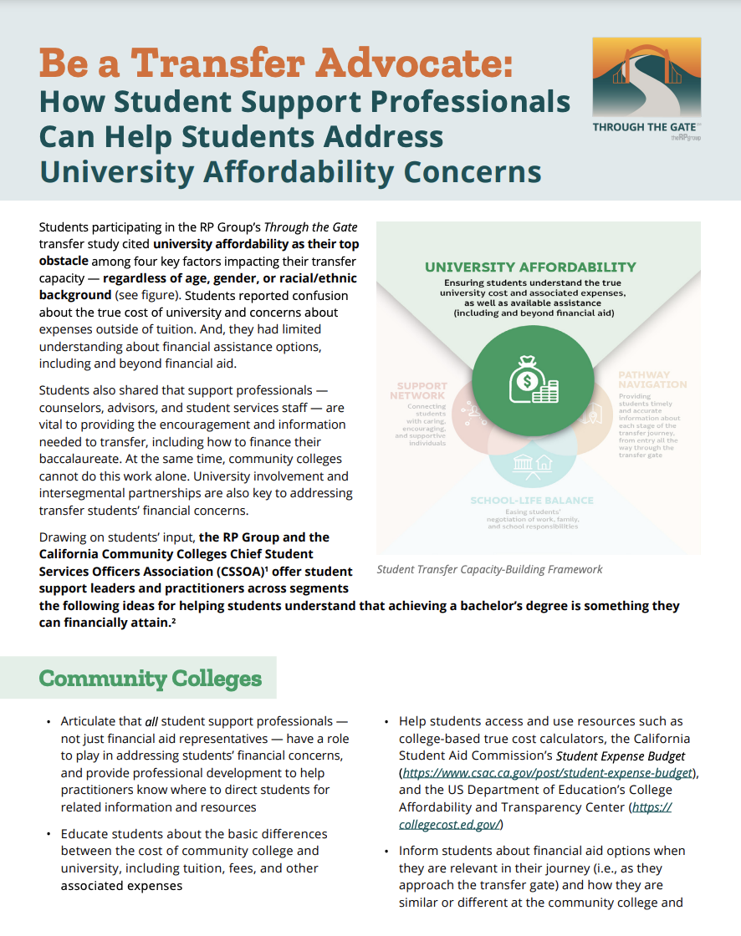
Through the Gate Resources
Notes:
Alyssa

Slide 22
Resources
Be A Transfer Advocate: How Faculty Can Strengthen Students’ Transfer Success
Through the Gate Transfer Initiative
C-ID: Transfer and Articulation System for California’s colleges and universities
Notes:
Alyssa

Slide 23
Questions?
Notes:
Alyssa
We will share resources in chat and ask attendees to drop resources
jamboard
Crowdsource resource

Slide 24
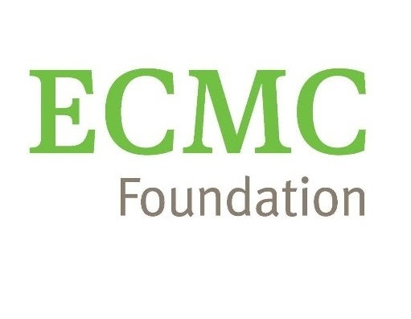
For more information on the Through the Gate Initiative
Project Directors:
Dr. Darla Cooper
dcooper@rpgroup.org
Alyssa Nguyen
anguyen@rpgroup.org
Research made possible from the generous funding by:
www.rpgroup.org/through-the-gate
#StudentsThroughtheGate
Notes:
Refer to RP Group website

Slide 25
Thank you!

