Slide 1
2021 Academic Academy General Session
Dr. Katie Brohawn Director of Research, Evaluation, and Development Dr. Darla Cooper Executive Director
Alyssa Nguyen
Senior Director of Research and Evaluation
Through the Gate: Building Students’ Transfer-Capacity
Notes:
Timing: https://docs.google.com/spreadsheets/d/1loSR88UD4rUHCTncwt335mFuhMrhA8YuoGQtpQWQUcg/edit#gid=0
When students make significant progress toward a transfer goal, why don't they make it "through the gate" to university? What do students say about what impacts their transfer progress and how to strengthen their transfer success? Learn about student perspectives research from the RP Group's Through the Gate transfer study, including results from a large-scale survey of and in-depth interviews with current and exited CCC students who were close to the transfer gate, but had not yet made it to university. Hear directly from students about the factors impeding their transfer journey, despite significant progress toward this goal. Discover how to apply this research approach on your campus to advance Guided Pathways planning, including bringing student perspectives into your efforts to improve students' transfer outcomes.

Slide 2
The RP Group www.rpgroup.org
Mission
As the representative organization for Institutional Research, Planning, and Effectiveness (IRPE) professionals in the California Community Colleges (CCC) system, strengthen CCCs’ ability to gather, analyze, and act on information in order to enhance student equity and success
Services
Research, evaluation, planning, professional development, and technical assistance—designed and conducted by CCC practitioners
Organization
501(c)3 with roots as membership organization
Notes:
Darla

Slide 3
Focus on...
Overview of the Through the Gate study
Introduction of Transfer Capacity-Building Framework
Effects of the pandemic on transfer
Advocating for transfer
Notes:
Darla

Slide 4
A Fresh Take on the Transfer Challenge
Overview of Study
Notes:
Darla
Overall description and purpose of TTG (5 minutes)

Slide 5
Poll:
Of the students who meet most or all of their transfer requirements, which student group is most likely make it through the gate?
Notes:
Darla
So why is this important? Do first year students on a transfer path need the same resources and information as students who are close to completing their transfer requirements? What about your underrerepresented groups like AA relative to their White peers?
Poll:
Of the students who meet most or all of their transfer requirements, which student group is most likely make it through the gate?
African American/Black
Alaska Native/Native American
Asian American
Hispanic/Latina/o/x
White
Other

Slide 6
Research Approach
Phase 1:
Mapping the Transfer Landscape
Phase 2:
Getting Better Directions
Phase 3:
Engaging for Action
Quantitative research to better understand the transfer landscape focusing on students who met all or most of their requirements but have not transferred
.
Mixed-methods research to understand what factors impact these students’ journeys and how policy and practice might change to propel them through the gate
Convenings with postsecondary leaders, educators, researchers, and advocacy groups to identify strategic opportunities to strengthen transfer success based on findings
Notes:
Darla

Slide 7
A Missed Opportunity
Phase 1:
Mapping the Transfer Landscape
From quantitative analysis of students’ transfer outcomes...
Annually, nearly 60K “high-leverage” students do not make it to university
Students historically marginalized by our higher ed systems are more likely to get stuck
Notes:
Agreed that transfer is a mechanism for increasing baccalaureate production, diversifying workforce, and boosting economic and social mobility for historically underserved populations
Yet, research identifies a missed opportunity: annually nearly 60k who show the determination and ability to transfer don’t make it to university and students historically marginalized more likely to get stuck at the transfer gate
Between 2010-2015…
~300K of 875K CCC students had not yet made it through the transfer gate

Slide 8
Transfer Continuum
Phase 1:
Mapping the Transfer Landscape
＞50% of these students exit without credentials
Math is a barrier
Time is the enemy
Once African Americans reach key milestones, they are most likely to transfer…but too few get this far
Latino students more likely to be at or near the gate
Notes:
Research Question:
How many students get stuck close to the transfer gate?
Population:
875,630 CCC students
Enrolled b/w 2010-2011 and 2014-2015
Outcomes through spring 2016
Subgroups:
67% Transfer Achievers (583,074)
16% Students At the Gate (135,557)
18% Students Near the Gate (156,999)

Slide 9
Students’ Perspectives and Experiences
Phase 2:
Getting Better Directions
Surveys and interviews with over 800 students across 31 CCC reveal:
Students are motivated to transfer to have a better life, for themselves and their families.
Students need a more holistic and integrated approach to ensure progress toward their educational goal: a bachelor’s degree.
Community colleges can’t do this work alone; intersegmental collaboration and university involvement is critical.
Notes:
Katie
Why do so many students who are close to achieving their transfer goal stop short of making this transition?
What can we do to help students who are close to transfer make it through the gate to university?
What is holding back different student groups, and how can we help them continue their journey?
92% reported they are pursuing a bachelor’s degree to increase their career options and make more money (86%)

Slide 10
Phase 2:
Getting Better Directions
Notes:
Katie

Slide 11
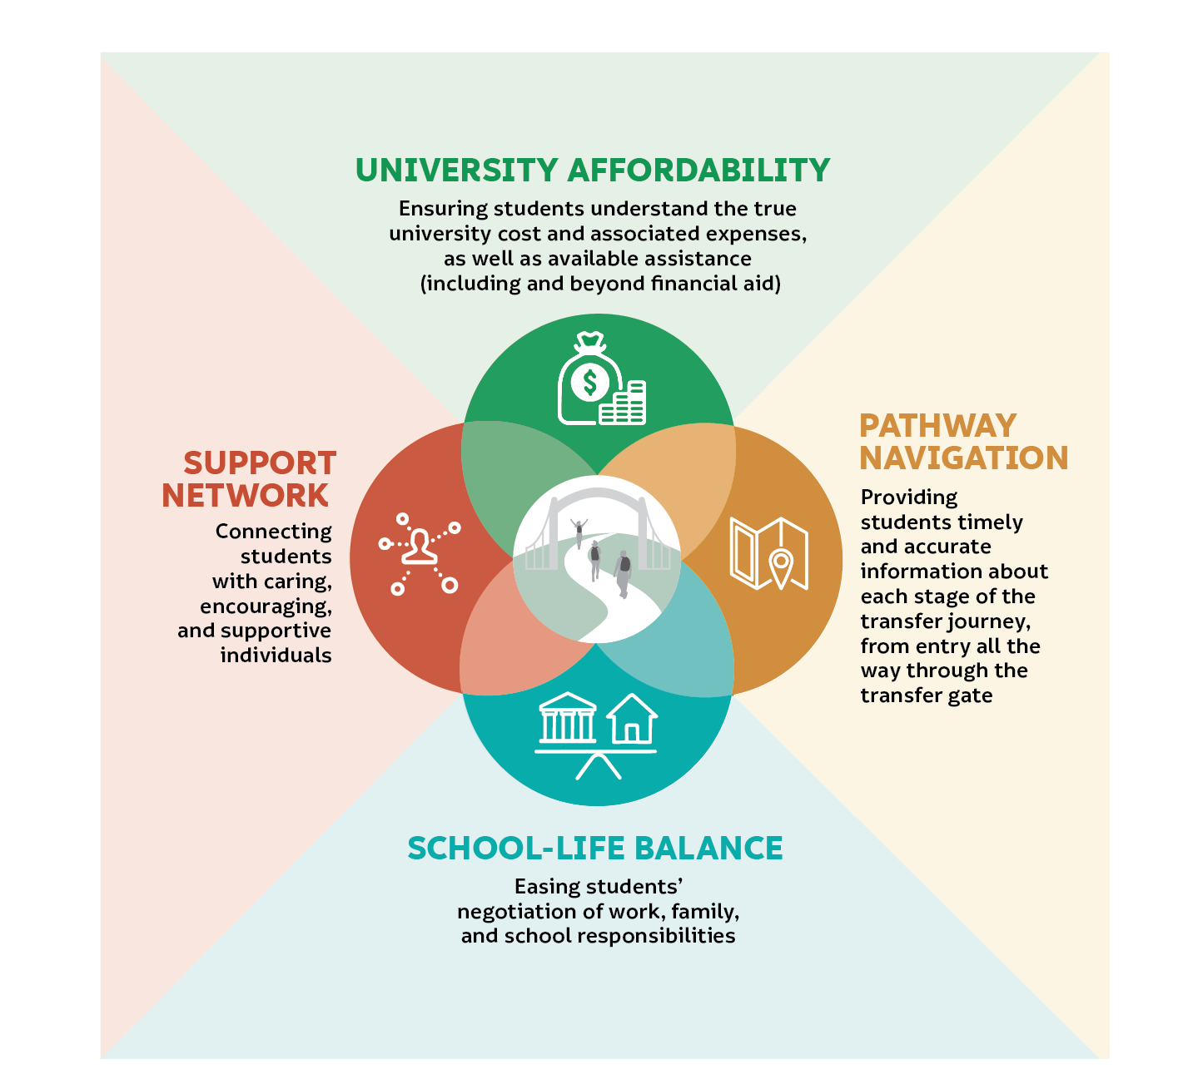
Framework for Building Students’ Transfer Capacity
Phase 2:
Getting Better Directions
Notes:
Alyssa
Students say finances are the biggest hurdle to transfer
Students are juggling numerous and often competing school, work, and family responsibilities
Students are missing accurate, timely information about pursuing a baccalaureate throughout their transfer journey—from both community colleges and universities
Students say the absence of social support negatively impacts their transfer decision- making and compromises their capacity for pursuing a bachelor’s degree

Slide 12
Students say finances are the biggest hurdle to transfer
One really big thing that’s scaring me is the money…. I mean, it's almost unimaginable that I have to spend the amount that one would pay for a very big house in California simply on education.
Help students understand all costs associated with attending a university and the full complement of financial assistance options
Notes:
Alyssa
CONSIDER ADDING POLL/CHAT QUESTION AFTER EACH FACTOR ASKING THEM TO NAME STRATEGIES
Finances are the biggest hurdle students cite regarding transfer regardless of age, gender, or racial/ethnic background.·
Students often do not know the true cost of university compared to what it costs to attend community college
75% of students describe the cost of the university tuition as “very challenging,” with nearly half listing it as the biggest challenge they face when considering transfer
Over four out of five of students (82%) indicate that getting enough financial aid to pay for their education is very motivating to their transfer effort
Help students understand all costs associated with attending a university and the full complement of financial assistance options

Slide 13
Students are juggling numerous and often competing school, work, and family responsibilities
I have to take calculus for business…. The problem is [my college] doesn’t offer [it] at night or on the weekends. It’s a morning class at [the main campus]…. That may work for a millennial, but not for someone with a full-time job.
Actively recognize the complexity of students’ lives in how educational services and supports are delivered
Notes:
Alyssa
Students are juggling numerous and often competing school, work, and family responsibilities in an effort to address financial hurdles.
58% find balancing school and work responsibilities “very challenging”
42% find balancing school and family responsibilities “very challenging”
schools are rarely organized to address many students’ complex realities.
Actively recognize the complexity of students’ lives in how educational services and supports are delivered, for example, consider mor student-centered course scheduling and coordinate with university partners to identify options for impacted programs for placebound students

Slide 14
Students are often missing accurate and timely information about pursuing a baccalaureate throughout their transfer journey—from both community colleges and universities.
A lot of people are left confused in what they’re doing…there’s all kinds of figuring out on their own…kind of teetering on the edge of, “Am I doing this right? Am I taking the right classes?” I think the ones who have it real lucky are the ones that consistently go and ask a bunch of questions and don’t stop until [they] get answers. And that kind of isn’t really good.
Proactively provide clear and accurate information about transfer processes and requirements, strategically conveyed across students’ entire community college journey
Notes:
Alyssa
Students describe challenges getting on the right transfer path from the get-go and knowing what to do along the way
Students generally highlight the significant self-reliance needed to navigate often confusing transfer pathways
Students describe triangulating information from a variety of resources to sus out and verify what to study, what courses to take, where to transfer, what practical steps to take to apply to those destinations and when, what it might cost, and how to get financial assistance.
What students need are for colleges and universities to provide clear and accurate information about transfer processes and requirements, strategically conveyed across students’ entire community college journey. Examples of these include Develop technology solutions that help students access updated info and real-time pathway advice and facilitating meetings between college and university faculty by academic department to align expectations for transfer students

Slide 15
Students say the absence of social support negatively impacts their transfer decision-making and compromises their capacity for pursuing a bachelor’s degree.
A lot of times, it feels like people are fighting their own battles [at my college]…. It just doesn’t really feel like everyone’s connected…like they’re fighting together. A lot of times, it feels like a lot of people are on their personal journeys by themselves.
Intentionally connect students to a network of supporters who demonstrate an active investment in their transfer success
Notes:
Alyssa
Students highlighted the importance that support (both from inside and outside the college) can significantly impact motivation
Having a solid support network can be the key to addressing the other three factors impacting their transfer experience—boosting their financial awareness, fostering school-life balance, helping them navigate the transfer path
What students shared about this factor underscores that this network is not a “nice to have.”
Intentionally connect students to a network of supporters who demonstrate an active investment in their transfer success
Colleges play an essential role in activating this network, especially in the absence of support at home or in students’ off-campus communities
Students often feel alone
Students turn to instructors and counselors
Students universally emphasize the consequential impact counselors can make on students’ transfer capacity, depending on the counselor’s approach.
when counselors go beyond simply providing information to demonstrating a true personal interest in their transfer success, it can profoundly and positively influence their perceived and actual readiness for university
counselors who take a more transactional approach can hinder their educational journey

Slide 16
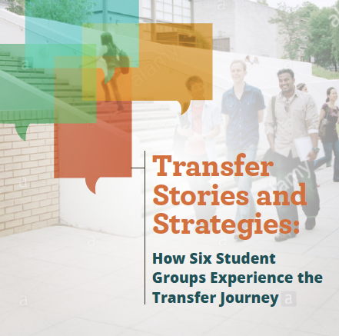
Unique Experience of Focal Student Groups
Phase 2:
Getting Better Directions
Hispanic and Latina/o/x Students
African-American/Black Students
Female Students
Older Students
Exited Students with Transfer Goals
Central Valley Students
Notes:
Katie
In addition, we will also be sharing some snippets of where there were differences found between certain student groups in terms of their experiences of each of the factors.
Specifically, in this brief we released, we provide a snapshot for six focal student groups where we saw differences in their experiences and strategies to consider based on these differences for each group

Slide 17
Hispanic and Latina/o/x students are more likely than White and Asian peers to...
Indicate getting enough financial aid is highly motivating
Report that the cost of university tuition is very challenging
Report that having universities near their home is highly motivating
Identify they used and found helpful a wide range of transfer resources (e.g., counseling sessions, online resources, transfer center)
Say most people they grew up with never attended university
Report that family encouragement and college support is highly motivating
Notes:
Katie
support network

Slide 18
Sample Strategies for Supporting Hispanic and Latina/o/x Students
Engage with K-12 partners to involve students and their families before they get to college and throughout the entire transfer process
Connect students to Hispanic and Latina/o/x graduates who successfully transferred to help them learn about what is possible and what the movement to university is like
Work with regional universities to inform students about accessing university-level programming remotely and/or on the college campus
Notes:
Katie

Slide 19
African-American/Black students are more likely than White peers to...
Report that transportation to/from a university campus is very challenging
Identify they used and found helpful a wide range of transfer resources (e.g., counseling sessions, online resources, transfer center)
Say most people they grew up with never attended university
Notes:
Katie
pathway navigation

Slide 20
Sample Strategies for Supporting African-American/ Black Students
Work with regional universities to highlight various transportation options (e.g., campus bus routes, ridesharing)
Connect them to affinity programs while scaling effective approaches to ensure the vast majority learn about transfer expectations and receive hands-on support
Connect students to African-American/Black graduates who successfully transferred to help them learn about what is possible and what the movement to university is like
Notes:
Katie

Slide 21
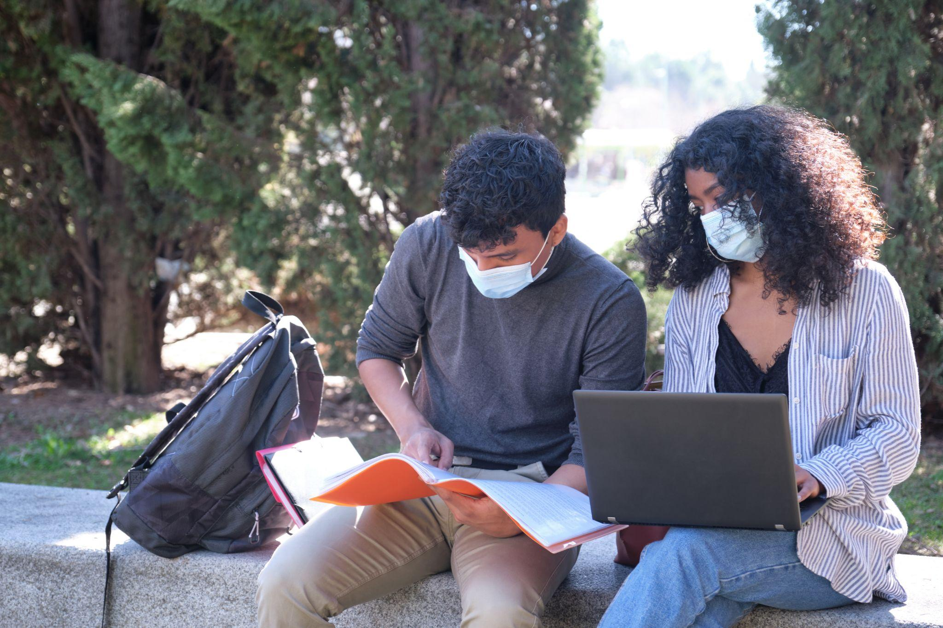
How has the pandemic affected students’ transfer experiences?
Notes:
Katie

Slide 22
Surveys and focus groups with nearly 8,000 students across 67 CCC reveal:
Pandemic Effects on Transfer
2 out of 5 students’ transfer plans were impacted by the pandemic
2 out of 5 students found it harder to access counselors/advisors
Expressed concerns about being adequately prepared for university-level work
I was admitted to (a UC) for the Fall of 2020 but (the UC) withdrew my admission on the day of class registration saying I had to complete one more subject. I was communicating with them and had informed them because of COVID.... Office visits were not allowed, phones were off, and could not get a counselor to help me register for the class. I could not take that class. I had explained this scenario to (the UC) and they were okay until the day I needed to register for my classes they had me withdrew my application. My dream was crushed into million pieces...
Notes:
Katie

Slide 23
Surveys and focus groups with nearly 8,000 students across 67 CCC reveal:
Pandemic Effects on Transfer
Fewer than 1 out of 3 students were aware of CCC, CSU, or UC changes to transfer requirements
The challenges associated with each transfer-capacity factor were substantially higher during the pandemic than before, most notable university affordability
The uncertainty as to how next year will be is what is causing the most stress, I am currently working at a warehouse to afford food and pay bills but I work graveyard shift, not knowing if school will be back in person really stresses me out because I am unsure on whether to find a new job that will fit my future schedule or keep the one I have at the moment.
Notes:
Katie

Slide 24
How Faculty Can Strengthen
Students’ Transfer Success
Advocating for Transfer Success
Address transfer readiness in your classroom
Share your own transfer story to students
Build students’ transfer capacity as an academic program
Promote pathways to transfer in your program area
Support statewide action to improve transfer outcomes
Support the expansion of ADTs and adoption by university partners
Notes:
Alyssa

Slide 25
How the RP Group is continuing to support transfer
Advocating for Transfer Success
Co-developing resources for key stakeholders to support transfer
Faculty
Student Support Professionals
Students to advocate on their own behalf
Conducting timely and relevant research to support institutions with transfer
Impact of the pandemic on students’ transfer experiences (briefs forthcoming this month, and a webinar on 10/20)
Statewide study focused on identifying the “tipping points” that facilitate African-American/Black student’ transfer success
Notes:
Alyssa

Slide 26
Through the Gate > Looking Ahead
Recent publications:
Students Speak: Understanding the Impact of the Pandemic on their Transfer Journeys
Transfer Leaders Speak: Keeping Students on the Transfer Path, during the Pandemic and Beyond
Upcoming resource:
Take Charge of Your Transfer Success Upcoming research study:
African American Transfer Tipping Point Study
Upcoming webinar:
National Transfer Student Week Webinar, 10/20/21, 12:00 - 1:30 PST
Featuring Student Senate for California Community Colleges Leaders, Berkeley City College and Cuesta College Transfer Practitioners
Notes:
Reinforce that we can do this work alone! We need our university partners to help us with this work.

Slide 27
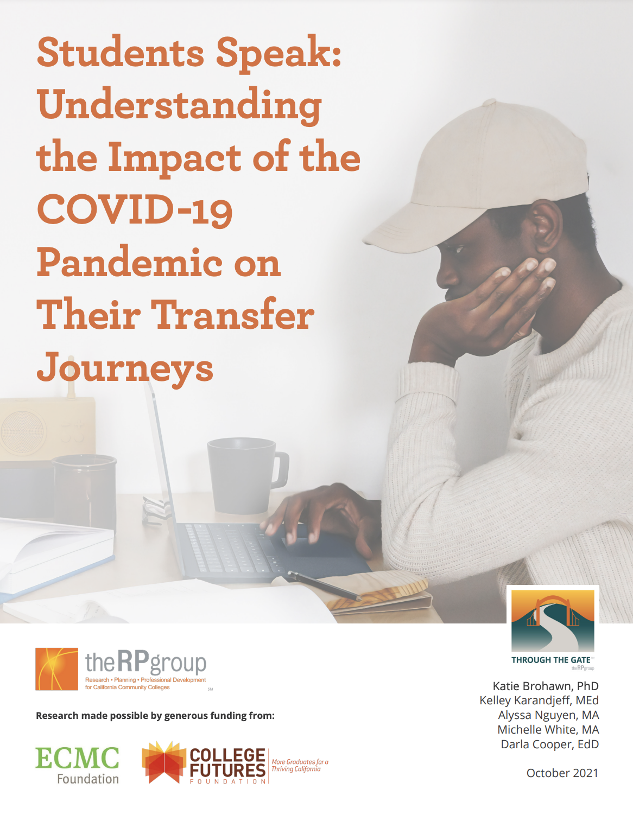
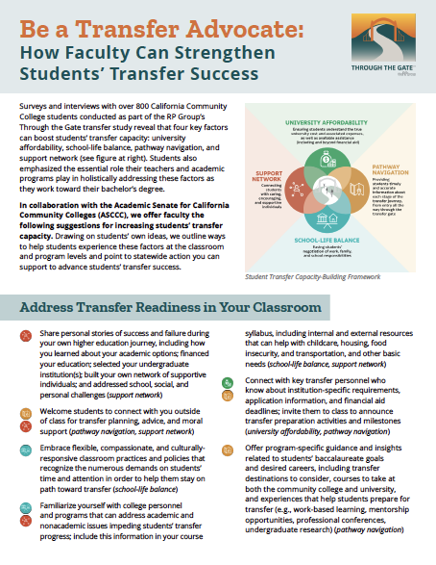
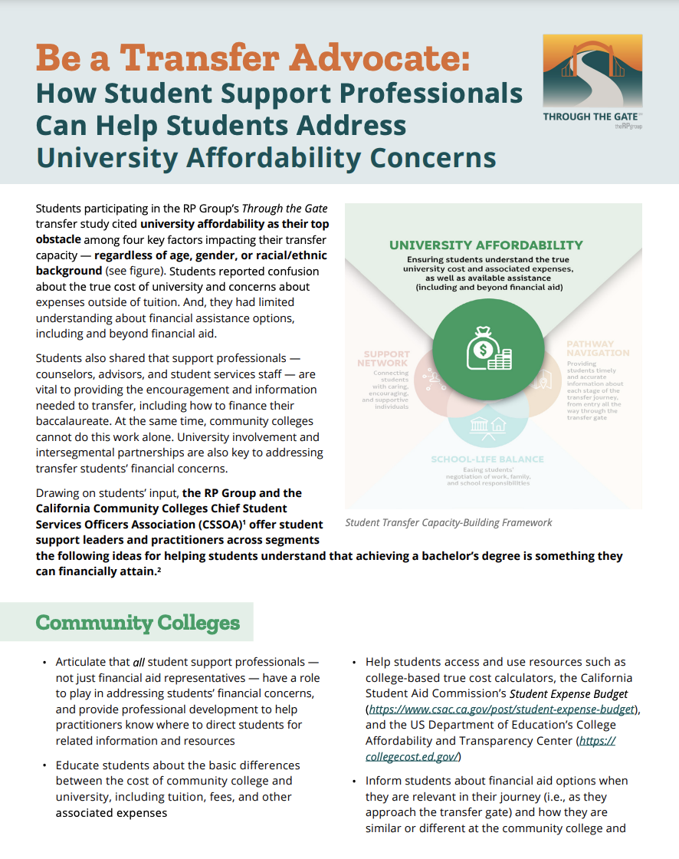
Through the Gate Resources
Notes:
Alyssa

Slide 28
Questions?
Notes:
Alyssa

Slide 29
For more information on the Through the Gate Initiative
Dr. Katie Brohawn kbrohawn@rpgroup.org
Dr. Darla Cooper
dcooper@rpgroup.org
Alyssa Nguyen
anguyen@rpgroup.org
Research made possible from the generous funding by:
www.rpgroup.org/through-the-gate
#StudentsThroughtheGate
Notes:
Refer to RP Group website

Slide 30
Thank you!

