Slide 1
Equity and Distance Education – Synchronous vs Asynchronous Instruction
Julie Bruno, OERI Communications Lead, Sierra College
Jennifer Paris, OERI Regional Lead, College of the Canyons

Slide 2
Description
“Traditional” distance education emphasizes a 24/7 educational experience with learning happening at the student’s convenience. “Temporary remote instruction” resulted in a new take on teaching at a distance – with many faculty choosing to teach synchronously. If your true goal is establishing an equitable learning environment, which modality should you choose? Join us for a robust discussion of the pros and cons of both approaches.
Notes:
And just a forewarning, if you came here hoping we would have the answers, we don’t.

Slide 3
Overview
Clarifying
  Synchronous vs. Asynchronous
  Traditional online vs. Temporary remote
Qualities of different distance education modalities
Discussion on equity
What’s Next?

Slide 4
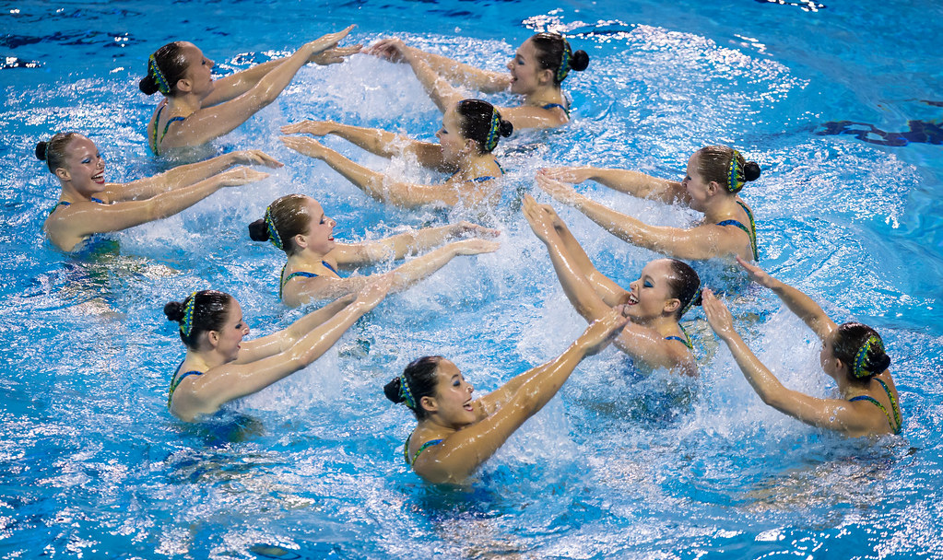

Synchronous vs Asynchronous Learning
Synchronous – learning where the instructor and the student are in the same place, at the same time
Asynchronous – learning occurs at a different time and place particular to each learner
Image by Synchro Canada is licensed under CC BY-NC-SA
Image by Tubagus Andri Maulana on Unsplash
Notes:
Maybe we should have used the swimming analogy when we trying to help students navigate what synchronous and asynchronous meant. ☺

Slide 5
Distance Education: Then & Now
Traditional Online
  Prior approval to be offered online
  Required training for instructors
Temporary Remote Instruction
  Blanket or emergency/provisional approval
  May have lessened training requirements
  What this looked/looks varies at each college and in each term

Slide 6
To Frame Our Discussion: Finding a Common Ground
Terminology
  Asynchronous – fully online
  Synchronous – not covering content in LMS, required virtual meeting for entire class time
  Combination of both – some content in LMS and some required virtual meeting
Qualities rather than pros and cons
Notes:
So we are trying to avoid institution specific language, but want some common ground to discuss different modalities. So we’re going with the these terms, even though we know they confused students (and probably faculty too).
And because pros and cons can end up quite subjective, we’ll discuss things more holistically by looking at the qualities of each modality.

Slide 7






Asynchronous Courses
Photo by Mimi Thian on Unsplash
Photo by Alejandro Escamilla on Unsplash
Photo by NESA by Makers on Unsplash
Photo by 卡晨 on Unsplash
Photo by Andrew Neel on Unsplash
Photo by Charles Deluvio on Unsplash
Notes:
Asynchronous classes look a bit like this. Everyone is working in their own space, when the time is right for them

Slide 8
Qualities of Asynchronous Courses
Flexibility for students and faculty
Established research on best practices
Established training protocols
Requires self-discipline and time management of students

Slide 9
Qualities of Asynchronous Courses cont.
Good design is time-consuming, but imperative to quality
Students may struggle if unfamiliar with technology and/or expectations
Faculty must maintain regular and effective contact

Slide 10

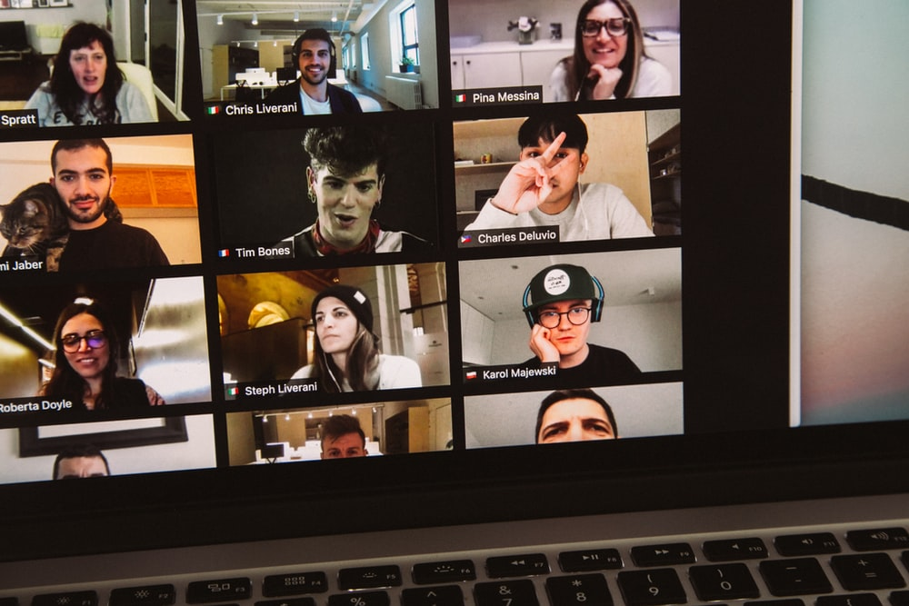
Synchronous Courses
Photo by Gabriel Benois on Unsplash
Photo by Charles Deluvio on Unsplash
Notes:
Synchronous classes probably still look a lot like the last slide of pictures, but if you were to view their screens, you would see something like this.

Slide 11
Qualities of Synchronous Courses
Set time students and faculty must commit to
Allows for instant communication and interaction
Seeing/hearing others may feel more like face-to-face classes

Slide 12
Qualities of Synchronous Courses cont.
Requires faculty to develop skillset to make classes engaging
Lack of established best practices
Not addressed in most trainings for teaching online
Technology being used is often unfamiliar with students and faculty

Slide 13
Qualities of Synchronous Courses cont.
Requires dedicated space for camera and mic to be on
Zoom fatigue
Technical issues (access to wifi, bandwidth, etc.) can prevent access to students and faculty

Slide 14


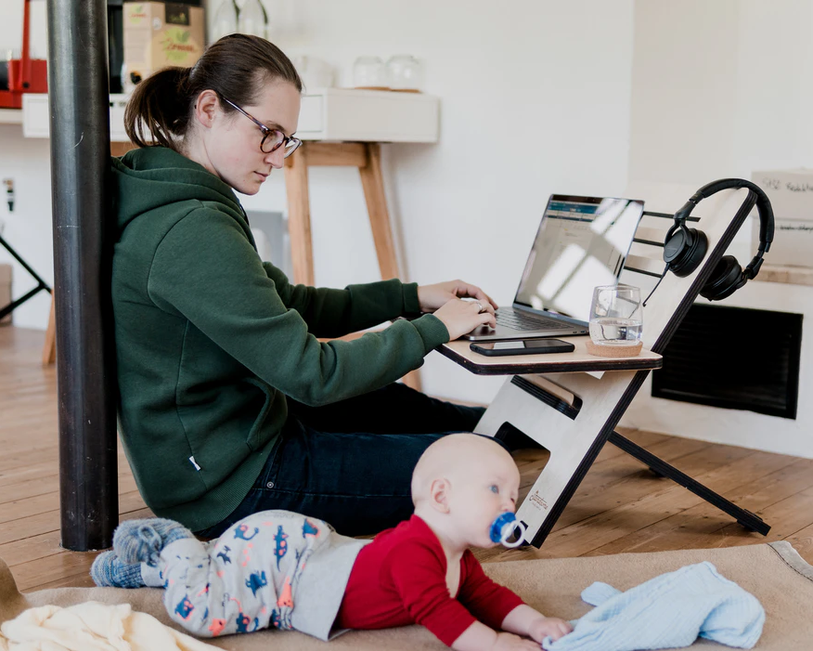
Both Asynchronous and Synchronous
Photo by Allie on Unsplash
Photo by Radiofabrik is licensed under CC BY 2.0
Photo by Standsome Worklifestyle on Unsplash
Notes:
And when we combine them, students spend time both working independently and meeting together virtually.

Slide 15
Qualities of Courses Using Both Asynchronous and Synchronous
Could bring in the best of both modalities
  Real-time interactions
  Less time spent at set times
Double cognitive load
  Requires training and skill in both for faculty
  Students must learn how to navigate both LMS and Zoom

Slide 16
Equity Discussion
Are some types of online instruction more equitable than others?
How do we decide what to do for our students and our disciplines?
What types is your college supporting and how has it impacted students?

Slide 17
What’s Next?
How will education change as a result of the Covid pandemic?
What are the implications for online and on-ground instruction?
Has your experience this past year changed your approach to your classes?
Where do we go from here?

