Slide 1
External Influences on Transfer Reform Friday, October 8 | 11:00-12:15
Notes:
Ginni

Slide 2
Presenters…
Wendy Brill-Wynkoop, FACCC President
Ginni May, ASCCC Vice President
David O’Brien, CCCCO Vice Chancellor of Government Relations
Notes:
All

Slide 3
Description
Everyone seems to have an opinion on how to increase transfer. Come to this session to learn how internal and external groups are leading discussions on transfer. Hear about current legislative efforts that could dramatically impact the future of transfer. Consider ways to lead transfer reform dialogue.
Notes:
Ginni

Slide 4
Overview
History of transfer legislation
Transfer Opportunities
Barriers to Transfer
Current legislative efforts focused on transfer
Leading the dialogue on transfer reform
Advocacy
Notes:
Ginni

Slide 5
But wait…an Acronym Tutorial
ASCCC – Academic Senate for California Community Colleges
CCCCO – California Community Colleges Chancellor’s Office
FACCC – Faculty Association of California Community Colleges
SSCCC – Student Senate for California Community Colleges
AB – Assembly Bill
SB – Senate Bill
CFT – California Federation of Teachers
CCA – Community College Association
CCCI – California Community Colleges Independents
CCLC – Community College League of California
TMC – Transfer Model Curriculum
ADT – Associate Degree for Transfer
Did we miss any? Put it in the chat…
Notes:
Ginni

Slide 6
History of Transfer Legislation
Notes:
Ginni – expternal influences

Slide 7
History of Transfer Legislation
SB 1440 (Padilla, 2010) Student Transfer Achievement Reform Act
sponsors by CCCCO, CSUCO, CCCSS, CSUSA, Campaign for College Opportunity
Prior bill: AB 440 (Beall, 2009) Transfer Degree as introduced 2/24/09,
Guaranteed transfer:
no more than 60 semester units to a CSU campus in a similar major
no more than 60 units required to complete the baccalaureate degree
SB 440 (Padilla, 2013) Student Transfer Achievement Reform Act
Required colleges to offer an ADT if:
there is a transfer model curriculum (TMC), and
the college offers a local associate degree in same major
Notes:
Ginni – external influences

Slide 8
Transfer Opportunities to CSU and more…
Local Associate Degrees
Used for both transfer and career
Agreements made college to college
Associate Degree for Transfer (ADT)
SB 1440 (Padilla 2010), SB 440 (Padilla, 2013)
Transfer Model Curriculum (TMC) – CCC and CSU collaboration
Agreements with private colleges:
Association of Independent California Colleges and Universities (AICCU) and
Historically Black Colleges and Universities (HBCU)
Notes:
Ginni

Slide 9
Transfer Opportunities to UC
Transfer Agreement Guarantee (TAG)
Six UC campuses participating, choose one campus, GPA requirements
University of California Transfer Pathway (UCTP)
20 most popular majors, not a transfer guarantee
Pathways+
Combination of TAG and UCTP
Notes:
Ginni

Slide 10
Transfer Opportunities
Note: An associate degree is not required for transfer
CSU
Local Associate Degree
ADT
UC
TAG
UCTP
Private and Out of State
Local Associate Degree
ADT
Pathways+
Other
Notes:
Ginni

Slide 11
Barriers to Transfer
Capacity at transfer institutions
CSU
UC
CSU determines similarity for ADT transfer guarantee
Similarity determined by campus
Campus can remove similarity
Total cost of a baccalaureate degree
Student Basic needs
Land-locked students
Students may be admitted to campus, but not one near or where they can live
Notes:
Ginni
Recently, CSU Fresno determined the following TMCs no longer similar:
Business Administration TMC.
English TMC
Nutrition and Dietetics TMC
Computer Science TMC

Slide 12
AB 928 (Berman)
This bill will:
Establish the Associate Degree for Transfer Intersegmental Implementation Committee to serve as the primary entity charged with the oversight of the ADT;
Require the Intersegmental Committee of the Academic Senates to establish a singular lower division GE pathway that meets the academic requirements necessary for transfer admission into both segments;
Require CCCs to place students who declare a goal of transfer on the ADT pathway if such a pathway exists for their intended major.
Current status: Signed by the Governor on October 6, 2021
Notes:
David

Slide 13
AB 1111 and California Budget 2021-22
The 2021-22 State Budget already did:
Allocate $10 million to the CCCCO to form a workgroup to support the development and implementation of a common course numbering system throughout the CCCs.
AB 1111:
Require the establishment of a common course numbering system for all GE and transfer pathway courses throughout the CCCs by July 1, 2024;
Urge the common course numbering workgroup (see above) to consider starting with courses in the current C-ID system and expand from there.
Current status: State Budget was signed and went into effect in July; AB 1111 was signed by the Governor on October 6, 2021
Notes:
David

Slide 14
Leading the Dialog on Transfer Reform
Curriculum in Legislation leads to…
Opportunities
Make change where there has been resistance or ongoing concerns
Build relationships with legislators/staff and local organization to increase awareness and understanding of the important role of practitioners
Challenges
Unintended consequences
Bill language can change through the process up until approval
Takes an act of law to change legislation
Notes:
Ginni

Slide 15
Leading the Dialog on Transfer Reform
Intersegmental Committee of Academic Senates (ICAS)
Intersegmental Curriculum Workgroup (ICW)
C-ID Advisory Committee
C-ID Leadership
ASCCC Transfer Alignment Project
Guided Pathways
Communicating Transfer Opportunities is KEY!
Discipline and Counseling Faculty working together
College Catalog (space is no longer costly, so there is room!) and other publications
Administrative Support is crucial
Notes:
Ginni

Slide 16
Leading the Dialogue on Transfer Reform
Looking at the Data in real time
If we don’t have the data, how can we lead the dialogue?
Policies that will address the barriers to transfer
Total cost of college
Cal Grant reform and Financial Aid reform
Basic needs
Solutions for working/adult students
Capacity at the four-year institutions
Honoring the “guarantee” at the CSUs
Increased access to counselors and program planning
Notes:
Wendy

Slide 17
Note: In 2020, 43% did not earn an associate degree
Student Origin - Now PASSWORD protected! Link: https://www.calstate.edu/data-center/institutional-research-analyses/Pages/enrollment.aspx
Notes:
Ginni – speaking of data…this screen shot taken several months ago on the CSU website is now password protected

Slide 18
Advocacy – System Practitioners
ASCCC
Legislative Visits/Legislative Advocacy Day
Local Academic Senate Legislative Liaisons
Advocacy Day with ICAS
Advocacy Training series with FACCC
FACCC
Sponsor legislation and advocate for budget priorities
Advocacy Training
Monthly Legislative Roundtable
Advocacy Training series with ASCCC
CCCCO
System Budget and Legislative Request process
Consultation Council monthly meetings
Government Relations policy and advocacy webinars
Legislative Visits
Notes:
Ginni, Wendy, David

Slide 19
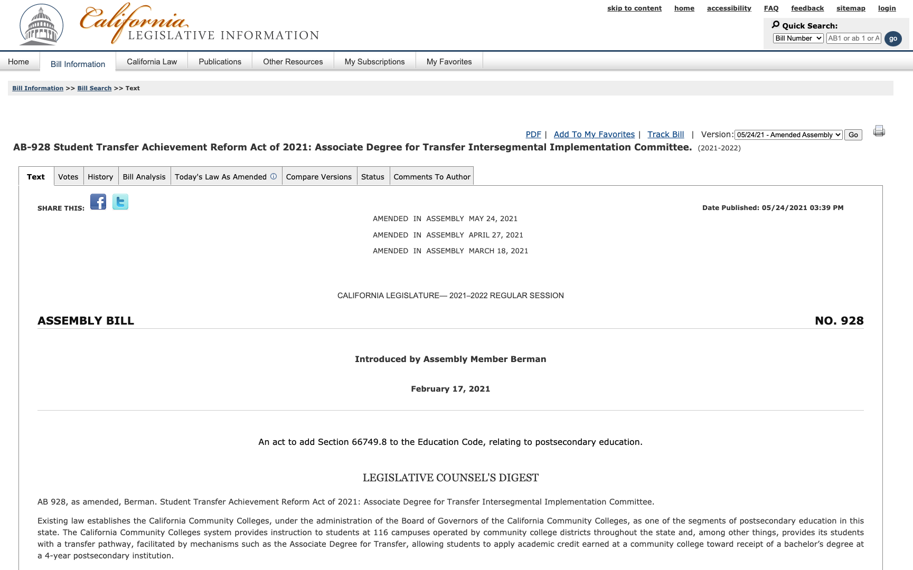
Staying Informed
California Legislature
Bill Search Site
s

Slide 20
Staying Informed Assembly Members and Senators are limited to introducing fifty and forty bills (each, respectively) per two-year session. Possible 5,600 bills per two-year cycle
2020 Bills significantly reduced due to Covid
2,390 Bills introduced in the state legislature
231 bills introduced tracked by CCCCO Matrix
513 made it to the Governor’s desk
457 became law, 56 vetoed
37 of them pertinent to CCCs
2021
2,379 Bills introduced in the state legislature
94 bills introduced tracked by CCCCO Matrix
650 made it to the Governor’s desk
Governor has until October 11 for signatures and vetos …stay-tuned!
Notes:
Wendy – we should know how many made it to the Gov desk. I will find out.

Slide 21
It’s a lot to keep up with… so let system partners help. Check positions on
ASCCC Legislative Positions
FACCC Legislative Positions
CFT Legislative Updates
CCA Legislation and Political Action
CCCCO Tracked Legislation
CCLC Legislative Actions
Notes:
Wendy

Slide 22
Advocacy Tool Kit
Call/Email your representative
Ask others to join you
Do your research and be prepared
Meet with Representative
Follow up!
Send a thank you note
Notes:
Wendy

Slide 23
The Do’s and Don’ts of Advocating
Be prepared, honest, and respectful
Breathe
Be reliable
Select a spokesperson
Ask for support
Leave something behind
Notes:
Wendy

Slide 24
System Partners Advocacy Listserves
ASCCC Sign up for the ASCCC legislative liaison listserv by emailing info@asccc.org
FACCC
This is a new two-way listserv where you can post questions and have discussions about legislation
Send email to: FACCCadvocates+subscribe@googlegroups.com
You will receive an automatic email, follow link, click join
CCCCO
ADVOCATES@listserv.cccnext.net
Notes:
Wendy

Slide 25
Resources
AB 928 (Berman, 2021) – Student Transfer Achievement Reform Act of 2021: Associate Degree for Transfer Intersegmental Implementation Committee
AB 1111 (Berman, 2021) – Postsecondary education: common course numbering system.
California Budget 2021-22 – $10M for Common Course Numbering
LegiScan: https://legiscan.com
California Legislative Information: https://leginfo.legislature.ca.gov

Slide 26
Discussion...
Thank You!

