Slide 1
Student Success is Everyone’s Job

Slide 2
www.cacareercafe.com
www.cacareerbriefs.com
Notes:
The Career Café (www.cacareercafe.com) and it’s associated CA Career Briefs site for CA Community College Faculty and Career Professionals (www.cacareerbriefs.com) were both made possible through SB70 funding from the California Community Colleges Chancellor’s Office.

Slide 3
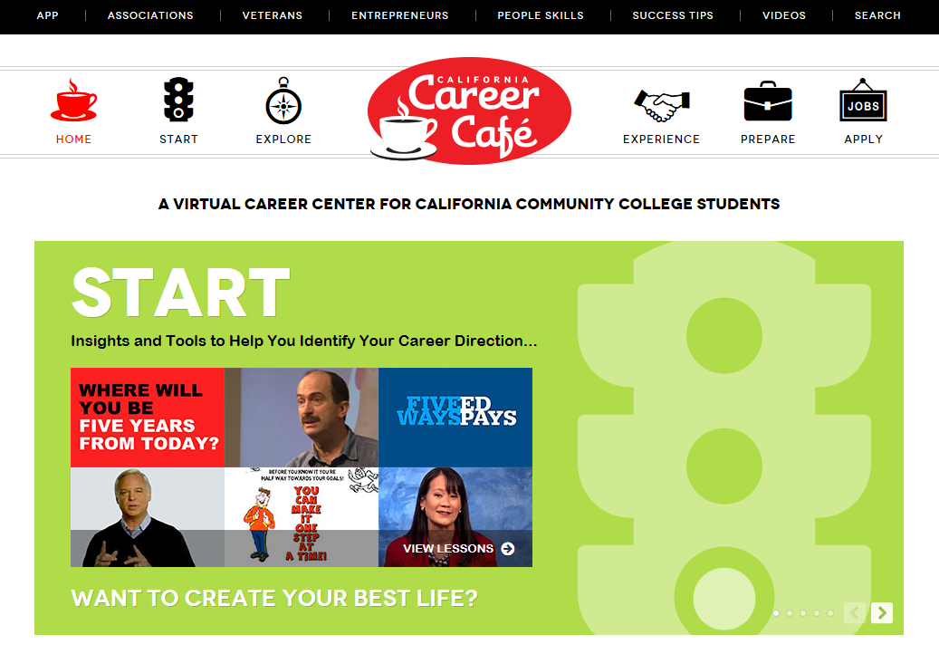
Overview of Career Cafe

Slide 4
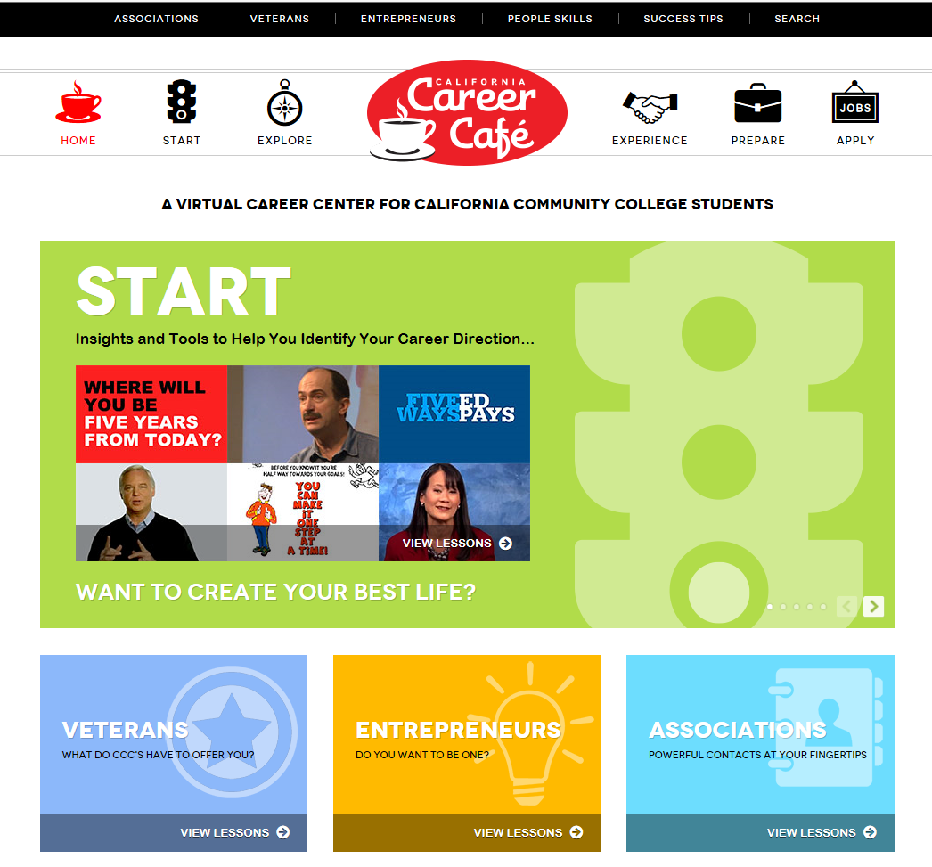
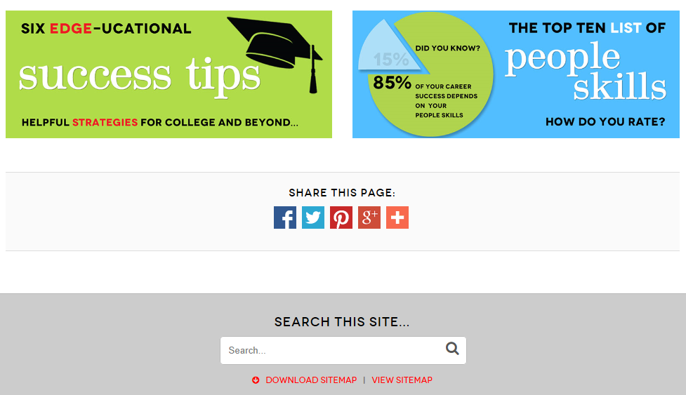
Notes:
In addition – on the Café homepage… there are special areas to explore specifically
for veterans
a section for those students interested in being an entrepreneur
as well as information on various professional associations in order to network with those already working in a particular career.
success tips and the people skills section on here – this is where people skills / soft skills that employers look for are highlighted for the student – a top ten list.
there are inspiring quotes, video links and quizzes for students rating themselves on the skills.

Slide 5
Notes:
Getting back to START on the Cafe, click on the START icon ….

Slide 6
Notes:
The START menu page. Every Section has a menu page like this one. You can see different lesson options in this particular START section. These lessons are focused on insight and tools for identifying a career direction. I will choose “Possibilities” as an example.

Slide 7
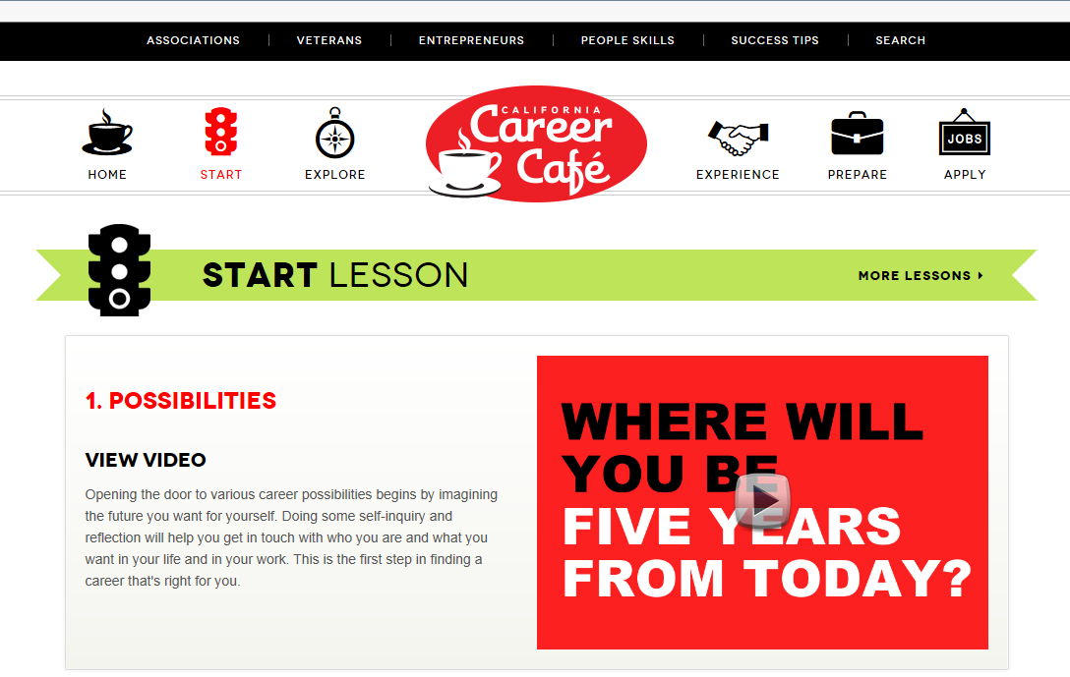
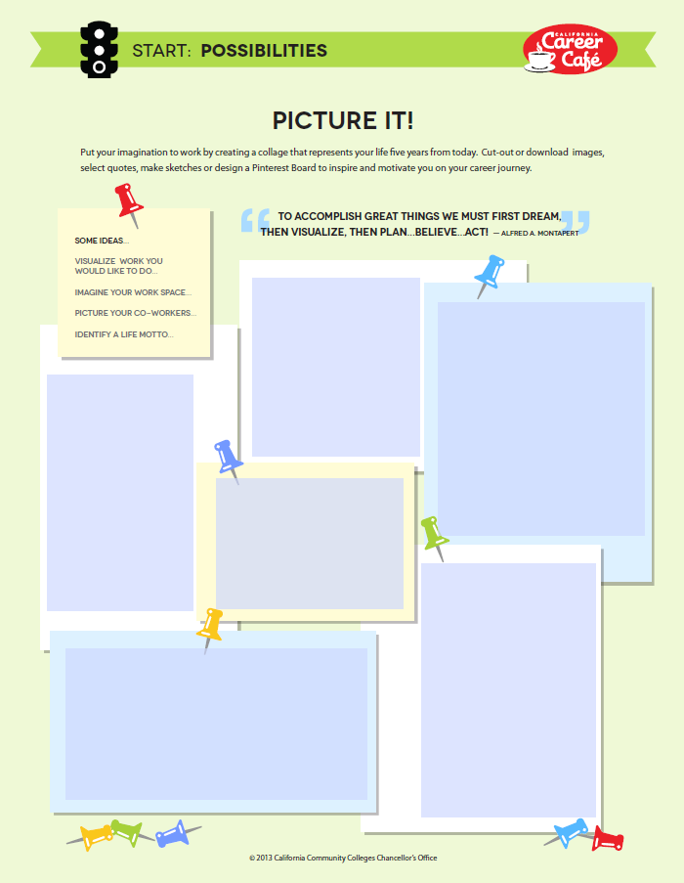
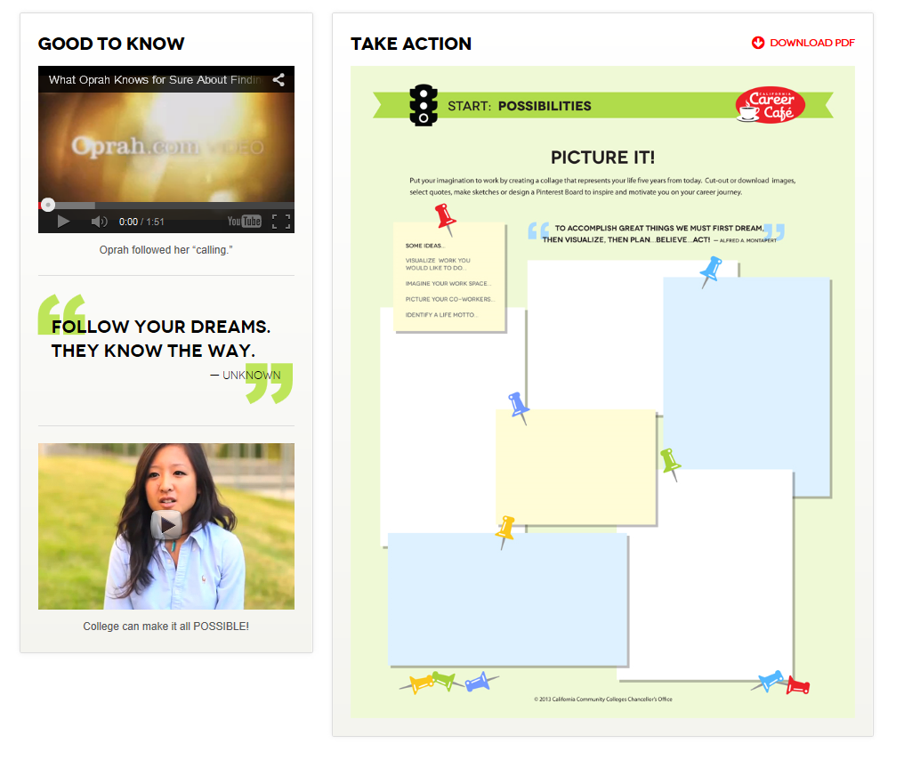
http://www.youtube.com/watch?v=3J7AvMFifR8&feature=player_embedded
Notes:
Possibilities Section on START asks the student to imagining the future they want.
Doing self-inquiry will help this process. Who are you? What do they want out of want in life? It’s their first step to finding a career.
Each of the four sections within the café Start, Explore, Experience , prepare look similar to this layout when drilling down from the menu page.
Each section has:
A basic explanation of the category
Short, engaging videos and/or Facts and Tips
And Student Lessons (that tie into the Career Action Plans).
Let’s watch a short clip from Oprah so you can get an idea of what the video portions look like and how they might inspire and inform students…(CLICK ON OPRAH)
Also, a short clip from a college student saying college is POSSIBLE! The site features a lot of Community College Students in the videos because they are obviously very relatable to the viewers.
New! Here is the activity worksheet for this lesson - ALL of the PDF student activity sheets on the Café are now fillable forms. They are up on the website. Students can fill out the forms online save and send it electronically -- or it can be printed out and handed in the old-fashioned way.

Slide 8
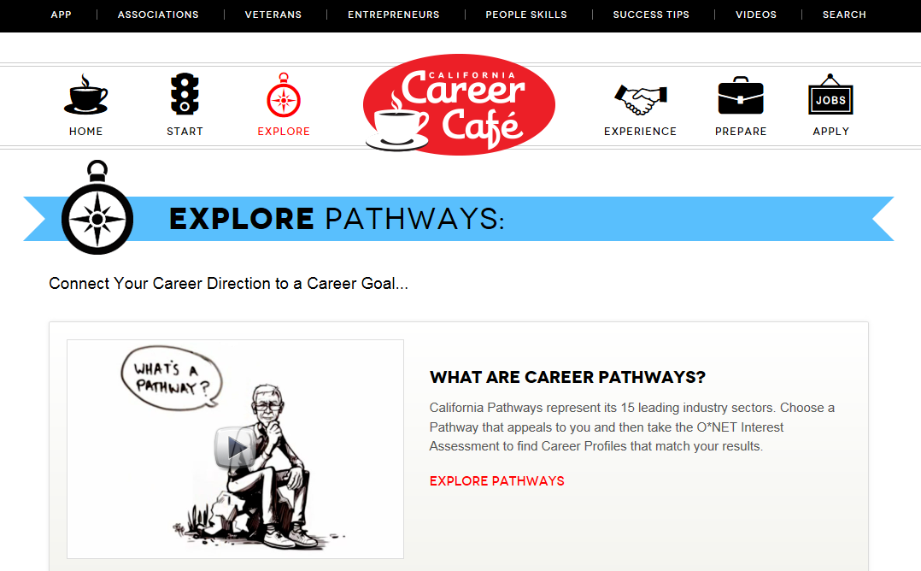
EXPLORE Career Pathways

Slide 9
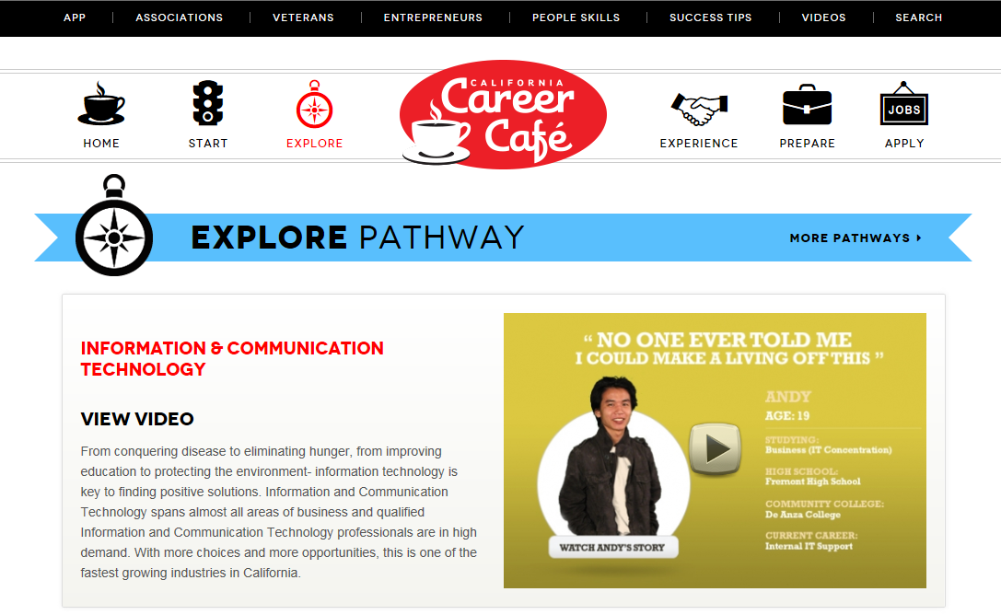
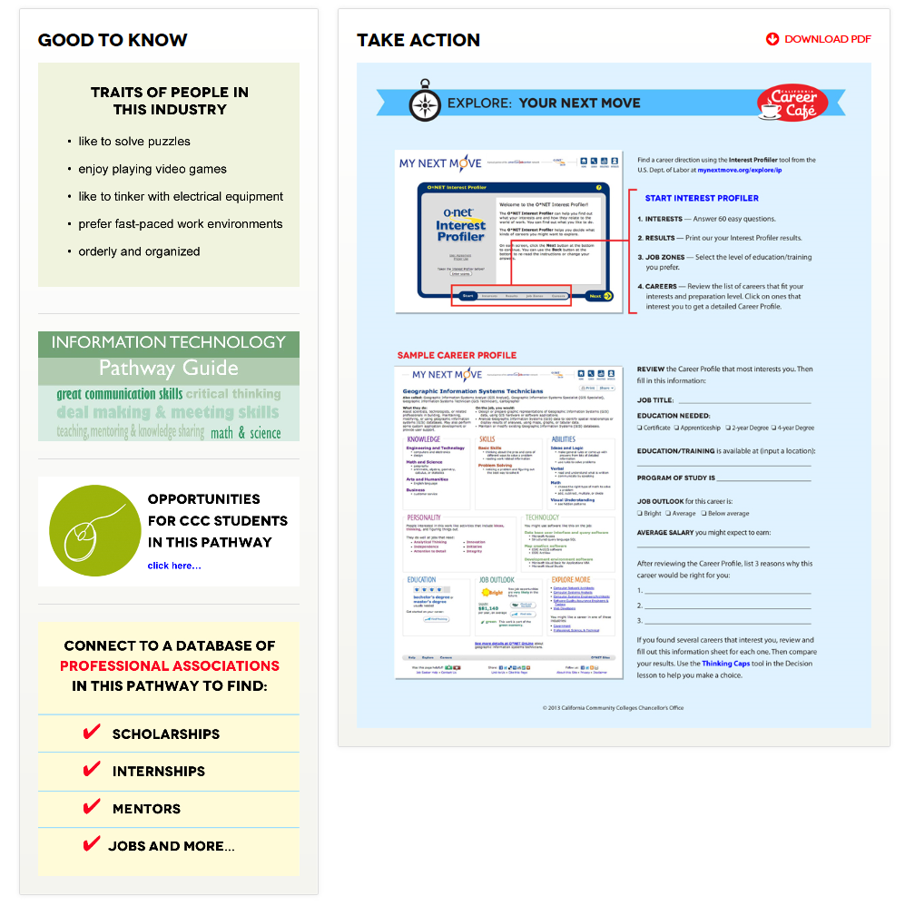
Notes:
Each Pathway goes into great detail with a short video profile of a community college student who studied and is working in that particular field
A really great way to relate to the student viewer - also, the student will find common traits of people working in this industry
a link to the various opportunities in that Pathway
links to professional associations related to that industry
and a career profile, which will take us to the next step in the CAP.

Slide 10
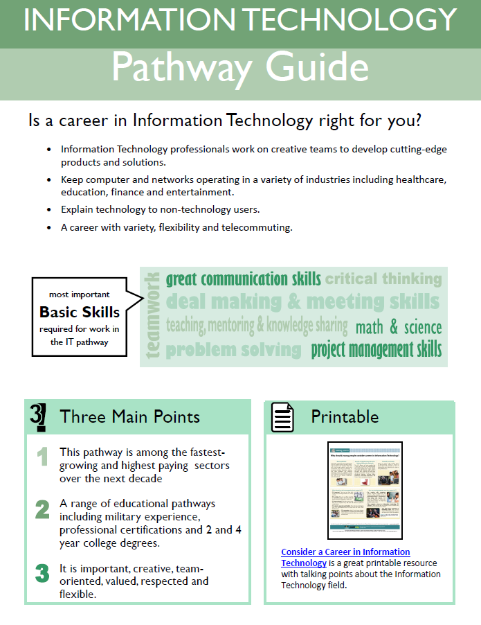
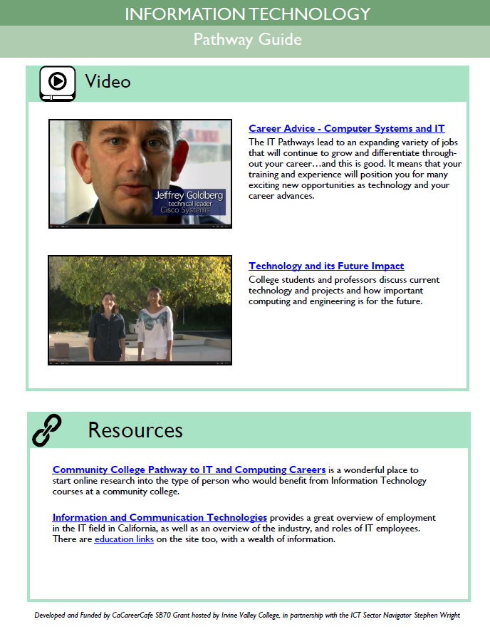

Slide 11
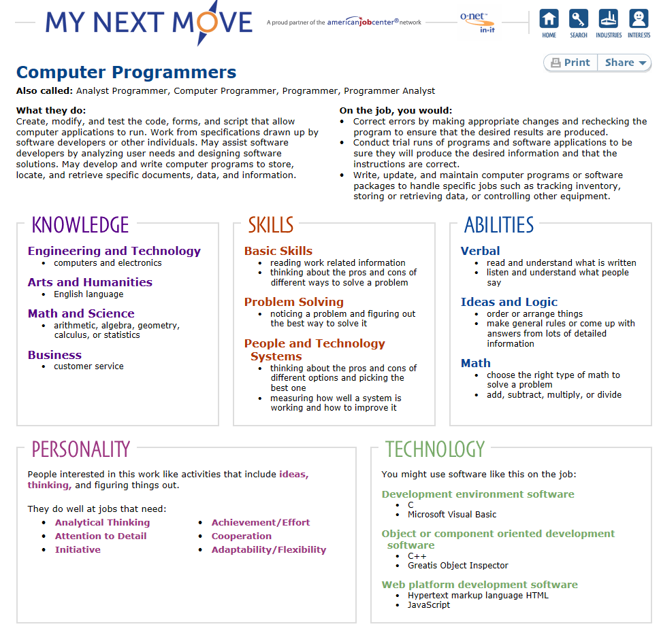
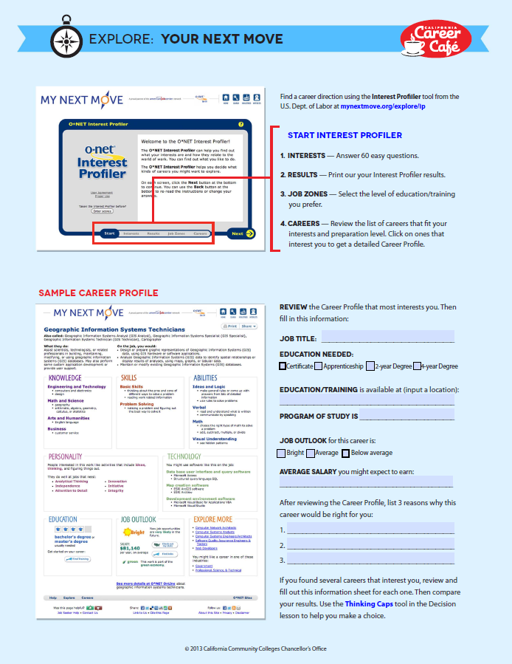
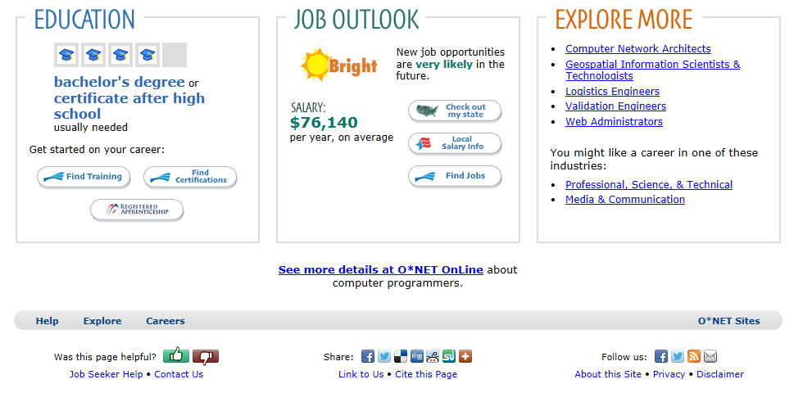
Notes:
STEP 3 Links to the O*Net Profiler - where students can review actual career profiles.
My Next Move Career Profile Sheet for Interior Designer. To use as an example “Interior Designers” it details what a Interior Designer does in their daily work, how they work on the job, knowledge, skills, abilities, personality and technology required to be successful in this career.
Also, a student can see an education path requirement along with job outlook, salary range per year on average and links to explore other opportunities that are related to that field.
The Explore Your Next Move activity sheet on the Café site correlates with O’Net and gives the student an assigned set of questions for their career of choice so they can write an educational plan and understand what is required for training in that career -- and also very important – answer questions as to why the student feels it is a good career match for them.

Slide 12
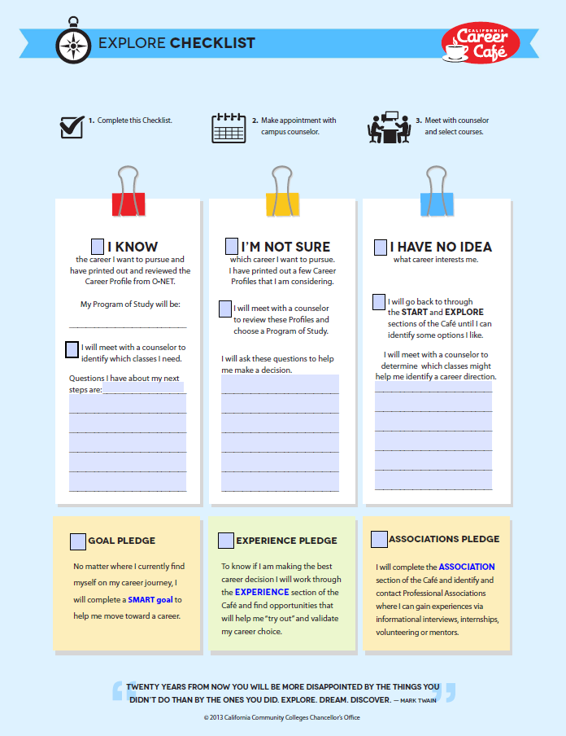

Slide 13
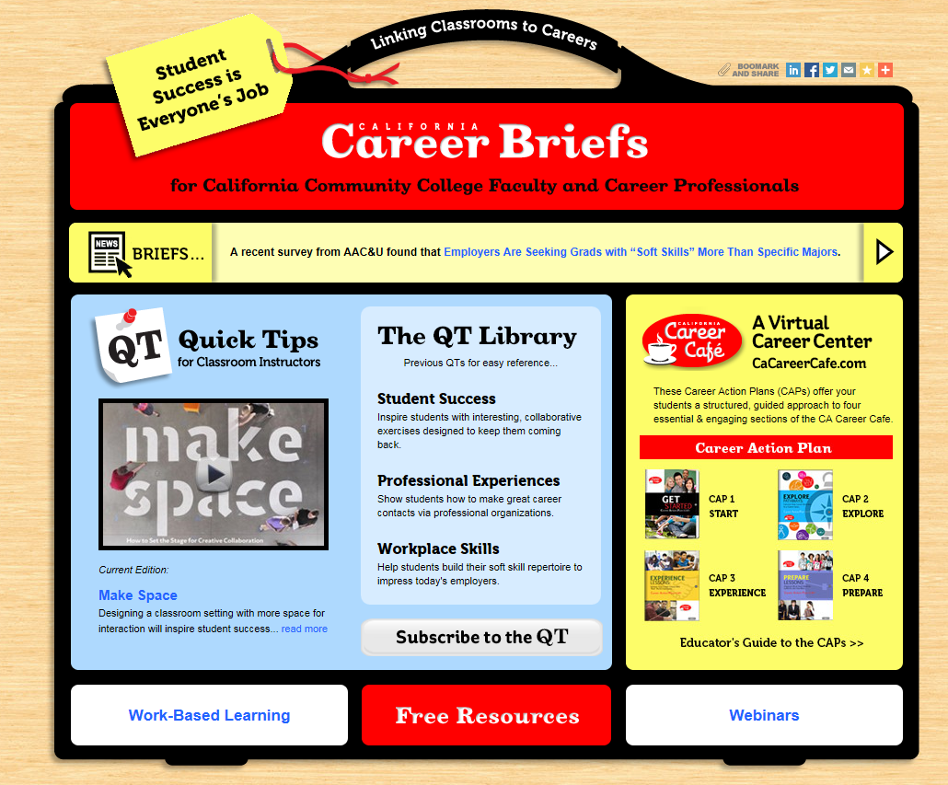
CAPS (Career Action Plans)
Notes:
So…that’s a brief overview of the Café and Briefs website.
FOCUS on Career Action Plans or CAPS
The “CAPS” offer educators a way to inform students through a structured, guided approach to the four essential and engaging sections on the Career Café website which are again, Start/Explore/Experience/Prepare.
The CAP exercises focus on Student Learning Outcomes and accountability measures that are already organized and ready for faculty and career professionals to use.
The Educator’s guide to the CAPS is a resource for the educator and features:
Checklists to determine student starting position on each Café section.
Pre-tests
Post-tests
Student Learning Outcomes outlined for each CAP for ease of reporting

Slide 14
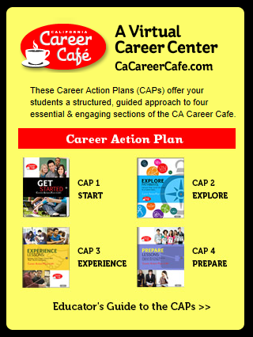
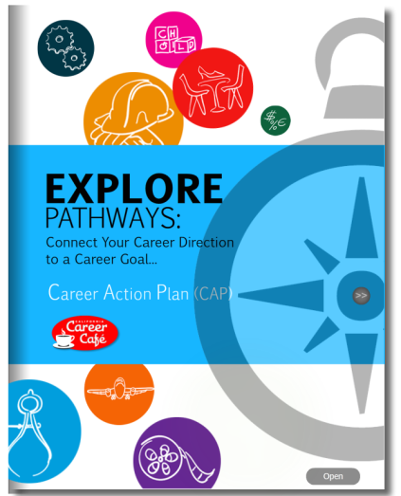
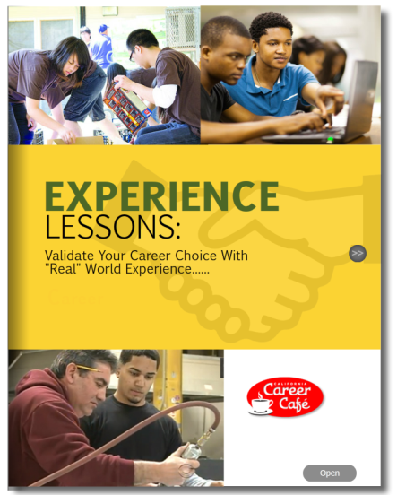
Notes:
Last is CAP 4 – Prepare – lessons to organize what is need to land a job

Slide 15
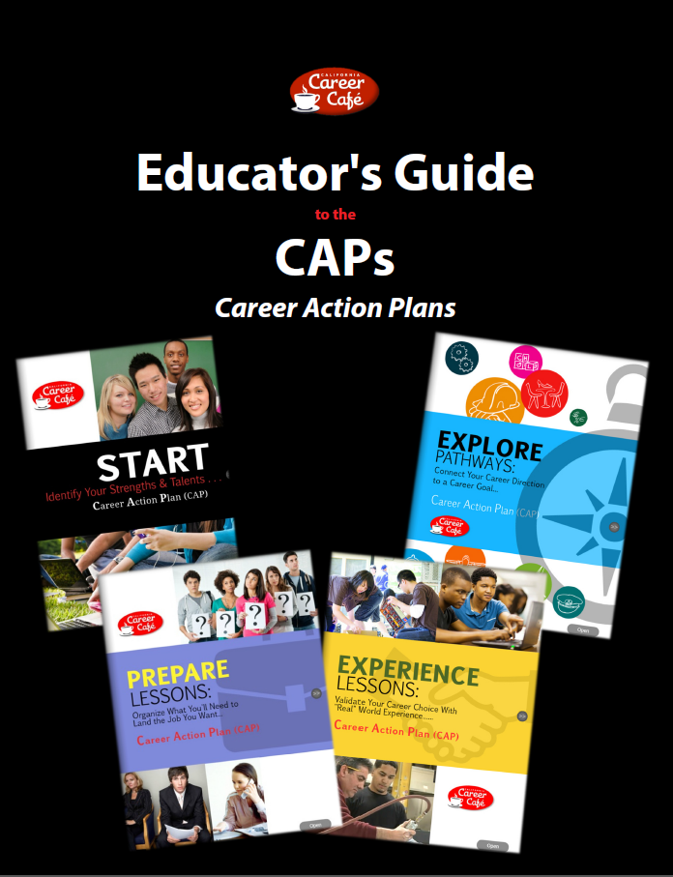
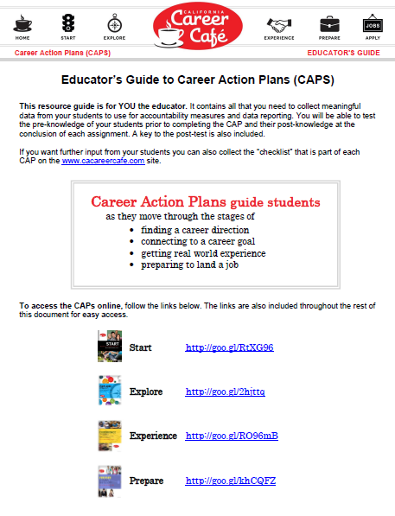
Notes:
The Educator’s Guide is in a pdf format and provides comprehensive information about the CAPs with direct links to the lessons by CAP.
The CAPs were designed to benefit not only the students as they are making career choices, but they were also designed to help educators and career professionals monitor and collect information about groups of students as they go through the career discovery process.

Slide 16
Notes:
Here are the four accountability statements for the Career Action Plan.
After the student completes their assigned lessons in each section of the 4 CAPs, they should experience the results as listed. We will go through each of these statements in greater detail at the end of each CAP in just a moment.

Slide 17
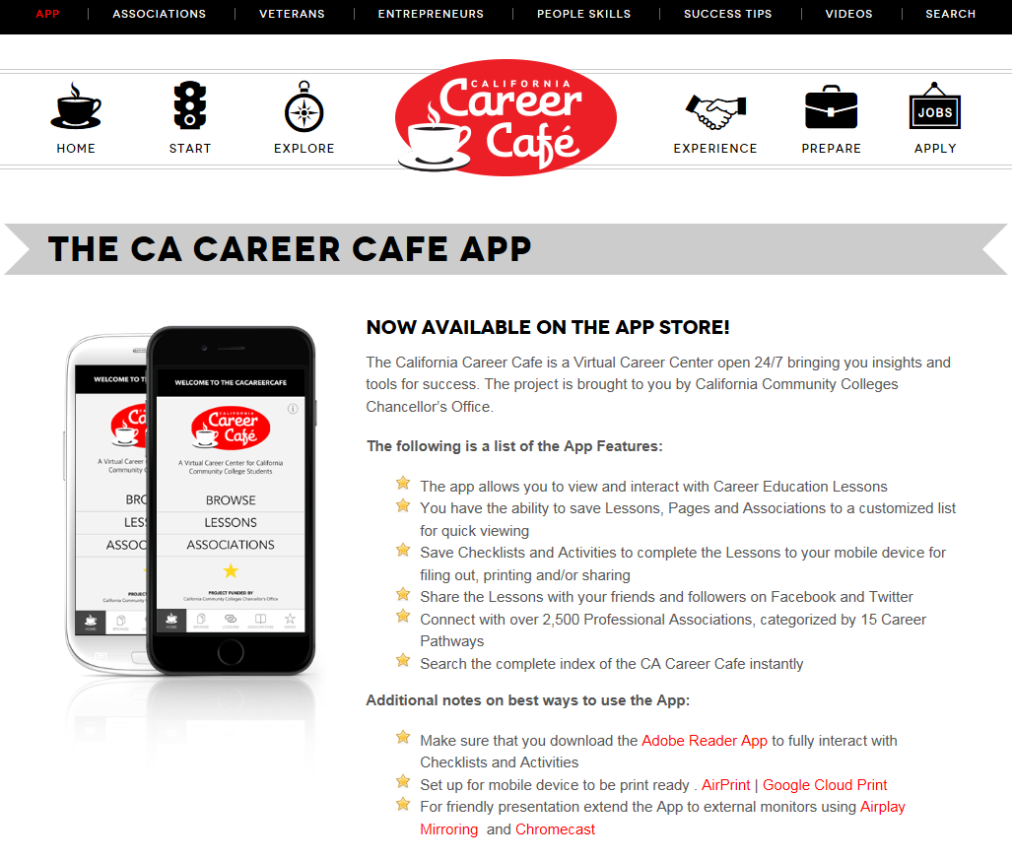
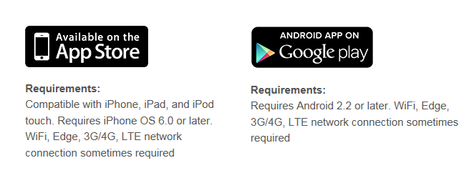

Slide 18
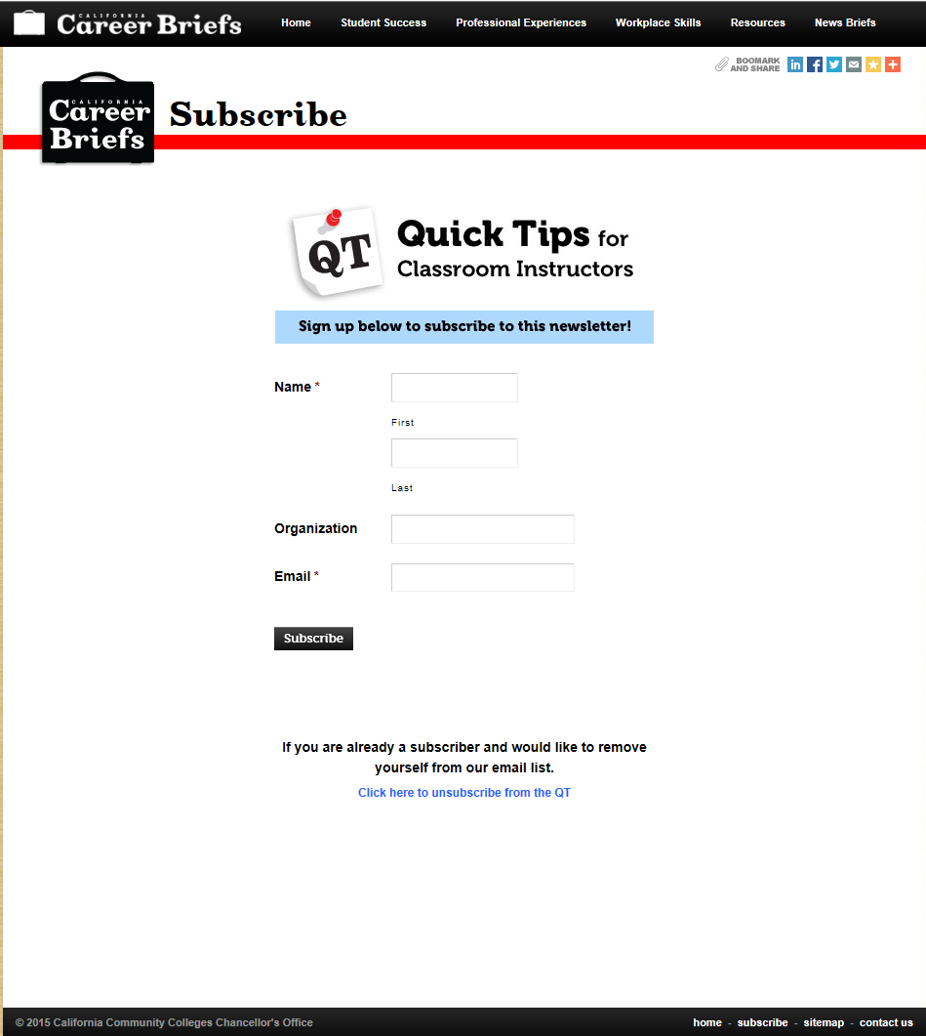
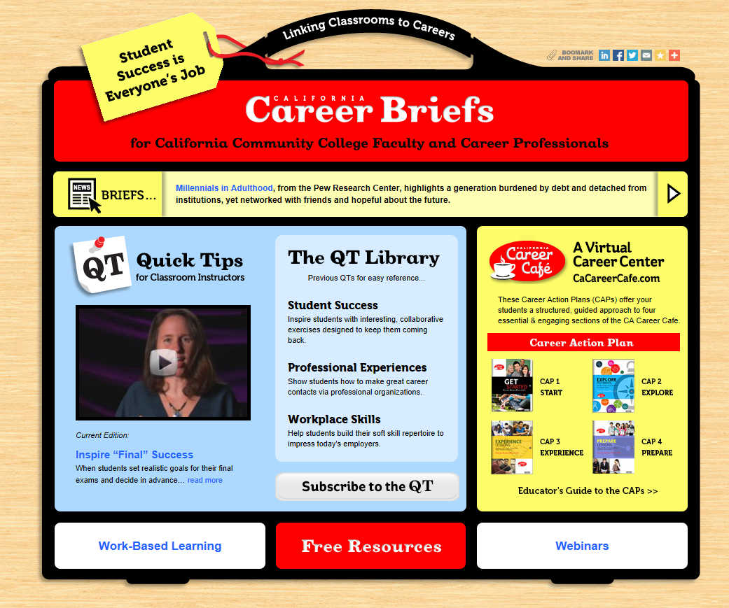

Slide 19
www.cacareercafe.com
www.cacareerbriefs.com
Susan Coleman: scoleman@occ.cccd.edu
Rita Jones: rjones@occ.cccd.edu
Notes:
If you have any questions or comments or if you want to share your best practices as they relate to the Café, please feel free to contact Susan Coleman or Rita Jones.

