Slide 1
Academic Freedom and Equity

Slide 2
PRESENTERS
Wendy Brill-Wynkoop, College of the Canyons
Julie Bruno, Sierra College
Stephanie Curry, ASCCC North Representative

Slide 3
BREAKOUT DESCRIPTION
The tenets of Academic Freedom afford specific protections and responsibilities to faculty, which affect our day to day practice as educators. Although our districts are required to have an Academic Freedom policy, many faculty are not aware of the importance of developing specific processes to ensure the rights of faculty to practice Academic Freedom, both in and outside of the classroom. Come to the session to learn about the work being done by the ASCCC in supporting faculty Academic Freedom rights and how those rights support equity.

Slide 4
What is Academic Freedom
Academic Freedom is required so that the faculty professionals who teach and research are protected from external forces that might try to influence the development of culture, science, and knowledge in order to serve any interest other than the intellectual, socioeconomic, and socioemotional advancement of students through the attainment of an education.

Slide 5
AAUP and Academic Freedom
Academic freedom is related to the pursuit of knowledge without unnecessary restrictions.
The AAUP’s Statement on Professional Ethics contains the following that supports this idea:
Professors, guided by a deep conviction of the worth and dignity of the advancement of knowledge, recognize the special responsibilities placed upon them. Their primary responsibility to their subject is to seek and to state the truth as they see it.
As teachers, professors encourage the free pursuit of learning in their students. They hold before them the best scholarly and ethical standards of their discipline.
…professors seek above all to be effective teachers and scholars
http://www.aaup.org/AAUP/pubsres/policydocs/contents/statementonprofessionalethics.htm

Slide 6
Importance of Academic Freedom in the advancement of Equity and Anti-Racism
The Connection between academic freedom and equity is fundamental.
Without the rights of faculty to speak, research and pursue diverse ideas, equity is not possible.
Academic Freedom allow faculty to academically challenge racist ideologies ad structures in the context of their expertise
Academic Freedom allows students to be introduced to a diverse range if ideas that often contrast and compete with each other within an academic framework and invites them to participate in a rigorous analysis, the development of a independent critical judgement
Allows faculty members the freedom to shape their courses in a way that allows for their subjects to be viewed, analyzed from different and specific lenses, particularly when the contrast with more traditional established theories
Notes:
Stephanie - should this be moved to the beginning?

Slide 7
So What Does Academic Freedom Really Mean?
Many colleges have specific procedures that outline what their academic freedom policy permits.
Academic Freedom procedures related to academic freedom should address the following best practices from the American Association of University Professors:
Research and publication of the results
Classroom in discussing their subject
When they speak or write as citizens, they should be free from institutional censorship or discipline
Academic freedom is not absolute or equivalent to freedom of speech

Slide 8
Things Academic Freedom Allows
Academic freedom typically allows faculty to do the following:
Present the course content (per the Course Outline of Record) in the way they deem most appropriate
Determine the assignments, readings, assessments, and exams that will work best for their class.
To create a classroom environment where controversial topics can be discussed without being censored as long as the topic relates to the course. Recognizing student’s right to first amendment (freedom of speech)

Slide 9
Limitations on Academic Freedom
Limitations on Academic Freedom
Right of professor to determine content of courses – as specified by Course Outline of Record, departmental and/or curriculum committee decision
Teachers are allowed to compel speech from students as long as doing so was “reasonably related to pedagogical concerns”
Not absolute to the point of compromising a student’s right to learn in a hostile-free environment
https://www.aaup.org/our-work/protecting-academic-freedom/academic-freedom-and-first-amendment-2007

Slide 10
Academic Freedom is not Freedom of Speech
Freedom of Speech
1st amendment right for faculty AND students
Restricts the right of a public institution, including a public college or university, to regulate expression
Instructors are not to required to provide class time for students to voice views that contradict the material being taught however, instructors are required to allow students to express opposing views and values to some extent where the instructor invites expression of students’ personal opinions and ideas
In the classroom, speech must be germane to the subject matter and advances an academic message (stick to your subject)
Private institutions first amendment protections are often limited and do not have the same protections as public institutions
Email on district server, electronic communications, and faculty pages are not necessary protected under “free speech”
https://www.aaup.org/our-work/protecting-academic-freedom/academic-freedom-and-first-amendment-2007

Slide 11
Policies and Collective Bargaining Agreement
Academic Freedom is an area of overlapping purview between the Senate and the Union
In support of academic senates and unions working together, the 2005 AAUP statement goes on to say that “[s]trong senates and strong union chapters can work together to preserve and protect academic freedom on campus. Together, they establish the institutional terrain and precedents on which individual rights are defined, defended, and sometimes adjudicated.”
Recommend the Senate and Union have a joint understanding

Slide 12
Academic Freedom Policy required by Title 5
§ 51023. Faculty.
The governing board of a community college district shall:
(a) adopt a policy statement on academic freedom which shall be made available to faculty;
(b) adopt procedures which are consistent with the provisions of sections 53200-53206, regarding the role of academic senates and faculty councils;
(c) substantially comply with district adopted policy and procedures adopted pursuant to subdivisions (a) and (b).

Slide 13
ACCJC’s Standard I.C.7
In order to assure institutional and academic integrity, the institution uses and publishes governing board policies on academic freedom and responsibility. These policies make clear the institution’s commitment to the free pursuit and dissemination of knowledge, and its support for an atmosphere in which intellectual freedom exists for all constituencies, including faculty and students.

Slide 14
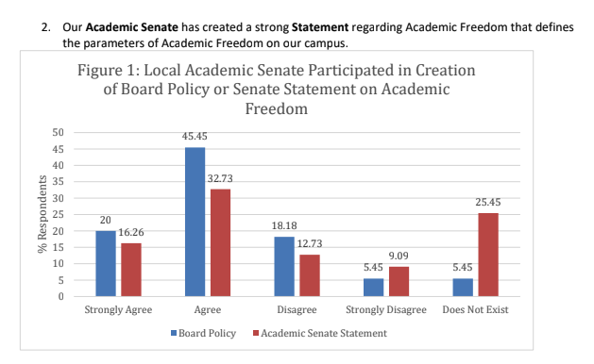

Slide 15
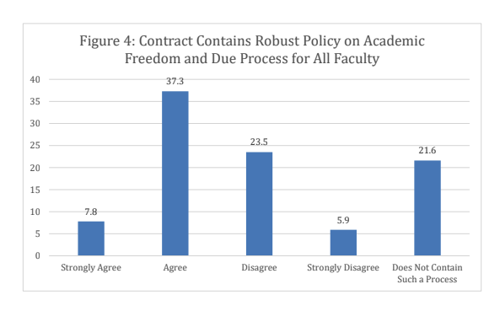
Collective Bargaining Agreement
Less than 50% of the faculty CBAs at the CCCs have mention of academic freedom
Most CBAs simply reference the district policy
In order to protect academic freedom, the collective bargaining agreement should strive to assert the unique right of academia particularly in the areas of:
tenure
evaluation
due process

Slide 16
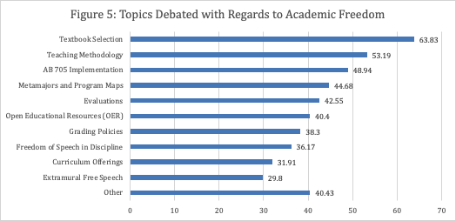

Slide 17
Academic Freedom and Tenure
Tenure is the primary safeguard of academic freedom.
However, “approximately 70% of faculty within the system and do not have the protections of tenure status...This weakening of tenure adversely affects the protection and benefits of academic freedom, including participation in governance, for all faculty. “
(Protecting the Future of Academic Freedom, 19)

Slide 18
Protecting Academic Freedom and Tenure
Although colleges have academic freedom policies and some unions have negotiated language into the contract, it may not be enough as faculty face direct threats to academic freedom.
For part time faculty
Threats of job loss if violations of academic freedom are called out or grieved.
No or minimal compensation for shared governance.
Burden of governance falls to full time faculty

Slide 19
Academic Freedom and Evaluations
The demographic changes on our campuses have introduced diverse concepts and ideas into an academic environment that has and continues to be dominated by patriarchal euro-centric paradigms.
Does our evaluation process embrace these diverse ideas and concepts or does it perpetuate “traditional” academic paradigms?
Do we (perhaps unintentionally) constrain our colleagues through the evaluation process?

Slide 20
Protecting Academic Freedom: What Senates and Unions can do Together?
Advocate for increases in tenure positions and expand tenure protections to all faculty
Provide joint training on how to conduct evaluations that includes honoring the academic freedom of our colleagues.
Educate administrators, board members, and the community as well on the importance of academic freedom, tenure and shared governance as the most effective methods in ensuring the integrity of the institution and enduring public trust..

Slide 21
Protecting Academic Freedom: What Senates Can Do?
Review and revise college governance policies to ensure that academic freedom for all faculty is protected.
Provide professional development in the parameters, practice, and responsibilities of academic freedom for all faculty and administrators.
Adopt a statement regarding the parameters and practice of academic freedom in a variety of areas such as:
the implementation of diverse and innovative pedagogies,
curriculum,
evaluations, and
grading policies.

Slide 22
Policy musts
Equity! When reviewing policies look at colleges structures and ensure all voices are represented in process
Academic Freedom policy should not make a distinction between full-time and part-time.
The same freedoms that come from an academic freedom policy applies to all faculty members, no matter how long they have been at the college.
Academic freedom policies might seem similar to tenure, but the protections of tenure extend to activities outside of the classroom. Academic freedom is intended to apply to the instructional environment.

Slide 23
Academic Freedom Paper
Introduction
Academic Freedom Defined
California Community College Changing Demographics
Academic Freedom and Free Speech
Academic Freedom and Marginalized Communities
Freedom of Research and Publication
Freedom in the Classroom
Freedom for Public Discussion
Academic freedom, tenure, and shared governance for full and part time faculty
Academic Freedom and Tenure

Slide 24
Academic Freedom Paper
Recommendations
Recommendations for local senates:
Recommendations for local senates in collaboration with union colleagues:
Academic Freedom Resources
Appendices
Appendix 1: 1940 Statement of Principles on Academic Freedom and Tenure with 1970 Interpretive Comments
Appendix 2: Academic Freedom Contract Language
Appendix 3: Executive Summary of ASCCC Academic Freedom Survey Results
Appendix 4: College of the Canyons Joint Understanding Between Senate and Union

Slide 25
Paper recommendations for local senates:
Recommend that local senates create a statement on academic freedom, in addition to the board policy, that delineates the specific issues and parameters of academic freedom for faculty. (this needs refining)
Recommend that local senates provide consistent and ongoing professional development for full and part-time faculty and senate leaders (curriculum, program review, policy chairs, senators, etc.) in the principles and tenets of academic freedom including in onboarding new faculty.
Recommend that local senates work to review, revise and strengthen shared governance processes, policies and procedures in relation to academic freedom so that shared governance protects dissenting opinions in the decision-making process. Dissent is vital to protect Academic Freedom.
Notes:
Statement on AF
Professional development and standing committee with expertise in the area of AF
Review Policy, procedures to strengthen governance process
Dissent - vital to AF

Slide 26
Paper recommendations for local senates in collaboration with union colleagues:
Recommend that local senates work with union colleagues to develop due process around violations or perceived violations that fall within academic freedom that includes a duly constituted (appointed or elected) faculty committee to review and recommend action.
Recommend that local senates collaborate with union colleagues on codifying the protection and parameters of academic freedom in contract in light of faculty evaluations, curriculum, online instruction, dual enrollment, open educational resources, guided pathways, etc.
Recommend that local senates work with union colleagues to train faculty on engaging in tenure and faculty evaluations in light of academic freedom.
Recommend that local senates support union colleagues in negotiating compensation for adjunct faculty participation in shared governance.
Recommend that local senates and union colleagues review AAUP resources and recommendations

Slide 27
Resources
AAUP 1940 Statement of Principles on Academic Freedom and Tenure
https://www.aaup.org/report/1940-statement-principles-academic-freedom-and-tenure
AAUP Academic Unionism Statement
https://www.aaup.org/academic-unionism-statement
Assembly Bill 1725 Vasconcellos (1988)
https://www.asccc.org/sites/default/files/1988%20AB%201725%20Community%20College%20Reform%20Act%20%28Vasconcellos%29.pdf
AAUP Red Book – Policy Documents and Reports, American Association of University Professors, 2015
https://www.aaup.org/reports-publications/publications/redbook

Slide 28
Resources
Academic Freedom in the 21st-Century College and University: Academic Freedom for All Faculty and Instructional Staff
https://www.aft.org/sites/default/files/academicfreedomstatement0907.pdf
AAUP Statement on Academic Government for Institutions Engaged in Collective Bargaining https://www.aaup.org/report/statement-academic-government-institutions-engaged-collective-bargaining
Messier, John “Shared Governance and Academic Freedom: Yes, This Is Union Work” 2017, NEA
https://www.nea.org/assets/docs/TA2017S_Messier.pdf
Reichman, Henry “Professionalism and Unionism: Academic Freedom, Collective Bargaining, and the American Association of University Professors” AAUP Journal of Academic Freedom, 2015
https://www.aaup.org/sites/default/files/Reichman_0.pdf
Reichman, Henry, The Future of Academic Freedom, John Hopkins University Press, 2019

Slide 29
Comments and Questions

Slide 30
Presenter contact information
Julie Bruno: jbruno@sierracollege.edu
Stephanie Curry: stephanie.curry@reedleycollege.edu
Wendy Brill-Wynkoop: wendy.brill@canyons.edu

