Slide 1
Assessment Integrity in a COVID-19 Teaching Environment v2

Slide 2
Assessment Integrity in a COVID-19 Teaching Environment
Today we have about 50 minutes to review important issues regarding assessment/grading in courses previously Face2Face and now asynchronous or synchronous and virtual.
Part 1 - a reminder of principles for assessment/testing/grading and strategies that promote academic integrity and a summary of previous webinar input
Part 2 – specific issues you have identified or solutions you have found

Slide 3
Help us facilitate an open conversation
We have small groups to allow for interaction
We have found that chat and raising your hand doesn’t work as well as simply muting yourself (we have NOT muted you)
Unmute yourself when you want to talk and we will call on you in order so you can share
Then return to mute after sharing
If you have a better online conversation mechanism – let us know

Slide 4
Definition and reminder
Where would you find typically these policies?
Board Policy
Administrative Procedures or Policies
Faculty Handbook
Student Handbooks
Syllabi
Websites
Catalogs
These policies are required for accreditation to ensure that we get federal student financial aid
It is a good time to review these
We have always been required to have academic honesty or integrity policies and to clearly communicate consequences.

Slide 5
Why do you think misconduct occurs?
Panic, lack of time or study, procrastination, stressed, afraid, etc.
Unclear on academic integrity definitions
Lacking confidence in their own words or thoughts (plagiarism)
Inadequate preparation and expectations in research, citations, note-taking
Misunderstanding about the scaffolding of coursework where skills build, and expectations increase
Misunderstanding regarding “open book”
Easy to purchase responses aligned with a consumer mentality – I want the product the process is unimportant

Slide 6
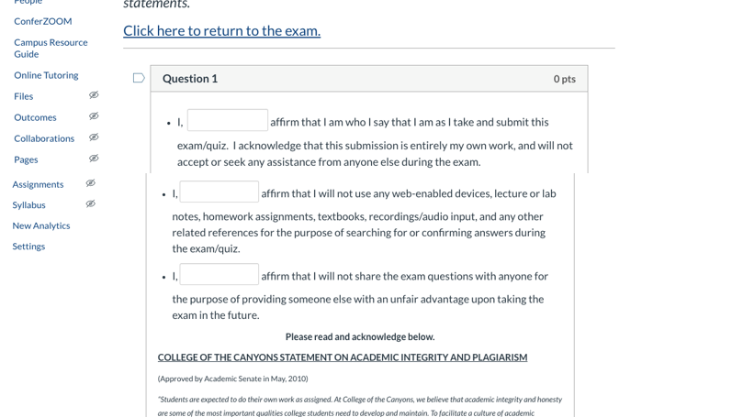
One example of integrity statement before quizzes and exams from AJ at College of the Canyons

Slide 7
What are some Hot Spots for Academic Dishonesty?
Online Exams, Quizzes, Assessments
Lab reports
Using translation apps
Copy and paste research/Google
Group work – rubric and expectations
Sequential tests/quizzes within sections
Phone a friend
Unlimited time
Multiple choice
Discussion forums for points

Slide 8
Ideal Assessment Methods in Online Courses
There’s a substantial amount of research devoted to determining the best approach to assess online learning (namely authentic, engaging, and involved activities with sound philosophical and pedagogical links).
What should be the current focus?
What’s the absolute best?
What’s the best for right now?
A mix of both?
What will serve students the best?
How can we realistically accomplish it?
https://www.insidehighered.com/digital-learning/article/2018/10/31/qa-strategies-better-assessments-online-learning
https://www.insidehighered.com/digital-learning/article/2018/10/31/qa-strategies-better-assessments-online-learning

Slide 9
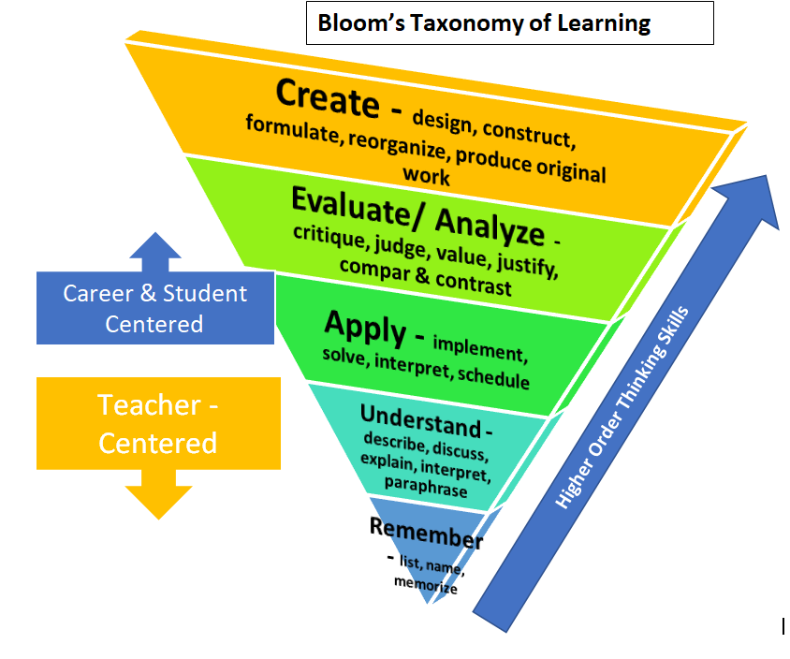
Align interventions and messaging to prevent misconduct
Be intrusive, be available
Explain appropriate citations/references, notetaking, paraphrasing
Have student email you about academic integrity(see resources)
Consider difficulties for students (access to materials, time, etc)
Create assessments at the highest Blooms taxonomy levels - SLOs
Construct rubrics to provide points for good academic behavior

Slide 10
Some Issues and Solutions Shared by Colleagues
Issues with Synchronous and Asynchronous
Issues with Proctorio
An assignment where students send faculty an email defining academic honesty
Certificate of integrity
Survey students to see what kind of testing, assignments, quizzes work best (learning and testing styles)
One college department designed all assessments open book since they could not control those who would or wouldn’t
Start with low level, low point questions to dis-incentivize cheating -> progress to higher level applications with more individualized responses and higher points

Slide 11
Some Solutions Shared by Colleagues
Give them an online quiz with a writing portion about the quiz
A Film faculty shared she created an extra credit assignment to keep spirits up by focusing the assignment on a comedy
To prevent discussion board reposting/plagiarism when used for points, use a setting that will not post others’ responses until the student posts theirs first
Faculty strategically approached students’ lack of time and distractions by breaking exams into smaller parts, allowing students to take breaks
Flexibility and equitability – timing is not always the same limitation if kids and family are home, if using a cell phone instead of a computer for tests
Randomizing questions, randomizing answers, different groups with different assessments
Assessing higher order skills – scenarios, case studies, large problems
Create higher point values now and less when the disease may impact families more in the later months

Slide 12
Input from an Experienced Online Faculty
Rethink assessment, online assessment is fundamentally different with different purposes (quizzes)
Only share exam after everyone in all sections have taken it
Discuss main issues in abstract but don’t limit review of the exams
Get students invested in exam reviews – find errors, improve questions, describe mis-understanding
Consider the stakes and the purpose for every assignment – analyze high stakes assessments

Slide 13
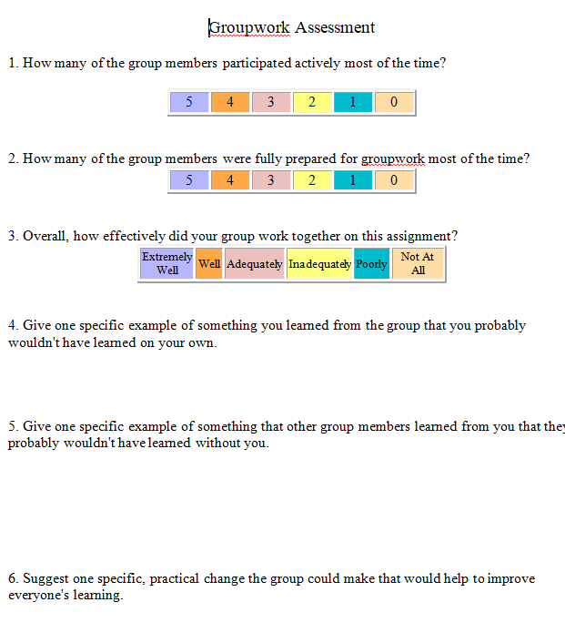
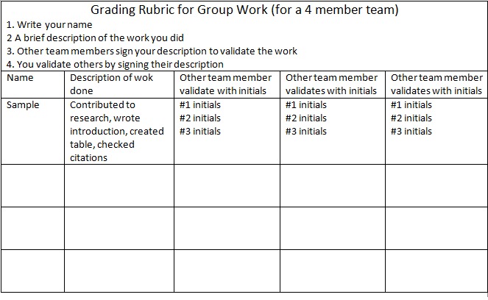
IDEAS for Group Integrity

Slide 14
Ongoing concerns
Faculty are struggling with this rapid shift
Balance preventing cheating with writing a good exam. The best of both worlds takes time, training and trials.
What does “open book” truly mean?
Some disciplines have specific concerns nursing, A&P, microbiology, foreign language faculty
Conversion to appropriate online assessments is work and time heavy.
Testing without student experience - 3D not 2D.
Connect with students a few times a week
In a no contact world - use words to provide feedback

Slide 15
Now your turn
What are you doing in summer? What are you considering for fall?
What are some?
thoughts
potential
existing issues
solutions
resources

Slide 16
Resources
Assignments to Enhance commitment to academic integrity
https://academicintegrity.as.ua.edu/faculty-resources/sample-assignments/
https://citl.indiana.edu/teaching-resources/academic-integrity/designing-assignments-encourage-integrity/index.html
Better Assessments Online
https://www.insidehighered.com/digital-learning/article/2018/10/31/qa-strategies-better-assessments-online-learning
Defining Academic Honesty
https://www.chabotcollege.edu/governance/academic-senate/core-academic-values.php & http://www.chabotcollege.edu/student-services/student-conduct-guidelines-address-violation.php
https://www.learningoutcomesassessment.org/wp-content/uploads/2020/01/A-New-Decade-for-Assessment.pdf
https://www.learningoutcomesassessment.org/wp-content/uploads/2019/02/OccasionalPaper29.pdf

Slide 17
Resources and further input
Wednesday, April 22 2:00PM - 3:00PM: Data Implications for Spring 2020 - Register for Data Implications for Spring 2020
Follow up & summary webinar Friday April 24 11:00AM - 12:00PM: Data Implications for Spring 2020 - Register for Data Implications for Spring 2020
ASCCC COVID-19 https://asccc.org/covid-19-faculty-resources
Direct questions to info@asccc.org
ACCJC https://accjc.org/covid-19/
CCCCO https://www.cccco.edu/About-Us/Chancellors-Office/Divisions/Communications-and-Marketing/Novel-Coronavirus

