Slide 1
Statewide Directors
Employer Engagement
Powered by the California Community College Chancellors Office
Workforce and Economic Development Division

Slide 2


Audrey Le Baudour
Regional Director, RHT
Bay Area Region
audrey@bayarearht.com
Joy Hermsen
Statewide Director, RHT
hermsen_joy@rsccd.edu

Slide 3

Rouxbe.com
Community of Practice
  Rapid Response
  Supplemental Instruction
Vetted Multiple Products
Negotiated Contract
  RJV / Cost Share
  BACCC Contract Holder
Regions / Schools
Students
  CC and Dual-Enrollment
Sustainable
Value to Instructors / Students

Slide 4
Agriculture, Water, Environmental Technology

Slide 5
Agriculture, Water, Environmental Technology
Ag and NR Pathway – Instructors from HS to University
California AgNR Education Resources – https://www.calaged.org/
CA Community College AGNR COVID and lab resources - http://www.agnrcurriculum.org/
AgNR Canvas Group – Commons
AgNR Facebook group – Teaching Agriculture Ideas
AgNR listserv
Thank you! nancy.gutierrez@reedleycollege.edu

Slide 6

Advanced Manufacturing Sector
Sector Activities

Slide 7
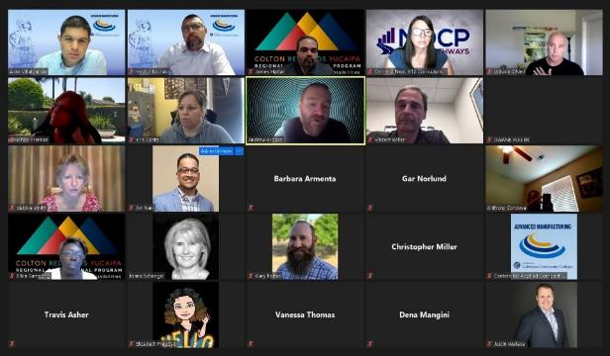
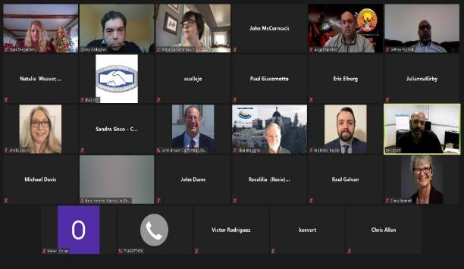

Communities of Practice
Community of Practice monthly Zoom calls
Led by the Regional Directors of Employer Engagement in Advanced Manufacturing
Open to both Community College and K-12 Faculty
Sharing Best Practices for Curriculum Delivery

Slide 8


DoD CADENCE
Faculty Externship and
Student Internship Project
Governor’s Office grant to place student interns and faculty externs at DoD contractors to assist with advanced technology use and implementation.
Partnering with Business Sector
Issuing RFA to select ten colleges
Providing $8,000 stipends to faculty coaches
Providing training for faculty coaches
Community of Practice monthly Zoom calls
FCCC acts as employer of record

Slide 9
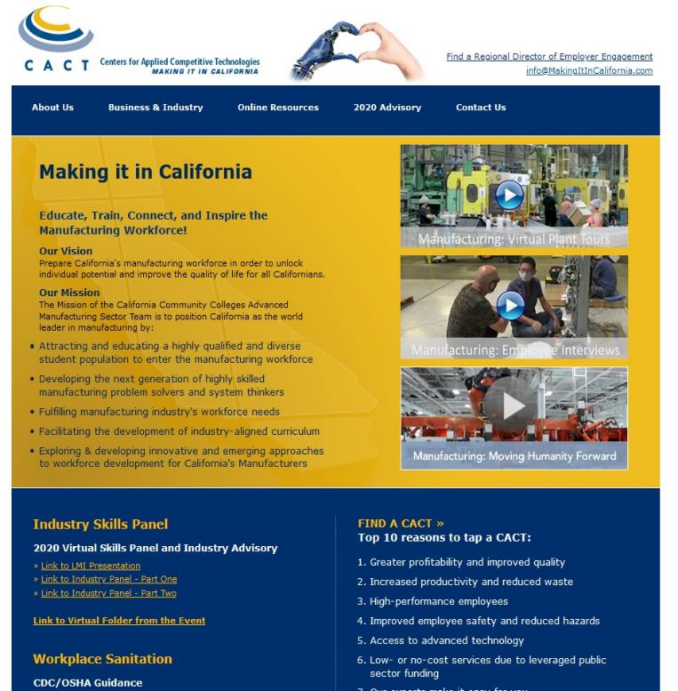
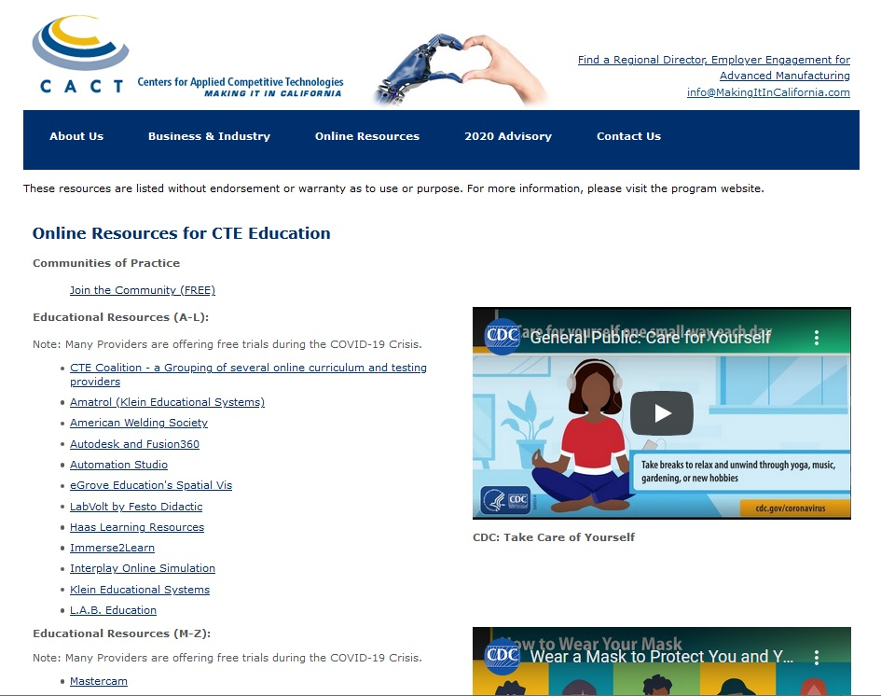
Continually Updated Website www.cact.org
Central Repository of Online Curriculum and Testing Vendors
Amatrol to Verisurf
Chromebook Access to Programs
Labor Market Information
Industry Panel
Q and A Sessions
Bay Area NetLab
Statewide Industry Advisory
Amazon Cloud Service

Slide 10
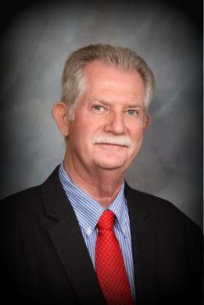


Alan Braggins
Advanced Manufacturing Sector
Statewide Director Employer Engagement
(909) 652-8497
Alan.Braggins@Chaffey.edu
www.cact.org

Slide 11

James Morante
Statewide Director morantecomms@gmail.com
530-760-5270
Notes:
Note: to replace the example logo above with your own, right-click the example logo and select “Change Picture, From a File.” Find your logo file in the dialog box and click “Open.” While holding the Shift key, move your logo left or right until its left edge aligns with the vertical guide.

Slide 12

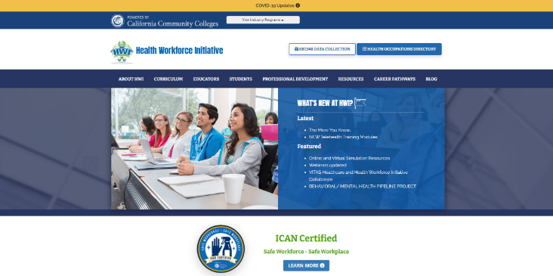
https://ca-hwi.org/

Slide 13
Resources for Faculty
Virtual Simulation resources
Shadow Health
IHuman
VSim for Nursing
Nursing.com
Labster
State resources
California Simulation Alliance – developed scenarios for students
Health Impact – Toolkit for educators/ students to return to clinical

Slide 14
Industry/ Student resources
ICAN – Infection Control for All Now
  Free self-paced basic training program is aimed at strengthening infection control and prevention competencies among Californians who work in the non-medical work environments.
HI-TOUCH HEALTH CARE: THE CRITICAL SIX SOFT SKILLS
  Training modules for softer skills interchangeable for all sectors
    Communication
    Workplace Ethics
    Team Building
    Problem Solving
    Diversity, Compassion
  Free use, free source, vetted by industry

Slide 15
https://ca-hwi.org/

Slide 16
Faculty Professional Development & Engagement
Communities of Practice
  Nursing
  Licensed Vocational Nursing
  Certified Nurse Assistance
  Dental Hygiene
  Dental Assisting
  Public Safety (in development)
Nurse Tim – faculty development for all Allied Health and Nursing
  Monthly webinars
State agency forums
  CPDH
  DBC
  DHBC
  LVN
  BRN

Slide 17
Contact
Statewide Director Employer Engagement - Health
John Cordova
College of the Canyons
26455 Rockwell Canyon Road
Santa Clarita, CA 91355
Phone: (562) 505-4409
Email: John.Cordova@canyons.edu
https://ca-hwi.org/about-hwi/contact-us/

Slide 18
https://ca-hwi.org/

Slide 19
Resources for Faculty
Virtual Simulation resources
Shadow Health
IHuman
VSim for Nursing
Nursing.com
Labster
State resources
California Simulation Alliance – developed scenarios for students
Health Impact – Toolkit for educators/ students to return to clinical

Slide 20
Faculty Professional Development
Communities of Practice
  Nursing
  Licensed Vocational Nursing
  Certified Nurse Assistance
  Dental Hygiene
  Dental Assisting
  Public Safety (in development)
Nurse Tim – faculty development for all Allied Health and Nursing
  Monthly webinars
State agency forums
  CPDH
  DBC
  DHBC
  LVN
  BRN

Slide 21
Contact
Statewide Director Employer Engagement Health
John Cordova
College of the Canyons
26455 Rockwell Canyon Road
Santa Clarita, CA 91355
Phone: (562) 505-4409
Email: John.Cordova@canyons.edu
https://ca-hwi.org/about-hwi/contact-us/

Slide 22

Questions

Slide 23
ICT Educator
Webinar
Series
ICT Remote Labs
ictdmsector.org

Slide 24
ICT Sector Remote Labs and Certification Testing
Labs:
  NetLab+
    IT, Autodesk, Adobe Suite MS Office
  Practice Labs:
    IT, Microsoft Office
  Google
    Google IT Certification labs
VENDOR-SPECIFIC REMOTE TESTING INFORMATION
  AWS,
  CompTIA,
  Cisco,
  Microsoft
ictdmsector.org

Slide 25
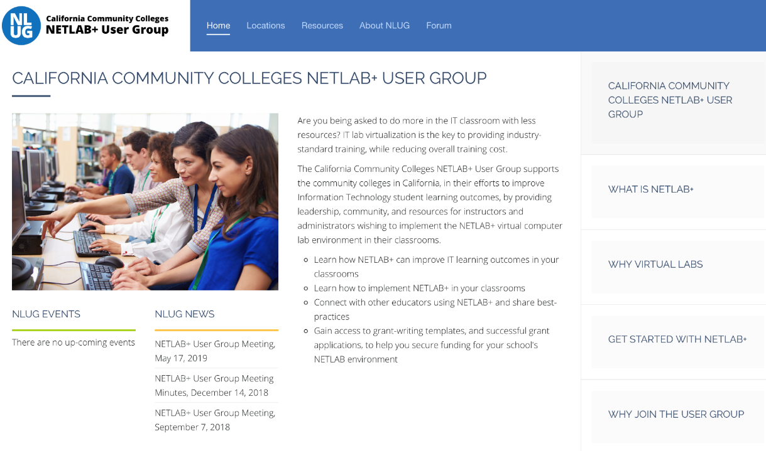

Slide 26
ICT Remote Labs WEBINARS
ictdmsector.org
Virtual Labs Update: Practice Labs User Group Discussion
  Friday Dec 11 10:am
GOOGLE CAREER CERTIFICATES: UPDATES AND HOW TO GET INVOLVED
  October 23, 2020
NETLAB+ ENABLES DELIVERY OF AUTODESK & ADOBE SUITE IN THE BAY REGION, PLUS LAB UPDATES FROM NDG
  September 18, 2020
VIRTUAL REALITY TRAINING FOR LABS WITH EON REALITY
  May 29, 2020
USING VIRTUAL LABS FOR BUSINESS AND ADVANCED MANUFACTURING APPLICATIONS
  May 8, 2020
HUMANIZING REMOTE INSTRUCTION
  March 27, 2020
CONNECTING WITH YOUR LEARNERS BEFORE, DURING AND AFTER CLASS
  January 24, 2020

Slide 27
Global Trade

Slide 28


Slide 29
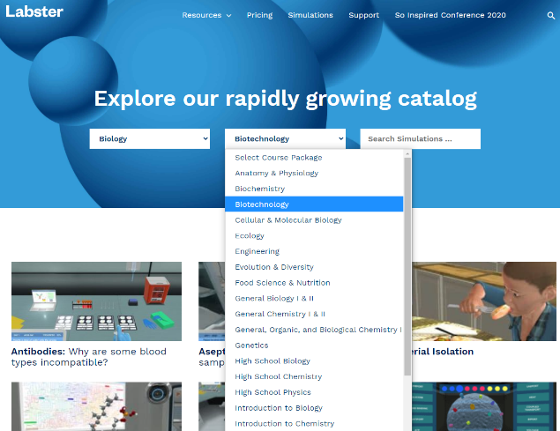
Lab Simulation Software
Labster: Statewide License through 6/30/2021
Paid for by the California Community Colleges Chancellor’s Office
https://www.labster.com

Slide 30
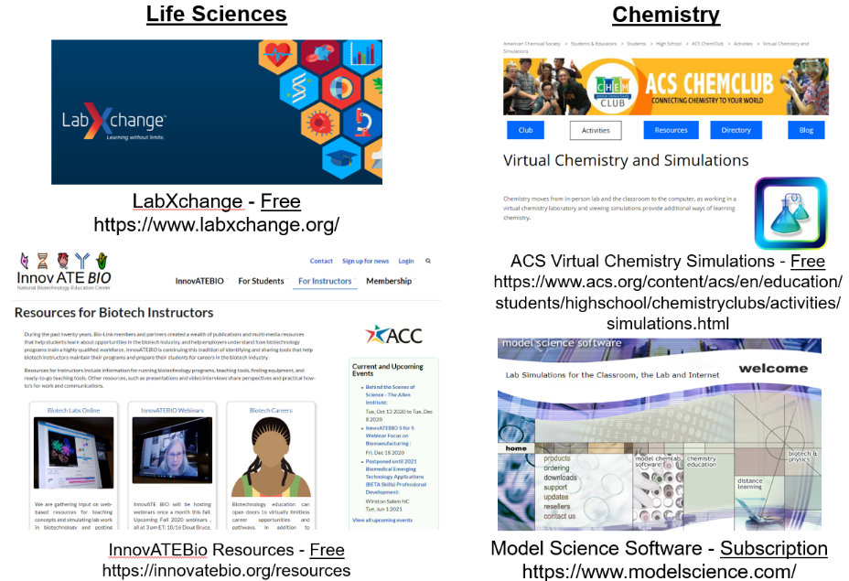
Lab Simulation Software

Slide 31
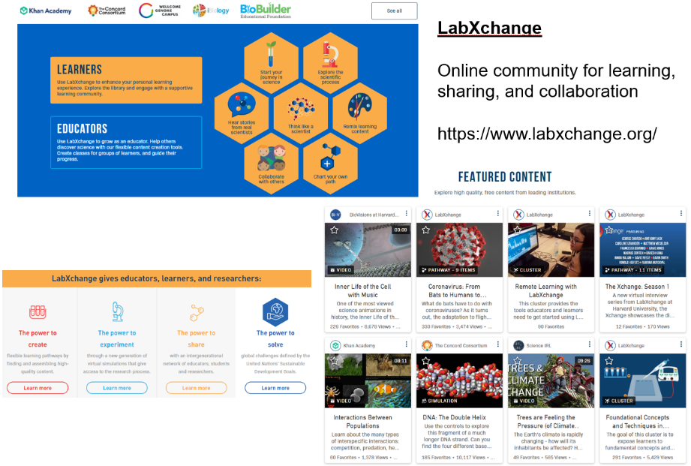
Lab Simulation Software

Slide 32
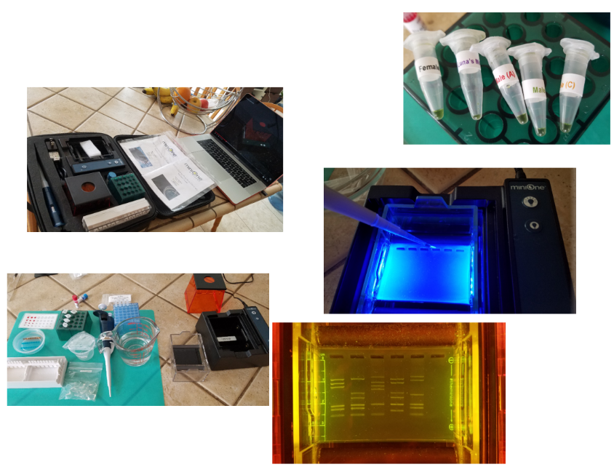

Commercial Lab Kits for At-Home Use
Embitec MiniOne DNA Fingerprinting Lab Kit $289
Funding: SWP; CARES Act

Slide 33
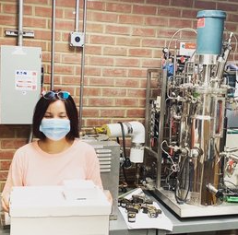
Instructor-Designed Lab Kits for At-Home Use
Laney College
Biohacking kits and curriculum from The Oden
Lab Archives for lab notebooks (mynotebook.labarchives.com) Includes a CRISPR experiment
Other Colleges:
Glendale College
Santiago Canyon College
San Diego Miramar College
MiraCosta College
Ventura College
Microscopes checked out to students
Mt. San Santonio College: 1,008 microscopes for intro biol; 303 for microbiology
Merritt College
Glendale College

Slide 34
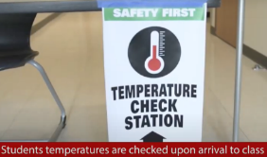
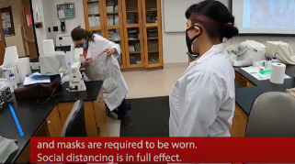
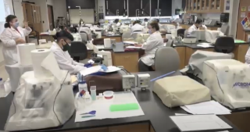
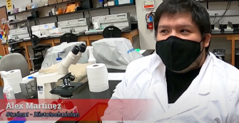
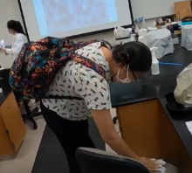
On-Campus Courses
Temperature checks
Face masks
Social distancing
Sanitization
Equipment
Stations
Essential programs return to Mt. SAC Campus
https://www.mtsac.edu/newsroom/news/posts/return_to_campus.html

Slide 35
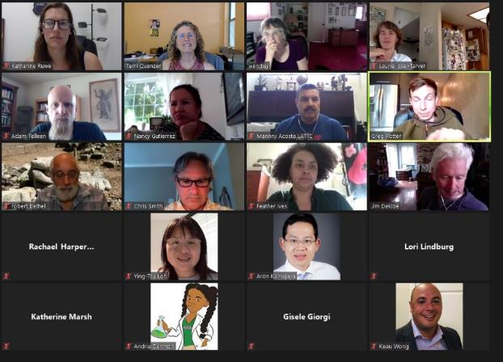
Faculty Community of Practice – Weekly Calls

Slide 36

Terri Quenzer, Ph.D.
Statewide Director, Life Sciences/Biotech
Email: tquenzer@sdccd.edu
Cell: (619) 922-0696
LinkedIn: https://www.linkedin.com/in/terri-quenzer-ph-d-a387aa1/

Slide 37
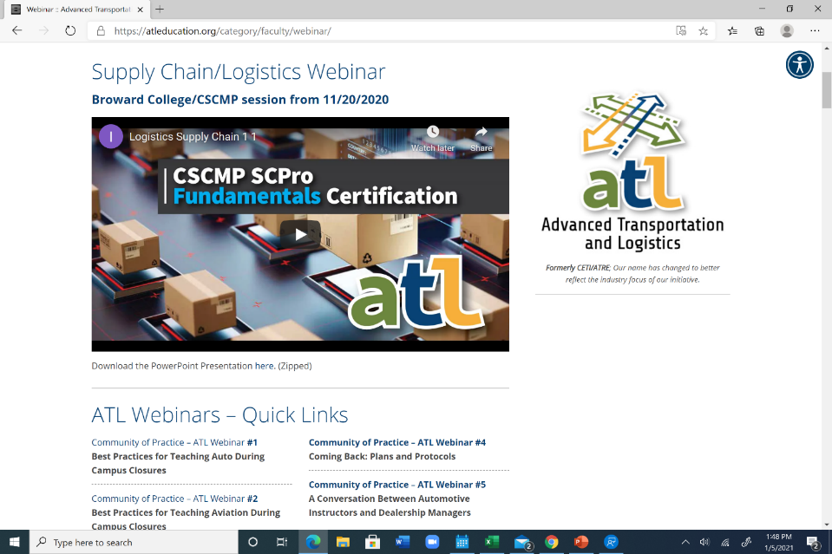

Slide 38
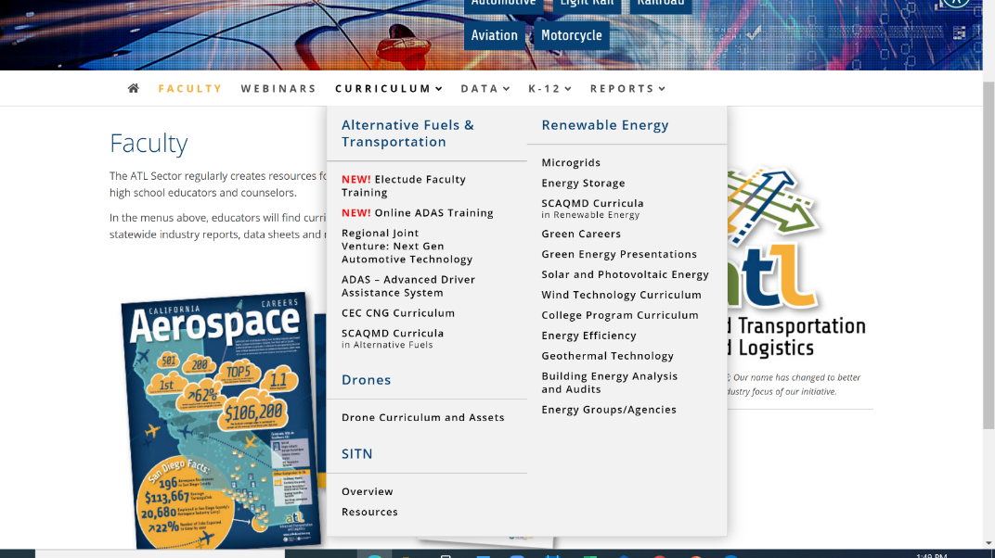

Slide 39
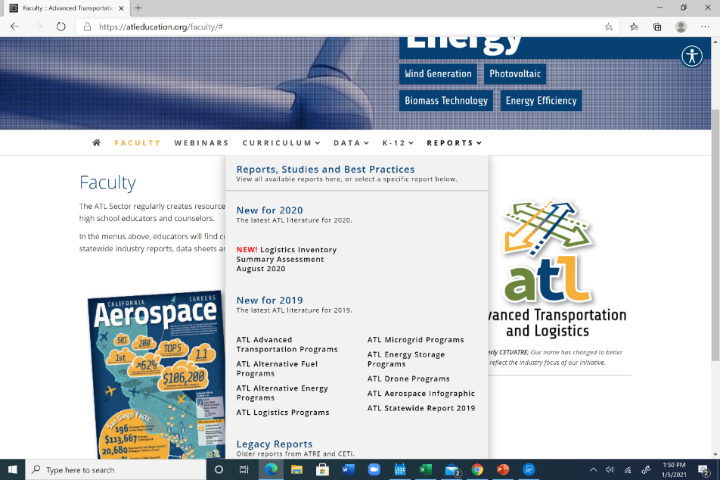

Slide 40
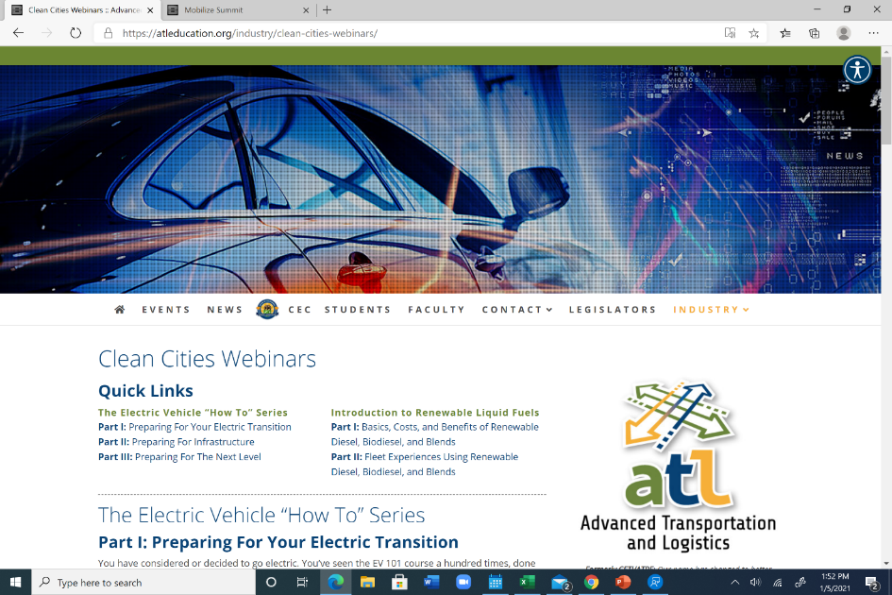

Slide 41
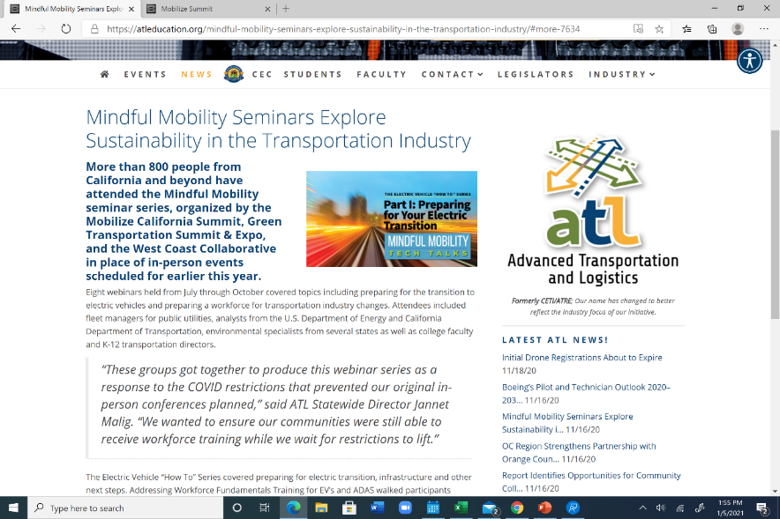

Slide 42


Jannet Malig
Statewide Director
Advanced Transportation & Logistics
Email: jmalig@cerritos.edu
Mobile: (562)712-3816

Slide 43
Business and Entrepreneurship Sector
Charles Eason, Statewide Director Business and Entrepreneurship
(707) 863-7846
Charles.Eason@Solano.edu
www.businessandentrepreneurship.net

Slide 44
Nasdaq Student Internships & Faculty Externships
Partnered with Nasdaq Entrepreneurial Center to place student interns and faculty externs at Nasdaq early stage companies
Moved to virtual internships last March
Twenty colleges participated in ISPIC pilot
Provided $2,500 stipends to faculty coaches
Provided training for faculty coaches
Community of Practice monthly Zoom calls
Seeking to continue project with SWP funds

Slide 45
DoD CASCADE Student Internship Project
Governor’s Office grant to place student interns and faculty externs at DoD SBIR companies to assist with cybersecurity.
Moved to virtual internships last March
Ten colleges participated
Provided $7,500 stipends to faculty coaches
Provided training for faculty coaches
Community of Practice monthly Zoom calls
FCCC acts as employer of record

Slide 46


DoD CADENCE Student Internship Project
Governor’s Office grant to place student interns and faculty externs at DoD SBIR companies to assist with dual use tech.
Partnering with Advanced Mfg Sector
Issuing RFA to select ten colleges
Providing $8,000 stipends to faculty coaches
Providing training for faculty coaches
Community of Practice monthly Zoom calls
FCCC acts as employer of record

Slide 47

Teaching Entrepreneurship Resource
www.teachingentrepreneurship.org

Slide 48
Questions

Slide 49
Thank you
Technical Assistant Provider page
  https://www.cccco.edu/About-Us/Chancellors-Office/Divisions/Workforce-and-Economic-Development/Technical-Assistance-Providers

