Slide 1
Achieving Equity
through Humanized Online Teaching
2020 ASCCC Academic Academy
Michelle Pacansky-Brock
faculty mentor, online teaching & learning
CVC-OEI/@ONE
Foothill-DeAnza Community College District
brocansky.com • @brocansky • mpb@cvc.edu
Photo by Hazel Marie on Flickr, CC-BY-NC

Slide 2
Goals
1
2
3
Define the problem that Humanizing seeks to improve.
Examine the principles and research that guides Humanizing.
Preview 8 Humanized Online Teaching Elements that serve as kindness cues that promote trust and belonging for diverse students online.

Slide 3
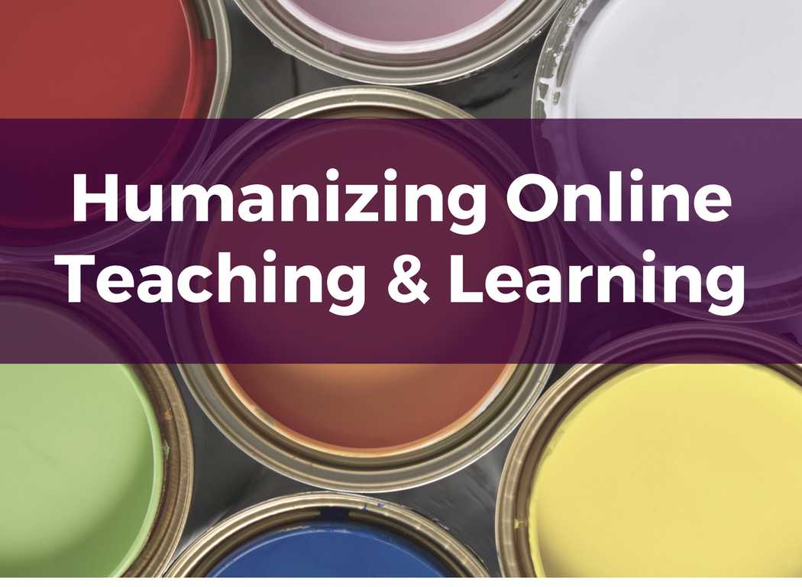
Humanizing Online Teaching is a grassroots movement that began 10+ years ago in the California Community Colleges and has been fueled through @ONE (Online Network of Educators).
Follow the hashtag on Twitter and build your network of humanizing educators!
4-week facilitated online course offered by @ONE, facilitated by CCC faculty. Learn more about the course.
Self-paced resources from CVC-OEI/@ONE.
Learn more about the Humanizing Challenge.
#HumanizeOL
Humanizing
CHALLENGE

Slide 4
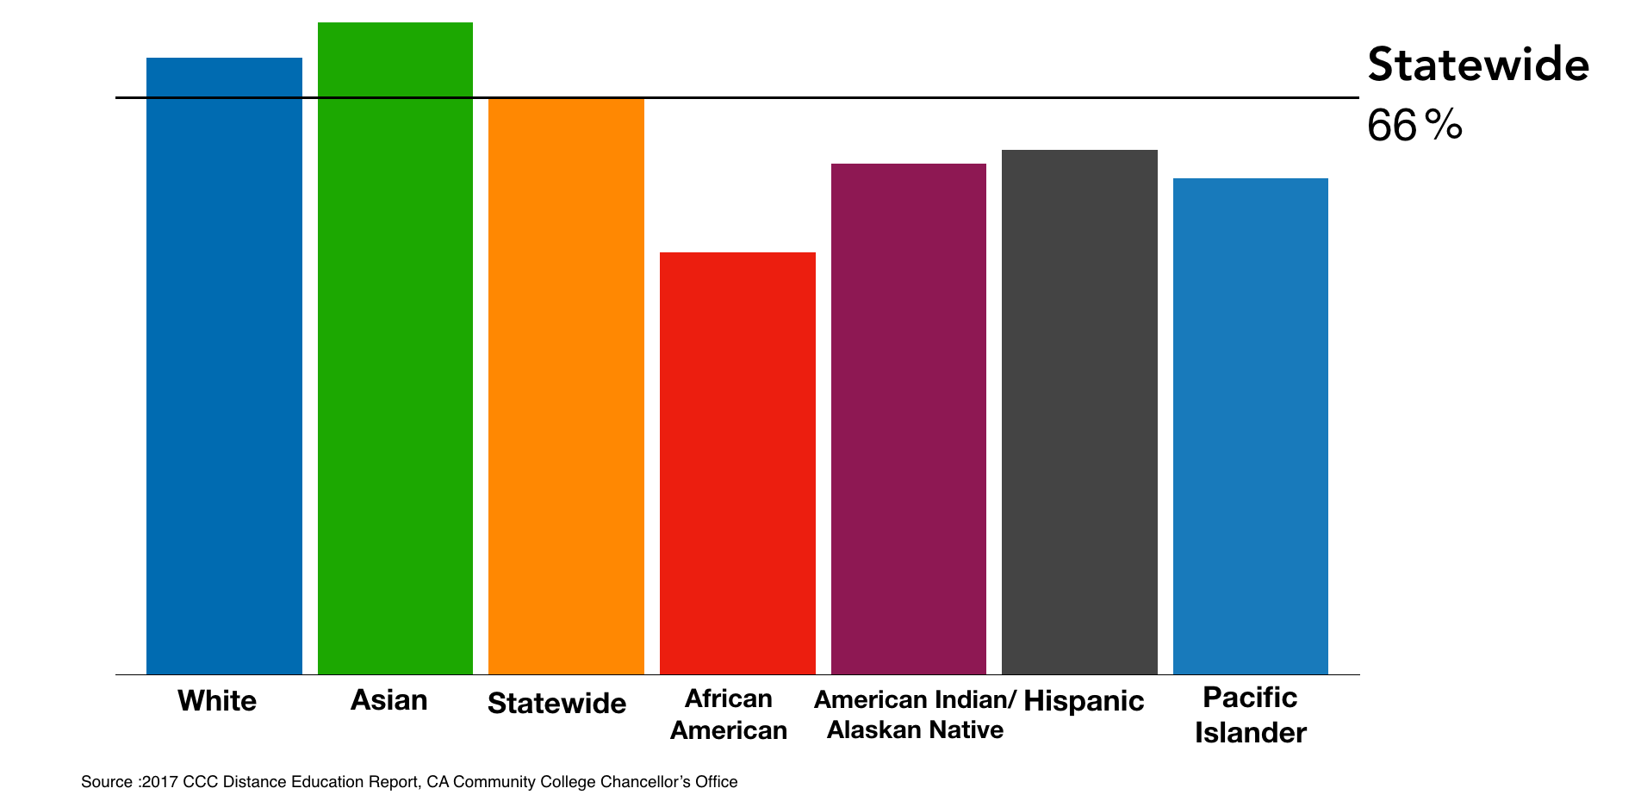
Disaggregated 2016-17 Online Course Success Rates
California Community Colleges (CCCs)
Notes:
This chart shows 2016-17 online course success rates for the California Community College system. A horizontal line marks the average statewide success rate of 66%. There are six colored vertical bars that represent the success rates of White, Asian, African American, American Indian/Alaskan Native, Hispanice, and Pacific Islander students. All racial and ethnic groups are below the statewide average except for White and Asian students. The gaps are similar to those we see in face-to-face community college courses; however, the gaps are bigger online.

Slide 5
When a flower doesn’t bloom, you fix the environment in which it grows, not the flower.
-Alexander den Heijer
Slide by Michelle Pacansky-Brock, CC-BY-NC

Slide 6
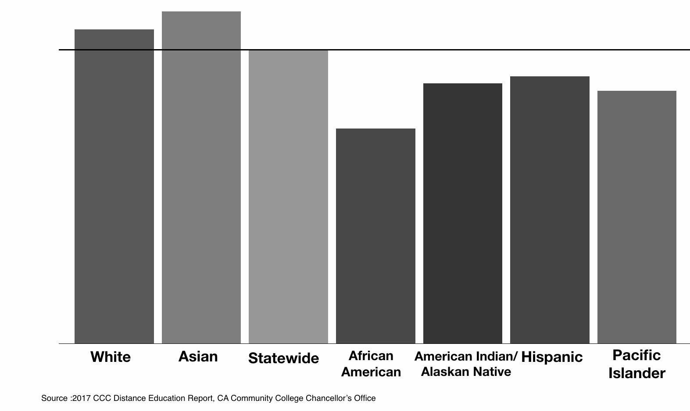
Disaggregated 2016-17 Online Course Success Rates
California Community Colleges (CCCs)
Opportunity Gaps!

Slide 7
Equality = Equity

Slide 8
Equality: Treat all students the same

Slide 9
Equity: ensure all students have what they need to succeed

Slide 10
What are the barriers in our online courses that disproportionately impact our Black, Hispanic, and Indigenous students?

Slide 11
Barrier #1: Deficit-based thinking
https://hechingerreport.org/weakest-students-more-likely-to-take-online-college-classes-but-do-worse-in-them/
Slide by Michelle Pacansky-Brock, CC-BY-NC

Slide 12
Barrier #2: Lack of Human Connection
Connection starts with psychological safety
Develops through vulnerability and empathy
Fosters belonging and engagement
Connection is more important for some students
Slide by Michelle Pacansky-Brock, CC-BY-NC

Slide 13
Principles of Humanized Online Teaching
presence
awareness
empathy
Don’t be a robot.
Know your students.
See things through your students’ eyes.
Get the infographic: How to Humanize Your Online Class
Slide by Michelle Pacansky-Brock, CC-BY-NC

Slide 14
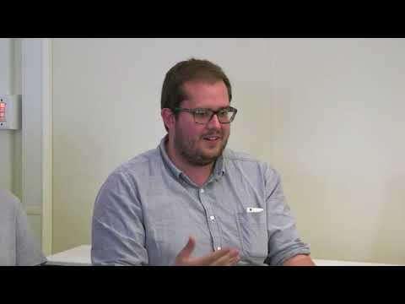
Presence
Teaching & Learning Innovations at CSU Channel Islands, CC-BY-NC

Slide 15
Awareness & Empathy
start at :50
CVC-OEI/@ONE, CC-BY

Slide 16
What course design features influences online community college student performance most?
Quality instructor-student interactions
(Quality = an instructor who cares)
Jaggars, S. S. & Xu, D. (2016). How do online course design features influence student performance? Computers & Education, 95, April 2016, 270-284.
Slide by Michelle Pacansky-Brock, CC-BY-NC

Slide 17
Immordino-Yang, M. H. & Damasio, A. (2007). We feel, therefore we learn: The relevance of affective and social neuroscience to education, Mind Brain and Education, 1(1), 3-10.
Rendón, L. (2009) Sentipensante (Sensing/Thinking) Pedagogy, Stylus Publishing.
Slide by Michelle Pacansky-Brock, CC-BY-NC

Slide 18
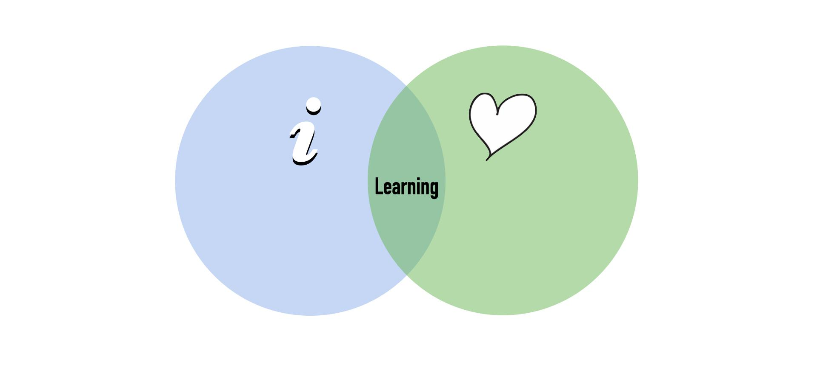
Immordino-Yang, M. H. & Damasio, A. (2007). We feel, therefore we learn: The relevance of affective and social neuroscience to education, Mind Brain and Education, 1(1), 3-10.
Rendón, L. (2009) Sentipensante (Sensing/Thinking) Pedagogy, Stylus Publishing.
Slide by Michelle Pacansky-Brock, CC-BY-NC

Slide 19
“
“... emotions are not just messy toddlers in a china shop, running around breaking and obscuring delicate cognitive glassware. Instead, they are more like the shelves underlying the glassware; without them cognition has less support.”
Mary Helen Immordino-Yang & Antonio Demasio
We Feel, Therefore We Learn: The Relevance of Affective Social Neuroscience to Education
Rendón, L. (2009) Sentipensante (Sensing/Thinking) Pedagogy, Stylus Publishing.
Slide by Michelle Pacansky-Brock, CC-BY-NC
Slide by Michelle Pacansky-Brock, CC-BY-NC

Slide 20
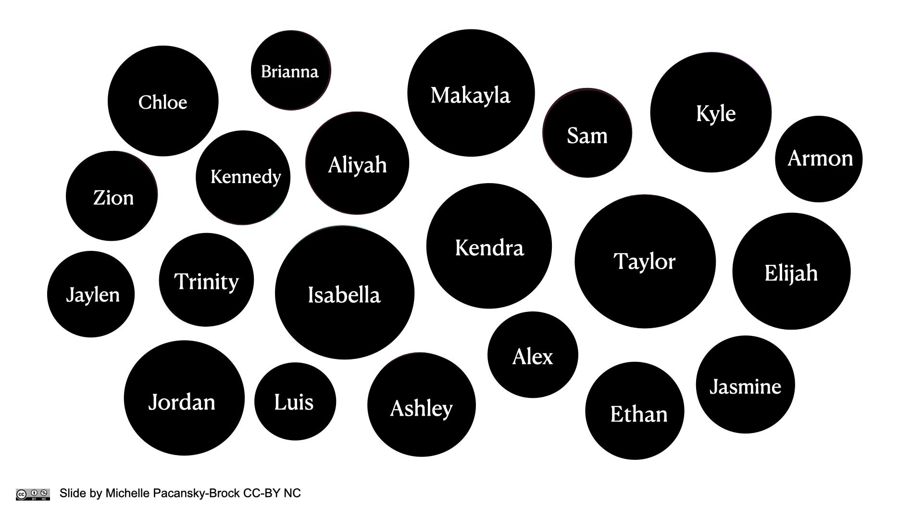
Slide by Michelle Pacansky-Brock, CC-BY-NC

Slide 22
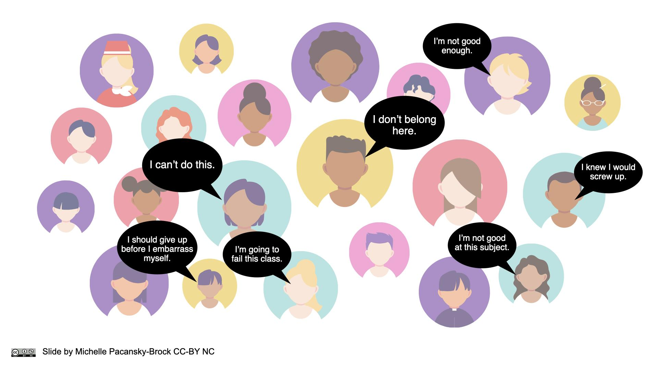
Slide by Michelle Pacansky-Brock, CC-BY-NC

Slide 23
The antidote is connection.
Slide by Michelle Pacansky-Brock, CC-BY-NC

Slide 24
“Instructor-student relationships lie at the heart of humanized” online courses, “serving as the connective tissue between
students, engagement, and rigor.”
Pacansky-Brock, Smedshammer, Vincent-Layton (2020)
Pacansky-Brock, M., Smedshammer, M., & Vincent-Layton, K. (2020). Humanizing Online Teaching to Equitize Higher Education. Current Issues in Education, 21(2).
Photo by Michel Paz on Unsplash
Slide by Michelle Pacansky-Brock, CC-BY-NC

Slide 25
Vulnerability
“is uncertainty, risk, and emotional exposure.”
-Brené Brown, researcher, author, professor
Slide by Michelle Pacansky-Brock, CC-BY-NC

Slide 26
In our session chat, please share:
Check-in
What is resonating with you?
Photo by Nikita Taparia on Unsplash

Slide 27
Culturally Responsive Online Teaching
Photo by Nikita Taparia on Unsplash
Photo by Bud Helisson on Unsplash

Slide 28
Our students are not underprepared. They are prepared differently.
Photo by Nikita Taparia on Unsplash

Slide 29
Cultural Differences
Culture influences how you communicate and how your students interpret your communications.
Low Context Cultures
High Context Cultures
Context (situation, people, nonverbal elements) is less important than words
Relationships begin and end quickly
Learning occurs by following the directions and explanations of others
Context (situation, people, nonverbal elements) is more important than words
Relationships build slowly and depend on trust
Groups are preferred for learning
Halverson, C. B. (1993). Cultural-context Inventory: The Effects of Culture on Behavior and Work Style. In Pfeiffer, J. W. (ed.)., Annual: Developing Human Resources, Pfeiffer and Company, San Diego, CA.
Slide by Michelle Pacansky-Brock, CC-BY-NC

Slide 30
Influence of Race on Belonging
Humans are a social species; belonging (seeing oneself as socially connected) is a basic human need
Members of socially stigmatized groups are more likely to experience belonging uncertainty, triggered by:
lack of social connectedness (which can be exacerbated by online courses)
macro and microaggressions
negative stereotypes in and out of the classroom
Research shows: When White and Black students are exposed to the same threats of social connectedness, the motivation of Black students is impacted more severely (Walton & Cohen, 2007)
Walton, G. M., & Cohen, G. L. (2007). A question of belonging: Race, social fit, and achievement. Journal of Personality and Social Psychology, 92(1), 82.
Slide by Michelle Pacansky-Brock, CC-BY-NC

Slide 31
Trauma and Learning
Trauma changes the brain
Executive functioning and self-regulation skills are derailed
Inability to plan, focus, remember, juggle
A traumatized brain continuously scans an environment for danger and safety cues
What are those cues in your online course?
How do we foster safety and trust online?
Trauma-aware Teaching Checklist by Karen Costa

Slide 32
Definition of macro and micro aggression and affirmation of social inclusion (Estrada, Eroy-Reveles, Matsui, 2018).
Threat
Kindness
Macro Aggression
Macro Affirmation
Obvious or blatant racism, discrimination, prejudice, hate, rejection
Obvious or blatant acts of social inclusion in community and respect for dignity
Micro Aggression
Micro Affirmation
Subtle or ambiguous cues of racism, discrimination, prejudice, hate, rejection
Subtle or ambiguous acts of social inclusion in community and respect for dignity
Estrada, M., Eroy-Reveles, A. & Matsui J., (2018). The influence of affirming kindness and community on broadening participation in STEM career pathways. Social Issues and Policy Review, 12(1), 258-297.
Slide by Michelle Pacansky-Brock, CC-BY-NC

Slide 33
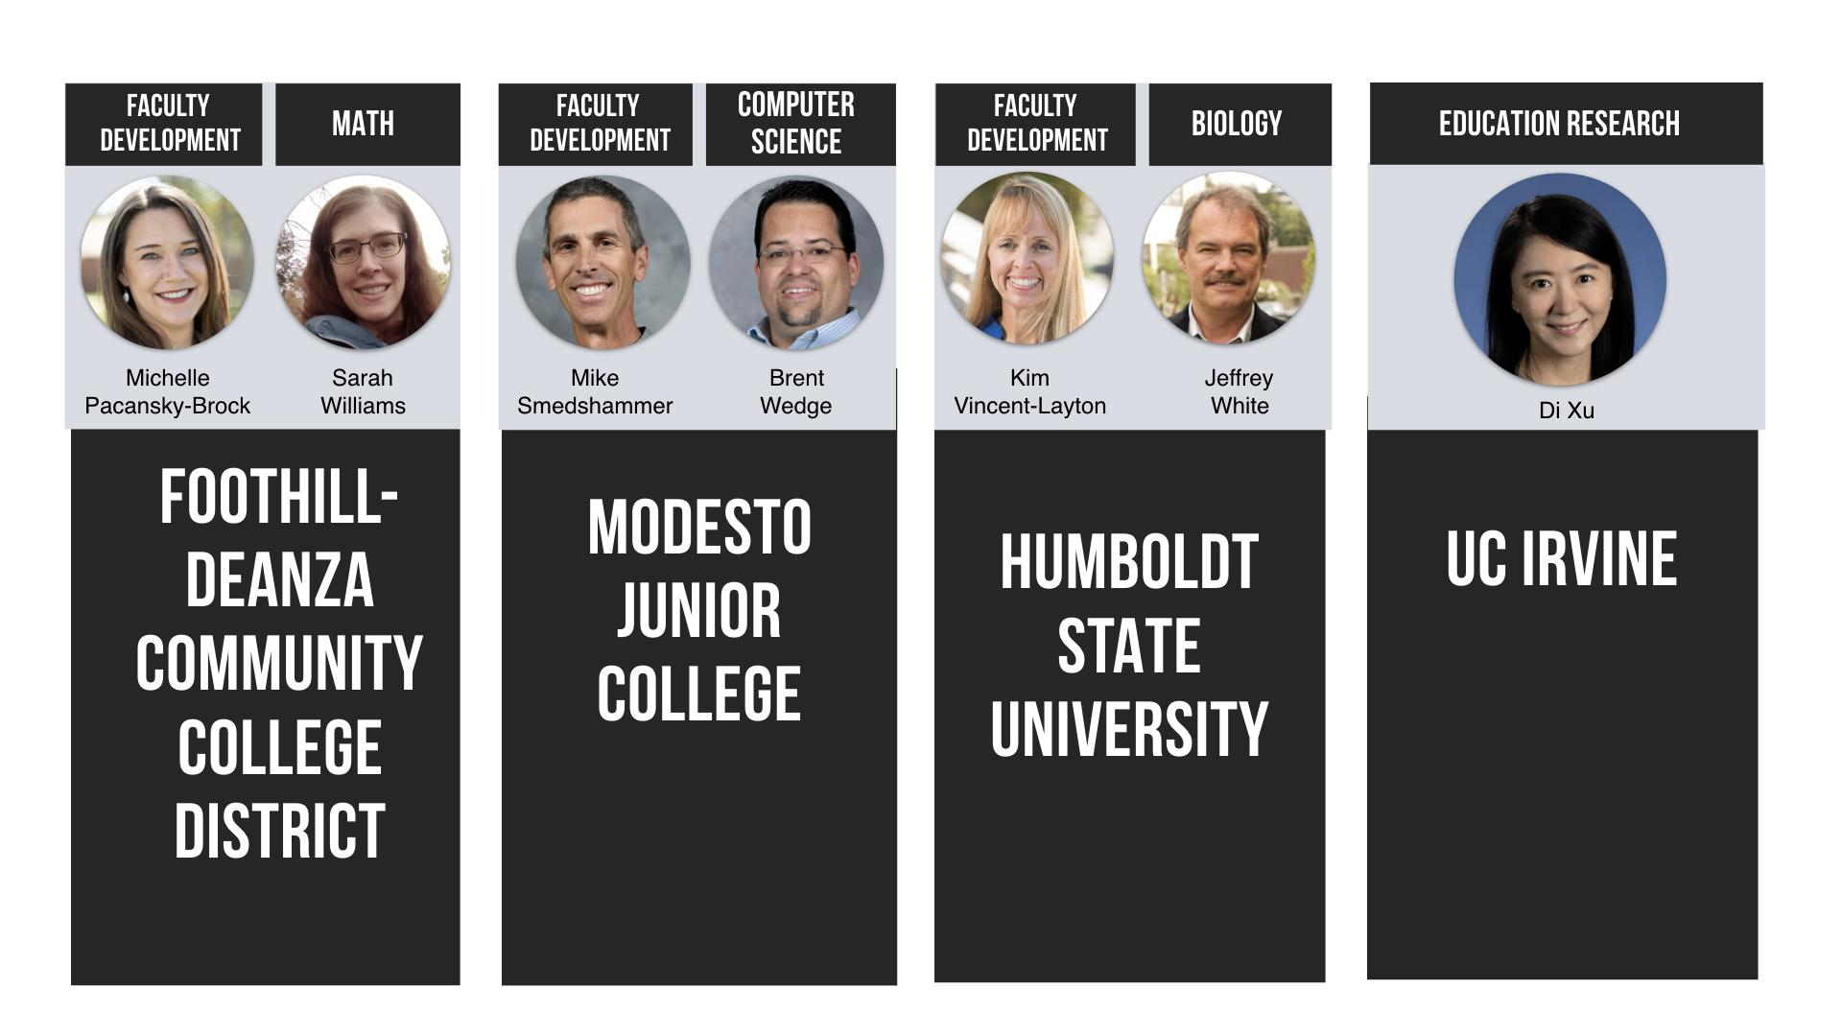
Humanizing STEM Grant Project Team
Funded by the California Education Learning Lab
Slide by Michelle Pacansky-Brock, CC-BY-NC

Slide 34
8 Humanized Online Teaching Elements
Created with funds from the California Education Learning Lab. Shared with a CC-BY-NC License. Please attribute: Pacansky-Brock, M., Smedshammer, M., & Vincent-Layton, K. (2020) CC-BY-NC

Slide 35
6-week asynchronous online professional development program in Canvas
Models 8 humanizing elements and warm demander pedagogy
Culminates in the creation of a Humanizing Showcase and redesigned online course
Showcases from pilot participants with examples of Humanizing elements:
Brent Wedge, Computer Science, Modesto Junior College
Jeffrey White, Biology, Humboldt State University
Sarah Williams, Math, Foothill College
Influenced by the CVC-OEI/@ONE courses: Humanizing Online Teaching & Learning and Equity and Culturally Responsive Teaching in the Online Environment, which are shared with a CC-BY license.
Slide by Michelle Pacansky-Brock, CC-BY-NC

Slide 36
Registration
Week 1
Week 2
Week 3
Employ strategies to mitigate “belongingness uncertainty”
(Walton & Cohen, 2007) and trauma.
Walton, G. M., & Cohen, G. L. (2007). A question of belonging: Race, social fit, and achievement. Journal of Personality and Social Psychology, 92(1), 82.
Slide by Michelle Pacansky-Brock, CC-BY-NC

Slide 37
Liquid Syllabus
Sends the cue: “I will be a partner in your learning.”
Example by Katie Wittman-Conklin, shared with permission
Slide by Michelle Pacansky-Brock, CC-BY-NC
Pacansky-Brock, (2017, 2014); Pacansky-Brock, Smedshammer, Vincent-Layton, (2020)

Slide 38
Pacansky-Brock, (2017, 2014); Pacansky-Brock, Smedshammer, Vincent-Layton, (2020)

Slide 39
Liquid Syllabus
Created with a website tool (Google Sites)
Public
Phone-friendly
Accessible (alt-text, color contrast, headings/subheadings, lists)
Components:
Starts with a captioned brief, imperfect welcome video
Written with welcoming., hopeful language
Tips for success
Learning pact
Inclusive images
Pacansky-Brock, (2017, 2014); Pacansky-Brock, Smedshammer, Vincent-Layton, (2020)
Example by Sarah Williams, Foothill College.
Slide by Michelle Pacansky-Brock, CC-BY-NC

Slide 40
Liquid Syllabus
Examples
Sarah Williams, Math, Foothill College
Brent Wedge, Computer Science, Modesto Junior College
Learn how to create your own Liquid Syllabus!
Pacansky-Brock, (2017, 2014); Pacansky-Brock, Smedshammer, Vincent-Layton, (2020)
Example by Sarah Williams, Foothill College.
Slide by Michelle Pacansky-Brock, CC-BY-NC

Slide 41
Create a Learning Pact
What you can expect from me:
What I will expect from you:
I will treat you with dignity and respect and be flexible to support your individual needs.
I will provide you with a clear, organized course that is designed to ensure you meet our course outcomes in a meaningful manner.
I will provide a variety of assignments to ensure your learning needs are met.
I will be actively present in your learning.
I will provide a supportive environment for you to share and discuss ideas with your peers.
I will reach out to you when I sense that you need support.
I won't be perfect. I am human and will make mistakes at times. I will view mistakes as an opportunity to learn and grow.
Is there anything else you’d like to add to this list?
You will strive to be an active participant in this course and strive to meet due dates.
You will maintain and open line of communication with me so I understand how to support you.
You will contact me if you have a concern with meeting a due date.
You will treat your peers and me with dignity and respect.
You will do your best to have patience with technology. There will be hiccups, expect them. We will get through them together.
You will give yourself grace. Expect to make mistakes. You are human.
Is there anything else you would like to add to this list?
This learning pact by Michelle Pacansky-Brock is shared in the public domain. You are free to adapt as you wish for your own teaching without permission.

Slide 42
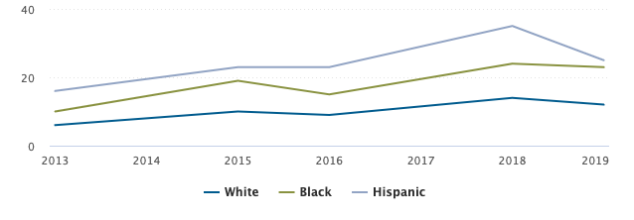
Phone-friendly learning environments are anti-racist
% of U.S. adults who do not use broadband at home but own smartphones, by race
Pew Research Center, (2019). Mobile Fact Sheet.
Slide by Michelle Pacansky-Brock, CC-BY-NC

Slide 43
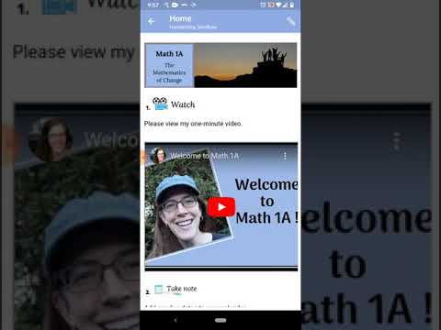
2. A Humanized Homepage
Sends the cue: “You are welcome here.”
Sarah Williams, Calculus, Foothill College

Slide 44
3. Getting to Know You Survey
“I want to know how to support you.”
What are your preferred pronouns?
I will leave you feedback in video format. Does that work for you?
Yes, sounds great.
No, thanks. I prefer written feedback.
In one word, describe how you are feeling about this class.
Please share one thing that may interfere with your success in this class.
See a Google Forms sample: brocansky.com/humanizing/student-info
Import from the Canvas Commons: Search for #HumanizingSTEM

Slide 45
Adapt Your Teaching
During your course
Sends the cue: “I believe in you.”
Enable the Notes column in the Canvas gradebook.
Take notes about what you learn from the survey.
Track activity and performance.
Reach out directly before it’s too late.
4. Record voice and video feedback in the gradebook for high opportunity students.
Photo by Markus Spiske on Unsplash

Slide 46
5. Self-Affirming Ice Breaker
Sends the cue: Your values and experiences matter.
Spitzer, B. and Aronson, J. (2015). Minding and mending the gap: Social psychological interventions to reduce educational disparities. The British Psychological Society, 85, 1-18.

Slide 47
Self-Affirming Ice Breaker
Prompt: Share a photograph of someone/something important to you and share why.
Spitzer, B. and Aronson, J. (2015). Minding and mending the gap: Social psychological interventions to reduce educational disparities. The British Psychological Society, 85, 1-18.

Slide 48
6. “Wisdom Wall” Assignment(s)
Students reflect and share successful strategies with future students.
Pacansky-Brock, M. (2017). Best practices for teaching with emerging technologies (2nd ed.). New York, NY: Routledge.

Slide 49
7. Bumper Videos
Brief, Visually Oriented Video: Clarify a sticky topic or introduce a module/assignment
Brent Wedge, Computer Science, Modesto Junior College. Made with Adobe Spark.
Slide by Michelle Pacansky-Brock, CC-BY-NC

Slide 50
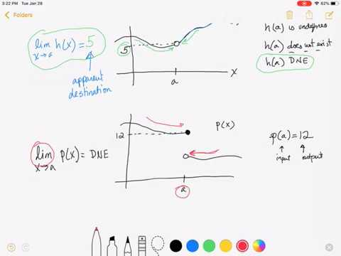
8. Microlectures
Focused instructional videos.
Sarah Williams, Calculus, Foothill College. Made with MS OneNote & Zoom or Screencast-O-Matic
Slide by Michelle Pacansky-Brock, CC-BY-NC

Slide 51
8 Humanized Online Teaching Elements
Created with funds from the California Education Learning Lab. Shared with a CC-BY-NC License. Please attribute: Pacansky-Brock, M., Smedshammer, M., & Vincent-Layton, K. (2020) CC-BY-NC

Slide 52
Relationships start with psychological safety and creating psychological safety requires us to take off our emotional armor and be vulnerable.
Brené Brown

Slide 53
For more information about Humanizing
Pacansky-Brock, M., Smedshammer, M., & Vincent-Layton, K. (2020). Humanizing Online Teaching to Equitize Higher Education. Current Issues in Education, 21(2).
Follow the hashtag on Twitter and build your network of humanizing educators!
4-week facilitated online course offered by @ONE, facilitated by CCC faculty. Learn more about the course.
Self-paced resources from CVC-OEI/@ONE.
Learn more about the Humanizing Challenge.
#HumanizeOL
Humanizing
CHALLENGE
Slide by Michelle Pacansky-Brock, CC-BY-NC

Slide 54
References & Resources
Estrada, M., Burnett, M., Campbell, A. G., Campbell, P. B., Denetclaw, W. F., Gutiérrez, C. G., ... Zavala, M. (2016). Improving underrepresented minority student persistence in STEM. CBE Life Sciences Education, 15 (3).
Estrada, M., Eroy-Reveles, A., & Matsui, J. (2018). The Influence of Affirming Kindness and Community on Broadening Participation in STEM Career Pathways. Social issues and policy review, 12(1), 258–297. doi:10.1111/sipr.12046
Jaggars, S. S., & Xu, D. (2014). Performance gaps between online and face-to-face courses: Differences across types of students and academic subject areas. Journal of Higher Education, 85(5), 633-659.
Jaggars, S. S. & Xu, D. (2016). How do online course design features influence student performance? Computers & Education, 95, April 2016, 270-284.
Hammond, Z. L. (2014). Culturally Responsive Teaching and the Brain: Promoting Authentic Engagement and Rigor Among Culturally and Linguistically Diverse Students. Corwin Publishers.
Hart, C. M. D., Friedmann, E., & Hill, M. (2018). Online course-taking and student outcomes in California community colleges,Education Finance and Policy, 13(1), 42-71.https://doi.org/10.1162/edfp_a_00218
Immordino-Yang, M. H. & Damasio, A. (2007). We feel, therefore we learn: The relevance of affective and social neuroscience to education, Mind Brain and Education, 1(1), 3-10.
Kleinfeld, J. (1972). Effective Teachers of Indian and Eskimo High School Students. Institute of Social, Economic and Government Research, University of Alaska

Slide 55
References & Resources
Kleinfeld, J. (1975). Effective teachers of Eskimo and Indian students. School Review, 83, 301–344.
Munoz, S. & Rendón, L. (2011). Revisiting validation theory: Theoretical foundations, applications, and extensions. Enrollment Management Journal. 5. 12-33.
Pacansky-Brock, M. (2017). Best practices for teaching with emerging technologies (2nd ed.). New York, NY: Routledge.
Pacansky-Brock, M. (2014, August 13). The Liquid Syllabus: Are you ready?, [blog post].
Pacansky-Brock, M., Smedshammer, M., & Vincent-Layton, K. (2020). Humanizing Online Teaching to Equitize Higher Education. Current Issues in Education, 21(2).
Rendón, L. I. (1994). Validating culturally diverse students: Toward a new model of learning and student development, Innovative Higher Education, 19 (1), 33-51.
Rendón, L. (2009) Sentipensante (Sensing/Thinking) Pedagogy, Stylus Publishing.
Riegle-Crumb, C., King, B., & Irizarry, Y. (2019). Does STEM Stand Out? Examining Racial/Ethnic Gaps in Persistence Across Postsecondary Fields. Educational Researcher, 48(3), 133–144. https://doi.org/10.3102/0013189X19831006
Spitzer, B. and Aronson, J. (2015). Minding and mending the gap: Social psychological interventions to reduce educational disparities. The British Psychological Society, 85, 1-18.
Walton, G. M., & Cohen, G. L. (2007). A question of belonging: Race, social fit, and achievement. Journal of Personality and Social Psychology, 92(1), 82.

