Slide 1
Active Learning in the Online Environment and Motivating Your Students

Slide 2
ASCCC Part-time Committee Faculty
Alpha Lewis, ASCCC Part-time Committee
Monica Serafin, Rio Hondo College
Notes:
Part-time Committee Self Introductions: 30 seconds each: state your discipline and college(s)

Slide 3
Session Description
Active learning in the online environment is essential during this pandemic, as online learning and remote instruction have become the primary delivery method for instruction. Culturally relevant methodologies and innovative techniques can make the online learning experience engaging. Building active learning into your course shell and including it in your curriculum is an effective way to motivate students. Active learning engages the student on multiple levels by involving them in the course learning and encouraging higher-order thinking tasks such as analysis, synthesis, and evaluation.

Slide 4
Today, we will
Active vs. Passive learning
Engage in Q&A from attendees
The journey from passive to active learning
Tools and Tips for Active learning
“Role Play.” example

Slide 5
Questions: Use the Pathable platform CHAT box

Slide 6
Active vs Passive Learning
Characteristics | Active Learning | Passive Learning
Role of teachers | “Guide on the side” Facilitators create learning environments & experiences | “Sage on the Stage” The Master of the subject matter transfers knowledge
Role of students | To interact with the information: understand, analyze, apply, synthesize, create. (levels) | To internalize the information: take notes.
Advantages | Allows for frequent feedback; stimulates attention, participation & discussion, develops critical thinking. | Allows for more info to be presented; gives teacher more control over the learning environment
Disadvantages | Students may become distracted; less content delivered. | Students become disengaged;

Slide 7
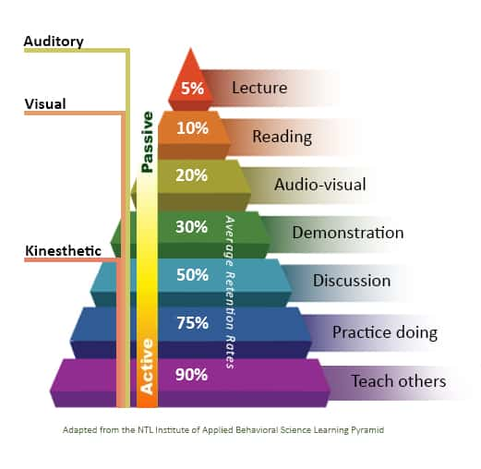
The Learning Pyramid

Slide 8
The Journey from Passive to Active Learning
Pre-Covid
Spring 2020
Fall 2020
Spring 2021
The advantages of active learning are well documented
Passive learning methods persist.
The shift to remote learning; acceleration of use of digital technologies
Existing racial and socio-economic achievement gaps widen.
Feedback suggests student success linked to flexibility, communication and strong student engagement (i.e. ACTIVE LEARNING);
Learning curves
Dust off existing good ideas; come up with new ones
Recommit to our collective purpose.

Slide 9
Curated Resources for Active Online Learning
Connect and Communicate with students
Keep everything organized
Lesson Design strategies for online learning:
“Flip the classroom”
Apps!
Provide options
Revise/Reflect/REST!
Notes:
Connect and Communicate with students: asynchronous, outgoing, incoming, ongoing.
Keep everything organized: create a central hub, limit external apps
Lesson Design strategies for online learning
“Flip the classroom”- If the foundational knowledge has been delivered outside the classroom, the synchronous time with your students can focus a 100% on active learning (Cult of Pedagogy)
5E’s (Catlyn Tucker): Explore, Explain, Elaborate, Evaluate
Options for delivering content: traditional modes (video, pdfs,etc) as well as crowdsourcing (padlet, canva, google slides, flipgrid, peardeck); formative assessment (Quizizz, Kahoot); project-based learning (campaigns, role play, mock trials, publishing)
Options for demonstrating learning: offer choices, engage multiple intelligences, ongoing projects, relevance.
Revise/Reflect/REST!

Slide 10
Breakout Room Tips
Clear Instructions
Shared Task
Why is this relevant?
Monitor multiple breakout rooms
Report Back
Games
Notes:
Clear Instructions: Breakout rooms work much better if the instructions are specific and clear, with a rubric if possible. Make sure students have access to the instructions once they are inside the breakout rooms.
Shared Task/Collaborative Project: This can be a shared Google Doc (have each student type in a different color so you can see who contributed what), a Google Slide, a Padlet, a Canva design—the possibilities are endless.
Who Cares? Why is this relevant?: Just like in the classroom, any assignment will get better engagement if the task actually matters to students, so if you’re not getting the response you want, relevance may be the root of the problem.
Monitoring multiple breakout room discussions: Create a single Google Slides presentation and assign a different slide to each group for recording their work. The teacher scrolls through the slides to monitor work in all groups at once, rather than toggling between files. If you go to the View menu and choose Grid View you can actually see thumbnails of all slides at once, which will give you a birds’ eye view of activity. Other google options are the app Jamboard, and the wildly popular google add-on, Pear Deck.
Report Back: Groups are also usually more successful if students are expected to return with some sort of response or product to share with the larger class

Slide 11
“Role Play”
Choose a country of interest outside of The United States of America.
Choose your preferred industry sector.
Identify a company working in your preferred sector and country and explain why you admire that company.
Notes:
The course scenario involves you as a subject matter expert (SME) with deep insight into a specific industry within a particular country. You, along with your classmate (your partner SME), will share insight learned throughout the course, we will manage the various interests in the discussion sections.

Slide 12
“Role Play” Discussion
Tell the class which American companies are successfully franchising in your country of interest?
Now examine if there are franchises from your country of interest in America, where are they located and in what industries are they making the most impact.
Research and tell us if there are opportunities for licensing agreements with your proxy company? In other words, how can you become a part of your proxy company while maintaining business ownership?

Slide 13
Community Discussions
Notes:
Finish the slides by Wednesday.

Slide 14
Further Information and Support
Email info@asccc.org

