Slide 1
Addressing Equity in the Arts and Humanities Through Curriculum
Nate Donahue, ASCCC At-Large Representative, Santa Monica College
Silvester Henderson, ASCCC At-Large Representative,
Los Medanos College
Friday, July 12th, 2019 Curriculum Institute
2:15pm-3:30pm
ASCCC Curriculum Institute July 10 - July 13, 2019
San Francisco, CA

Slide 2
The Types of Discussions we will have in this workshop:
What it means to teach the canon in 2019
How can we teach the canon through an equitable lens?
What does inclusion look like on our syllabi and in our course assignments?
How can we use the COR to promote equity?
How can we impart knowledge of content and historical fact as well as lead
students toward an understanding of equity and social justice?
ASCCC Curriculum Institute July 10 - July 13, 2019
San Francisco, CA

Slide 3
Conversations about the Western canon:
What is the importance of teaching the canon today?
How can we present the canon through an equitable lens:
Structural analysis of epistemological systems
Deconstruction of how the canon was built and codified
Inclusion of the work of people of color, either working
within or against the canon
Honest discussions about cultural appropriation and exploitation
ASCCC Curriculum Institute July 10 - July 13, 2019
San Francisco, CA

Slide 4
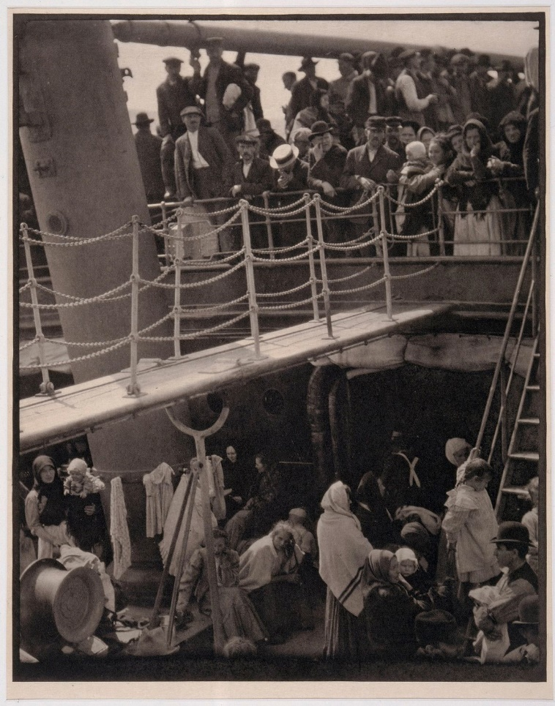
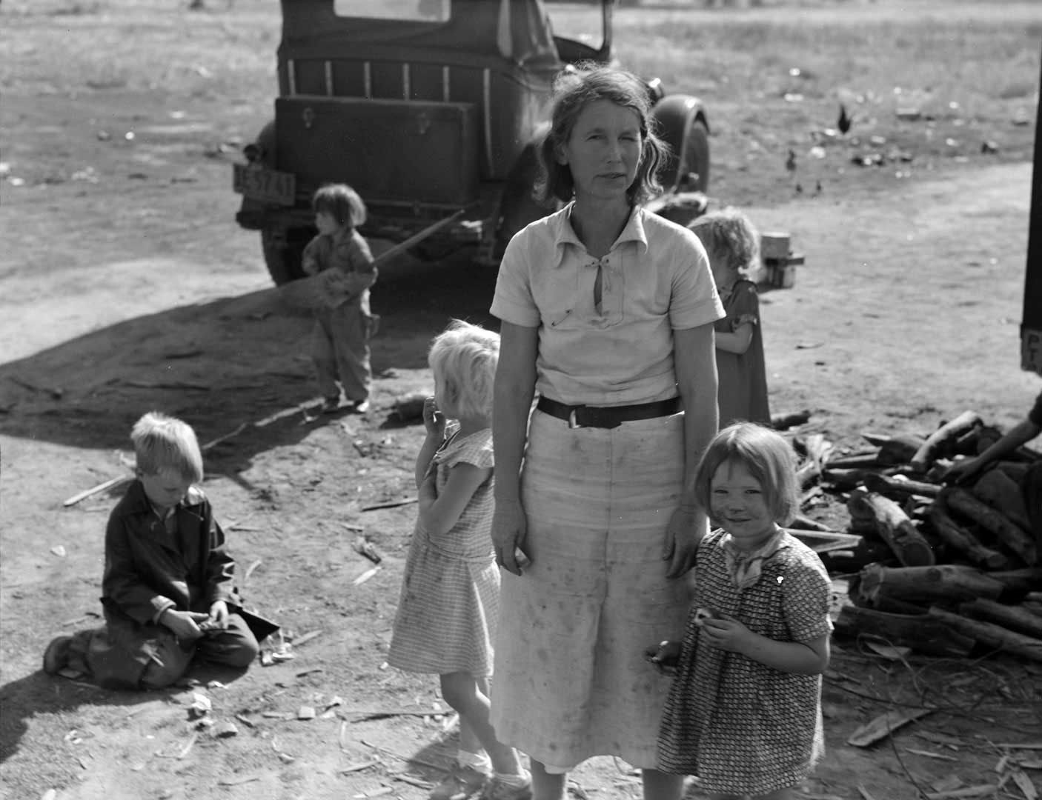
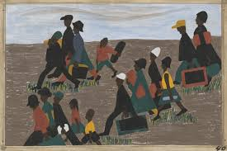
EXAMPLE THEMATIC AND INCLUSIVE SUBJECT MATTER: MIGRATION
Jacob Lawrence, Migration Series,
Albert Steiglitz, Steerage
Dorothea Lange, Migrant Mother

Slide 5
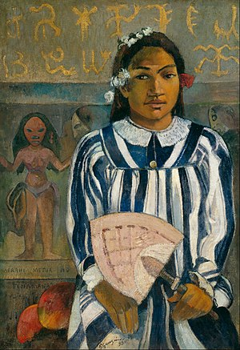
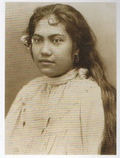
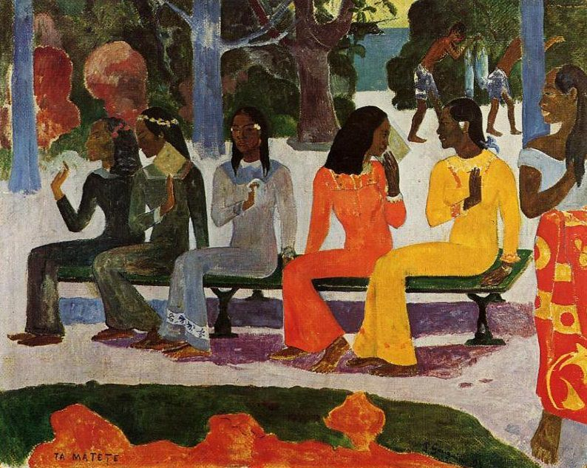
GAUGUIN AND AVANT-GARDE MODERNISM
AS A PRACTICE OF COLONIALISM AND CULTURAL APPROPRIATION.
ASCCC Curriculum Institute July 10 - July 13, 2019
San Francisco, CA

Slide 6
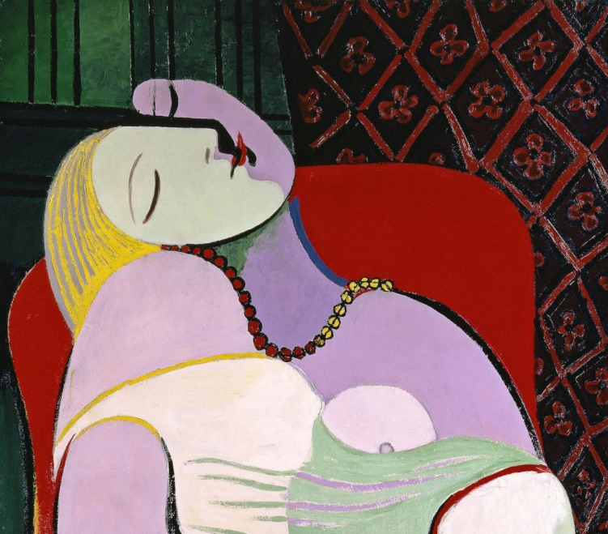
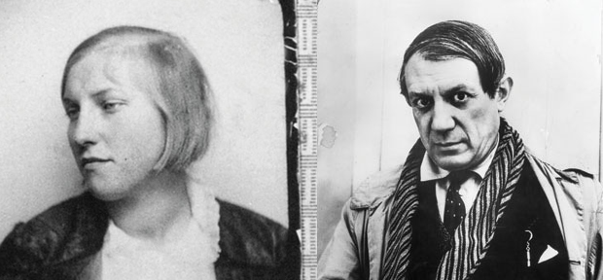
PICASSO IN THE 21st CENTURY means we must acknowledge: She was 15 and he was over 40.
Name the fact that Picasso praise based on his masculine identity as a ladies man who identified with the Bull.
FOCUS ON THE CONTRIBUTION OF THE MODELS AS ACTIVE CREATORS

Slide 7
Equity starts on the Syllabus and in Curriculum
Does the COR and syllabus feature course content and other material that are inclusive
of people of color and LGBTQ+ voices, and a multiplicity of critical methodologies:
Feminist, Marxist, Psychoanalytic, Deconstruction, Queer Theory, Black Liberation Theory,?
Are your SLO’s and PLO’s also skills based? Or do they solely focus on the repetition
and retention of canonical knowledge “Soft Skills” should
be reflected in course and program outcomes.
Do assignments and projects give students a chance to reflect upon their own identity,
and do they allow students to question the production and replication of the traditional canon?
ASCCC Curriculum Institute July 10 - July 13, 2019
San Francisco, CA

Slide 8
USE REQUIRED ELEMENTS OF COR TO DRIVE EQUITABLE
CURRICULUM DEVELOPMENT AND REVISION:
Required Element #2: Mission
The mission of the college should drive all curriculum development as well as potential revision when the mission of the college is changed or expanded. Currently Education Code § 66010.4 defines the mission of the California community colleges as focused on lower division transfer preparation, vocational education, and basic skills education. However, many colleges have additional aspects of their missions which might also drive curriculum development, such as diversity of student population or interest in adult education. Local curriculum processes should include questions that prompt faculty to consider the mission when making new course proposals, revising existing courses, or adding new courses to programs. Accreditation standards for many agencies also involve the role of the college mission in institutional planning and may therefore need to be considered in terms of curriculum development and revision
ASCCC Curriculum Institute July 10 - July 13, 2019
San Francisco, CA

Slide 9
USE REQUIRED ELEMENTS OF COR TO DRIVE EQUITABLE
CURRICULUM DEVELOPMENT AND REVISION:
Required Core Element #6: Course Description
Course Description When any course is developed, the course purpose or description sets the stage for all subsequent elements on the COR. Embedded within a course’s description are the reasons that the course exists and a holistic overview of objectives, content, and outcomes. Without this defining statement, instructors teaching sections of a course may be unclear on the scope of the course, how content should be taught, or how discrete objectives or the overarching student learning outcomes statements should be assessed. A course without a description that is clearly distinct from another course should not exist, and all courses should include defined student learning outcomes relevant to and supported by the course objectives.
ASCCC Curriculum Institute July 10 - July 13, 2019
San Francisco, CA

Slide 10
What does it mean to teach the Humanities through an equitable lens?
Be ready to have honest conversations about the production of knowledge in the humanities disciplines and historical and current oppression of people of color throughout history
Teach the humanities from a global perspective, do not rely solely on the Western canon.
Be mindful how you include new content into your course: BEWARE THE APPENDAGE METHOD
Celebrate knowledge, art and beauty, but reveal the structural systems and conditions which created these products.
ASCCC Curriculum Institute July 10 - July 13, 2019
San Francisco, CA

Slide 11
TEACHING THE RENAISSANCE DIFFERENTLY
-Formal analysis of painting, sculpture and architechture
-Celebration of technological, aesthetic, and scientific advances….
BUT…..
- Creation of European Identity based in a concept of whiteness and
the commencement of the age of colonization and violent expulsion of the
Moors in Spain in 1492.
Capitalism drives European Imperialism and produces cultural appropriation
What is the difference between cultural exploitation and exchange?
Art used to express the political, social, and economic prerogatives of
power and domination.
ASCCC Curriculum Institute July 10 - July 13, 2019
San Francisco, CA

Slide 12
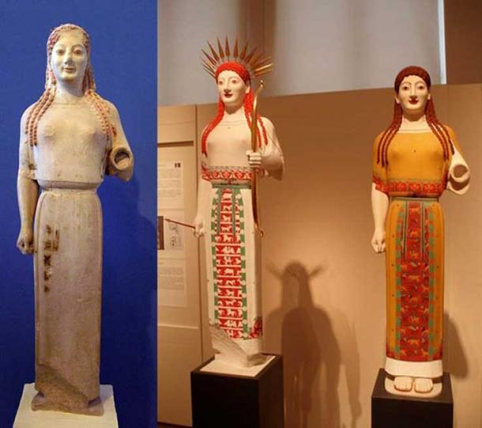
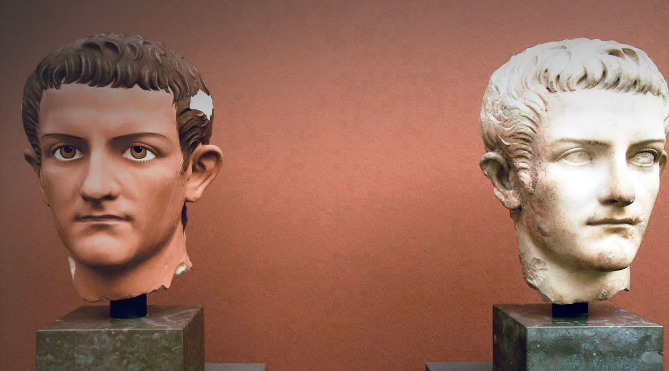
THE RENAISSANCE AS A PROMOTION OF “WHITENESS” AS STANDARD,
CLASSICAL, AND DESIREABLE
ASCCC Curriculum Institute July 10 - July 13, 2019
San Francisco, CA

Slide 13
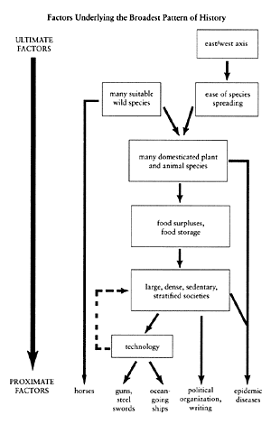
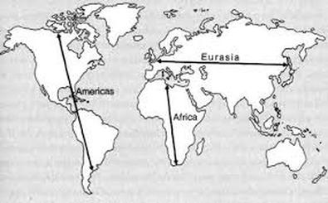
What geographical and historical factors made Western Colonization
Possible?
If we don’t explain this, we may reinforce ideas of superiority.
Jared Diamond, Guns, Germs and Steel.
ASCCC Curriculum Institute July 10 - July 13, 2019
San Francisco, CA

Slide 14
CASE STUDY: MUSIC AND PERFORMANCE ART
USING MUSIC AND PERFORMANCE ART TO TEACH INCLUSIVE HISTORY AND TEACH THE LIFE SKILLS (NOT SOFT SKILLS!) THAT EMPLOYERS AND TRANSFER INSTISTUTIONS WANT!
ASCCC Curriculum Institute July 10 - July 13, 2019
San Francisco, CA

Slide 15
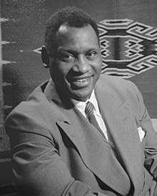
Music – “The Quadrivium” – Value within Higher Education.
.
Quadrivium: “a group of studies consisting of arithmetic, music, geometry, and astronomy and forming the upper division of the seven liberal arts in medieval universities”
https://www.merriam-webster.com/dictionary/quadrivium
Paul Robeson (1898 – 1976) was a famous African-American athlete, singer (Bass-Baritone) , actor, and advocate for the civil rights of people around the world. He rose to prominence in a time when segregation was legal in the United States, and Black people were being lynched by racist mobs, especially in the South. Selection: “Deep River” – Harry Burleigh, Composer
https://www.youtube.com/watch?v=-l_6nSldtnI
“Music incarnates (embodies) fundamental properties of the world. The intricate relationships between math and music, the parallels between musical and literary structures, the metaphors music provides for theology, and other such correlations hint that beneath them all lies a deeper reality shared in common, beckoning further exploration.”
https://www.circeinstitute.org/blog/bring-back-boethius-or-why-musics-quadrivium

Slide 16
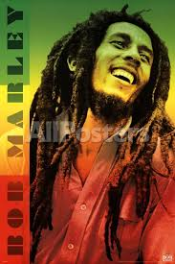
Social Intelligence & Ethnomathematics.
Social Intelligence
Social Intelligence (SI) is the ability to get along well with others, and to get them to cooperate with you. Sometimes referred to simplistically as "people skills,“
Perceptual, language and literacy skills
Soft Skills
Intellectual development – Think Broadly!
(Ro
Ethnomathematics
“Music is one of the prime examples of ethnomathematics because every culture has their own understanding of what music is and how it should work.”
Ability to analyze sounds in relationship to culture and duration (Math).
Encourages a greater interest in math.
Ability to analyze language, linguistics, culture, gender and social difference.
https://kb.osu.edu/bitstream/handle/1811/78917/OJSM_71_Spring2015_31.pdf?sequence=1
Robert Bob Marley (1945 – 1981) - Jamaican singer who popularized
“Reggae”. (1945-1981)
https://www.youtube.com/watch?v=2Dq33kK9nDU

Slide 17
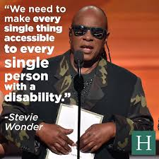
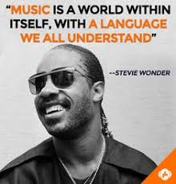
“The Social Justice” Advocate : Equity, Diversity & Inclusion”
Stevie Wonder – “Political Activism”
The song became a hit, and Wonder worked with Coretta Scott King to gain support for the national holiday. By 1982, they delivered a petition with 6 million signatures in favor of the holiday to the Speaker of the House. On November 3, 1983, President Ronald Reagan signed a bill marking the third Monday of every January, as Martin Luther King, Jr., day, and in January 1986, the first national Martin Luther King, Jr., holiday was observed.
E
Q
U
A
L
I
T
Y
&
E
Q
U
I
T
Y
Stevie Wonder has always blended his musical genius with social activism. He has pleaded for an end to racism, promoted equality for those with disabilities and in recent years, advocated gun control.
Wonder’s efforts to get a national holiday established for Martin Luther King Jr., arguably helped make that dream a reality. Stevie Wonder released “Happy Birthday,” in support of enacting the holiday near the King’s January 15 birthday, featuring these lyrics:
“I just never understood
How a man who died for good
Could not have a day that would
Be set aside for his recognition.”
https://www.biography.com/news/politically-active-musicians
https://www.youtube.com/watch?v=sLQNMWHjC-0&start_radio=1&list=RDsLQNMWHjC-0&t=59

Slide 18
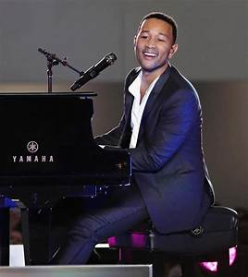
“The Urban Male Music Student Performer & Higher Education
Black Males & Music
John Legend - Early Life and Career
Grammy Award-winning singer-songwriter, John Legend was born John Roger Stephens on December 28, 1978, in Springfield, Ohio. A child prodigy, Legend's grandmother taught him how to play the piano, and he grew up singing in the church choir. He went on to attend the University of Pennsylvania, where he directed a co-ed a cappella group. After graduation, he switched gears and worked for Boston Consulting Group, but continued to perform in nightclubs in New York City
that this experience of making music is helping to create a more efficient brain, a brain that is going to be able to help a person learn and communicate, especially through sound.” https://www.huffingtonpost.com/2014/09/02/harmony-project-music-study_n_5755448.html
C
0
G
N
I
T
I
V
E
G
R
O
W
T
H
“In a study out Tuesday from Northwestern University, researchers looked at the impact of music education on at-risk children’s nervous systems and found that music lessons could help them develop language and reading skills. The study is the first to document the influence of after-school music education on the brains of disadvantaged children, as opposed to affluent children receiving private lessons. “It would appear that music is an effective strategy for helping to close the achievement gap,” Kraus said. “What seems to be happening is
https://www.youtube.com/watch?v=HUZOKvYcx_o
https://www.youtube.com/watch?v=KQRq9FZqNj0
https://www.biography.com/people/john-legend-201302

Slide 19
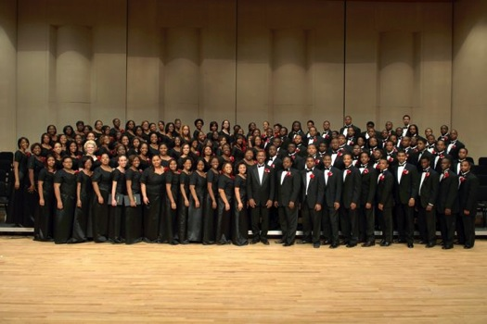
Dr. Nathan Carter & Morgan State University Choir
The Black Male, Urban Music & Leader/Conductor
The Urban Music Conductor (Skill Set)
Inspirational
Influence
Conflict management
Teamwork and collaboration
Self-management
Emotional self- control
Adaptability
Achievement orientation.
Positive attitude.
International Journal of Music and Performing Arts
June 2015, Vol. 3, No. 1, pp. 84-88
Conferences/ Professional Development
The Urban Music Leadership Conference (UMLC) was founded in 1995 by Judy Svengalis, then music supervisor for the Des Moines, Iowa schools. She realized the complexity of the jobs of fine arts urban fine arts directors, and music or visual and performing arts teachers. Topics such as, standards in the arts, assessment, advocacy, professional development and recruiting and retaining of music educators are addressed at the annual conference among other topics of vital importance to urban music education. Presenters at the conference are distinguished leaders in the arts community including MENC presidents, university faculty, music corporation executives, state level education administrators, arts organization directors and performers. The experience and expertise of these presenters contributes to the success of UMLC.
https://www.umlc.net/about-us.html
https://www.youtube.com/watch?v=ZvAuw4xsF1c

Slide 20
CONVERSATION AND QUESTIONS
HOW DO YOU PRACTICE EQUITY IN CURRICULUM?
ASCCC Curriculum Institute July 10 - July 13, 2019
San Francisco, CA

