Slide 1
Part-Time Faculty Advocacy

Slide 2
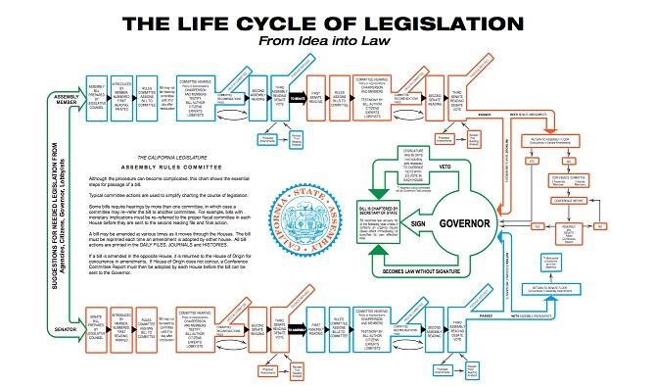

Slide 3
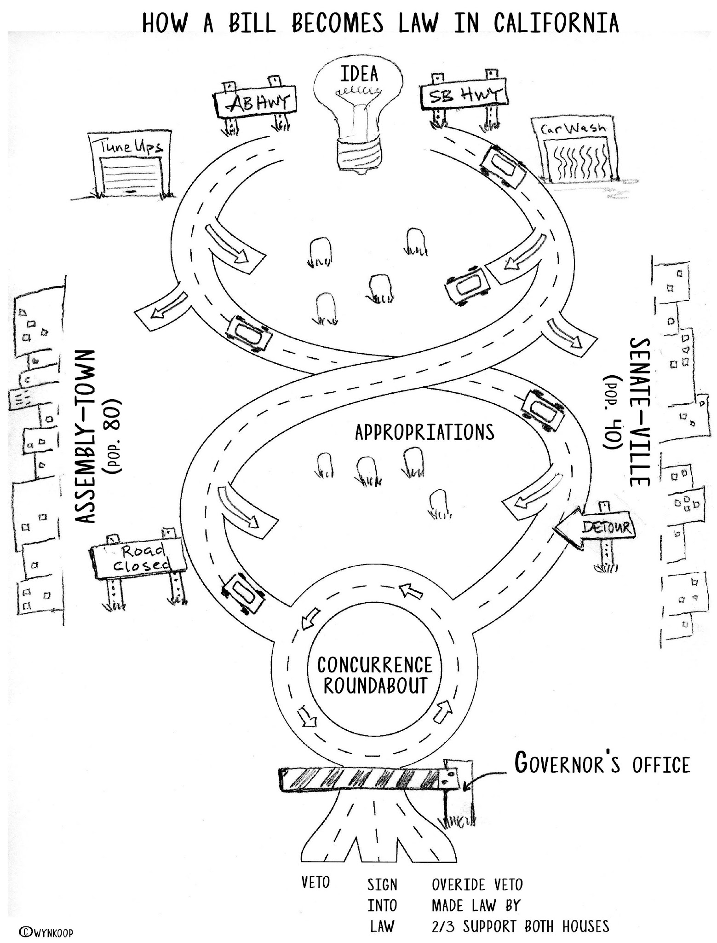
Notes:
w
Explain Sponsor
Author ( legislator)
Policy committees
Appropriations – suspense
House of origin
Concurrence
Gov- do nothing, veto, or sign
Co-Sponsor
CTA cooperatively works with one or more other groups to develop, introduce and seek the passage of the proposal. This position is to be utilized when necessary to join with other organizations.
Sponsor
CTA develops the legislation and has it introduced by a member of the Legislature.

Slide 4
LEGISLATIVE CYCLE: JAN - SEPT
January – February
A bill is introduced by member of Senate (numbered as SB) or Assembly (numbered as AB).
March – May (House of Origin)
Amendments – revisions, improvements
Committees hearings
Education, Appropriations (fiscal)
Last week of May
Bills that make it, go to the floor of the house for vote
June – August
Same process is repeated in other house
September
Concurrence
If both houses pass the bill then it moves onto the Governor’s desk
Governor’s Desk
Veto – reject the bill
Sign – make the bill into law
House override – 2/3 vote of both houses
Notes:
w

Slide 5
September
January
May
June

Slide 6
HOW MANY BILLS
Assembly Members and Senators are limited to introducing fifty and forty bills (each, respectively) per two-year session. Possible 5,600 bills per two year cycle.
2021
2,379 Bills introduced in the state legislature
203 bills introduced pertinent to CCCs
836 made it to the Governor’s desk
91 new laws pertinent to CCCs
Notes:
w

Slide 7
CONTACTS AND INFORMATION
Senate
https://www.senate.ca.gov/
Roster of Members
https://www.senate.ca.gov/senators
Web Broadcasts of Hearings
https://www.senate.ca.gov/media
Assembly
https://www.assembly.ca.gov/
Roster of Members
https://www.assembly.ca.gov/assemblymembers
Web Broadcasts of Hearings
https://www.assembly.ca.gov/todaysevents
Find your Representative http://findyourrep.legislature.ca.gov/
Track Legislation https://leginfo.legislature.ca.gov/

Slide 8
CCC SYSTEM PARTNERS ADVOCACY
ASCCC Legislative Updates
FACCC Legislative Positions
CFT Legislative Updates
CCA Legislation and Political Action
CCCCO Tracked Legislation
CCLC Legislative Actions
Notes:
w

Slide 9
IMPORTANT COMMITTEES
Assembly Higher Education (Fong)
Jeanice Warden-Washington - Chief Consultant
Assembly Budget (Ting)
Mark Martin, Principal Consultant
Sub 2 Education Finance (McCarty)
Senate Education (Newman)
Olgalilia Ramirez, Consultant
Senate Budget & Fiscal Review (Skinner)
Dr. Chris Francis, Principal Consultant
Subcommittee 1 on Education (Laird)

Slide 10
Advocacy in Action
What are the the main asks for policymakers?
How do the asks benefit part-time faculty and the students they serve?

Slide 11
Documenting the Asks
Click Here to Use the Jamboard

Slide 12
Working as a Group: Example
Introductions
Leader of advocacy team summarizes all four “asks”
Rotate through each team member
Diving deeper into a single “ask”
Provide a concise example that illustrates the benefit to students
Leader
Remind legislator or staffer of advocacy materials
Ask if there is anything other materials or resources that you can provide
Conclude
Thank You
Notes:
w

Slide 13
Break Into Groups
10 minutes: Add asks to the Jamboard
25 minutes: Practice advocating.

Slide 14
10 minutes: Recap group work

Slide 15
Next Steps:
Unite faculty to amply our voice at the local level and throughout the state:
Participate in your local senate and college committees
Be a member of your union and get involved
Write op-eds to your local newspaper and education publications (EdSource, Inside Higher Ed, etc.)
Be active on Twitter and engage in community college policy conversations
Join FACCC to increase power to lobby the legislature and represent faculty in the state consultation process

