Slide 1
All About Resources: Standard III
Dolores Davison, ASCCC Secretary
Sam Foster, ASCCC South Representative
Zaida O’Connor, College of the Canyons

Slide 2
Let’s Get to Know Each Other
What is your role on your local campus/district?
Are you from a single- or multi-campus district?
How soon is your next accreditation visit?

Slide 3
Do you have sites away from the main campus that offer courses?
Do you have significant distance education/online offerings?
Do you offer any correspondence courses?

Slide 4
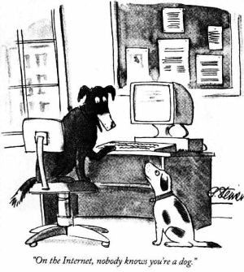
If This Applies, It’s A Correspondence Course

Slide 5
Objective
Discuss effective practices in utilizing resources to meet Standard III including how distance education and off campus courses are supported.

Slide 6
Standard III All About Resources
How are we using our resources to support the mission of the college?
How is it documented?

Slide 7
Exploring Standard III: Resources
Standard | Description
III.A | Human Resources
III.B | Physical Resources
III.C | Technology Resources
III.D | Financial Resources

Slide 8
Which substandard do you feel most confident about?
Human Resources
Physical Resources
Technology Resources
Financial Resources

Slide 9
Which substandard do you feel you need the most help with?
Human Resources
Physical Resources
Technology Resources
Financial Resources

Slide 10
Which substandard was the easiest to integrate with distance education?
Human Resources
Physical Resources
Technology Resources
Financial Resources

Slide 11
Which substandard was the most challenging to integrate with distance education?
Human Resources
Physical Resources
Technology Resources
Financial Resources

Slide 12
Human Resources (Standard III.A)
Administrator Roles
Faculty Roles
Single- or Multi-College District

Slide 13
Major Components of Standard III.A
Qualifications and hiring criteria for faculty and administrators and staff
Evaluations of faculty and staff
Appropriate staffing levels for full time and part time faculty, administrators and support personnel
Professional development and support

Slide 14
A Deeper Look
Evaluations
Is the use of distance education a component of evaluation for faculty that teach using that methodology?
Are results of outcome assessments used to improve teaching and learning?

Slide 15
Appropriate Staffing Levels
Who determines this?
How is it documented?
Professional Development and support for all personnel
Who determines what is needed?
Are Board members included?
How is it documented?

Slide 16
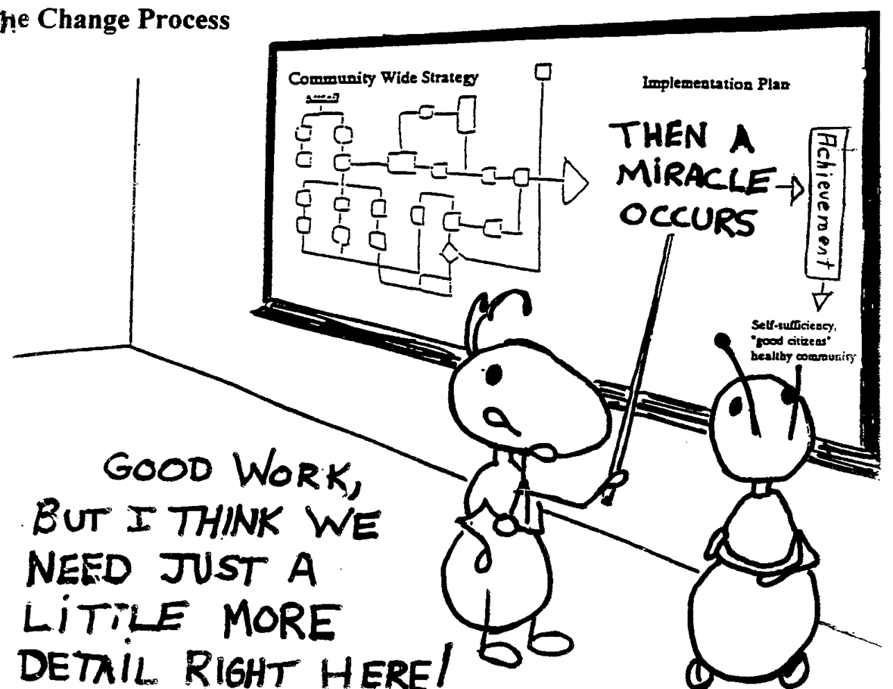
Documentation is Crucial

Slide 17
Physical Resources: Standard III.B
Is this just the job of the facilities personnel?
What role do faculty and other staff have in meeting this standard?

Slide 18
Consider these questions about physical resources
How is access to facilities and the quality of those facilities assured, especially for off-site locations?
What about facilities and equipment to support distance education?

Slide 19
What are your plans for maintaining and updated facilities resources?
What are your long range capital plans to support improvement of resources (Master Plan)?

Slide 20
Technology Resources: Standard III.C
What are the roles of faculty, staff, and administrators in addressing this standard?
Does your institution have a technology plan?

Slide 21
A Deeper Look at the Technology Standard
Does your institution have adequate technology?
How do you know?
Who decides?
When do you upgrade technology?
Is there a plan?

Slide 22
How are faculty and staff trained to use technology?
How are the needs of faculty responsible for distance education courses accounted for?
What is your overall plan for technology?
How do you know it’s working?

Slide 23
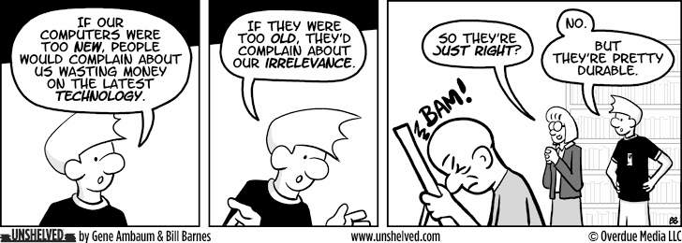
About That Tech Plan …

Slide 24
Financial Resources: Standard III.D
Standard | Description
III.D.1-3 | Fiscal Resources: Planning
III.D.4-10 | Fiscal Resources: Fiscal Responsibility and Stability
III.D.11-15 | Fiscal Resources: Liabilities
III.D.16 | Fiscal Resources: Contractual Agreements

Slide 25
Planning
How is it done and what does it include?
Does planning drive the budget? What evidence supports that?
What is the role of faculty and the college governance structure?
How is allocation among multiple sites determined?

Slide 26
Financial Responsibility and Stability
How are funding priorities established?
Do those doing the planning have access to accurate financial information?
How is the financial record keeping evaluated?

Slide 27
Liabilities: Why should we care?
Can we pay our bills?
Are there short term and long term plans to address our liabilities?

Slide 28
Documenting Our Good Work

Slide 29
Documenting Our Good Work
What are types of evidence that can be used to support Standard III?
What items are more difficult to document?
Are there any creative ways that have been used to document relevant activity?

Slide 30
Standard III in Summary
We must continue to utilize our resources to achieve our college mission.
We must document how we do it.

Slide 31
Available Resources from ACCJC
Accreditation Reference Handbook
Checklist for Evaluating Compliance with Federal Regulations and Related Commission Policies
Eligibility, Candidacy, and Initial Accreditation Manual
Guide to Evaluating & Improving Institutions
Guide to Evaluating Distance Education and Correspondence Education

Slide 32
Available Resources from ASCCC
Effective Practices in Accreditation
ASCCC Accreditation Committee web page

Slide 33
Questions?
Dolores Davison (davisondolores@foothill.edu)
Sam Foster (SFoster@fullcoll.edu)
Zaida O’Connor (zaida_ocon@yahoo.com )

