Slide 1
Reading the World in California
Anne Argyriou
Instructional Design and Innovation Institute
March 17, 2017

Slide 2
Reading 211: Developmental Reading
Course is one level below transfer English
Students directed to course via placement exam
Students graduated high school but did not place into college level English
Most transfer courses have an Advisory of EWRT 1A (transfer English)
Developmental Approach
Focus is on developing students’ reading abilities, rather than deficit-model
Emphasis on reading comprehension and higher-order critical thinking
Start with what they can do and build on those skills
Demographics
Most Ss who place into READ also into developmental EWRT
About 55% are 19 years old (or younger)
About half are in first year of college

Slide 3
Why Internationalize READ 211?
Goals:
Add course readings to include more ethnicities to reflect California’s population
Course text: California Dreams and Realities, by Maasik and Solomon
Improve Reading Skills
“Hook” via adding more cultures, countries
Create, enlarge, activate “schema”
Encourage Critical Thinking
Christenbury’s Questioning Circles: Self, Text, World, Other Text
Comparison of cultures or countries (self, world, other text)
Schema development

Slide 4
Internationalize: Course Materials
Via course materials & assignments, not the Course Outline of Record
Course themes
Main: California Dreams and Realities (by Maasik & Solomon)
Sub-themes: Immigration; Education; Identity
Goal: increase ethnicities & cultures represented in Education and Immigration units
Course Materials Added
Education
The Smartest Kids in the World (Korea, Finland, Poland)
New High School Outsiders (Refugees in USA)
Immigration
Fractured Lands: How the Arab World Came Apart (Libya, Syria,
Young Rural Women in India Chase Big City Dreams
Japan Limited Immigration; Now It’s Short of Workers

Slide 5
Internationlize: Annotations
What changed?
Prior
Emphasis on whole text: structure, comprehension, and interpretation
Teacher led: students would work on questions determined by instructor
Annotation taught as a strategy, for students’ individual use
Lacuna
Annotation becomes centerpiece of the course
Students identify passages to focus on
Students comment on passage, to develop into fuller analysis
Student Writing
Annotations have a 4 sentence minimum, but Ss need guidance
Paragraphs answer an interpretive question, using “quote sandwiches”
“Responses” on Lacuna: lengthier, 1-page responses, multiple quote sandwiches

Slide 6
Lacuna: What is it?
On-line Annotation Program
Three parts: annotation, writing, sewing kit
Course instructor approves who joins the course using Lacuna
Annotation
Students select portions of the text to annotate
Annotators can determine the audience: Private, Instructor, Peer Group, Class
Writing
Responses: similar to a blog post, Ss write an extended piece and post it
Ss can use annotations to write a “response”
Sewing Kit
Students can select annotations, responses, to link together
Good for linking annotations across multiple texts to respond to an assignment

Slide 7
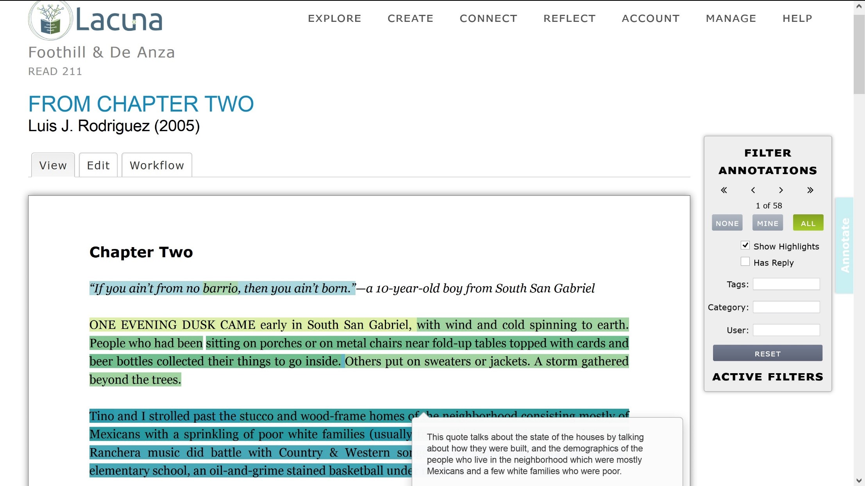
Lacuna Screenshot

Slide 8
Lacuna: How Do Students Use It?
Reading texts
Most texts for this section are on Lacuna
Ss prefer to read on-line when they have a computer or iPad (zoom & share)
Annotation
Primarily in response to assignment requiring annotation
Some spontaneous annotation beginning to occur
Many Ss beginning to select text to show me, but do not actually annotate
Responses
When assigned
Need computer to type easily—iPads?
Learning Curve
Technology can add a confusing layer
Practice activity first on paper, so Ss not learning two things at once

Slide 9
Results so far…
Not quite what I had expected ☺
Ss need more guidance to compare cultures/countries
Annotations focused on comprehension for more challenging readings
Future adjustments
Directly ask for comparisons
Incorporate unit questions to drive comparison and analysis
Book serves as a lynchpin
Students
Raising awareness that other countries different
Activating schema
Comparisons need to be explicitly asked for, otherwise only a few students do w/o prompt
Lacuna
Students need explanation of reasons to select passages from text
Students need guidance in what to write in annotations
Faculty may need to determine how to use annotation if not doing so already
Faculty need to consider technology access issues: either a computer lab, or BYOD

Slide 10
Acknowledgements
Stanford
Katherine Welsh, EPIC Program
Brian Johnsrud, Lacuna Director
Daniel Bush, Instructional Designer
EPIC Program
De Anza College
Lorrie Ranck, Associate VP Instruction
Thomas Ray, Dean of Language Arts
Deepa Yuvaraj, Dare Coordinator, iPad Wrangler
De Anza EPIC Fellows ☺ Clara Lam, Monika Thomas, Susan Thomas, Anthony Santa Ana

