Slide 1
Anti-Racism Best Practices for Student Services Educators
Notes:
Presenter: Stephanie and Julie

Slide 2
PRESENTERS
Hossna Sadat Ahadi, Palomar College, RwLS Committee
Luis Guerrero, Palomar College
Facilitators
Stephanie Curry, ASCCC North Representative
Julie Oliver, ASCCC Area A Representative
Notes:
Presenter: Stephanie and Julie

Slide 3
BREAKOUT DESCRIPTION
Come learn and share best practices for infusing Anti-Racism in student support. What can we do to holistically support all of our students through intentional equity driven processes and policies? Learn from student service practitioners who have embedded antiracism work into student services at their colleges.
Notes:
Presenter: Stephanie and Julie

Slide 4
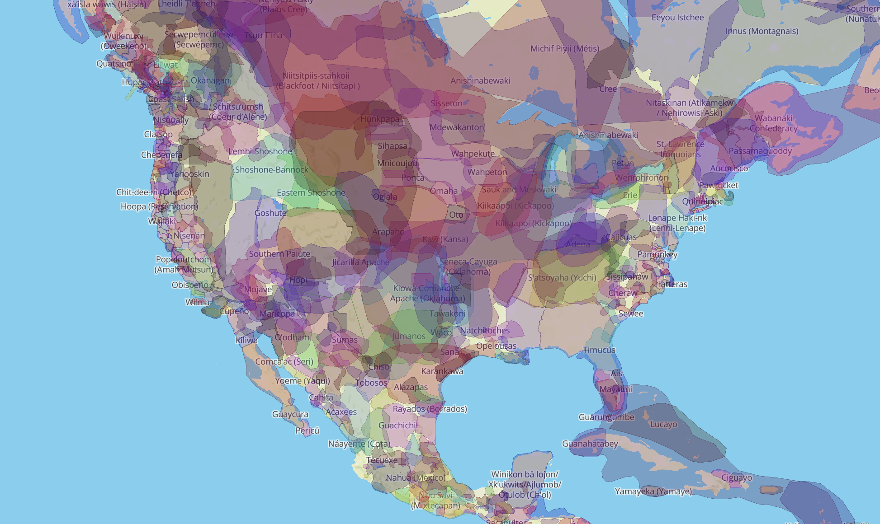
Land Acknowledgement
https://native-land.ca/
Notes:
Presenter: Hossna
We would like to make a land acknowledgement and recognized that we in North County, San Diego are blessed to be on the land of the Luiseno and Kumeyaay people.
It’s important to understand and acknowledge the land of indigenous communities. Now I will share a link with you so you can see the native land you live and work in.
https://native-land.ca/

Slide 5
Student Services Ethos
Notes:
Presenter: Hossna
When students often think of student services they think of the array of services in this division that supports their journey in community college.
From getting on the path with admissions and records, to applying and receiving funds through financial aid which is a critical matter for students who are living at the poverty line or below it. With counseling services, students are validated and supported with their academic, career, and personal goals.
Categorical programs further provides intrusive support for specific populations to feel belonging and engaged while being enrolled in college. The common thread throughout student services is that faculty and staff build a relationship with students and understand their barriers they are confronted with and find ways to eradicate those barriers so they can continue with their educational journey in community college.
While I’m faculty in counseling, my colleague Luis is faculty in mathematics and we both began talking about the importance of dismantling barriers are students are confronted with. Not just recommending students to go to student services to seek support, but being accountable as an instructor to do this in the classroom through teaching and the course syllabus. It’s important to be equity-minded & antiracist professor that will inspire and support students towards success!

Slide 6
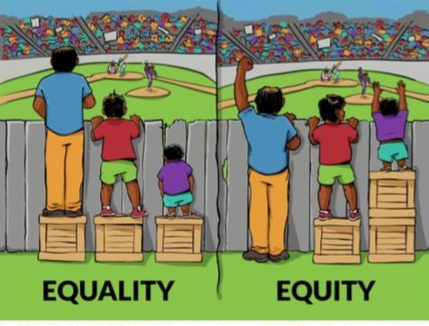
How Does Decolonization relate to Equity & Antiracism?
Syllabus- a tool that can define equity in your course
Student’s phenomenology in your course
Student-Centered Syllabus =Student Success & Achievement
Notes:
Presenter: Hossna
Slide 2: What is Equity
We have all seen the image of three people who are watching the ball game (equality), then raising of bricks to ensure everyone is watching the game at the same height (equity), but decolonization and our vision of equity only occurs when we breakdown the fence and all three people are actually playing the game and not watching it on the sidelines. Interestingly, those who are watching the game also happen to racially-minoritized in this image. As even with this image white hegemony and supremacy is being illustrated.
First as instructor, place yourself in the role as a first-generation, Black Indigenou Person of Color (BIPOC) student, who is living with a disability or in poverty.
Center for Urban Education (CUE) at USC developed a report regarding the syllabus being used a tool of addressing racial equity by three objectives:
(Read PPT Point) Understanding how the syllabus can act as a tool of equity (a syllabus is a tool to introduce the ethos of your class, official agreement of partnership between learner and teacher, and equity language and statements that welcome students coming from all walks of life, especially students of color who have been marginalized and microaggressed.
(Read PPT Point) Considering the experiences of students of color (promoting sense of belonging for students of color, being intentional with including equity backgrounds related to race, gender, sexuality, religions, disabilities, socio-economic status, learning comprehension and more). Deconstructing the representation of white students as the ‘norm’.
(Read PPT Point) Reimagining the syllabus to serve students (students are the focal point of who we are serving on campus)

Slide 7
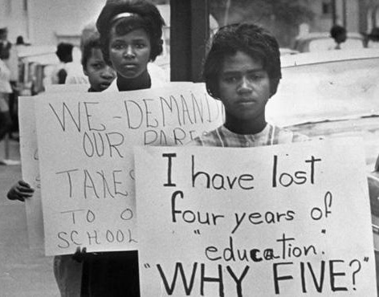
Historical Perspectives
Notes:
Presenter: Hossna
The foundation and history of teaching curriculum and pedagogy were framed with a colonized approach and logic. What this means is that academia has become based on white hegemony, power, annd hierarchy, disregarding the perspective and lived experiences of Black Indigenous People of Color. Intersectional identities such as race, economic standing, gender, sexuality, disability, immigration status, English Language Learner (ELL), and first-generation scholarship increase the need for teaching to become decolonized, equity-focused, student-centered, and antiracist. Thus, systemic and structural racism will need to be dismantled to see BIPOC students thrive academically and prevent marginalization from continuing in the classroom. To gain an holistic perspective, we looked at scholarly research that provides diverse methods to construct a decolonized and equity-minded course syllabus.

Slide 8
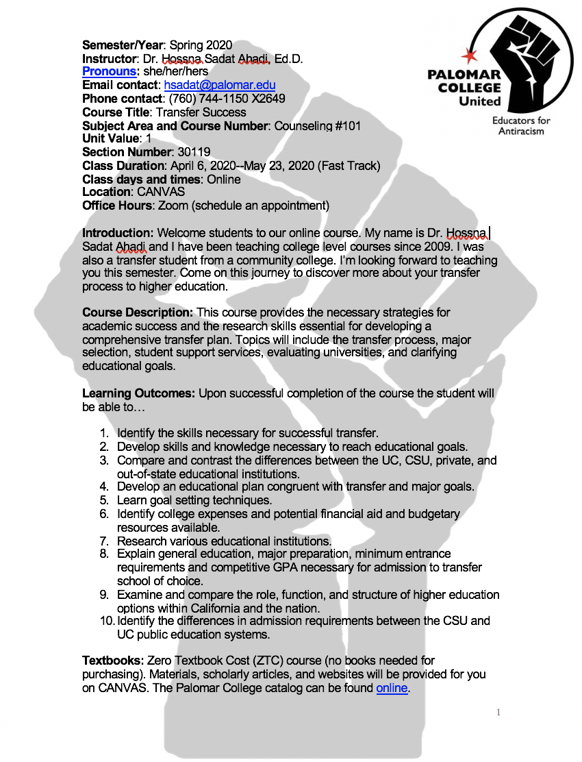
Counseling Course Syllabus
Notes:
Presenter: Hossna
Slide 4: Counseling course syllabus example
(Course Syllabus)
The purpose of the course syllabus is to create a partnership between the student and faculty member.
It’s important to first have an introduction in your course syllabus that welcomes students to their course and allows them to get to know you more such as you being a community college graduate, first-generation student in your family, and any other intersectional identities that validate your diversified students.
Now that we are remotely teaching due to the global pandemic, our student are further eager to reach us. It’s important to include various modalities for students to reach us (CANVAS, email, google voice, etc.)
Gender pronouns are important to share with your students and have your college’s guide or an online guide that specifies the difference between binary and non-binary genders are important to link on your course syllabus. Having an activity to get to know how your students would like to be called upon is important for inclusivity and validation.
Instead of writing punitive rules that convey to students what not to do, have them co-create the space that helps them focus on what to do instead of what not to do.
Traditional course syllabus outlines how students fail, get dismissed, and consequences for misconduct. By equitizing your course syllabus, you are welcome and supporting students in non-hierarchical and un-intimidating approach.
Having a blurb about respecting perspectives but no microaggressions allowed provides understanding for students what entails microaggression. In my course syllabus, I have linked Sue and Colleagues report in 2007 about racial microaggressions and I also create an ice-breaker activity around this to further unpack what this is and how to challenge it.
Having hyperlinks to various student support services such as applying to EOPS, CARE, CalWorks, Foster Youth, TRIO, Disability Services, Behavioral Health Services, and Housing and Food Pantry resources provides greater social and cultural capital for students.
Critically assess your student data related to incompletion and changing teaching pedagogy and delivery before running data again.
We have to reflect and deconstruct our course syllabus to build our student’s confidence and let it be the zipper that connects teaching and learning. The first week is the most important as it allows learners to see the engaging content.

Slide 9
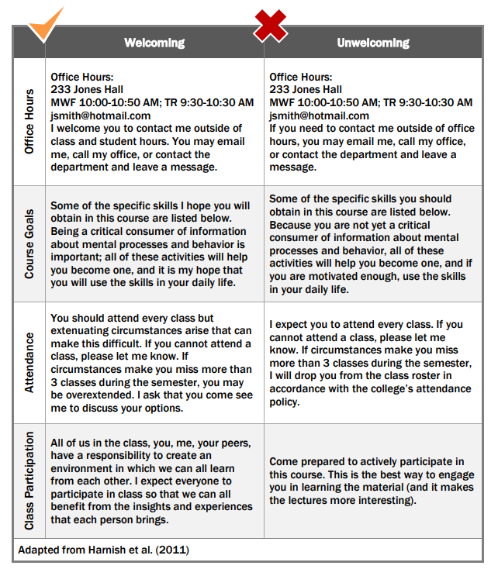
Language
Notes:
Presenter: Luis
Harnish, R. J., & Bridges, K. R. (2011). Effect of syllabus tone: Students’ perceptions of instructor and course. Social Psychology of Education, 14(3), 319-330.
Avoid: Deficit thinking and punitive language
Include: Validating, welcoming, engaging and sense of belonging language

Slide 10
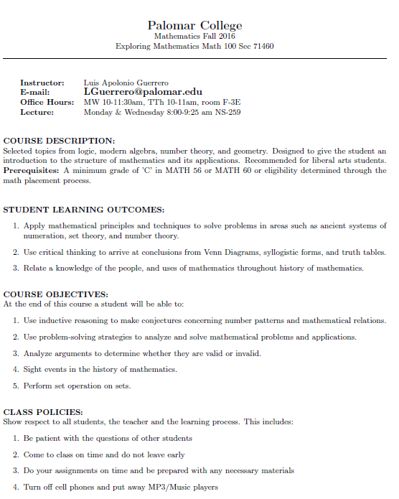
Math Syllabus
Notes:
Presenter: Luis
Slide 5: Math course syllabus example
Before equity: geared toward concise and short ‘one page’ syllabus. Barebone information, short and sweet. Not inviting. Dry. Bleak. Monochrome. Geared toward ‘professionals’. Faculty centered instead of student centered.
I am your biggest supporter and invested in your success, help me to help you, and be aware of time commitments to do well in our class. Mistakes are expected and respected.
This has to be a personal journey, you can add as much or as little as YOU feel comfortable, and not fake it, rather really commit to the framework and access you are giving students
Can still make it accessible by doing alternate text in pictures, and organizing ‘order’ of reading. Make your document or presentation more accessible and Accessibility for Docs editors
https://docs.google.com/document/d/1TF9nID45ho02DfI-ko9oC-p422FcyRfnsMhe6yJe9TM/edit?usp=sharing
Need to link with activities before the semester starts (syllabus quiz), or with first week (scavenger hunt, presentations, gallery walk, etc.)
Still a work in progress, lots of work was done in light of AB705 mandate, and trying to support students in co-requisite classes
New to decolonizing theory, need to change class activities, book and syllabus to best reflect new framework to help more students. Not just use ‘standard’ publishers books/resources just because they are convenient, rather really ask if it offers many viewpoints
Be honest, not all of my classes currently can be converted to OER, yet strive to convert as many as possible and expand as more resources are created, especially in this remote learning world

Slide 11
Equity Highlights
Your Introduction/Personalization
Availability
Equitizing Teaching
Student input
Explicit Language
Early Alert
Supportive Teaching
Language about Policy
Resources/textbooks
Canvas Course
Positive Messaging/Affirmations
Gender Pronouns (Palomar Guide 1 & 2)
Notes:
Presenter: Hossna
Slide 6: Equity themes to include in your course syllabus
Do students know who you are? Consider introducing yourself (race/ethnicity, gender pronouns, academic experience, cultural identity, etc.) as the instructor of the course and providing antiracist and equity-minded messaging to welcome your students.
Are there multiple methods students can contact you and is there flexibility on communication times?
What books, articles and readings have been intentionally selected in your course? Are your course resources inclusive to race, socio-economic standing, gender, sexuality, disability, immigration status, English Language Learner (ELL), first-generation students, etc.?
Do students have input in shaping content and co-create community rules outlined in the course syllabus?
Is there explicit language about the intolerance of microaggressions and racist remarks, action, and behavior in the course?
Is there messaging regarding your responsibility as a faculty member to alert learners early if participation, learning, and attendance are not met?
Are mistakes expected, respected, and used to elevate students' understanding of your subject? Do you offer opportunities for retaking missed/late work? What opportunities are there for students to catch up if they are behind due to technological barriers or other personal deterrents?
Is language around policies and expectations of students supportive and not punitive or deficit thinking?
Does your course syllabus provide information regarding housing and food insecurities, along with other on and off campus resources that benefits economically disadvantaged students? Considering your textbook costs and the financial instability students are confronted with.
Is your course on Canvas accessible, clear, inclusive, welcoming, and supportive for all learners to follow despite the modality of asynchronous and synchronous teaching?
Are there positive messages and affirmations displayed in your course syllabus and CANVAS to further validate and provide a greater sense of belonging for BIPOC students in the course? Do the images and videos in the course showcase diversity and representation of the students we serve?
Gender Pronoun Guide (click on links)

Slide 12
Resources used for Students?
Please answer the Mentimeter Poll
Notes:
Presenter Luis: Explain to participants on how to access mentimeter and maybe share with Stephanie and Julie to post in the chat.
https://www.mentimeter.com/s/a701f49c6d2714e05525b65280108062/a72c1622e078/edit
MENTIMETER icebreaker activity
Please answer the the question

Slide 13
Who is responsible instruction or student services?
Please answer the Mentimeter Poll
Notes:
Presenter Luis: Explain to participants on how to access mentimeter and maybe share with Stephanie and Julie to post in the chat.
https://www.mentimeter.com/s/a701f49c6d2714e05525b65280108062/a72c1622e078/edit
MENTIMETER icebreaker activity
Please answer the the question

Slide 14
Notes:
Presenter: Luis
One of our colleagues at Palomar College shared the Black Illustrations with us and this might be something you want to include in your syllabus, powerpoints, CANVAS, etc. : https://www.blackillustrations.com/?fbclid=IwAR1e13B5Eu4vV35wqzfi8XMYBXKrXaa56k2rIRsZLNHcsccV6Ev4HlYJk_8

Slide 15
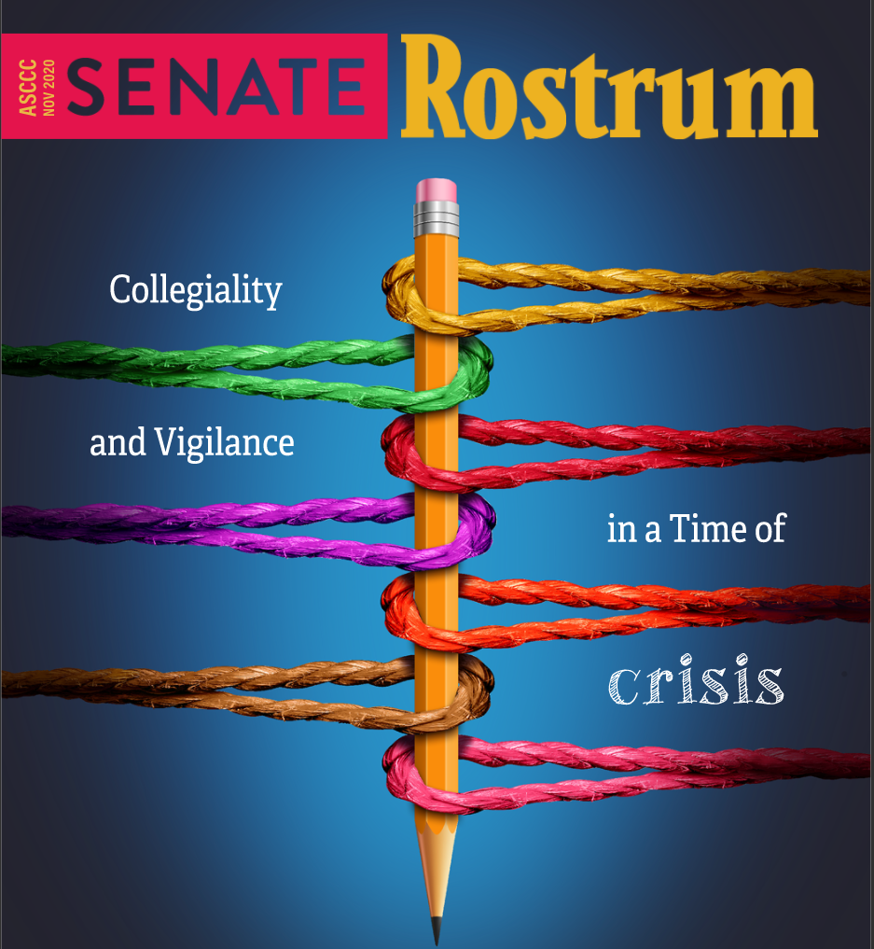
November Rostrum
Decolonizing Your Syllabus, an Anti-Racist Guide for Your College
(page 42)
Notes:
https://www.asccc.org/content/decolonizing-your-syllabus-anti-racist-guide-your-college

Slide 16
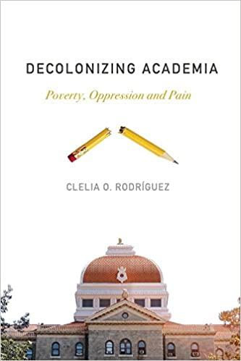
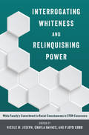
Decolonize your Area Resources
It’s time to decolonize that syllabus
Creating and Rethinking Syllabi
Decolonizing your syllabus? You might have missed some steps
Yes, mathematics can be decolonised. Here’s how to begin
Ethnomathematics and Language in Decolonizing Mathematics
Syllabus Review Guide for Equity-Minded Practice
An Equity Centered Syllabus Journey
From Blah to Bling: Building an Equity-Minded Syllabus
Notes:
Presenter: Luis
Bhambra, G. K.; Nisancioglu K. and Gebrial, D. (2018) Decolonizing the University ISBN 9780745338200
#RhodesMustFall, sparked an international movement calling for the decolonization of universities all over the world.
Rodríguez, C. O. (2018) Decolonizing Academia Poverty, Oppression and Pain ISBN 978-1773630748
Illustrates how academia is a racialized structure that erases the voices of people of colour, particularly women.
Kanth, R. (2009) The Challenge of Eurocentrism Global Perspectives, Policy, and Prospects ISBN 9780230612273
Eurocentrism is the current object of a global critique, which has the potential to be as significant as Marxist and Feminist critiques have been.
Joseph, N. M.; Haynes, J. and Cobb, F. (2015) Interrogating Whiteness and Relinquishing Power: White Faculty’s Commitment to Racial Consciousness in STEM Classrooms. ISBN 9781454193432
illuminating the critical influence that racial consciousness has on the behaviors of White faculty in the classroom
Joseph, G. G. (2010) The Crest of the Peacock: Non-European Roots of Mathematics ISBN 9780691135267
Breathtaking multicultural tour of the roots and shoots of non-European mathematics.
Powell, A.B. and Frankenstein, M. (1997) Ethnomathematics Challenging Eurocentrism in Mathematics Education ISBN 9780791433522
Focus on the issues of access and equity within mathematics and identifies ways to assist teachers in providing quality mathematics to traditionally underserved and underrepresented

Slide 17
Decolonize Your Area Activity
Notes:
(HSA) Now is your time to reflect on what practices you will implement in your service area or either instruction or student services. Luis will share a link with you in the chat, so please click on it and look over the two examples we provided.
Please include your area of teaching or student services and what decolonized, equity, or antiracist practice would you like to implement moving forward?
https://docs.google.com/document/d/1lmwAb19ISxvjorB0uPKQtNqG4H1rfqREeu0J4fEN5lY/edit?usp=sharing

Slide 18
Thank you!
Stephanie Curry
ASCCC North Representative
info@asccc.org
Julie Oliver
ASCCC Area A Representative
info@asccc.org
Hossna Sadat Ahadi
Counseling Faculty
RwLS Committee
hsadat@palomar.edu
Luis Guerrero
Math Faculty
lguerrero@palomar.edu
Notes:
Presenters: LG and HSA
Slide 10:
HSA
We want to thank you all for attending this workshop and we hope you are able to now reconstruct your course syllabus to being equity and antiracist focus.
In an ideal world, every syllabus and course would be decolonized
One of the quotes I love is from Dr. Bettina Love “Education can’t save us, we have to save education”
LG
PDF resource file in chatbox
Please indicate question in the mentimeter.
One of the quotes I love is from Ibram X. Kendi “Like fighting an addiction, being an antiracist requires persistent self-awareness, constant self-criticism, and regular self-examination.”

