Slide 1
Curriculum* and Apprenticeships *And Other Stuff
Dolores Davison, ASCCC Secretary
John Freitas, ASCCC Treasurer
John Stanskas, ASCCC Vice President
Spring 2017 Plenary Session
San Mateo Marriott

Slide 2
Today we will…
Go Way, Way Back with a Historian
Scope out the Lay of the Land in the Present
Practically, What’s Happening in California
What’s a RACC?
Senate Roles
Curriculum
Minimum Qualifications
Program Review
Path Forward

Slide 3
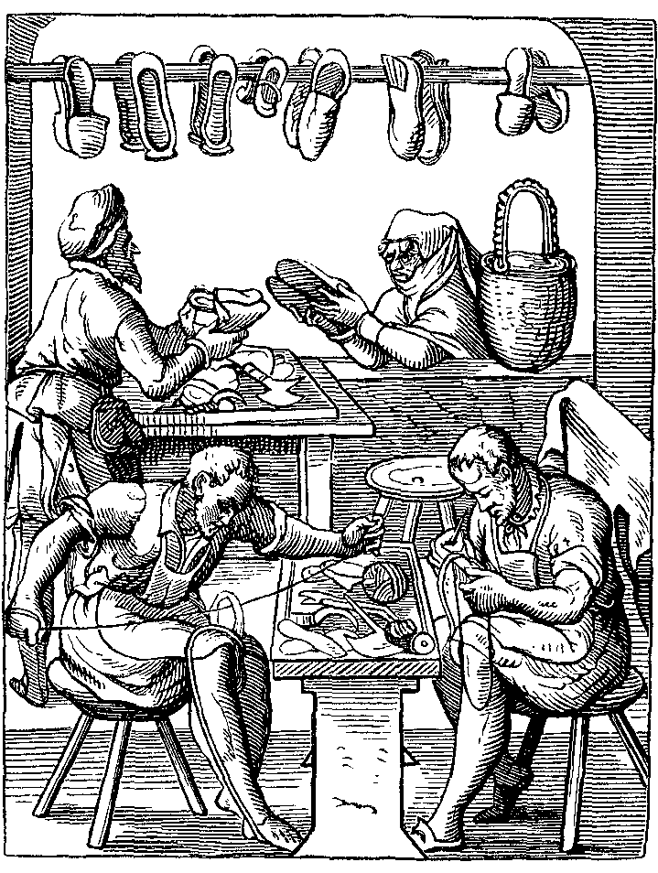
The History of Apprenticeship

Slide 4
Medieval Times
Guilds were formed to provide training, ensure quality, protect jobs, and provide a sense of stability around certain occupations that were considered “the trades”
By the late 13th century, in order to become a guildman, an individual had to go through three levels of training:
Apprentice
Journeyman
Master

Slide 5
Stages of Training
Apprenticeship: usually a young man in his teens whose parents paid to have a master take him on.
Journeyman: entitled to a salary but worked under the direction of a master.
Master: owned the shop and employed both apprentices and journeyman.

Slide 6
Why Does This Matter?
Formal education was not open to any but the elites
Guilds offered an opportunity for advancement
Guilds also offered a variety of educational opportunities
Trades
Literacy
Basic accounting

Slide 7
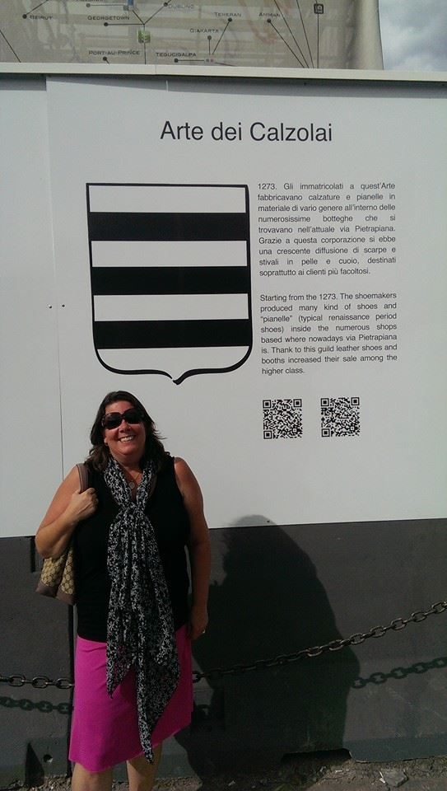
Arte dei Calzolai in Firenze

Slide 8
Why Is Apprenticeship Important?
“Learning while earning” – Apprentices earn industry recognized skills and money while learning that skill.
Apprentices can earn educational certification and college credits - graduates earn journeyworker Certificate of Completion from the state and the appropriate state license.
Avenue to skilled job-market and career opportunities.

Slide 9
Apprenticeships – The Basics
Apprenticeship program standards governed by state and federal education and labor codes and regulations.
Must be run through Local Education Agencies (LEA) – K-12, community college, ROCP.
Curriculum includes paid work experience and Related and Supplemental Instruction (RSI) courses.
Apprenticeship completion results in journey-level status.
Instructor qualifications governed by state and federal regulations.

Slide 10
Apprenticeships – In Practice
Most apprenticeships today occur in traditional construction trades:
Electrical
Iron Workers
Plumbing
Carpentry
Sheet metal
Also exist in non-construction areas, such as cosmetology, cyber security, auto and bus mechanics, HVAC.
There is interest in expanding apprenticeships, e.g. Strong Workforce Task Force Recommendation 1(c).

Slide 11
Apprenticeships – In Practice
In California, most apprenticeship is aligned with adult school or community college (RSI Money).
In the community colleges, 39 participate in a registered apprenticeship program according to the Chancellor’s Office.
Largest programs include programs offered through Santiago Canyon College, Foothill College, Rio Hondo College, and Cerritos College.
Registered Apprenticeship College Consortium (RACC) – college credit reciprocity for apprenticeship graduates.

Slide 12
Apprenticeships – In Practice
NOT funded through regular apportionment
Funded through RSI money – requires educational facility cooperative agreement
AB86 made the CCC CO the fiscal agent for apprenticeship
Usually a split of 85% to the trade union and 15% to the college
NOT usually a full-time faculty instructor but an employee of the trade union
NOT usually offered on a college campus
Most apprenticeship programs generate few college certificates and a negligible number of degrees

Slide 13
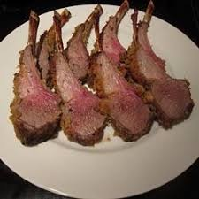
What is the “RACC?”

Slide 14
Registered Apprenticeship College Consortium
Registered Apprenticeship College Consortium – A consortium of employers, labor-management groups (sponsors), and two- and four-year colleges run by the U.S. Department of Labor.
Goal - facilitate the articulation of the Registered Apprenticeship certificate for college credit on a national scale, and increase completion of postsecondary degrees by apprenticeship graduates.
Reciprocity - Members agree to accept college credit as determined by third party evaluators.
Credit for Prior Learning – college-level equivalency of the training and education programs offered outside of the traditional college classroom setting translated into college credit equivalencies by third party evaluators.
Third Party Evaluators – Must be acceptable to the U.S. Departments of Education and Labor:
American Council on Education (ACE).
National College Credit Recommendation Service (NCCRS), established by the Board of Regents of the University of the State of New York.
Two- and four-year postsecondary institutions that provide academic program reviews with evaluation standards similar to ACE and NCCRS.

Slide 15
RACC Framework - Principles
Principle 1: Registered Apprenticeship graduates receive appropriate college credit for prior learning obtained while in Registered Apprenticeship programs.
Principle 2: Educational institutions should maintain necessary flexibility in:
Admissions, credit transfer, and recognition of other applicable learning, including through RACCs.
Scheduling and format of courses.
Academic residency requirements to offset apprentices’ mobility, potential isolation from campuses, and part-time student status.
Principle 3: Members should exhibit a clear understanding of, and support for, their respective roles in articulation efforts.
Also, 5 criteria for RACC membership…they involve academic and professional matters, so senates should review these!
More information on RACC Framework: https://doleta.gov/oa/pdf/RACC_framework.pdf
Notes:
The 5 criteria for RACC membership - Crediting Learning from the Registered Apprenticeship Certificate, Consistent Policies with Peer Colleges, Transfer of College Credit, Academic Residency Requirements, Crediting Extra-Institutional Learning.

Slide 16
Is Your College in a RACC?
Do you know if your college is in a RACC?
https://doleta.gov/oa/RACC/College_Members.cfm
What are the senate issues?

Slide 17
Role of the Academic Senate
Academic Senates are responsible for ensuring academic quality and rigor for earned college credit, no matter the funding source.
Academic Senates are responsible for ensuring appropriately prepared faculty are meeting the college’s needs for curriculum delivery.
Academic Senates are responsible for programmatic review, program creation and discontinuance, and ensuring all programs are aligned with student equity goals.

Slide 18
Apprenticeship Minimum Qualifications
Defined in Title 5 sec. 53413 for CCCs
Currently an associate’s degree plus 4 years of occupational experience, or 6 years of occupational experience, journeyworker status, and 18 units of degree applicable college level coursework (paraphrased).
U.S. Department of Labor Regulations 29 CFR sec. 29.5 specify federal requirements
Meet the State Department of Education's requirements for a vocational-technical instructor in the State of registration, or be a subject matter expert, which is an individual, such as a journeyworker, who is recognized within an industry as having expertise in a specific occupation.
Have training in teaching techniques and adult learning styles, which may occur before or after the apprenticeship instructor has started to provide the related technical instruction.
Notes:
Called out for review in SWP Law

Slide 19
Path Forward: Changes to Apprenticeship MQs
Paraphrased Draft Revision to Credit MQ Language in sec. 53413(a):
(1) Associate degree, plus four years of occupational experience – no change.
(2) Six years of occupational experience, a journeyman’s certificate where applicable, and completion of at least 12 semester units of degree applicable college level course work (in addition to the apprenticeship credits), which may be completed within two years of hire – Reduced from current 18 units.
(3) Six years of and served as an apprenticeship instructor for an approved apprenticeship training organization for a minimum of ten years – New. Adds the occupational experience requirement to the original CAC proposal.
(4) The equivalent – New language. Currently allowed, but added so that it’s explicit.
CAC provisions that made credit MQs weaker than noncredit MQs eliminated.

Slide 20
Path Forward: Changes to Apprenticeship MQs
California Apprenticeship Council adopted a proposal to change credit apprenticeship MQs on January 26, 2017.
ASCCC Apprenticeship MQ Work Group met April 6 and adopted draft language.
Hearings to be held late April/early May on draft language.
ASCCC and CAC representatives to meet in May to finalize MQ language.
ASCCC hearing and action at fall plenary.
Subsequent review and action at Consultation Council and the BOG.

Slide 21
Path Forward: Program Review
Colleges should be prepared to evaluate new apprenticeship proposals to meet the needs of their communities and workforce.
College programs in apprenticeship should be reviewed for efficacy by the college in it’s regular processes.
Programs should meet the goals of student equity the college has set.

Slide 22
Path Forward: Curricular Review
Most apprenticeship program instruction is created and approved by a state or federal agency to ensure skills and knowledge required by the trade,
Curriculum committees review appropriateness of breadth and depth required for college level instruction, if credit, and
Appropriate discipline placement for faculty preparation to meet the instructional goals of the college.

Slide 23
Some Resources
Doing What Matters Apprenticeship Site http://doingwhatmatters.cccco.edu/ForWEDDGrantees/ApprenticeshipToolKit.aspx
U.S. Department of Labor
Apprenticeship USA: https://www.dol.gov/featured/apprenticeship
Registered Apprenticeship College Consortium (RACC) Information: https://doleta.gov/oa/racc.cfm
California Department of Industrial Relations (DIR)
DIR Division of Apprenticeship Standards Site: http://www.dir.ca.gov/das/das.html
California Apprenticeship Council: http://www.dir.ca.gov/cac/cac.html

Slide 24
Questions?
John Freitas freitaje@lacitycollege.edu
Dolores Davison davisondolores@fhda.edu
John Stanskas jstanskas@valleycollege.edu
Thank You!

