Slide 1
Apprenticeship 2019 ASCCC Career and Noncredit Education Institute
Craig Rutan, ASCCC Secretary
Thaïs Winsome, Mission College

Slide 2
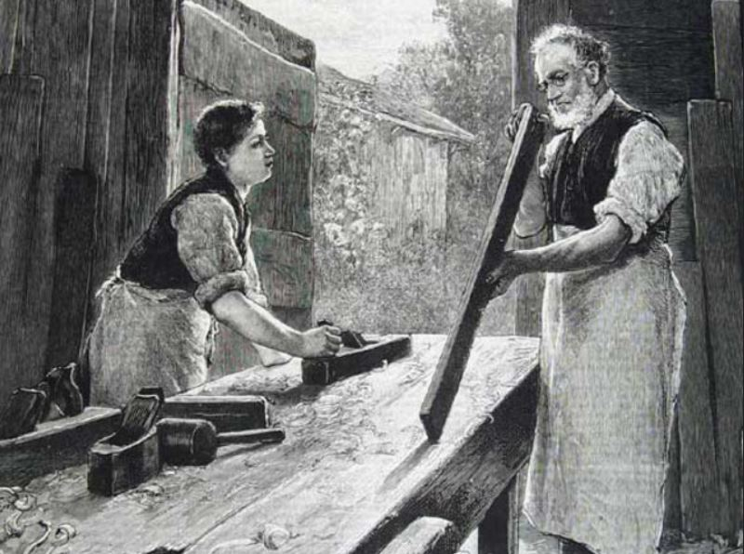
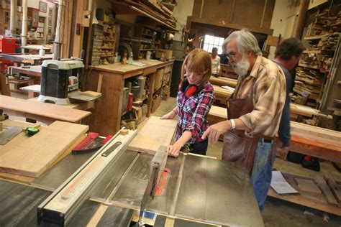
Outline
The Apprenticeship Program Defined
Attributes of apprenticeship programs
Developing the Apprenticeship Program
Caveats and potential pitfalls
Resources

Slide 3
In Medieval Times…
Guilds were formed to provide training, ensure quality, protect jobs, and provide a sense of stability around certain occupations that were considered “the trades.”
By the late 13th century, in order to become a guildman, an individual had to go through three levels of training:
Apprentice
Journeyman
Master

Slide 4
Medieval Times - Stages of Training
Apprenticeship: usually a young man in his teens whose parents paid to have a master take him on.
Journeyman: entitled to a salary but worked under the direction of a master.
Master: owned the shop and employed both apprentices and journeyman.
This historical nomenclature is still used today.

Slide 5
Apprenticeship is
A training program that combines classroom instruction or education with on-the-job training under the close supervision of a skilled worker in a craft, trade, or profession.
~ 4 hours On-the-Job Training (OJT) for every hour of Related and Supplemental Instruction (RSI)

Slide 6
Why Is Apprenticeship Important?
“Learning while earning” – Apprentices earn industry recognized skills and money while learning that skill.
Apprentices can earn educational certification and college credits - graduates earn journeyworker Certificate of Completion from the state and the appropriate state license.
Avenue to skilled job-market and career opportunities.

Slide 7
Apprenticeships – The Basics
Apprenticeship program standards governed by state and federal education and labor codes and regulations.
Must be run through Local Education Agencies (LEA) – K-12, community college, ROCP.
Curriculum includes paid work experience and Related and Supplemental Instruction (RSI) courses.
Apprenticeship completion results in journeyperson-level status.
Instructor qualifications governed by state and federal regulations.

Slide 8
Apprenticeship is a partnership
PARTNERS:
PROVIDES:
EMPLOYER Jobs/training
PROGRAM Oversight
APPRENTICE Time

Slide 9
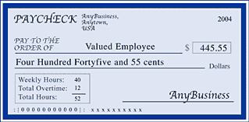
Commitment from Employer
Employer Commitment
Employer contributes
Employ apprentice
Train apprentice
Pay agreed rates
Agreed advancements
Support Program Sponsor
Hours
Skilled supervisor
$
$
$

Slide 10
Commitment from Apprentice
Apprentice commitment
Apprentice earns
Works for reduced rate
Focus on learning
Attend Class
Meet learning criteria
$
On Job Training
RSI
MITC

Slide 11
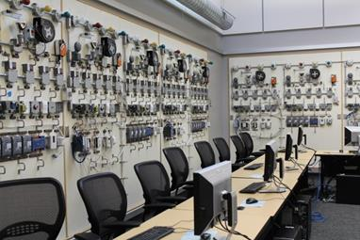
Program Commitment
No Cost to Apprentice
Equal Opportunity Application Process
Develop and Monitor MITC (Minimum Industry Training Criteria)
Monitor OJT (On-the-job training)
Design & Monitor RSI Curriculum
Recruit & Monitor RSI Instructors
Financial Administration (Partner with LEA)
Government Compliance

Slide 12
Apprenticeships – Typical Practice
NOT funded through regular apportionment
Funded through RSI money and by labor trust funds – requires educational facility cooperative agreement with apprenticeship program sponsor, typically a Joint Apprenticeship Training Committee (JATC) for a given trade.
AB86 made the CCCCO the fiscal agent for apprenticeship
Usually a split of 85% to the trade union and 15% to the college
NOT usually a full-time faculty instructor but an employee of the trade union
NOT usually offered on a college campus

Slide 13
Attributes of Apprenticeship Programs
How do apprenticeship programs differ from other programs?
Statutory Requirements and oversight
Admission
Length to completion
Funding and attendance accounting
Restriction on enrollment
Off-site instruction
Minimum qualifications of faculty
Curriculum development
Students

Slide 14
Attributes of Apprenticeships – Statutory requirements and oversight
All California Education Code & Title 5 statutes regarding programs and curriculum apply for apprenticeships just as they do for regular programs
This includes regulations regarding hiring and evaluation of faculty
Apprenticeships must also meet additional statutes and regulations
California Labor Code, sections 3070-3098
California Code of Regulations, Title 8, Division 1, Chapter 2, Subchapter 1
California Education Code, sections 76350, Section 79149 (new section as of July 2018)
Apprenticeships are under additional oversight of the Division of Apprenticeship Standards

Slide 15
Attributes of Apprenticeships – Admission & Matriculation
Students are already employed as apprentices in the field
Apply for admission through the sponsor
May not follow CCCApply or other college process
May require special processing on the part of Registrar’s Office
Should still be considered fully-matriculated students of the institution
Apprentices do not pay fees or other charges for any course of activity or community college course related to their program
Includes GE or other courses associated with apprenticeship degree or certificate
Fees or other charges may be required for GE or other courses taken outside of the apprenticeship program but allow students to earn additional degrees or certificates

Slide 16
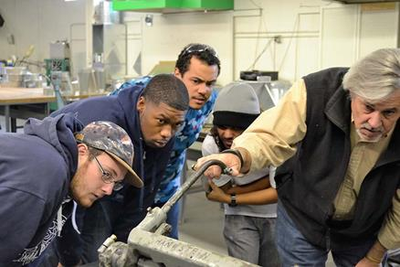
Attributes of Apprenticeships – Length to Completion
Completion of the program may take many years
1000s of hours of on-the-job training
Students are completing program course requirements off-site, odd hours
Competency and General education requirements have to fit in around the apprenticeship requirements
Completion of additional non apprenticeship courses may allow students to receive a degree or certificate in addition to their apprenticeship certificate or degree.

Slide 17
Attributes of Apprenticeships – Funding and Attendance Accounting
Traditionally funded by local grants and/or federal/state agreements through Related & Supplemental Instruction (RSI) funds, aka Montoya funds
AB 1809, effective July 1, 2018, will significantly impact funding for RSI.
Attendance Accounting
Positive attendance for most core courses
For RSI funds accounting is done through the 321 (not 320!) accounting process

Slide 18
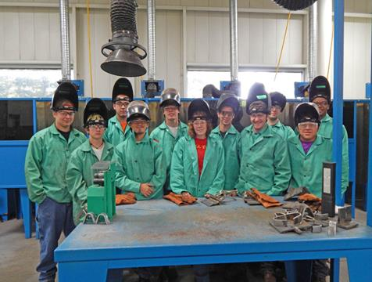
Attributes of Apprenticeships – Restrictions on Enrollment
Students often complete program as a cohort
Apprenticeships courses may legally restrict enrollment only to students enrolled in the program
This does not apply to non-apprenticeship competency/general education courses or other courses that are used to fulfill requirements for a degree or certificate

Slide 19
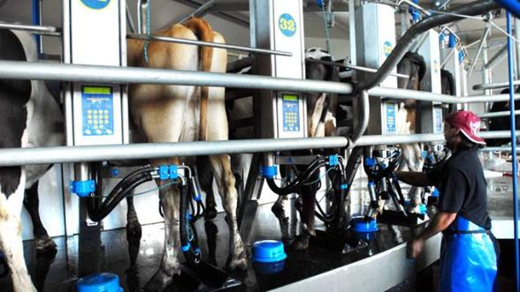
Attributes of Apprenticeships – Off-site Instruction
Off-site Instruction may occur at odd times, odd places
This can create challenges for on-campus faculty who participate in the hiring, observation and evaluation of apprenticeship faculty.
May require MOU or other agreement with faculty union to allow instruction under conditions other than specified in regular contract

Slide 20
Attributes of Apprenticeships – Faculty Minimum Qualifications
Minimum Qualifications effective May 14, 2018
Possession of an associate degree, plus four years of occupational experience in subject matter to be taught
Or
Six years of occupational experience in the subject matter to be taught, a journeyman’s certificate in subject matter and completion of 12 semester units of apprenticeship or college level course work. The 12 units may be satisfied concurrently during the first two years of employment as an apprenticeship instructor.
Additional new language on emergency hires for apprenticeship faculty.

Slide 21
Attributes of Apprenticeships – Curriculum Development
There is a strong probability that no current college faculty have expertise in the apprenticeship field, especially if it is a trade or a new apprenticeship program
The curriculum committee may be asked to work with a curriculum that has been previously developed for another college’s program or for a training program offered by the sponsor
The curriculum committee may need to work directly with apprenticeship content experts to translate courses and programs into PCAH-compliant community college curriculum

Slide 22
Attributes of Apprenticeships – Student goals and engagement
Students are working full time in the field
Workload plus off-site instruction require that the college reach out to the students rather than the other way around
Strong recommendation: have a liaison person on college staff to coordinate student outreach and continued contact
Keep students appraised of college milestones
Assist with any student-services related issues

Slide 23
Developing the Apprenticeship Program
Initial contact with Union/Industry Partner(s)
Shared governance process
Program faculty & Academic Senate
Student services
Establish MOU, Local Education Agency (LEA) and any ancillary contracts
Establish college infrastructure
advisory committee, if required by district governing board
local faculty representation
accounting infrastructure
Develop curriculum (credit or noncredit)
Follow approval process
Obtain DAS approval documentation
Submit program for approval by local board and CO

Slide 24
Developing the Apprenticeship Program – Initial contact with union/industry partner(s)
Local labor needs may prompt colleges to create a local apprenticeship programs based on programs established at community colleges in other geographical areas
Established apprenticeship programs may choose to expand the scope of offerings based on local needs
Existing apprenticeship programs may choose to move from one college to a different college for a variety of reasons
New opportunities may arise in the community
Example: Santa Clara Valley VTA Transportation Apprenticeship Program

Slide 25
Developing the Apprenticeship Program - Shared Governance Process
Apprenticeships are academic programs, and as such require review and approval by the Academic Senate
College based faculty will need to support new college apprenticeship programs
Curriculum must be approved by college Curriculum Review Committees
Apprenticeship faculty must be hired, observed and evaluated by faculty
SLOs will need to be assessed for all programs offered by the college including apprenticeship programs.
Counseling, Admissions and Records and other support services may need to be in place to support the students
GE and competency courses may be needed to support a degree available for students and may need to be offered in a manner that supports their unique needs of these students (e.g. distance education, classes offered off-site at non-traditional times)

Slide 26
Developing the Apprenticeship Program - Shared Governance with College Constituency Groups
Do College-based faculty, Student Services and other units have the capacity to handle unique needs of apprenticeship programs and students?
Faculty, Classified and Administrators that will be affected by increased workload should be consulted for buy-in and approval
Examples of issues that may arise
Manual coding of fee payment waivers
Processing of large numbers of positive-attendance rosters
Special scheduling processes to accommodate off-term or oddly-scheduled classes

Slide 27
Developing the Apprenticeship Program – Department of Apprenticeship Standards (DAS) and Local Documentation
Develop DAS24 documentation – State of California Department of Industrial Relations form establishing the partnership between Labor program and Local Education Agency (LEA)
Approve MOU between Labor program and LEA (COMMUNITY College)
Approve any ancillary contracts
e.g. noncredit or not-for-credit instruction in ESL offered through the college but not part of the actual apprenticeship program

Slide 28
Developing the Apprenticeship Program - Establish college infrastructure
College must decide whether to have a local faculty group, such as a department, take on primary oversight of the program or maintain oversight wholly within an administrative unit
Faculty must be in place for curricular oversight and faculty evaluations, per Ed Code
Bulk of faculty may be off-site practitioners but still part of college faculty for purposes of evaluation
The apprenticeship program will need clerical/administrative support at the college level similar to other department or programs

Slide 29
Developing the Apprenticeship Program - Develop Curriculum
Both credit and noncredit courses may be included in apprenticeship programs
Core apprenticeship courses will require a discipline-specific TOP Code (or as close as possible)
Some programs include Work Experience
CO requires that the Work Experience carry a discipline-specific TOP Code
Ensure that curriculum meets all statutory requirements and Chancellor’s Office guidelines
Units and hours
Prerequisites
Note that apprenticeship partners may not have prior experience with community college curriculum

Slide 30
Developing the Apprenticeship Program - The Approval Process
Obtain DAS approval documentation
Requires application and review – allow time for this!
Obtain review by regional consortium, if desired (not required)
Submit program for approval by local board and Chancellor’s Office
Program narrative specific to apprenticeships
labor-market analysis
DAS approval letter
Apprenticeship programs, with and without noncredit instruction, still require full approval by the Chancellor’s Office (as of this writing)

Slide 31
Best Practices, Caveats & Potential Pitfalls
Apprenticeship has a long history, and the construction crafts and trades are very proud of that history.
The “apprenticeship community” (i.e. the trades) are very proud of the quality of their programs. However, apprenticeship is expanding beyond the traditional trades into areas that don’t necessarily have the same history with apprenticeships (and it’s important to be mindful of that).
The apprenticeship community has a very strong sense of ownership because they are training their future colleagues through their apprenticeship programs, and their best apprentices are typically future apprenticeship instructors.
Real or perceived lack of respect from college faculty can lead to friction and mistrust.
It is important for senate and curriculum leaders to build mutually respectful relationships with apprenticeship program sponsors and the apprenticeship community to foster understanding of each other’s processes and practices. Consider attending a California Apprenticeship Council meeting.

Slide 32
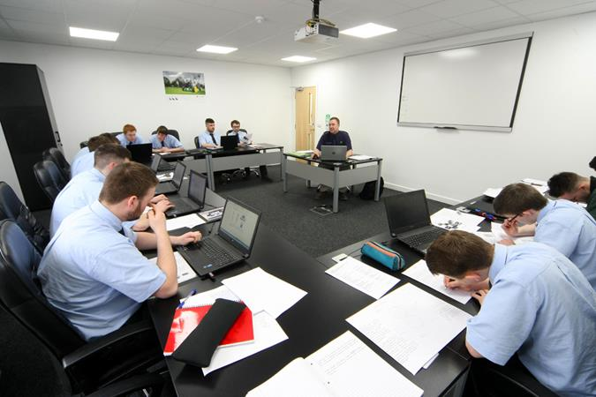
Questions??

Slide 33
Resources
PCAH (Program and Course Approval Handbook, 6th ed.)
http://extranet.cccco.edu/Portals/1/AA/Credit/2017/PCAH6thEditionJuly_FINAL.pdf
Division of Apprenticeship Standards
https://www.dir.ca.gov/das/das.html
California Apprenticeship Council
https://www.dir.ca.gov/cac/cac.html
Chancellor’s page on Apprenticeships
http://extranet.cccco.edu/Divisions/AcademicAffairs/CurriculumandInstructionUnit/Apprenticeship.aspx

Slide 34
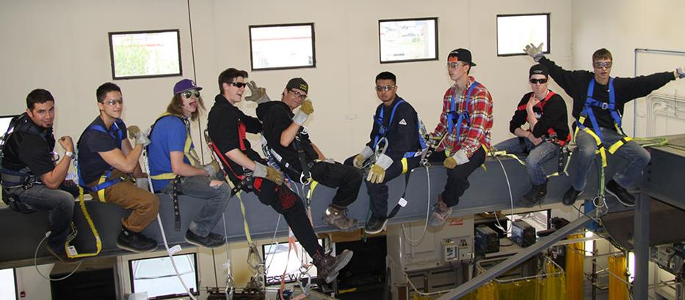
THANK YOU!!

