Slide 1
Equity-Mindedness for Hiring in a Virtual Format During a State of Emergency: Follow-up Session
Mayra Cruz, Area B Representative (she/her/ella)
Dr. Luke Lara, Faculty Leadership Development Committee member (he/him/his)
Dr. Valyncia C. Raphael, Director of Diversity, Compliance, and Title IX Coordinator, Cerritos College, ACHRO (she/her/hers)
Friday, April 10, 2020
11:00 p.m. -- 12:00 p.m.

Slide 2
Today, we will...
Answer questions
Offering ways to apply the content covered in “Equity Mindedness for Hiring in a Virtual Format During a State of Emergency” webinar on April 8th

Slide 3
Questions During Webinar
Type your questions in the Q&A box

Slide 4
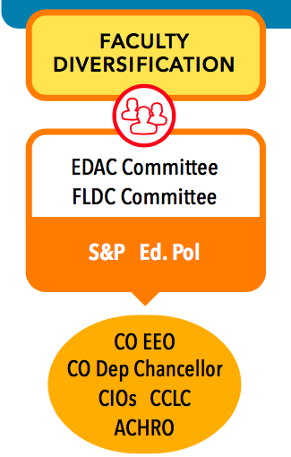
ASCCC Faculty Diversification Goal
Having faculty of color in the college I attend is essential to a meaningful and engaging college experience. As a student of color, I feel represented in my college when a faculty member look like me and empathizes with my experiences. It gives me a sense of belonging, and encourages me to further engage with my learning experience.
--Tiffany N. (Foothill College)
Notes:
Question posed to students: Why does having a faculty of color matter to you?

Slide 6
Overview
Conversations about question development
Assessment: Interview, 2nd minimum qualification/document and teaching
Notes:
Have norming conversations about what are the key components of each screening criteria.
Evaluate resume: major/coursework, work abroad or in diverse communities, geographic diversity, work/learning at HSI, BSU, tribal college, high school with similar student population, awards/publications/presentations related to EDI work

Slide 7
Example: Interview Question Development
Desirable Qualification: Knowledge and use of technology in counseling.
Interview Question: New technologies are transforming effective counseling. Please describe how you have used technology to enhance learning for first-time-to-college students aged 25 and over.
Components of Model Answers:
Currency and depth of knowledge of current counseling technology tools for career development and transfer preparation
Consideration of needs and challenges specific to adult students
Value and awareness of multiple modalities to communicate with and meet student needs
Notes:
Behavioral Based Questions 3 Part Formula
*Helpful lead in
*Open-ended question
*Desired behavior
“Good/model” answers demonstrate success in related contexts

Slide 8
Rubrics
Building a rubric
A practical sample

Slide 9
Building Rubrics
Identify your criteria
Map out your rating scale
Set up the criteria and ratings w/in your preferred framework
Plug in your information & refine
Notes:
Identify your criteria
Job description
Mission/values statement
Diversity statement
TIP - These should match the questions you are asking the application documents/or the applicant in interviews questions
Map out your rating scale (e.g. 0-5, 0-10)
Set up the criteria and ratings w/in your preferred framework (each item should have a description)
Plug in your information & refine
TIP - Use can be fore one question, a series of screeneing items, diversity questions or stand alone items

Slide 10
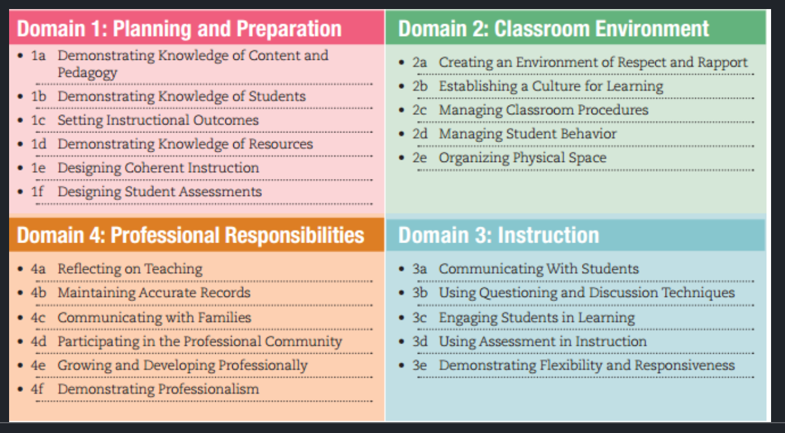
Example - Teaching Skills Source Materials
Danielson’s 4 Domains of Teaching
(Danielson, 2013)
Notes:
Can be Danielson’s 4 domains, could also use Bloom’s taxonomy, etc.

Slide 11
Example: EEO/Diversity Statement and Rubric
Example: This position may require you to apply relevant knowledge, skills, and/or abilities in some or all of the following job functions: (1) curriculum development; (2) learning activities; (3) teaching/counseling practices; or (4) library reference services or collection development.
Prompt: Please reflect on one of the above job functions and give one or more examples of how you have or would create, modify, and/or perform it to meet the needs of a diverse student population.
Notes:
One point of data that can be used to triangulate assessment of 2nd minimum qualification
Often, a supplemental question on application or separate document

Slide 12
EEO/Diversity Statement Rubric continued
Rubric: KSAs related to 2nd minimum qualification and college’s goals for DEI
Minimal evidence (0 points)
Candidate only provides one or less examples. Candidate does not demonstrate an awareness of knowledge, skills, and/or abilities (KSAs) necessary to contribute to fulfilling the college’s goals for diversity, equity, and inclusion.
Partial evidence (1 points)
Candidate only provides one or two examples. Candidate shows an awareness of KSAs necessary to contribute to fulfilling the college’s goals for diversity, equity and inclusion. AND/OR
Candidate shows a readiness for KSAs necessary to contribute to fulfilling the college’s goals for diversity, equity and inclusion.
Complete Evidence (3 points)
Candidate gives two or more concrete examples of times when they applied KSAs or how they would apply KSAs that would be necessary to fulfill the college’s goals for diversity, equity and inclusion. The candidate includes evidence of critical self-reflection through use of data to inform decisions.

Slide 14
Resources
Danielson, C. (2013). The framework for teaching evaluation instrument, 2013 instructionally focused edition. Retrieved January, 17, 2017.
University of California - Berkeley Office for Faculty Equity & Welfare. (2018, August). Rubric to Assess Candidate Contributions to Diversity, Equity, and Inclusion https://ofew.berkeley.edu/sites/default/files/rubric_to_assess_candidate_contributions_to_diversity_equity_and_inclusion.pdf
Notes:
Additional resource:
This rubric was created using the Association of American Colleges and Universities (AAC&U) Critical Thinking VALUE Rubric. Retrieved from https://www.aacu.org/value-rubrics
Intercultural Knowledge and Competence Value Rubric.

Slide 16
For Further Information and Support
Visit the COVID-19 Faculty Resource page
Email info@asccc.org
Always ask your local Human Resources or legal council
Contact Info:
llara@miracosta.edu
cruzmayra@fhda.edu
vraphael@cerritos.edu

