Slide 1


Assessment Pandemonium
Academic Academy
October 8, 2020

Slide 2
Assessment Pandemonium – Lessons Learned
Janet Fulks – Co-Chair ASCCC Guided Pathways Task Force
John Gerhold – Music Professor, Bakersfield College, President MACCC
Meridith Selden – Psychology Professor, Yuba College, ASCCC Guided Pathways Task Force Faculty Lead
A sudden transition to remote instruction requires not only changes in teaching, but changes in how you measure learning.
What can we learn from the unstructured experimentation that ensued in higher education as a consequence of COVID-19?
How did faculty find effective ways to measure learning?

Slide 3
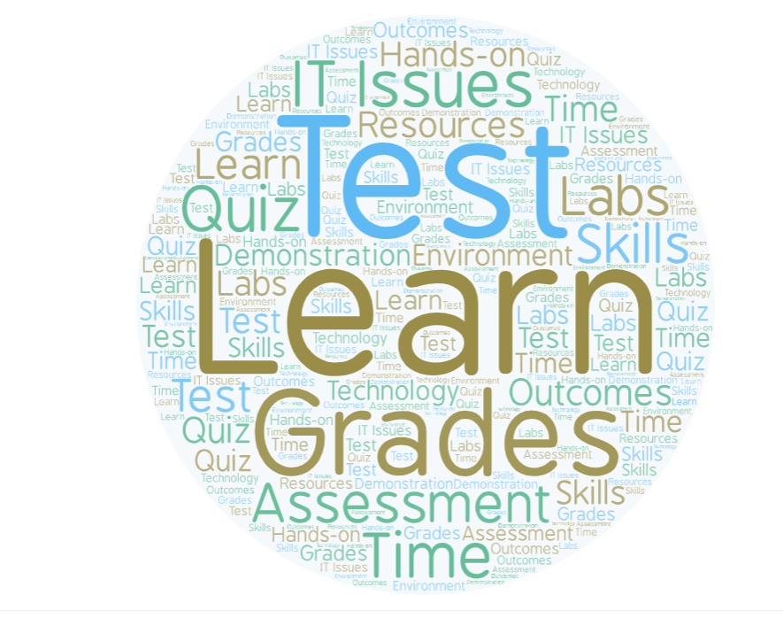
Today’s Presentation
How extensive were the challenges?
Identifying Issues
Analysis
Design Process
  Maintaining Rigor and Accuracy
  Validity and reproducibility
  Potential Answers
Resources
Notes:
ASCCC webinars in Spring 2020 revealed a cacophony of issues and frustration by faculty and students. Several listening session were held to identify issues, potential answers and share strategies. The Spring issues were greatly impacted by a short timeline (for some overnight) in moving remotely. The tools and experience were in short supply. Faculty were constantly moving between new tasks, technology difficulties, communication gaps and a relentless barrage of messages about requirements, ed code, grading, timelines, etc. Students were lost in a virtual world – some struggling to find the course, others impatient with faculty inexperience in this delivery, many with children at home, job changes and issues health or family. Faculty struggled as they identified student integrity issues and access issues. These reports were summarized by ASCCC and follow-up webinars and PD were planned and executed. The Academic Academy presentation today is a result of those issues. To follow –up a survey was distributed by the presenters to the ASCCC listserv in an effort to identify whether there were existing issues, identify those current issues and determine a little about the core of those issues. This presentation reports on those survey results and some solutions offered by faculty, @ONE and other colleges and universities to address the unique issues of assessment in a COVID-19 environment where many faculty and students are online whether they want to or not. The vast majority felt that in Spring 2020 there were major issues primarily due to lack of preparation and training; fall 2020 some faculty felt that they were able to adjust and improve to a great extent
NOTE: Several people who shared extreme frustration in Spring 2020 had changed their perspective and found they had learned skills they would use even F2F – but EVERYONE stated that the amount of work and time was very extensive.

Slide 4
Input from Assessment Survey 425 Responses (67% Full-time faculty, 32% Part-Time Faculty, 1% other)
Notes:
The vast majority felt that in Spring 2020 there were major issues primarily due to lack of preparation and training; fall 2020 some faculty felt that they were able to adjust and improve to a great extent
The first question was developed on a decision try to determine whether people thought ANY assessment could be done online – only 13% felt that it could not be done, although 43% felt it was dependent on discipline. However, 60% of the respondents reported that the abrupt move to online was difficult.
A huge variety of disciplines
Administration of Justice/Criminal Justice 2 Advanced Biomedical Equipment Technology Aeronautics/Aviation 2 Anthropology 3 dean DE coordinator 3 Art /Art History,/sculpture/studio art 11 Non-classroom animation and visual effects/digital media 2 DSPS Architectural Design Technology
2 Dual Enrollment Automotive 3 Articulation Officer Biology 20 Instructional Technology Anatomy and Physiology 4 Library Microbiology 1 Student Services Business 9 Accounting 7 Microsoft Applications 1 Chemistry 22 Computer Science CIS/CISP 12 Communication 11 Cosmetology 1 Counseling 11 CTE 1 Culinary Arts/ Hospitality 2 Dance 2 Deaf Culture/ASL 1 Design & Engineering Technology 4 Early Childhood Education 8 Earth Science 1 Economics 5 Electronics 3 Energy 1 English (Reading) 49 ESL 14 Fashion 2 Film 2 Fine Art 3 Fire Tech Foreign Languages Funeral Service Education Geography/Geoscience 5 Gerontology 2 history 6 Horticulture / Plant Science/landscape architecture 2 HVAC Human Career Development 4 Humanities 3 kinesiology 3 Online Course design 1 Mathematics/stats 44 Medical Assisting 1 Mortuary Science 1 Music 4 Nursing 2 Nutrition 5 Physics/Astronomy 9 Political Science 4 Psychology 12 Respiratory care 1 Social Sciences 2 Sociology 6 Spanish 1 Speech pathology 2 STEM 1 Theater/TV/Film 4 Veterinary Science/Animal Science 1 Women/Gender/Queer Studies, English (literature and composition), Social Justice Studies 1

Slide 5
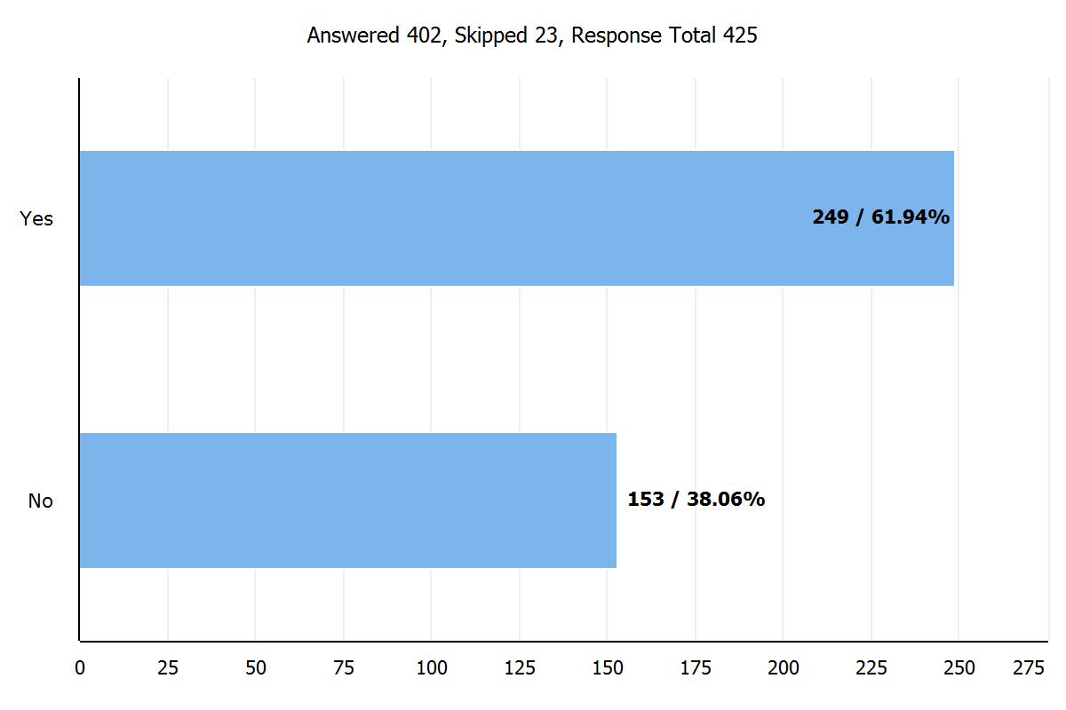
Did you encounter any issues with assessment in the online environment?
Notes:
However, 62% of all respondents indicated that they had encountered issues assessing in the online environment. As expected, those faculty who had been online before the event or those with hybrid classes found fewer issues.

Slide 6
Identifying the issues
  Time (Both Faculty and Student)
  Technology Issues
  Student Access and Equity
  Integrity
  Teaching Strategies and Pedagogy
Notes:
The issues identified by the respondents included the huge investment of time to get content online, the time to reformat assessments and the ongoing time requirements grading and communicating with students, trouble shooting IT issues and reaching out to students.

Slide 7
How would you interpret these data?
Notes:
Meridith

Slide 8
Mean = 6.32
Notes:
Meridith
Overall 53% selected on a scale of 1-10 – 7 and above 25% selected 4 and below

Slide 10
Identifying the Issues
Analysis
  Some very specific issues with technology
  Discipline issues related to assessment
  Complex issues and interpretation (e.g. equity, integrity, privacy, socioeconomic status)

Slide 11
Analysis
Notes:
Janet – Using the initial responses in Spring 202 we asked for an update on issues; Answers to this question include many faculty struggling with feeling as though they were not adequately able to help students show what they had learned, meet learning outcomes and coach them to gain appropriate skill levels. There was frustration with getting materials, equipment, and technology. There were issues with inability to produce assessments and assessment responses by students – unique to the language of disciplines e.g. scientific notation, mathematic symbols, visuals etc. Even photos were not equally accessible or accurate given different platforms or hardware limitations. Streaming worked for some but others indicated frustration with broadband access.

Slide 12
Notes:
Meridith

Slide 14
None of the virtual simulation tools give us a good assessment of how the students are learning. Students with needs/issues do not have a chance to see their what they are.
Survey Comments about Issues
Student's home environments interfere with full engagement with classes
Proctorio on Connect is worthless
Online proctoring software is invasive and not equitable for students.
Biggest problem is the differences in students’ hardware, apps, reliable Wi-Fi, etc. There is not a level playing field which is problematic.
Notes:
Comments on design from survey

Slide 15

Analysis
It's less about the discipline and more about the kind of assessment the class typically uses. Collaborative efforts, like projects, dances, theatre performances, etc.
Disciplines that might have difficulty
Performance based courses – theater, music, choir, band, studio arts, dance, communication
Courses requiring special equipment – Welding, Auto, Information Technology, Computer Science (servers etc.)
Product based courses – Culinary Arts, Art, Ceramics, Manufacturing, Engineering
Skills based Courses – Welding, Auto, Nursing, Allied Health, Embalming, Fire, Police
Activity Courses – PE, Dance
Any disciplines where lower socioeconomic classes of students were found to be lacking in basic technology required to carry out an effective online teaching environment.
Notes:
Janet or John

Slide 16
Fluctuation in Student Performance
Exam #2 was directly AFTER the transition to emergency remote education
Notes:
Meridith – A real life example of the issues that arose in Spring 2020

Slide 17
Fluctuation in Student Performance
Far fewer “D”s….
Notes:
Meridith – and share conclusions about adjusting and this semester using open book and able to adapt better. Also share the difference between higher level course assessments and lower level course assessments.

Slide 18
John’s Music Class
Notes:
In addition to issues with online quizzing. It is difficult to hear the notes due to technical issues, software and hardware as well as internet connection does not provide clear ability to assess students in music. John shares the example at his piano and the difference in sound etc.

Slide 19
Identifying the issues
Design Process
  Purpose of Assessment
  Design principles
  Student Learning Outcomes (Rigor, Accuracy, Assessment Validity and Reproducibility)

Slide 20
Purpose of Assessment
Require a grade
Achieving/Measure/Validate Learning Outcomes
Adhere to accreditation and federal standards
Fairness – within course, within sections, within program, within college
A Tool to recognize equity issues
Guarantee skills are achieved
  Acquiring skills for a sequence
  Acquiring skills for work

Slide 21
Assessment for Learning
Feedback to student is formative, rapid and designed to provide specific improvement. Low stakes, focuses on individual students.
Assessment as Learning
Students learn as they are engaged in the learning process, including self-assessment, learning styles and strategies.
Teachers learn as they evaluate of assessment tools and outcomes.
Assessment of Learning
Evaluation in a summative sense that holds student performance up to standards, expectations and achievement/performance.
Assessment for Institutional Improvement
Institution-wide look at assessment results, focusing on cohorts and goals, using results for large scale improvement.

Slide 22
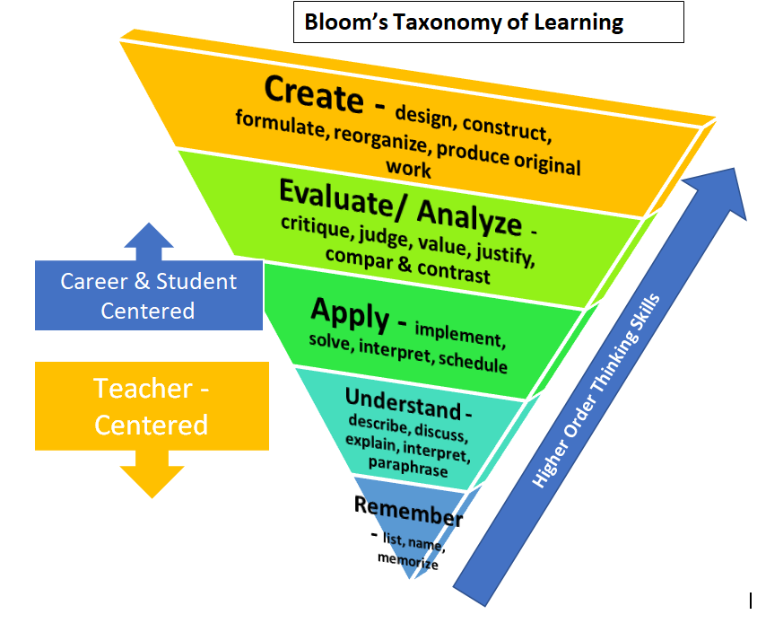
Design Process
Bloom’s Taxonomy
Notes:
Align interventions and messaging
Explain appropriate citations/references, notetaking, paraphrasing
Have student email you about academic integrity(see resources)
Consider difficulties for students (access to materials, time, etc.)
Create assessments at the highest Blooms taxonomy levels
Construct rubrics to provide points for good academic behavior
Different student products and easier to see students sharing answers

Slide 23

Maintaining Rigor and Accuracy
Validity and Reproducibility
This is an update regarding how UC will handle articulation agreements with California Community Colleges (CCCs) for the 2020-21 academic year. All 9 undergraduate UC campuses have once again agreed to operate under the following general principles:
UC will honor established articulation agreements and rely on local CCCs to do their best in fulfilling the terms of the articulation as described in the approved CORs (Course Outlines of Record).
Temporarily revising CCC course offerings (e.g., science courses with in-person labs that transition to online lectures with virtual labs or some other lab substitute) is acceptable and will not pose an issue for UC as long as the intended student learning outcomes are met. Such practice already exists now with credit by exam, whereby unit credits for transfer are earned based on demonstrated outcomes or competency in the course, and not based solely on student learning hours.
Support of these principles has been affirmed by UC campus Admissions Directors, as well as our relevant faculty Academic Senate committees: the Board of Admissions and Relations with Schools (BOARS) and the University Committee on Educational Policy (UCEP). Continuing to follow the approach as outlined above will allow us to use established articulation agreements without having to alter them for any temporary accommodations due to the pandemic.
In addition, the UCOP Transfer Articulation team will maintain our usual practice of approving CCC courses for transferability based on the UC Transferable Course Agreement (TCA) Guidelines<https://www.ucop.edu/transfer-articulation/transferable-course-agreements/tca-policy/regulations-by-subject-area.html> – which do not factor in the course delivery mode (online, in person, or hybrid). Once CCC courses are approved for UC-transferability, they are then eligible for campus-level approvals for course-to-course articulations.
Notes:
We are not able to just redefine grading. We meet the standards of our transfer colleges and our trade and vocational expectations.

Slide 24
We need to get our head out of the old-world view that learning assessments have to require memorization & regurgitation. There are SO many exciting and innovative ways to take advantage of resources we could not use before. For example, I have made much more use of Google Earth, a resource that was not available in my face to face class.
Survey Comments about Designing Assessment
Switched from a closed book to an open book exam
I provide performance-based assessments that ensure student completion: oral presentation, flip grid recordings, multiple drafts of writing, etc.
So many faculty still "test" - but assessment is so much more.
Notes:
Comments on design from survey

Slide 25
Selecting the Right Assessments
Formative Assessment
Summative Assessment
Low stakes – do not heavily influence grades
Often addresses learning objectives (lower level than SLOs)
Rapid feedback (powerful effect on retention)
Opportunity to retake, improve, correct
Helps students improve skills
Helps faculty improve practices (communication, lecture, assessment)
More group work
Self-assessment
Lower Bloom’s (sometimes)
https://resources.depaul.edu/teaching-commons/teaching-guides/feedback-grading/Pages/low-stakes-assignments.aspx
High stakes – more points to influence grades
Directly related to learning outcomes
More individualized answers (Problem solving, analysis, evaluation)
Requires synthesis across the course or program
Some disciplines – performance, hands on, portfolio, product, presentation
https://resources.depaul.edu/teaching-commons/teaching-guides/feedback-grading/Pages/high-stakes-assignments.aspx
Notes:
Course level, prerequisite skills and student learning outcomes will determine many aspects of the assessments. However, a general structure validated by many teaching and learning centers includes looking at assessments from two design strategies. This information is not new and this online environment gives us an opportunity to re-examine what we are doing based upon the time and effort for students and faculty aligned with the stakes assigned to the assessment.
https://stearnscenter.gmu.edu/wp-content/uploads/20-PPF-Low-Stakes-Assessment-HANDOUT.pdf

Slide 26
George Mason University
Teaching in a Pandemic: Low-stakes assessment and student accountability stearnscenter.gmu.edu/wp-content/uploads/20-PPF-Low-Stakes-Assessment-HANDOUT.pdf
Restructuring Assessments
Provides low stakes frequent assessments – only a portion of a learning outcome, small impact on overall grade)
Promotes accountability and time management – regular work requires students create time and stay on task
Provides more student interaction– better understand individual students, regular feedback enhances retention
Illuminates course adjustments - frequent results inform course flow, content mastery
Addressing faculty and student time
Students can identify areas to spend more time
Faculty adjust feedback – automatic, self-check or retake, combined common errors message, rubric, voice recording
Notes:
Quote from GMU handout - “Busywork” and “spoon-feeding” identify tasks that have no value to learners or even set the learners back, by asking them to invest time with a poor return or to avoid responsibilities. When you believe and communicate values like the ones listed here, you and students can move forward into low-stakes assessment with more confidence: • This assessment provides crucial feedback to students about how their learning is going, so students can correct problems early or seek additional resources—both of which are signs of independent, long-term learning strategies • This assessment provides crucial feedback to faculty about student learning, so that faculty can improve their support for student learning around particularly difficult tasks • This assessment helps students to solidify their understanding of basic concepts and applications so that they will be more prepared for complex individual performances (exams, projects) later in the course

Slide 27
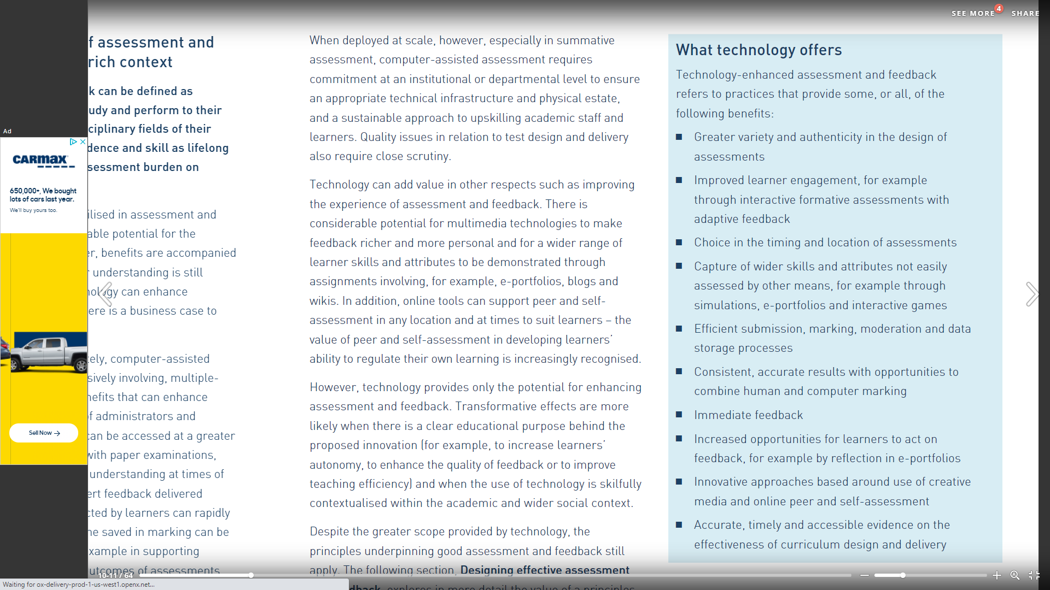
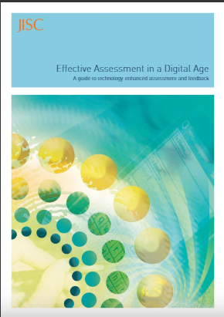
Potential Advantages to Online Assessment
https://issuu.com/jiscinfonet/docs/jisc_effective_assessment_in_a_digital_age_2010
Notes:
• Greater variety and authenticity in the design of assessments; • Improved learner engagement, for example through interactive formative assessments with adaptive feedback; • Choice in the timing and location of assessments; • Capture of wider skills and attributes not easily assessed by other means, for example through simulations, e-portfolios and interactive games; • Efficient submission, marking, moderation and data storage processes; • Consistent, accurate results with opportunities to combine human and computer marking; • Increased opportunities for learners to act on feedback, for example by reflection in e-portfolios; • Innovative approaches based around use of creative media and online peer and self-assessment; Accurate, timely and accessible evidence on the effectiveness of curriculum design and delivery. (p. 9)

Slide 28
Identifying the issues
Resources
  @ONE courses
  National Institute for Learning Outcomes Assessment (NILOA)
  Resources from Other colleges
  Resources from this presentation

Slide 29
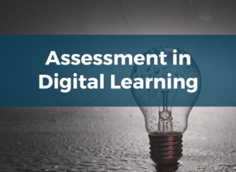
Outcomes - By the end of this course, participants will be able to:
1. Create assessments aligned to the OEI Course Design Rubric
2. Develop unit-level learning objectives in student-centered language with demonstrable learning outcomes
3. Design a variety of valid and authentic formative and summative assessments aligned to the course objectives
4. Design student self-assessments;
Write clear and detailed assessment instructions
5. Create clear descriptive rubrics that support desired outcomes
6. Develop an assessment plan for one unit of your course that supports regular assessment with timely, meaningful feedback.
https://onlinenetworkofeducators.org/course-cards/assessment-in-digital-learning/
Notes:
Description
Assessment is not just for testing anymore! This course explores the concept of assessment as a design tool that allows you to build a course centered around student learning. In this course, we’ll explore a design process called the assessment loop, looking at the ways clear learning outcomes, thoughtfully designed assessment, and analysis of assessment results can help you engage your students and build a better course. The course covers writing clear unit-level learning goals, aligning assessments to learning goals, developing authentic summative assessments and developing formative assessments that provide rich and meaningful feedback for students. In addition, we’ll explore various assignment options in Canvas, and develop an overarching plan for using assessments in digital learning environments.
Details
Fulfills: This course is part of the Certificate in Online Teaching & Design and fulfills Section C: Assessment. Participants who successfully complete this course will earn a course badge.
Duration: 4 Weeks
Time Commitment: approximately 10 hours per week, for a total of 40 hours
Level of Difficulty: Intermediate. To get the most from this course, you should have some familiarity with online teaching and with Canvas. For those who have never taught online, it is highly recommended you take Introduction to Course Design and Introduction to Canvas before beginning this course.
Outcomes
By the end of this course, participants will be able to:
Create assessments aligned to the OEI Course Design Rubric
Develop unit-level learning objectives in student-centered language with demonstrable learning outcomes;
Design a variety of valid and authentic formative and summative assessments aligned to the course objectives;
Design student self-assessments;
Write clear and detailed assessment instructions;
Create clear descriptive rubrics that support desired outcomes;
Develop an assessment plan for one unit of your course that supports regular assessment with timely, meaningful feedback.
https://onlinenetworkofeducators.org/course-cards/equity-culturally-responsive-teaching-in-the-online-learning-environment/

Slide 30

Outcomes -To successfully complete this course, participants will:
Analyze your assumptions and beliefs about the diverse students served by California community colleges
Interrogate the alignment of your teaching values and teaching practices
Apply principles of Culturally Responsive Teaching & Learning (CRTL) to your online course;
Identify and discuss course-level barriers that disproportionately impact minoritized students including unconscious bias, microaggressions, stereotype threat, and privilege and power\Create an equity-minded course syllabus leveraging peer feedback that welcomes and supports all students
Write an action plan that describes how you will continue to advance your equity-minded online teaching practices.
https://onlinenetworkofeducators.org/course-cards/equity-culturally-responsive-teaching-in-the-online-learning-environment/
Notes:
Description
This course will guide you through a critical journey of becoming an equity-minded educator with the goal of cultivating inclusive experiences that empower all students to achieve their full intellectual capacity. As a participant in this course, you will apply principles of Culturally Responsive Teaching and Learning (CRTL) to your online course. In a collaborative peer-to-peer learning environment, you will analyze your core teaching values, interrogate your online teaching practices, and leave the course with an equity-minded syllabus and an action plan to continue to advance equity in your course and institution.
Duration: 4 weeks
Time Commitment: approximately 10 hours per week, for a total of 40 hours
Level of Difficulty: Intermediate.

Slide 31
A New Decade for Assessment: Embedding Equity into Assessment Praxis
Defining Equity-minded and Culturally-responsive Assessment
  mindful of student populations
  involving students in the process of assessing learning
Critical Look at our Student Learning Outcomes and Assessment
  Ensure students know expectations
  Communicate appropriately
  Increase assessment transparency
Disaggregating data
  To drive changes to improve our practices
  Examine unintentional privilege to some students
https://www.learningoutcomesassessment.org/wp-content/uploads/2020/01/A-New-Decade-for-Assessment.pdf
Notes:
“An assessment process that is not mindful of equity can risk becoming a tool that promotes inequities, whether intentional or not.” page 4 Montenegro, E., & Jankowski, N. A. (2020, January). A new decade for assessment: Embedding equity into assessment praxis (Occasional Paper No. 42). Urbana, IL: University of Illinois and Indiana University, National Institute for Learning Outcomes Assessment (NILOA)

Slide 32
Sample Solution from Indiana University
Begin by describing plagiarism, giving examples, expectations, acknowledging the constraint on time , nor any other think will justify using other’s work
Use rubrics and clear instructions - clarifies the required task(s), describe the limitations and boundaries for group work and collaboration; clearly define the value and importance of each grading criterion – part of this could be draft work or other notes indicating student engagement and self-work
Change assignments frequently and from section to section
Use In-class or timed writing to gauge students’ style and also to help students self-evaluate growth and skill sets
Make specific assignments – assign specific research documents with narrow comparisons or conclusions
Use a focused problem, question or case study
https://citl.indiana.edu/teaching-resources/academic-integrity/designing-assignments-encourage-integrity/index.html
Notes:
Example at one university
Good for courses with a writing emphasis but may not be applicable in all courses
Additionally:
Small assignments that can be repeated – low stakes repeatable
Changing the weighting with the value of the assessment on the student – higher stakes don’t always translate over the internet well especially if performing – without instrumentation or software may not be able to do these,
Zoom is a difficult system to use if sound is part of the assessment – may lose some or the sound, interference, inaccurate set up

Slide 33

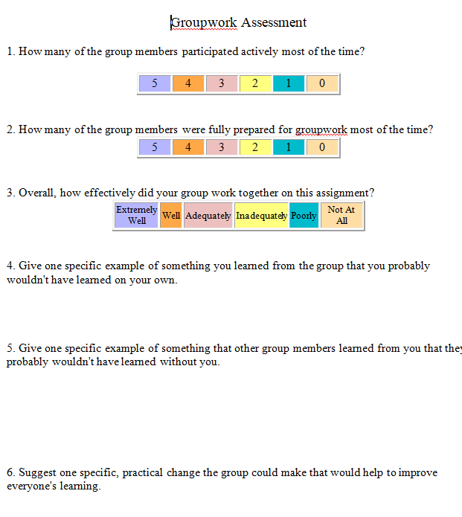
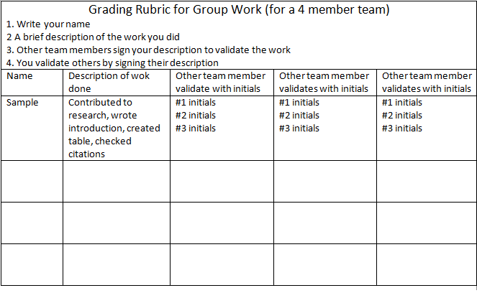
IDEAS for Group Integrity
Notes:
Examples of using rubrics or embedding assessments for groupwork - adding accountability within the group

Slide 34
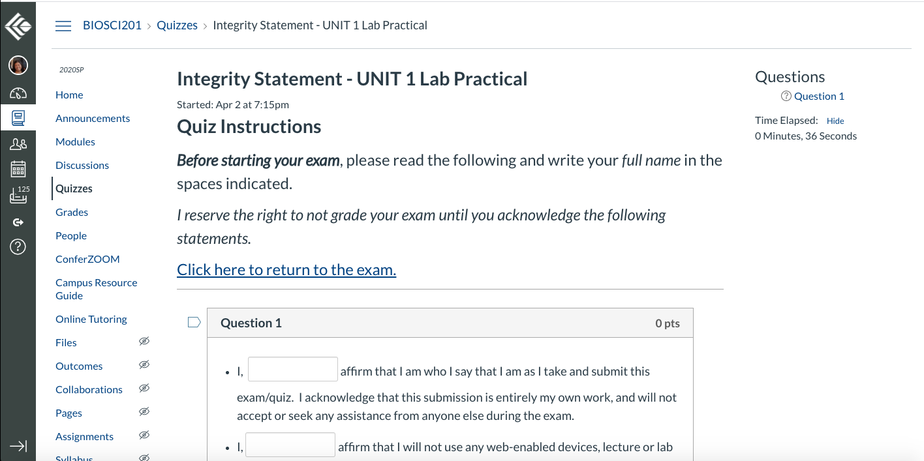
Notes:
Example of an integrity statement from one college (next three slides are statement before each assessment

Slide 35
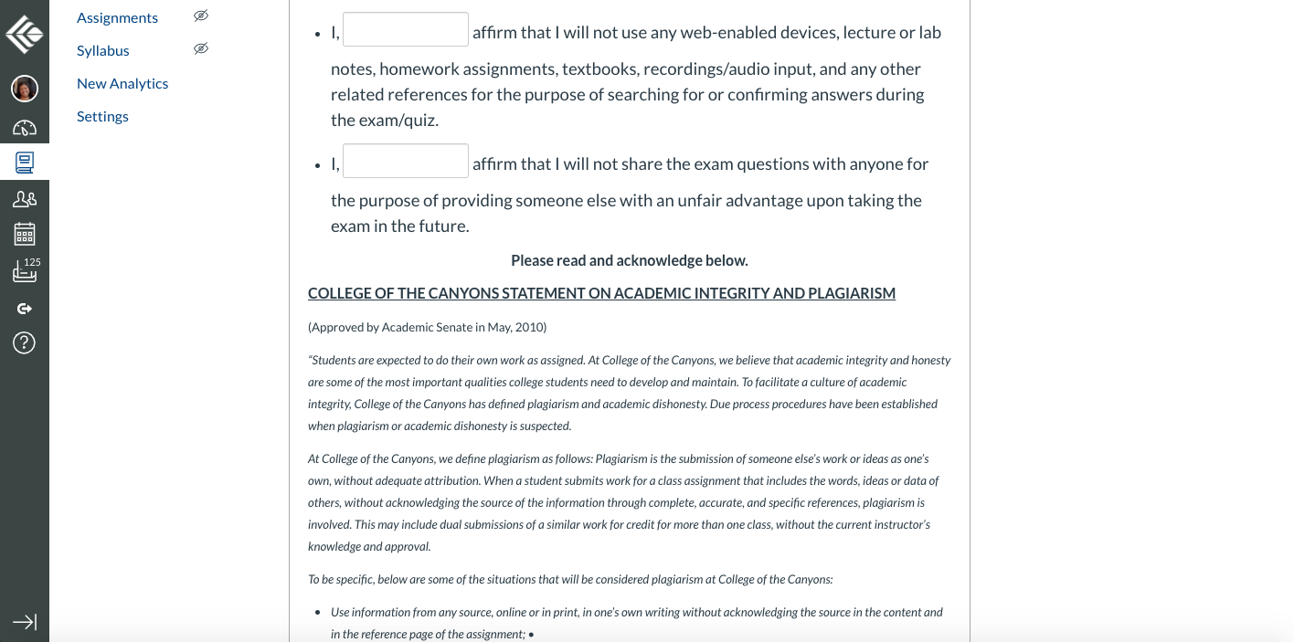

Slide 36
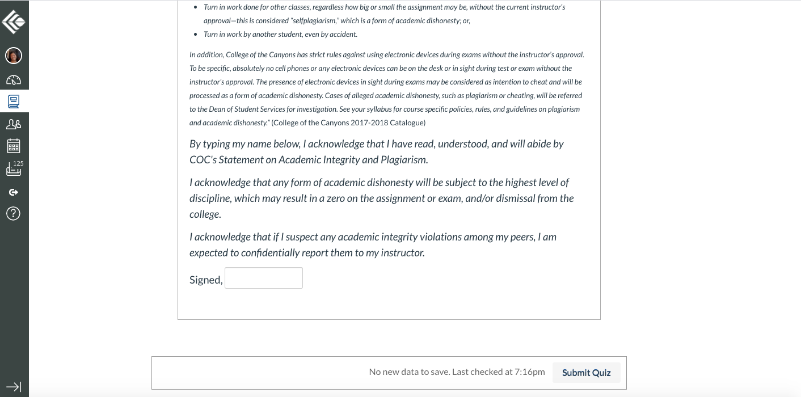

Slide 37
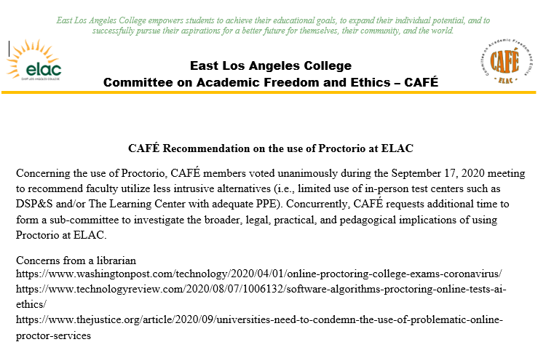
Notes:
Example of a senate action on a concern with Proctorio by ELAC - CAFE

Slide 38
Concluding thoughts
One Survey Response
“The national unrest over summer 2020 was important to address in college classes as possible. Switching lecture and content already prepared was a huge challenge to switch in 1 week. It was WORTH it. Best class EVER, but was so much work, and probably many instructors could not adapt as they could live.”
Posted for this Presentation
Power point
Assessment Survey Results
Selected Comments from the Survey

Slide 39
Resources and Works cited
@ONE courses for faculty on Assessment
Assessment in Digital Learning https://onlinenetworkofeducators.org/course-cards/assessment-in-digital-learning/
Equity and Culturally Responsive Teaching https://onlinenetworkofeducators.org/course-cards/equity-culturally-responsive-teaching-in-the-online-learning-environment/
Assignments to Enhance commitment to academic integrity
Sample Assignments https://academicintegrity.as.ua.edu/faculty-resources/sample-assignments/
Designing Assignments to Encourage Integrity https://citl.indiana.edu/teaching-resources/academic-integrity/designing-assignments-encourage-integrity/index.html
Better Assessments Online
Strategies for Better Online Assessment https://www.insidehighered.com/digital-learning/article/2018/10/31/qa-strategies-better-assessments-online-learning
Assessment Strategies for Online Learning Engagement and Authenticity https://www.aupress.ca/app/uploads/120279_99Z_Conrad_Openo_2018-Assessment_Strategies_for_Online_Learning.pdf

Slide 40
Resources and Works cited
Ewell, P. T. (2009, November). Assessment, accountability, and improvement: Revisiting the tension. (Occasional Paper No. 1). Urbana, IL: University of Illinois and Indiana University, National Institute for Learning Outcomes Assessment (NILOA)
https://www.learningoutcomesassessment.org/wp-content/uploads/2019/02/OccasionalPaper1.pdf
A New Decade for Assessment: Embedding Equity into Assessment Praxis Montenegro, E., & Jankowski, N. A. (2020, January). A new decade for assessment: Embedding equity into assessment praxis (Occasional Paper No. 42). Urbana, IL: University of Illinois and Indiana University, National Institute for Learning Outcomes Assessment (NILOA).
https://www.learningoutcomesassessment.org/wp-content/uploads/2020/01/A-New-Decade-for-Assessment.pdf
Teaching in a Pandemic: Low stakes assessment and student accountability(George Mason University) https://stearnscenter.gmu.edu/wp-content/uploads/20-PPF-Low-Stakes-Assessment-HANDOUT.pdf
JISC Effective Assessment in a Digital Age 2010, Published on Oct 20, 2010, JISC publication
https://issuu.com/jiscinfonet/docs/jisc_effective_assessment_in_a_digital_age_2010

