Slide 1
Assigning Courses to Disciplines
Rebecca Eikey, ASCCC Area C Representative
Michelle Grimes-Hillman, Long Beach City College
Carrie Roberson, ASCCC North Representative
2018 Curriculum Institute
Riverside Convention Center

Slide 2
Today, we will discuss…
Minimum Qualifications (MQs)
The Disciplines List
Assigning Courses to Disciplines

Slide 3
What is a Discipline?
A “discipline” is defined as a grouping of courses that share common academic or vocational preparation, which are typically defined by a degree or degrees (MFA, MA, BA, MS, etc), or specific professional preparation.
Discipline is from the perspective of faculty preparation.
Faculty must meet the MQs for the discipline of the faculty member’s assignment.
Not the same as local departments or subject areas.
Example:
Local Department or Subject Name: Child and Family Studies
Official Discipline: Early Childhood Education
Not the same as your local designator, a TOP code, or a FSA!

Slide 4
The Disciplines List
Specifies the minimum qualifications for each discipline
Revisions to Discipline List is done annually
Through local senate or through professional organization
Must have two separate senate districts approve the proposal
Must provide evidence to support rationale for change
Minimum of two statewide hearings
Board of Governors considers the recommendations of the Academic Senate and formally acts on them
Notes:
Might be a situation where a college elects MORE THAN the minimum qualifications- more on that later?

Slide 5
Organization of the Disciplines List
Disciplines requiring a Master’s Degree
Disciplines where a Master’s degree is not normally expected but a Bachelor’s or Associate degree is expected
Disciplines in which a Master’s, Bachelor’s or Associate Degree is not generally expected or available in that specific discipline
Disciplines for non-credit instruction
Other – to include Administrators, Learning Center Coordinators, Health Services Professionals, Apprenticeship Instructors, DSP&S Counselors, Work Experience Coordinators, Faculty Interns, EOPS

Slide 6
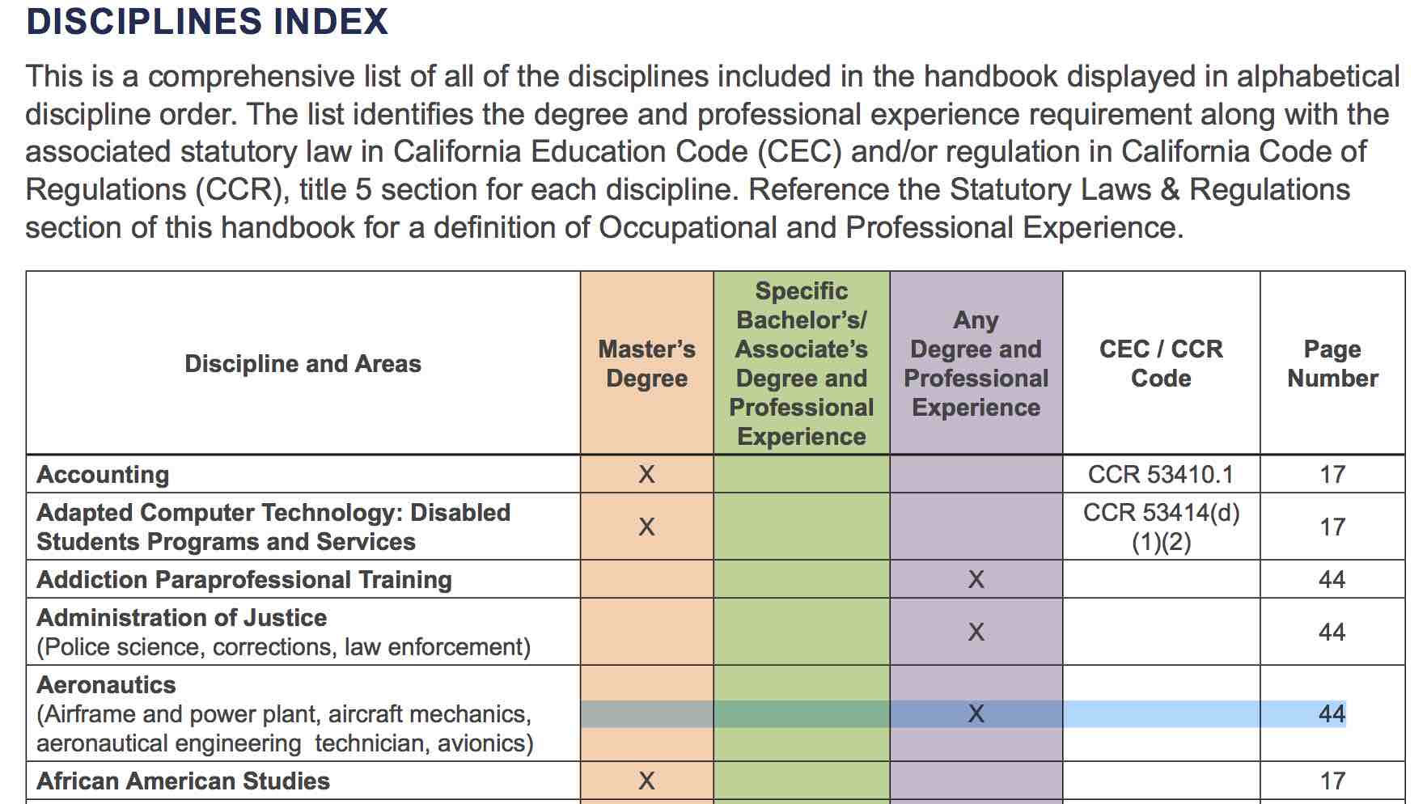

Slide 7
Minimum Qualifications
Degrees and credits generally must be from accredited institutions (§53406).
An occupational license or certificate is required in certain instances (§53417).
A district may hire a person who possesses qualifications different from, but equivalent to, those listed on the disciplines list, according to criteria and procedures agreed upon by the governing board and the academic senate (§53430).

Slide 8
Why Do We Care About Faculty Qualifications?
Minimum Qualifications are one mechanism that:
Ensures faculty preparation in the content area
Addresses Accreditation Standards
Is a 10+1 issue
Equivalency - Ed. Code §87359(b),
Minimum Qualifications - Ed. Code §87360(b)

Slide 9
Local Minimum Qualifications
A district may establish additional qualifications which are more rigorous than the state-established MQs.
However, local MQs cannot be less rigorous than the state-established MQs.

Slide 10
Courses, Disciplines, and MQs – Oh My!
Discipline
Defines required academic preparation and professional experience for faculty
Assignment of Course to Discipline Defines the MQs needed to teach the course.
Courses
What the faculty teach…curriculum!

Slide 11
Assigning Courses to Disciplines
Determine the minimum qualifications necessary to teach a course.
Local senates maintain responsibility for placing courses in disciplines (§53200(c)(1)).
All credit & noncredit courses must be placed within a discipline or disciplines.
Not required for community service courses
Notes:
The assignment is based on course content, not personnel issues, enrollment, or FTEF.
Courses should be placed in a discipline based on the knowledge required to teach the course.
Discipline faculty need to be involved.
Not all programs or department titles are disciplines.
TOP Codes are NOT disciplines!

Slide 12
Options for Assigning Courses
Course assigned to a single discipline.
Example: ENGL 101 assigned to English. The minimum qualifications for English provides adequate preparation to teach the course content.
Course assigned to more than one discipline with an “or”
Example: ARTS 101 assigned to Art or Graphic Design. The minimum qualifications for either discipline provide adequate preparation to teach the course content.
Course assigned to more than one discipline with an “and”
HUMA 120 assigned to Humanities and Ethnic Studies. The minimum qualifications for both disciplines together provide adequate preparation to teach the course content.

Slide 13
Multiple Disciplines
Do not need to have more than one course outline of record (COR) or be listed in the catalog under multiple subject codes. For Example:
ARTS 101 is assigned to Art OR Graphic Design on the COR. The college only maintains one COR for ARTS 101. The course is listed in the catalog ONLY as ARTS 101. However faculty who meet MQ for Art or Graphic Design can teach course.
May be “double-coded”, i.e. recorded on two or more CORs and listed in the catalog under each subject code. For example:
Social Psychology is recorded on two separate CORs, one as PSYC 120, one as SOCI 120. It is listed in the catalog under both subject codes. Double-coded courses should have identical CORs.

Slide 14
Impact on Teaching
Single Discipline:
Faculty who meet minimum qualifications or the locally-determined equivalent for that discipline are eligible to teach the courses within that particular discipline.
More than one discipline with an “or”:
Faculty who meet minimum qualifications or the locally-determined equivalent in any of the listed disciplines are eligible to teach the course.
More than one discipline with an “and”:
Faculty who meet minimum qualifications or the locally-determined equivalent for ALL of the listed disciplines are eligible to teach the course.

Slide 15
Interdisciplinary Studies
The Disciplines List includes the discipline of Interdisciplinary Studies.
The minimum qualifications for Interdisciplinary Studies are:
Master’s in the interdisciplinary area OR master’s in one of the disciplines included in the interdisciplinary area and upper division or graduate coursework in at least one other constituent discipline.
Any time interdisciplinary studies is used, the disciplines for a particular course MUST be specified.

Slide 16
Local Disciplines Assignment
A district may locally assign any discipline on the state list for local use, but they do not have to use any particular discipline.
For instance, if a district has not locally adopted the discipline of Art History, it could assign all of its Art History courses to the discipline of Art.
In this case, the MQs for Art History classes in that district would be those defined for the Art discipline, not the Art History discipline (unless/until the district chose to change this).

Slide 17
Single Course Equivalency
Ed Code and Title 5 refer to qualifications in terms of Disciplines not courses or subject areas within a Discipline (Ed Code §87357; Title 5 §53410 and §53430)
Legal Opinion L 03-28, Chancellor’s Office Legal Division
Faculty are hired to teach within disciplines, not a course
Therefore faculty are qualified to teach all courses assigned to that discipline
Resolution 19.03 (S18): Oppose Efforts to Permit Single-Course Equivalency

Slide 18
Disciplines vs. Departments
Departments are locally defined organizational structures.
Instructional faculty teach courses assigned to disciplines, not departments.
Faculty must meet the MQs of the disciplines to which courses are assigned.
Example: The LACC Chemistry and Earth Sciences Department offers courses in Chemistry, Geology, Oceanography, and Geography. Who teaches which course?

Slide 19
Disciplines | Courses
Earth Science | EARTH 1 GEOL 1 GEOL 6 OCEANO 1
Chemistry | CHEM 60 CHEM 101 CHEM 102 CHEM 211 CHEM 212 CHEM 221
Geography | GEOG 1 GEOG 15
Courses Assigned to Disciplines

Slide 20
Conflicts When Assigning Courses
Imagine that the faculty in your physics department want to create a new course on the Philosophy of Science and would like this to be a physics course.
The philosophy faculty object to the placement of the course in physics and believe that the course should be part of philosophy.
How does your local process deal with conflicts like this?

Slide 21
Which Discipline(s) Would You Assign?
Multimedia Applications for the Web
Introduction to the use of multimedia components, images, typography, motion and audio, for designing websites. Software may include Photoshop, Dreamweaver, SoundEdit 16 and Flash. Projects include conceptualizing, storyboarding, and designing Web page layout. Application of design elements to Web page creation.

Slide 22
Which Discipline(s) Would You Assign?
Introduction to Peace and Conflict Studies
Historical, social and economic development of the world order along with a wide range approach integral to the examination of global studies, peace and conflict resolution. The study of peace and conflict areas to include the war system, war prevention, nonviolence, human rights, social justice, environmental sustainability and the role of the United Nations and other international governing bodies.

Slide 23
Which Discipline(s) Would You Assign?
Introduction to Geographic Information System
This course introduces basic scientific principles of Geographic Information Systems (GIS) as they relate to working with data that have important spatial orientation and organization. Geometric and geographic concepts and theories are used to develop scientific methods for proper communication of the data and the solution of problems that have spatial relationships. Course covers basic concepts in mapping and orientation, the development of map scales and comparison of different coordinate systems and data error analysis.

Slide 24
Multi-College Districts
While some multi-college districts have common courses, others do not.
Since your district has one set of minimum qualifications, similar courses should be placed in the same discipline, even if they are called different things.
Your local process may be different than those in single college districts

Slide 25
Summary
All Courses must be assigned to a discipline listed in the Discipline’s List and the assignment of courses is under the academic senate’s/curriculum committee’s authority.
The process for assigning courses is locally determined and may differ from college to college
Different colleges may choose to use different disciplines for similar courses!
Create a clear local process that outlines who is involved and who makes the ultimate decision.

Slide 26
Questions?
Thank you for joining us
Rebecca Eikey (Rebecca.eikey@canyons.edu)
Michelle Grimes-Hillman (mhillman@lbcc.edu)
Carrie Roberson (robersonca@butte.edu)

