Slide 1

Assignment Design and Curriculum Mapping
Natasha Jankowski, Director
National Institute for Learning Outcomes Assessment (NILOA)

Slide 2


NILOA
NILOA’s mission is to discover and disseminate effective use of assessment data to strengthen undergraduate education and support institutions in their assessment efforts.
● Surveys ● Web Scans ● Case Studies ● Focus Groups
● Occasional Papers ● Website ● Resources ● Newsletter ● Presentations ● Transparency Framework ● Featured Websites ● Accreditation Resources ● Assessment Event Calendar ● Assessment News ● Measuring Quality Inventory ● Policy Analysis ● Environmental Scan ● Degree Qualifications Profile ● Tuning
  www.learningoutcomesassessment.org

Slide 3
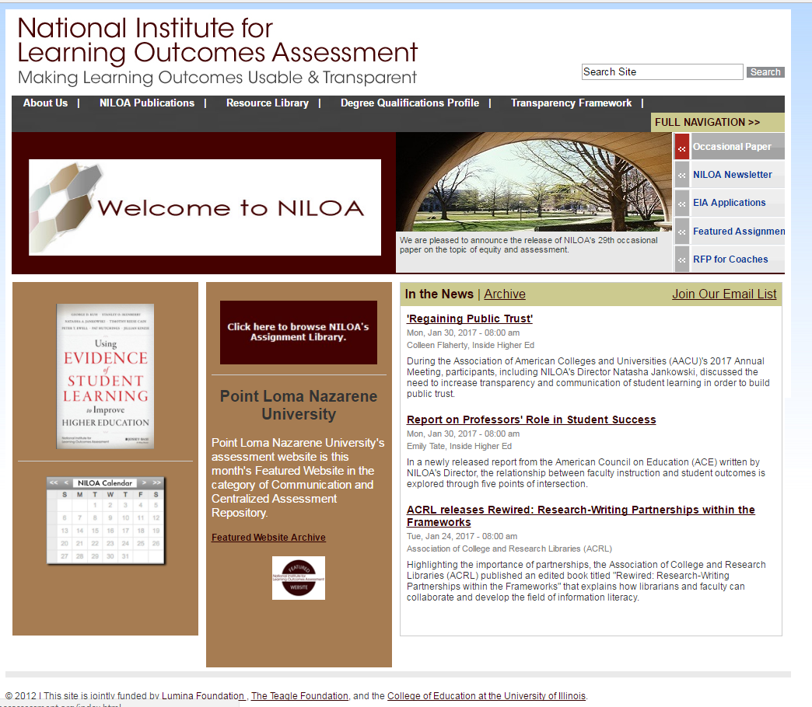

Slide 4

Purpose
Why do we do assessment? What is the value and purpose of engaging in assessing student learning?

Slide 5
Value
Institutions of higher education are increasingly asked to show the value of attending, i.e. impact in relation to cost; employment
Public and policy makers want assurance of the quality of higher education
Regional and specialized accreditors are asking institutions to show evidence of student learning and instances of use
Notes:
As the field of potential providers of education expand, institutions are asked to show the impact on student learning of attending, as costs rise and students can choose from MOOCs, for-profit providers, etc. showing the impact of an institutional experience on students is increasingly important
Regional accrediting agencies have moved from asking for outcome statements and plans to assess to actually showing evidence of student learning and the increase in student learning over time or the use of evidence of student learning to improve and enhance the student experience
To meet these demands, institutions of higher education are turning to assessment as a means to show value, to inform institutional decision making, and to determine where students are in need of enhanced support or additional opportunities to engage in learning
In assessment, the field is moving from doing assessment because it is something that has to be done and is just undertaken for the sake of doing assessment, to something that is integrated and interwoven into the institutional structure, something that occurs on an ongoing and continual basis, is linked with ideas of continuous improvement, and is done as a means to the end of improved student learning

Slide 6
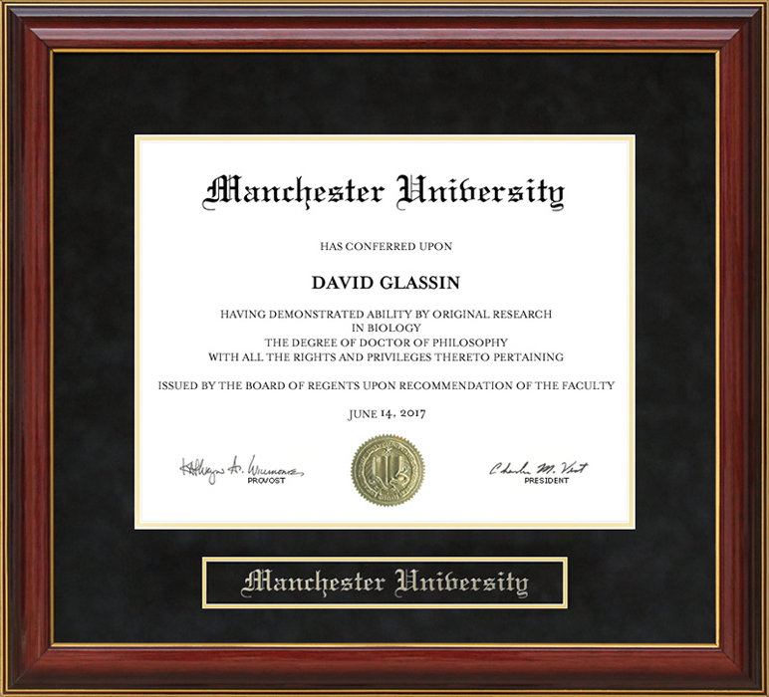

WHAT DOES A
A DEGREE REPRESENT?
seat time?
Carnegie credit hours?
grade point averages?
required courses?
clinical hours?
All of these suggest what degrees represent in terms of numbers.
What do degrees represent
in terms of learning?

Slide 7
But…
Do our assessments help answer these questions or prepare students for experiences in the “real world” or in the field of employment?
How can we offer various approaches to authentically assess student learning – not just in our course, but how our courses connect and add up to an integrated degree or credential?
Course Program College General Education

Slide 8
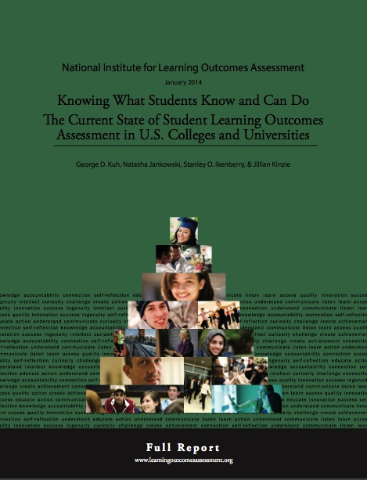
Why Focus on Assignments?
Most valuable assessment approaches:
Classroom-based assessment
National student surveys
Rubrics
http://www.learningoutcomeassessment.org/knowingwhatstudentsknowandcando.html

Slide 9
Faculty are working to create a curriculum that intentionally builds in integrated learning opportunities over time for students to apply and practice as well as transfer their knowledge and skills through assignments, in and out of courses.
Notes:
Can’t assume coverage in a course
How embed – can’t wait until the end as summative assessment, needs to be formative along the way (mention workshop on assignment design)

Slide 10
But we have tensions…

Slide 11

Pathways
Institutions are redesigning curriculum and making scaffolded pathways for students – do the students know about it and move through the curriculum in the way it is designed?

Slide 12

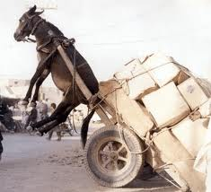
Are students even aware?
Student focus groups reveal that most students are not even aware they are being assessed. But upon learning about assessment…wish they had been told about it earlier.

Slide 13
Transparency in Assignments
Transparency in Teaching and Learning: https://www.unlv.edu/provost/teachingandlearning
Purpose
Skills you’ll practice by doing this assignment
Content knowledge you’ll gain from doing this assignment
How you can use these in your life beyond the context of this course, in and beyond college
Task
What to do
How to do it (Are there recommended steps? What roadblocks/mistakes should you avoid?)
Criteria
(Are you on the right track? How to know you’re doing what’s expected?)
Annotated examples of successful work
(What’s good about these examples? Use the checklist to identify the successful parts.)

Slide 14
Rubrics
Do we share our rubrics or criteria with students and actively engage them in the review process?
Rubric Criteria | Student Evaluation | Faculty Feedback
Rubric Content | Stipulate why gave score did | Faculty stipulate why gave score did
 | Stipulate what they need to do to advance | Targeted feedback to improve
Notes:
The case of the CIC project – the big ten schools

Slide 15
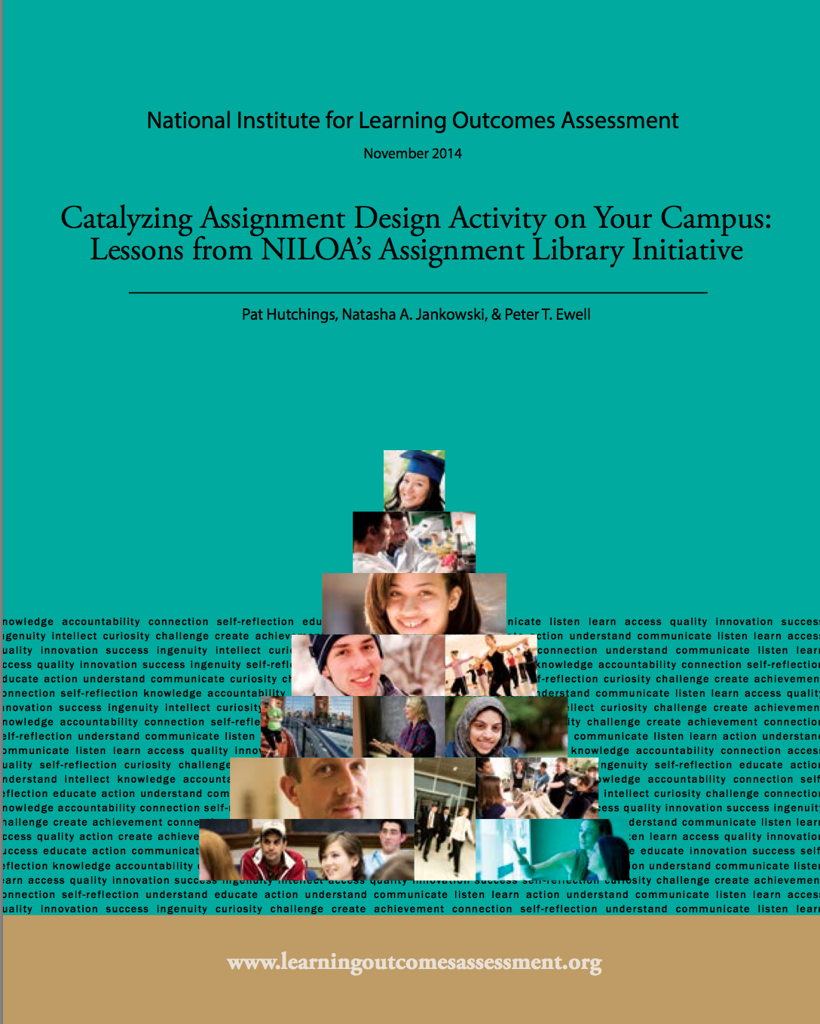
Summative to Formative
  Embedded assignments
  Feedback and feed forward
  Integrate with advising
  Move from assessing at end of program or time at institution to assessing throughout
  Know before capstone or summative assessments where students are – all students

Slide 16
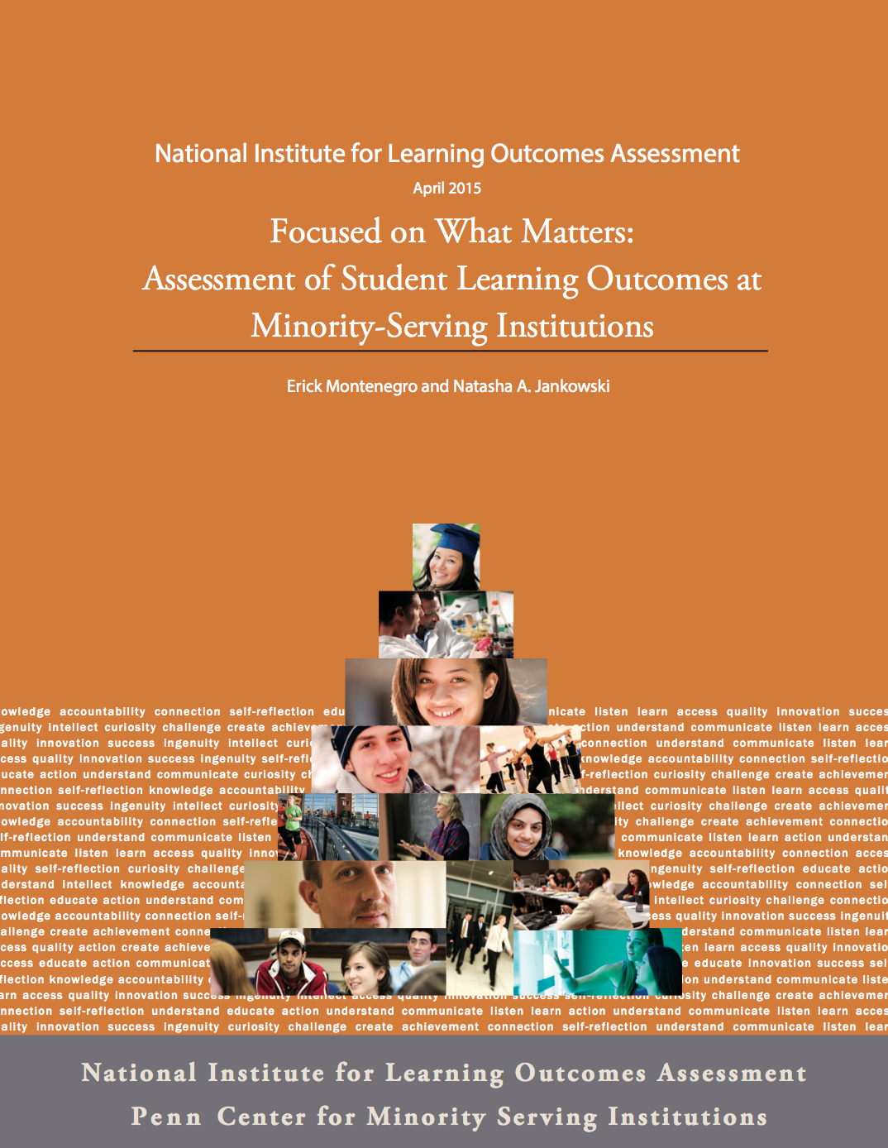
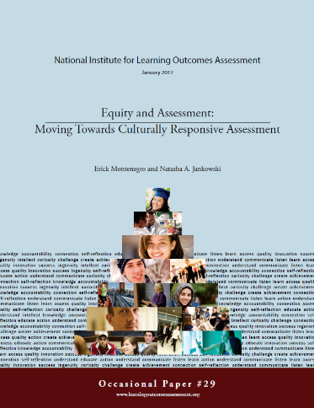
Student-centered assessments
  Is it one assessment for all students or multiple paths to demonstrate learning in ways that focus upon students?
  What would culturally responsive assessments look like?

Slide 17

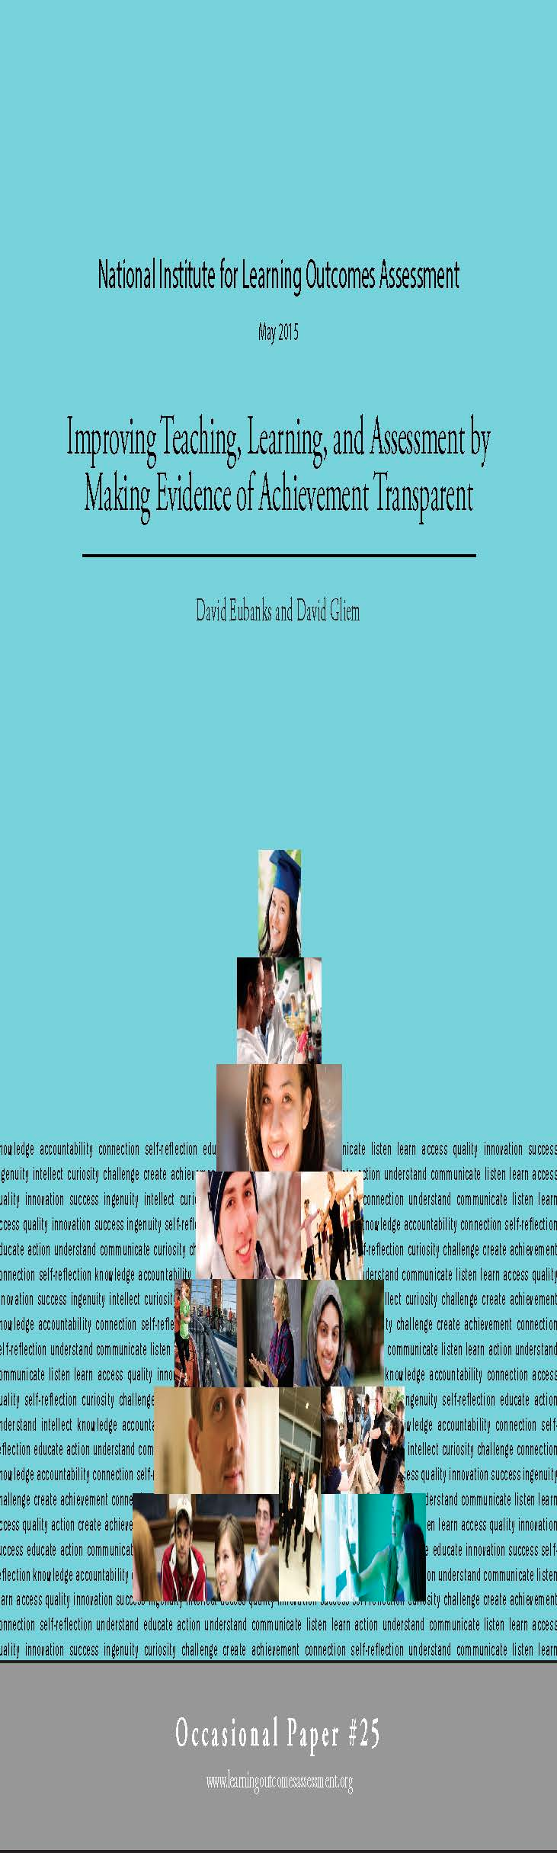
Meta-cognition
Foster ability in students to evaluate their own learning
Communication to students – transparency
Make aware of assessments
  Rubrics – allow students to evaluate their own learning
  Example of group work feedback
  Assignment audience shift and genre shift

Slide 18
Involving students
Assessment is not something we do to students it is something we do with students.
How do we think about alignment from shared outcomes to data collection? How do we decide where learning in relation to outcomes occur and where we should collect data?
  Career services
  Making sense of data – the story of the lonely students
  Changing how we report around outcomes

Slide 19
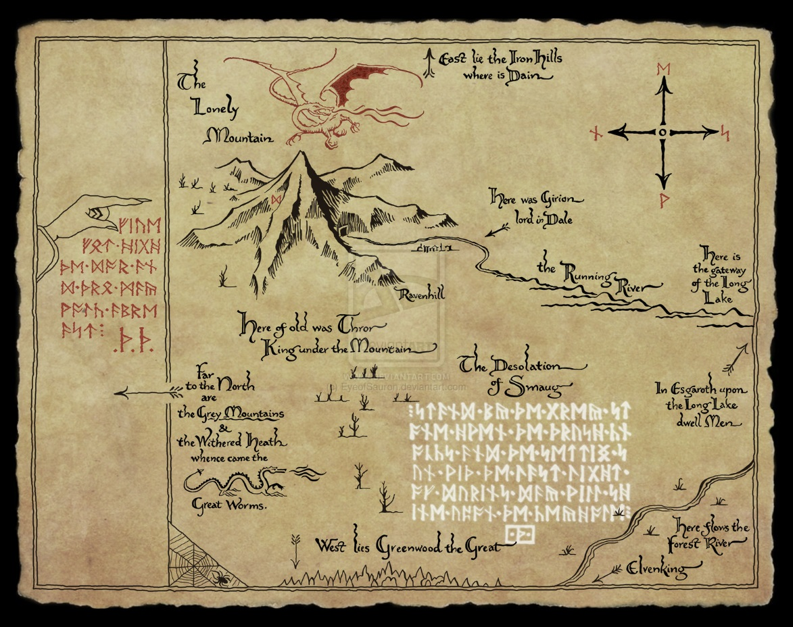
Implications for our work
Listen to your faculty!
  Complaints are generally on target
  There are things that our current reporting system does not capture
Alignment and mapping are crucial

Slide 20

Fitness of Method or Approach
Part of alignment is fitness of method or approach – if asking students to explain something, multiple choice test might not be the best approach, but if asking students to identify – it might be very appropriate…

Slide 21

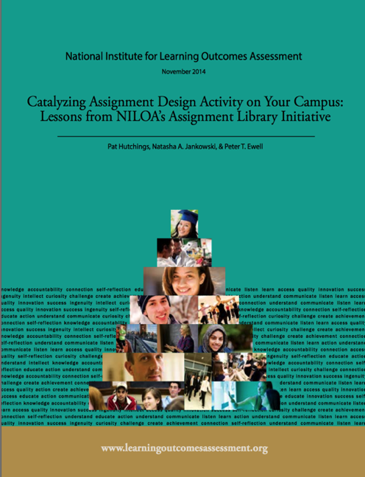
Verbs (and I don’t mean Bloom’s)
Alignment and fitness of method occur in relation to the verbs identified in the learning outcome statement
In your own assignment – what are you asking students to actually do or demonstrate?

Slide 22
Alignment
How do you ensure alignment between our assignments and a given learning outcome for a learning experience?
How do we create assignments and activities that will elicit student demonstration of a specific learning outcome?
How do we know that we have mapped our assignment to rubric criteria?
Notes:
Where do students engage with these outcomes across a curriculum or collegiate experience and how are we capturing that learning?
Does this assignment or course introduce/reinforce/demonstrate mastery?
Where will it be practiced later? Is there a chance to try again based on feedback?
How does the assignment relate to evaluation criteria (rubric or otherwise)?

Slide 23

Possibilities
Ideas on assignment modification
  Shifting audience (in writing assignment)
  Modify genre (blog, pamphlet, drama, graphic novel, poster, oral presentation, debate)
  Practice throughout courses
  Planning and timing of feedback
Notes:
Pair with another faculty member and course, or if sequence of courses, think about how builds over time (carry over assignment)

Slide 24
The NILOA Initiative
An online library of high-quality peer-endorsed assignments linked to DQP outcomes.
Designed by faculty, part of the intellectual work they already do, course embedded.
Building on campus efforts already underway
Reflecting a conception of assessment as integral to teaching and learning vs “exoskeleton” (Ewell 2013).
Notes:
What this work came out of – faculty on the ground with questions…

Slide 25
What we did (and will do again)
Invited faculty applications (with draft assignment)
Brought the group together for a day-long meeting
Worked in 5-6 person, facilitated “charrettes”
Notes:
Pat

Slide 26
76% of participants said “it helped me more clearly see my assignment through my students’ eyes.
59%: I’m more aware of aligning my assignments with desired institutional outcomes.
38%: helped to lead or facilitate an event about assignment design on their campus
Notes:
However, a lot of this work extended beyond assignment design in a course when looking at connections, and began to tie in with curriculum mapping – so, would it be usefl to everyone to talk a bit about that?

Slide 27
What’s a“charrette”?
"Charrette" (Fr.) means a small cart. Because architecture students once deposited their assignments in it as the cart was rolled through the studio, architects now use the word to refer to an intense creative effort in a limited time period.

Slide 28
Aussi . . .
In the tradition of the “atelier,” architecture students progress through the curriculum in the company of their mentors and peers. This approach offers an interesting model for an integrated education.
(b) The tradition rests on the assumption that much of your learning will come from one another.

Slide 29
Small Group Process
25-30 minute segments per person/assignment
Present assignment briefly—which outcomes, what course, which students, how does it work….
Discussion with group (focus on questions on feedback form)
Save 5 minutes for written feedback
Breath
Start again…
Debrief at end

Slide 30
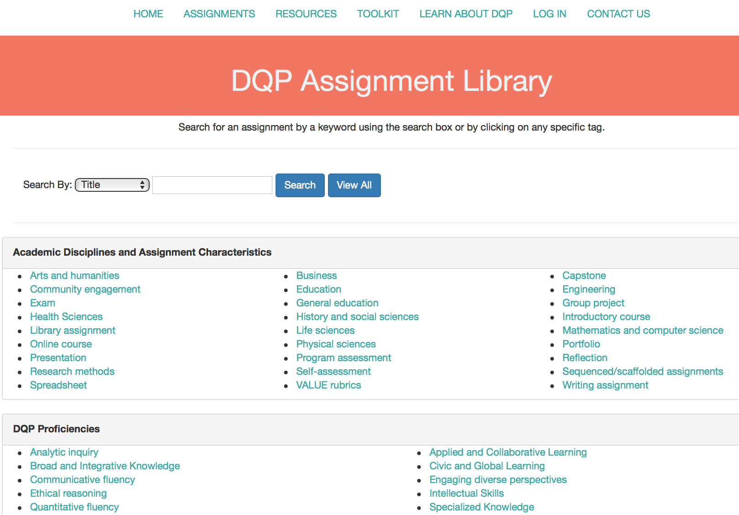
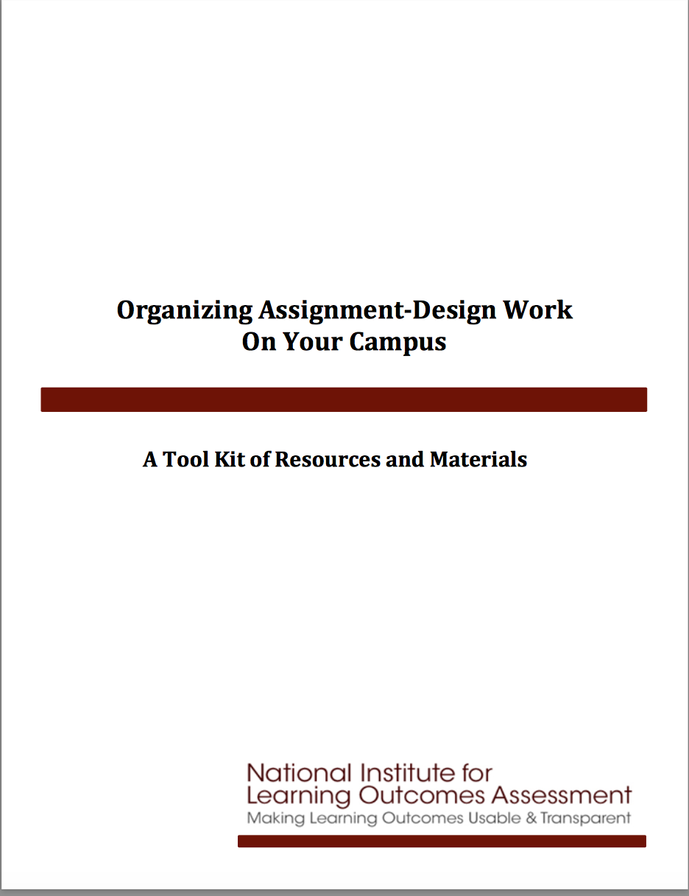
Toolkits and library

Slide 31
Curriculum Mapping: The Process
Focused on curriculum and program learning outcomes
Two-dimensional matrix representing courses on one axis and outcomes on the other
Faculty identify which courses address which learning outcomes
Is it an individual process or one of consensus building?
If two faculty members individually mapped the curriculum would they end up with the same map?
What is standard of alignment? Is one paper in one class enough?
Notes:
Faculty led process
May be done individually or in groups – sometimes faculty fill out an excel sheet and others compile it across the program (so for each of your courses indicate which)
But really it is a missed opportunity at consensus building if done alone

Slide 34
Why do curriculum mapping?
What are we hoping to achieve through mapping the curriculum?
  Alignment (within a program, between general education and institutional goals, etc.)
  Identifying where and how particular outcomes are expected, explicitly taught for, and assessed (Ewell, 2013)
  Backwards design the curriculum
  Understand the nature and role of course pre-requisites
  Mapping as a lens – it is a way of seeing organizational structure
  Do our assumptions about alignment actually hold?
Notes:
What is it that we are expecting students to know and be able to do upon entry in this course? Does that come from our program or somewhere else?
Backwards design – Wiggins and McTighe

Slide 35
What else can be mapped?
Content
Structure
Course-taking patterns
Assignment timing
Co-curriculum
Where does learning happen? Does a curriculum map inherently assume academic affairs at the expense of student affairs or other institutional elements? CTE? Continuing Ed? Employment?

Slide 36
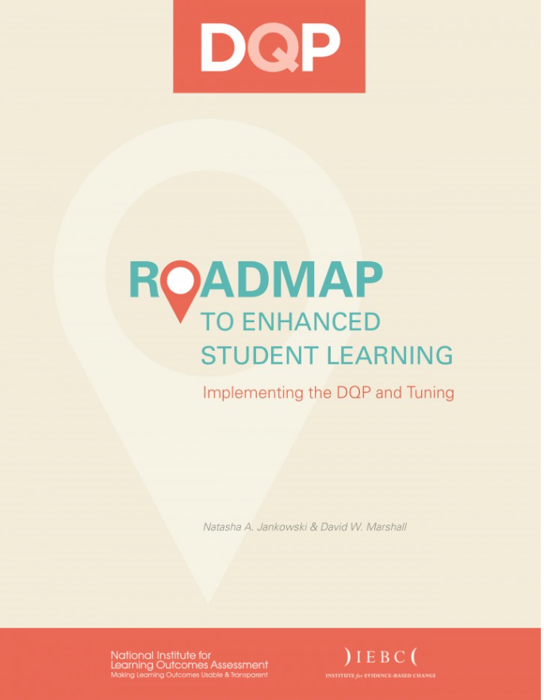

Resources on Mapping

Slide 37

Questions and discussion
Email: njankow2@illinois.edu
http://www.learningoutcomesassessment.org
www.assignmentlibrary.org
www.degreeprofile.org

