Slide 1
Award Winning Campus Programs that Increase Diversity Awareness Shannon Vellone Mills B.J. Snowden

Slide 2
Why are diversity awareness programs important?
Diversity awareness and programming is an essential part of the college experience, as students prepare for participating in a multicultural society and jobs in an ever-increasingly diverse and global workplace.

Slide 3
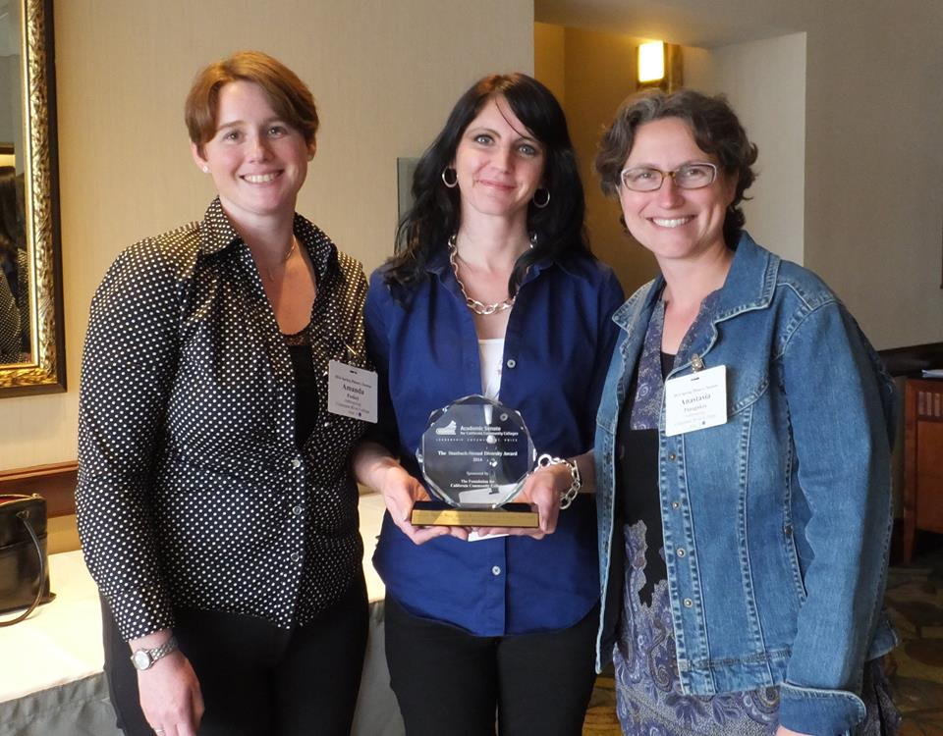
CRC’s Anthropology Program:
Regina Stanback Stroud Diversity Award
Golden Hawk Award
Statement of Values and Responsibility
Creating a culture of awareness
Mentoring of adjunct faculty creating expectations to engage
Anthro adjunct = Crystal Apple Award winner for her work in diversity awareness
Outreach to get students to participate in activities that they may not otherwise consider
Utilization of all means possible!
Curriculum, social media, cross disciplinary events, field trips, student opportunities, social activities & workshops

Slide 4
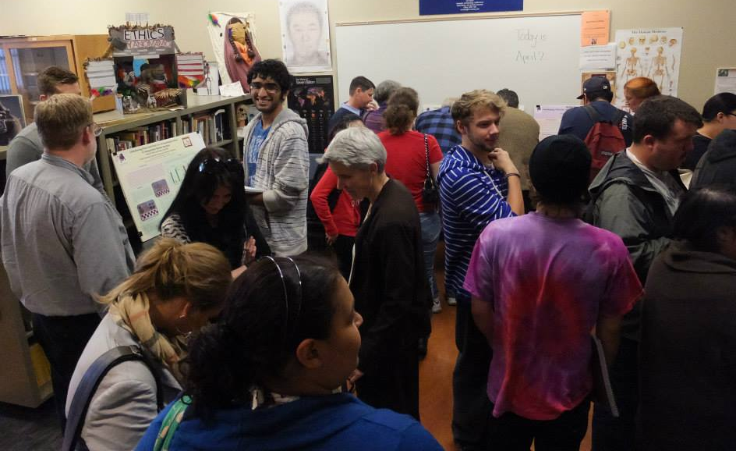
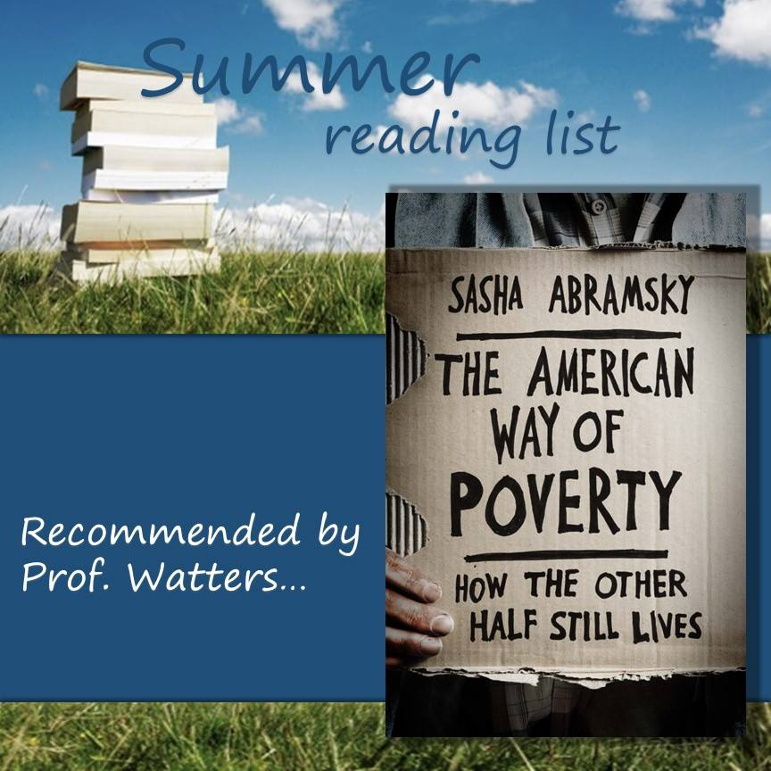
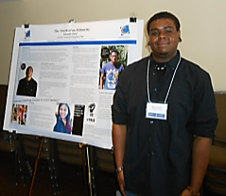
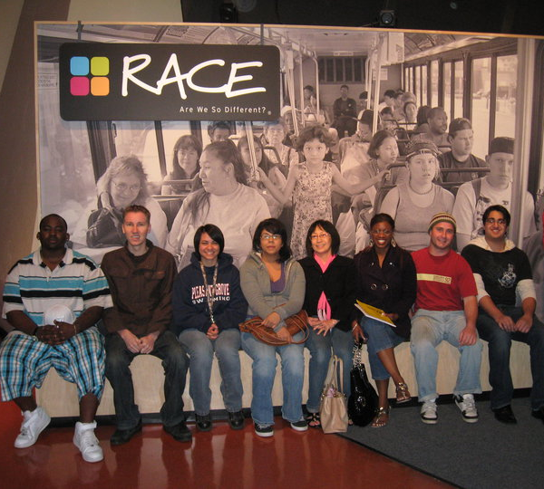
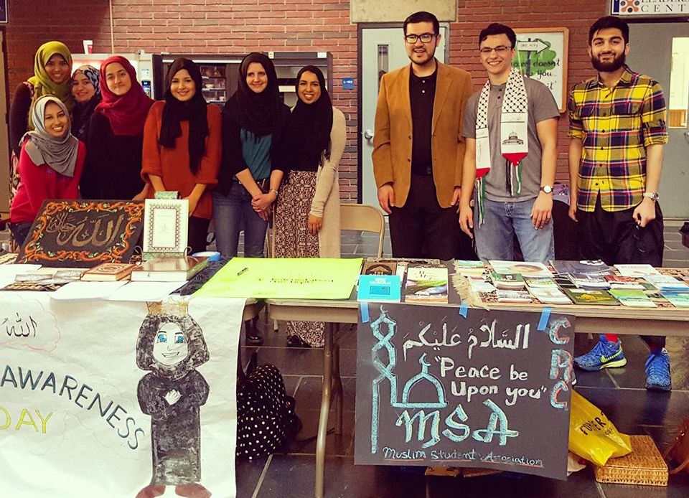
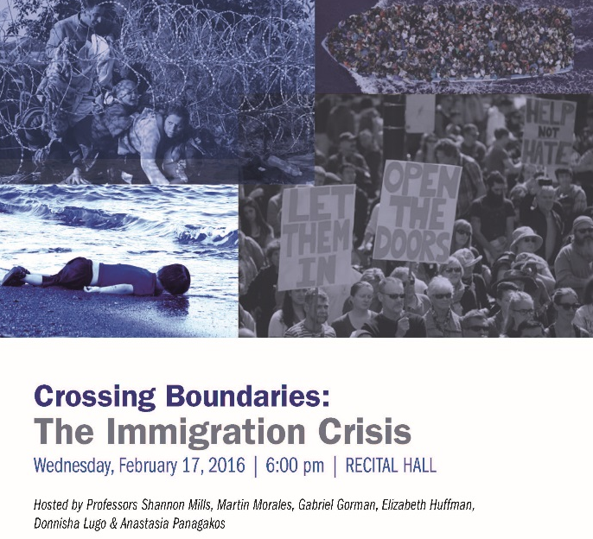
Anthropology: Creating a way of life.

Slide 5
Jumpstart
Summer Initiative
Targeted to 18-20 year old males
In coordination with UC Davis
Mentoring and Coursework
Expanded to include math boot camp

Slide 6
Freshman Seminar
Designed to help students successfully transition from high school to college, emphasizes collaborative/active learning. This course received the 2008 John Rice Diversity Award, and the 2012 Exemplary Program Award by the California Community College BOG, and was highlighted as a model First Year Experience Program for new students in the “Basic Skills Initiative E-Resource” publication (2013).

Slide 7
Freshman Seminar
Topics covered include: How To Get Organized, Exploring Your Academic Journey, Deciphering College Publications, Financing Your Education, Problem Solving Strategies, How to Run Effective Study Groups, Tips for Transferring to a University, Academic Integrity and more.
Discipline Specific

Slide 8
Freshman Seminar
3 units CSU Transferable Credit
Counts under CSU General Education Pattern AREA E1 section
Available during Summer Session
2 Sections available during Fall Semester
2 Sections available during Spring Semester

Slide 9
First Year Experience
Student Equity Plan Funded
Increases awareness of equity gaps
Recruits incoming freshman with active recruiting as determined by plan data
Mandatory summer experience (workshops)
Structured academic pathways for foundational success
Student support services key
Not a “program”…an experience ☺

Slide 10
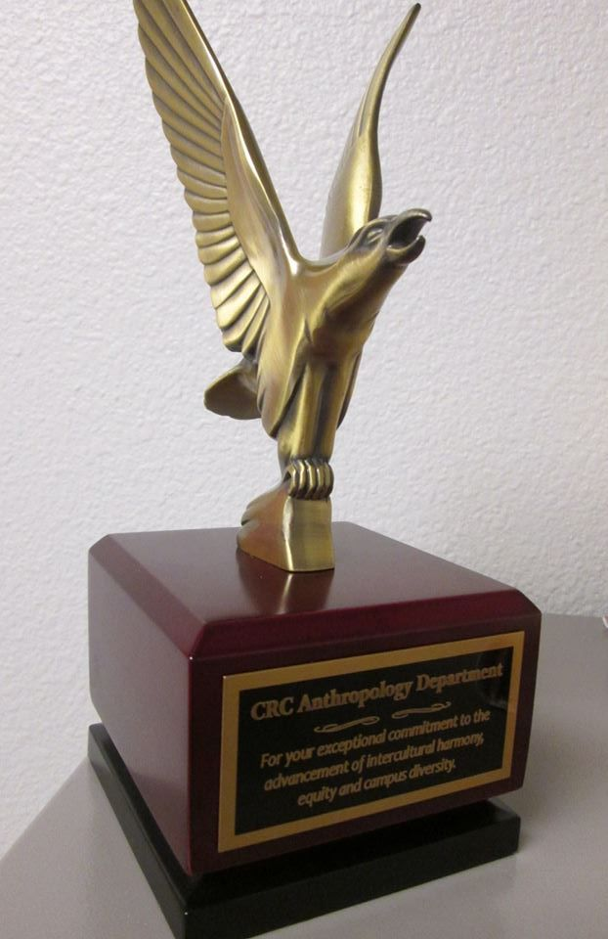
Local Awards
Golden Hawk Award
Sterling Award
Crystal Apple Award

Slide 11
Statewide Awards
Dr. John W. Rice Diversity & Equity Award
Regina Stanback Stroud Diversity Award

Slide 12
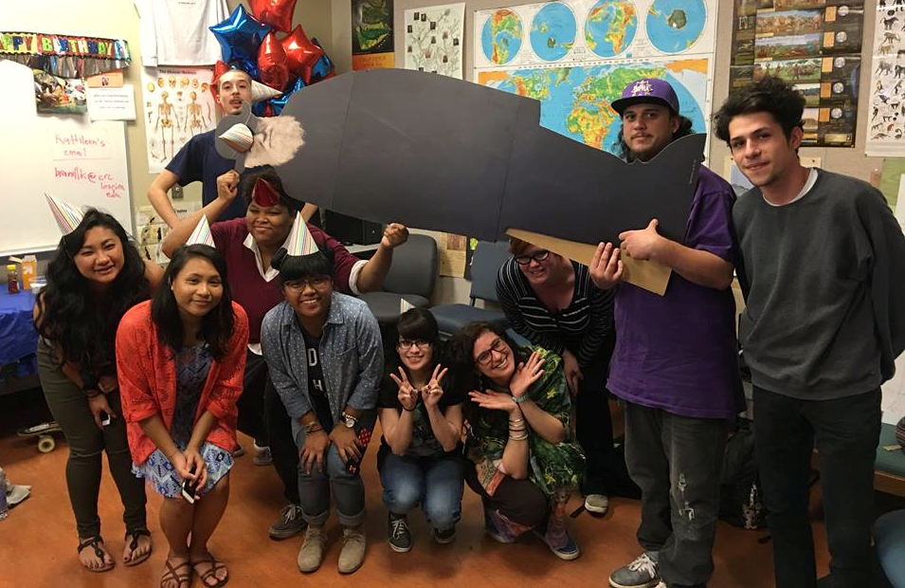
Why Awards?
Celebrating Program Success
Faculty motivation to continue important work
Increased student engagement
Increased persistence in at-risk students
Inform your colleagues – diversity awareness is NOT limited to students!

Slide 13
Thank You
Shannon Vellone Mills
Professor of Anthropology
Cosumnes River College
millss@crc.losrios.edu
BJ Snowden
Professor of Radio TV and Film Production
Cosumnes River College
snowder@crc.losrios.edu

