Slide 1
Developing Faculty Leaders and Empowering Diverse Voices in Local Academic Senate Matters Thursday November 3, 2022 ǀ 3:30pm – 4:45pm

Slide 2
Session Description
It is well established in educational leadership research that decision-making is at its best when diverse voices are amplified and when alternative perspectives are considered. Decisions are often influenced by who holds formal leadership roles. Currently, faculty from underrepresented groups are not being equitably elevated to positions of leadership in our academic senates and other significant decision-making committees. As faculty leaders we have an obligation to represent all our faculty and ensure that the often-marginalized voices are being heard. In this session we will discuss strategies to empower diverse faculty to engage in college participatory governance; consider ways to make space to promote authentic participation; create paths for leadership opportunities; and identify orientation strategies to help new faculty consider themselves as future faculty leaders.

Slide 3
Introductions
Christopher Howerton, ASCCC North Representative
Suman Mudunuri, ASCCC FLDC Committee
Manuel Vélez, ASCCC Area D Representative
Notes:
Each of us will take a turn introducing ourselves in this order.

Slide 4
Topics to Discuss
Strategies to promote authentic participation
Ways to encourage diverse faculty to participate in college governance
Creating leadership paths for new faculty or those who have been disengaged
Orientation of new faculty to promote future faculty leaders
Assessing your own structures for barriers
Notes:
Ways to encourage diverse faculty to participate in college governance
Strategies to promote authentic participation (for yourself as a leader and making space for others to feel comfortable to do so)
Creating leadership paths for new faculty or those who have been disengaged
Orientation of new faculty to promote future faculty leaders - SM?
Assessing your own structures for barriers
Transition: One of the barriers to active (let alone authentic) participation is “meeting hate” and negative perceptions people may have of meetings.
Poll the audience: By a show of hands, how many of you LOVE going to meetings? or when you see a meeting invite pop up on your calendar you get that giddy feeling of excitement?

Slide 5
Perceptions of Meetings
What are your first impression of governance meetings?
How did you feel going to your first governance meeting, as an observer? As a member? As a leader?
If we asked you to describe a typical committee meeting for your college, what would it look like? Who would be represented? Who would be leading?
How would you describe the interpersonal climate? Competitive? Defensive? Collaborative? Equitable? Others?
Notes:
joining these groups can be very intimidating. Often there are linguistic barriers with acronyms, jargon, or other specialized vocabulary.
Is the perception the reality? Based on past negative meeting experiences, some marginalized voices may elect not to even participate.
Some of the complaints about meetings include:
Complaint 1: One or two people do all the talking, Complaint 2: Meetings aren’t run effectively
Complaint 3: The meeting should have been an email
Complaint 4: Everyone is on their phones
Complaint 5: The meetings are redundant
Other complaints include: competitive interrupting, not respectful of individual contributions, being spoken down to, or mansplaning, gaslighting, not trusting my expertise in my field, etc. others from the room?

Slide 6
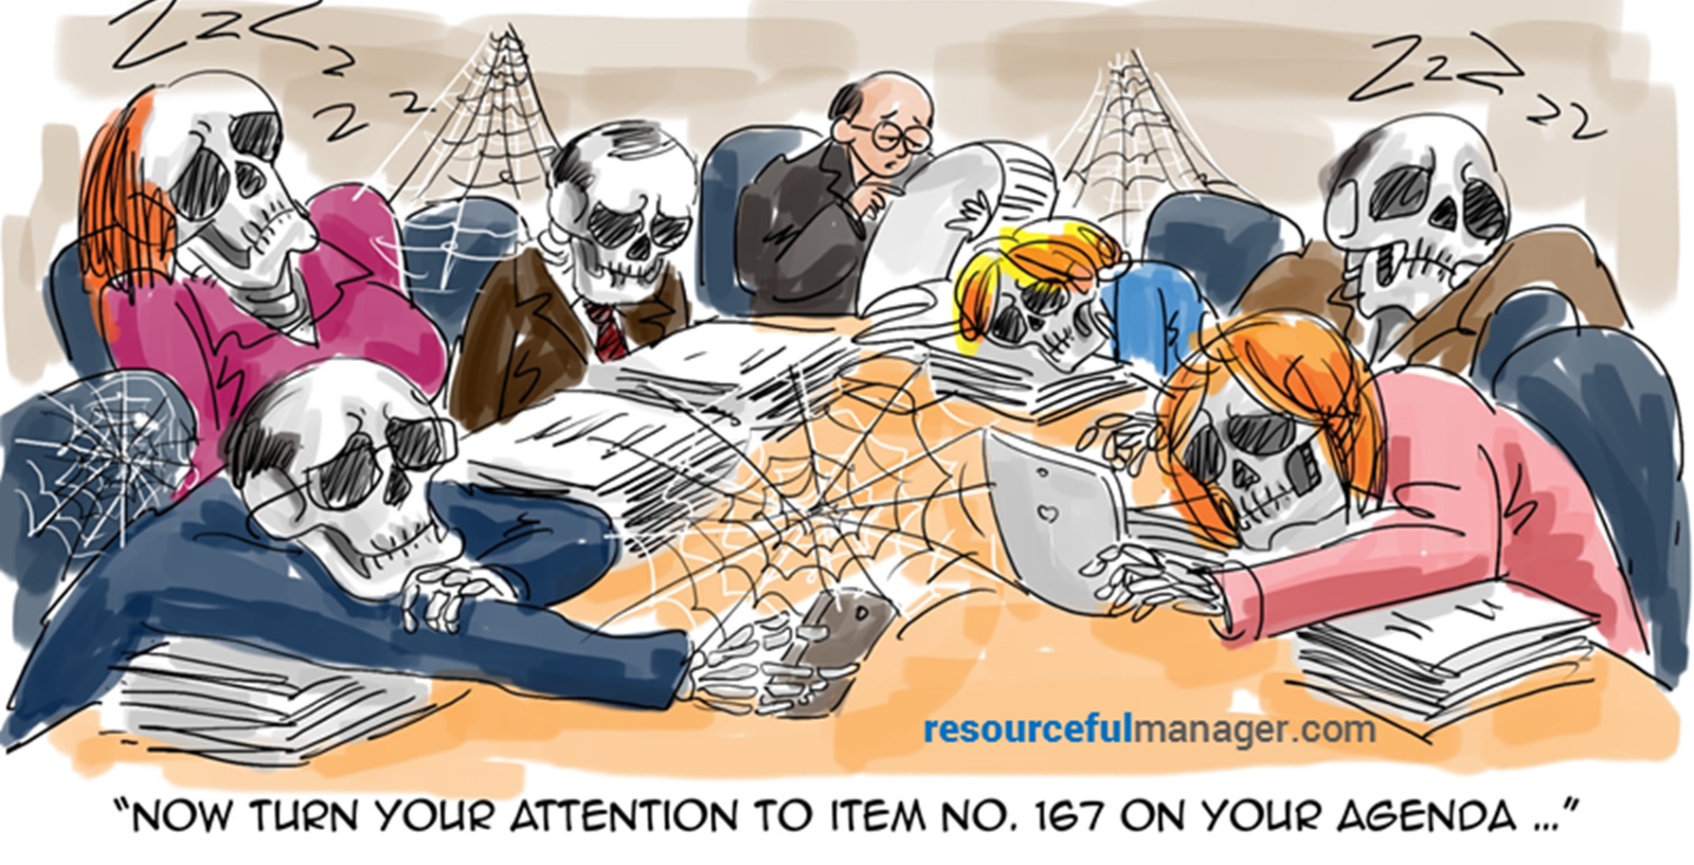

Slide 7
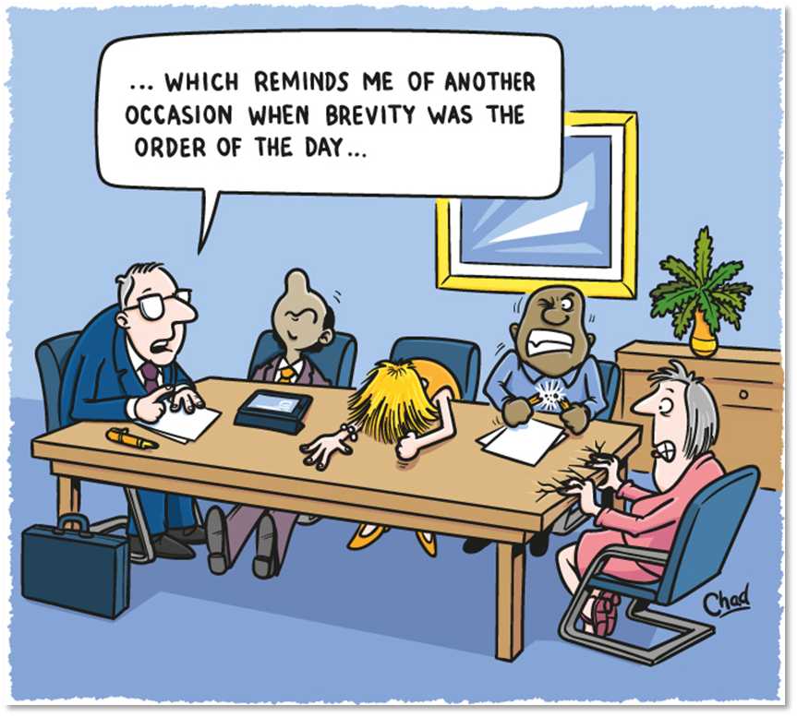
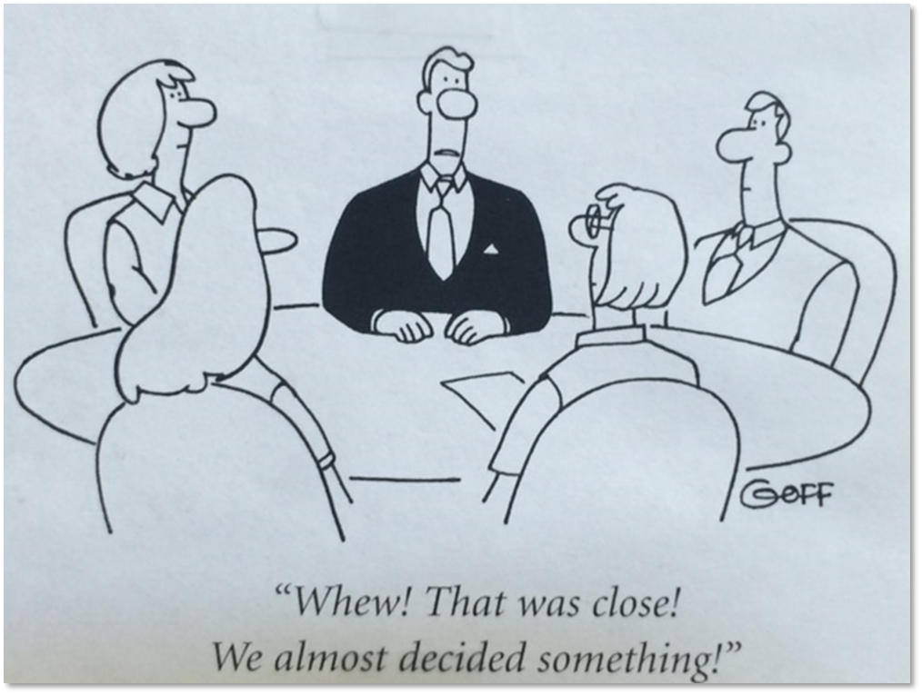

Slide 8
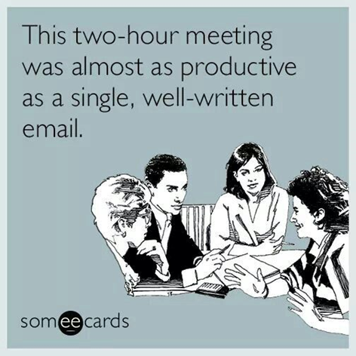
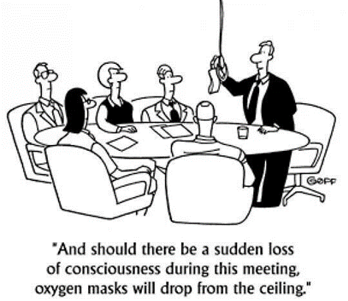
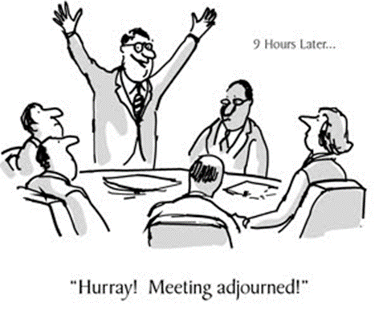
Notes:
note that even in these fun examples/memes….who’s leading…a white man. The white voice?

Slide 9
Strategies to Promote Authentic Participation
As a group setting explicit norms and understandings to value contributions from diverse ideas
Storytelling as a Leadership style
Authenticity and Vulnerability
Knowing your values as a leader and as a participant
Staying grounded and area of yourself
Leading with intention
Validating each others experience
Notes:
Suman
Leader authentic voice - Requires emotional openness and Builds bridges and increase trust
Your values - (communicate our values and how we advocate/connect with others because of these). Staying grounded and aware of yourself
Member authentic voice
(What is your why behind the choices you make?). Including various voices in decision making. Staying open to all perspectives and experiences. Validating another's experience even if you don't understand.

Slide 10
“A diverse mix of voices leads to better discussions, decisions, and outcomes for everyone.”
-Sundar Pichai (Google CEO)
“Creating a more diverse workplace will help to keep your team members’ biases in check and make them question their assumptions.”
-David Rock and Heidi Grant
(Why Diverse Teams are Smarter) Harvard Business Review Nov. 04, 2016
Notes:
ADD this orally,
Inclusive teams make better business decisions up to 87% of the time, and decisions made and executed by diverse teams delivered 60% better results.
Report on Inclusive decision making by Cloverpop

Slide 11
Cultivating Diverse Faculty Leadership
Commitment to diverse leadership requires intentional and organized efforts that focus on a long-term shift towards inclusive and welcoming environments. Faculty leadership can foster inclusive environments in the following ways:
Host Diversity-Themed Campus/Faculty Forums
Diversity Audits/Assessment
Professional Development
Diversity-Themed Mentorship Programs
Adopt a Cultural Humility Framework
Notes:
manuel?

Slide 12
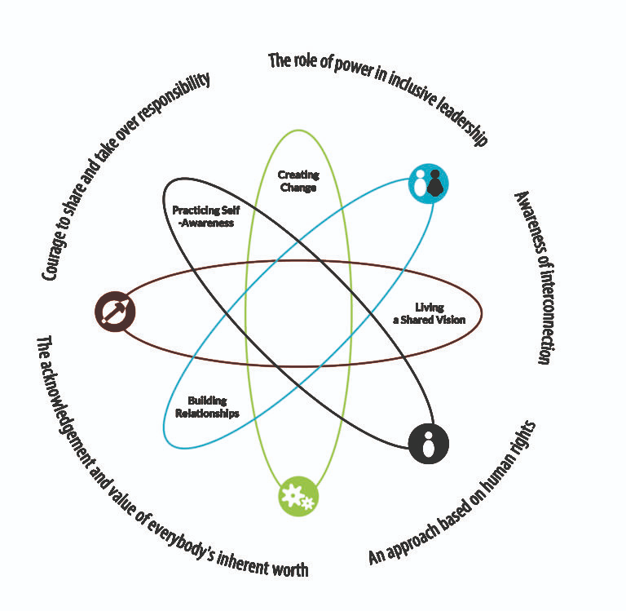
The Inclusive Leadership Framework
According to the Inclusive Leadership Handbook, an inclusive leadership approach “appreciates diversity, invites and welcomes everyone’s individual contribution, and encourages full engagement with the processes of decision-making and shaping reality. The following traits are important for creating an inclusive environment
● Visible commitment: Leaders articulate a genuine commitment to diversity, challenge the status quo, hold others accountable, and make diversity and inclusion a personal priority.
● Humility: Leaders are modest about capabilities, admit mistakes, and create the space for others to contribute.
● Awareness of bias: Leaders show awareness of personal blind spots and flaws in the system and work hard to ensure meritocracy [value based on their own abilities].
● Curiosity about others: Leaders demonstrate an open mindset and deep curiosity about others, listen without judgment, and seek empathy to understand those around them.
● Cultural intelligence: Leaders are attentive to others’ cultures and adapt as required.
● Effective collaboration: Leaders empower others, pay attention to the diversity of thinking and psychological safety, and focus on team cohesion
Notes:
“Effective, inclusive leadership within the field of education also requires the knowledge and wisdom to examine the systems and attitudes within an education system and challenge the policies and practices to ensure they are not biased, exclusionary, or harmful to children. Such leadership can impact school culture, student outcomes, and teacher morale and effectiveness.”

Slide 13
Creating Leadership Paths
Role of standing committee chairs, how are they chosen?
are there formal coordinator opportunities?
committee appointed?
senate assigned?
Workgroups within committee, ad hoc, short-term leading initiatives
College-wide initiatives
Term lengths and set number of terms?
Understanding motivation:
Why do people seek the role?
Why do people elect to stay in the role?

Slide 14
“I truly believe that onboarding is an art. Each new employee brings with them a potential to achieve and succeed. To lose the energy of a new hire through poor onboarding is an opportunity lost.”
-Sarah Wetzel
(Director of Human Resources at engage:DBR
“The ‘purpose’ element of onboarding is where you begin to lay the foundation of success for your new team member.”
-Mitch Gray
(Author, How to Hire and Keep Great People)

Slide 15
Orientation for New Faculty
Structure of orientation
informal/formal; ongoing/one-time; one-on-one/cohort; district-wide/college specific/division or department level?...
depends of college culture and size
Mentorship
10+1 vs Working Conditions
Possible Topics:
representatives, timelines, standing meetings of your AS and other committees (e.g. curriculum, DE, etc.)
other topics?
invitation to visit open meetings
Notes:
Depending on the size of your college, what ways do we provide orientation for new faculty members?
What is it like coming into a new organization without any orientation? A lot of unknowns, assumptions about past practice and applying it in a new context (could that be a problem?) Benefit, makes a new faculty member feel supported, welcomed, and safe. - especially important for our BIPOC faculty
Informal or formal program of orientation? How does new faculty learn the explicit norms of your organization….what about the implicit norms of your organization?
mentorship (formal or informal) appointed, peer selected, is there a role for members on tenure evaluation committees to support the development of faculty?
Helping new faculty understand the role of participatory governance and their voice in 10+1 as the senate is the official voice of faculty for academic and professional matters, however, there may be questions that are more appropriate for their union reps. (is a collaboration in orientation possible?) Great opportunity to give out the 10+1 cards and invite new faculty to come observe open meetings…maybe an interactive punch card where once completed they get some college swag…does not have to feel stuffy and formal.
Clear where they can go to get more clarification if needed.

Slide 16
Assessing Your Own Structures for Barriers
What is your faculty appointment process like?
How does your senate support succession planning?
What are ways that your senate collects input?
What voices are missing in discussions?
What resources do you make available for faculty who take on leadership opportunities in participatory governance?
Notes:
Need to break barriers and encourage faculty
Faculty Appointments: Does your process promote diverse pools of interested faculty? Have you assessed the diversity of your past faculty appointments? Does it seem that there are just a handful of key faculty that seem to be on everything? When appointing faculty is it open to the whole senate or just an individual representative of the senate to make the appointment? could there be bias? Do you ask for just a name to be submitted if interested in serving or do you request other information to make a more informed appointment? Extra consideration when appointing to search/hiring committees?
Succession Planning: What is the diversity on your senate and as terms expire or opportunities emerge how is your senate actively recruiting and encouraging diverse faculty to consider applying for the experience? Typically senate leadership emerges from senators who have experience..how do we make experience opportunities early so that there can be succession planning?
Collecting Input: As your senate seeks input from faculty on various plans, processes are you actively seeking those voices who are not at the table or offering opportunities for additional input? What about the ways you seek input from your part-time faculty (often times more diverse than your ft ranks)?
What voices are missing?
Resources: What resources does your senate make available to faculty who do step up to be involved with participatory governance? formal or informal support?

Slide 17
Notes:
Share caution as it relates to the element of “pushback”, playing the “long game”, finding allies and support within the members of your team to help change culture if needed. Also, how to hold our leaders accountable for these ideals…These are the challenges!
Remember no one is powerless.

Slide 18
Resources
ASCCC Local Senates Handbook
ASCCC Mentorship Handbook
Other Faculty Leadership Resources
email: info@asccc.org

