Slide 1
The Power of Voice: Using Narrative to Advocate for Faculty and Students Stephanie Curry, ASCCC Area A Representative Amber Gillis, ASCCC South Representative Carrie Roberson, ASCCC At-Large Representative Clemaus Tervalon, SSCCC President

Slide 2
Breakout Description
Given the current legislative landscape and its ever-changing effect on the California Community Colleges system, now, more than ever, are the voices and collective lived experiences of faculty and students vital to the advancement of authentic local and statewide discussions. Join us for a discussion about strategies to amplify faculty and student voices within the Academic Senate’s 10+1 purview at both your local academic senate and statewide through advocacy and service.

Slide 3
Session Outcomes
Recognize the value of narratives
Recognize how your educational journey tells a story
Review and consider strategies for sharing narratives
Share stories!

Slide 4
Why Narratives?
Narratives are the basis or foundation of understanding and the attribution of meaning to all events occurring in everyday life.
Narratives are also used to make sense of things around us in an attempt to find connection and purpose.
Narratives shape our sense of reality.
Narratives are multidimensional and are used by all in all settings - formal or informal.
Narratives have value because they carry with them the histories of a culture.
Narratives help us evaluate and understand the “why’s” in our lives.

Slide 5
Activity 1 – Part 1
Draw a visual representation of your educational journey without using sentences (use as few words as possible).
Consider the following related to your educational journey:
What was the thing that inspired you?
What is one thing that you wish people had known about you?
What did you learn from your own experience?
Notes:
5 minutes

Slide 6
Activity 1 – Part 2
Think - Pair – Share:
With a partner, share your drawing of your educational journey, and explain the illustration choices that you made to symbolize various aspects of your journey. Discuss commonalities with your partner.

Slide 7
Activity 1 - Takeaways
How do you use this activity to hear the narratives at your local campus?
How can you use activities that build on personal narratives to connect constituent groups?
How can you use activities to ensure student voices and their experiences are central to the work of your campus?

Slide 8
Narrative Voice as a Change Agent
“Human existence cannot be silent, nor can it be
nourished by false words, but only by true words,
with which men and women transform the world.”
Paulo Freire, Pedagogy of the Oppressed
Narratives close gaps that arise between traditional interviews and surveys.
We have to consider whose voices and whose narratives are traditionally shared and are mainstreamed.
Freire argues that narratives begets dialogue which requires critical thinking and advocacy.
“Without dialogue there is no communication, and without communication there can be no true education.” Frerie

Slide 9
Strategies for Sharing Narratives Locally
Create and maintain spaces for sharing narratives and stories
Establish community norms: classrooms, counseling/other student support spaces, college committee meetings, with constituent groups
Create a culture where quantitative and qualitative data is institutionally valued (data-driven vs. data-informed decision-making):
Program Review
Accreditation
Budgeting
Strategic Planning
Guided Pathways
Don’t forget: Look around and see who is not included in the dialog. Be intentional about seeking those voices and bringing them to the conversation.

Slide 10
Strategies for Sharing Narratives Statewide
Connections with your local associated student government and the Student Senate for California Community Colleges (SSCCC)
Share stories with the community:
Legislators/Policy-Makers
Community leadership
Intersegmental partners
Local businesses and industry
Across system partners
Each other!

Slide 11
Narratives Championed but Forgotten?
The CHALLENGE:
Many of our state and local processes, as well as our cultural values, tell faculty and colleges to discuss and consider student and faculty stories; however, when it comes to decision-making, these stories seem to be forgotten in favor of quantitative data only.
The OPPORTUNITY:
Qualitative data adds complexity to decision-making.
Narrative is open-ended and can reveal unexpected and important results.
Qualitative data can address anomalies in the quantitative data.
Qualitative data in the form of personal narratives humanizes data and increases advocacy efforts and sense of belonging.

Slide 12
Activity 2 – Sharing Stories (Part 1)
Part One: On your sheet of paper, write a few notes about how you share your story with others. If you don’t share your story, what prevents you from sharing your experiences with others?

Slide 13
Activity 2 – Sharing Stories (Part 2)
Part Two: With a thought partner, write down some ways that you might work to either create narrative spaces or strengthen narrative spaces at your local campus and/or community.

Slide 14
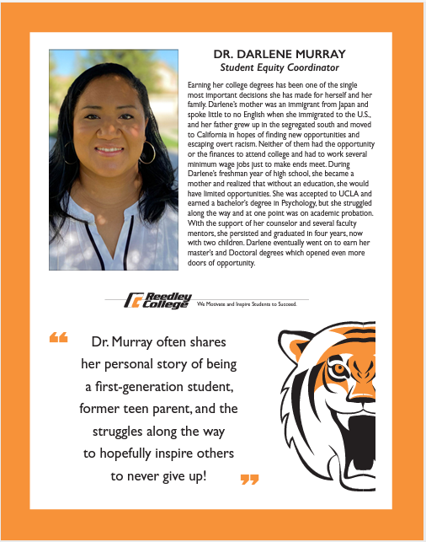
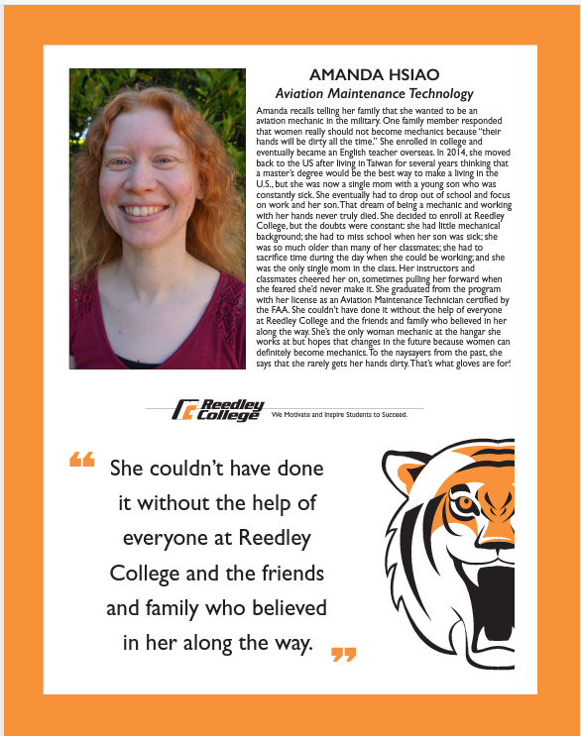
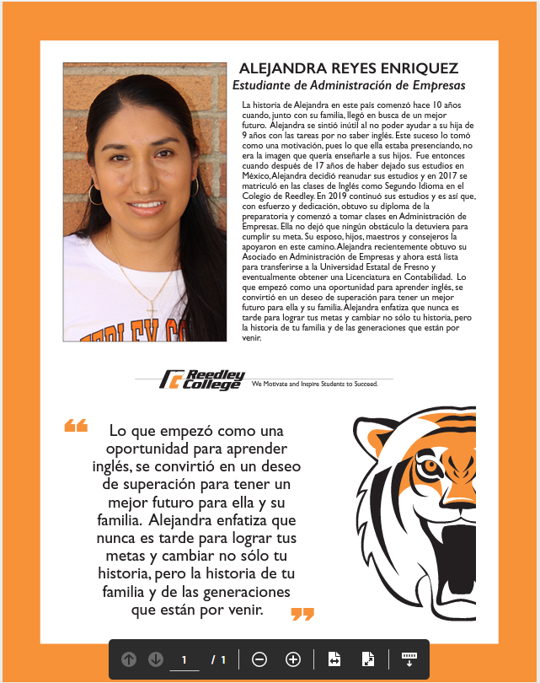
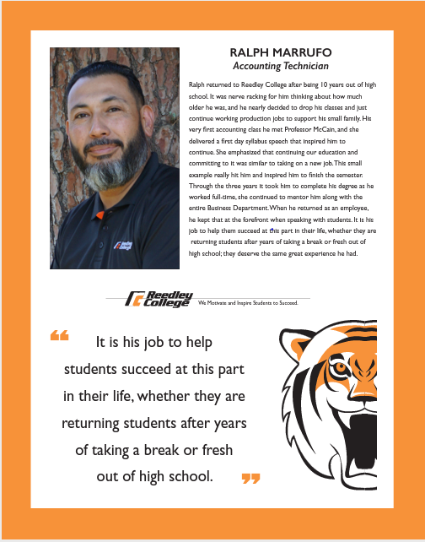
Sharing Stories– Reedley Project

Slide 15
Everyone has a story. What’s yours?

Slide 16
References
Freire, Paulo. Pedagogy of the Oppressed, 30th Anniversary Ed. Continuum Books, New York. 2007.
Brookfield, Stephen D., & Preskill, Stephen. Discussion as a Way of Teaching: Tools and Techniques for Democratic Classrooms, 2nd Ed. Jossey-Bass, New York. 2005

Slide 17
Thank You!
Let’s chat and share stories.

