Slide 1
Where Like Minds Gather: Building Meta Majors
Janet Fulks, Guided Pathways Lead for Capacity Building, Bakersfield College
Virginia May, ASCCC Treasurer, 2018-19 Curriculum Chair,
Sacramento City College
Thais Winsome, ASCCC Curriculum Committee, Mission College
2018 Curriculum Institute, Riverside, CA
Notes:
Thais

Slide 2
Overview
What are Meta Majors?
Developing Meta Majors
Examples
Digging in…
Discussion…
Notes:
Looking at the big picture Meta Major development is the first big transformative step for a college so defining it, discussing process (particularly leveraging existing governance structures for decision-making) is key. We will look at a variety of examples so that you can reference them later. The examples show differences, similarities and reflect a variety of guiding principles for developing your colleges groupings.

Slide 3
Meta Majors with Program Mapping
Notes:
Better Guidance at All Levels
Helps to Find Majors
Exploration
Demonstrates the Starting and Ending Points
Informs Choices
Reduce Excess Units
Related Careers and Salaries
Register for the Correct Math and General Education
Math Pathways – Depends on Major

Slide 4
What are Meta Majors?
Definitions…
Meta Majors are collections of academic majors that have related courses.
Meta Majors cluster groups of degrees and certificates that are considered similar from a student’s perspective.
Meta Majors give incoming students an opportunity for early exploration within a cluster of academic and career choices while still making progress to graduation.
More…
Notes:
Ginni – Meta Majors are described in various ways but the over-riding outcome is to provide a simpler student-facing picture of college and to create a inward facing structure that is manageable.

Slide 5
What are Meta Majors?
Other Titles for the Meta Major concept…
Focus Area
Cluster
Major Pathways
Clustering Majors
Career and Academic Pathways
Interest Areas
Career Clusters
Program Clusters
Others???
Notes:
Many colleges have elected to call these groupings different names depending upon their Mission, Vision and local culture. There is no RIGHT name.

Slide 6
City Colleges of Chicago
Notes:
City Colleges of Chicago have 10 FOCUS areas

Slide 7
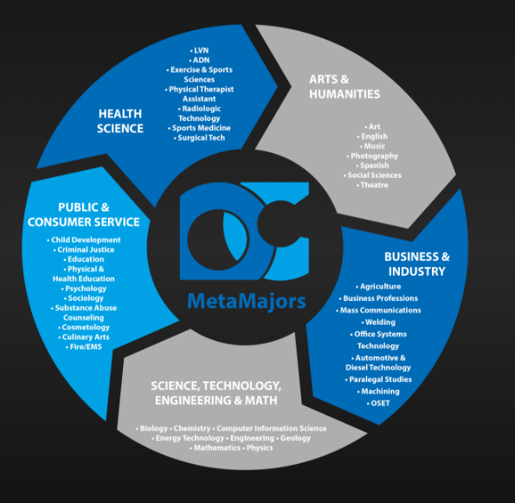
Notes:
Odessa College in Odessa Texas has 5 metamajors – “Odessa College Offers more than 45 Associate Degree programs and more than 70 professional certificates. Whether you're looking to start a new career right away, or transfer to a four-year institution” They have good definitions for each meta major at https://www.odessa.edu/programs/Metamajors/index.html
Arts & Humanities Students select courses of study including political science, world languages, cultural studies, literature, history, & fine arts. They will give a fresh voice to culture, ethics and policy, and will shape our society both today and in the future.
Business & Industry Students pursue courses of study from a variety of fields that include: information technology, graphic design, welding, marketing, logistics, automotive technology, communications, finance, architecture, agricultural science, and other industrial fields of study.
Health Science Students are preparing for careers in fields such as Nursing, Physical Therapy, Radiology, Medical Office Procedures and a variety of fields related to medicine. Programs are designed to prepare students for transfer and the workforce.
Public & Consumer Service Students select courses of study in the public and consumer service industry, including child development, cosmetology, criminal justice, culinary arts, emergency medical services, fire administration, psychology and sociology, and the education field.
Science, Technology, Engineering & Math Science, Technology, Engineering and Math students apply their knowledge and skills to in diverse programs including the petroleum industry, space industry & civil work projects. They will be the innovators of the future.
Odessa College 201 W. University, Odessa, TX 79764

Slide 8
Notes:
Wharton Junior College (in Texas) has 9 Major Pathways they divide academic and vocational pathways
Academic Pathways This includes the Associate of Arts (AA) and Associates of Arts in Teaching (AAT) and is designed for students planning to pursue a 4-year baccalaureate degree from a university. Applicants for the AA and AAT degree must
be TSI-satisfied in Reading, Writing and Math. AA and AAT degrees contain a set of common courses referred to as the General Education Core Curriculum.
Vocational Pathways The Associate of Applied Science (AAS) degree is an occupationally-oriented degree designed to prepare students for entry into a particular occupation upon completion. Applicants for the AAS degree must be TSI-satisfied in Reading, Writing and Math. AAS Degrees are comprised primarily of vocational/technical courses along with some general education courses.
Certificate Programs are designed to prepare students with specific occupational skills that enable them to enter the workforce in a short period of time. Some certificate programs waive TSI requirements.
Some vocational programs are offered in a Block Schedule Format.
For a description of student learning outcomes, topical outlines, and assessment practices for a course, see the Administrative Master Syllabus (AMS) Not sure about your major pathway? Try Career Coach!

Slide 9
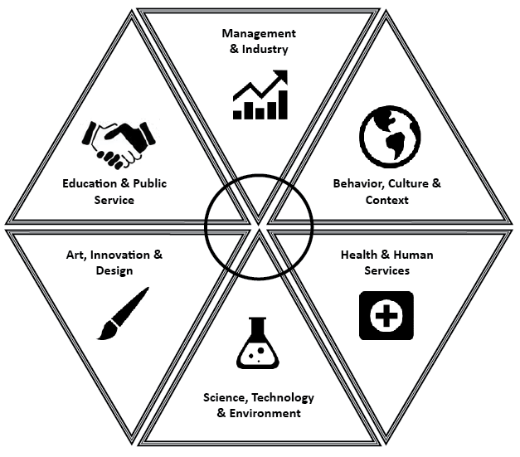
If you are wondering how you will narrow 200 majors into one, narrowing your options down into one or two meta-majors is a good place to start.
In Exploration, we concentrate on six broad areas where majors share similarities.
It is also important to note that no one college or school contains all the majors at Ohio State that are in a particular field of study.
Notes:
Ohio State University uses metamajors for exploration and colleges for majors see the definitions below
Arts, Innovation, and Design
Do you enjoy design and having creative control of your work? Are you interested in increasing awareness of the arts? Majors in the arts explore performance and/or production of various art forms as well as theory, history and the impact of art on society. This field of study is a great fit for students who like to create art and also for those who enjoy and value art.
Sample Curriculum: Arts, Innovation & Design
Health and Human Services Are you interested in science and helping people become healthier and well in all areas of their lives? Are you fascinated by the healthcare industry on all levels? Ohio State offers undergraduate licensure and certification majors in the healthcare field. University Exploration advisors also help students select undergraduate majors that do not lead to licensure, but instead these majors have the potential to lead to a post-baccalaureate health degree. Sample Curriculum: Health & Human Services
Behavior, Culture, and Context Do you love learning about people, society, culture and how they intertwine? Are you interested in communication & relationships? This area includes majors in the Humanities and Social Sciences that are great opportunities for students who love learning about people, cultures and relationships. Sample Curriculum: Behavior, Culture & Context
Management and Industry Are you interested in managing and leading people, looking at data and numbers, analyzing or persuading consumers? This area refers to business related majors, which are available in many different colleges at Ohio State. We have over 20 ways to pursue a business related major and your choice will depend on what your specific interests and skills are.
Sample Curriculum: Management & Industry
Education and Public Service Do you enjoy teaching, training and educating others? Are you interested in working directly with people from a leadership position? Ohio State offers education licensure programs at both the undergraduate and graduate level in a variety of subject areas as well as majors which open up career opportunities in a variety of work settings. ​Sample Curriculum: Education & Public Service
Science, Technology, and Environment Do you enjoy investigating how and why things work? Are you interested in how science is applied to everything in our lives? Majors within the Science, Technology and Environment field of study can be applied or theoretical. Majors in these areas often have a strong math and natural science core, which will require students to take several math and natural science courses as prerequisites to major coursework.
Sample Curriculum: STEM with math placement N​ Sample Curriculum: STEM with math placement M or higher

Slide 10
Cabrillo College’s Career and Academic Pathways (CAP)
Notes:
Cabrillo College has taken a first stab at Meta Majors calling them Career and Academic Pathways (CAP) note that some degrees are in multiple CAPs.

Slide 11
Common Elements of Meta Majors and Program Mapping:
Each Meta Major is clearly mapped to programs and careers.
Math/quantitative reasoning course is aligned with programs within the Meta Majors.
General Education (GE) core courses are mapped with Meta Majors (some or more prescriptive , others are not, some are mixed depending upon the outcomes).
Connections with GE courses and Meta Majors and majors are made clear.
Sometimes electives are aligned with Meta Majors.
Advising and student services are aligned with the student’s Meta Major.
Meta Majors may be aligned with local labor market demand.
Notes:
Each of these common elements should allow the college to consider guidelines to help them build areas. Initially each metamajor should be considered based upon the types of degrees and certificates within the grouping. Can programs and certificates be in one or more areas? Can departments be split between metamajors (e.g. Biology majors belong in STEM but allied health majors prerequisites (a large number of Biology students) belong in the Allied Health (nursing, x-ray, paramedic, etc) area which requires a completely different math pathway.
Aligning the organization by math needs is a next big step.

Slide 12
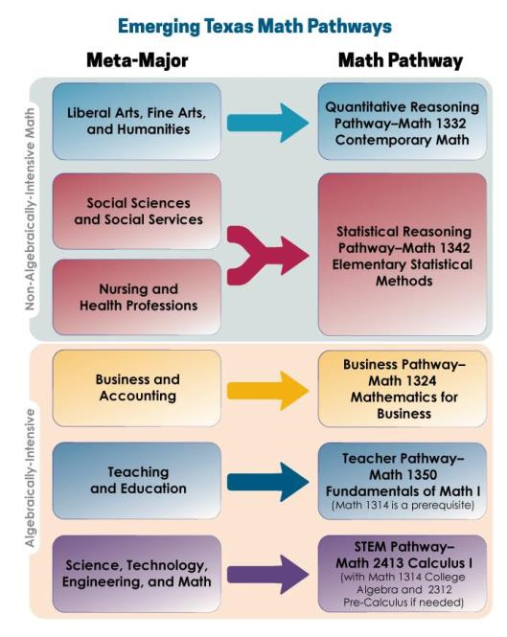
Notes:
A little deeper dive into quantitative reasoning/mathematics requirements help some grouping activities. Here the Dana Center in Texas exams some of the potential matches between meta Major and required math. Link in last slide

Slide 13
Multiple Paths FORWARD: Diversifying Mathematics as a Strategy for College Success
Notes:
Recent articles say that California is ahead of the country in this thinking – link on last slide

Slide 14
Analysis to Support Creating Meta Majors and Program Mapping
What is the full scope of programmatic offerings at the college?
Do the college’s programs align to the local labor market and/or university transfer partner?
Which general education courses align best to each Meta Major?
What are the common courses across all programs?
What is the required core within this Meta Major that allows students to branch off into various majors without losing any credits?
Which courses will introduce students to relevant faculty and career information early in their academic careers?
Which courses might not be included, and who needs to be involved in that decision?
Notes:
Questions From Jobs for the Future

Slide 15
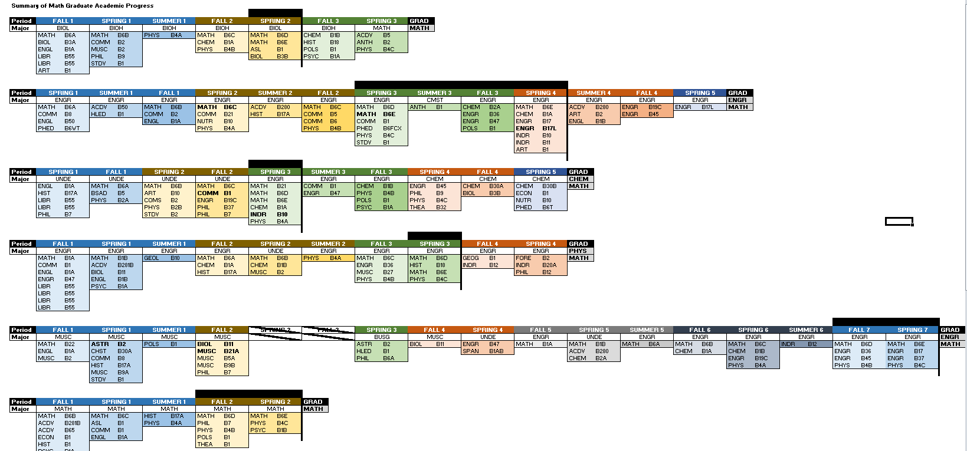
Graduating in Math at Bakersfield College an unguided pathway research project
Sample Pathways with Program Mapping
Notes:
The literature to substantiate guided pathways is based on a few (3) primary assumptions: students are graduating, students are getting too many units, students are taking too long.
Lets look at a few actual completers – this is an easy study to do at your college.
We chose the math graduates because math is a relatively simple major with primarily classes in one area and GE (unlike Bio or chemistry)
Each row represents one of the graduate’s school records, each color change is a new year, second line = major, hatch marks = stop out. Look at your sheet and number them 1 thru 9 (9 did not complete kept trying)

Slide 16
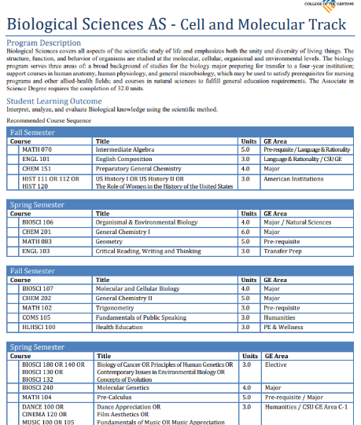
College of the Canyons— Program map for biology major transfer to UC
Notes:
Within the metamajors mapping of each program will allow you to determine overlap within coursework. Note that this program map, while only 2 years is 66 units with two 18 unit semesters. Most program paths start with the student at transfer level.

Slide 17
Notes:
Butte College program map for the same area of study within STEM (biology) is 3 years and 109+ units if starting at transfer level.

Slide 18
Developing Meta Majors
Effective practices ("reverse engineering" from program outcomes)
Curricular considerations (overlap)
Facilitating the conversation between faculty from different disciplines and services
Student voice!
What about program mapping—which should be done first?
Notes:
As you begin to explore Meta Majors you should look at what other colleges have done. The process is iterative and it is not a lone ranger task. Here is the evolving work from Florida showing the changes in thinking to expand to labor market and K-12.

Slide 19
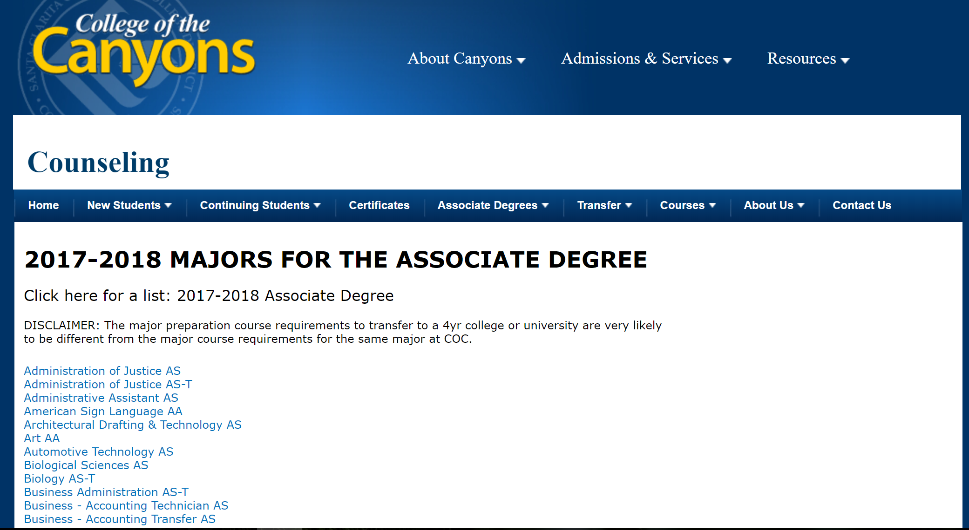
Observation: List of Majors with a Disclaimer

Slide 20
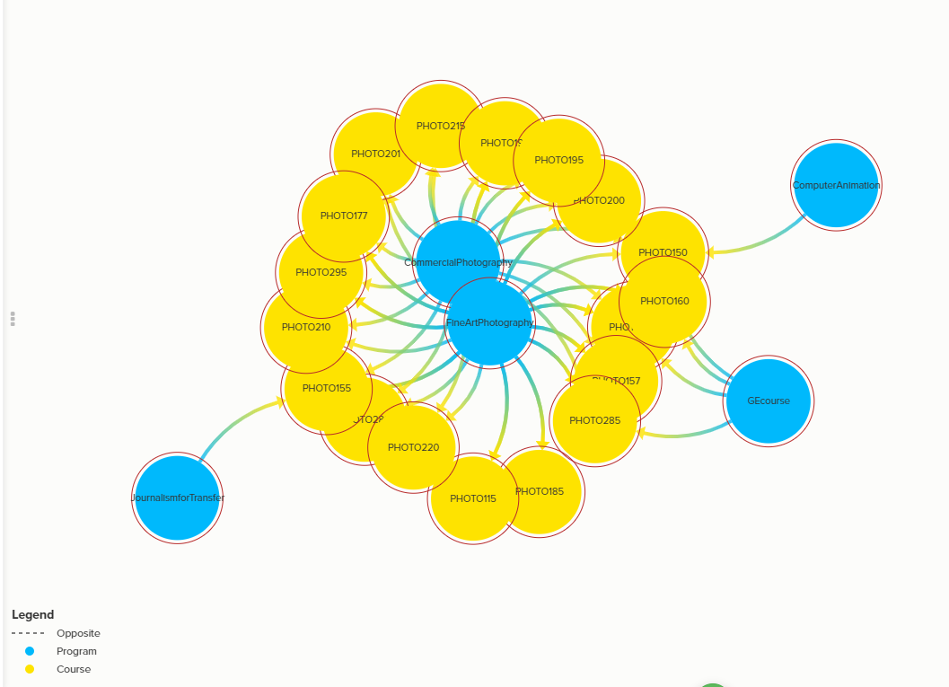
Programs that Require Photography Courses for Degree, Certificate, and/or Transfer
Kumu Map of Programs & Courses Visualization
Notes:
College of the Canyons and Skyline College used a free software program to map and visualize course overlap - Kumu is a powerful data visualization platform that helps you organize complex information into interactive relationship maps.
https://www.kumu.io/

Slide 21
Student Course Taking Behavior
Programs with the Greatest Percentage of its Students Successfully Completing Photography Courses who are not Fine Art Photography program completers
Notes:
College of the Canyons further examined course taking behavior of students by their major. They were especially looking at areas of commonality where students within a particular major took specific general education courses within areas. This helps us to better understand the student view. Look at the number and majors associated with photography outside of fine arts. It makes sense that this is a useful “Arts” course for Fireman or ASL based upon needs within their major.

Slide 22
Notes:
Initial iteration of Florida System
Lake Sumter State College, Leesburg Florida – first iteration of state imposed metamajors on all colleges – first iteration of Meta Majors in Florida system

Slide 23
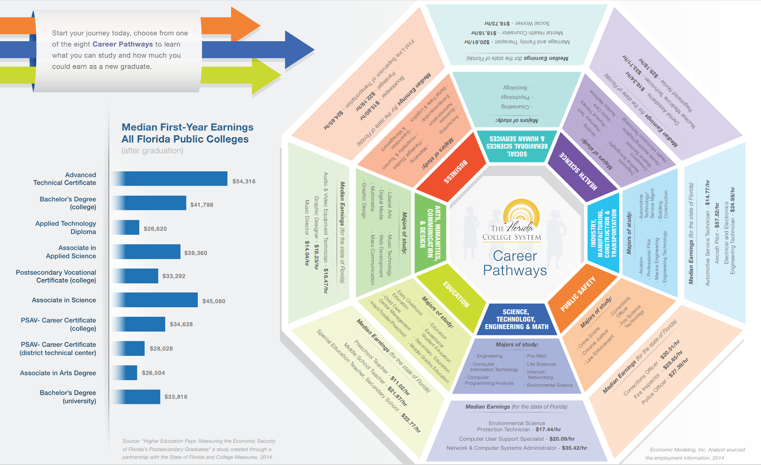
Florida College System
Notes:
Later iteration of Florida statewide pathways, mapped with the interactive deeper information for students.

Slide 24
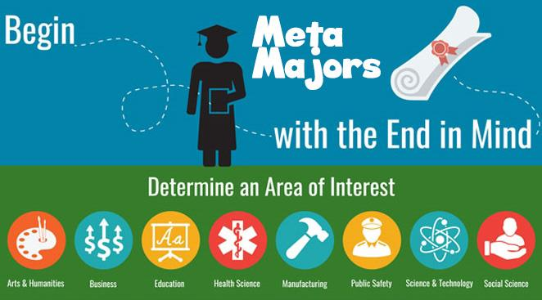
The Florida System aligns with K-12 pathways with the college and university 8 pathways as exemplified by this district, St Lucie Public Schools in Port St, Lucie, FL
Notes:
The Florida System aligns with K-12 as exemplified by this district, St Lucie Public Schools in Port St, Lucie, FL
http://www.stlucie.k12.fl.us/departments/career-and-technical-education/meta-majors/

Slide 25
Observation: First Screen of Majors

Slide 26
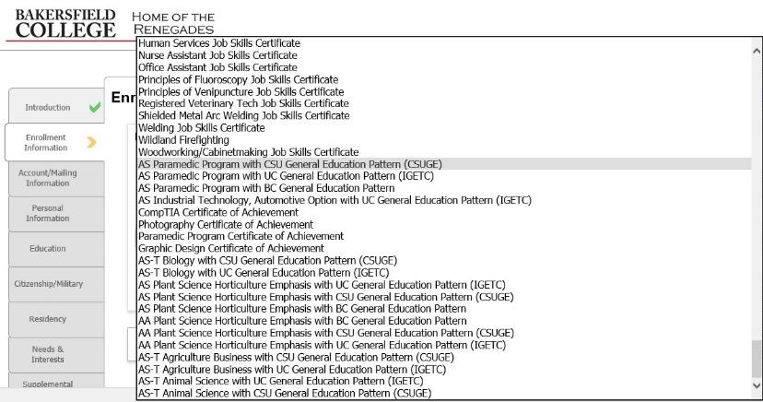
Observation: Ninth Screen of Majors

Slide 27
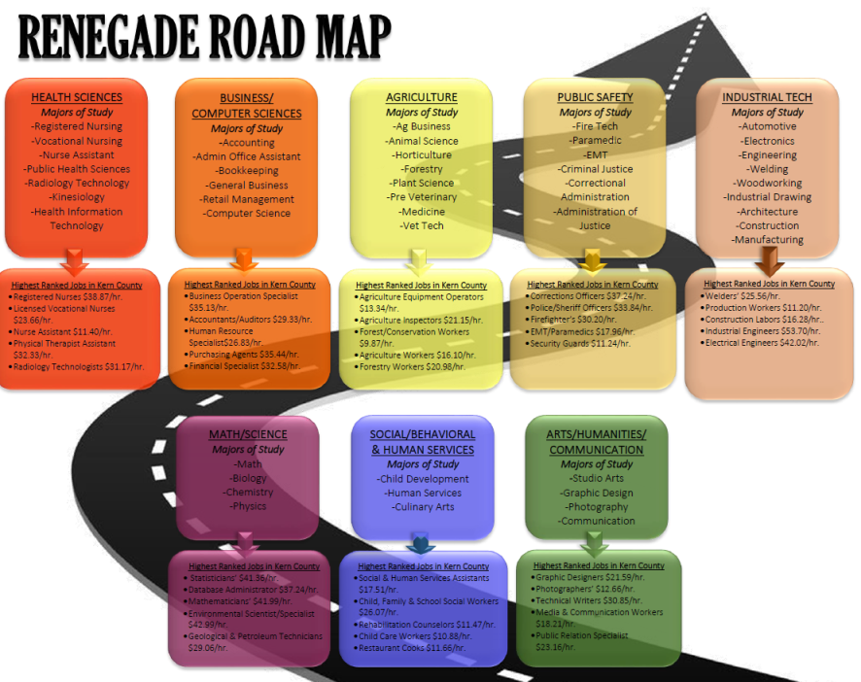
Notes:
Bakersfield College Focused on Outcomes and Jobs

Slide 28
Notes:
Refinement of the Renegade Road Map

Slide 29
Notes:
San Jacinto College in Texas First approach

Slide 30
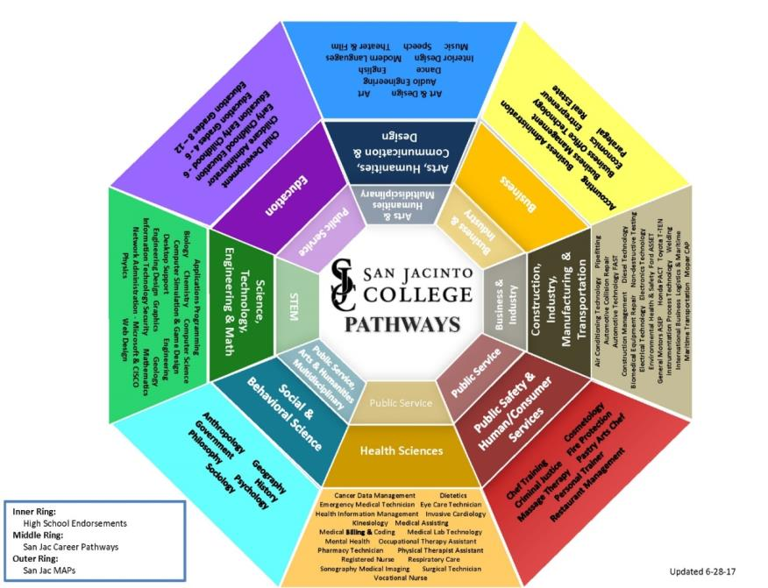
Notes:
Next iteration for San Jacinto College, TX (not Mt San Jacinto in CA)This includes the high school pathways in the inner most faded circle as aligned to the college pathways in the second brighter circle.

Slide 31
Additional Curricular Considerations
How does the college communicate Meta Majors to prospective students?
How does the college help students make informed choices about Meta Majors?
How does Meta Majors placement align with English, math and ESL placement?
Do orientations, first-year experience courses, and student success courses align to the Meta Major?
Will mapped pathways be presented to students as their default registration?
How will you incorporate the Golden 4 and other transfer requirements?
Will these organizational strategies have any unintended consequences on equity?
Notes:
Deeper exploration should include questions about implementation strategies and effects across the institution and with community partners.

Slide 32
What are the Outcomes?
Program clarity
Sequencing clarity
Specific data for nudges
Targeted messaging
Clear contacts for student questions
A village to lead the student to the outcome

Slide 33
Notes:
Program mapping and meta major analysis help colleges consider GE relevancy. This ADT at BC transfers into 6 different areas of Sociology BAs where the GE courses can help meet upper division requirements in some cases or better prepare students to make a decision about area of emphasis when transferring.

Slide 34
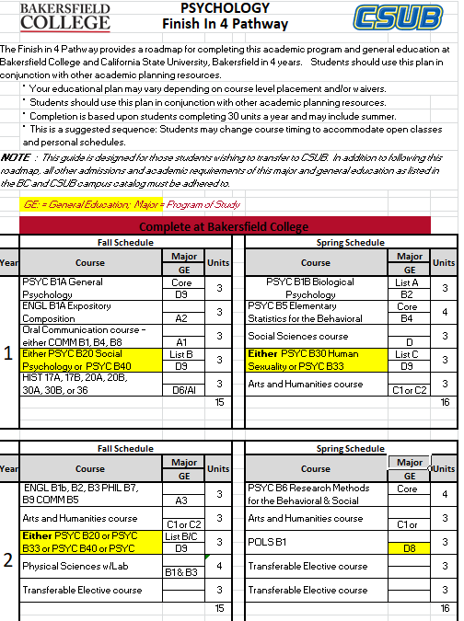
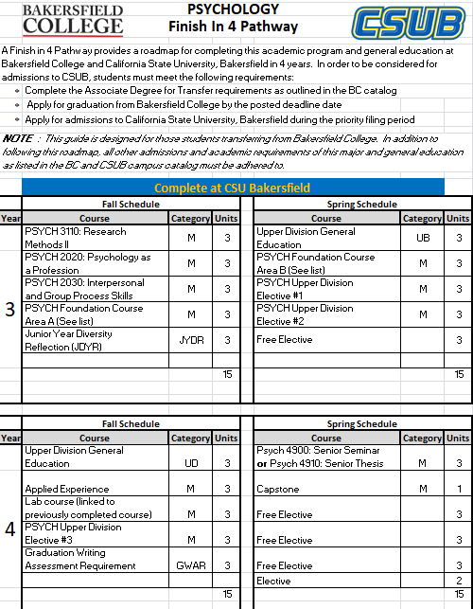
Notes:
This is an example of a program map that goes beyond the first two years to align with the BA years and guarantee graduation

Slide 35
Tracking Data by Meta Majors is manageable and makes a difference!
Notes:
Organization by metamajors has helped provide detail information to message students and to follow programs. Look at the large drop in Personal and Career exploration as the college has more carefully advised students.

Slide 36
Facilitating the Conversation
How much of a degree is within a particular department?
How do you incorporate representation from other disciplines?
Where do under-prepared or undecided students go and who plans for them?
How do you consider transfer requirements?
Where do conversations with high school faculty fit in?
Where do conversations with the students fit in?

Slide 37
Let’s give it a try!
Activities (select one) in groups of 4-5:
Overall organization: What guiding principles would you include in the development of Meta Majors (i.e. incorporation of GE and specificity, development or discontinuance of programs/courses, who should be involved in the discussion and final decisions)
Specifics: Use this list of majors and simple program outcomes to identify all the local college stakeholders that should be involved in identifying the Meta Majors, what steps need to take place to begin the process, and how will each Meta Major be integrated into the college pathways plan as a whole.
Alternative Activity: For those from colleges that have already developed Meta Majors...what would you do differently, if you could start all over again?

Slide 38
Follow-up Discussion and Q&A
What aspect of Meta Major development do you think will work best at your college?
What aspect will be the most challenging?
For those that have already begun Meta Major development, what worked well, and what didn’t?

Slide 39
Additional Resources
Meta-Majors: An Essential First Step on the Path to College Completion (JFF)
http://www.jff.org/publications/meta-majors-essential-first-step-path-college-completion
How meta-majors guide students toward on-time graduation (EAB)
https://www.eab.com/daily-briefing/2016/07/26/how-meta-majors-guide-students-toward-on-time-graduation
Key Meta-Major Questions to Consider
https://jfforg-prod-prime.s3.amazonaws.com/media/documents/Meta-Majors-Key-Questions-071816.pdf
Multiple Paths FORWARD: Diversifying Mathematics as a Strategy for College Success
https://www.wested.org/wp-content/uploads/2018/05/Multiple-Paths-Forward-Booth.pdf
Quantitative Reasoning the Next “Across the Curriculum” Movement by (AACU) Susan Elrod, 2014
https://www.aacu.org/peerreview/2014/summer/elrod
The Dana Center Mathematics Pathways: The Right Math for the Right Student at the Right Time
https://dcmathpathways.org/dcmp/dcmp-model

