Slide 1
CCC Baccalaureate Degrees – AB 927 (Medina, 2021) and Expanding Access for Students
Juan Arzola, ASCCC CTE LC Chair and At-Large Representative
Dolores Davison, ASCCC President

Slide 2
Breakout Description
This session will seek to highlight the benefits of offering community college baccalaureate programs Join this session as we examine how expanding access to CCB degrees offer students an additional pathway to their educational goals, while simultaneously meeting local workforce demands

Slide 3

The Desire for Baccalaureate Programs in California Is Not New…
Eight Legislative Items
AB 1932 (Maze, 2004)
AB 1280 (Maze, 2005)
AB 1455 (Hill, 2009)
AB 2400 (Block, 2010)
AB 661 (Block, 2011)
SB 850 (Block, 2014)*
SB 769 (Hill, 2017)
SB 1460 (Hill, 2018)*
*Passed

Slide 4
Nor Are We Alone…All of These States Currently Have CC Baccalaureate Programs
Arizona (AZ)
California (CA)
Colorado (CO)
Delaware (DE)
Florida (FL)
Georgia (GA)
Hawaii (HI)
Idaho (ID)
Indiana (IN)
Michigan (MI)
Missouri (MO)
Nevada (NV)
New Mexico (NM)
North Dakota (ND)
Ohio (OH)
Oklahoma (OK)
Oregon (OR)
South Carolina (SC)
Texas (TX)
Utah (UT)
Vermont (VT)
Washington (WA)
West Virginia (WV)
Wyoming (WY)

Slide 5
Some Quick Background Information – SB 850 (Block, 2014)
Allowed 15 districts to propose and implement one bachelor’s degree per district.
State Chancellor/BoG determined pilot districts based on resources, and local and regional needs
Coordination with UC and CSU (spoiler alert – neither system of public higher ed was pleased)
Duplication of public university programs was to be avoided
Legislature set student fees, state compensation
Local boards determined governance, administration, standards, and formats
Evaluation and report to Legislature, State Chancellor, and Board of Governors

Slide 6
15 Colleges Approved for the Pilot
College
Antelope Valley College
Bakersfield College
Cypress College
Feather River College
Foothill College
MiraCosta College
Modesto Junior College
Rio Hondo College
San Diego Mesa College
Santa Ana College
Santa Monica College
Shasta College
Skyline College
Solano College
West Los Angeles College
Program
Airframe Manufacturing Technology
Industrial Automation
Mortuary Science
Equine and Ranch Management
Dental Hygiene
Biomanufacturing
Respiratory Care
Automotive Technology
Health Information Management
Occupational Studies
Interaction Design
Health Information Management
Respiratory Care
Biomanufacturing
Dental Hygiene

Slide 7

Student Demographics for Pilot Cohorts…

Slide 8
s
ETHNICITY | Cohort 16 | Cohort 17 | Cohort 18 | Cohort 19 | Cohort 20 | Total
American Indian / Alaskan Native | 2% | 1% | 0% | 0% | 1% | 2%
Asian | 14% | 16% | 11% | 18% | 13% | 14%
Black / African- American | 5% | 4% | 7% | 4% | 6% | 5%
FilipinX | 8% | 6% | 9% | 5% | 7% | 8%
LatinX | 26% | 31% | 28% | 32% | 32% | 26%
Pacific Islander / Hawaiian Native | 1% | 1% | 0% | 1% | 0% | 1%
White | 37% | 32% | 37% | 30% | 31% | 37%
Multi-Ethnicity | 5% | 5% | 5% | 7% | 5% | 5%
Unknown | 3% | 4% | 3% | 3% | 5% | 3%
Total | 100% | 100% | 100% | 100% | 100% | 100%
Gender* | Percent
Female | 66%
Male | 33%
Unknown | 1%
75% belonged to at least one impacted groups** (first-generation college student, struggled financially, experienced homelessness or housing insecurity, indicated a disability, or is a veteran)
Source: * MIS and Legislative Analyst Office; ** Statewide Employment Survey

Slide 9
Pilot Program Graduation Rates
College | 2017-18 | 2018-19 | 2019-20 | 2020‐21*
Antelope Valley |  | 9 | 6 | 15
Bakersfield | 7 | 12 | 9 | 17
Cypress | 4 | 9 | 2 | 8
Feather River | 8 | 11 | 20 | 10
Foothill | 23 | 45 | 60 | 69
MiraCosta |  | 21 | 22 | 25
Modesto |  | 18 | 8 | 9
Rio Hondo |  | 10 | 11 | 9
San Diego Mesa | 10 | 15 | 28 | 27
Santa Ana |  | 23 | 11 | 18
Santa Monica | 13 | 22 | 15 | 26
Shasta | 2 | 6 | 8 | 6
Skyline | 18 | 2 |  | 6
Solano |  | 12 | 15 | 14
West Los Angeles | 28 | 48 | 42 | 32
Total | 113 | 263 | 257 | 291
Source: MIS and Legislative Analyst Office

Slide 10
Student Perceptions of the Bachelor’s Program
51% said they would not have pursued a Bachelor’s degree otherwise
87% agreed that the value of the program worth the tuition cost, and the tuition cost was affordable
92% agreed that community college should continue offering Bachelor’s degrees
Source: Statewide Employment Survey

Slide 11
Cost Calculations
 | Cost Per Semester Unit (resident fee)
First Two Years (traditional AA/AS/ADT degree) | $46/unit for two years (approximately 60 units)
Second Two Years | $46/unit + $84/unit (baccalaureate tuition) = $130/unit
Total Cost | $10, 560

Slide 12
Loan and Employment Outcomes
72% did not take out loan to complete the Bachelor’s program
83% employed in a job. Among them,
  80% found job within 3 months
  95% employed in the same field of study
  94% employed in the state of California
  $25,000 average income increase
Source: Statewide Employment Survey

Slide 13
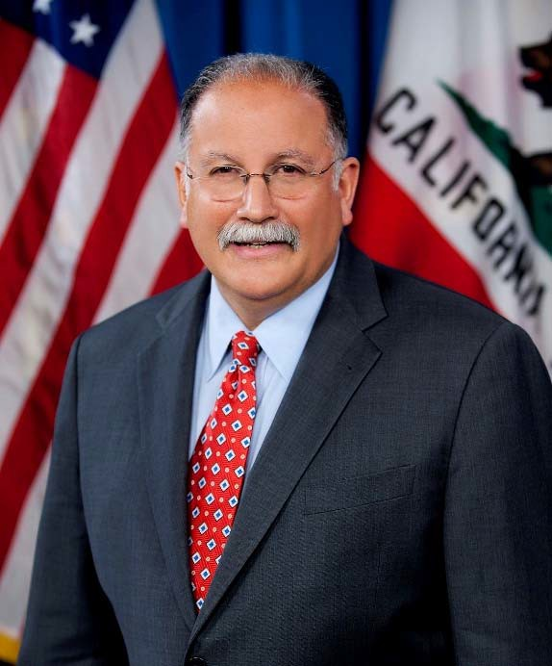
New Legislation – AB 927 (Medina, 2021)
This legislation:
Makes the 15 pilot programs permanent by removing the sunset provision
Expands this opportunity to all California community colleges through an approval process in the CCC Chancellor’s Office
Proposal approvals are limited to 30 per year, with submission dates of January 15 and August 15
Stronger consultation between the California Community Colleges Chancellors Office and the universities

Slide 14
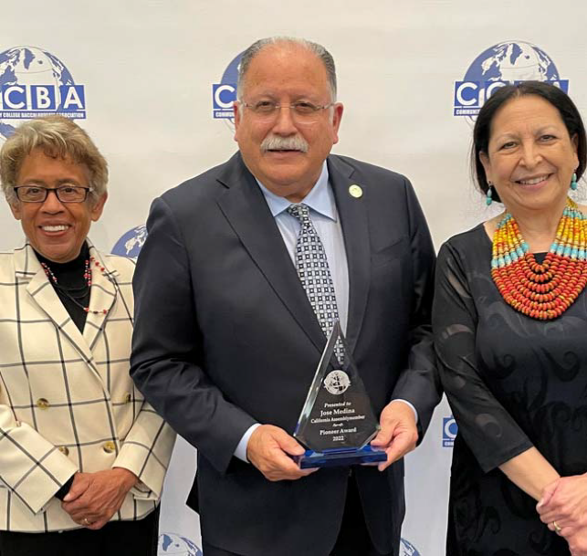
First Submissions due by 15 January 2022: Approved Programs to be Announced No Later than 31 May 2022
Programs That Were Submitted:
4 in Respiratory Care
Automotive Technology Management
Biomanufacturing
Cyber Defense and Analysis
Ecosystem Restoration and Applied Fire
Hisotechnology
Research Laboratory Technology

Slide 15
All Proposals (both for this round and ongoing) Must:
Demonstrate unmet workforce need
Include information regarding curriculum, financial support, and staffing plans
Include documentation regarding consultation with employers and industry
Must not duplicate programs offered by California’s public universities
Total baccalaureate degrees must not exceed 25% of a college’s total range of degrees

Slide 16
A Few Additional Requirements
ACCJC authorized to approve bachelor’s degrees through the substantive change process
Added to draft standards new requirements specific to bachelor’s degree
  Minimum 120 semester credits
  Minimum GE requirement 36 semester credits
  All standards apply and interpreted in the context of the degree (e.g. faculty credentials, library resources, etc. should be appropriate to the degree)
  Substantive Change Process

Slide 17
Benefits to Baccalaureate Degrees at the CCCs
Addresses workforce and economic needs, as mentioned frequently by Governor Newsom and others
Provides accessible bachelor’s degree programs for students who are “place bound” or are unable to attend one of the public higher education institutions
Provides high-quality education by colleges that often offer associate degree programs in the same workforce fields.
Is affordable - $10,560 for all 4 years in tuition costs (does not reflect total cost of attendance)

Slide 18
Lessons Learned and Challenges to Be Faced
Opposition is Inevitable
  Universities’ Fear of Competition
  Community Colleges’ Ideological/Emotional Concerns
  Expect at least two years of development
Identify a Legislative Champion
Quantify Needs
  Workforce Data
  Degrees
Address Details
  Accreditation
  Cost
Organize a Coalition
Obtain Endorsements
  Chamber of Commerce
  Professional Organizations
  Students
  Veterans Groups
Emphasize Educating the Public
  Media, Op-Eds, etc.

Slide 19
What’s Next?
New Proposals Due to the Chancellor’s Office by 15 August 2022
California Community College Baccalaureate Association (CCCBA) providing guidance to the CCCCO
Chancellor’s Office Baccalaureate Working Group
Reworking of the Baccalaureate Program Handbook to assist colleges
Labor Market Indicators and other materials being collected
Potential additional reports from the LAO and others about the programs
Possible Legislation regarding number of programs and duplication

Slide 20
Thank You!
Questions?
info@asccc.org
cccbac.org

