Slide 1
Baccalaureate Degrees and Accreditation
Craig Rutan (Santiago Canyon College)
Ekaterina (Katia) Fuchs (City College of San Francisco)
Notes:
Brief introduction of speaker and facilitator

Slide 2
A Brief History
SB 850, signed in September, 2014 allowed 15 colleges to each run one baccalaureate program
How were the pilot programs selected?
The initial pilot was to run through 2022
The pilot has been extended through 2026, and the restriction of only one program per college has been lifted.
Notes:
Talk a little about the factors that went into the selection of which program was offered as a baccalaureate degree program. (For example when the program was only offered at an expensive for-profit institution.

Slide 3
Programs that Started in Fall 2016
Antelope Valley – Airframe Manufacturing Technology
Bakersfield – Industrial Automation
Feather River – Equine and Ranch Management
Foothill – Dental Hygiene
Rio Hondo – Automotive Technology
San Diego Mesa – Health Information Management
Santa Monica – Interaction Design
Shasta – Health Information Management
Skyline – Respiratory Care
West Los Angeles – Dental Hygiene

Slide 4
Programs that Started in Fall 2017
Cypress – Mortuary Science
MiraCosta – Biomanufacturing
Modesto – Respiratory Care
Santa Ana– Occupational Studies
Solano – Biomanufacturing

Slide 5
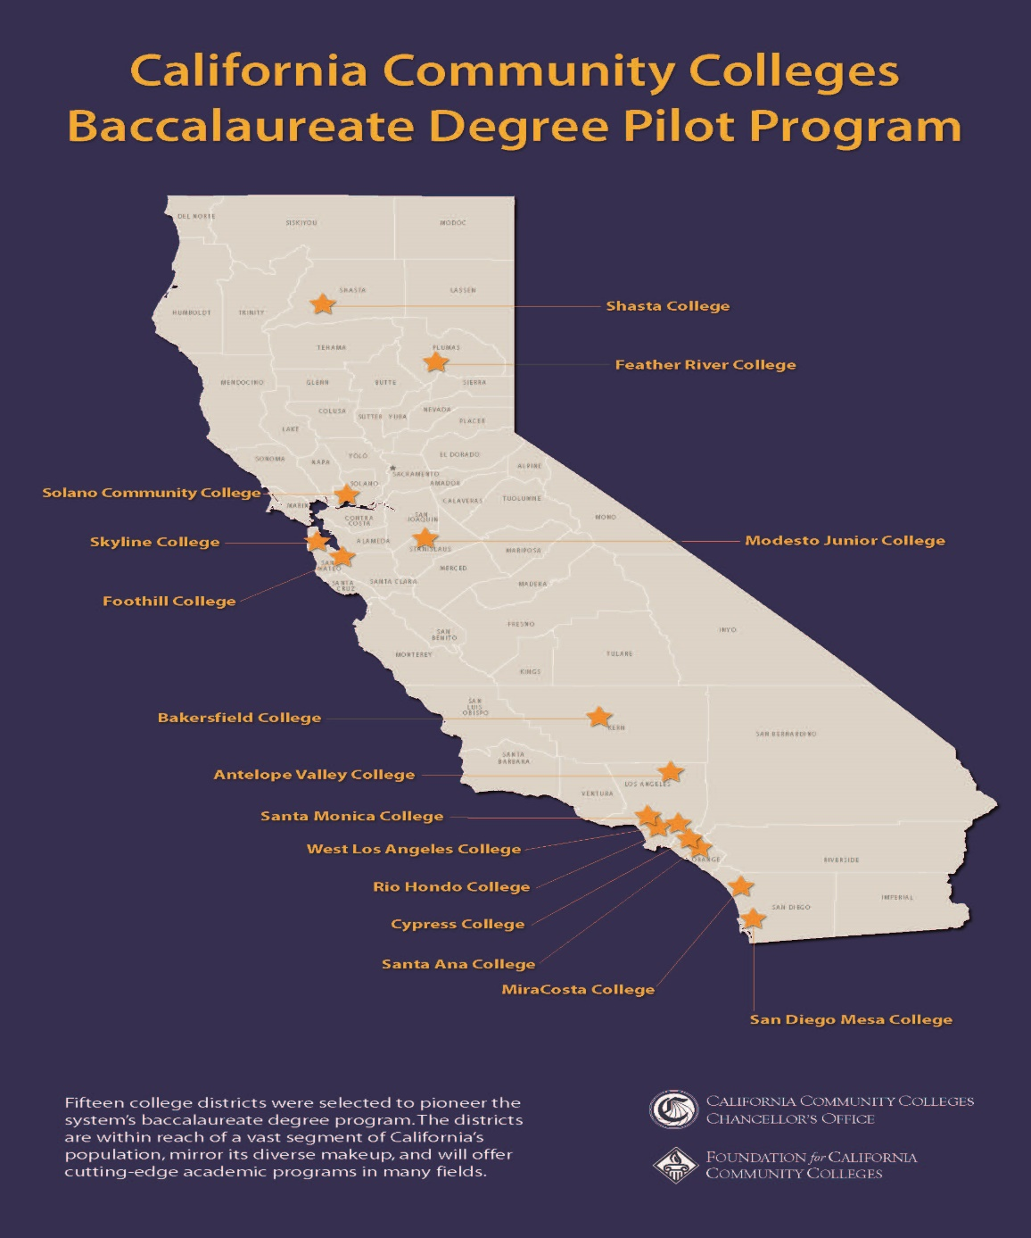

Slide 6
Accreditation of Baccalaureate Programs
Community Colleges offering a baccalaureate program often have to complete programmatic accreditation and accreditation by ACCJC.
Program accreditors often place specific curricular and faculty qualifications on the program. Program accreditors often require documentation that all program requirements are met and a site visit is often included.
When initially creating a baccalaureate program, colleges will need to submit a substantive change report to ACCJC. Representatives from the Commission will visit the college to evaluate the program and grant initial approval.
Baccalaureate programs are incorporated into ISERs following the initial program approval.
Notes:
Talk a little bit about the definition of “higher order of learning”

Slide 7
What to expect from ACCJC
ACCJC has produced a highlight document on the expectations for colleges implementing a baccalaureate program (link)
Colleges must be able to demonstrate that baccalaureate programs are funded, have sufficient resources, have qualified faculty, have integrated the program into institutional planning (all of these are expected for every program), and that there is a clear distinction between the learning outcomes for lower and upper division coursework.

Slide 8
Inconsistencies between ASCCC and ACCJC
The expectations that ACCJC and ASCCC laid out for baccalaureate programs are similar, but they are not exactly identical.
ASCCC (and the CCCCO) currently calls for colleges to have students complete CSU GE Breadth or IGETC and 6 units of upper division general education.
ACCJC requires fewer units of lower division GE and 9 units of upper division of GE.
Now that ACCJC is able to accredit more baccalaureate programs, they have indicated that they are willing to work with ASCCC and the CCCCO to bring the expectations into alignment

Slide 9
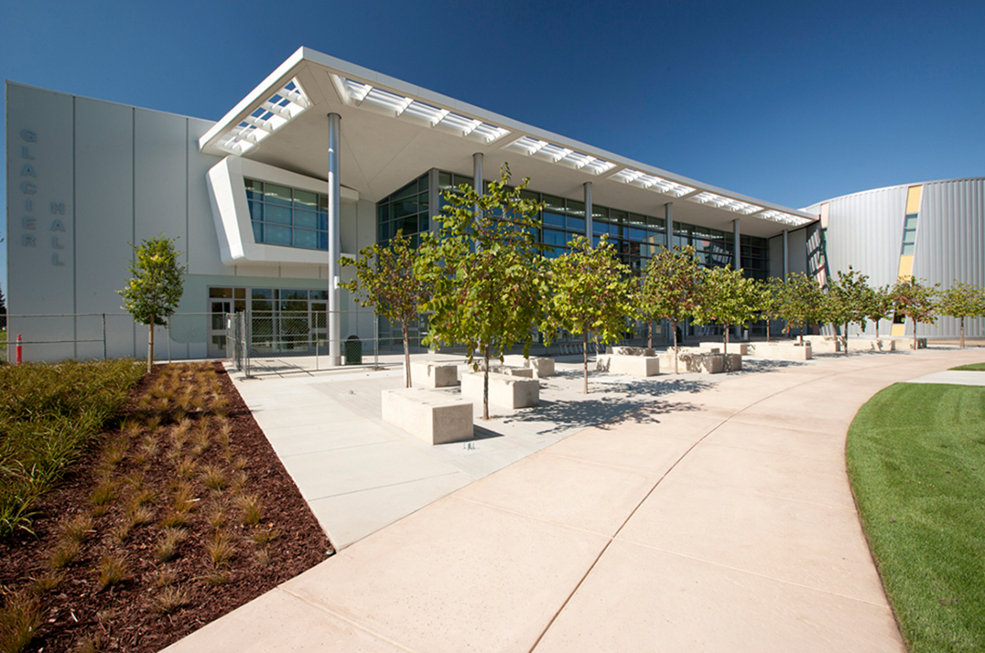
Modesto Junior College
Bachelor’s of Science in Respiratory Care
Modesto Jr. College/Skyline College
Bachelor’s of Science in Respiratory Care

Slide 10
Respiratory Care Profession
21, 000 Licensed Practitioners (California)
Licensure – Credential and Associate Degree Completion
2/3 Associate Degree Prepared
Limited Bachelor’s Degree Programs in California
Movement Towards Bachelors Degree Requirement
American Association for Respiratory Care (AARC)
California Society for Respiratory Care (CSRC)
Committee on Accreditation for Respiratory Care (CoARC)
California Respiratory Care Board (RCB)

Slide 11
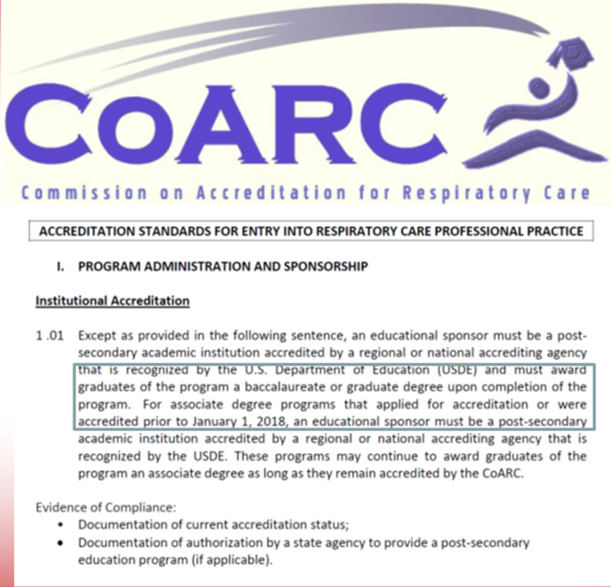
Movement Towards a B.S. Degree

Slide 12
Extensive Process
Application Submitted to CCC Chancellor's Office
Site Visit – CCC
Approved (CCC and ACCJC)
2+2 Hybrid Program with target for Online offering
Developed Curriculum (including Higher Division GEs)
Lots of Symposiums, Sessions, Conferences
Marketing
Faculty
Application process (Application Criteria)

Slide 13
Program Design
Working Adults
15 Month/Accelerated Program
Online
8 Weeks/Sessions (2 courses)
16 Week Semester
40 units
28 Respiratory Core Courses
12 Upper Division GE Courses
Final Capstone Project

Slide 14
Continuing work on baccalaureate programs
At the Fall 2019 Plenary Session, ASCCC adopted resolution 6.01 F2019 that called for the baccalaureate programs to become permanent and resolution 6.02 F2019 calling for the expansion of the baccalaureate programs to other colleges.
  Resolved, That the Academic Senate for California Community Colleges support the expansion of baccalaureate degree programs in the California community colleges in disciplines and communities that best serve the students of the California Community Colleges; and
  Resolved, That the Academic Senate for California Community Colleges urge the prioritization of programs in allied health fields in the expansion of baccalaureate degree programs.

Slide 15
Will my college ever get to offer a BS degree?
For new baccalaureate degrees to be established, the Legislature will need to expand the program.
Representatives from the colleges with baccalaureate degrees have been working with legislators to makes the degrees permanent and expand the offerings to other colleges.
The Legislative Analyst Office has released their final report on the baccalaureate programs (link) but their recommendations were not as positive as many in the system had hoped.
At this point, the future expansion of these programs is unclear.

Slide 16
Thank You!
efuchs@ccsf.edu
Rutan_Craig@sccollege.edu
Questions?

