Slide 1

Bakersfield College
Making It Happen
(MIH fulfilling our SEP, SSSP, ATD and BSI mandates)

Slide 2
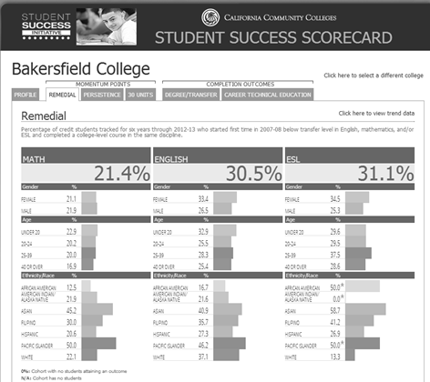

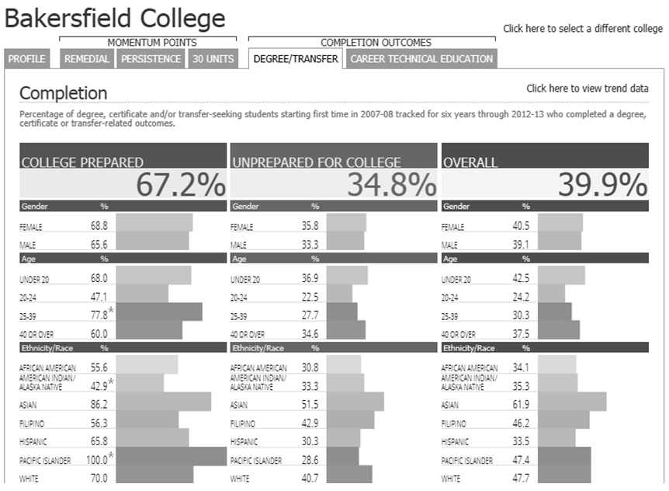
Key Data Issues for BC
Lowest CCSSE benchmarks
Student Faculty Interaction
Student Effort
Completion Data
Basic Skills Progress Data
CCSSE – Perception Data
Equity Data
SSSP-Student Service Data
Notes:
Janet – Key data concerns

Slide 3
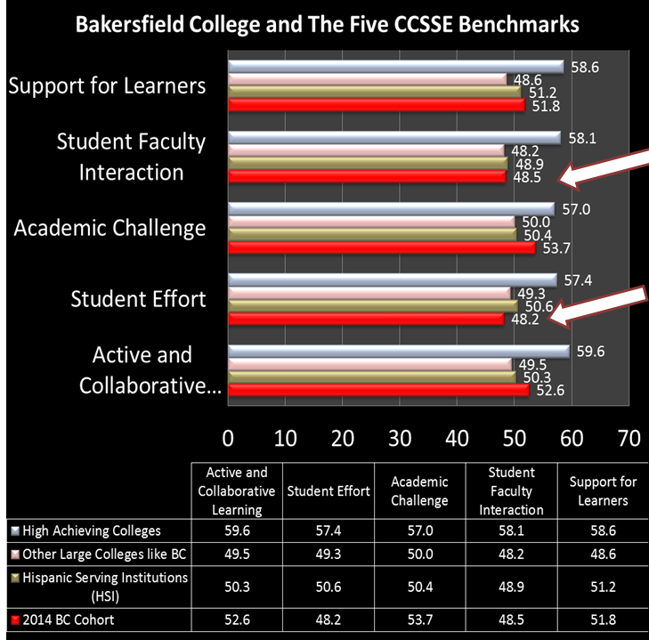
Bakersfield College 2014 CCSSE Benchmarks

Slide 4
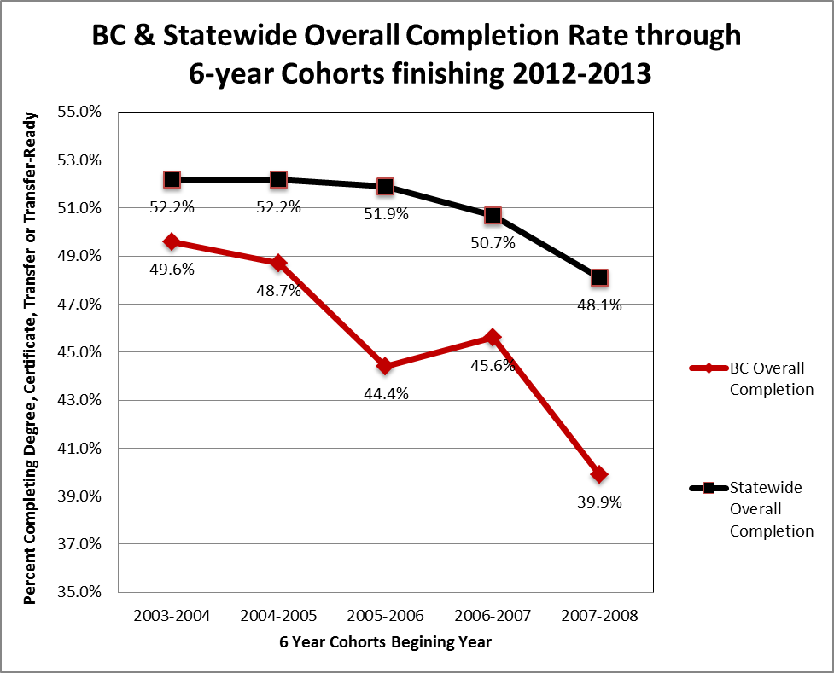

Slide 5

Notes:
ATD data showing positive results
SEPs seemed to be correlated with better outcomes
Math in first semester
English in first semester
But not all of this first semester

Slide 6

Overview of Intervention
Identify cohort traditionally known to require support (CalSOAP)
Examine & institute Multiple Measures
Examine Testing Practices
Recruit and train mentor personnel (faculty, staff & administrators)
Require frequent and proactive contact with mentees (relationship development)
Evaluate data
Notes:
Manny’s

Slide 7
What is CalSOAP?
California Student Opportunity & Access Program
CCC, CSU, and UC partnership
Est. in 1978 by State legislature
Raise achievement for:
  Low-income (some HS have 80-90% free lunch)
  Regions w/ low college eligibility and/or low participation rates
  First generation students
Notes:
Manny’s

Slide 8
Recommendations of MM work
Assessment procedures and placement decisions clearly communicated to students. Students should be informed about the entire set of multiple measures that are being used to assess their level of knowledge and skill and how those multiple measures will be analyzed.
Ensure that multiple measures are applied consistently for all students.
Collect multiple measures before students complete assessment tests, not just those who appeal their assessments.
Use measures that have a high degree of predictive validity.
Involve discussions by the local senate and discipline experts at each college.
Create a local selection of validated measures policy and data.
Include periodic review of multiple measures assessment policies.
Provide discipline experts and counseling faculty with information on why certain multiple measures have been selected for use at the college and the role that multiple measures can play in accurate placement.
Strive to produce an objective process and carefully examine the use of local measures that may be overly subjective, such as interviews.
Make weighting of multiple measures transparent and research based.

Slide 9
Title 5 on Multiple Measures
Title 5 §55502(i) clearly mandates that California community colleges use multiple measures in their assessment processes: “‘Multiple measures’ are a required component of a district’s assessment system and refer to the use of more than one assessment measure in order to assess the student”
The requirement to use multiple measures is reiterated in Title 5 §55522(a): “When using an English, mathematics, or ESL assessment test for placement, it must be used with one or more other measures to comprise multiple measures.”

Slide 10
BC Philosophy behind MMs and Assessment
Tests aren’t always the best measures
Tests alone are TERRIBLE measures
The goal is to predict success
More information provides better placement

Slide 11
High School Testing
Some shocking information – Students test better at the high schools than in a foreign location – a lot better
Challenge for BC, we have 41 feeder high schools
Previous testing was not web-based, therefore changed to Accuplacer – a web-based (more easily delivered) test which promised BC automatically applied multiple measures and branched (smart) testing.
Accuplacer also provided writing exam versus multiple choice for English

Slide 12
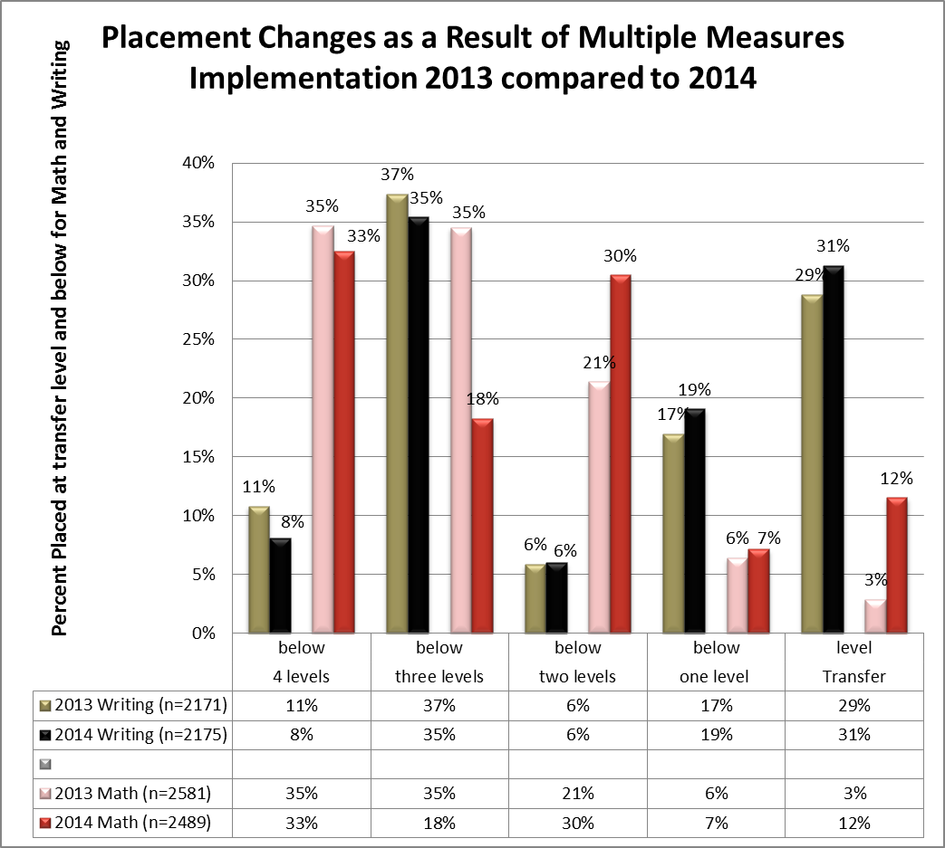

Slide 13
Not by a Single Test Alone: Multiple Measures
MATH Multiple Measures
Measures used:
1. Placement test score
2. Highest level math class with grade of B or higher and
3. HS GPA of 3.0 or higher
ENGLISH Multiple Measures
Measures used:
ESL placement into English 1A, ERWC (with C or better) EAP (college ready) or Placement test into English 1A
To BUMP
1. HS GPA (3.0 or above without PE) – called Cal Grant GPA
2. Highest English class with grade of B
3. 4 years of English with C or Better
4. AP English jr/sr year with grade of B
5. Reading compass score of 06 level (82-99)
6. 9 of any potential A-G courses (college prep)

Slide 14
Importance of First Semester Course -taking pattern
Previous data predicted better success if students took:
  Math first semester
  English first semester
  Had a full load of 12 or more units
IT DID NOT PREDICT a + b + c = better success
Changed strategy - Math and Reading or English and Reading
Communicate better with students about making choices but be directive ASEP

Slide 15
What we have learned from the data
GPA and Unit ceiling???????

Slide 16
What we have learned from the data
4 treatments
  Bumped up a level
  Accelerated
  Compressed
  Left with score placement validated by GPA and grades
The worst performance was from those left where they placed and
From those bumped more than once – need to record MM when it occurs (returning vs hs)

Slide 17
What we have learned from the data
MIH Group | Math (college-wide) | English (college-wide) | Reading (college-wide) | Total students enrolled from each cohort
2011 | 64% (50.5%) | 57% (57.4%) | 62% (59.3%) | 73
2012 | 59% (52.7%) | 64% (61%) | 75% (60.8%) | 92
2013 | 64% (53.1%) | 61% (61.8%) | 59% (61.6%) | 99
2014 | 47% | 60% | 62% | 326

Slide 18
How does the transition process affect Equity ?

Slide 19
Institutional Data Collection and Analysis
Operational Data: Number (and percentage) of Student Educational Plans completed
Notes:
Increase SEPs

Slide 20
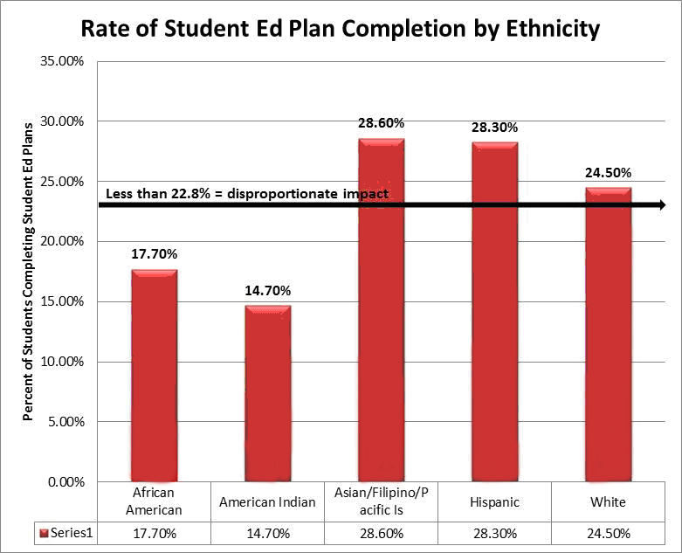
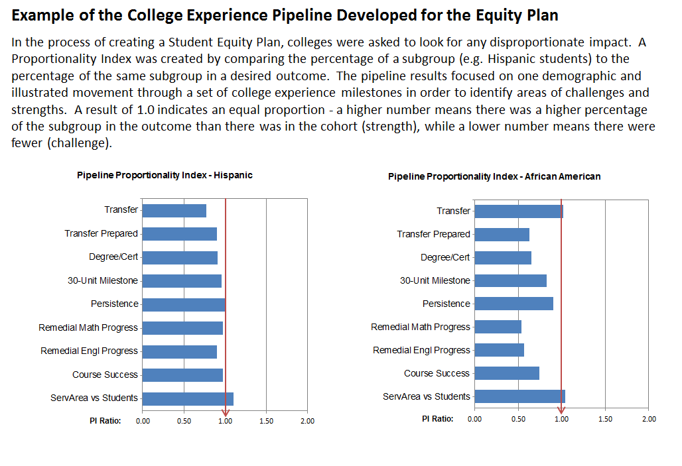
Notes:
Address equity through SEPs

Slide 21
Office of Equity and Inclusion
The BC Office of Equity and Inclusion
supports the mission to increase the educational pathways for students from diverse economic, cultural, and educational backgrounds to attain degrees and certificates, workplace skills, and preparation for transfer.
works collaboratively with existing Bakersfield College campus programs, departments, and services to create opportunities
Enhances campus climate in terms of diversity and support cultural awareness, understanding, respect and educational opportunities conveys a message of equity and inclusion by promoting opportunities that demonstrate fairness, equality, respect, and civility.

Slide 22
Office of Equity and Inclusion
Strategies include:
Equity TV focus on closing the achievement gaps through community engagement (you tube and Facebook 1-minute clips)
Parent Orientation
Spanish Translation Services
Community Leaders Engagement (Project Best, BSU, AASU)
Latino Network
Mentorship

Slide 23
MIH Strategies
Multiple Measures – Start accurately
Bridge Programs - Prepare academically
Progress faster – Compressed, accelerated, self-paced coursework
MIH Mentors – Engage personally
Classroom Interventions – Challenge intellectually, math and writing centers
Student Affairs Interventions – SSSP, tutoring, Supplemental Instruction
SARS Alert – Diagnose problems early
Tracking – Track effect interventions
Predictive Analysis – Forecast Success
Improve – Processes, procedures, curriculum, linkages
Scale up - Title V Grant

Slide 24
MIH
Making it Happen
Mentors
FT Faculty (22)
Adjunct (3)
Classified (4)
Administrators (12)
Personal Contact Progress Report Management
MIH Activities & Summary
Classroom Interventions FT Faculty(25);Adjunct(3)
Habits of the Mind Tools & Evaluation
ILO Assessment & Report
SARS Alert
Everyone
SARS ALert
Progress Cards
Student Ed Plans (SEP) DegreeWORKS & SARS

Slide 25


ENGLISH PLACEMENT 7323 STUDENTS PLACED 2012-13
English 1A Transfer, Degree and Certificate
29% placed
Potential UNITS Cost to get all to English 1A $1,677,552
3 semesters 10 units
18%
29%
Potential UNITS Cost to get all to English 1A $1,084,682
2 semesters
6 units
Potential UNITS Cost to get all to English 1A $208,851
1 semester
4 units

Slide 26

Lessons Learned and Unintended Consequences
Negative
Positive
Inability to use many college services
Problems with communicating through email
  Email address
  Not using email – texting
  No computers
Messaging and culture (financial aid & early alert)
Overall Math + English + Reading + 12 + units were too much all together
Learned about unit ceiling for this cohort
Correction of institutional barriers
A learning institution (president & classified)
Analysis of this group compared to overall
Equity insights
Improvements to bridge and summer
Improvements to other support services and instruction
Partners – high schools, community groups, CalPASS, CalSOAP

Slide 27
The End
Odella Johnson
Janet Fulks

