Slide 1
Benefits and Challenges in meeting ACCJC Standards in Multi-college Districts
Stephanie Curry: Reedley College, Past Academic Senate President, North Representative ASCCC
Roy Shahbazian: Academic Senate President, Santa Ana College
Leandra Martin: CIO Mission College, CCCCIO President

Slide 2
What Standards Overlap in Multi-college Districts?
It Depends …

Slide 3
What functions are centralized at the district level?
Common Shared Functions:
Human Resources (evaluation, hiring, policies) III.A
Physical Resources III.B
Technology Resources III.C
Financial Resources III.D

Slide 4
Other functions that may be shared ….
Common Curriculum (IIA)
Distance Education policies, procedures and support (IIA)
Library and Learning Support Services (IIB)
Student Support Services (IIC)

Slide 5
Standards that are Always Shared …
Governing Board (IV.C)
Board Policies
Administrative Procedures
Multi-College Districts or Systems (IV.D)

Slide 6
Benefits of common standards:
Forces colleges/district to work together toward a common goal
Improved processes
Shared goals
Improved communication
Leveraging the strength at each college

Slide 7
Challenges of having common standards:
Different ideas on how work should be done….
Distance between colleges & district and ease of communication
Needs and priorities may differ widely between different colleges
Difficult discussions are hard…

Slide 8
Best Practices:
Communication
Communication
Communication

Slide 9
Communication
Structures Meetings between Colleges & the District on relevant standards
Multiple meetings
Start this well before the writing of the ISER
Honest, robust discussions

Slide 10
Honest, robust, productive meetings around shared goals. ,

Slide 11
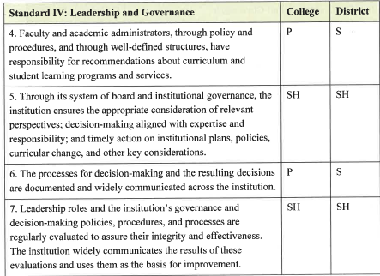
Create Shared Values & Tools: Function Maps
P = Primary Responsibility
S = Secondary Responsibility
SH = Shared Responsibility

Slide 12
Collaborate while preparing the ISER
Discuss how the colleges and district currently meet (or don’t meet) shared standards
Colleges should review each others standard drafts before they are finalized
Work together on writing any improvement plans or recommendations

Slide 13
Follow-Up after the ISER is completed
Agree to prioritize any recommendations or improvement plans resulting from these meetings
Set timelines & leads
Keep the communication open and collaborative

Slide 14
Reflect on Lessons Learned during this process:
Lessons learned at one college district:
The process of working together on the ISER clarified responsibility and processes between the district and the colleges
The administrators, faculty and staff at the other college and district were actually warm, friendly people when we worked with them on a common goal!
Together we were more effective in updating policies and procedures than when we operated separately.
We serve our students best when we work together as a team!

