Slide 1
A Life of Change: Sustaining the Momentum Beyond the ISER
John Freitas, ASCCC Treasurer
Steve Reynolds, ACCJC Vice-President
2018 Accreditation Institute
February 23-24

Slide 2
Welcome!
Tell us who you are.
What brings you here?
What would you like to learn?

Slide 3
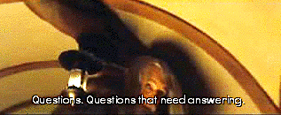
Some questions to start…
What is quality improvement?
What is quality assurance?
What is the difference between the two?

Slide 4
How Does Accreditation Give Your Institution Opportunities for Quality Improvement?
Institutional Self Evaluation Report
Self-identified improvement plans
Team-identified Recommendations for Improvement
Quality Focus Essay
Two projects to improve student learning and student achievement
Plans for implementing the projects
The Midterm Report
Report the results of the Quality Focus projects
Report results of Recommendations for Improvement
Report results of self-identified improvement plans

Slide 5
Discussion Time – Quality Improvement
ISER is institutional evaluation. What informs it?
Does ISER lead to the strategic plan?
What role does the QFE and Midterm Report play in QI?
What are your institutional mechanisms for quality improvement? What is your senate’s role?

Slide 6
How Does Accreditation Give Your Institution Opportunities for Quality Assurance?
Annual Reports
Certain improvements/innovations impact compliance with Title IV, leading to Substantive Change.
What are the triggers for substantive change?
Why is a substantive change application required?

Slide 7
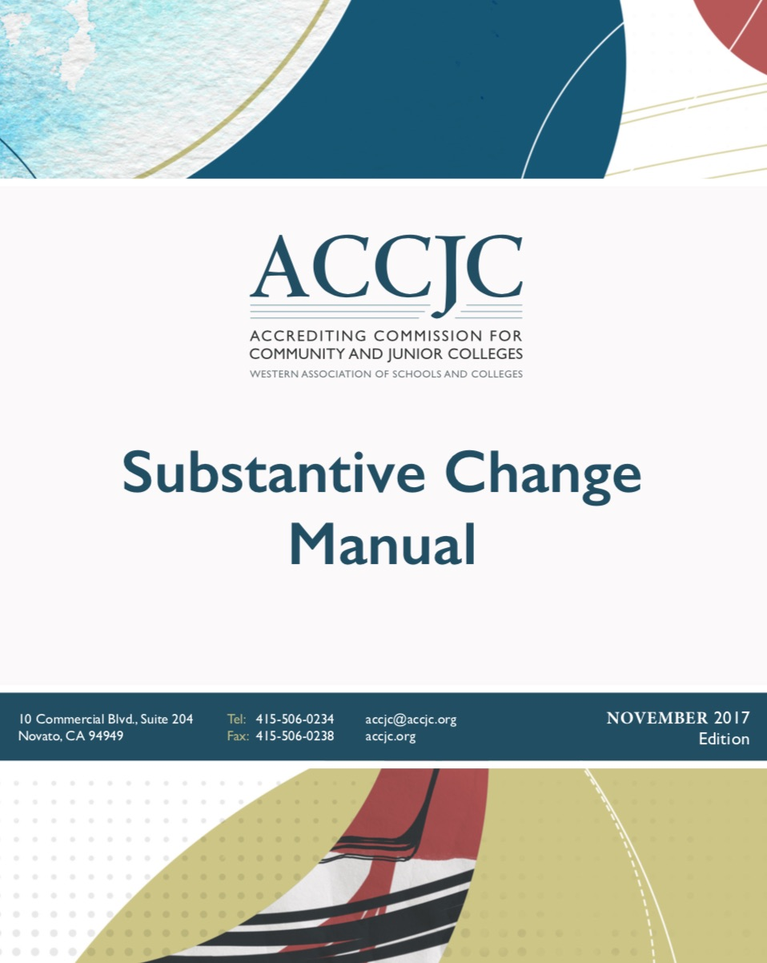
Substantive Change
Substantive change evaluation required if changes to an institution are significant enough to affect institutional quality.
Substantive change is triggered if:
Change in mission/scope/objectives/name
Change in nature of constituency served
Change in location/geographic area served
Change in control/legal status
Changes in courses/programs/mode of delivery (significant)
Change in credit awarded
Implementation direct assessment
Contractual relationship with non-regionally accredited institution
Any other significant change.

Slide 8
Discussion Time – Quality Assurance
What are your institution’s mechanisms for quality assurance?
How are annual reports to ACCJC used within this context?
What is your senate’s role?

Slide 9
Quality Improvement and Quality Assurance…Every Day!
Assessment of outcomes
Documenting that you use assessment results to plan improvements
Evaluation processes lead to planning processes
Course
Program
Institution
Personal

Slide 10
Are there effective practices that you would like to share?

Slide 11
Resources
ACCJC website at www.accjc.org
Council for Higher Education Accreditation www.chea.org
Change: The Magazine of Higher Learning http://www.tandfonline.com/loi/vchn20

Slide 12
Questions?
John Freitas – freitaje@lacitycollege.edu
Steve Reynolds – sreynolds@accjc.org
Thank you!

