Slide 1


New to Senate Leadership – Have Questions?
Rebecca Eikey, ASCCC Area C Representative
Conan McKay, ASCCC Area B Representative
Relations with Local Senates Committee
Leigh Anne Shaw, Skyline College
Peggy Campo, Norco College
Geoffrey Dyer, Taft College
Fall Plenary 2017
Irvine, CA

Slide 2

Overview of this Session
Ice Breaker
Responsibilities of the Academic Senate (10+1) and more
Running Meetings
Help & Support

Slide 3

Ice Breaker
What burning question(s) do you have about senate leadership?
Record on post-it note
Then, stick your note on the poster paper with the category you find most relevant

Slide 4
Roles & Responsibilities of Local Senate
Familiarity with the statutory context in which the senate operates
Knowledge of local participation/shared governance policies
Advocating for faculty interest
Maintaining effective relationships with other governance groups
Developing senate participation and leadership
Fostering communication

Slide 5

Some Questions to Consider
Where does the Academic Senate authority come from?
What is the role of the Academic Senate?
What does the Academic Senate have responsibility over?

Slide 6
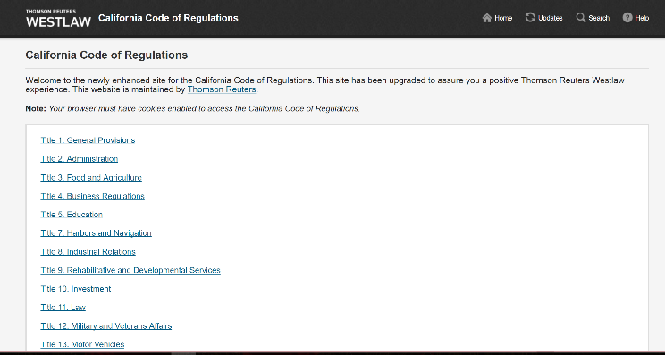
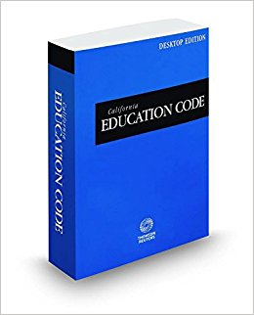
Where Does the Academic Senate Authority come from?
Education Code
Title 5 Regulations

Slide 7
California Education Code
Law resulting from legislation
Always supersedes Title 5 Regulations
Governance as related to academic senates was amended by AB 1725 in 1988

Slide 8
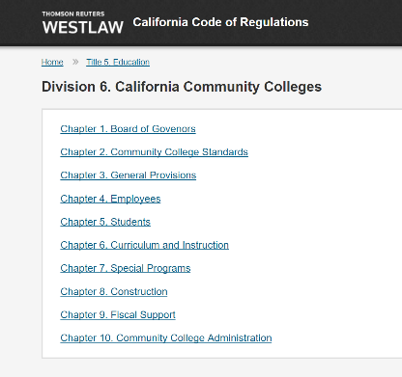
Title 5 Regulations
California Code of Regulations
Derived by the Board of Governors from the California Education Code
Division 6 – applies to California Community Colleges
Regulation with the force of law

Slide 9
What is the Role of the Academic Senate?
“The governing board of each community college district shall… Establish procedures that are consistent with minimum standards established by the board of governors to ensure faculty, staff, and students the opportunity to express their opinions at the campus level, to ensure that these opinions are given every reasonable consideration, to ensure the right to participate effectively in district and college governance, and to ensure the right of academic senates to assume primary responsibility for making recommendations in the areas of curriculum and academic standards.”
        70902 (b) (7) California Ed Code

Slide 10
What is the Role of the Academic Senate?
“Academic senate,” “faculty council,” and “faculty senate” means an organization formed in accordance with the provision of this Subchapter whose primary function, as the representative of the faculty, is to make recommendations to the administration of a college and to the governing board of a district with respect to academic & professional matters.”
    53200(b) Title 5

Slide 11
“Academic & Professional Matters”
“Academic professional matters” means the following policy development and implementation matters:”
    53200(C) Title 5
Curriculum & prerequisites
Degree & certificate requirements
Grading policies
Educational program development
Standards & policies regarding student preparation & success

Slide 12
“Academic & Professional Matters”
College governance structures as related to faculty roles
Faculty roles and involvement in accreditation, including self-study and annual reports
Policies for faculty development activities
Processes for program review
Processes for planning & budget
Plus 1:
Other academic & professional matters as
mutually agreed upon

Slide 13
What powers?
“The governing board…shall adopt policies for appropriate delegation of authority and responsibility to its college and/or district academic senate….”
§53203(a) Title 5
  Adopting the policies and procedures in (a) shall consult collegially with representatives of the academic senate. §53203(b) Title 5
  “…the academic senate shall retain the right to meet with or to appear before the governing board with respect to views, recommendations, or proposals of the senate.” §53203(c) Title 5
  An academic senate may assume such responsibilities and perform such functions as may be delegated to it by the governing board of the district… §53203(e) Title 5

Slide 14
What’s “Consult Collegially?”
“Consult collegially” means that the district governing board shall develop policies on academic and professional matters through either or both of the following methods, according to its own discretion:
(1) relying primarily upon the advice and judgment of the academic senate; or
(2) agreeing that the district governing board, or such representatives as it may designate, and the representatives of the academic senate shall have the obligation to reach mutual agreement by written resolution, regulation, or policy of the governing board effectuating such recommendations.
      § 53200(d) Title 5

Slide 15
Collegial Consultation - Defined
Section 53200(d)(1)
When rely primarily:
Section §53200 (d)(1)
When mutually agree:
The recommendations of the senate will normally be accepted…
Only in exceptional circumstances and for compelling reasons will the recommendations not be accepted.
If a recommendation is not accepted, the governing board, or its designee, upon request of the academic senate, shall promptly communicate its reasons in writing to the academic senate.
(and an agreement has not been reached)
Existing policy shall remain in effect except in cases of legal liability or fiscal hardship.
Board may act, after a good faith effort to reach agreement, only for compelling legal, fiscal, or organizational reasons.

Slide 16
What powers?
  “The appointment of faculty members to serve on college or district committees, task forces or other groups dealing with academic and professional matters, shall be made after consultation with the chief executive officer or his or her designee, by the academic senate. Notwithstanding this Subsection, the collective bargaining representative may seek to appoint faculty members to committees, task forces, or other groups. §53203(f) Title 5

Slide 17
Other Authority for Senates
Waiver of Minimum Qualifications; Equivalency (Ed Code § 87359(b))
Hiring Criteria (Ed Code § 87360(b))
Administrative Retreat Rights (Ed Code § 87359(b))
Tenure Evaluation Procedures (Ed Code § 87359(b))
Evaluation Procedures (Ed Code § 87359(b))

Slide 18
Constitution & Bylaws
The what and the how
There is a index of Ca Community Colleges’ on ASCCC website: http://www.asccc.org/sites/default/files/Senate%20Constitutions-Bylaws%20CODEX.pdf

Slide 19
Ralph M. Brown Act
Open Meetings Act (Government Code 54950-54960.5)
Requirement for local senates to follow addressed in 1983 Attorney General Opinion:
“The Attorney General concluded that academic senates are subject to Brown Act Requirements because Title 5 requires that local community college governing boards must recognize their local academic senates and thus local academic senate are subordinate creations of local boards of trustees.”

Slide 20
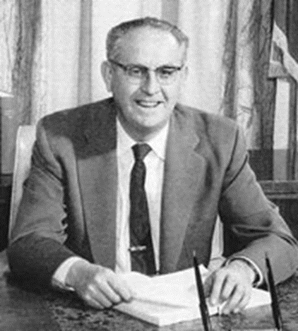
Ralph M. Brown Act
Commitment to:
  Openness
  Transparency
  Public Access to information

Slide 21
Ralph M. Brown Act
Includes:
  The Board of Trustees
  Any subcommittee or task force created by the Board with a majority of Board members serving on the group
  Any subcommittee or task force created by the Board which has defined, ongoing charge (either decision-making or advisory) OR has a regular meeting schedule set by the Board, regardless of Board membership
  Such as local academic senates, curriculum committees, and ….

Slide 22
Ralph M. Brown Act
What is considered a meeting?
  When a majority of the members gather to discuss business
  Any meetings with other groups to discuss business
  Can meet at social events like parties but cannot discuss business
  Can we call “special meetings?”
  Can we have email meetings?

Slide 23
Applying the Brown Act
All meetings are open!
  Must post agenda 72-hours ahead and in public space
  Must include
    Time & place & accessibility accommodations
    Public comments
    Action items with brief description
Who’s “in charge” of the agenda?

Slide 24

Applying the Brown Act
Votes
  All votes are public record
  Recorded in minutes… Rules of Order

Slide 25
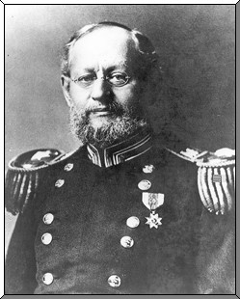
Rules of Order
Robert’s Rules of Order, Revised
http://www.robertsrules.com
Can choose elements to use
Who’s the Parliamentarian?

Slide 26

Senate Meeting
President’s Role in Meetings
  Prioritize
  Balance discussion and debate with decisions
  Keep agenda moving

Slide 27

Senate Meeting
Agenda Changes?
  Can change order
  Cannot add items – why?
  Can set time limits

Slide 28
Common Elements for Senate Agendas
  Public Comment
  Disability Access
  Consent Calendar
  Reports
  Action Items
  Discussion Items
  Unfinished Business
  New Future Business
  Announcements
  Other Sections?

Slide 29
Reports vs Discussion
The reports are information items only
  Senate members can appeal to have an item from Reports put on a future agenda as a discussion item
  Members are allowed to ask clarifying questions, but the reports are not intended for discussion, nor commentary

Slide 30

Action Items
Published agenda items only!
Need a first reading?
  Exceptions??
  What about a Quorum?

Slide 31
Discussion Items
Discuss only, no action
  Can be moved to action agenda
  May be information only (currently, no action required)
Important to note:
        All information must be available to the public
      Documents become public documents

Slide 32
Senators’ Roles & Responsibilities
Communicating with constituents
Preparation for Senate meetings
Involvement in issues
Serve on committees
Write resolutions
What else?
Knowledge
Involvement
Awareness
Commitment
Follow-through
Communication
Teamwork

Slide 33
Help & Resources
Sign up for ASCCC listservs
Technical Visit Requests
  Curriculum Technical Visits
    A Joint Program of the Academic Senate and California Community College Chief Instructional Officers (CCCCIOs)
  Governance Technical Visits
    A Joint Program of the Academic Senate and Community College League
The Relations with Local Senates Committee visits
Area representatives can also consult with or visit local senates. Requests for such visits should be forwarded through the ASCCC Office.
http://asccc.org/contact/request-services

Slide 34
Help & Resources
www.asccc.org
From this site you can get links to Senate Rostrum, ASCCC papers, Ed Code and Title 5 and Executive Board members
Local Senates Handbook, 2015
Scenarios to Illustrate Effective Participation in District and College Governance, 1995

Slide 35
Questions?

