Slide 1
Bylaws, Rules, and Periodic Review – Updates from Standards and Practices
Julie Adams, ASCCC Executive Director
Craig Rutan, ASCCC South Representative
2015 ASCCC Spring Plenary Session
Notes:
Craig

Slide 2
Overview
ASCCC a Nonprofit Organization
Summary of Bylaws Revisions
Summary of Rules Revisions
Periodic Review of ASCCC
Notes:
Craig

Slide 3
Why Change the Bylaws?
The last major revision was 2003!
ASCCC has changed in the last 12 years and the bylaws need to support our work and be in alignment with legal requirements.

Slide 4
Revision Process
Initial review by legal counsel to recommend changes to align with nonprofit law and corporations code
Standards and Practices review each article to determine if:
the existing language makes sense
if anything is missing and needs to be added
if the practices defined by the bylaws are effective for the current needs of ASCCC

Slide 5
Revision Timeline
Legal review and initial planning – July 2014
S&P begins revisions – Sept – Oct 2014
Draft presented at fall plenary – Nov 2014
Feedback from plenary discussed and first draft completed – Dec 2014
Draft reviewed by Executive Committee – Jan 2015
Draft sent to body for feedback – Feb 2015
Feedback incorporated and final draft completed by S&P – Feb 2015
Executive Committee approves sending revisions forward to the body for adoption – Mar 2015
Breakout and adoption – April 2015

Slide 6
ASCCC Is Not Like a Local Senate
Local senates are created by each district’s Board of Trustees – ASCCC was created by the faculty
ASCCC is a nonprofit organization with a 2 million dollar budget and ~ 10 employees.
The Executive Director is selected by the board and is the interface between the elected board and the employees.

Slide 7
Board of Directors?
Executive Committee has been replaced by Board of Directors in the bylaws only.
A board of directors is a body of elected or appointed members who jointly oversee the activities of an organization.
Board members have a fiduciary responsibility
to steer the organization towards a sustainable future
adopt sound governance and financial management policies
Ensure adequate resources
Hire an executive director to run the day-to-day management activities of the organization.

Slide 8
But Why Change?
The simple answer is because of the way the law is written.
When reviewing laws that ASCCC is subject to, the term Executive Committee refers to a subset of the Board that can be empowered to act between meetings. This is how the officers act now.
The bylaws are a legal document and it is important that they clearly align with nonprofit law in case of legal action against ASCCC

Slide 9
Do We Call You the Board of Directors?
No! The Board of Directors will still be referred to as the Executive Committee on the ASCCC website, in policy, and in discussions with our system partners.
This is a wording change to protect the elected representatives, but it does not change anything for the body.

Slide 10
Removing Executive Committee Members
Executive Committee members are representatives of the organization and need to act in accordance with policy, legal requirements, and adopted positions.
The revisions add the ability for delegates to recall a member and for a member to be removed for not fulfilling their obligations

Slide 11
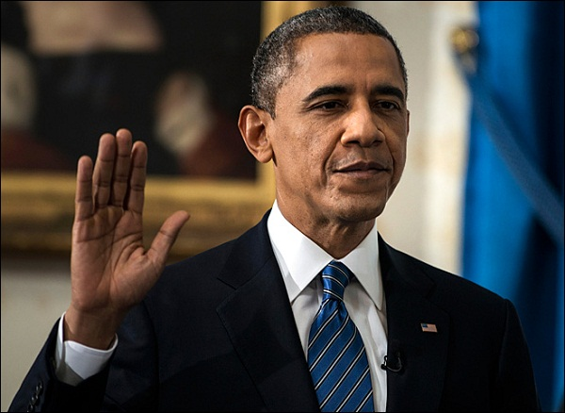
Term of Office
Newly elected members of the Executive Committee begin serving at orientation at the end of May.
Since Executive Committee members begin their work after orientation, we have changed the term of service to run from June 1 until May 31.

Slide 12
Changes to Satisfy Resolutions
Resolution 1.01 Fall 2009 designated the Executive Director as an ASCCC Officer.
The Executive Director does not vote on ANY actions of the Executive Committee. Only elected members have voting rights..
All Executive Committee meetings will be held in accordance with the Senate’s Policy on Open Meetings (Adopted March 2015)
This policy was created to comply with resolution 1.03 Spring 2014.

Slide 13
Senate Rules
Removed the duties of officers and placed them into the Bylaws.
Clarified that the Vice President will assume a vacancy in the Presidency of ASCCC
Added procedures for the member senates to recall a member of the Executive Committee
Changed the section on standing committees to allow the Executive Committee to determine the best committee structure to address the adopted positions of ASCCC.

Slide 14
Periodic Review of ASCCC
The periodic review process was adopted with the passage of resolution 1.02 Spring 2014.
Resolved, That the Academic Senate for California Community Colleges complete the selection process for the Review Task Force in Spring 2015 and undergo and complete its first periodic review by the Spring 2016 Plenary Session;
The review team will be composed of 10 attendees of ASCCC events
The review team recruitment is already underway.
The revised bylaws, rules, policy, and an internal evaluation by the Executive Committee will be provided to the review team. The internal evaluation will be completed by Executive Committee members in May 2014.

Slide 15
We Need Your Help
The Academic Senate is always looking for volunteers to serve at the statewide level. If you are interested in serving at the state level, please submit an application to serve at http://asccc.org/content/application-statewide-service

Slide 16
Thank You for Coming

