Slide 1
ESL CB21 Recoding Project
Regional Meetings: Clovis, Cypress, and Skyline Community Colleges
Fall 2019

Slide 2
CB21 Revision Project for ESL
Legislative Mandates:
AB705, California Adult Education Program (and the requirement to align assessment practices with CCs), and the need to revise CB21.
Previous Groundwork:
Common Assessment Initiative (CAI) rubrics for ESL were robustly vetted across the state and divide the ESL pathway into eight levels to transfer-level composition (TLC).
The Educational Functioning Levels (EFLs) are national standards, divide the ESL pathway into six levels and are used for WIOA Title II.
In 2018 the EFLs were substantially changed to increase rigor and focus on academic skills leading to English Composition.
Builds upon previous crosswalks of CB21 and the EFLs in 2017-2018

Slide 3
CB21 Revision Project for ESL
Credit ESL varies much more widely across the colleges than English. Some programs:
transition directly to transfer-level composition (TLC)
transition into developmental English
have sequences of integrated skills; others are made of multiple strands
may include pathways to CTE as well as TLC
Some colleges have:
credit ESL only
credit and noncredit ESL
various configurations of credit and noncredit ESL
noncredit ESL also includes VESL and EL Civics Pathways

Slide 4
CB21 Revision Project for ESL
WHAT’S BEEN DONE AND NEXT STEPS:
Larger group assigned by the ASCCC convened in Fall 2018
Mini-committee convened from late February to late July 2019 to dig in deeply to create a draft document & chart for the larger group to vet
Larger group reconvened in August to vet the work
Feedback from the field in the Fall (Regional meetings, CATESOL annual)
Consideration for adoption at November Plenary
(CAEP) Engagement with K12 Adult and CC practitioners on using the rubric to improve transition of AE students to credit pathways
NOTE: Starting with the AEBG crosswalk and the two processes, hundreds of hours have been invested in the work!

Slide 5
Frameworks
Common Assessment Initiative (CAI)
Educational Functioning Levels (EFL)
Existing CB21 rubric (2010)
Common European Framework of Reference (CEFR)/Global Scale of English (GSE)
Notes:
Add links where available

Slide 6
CB21 Revision Project for ESL
CHALLENGES:
HOW do we collapse eight levels into six while maintaining …
meaningful yet concise descriptions for the levels?
integrity of the language acquisition process from literacy to advanced academic one level below transfer-level composition?
the goal of creating a structure that can be used by all ESL credit and noncredit programs?

Slide 7
CB21 Revision Project for ESL
CHALLENGES:
HOW do we collapse eight levels into six while maintaining fidelity to the CAI descriptors and language that were so thoroughly vetted?

Slide 8
CB21 Revision Project for ESL
DISCLAIMERS:
Language acquisition takes time. The new CB21 standards do not represent one level per semester or quarter. As with the previous CB21, multiple courses can map to a level.
The descriptors represent skills gains and/or competencies. They are markers for assessing progress.

Slide 9
CB21 Revision Project for ESL
DISCLAIMERS:
Language used in the new CB21 rubrics was taken from documents that have already been thoroughly vetted by the field. The CAI rubrics were heavily relied upon unless language was lacking.
Other documents used were the 2010 CB21 rubrics, the CEFR, and the GSE.

Slide 10
CB21 Revision Project for ESL
DISCLAIMERS:
Distinction among the levels is based on the vetted documents.
e.g. adverbs such as “developing,” “adequately,” and “effectively” are used to distinguish levels consistent with the vetted documents.

Slide 11
CB21 Revision Project for ESL
DISCLAIMERS:
References to digital literacy were kept to a minimum due to the range of resources available at the various institutions across the state.
Language or concepts from newer initiatives such as Guided Pathways were not “folded in” in order to stay true to vetted documents.

Slide 12
CB21 Revision Project for ESL
“AHA!” MOMENTS IN APPLYING THE RUBRICS:
Focus on course objectives rather than course content.
Calibration takes time. Allow space for faculty to “soak it in.”
Process constraints: “older” courses may need refreshing, but most submission deadlines for Fall 2020 have passed.
Even optional/support ESL courses focusing on discrete skills courses will need a CB21 code.

Slide 13
CB21 Revision Project for ESL
FEEDBACK, PLEASE!:
These regional meetings are the first vetting with the field.
It is an iterative process, so feedback is valuable.

Slide 14
Valuable Feedback from Regional Meeting #1 : Central Valley Sept. 5, 2019
Broaden the subheading, 'Narrative and Expository Texts' to include other rhetorical modes (Productive: pages 6 & 8)
Questioned the use of code values "A – F" or numerical levels below transfer (LBT) "1-6" (entire document)
Create a companion document to clarify terms at each coding category:
Main Idea vs. Theme ( Interpretive: pages 1 & 2)
Conduct research ( Productive: page 6)
Write research projects ( Productive: page 6)

Slide 15
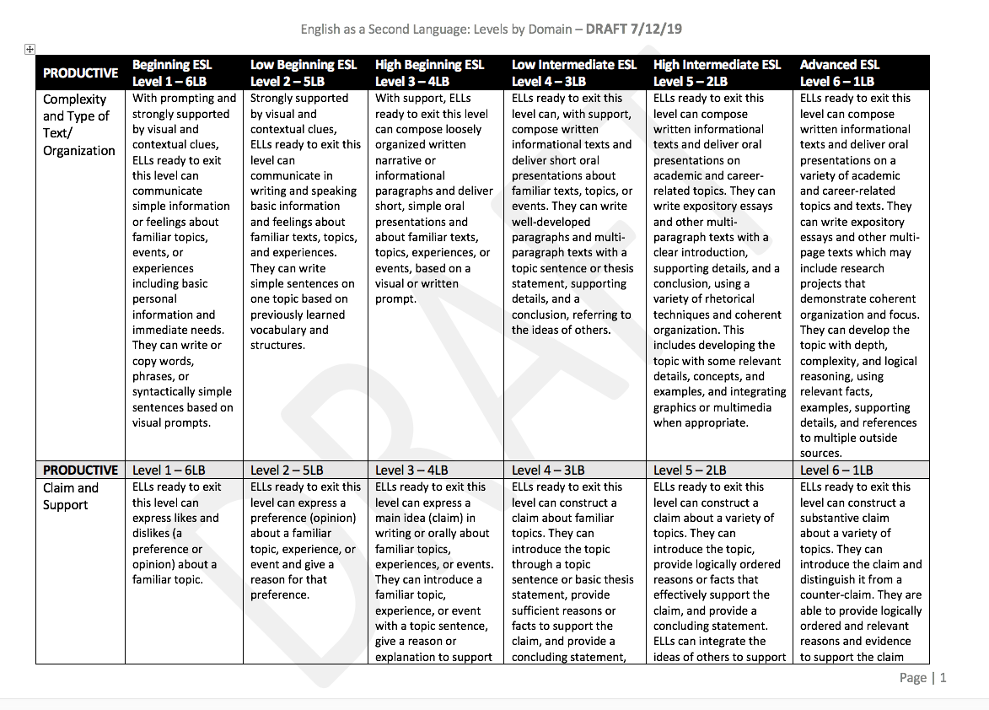
Draft chart for Productive Domain

Slide 16
While reviewing the CB 21 ESL Rubric,
Is there something significant missing from the CB21 ESL rubric?
Does anything in this draft of the CB 21 rubric constitute a 'deal breaker'?
Does the progression of skills across the levels and within the three modalities seem reasonable to you?

Slide 17
Remember:
The rubric establishes 'exit' competencies ( 'can do' outcomes).
The rubric does not drive your program.
More than one class can map to the same level.
Your optional/support ESL courses that are not in the sequence can be coded as support courses (CB 26)
There will be additional opportunities to provide feedback

Slide 18
Thank You for Coming
Do you have any questions?

