Slide 1
New Horizons: Competency Based Education & The CCC CBE Collaborative
Notes:
Cheryl

Slide 2
Presenters / Introductions
From the Chancellor’s Office
Aisha Lowe, Vice Chancellor for Educational Services and Support
Chantée Guiney, Specialist, Academic Planning and Support
From the Student Success Center at the Foundation for CCCs
Nadia Leal-Carrillo, Director of Policy Development
Amparo Diaz, Senior Policy Specialist
From ASCCC
Karen Chow, ASCCC Area B Representative
Cheryl Aschenbach, ASCCC Secretary
Notes:
Karen

Slide 3
Overview
Direct Assessment Competency-Based Education (DA CBE)
What is it?
Why implement it? Why now?
What are the differences between CBE, CPL, and traditional instruction?
CBE Collaborative
What is it?
What is the timeline
Who at colleges will be involved?
Anticipated Roles of Senate Presidents and Faculty
Notes:
Cheryl

Slide 4
Direct Assessment Competency-Based Education
What is it?
Why implement it? Why now?
What are the differences between CBE, Credit for Prior Learning (CPL), and traditional instruction?
Notes:
Aisha

Slide 5
What is Competency Based-Education (CBE)?
CBE in CCC context is Direct Assessment Competency-Based Education
“Direct assessment competency-based education” in the California community colleges is an intentional outcomes-based and equity-minded approach to earning a college degree in which the expectations of learning are held constant, but time is variable through a flexible, self-paced, high-touch and innovative learning practice (from proposed Title 5 regulations)
CBE is already possible within courses and programs. This effort is to now apply it to design and delivery of entire degree programs
CBE is a change from courses comprising a degree to competencies and sub-competencies within learning modules comprising a degree
Notes:
Aisha

Slide 6
What is Competency-Based Education (CBE)?
Both the evaluation of student achievement and the award of a degree or credential are based solely on the demonstration and mastery of competencies
Students proceed at their own pace rather than progressing through courses in a traditional academic term timeline; faculty assist and facilitate the progress of each student individually
Students are expected to demonstrate the competency at a high level of achievement (mastery = 80%)
Conventional grades are not necessarily assigned; mastery is recorded
No punitive grades
Establishes “credit-hour equivalencies” between CBE competencies and traditional course student learning outcomes
Notes:
Aisha

Slide 7
Why Implement It? Why Now?
Vision for Success & Core Commitments
Guided pathways: 4 pillars
Equity Imperative
Increased access and opportunity for working Californians with no college or some college but no degree
Source: Back to College: Part One: California’s Imperative to Re-Engage Adults by California Competes (Oct 2018)
Notes:
Aisha

Slide 8
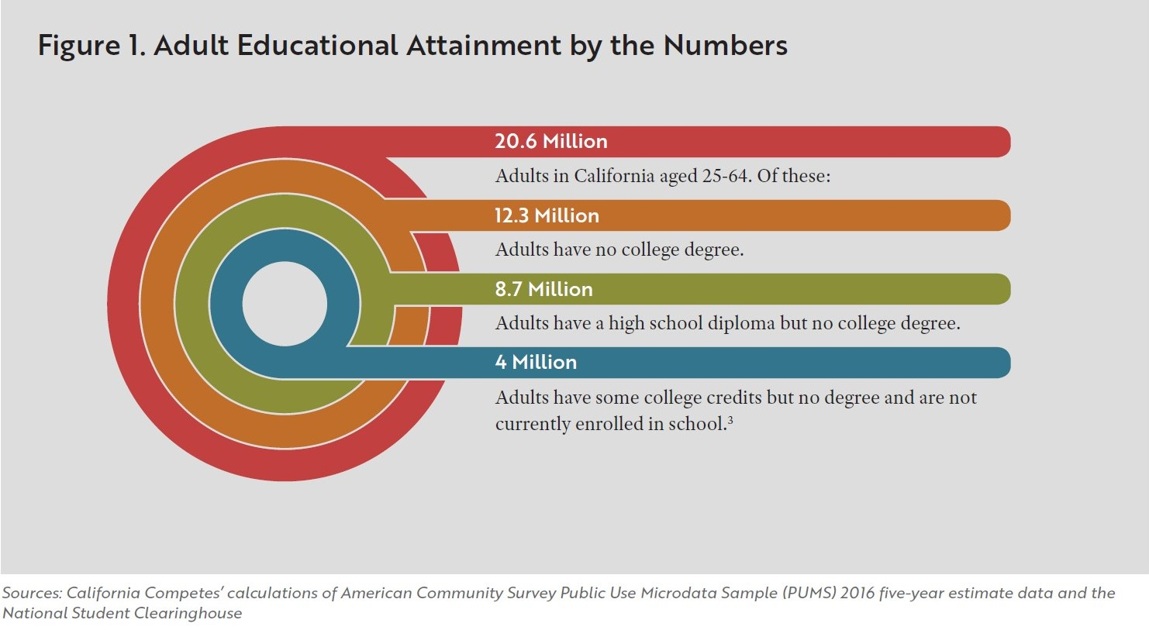
Why Implement It? Why Now?
Source: Back to College: Part One: California’s Imperative to Re-Engage Adults by California Competes (Oct 2018)
Notes:
Chantee
Talking Points:
College attainment vs completion highlights inequities in higher education
28% of Black Californians attended college but did not complete
Latinx students less likely to attend
White and Asian students more likely to start and complete

Slide 9
Why Implement It? Why Now?
Source: California Competes: California Postsecondary to Prosperity Dashboard
Notes:
Chantee
About 4 million adults in CA have some college but no degree and are not currently enrolled in an institution of postsecondary education

Slide 10
Why Implement It? Why Now?
Teaching & Learning must evolve to meet student needs
CBE is an addition to the CCC instructional portfolio
Students are seeking programs that are personalized, flexible, and relevant
COVID-19 demonstrated the need for flexibility
CBE degree programs can be designed for more integration between major preparation and general education (relevance)
CBE degree programs are emerging across the United States
Degree attainment increasingly important for attainment of living wage and as an economic driver
Notes:
Chantee
About 4 million adults in CA have some college but no degree and are not currently enrolled in an institution of postsecondary education

Slide 11
How is CBE Different?
CBE is not CPL: Credit for Prior Learning (CPL) is the awarding credit to eligible students based on previous collegiate-level learning, often in a non-accredited space, outside of a recognized college classroom.
Shifts in thinking from traditional instruction
From courses to modules
From seat time as a partial measure of learning to demonstration of competencies as a measure of learning
From fixed semesters and starting points to rolling “non-terms” and frequent individual starting points
From average is adequate to mastery at a minimum
From grading based on a collection of activities, exams, etc., to achievement of mastery based on completion of 80% on a rigorous authentic summative assessment
From faculty at the center of the learning experience to students at the center
Notes:
Aisha

Slide 12
CCC CBE Collaborative
What is it?
What is the timeline?
Who at colleges will be involved?
Notes:
Nadia

Slide 13
What is the CCC CBE Collaborative?
Colleges working together to implement DA CBE as early adopters
Goals:
Establish a Direct Assessment CBE implementation collaborative of early implementer colleges
Provide funding and implementation support to participating colleges
Create a blueprint (roadmap) for implementation of programs system-wide
Evaluate the implementation process and early student outcomes
Notes:
Nadia

Slide 14
What is the CCC CBE Collaborative?
Objectives:
Establish a local structure to support the development and implementation of DA CBE
Coordinate local implementation efforts and corresponding state supports
Inform regulatory policy and system-wide change needed to support implementation
Support the development and dissemination of a direct assessment CBE program blueprint for system-wide implementation
Cultivate a peer-learning community and network of CBE champions with the tools to support, education, and lead implementation efforts system-wide
Evaluate implementation opportunities, challenges, and outcomes
Notes:
Nadia

Slide 15
What is the CCC CBE Collaborative?
Module I: (6 mon)
Module II: (3 mon)
Module III: (9 mon)
Module IV: (6-12 mon)
Establish local infrastructure for innovation
Select the program
Design the program
Obtain regional accreditation and program approval
Module V: (8 – 12 mon)
Module VI: (3 mon)
Module VII: (4 mon)
Module VIII: (1 yearr post-implementation)
Build Operational Model
Obtain CCCCO Approval
Launch the program
Continued action research and scalability
Notes:
Nadia

Slide 16
Module Example
Module I : Establish local Infrastructure for Innovation (6 months)
Timing | 6 Months: Jan – June 2021
Objective | Generate local support for CBE programs and establish a CBE implementation team that is representative of the campus community.
Milestones | 1.1 CBE implementation committee with cross department representatives including representatives from the local academic senate, student services, institutional research, information technology services, and financial aid as well as relevant and appropriate faculty, staff and administrators is established. 1.2 Decision making protocol is determined. 1.3 Local board amends local policies in alignment with direct assessment CBE title 5 regulations. 1.4 Local academic senate resolution to support the development of direct assessment CBE programs is adopted.
Required Products | Copy of local Implementation committee charter Documentation of policy changes adopted locally Copy of local academic senate resolution Summary of process for creating an implementation committee, roster of implementation committee representatives, committee members’ roles & responsibilities, and a planning timeline
Payment | 2% of total funding ($10,000)
Notes:
Nadia

Slide 17
Collaborative Program Application Timeline
September 2020 | Proposed direct assessment CBE regulations presented at Consultation Council Proposed direct assessment CBE regulations first reading at BOG
October 2020 | CBE Collaborative Webinar Complete Collaborative Interest Form
November 2020 | Proposed direct assessment CBE regulations second reading at BOG Collaborative application made available
November - January | Complete the pre-application activities of Module I
February 2021 | Collaborative application due
March 2021 | Selected colleges notified
March 2021 | Direct Assessment CBE Collaborative launch
June 2021 | Module 1 deliverables due
Notes:
Amparo

Slide 18
Funding CBE Collaborative Programs
Program funding to support this work:
A total of $515,000 is available to each participating college and is contingent on the college meeting key milestones during each phase of the project.
Of this amount, $100,000 will be made available as seed funding.
Notes:
Amparo

Slide 19
Who Will Be Involved at Colleges ?
Implementation Committee should include cross department representatives, including representatives from the local academic senate, student services, institutional research, information technology services, and financial aid
Implementation Committee should include diverse representation of college departments and students
The following individuals and groups will need to be actively engaged in preliminary planning, support for the effort, and participate as needed
Governing Board, College President, and Lead Administrators
Academic Senate
Program faculty and program administrators (for selected program)
Academic Services
Counseling and Advising; Financial Aid
Information technology
Institutional Research
Human Resources
Student Senate
Notes:
Amparo

Slide 20
Anticipated Roles of Senate Presidents and Faculty
CBE Collaborative applications require support from local academic (resolution or action) and signature of senate president
CBE is curriculum…10+1 is applicable
Curriculum
Program development
Degree and certificate requirements
Standards or policies regarding student preparation and success
+Academic policy development within 10+1
Notes:
Cheryl & Karen

Slide 21
Which faculty will need to be involved?
Definitely:
Academic Senate presidents
Curriculum Chairs
Discipline faculty (within a designated major)
General education faculty
Articulation Officers
Possibly:
Guided pathways leads
Accreditation leads
Outcomes leads/coordinators
And…?
Notes:
Cheryl & Karen

Slide 22
Questions? Thank you!
Notes:
Cheryl

Slide 23
Appendix Slides

Slide 24
Vision for Success
Increase credential attainment by 20%
Increase transfer by 35% to UC & CSU
Decrease unit attainment for a degree
Increase employment for CTE students
Reduce and erase equity gaps
Reduce regional gaps
Core Commitments
Focus on students’ goals
Design and decide with the student in mind
Pair high expectations and high support
Evidence-based decisions
Own student performance
Enable innovation and action
Cross-system partnership
Notes:
Completion- Most students who enter a community college never complete a degree or certificate or transfer to a 4-year university
Time to Degree-CCC students who do reach a defined educational goal such as a degree or transfer take a long time to do so, often accumulating many excess course credits along the way
Achievement gaps persist across the CCCs and high-need regions of the state are not served equitably

Slide 25
Guided Pathways Principles
Notes:
GP PRINCIPLES
In California, Guided Pathways is tailored to the unique environments of the CCCs (Vs., p. 22)
(1) Clarifying the path for students. All courses are designed as part of a coherent pathway with a clear outcome, either transfer or a career outcome. Students understand what a given path will require of them, how the courses in a pathway are connected into a logical sequence that will prepare them for their end goal, what milestones they will meet along the way, and what outcomes they can expect at the end of the path. (Vs., p. 22)
(2) Helping students get on a path. Students explore career and/or transfer options before they begin college and extensively in their first year. Multiple measures are used to assess student academic needs. Students receive contextualized, integrated academic support to pass gateway courses. (Vs., p. 22)
(3) Helping students stay on their path. Students can easily track their own progress and receive ongoing, intrusive advising. Data systems monitor student progress. Students are provided support or redirected if they fall off track. (Vs., p. 22)
(4) Ensuring students are learning. Learning outcomes for every course and program are clear to the student and tied to a specific transfer, completion, or workforce outcome. Systems are in place for the college and students to track mastery of outcomes. Students are engaged in active, collaborative learning experiences. Faculty are leading efforts to improve teaching practices. (Vs., p. 22)

