Slide 1
Competency Based Education (CBE) LESSONS LEARNED FROM THE PILOT Antoniette Aizon, Madera Community College Randy Beach, Southwestern College, 5C Committee Candice Brooks, CCCCO, Dean Educational Services and Support Aisha Lowe, CCCCO, Vice Chancellor of Educational Services and Support Brian Palmiter, Southwestern College Carrie Roberson, ASCCC At-Large Representative
Notes:
INTROS/ WELCOME

Slide 2
Eight colleges were selected by the California Community Colleges Chancellor's office to form a pilot to implement CBE. Join us to learn about implementation of direct assessment competency-based education in the California community colleges and engage in dialogue about the equity intent, expected impacts, and more. Hear from members of the Chancellor's office and pilot college faculty about the work done and lessons learned from the pilot.
Notes:
Carrie to CCCCO

Slide 3
The Innovation Imperative
Teaching and learning must innovate to keep pace with advances in technology, shifting economic paradigms, modern employer demands, students’ evolving needs (psychological, tactical & relational), and an expanding global society.
What’s Blockbuster?

Slide 4
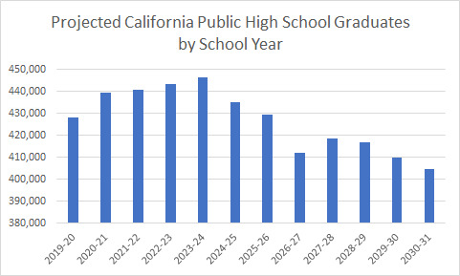
Older adults may become larger share of CCC population as numbers of high school graduates decline
Currently, 4 in 10 students at California Community Colleges are age 25+. For enrollment purposes, colleges may need to focus more on this population as the number of high school graduates declines.
Source: https://www.dof.ca.gov/forecasting/demographics/projections/Public_K-12_Graded_Enrollment/

Slide 5
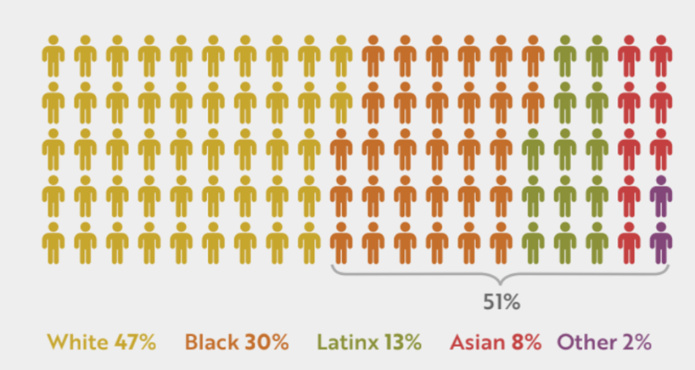
CCCs must focus on older adult learner attainment
6.8 million Californians ages 25-54 have a high school diploma but not a postsecondary degree. More than half of them are people of color.

Slide 6
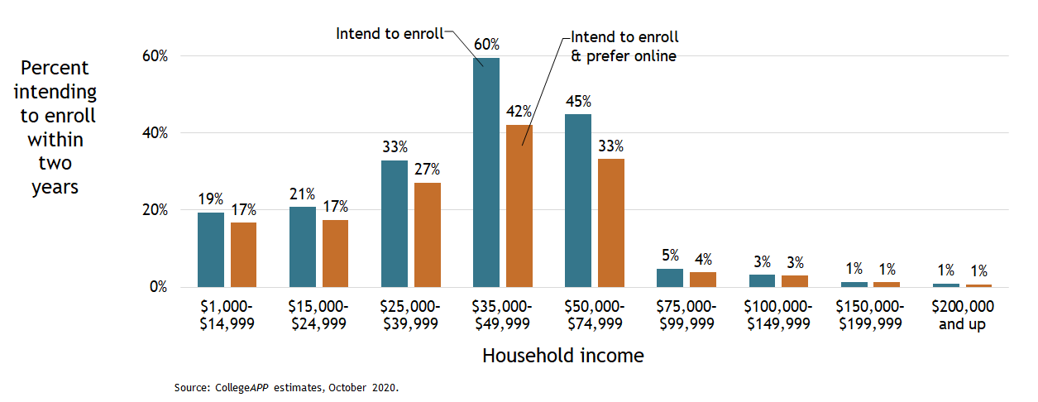
Online Education Trends

Slide 7
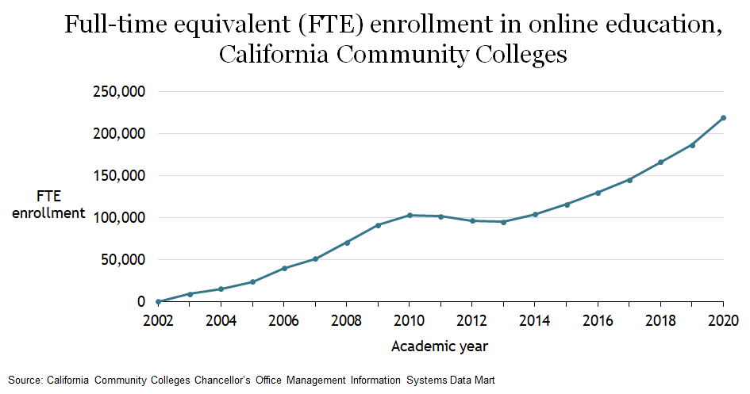
CCC Online Education Trends

Slide 8
Innovation is an equity imperative
Without high-quality CBE (& CPL) options students are more likely to enroll in for-profit institutions.
Black Californians are overrepresented in for-profit colleges.
A large proportion of Latinx Californians between the age 25 - 64 have no post-secondary education experience.
We must recognize the impact of long-standing systemic inequalities and design for those who were disenfranchised as a result of these inequities.
We must center learning around the student and empower them to take ownership of their educational experience.

Slide 9
Innovation is a sustainability imperative
Without high-quality, affordable, self-paced options millions of Californians, particularly those from historically excluded populations, will remain behind in educational attainment.
Our institutions must evolve and innovate to meet the needs of students. Our current system is a mismatch for many working adults who need greater flexibility.
We need to lead with an assets-based mindset that recognizes students’ lived experiences, strengths, and capabilities.
Evolution is necessary in order to fulfill the mission of the California Community Colleges and to meet the goals of the Vision for Success.

Slide 10
Direct Assessment Competency Based-Education

Slide 11
CBE Focuses on Mastery of Competencies
Credit Hour Model…
based on seat time originally designed to determine faculty pensions and not as a measure of learning.
Credit Hour is current basis for awarding financial aid, faculty workload & degree completion.
Competency Based Education… moves beyond seat-time focusing on mastery of learning exercises, through activities and experiences that align with clearly defined programmatic outcomes.
Hours will vary, but the learning is fixed.
Often fully online modules.
Flexible academic calendar term options.
“Cracking the Credit Hour” by Amy Laitinen
Notes:
Fully online modules
Different term options for the academic calendar

Slide 12
Direct Assessment CBE
not based on academic terms or credit hours
bases both the evaluation of student achievement and the award of a degree or credential solely on the mastery of competencies
students proceed at their own pace rather than progressing through courses offered in a traditional academic term
conventional grades are not necessarily assigned
students are expected to demonstrate the competency at a high level of achievement (80%+)
establishes “credit-hour equivalencies” for the student learning outcomes

Slide 13
Legal Authority & Responsibility
Direct assessment competency-based education is an intentional outcomes-based and equity-minded approach to earning a college degree in which the expectations of learning are held constant, but time is variable through a flexible, self-paced, high-touch and innovative learning practice.
Under Title 5 Regulations Direct Assessment Programs are Associate Degree Programs delivered through direct assessment (as defined by Federal Regulations); Programs are fully online or hybrid
Direct Assessment differs from more generalized competency-based education which can be used for non-credit degree pathways.

Slide 14
CBE is a tool for campus-wide transformation
Faculty Role, Load and Contracts
District/College Policies
Student Support Services
Dismantling silos to provide a tailored student experience leading to clearly defined competencies students can leverage in industry.
Student
Centered
DA CBE
Self
Directed
Variably
Paced
Institutional Data & Research
Outcomes
Focused
Financial Aid
SIS & LMS
Notes:
To highlight those high level barriers

Slide 15
CBE Implementation
January 2020 Presentation to Board of Governors
January 2020 – June 2020 Partnered with 5C to Establish Title 5 Regulations
September 2020 Presented Regulations at Sept BOG meeting (1st Reading)
November 2020 Regulations approved by the BOG
December 2020 Collaborative RFA
June 2021 Launched the Direct Assessment CBE Collaborative
Spring/Fall 2022 Seek ACCJC Approval
Spring 2024 CBE Programs Launch

Slide 16
2021-2024 CBE Collaborative Pilot
A collaborative of campuses implementing direct assessment CBE programs
Close coordination with the CCCCO
Seed money to launch programs
Program development support
Research implementation process and program outcomes
Recommendations for improvement
Inform broader system implementation

Slide 17
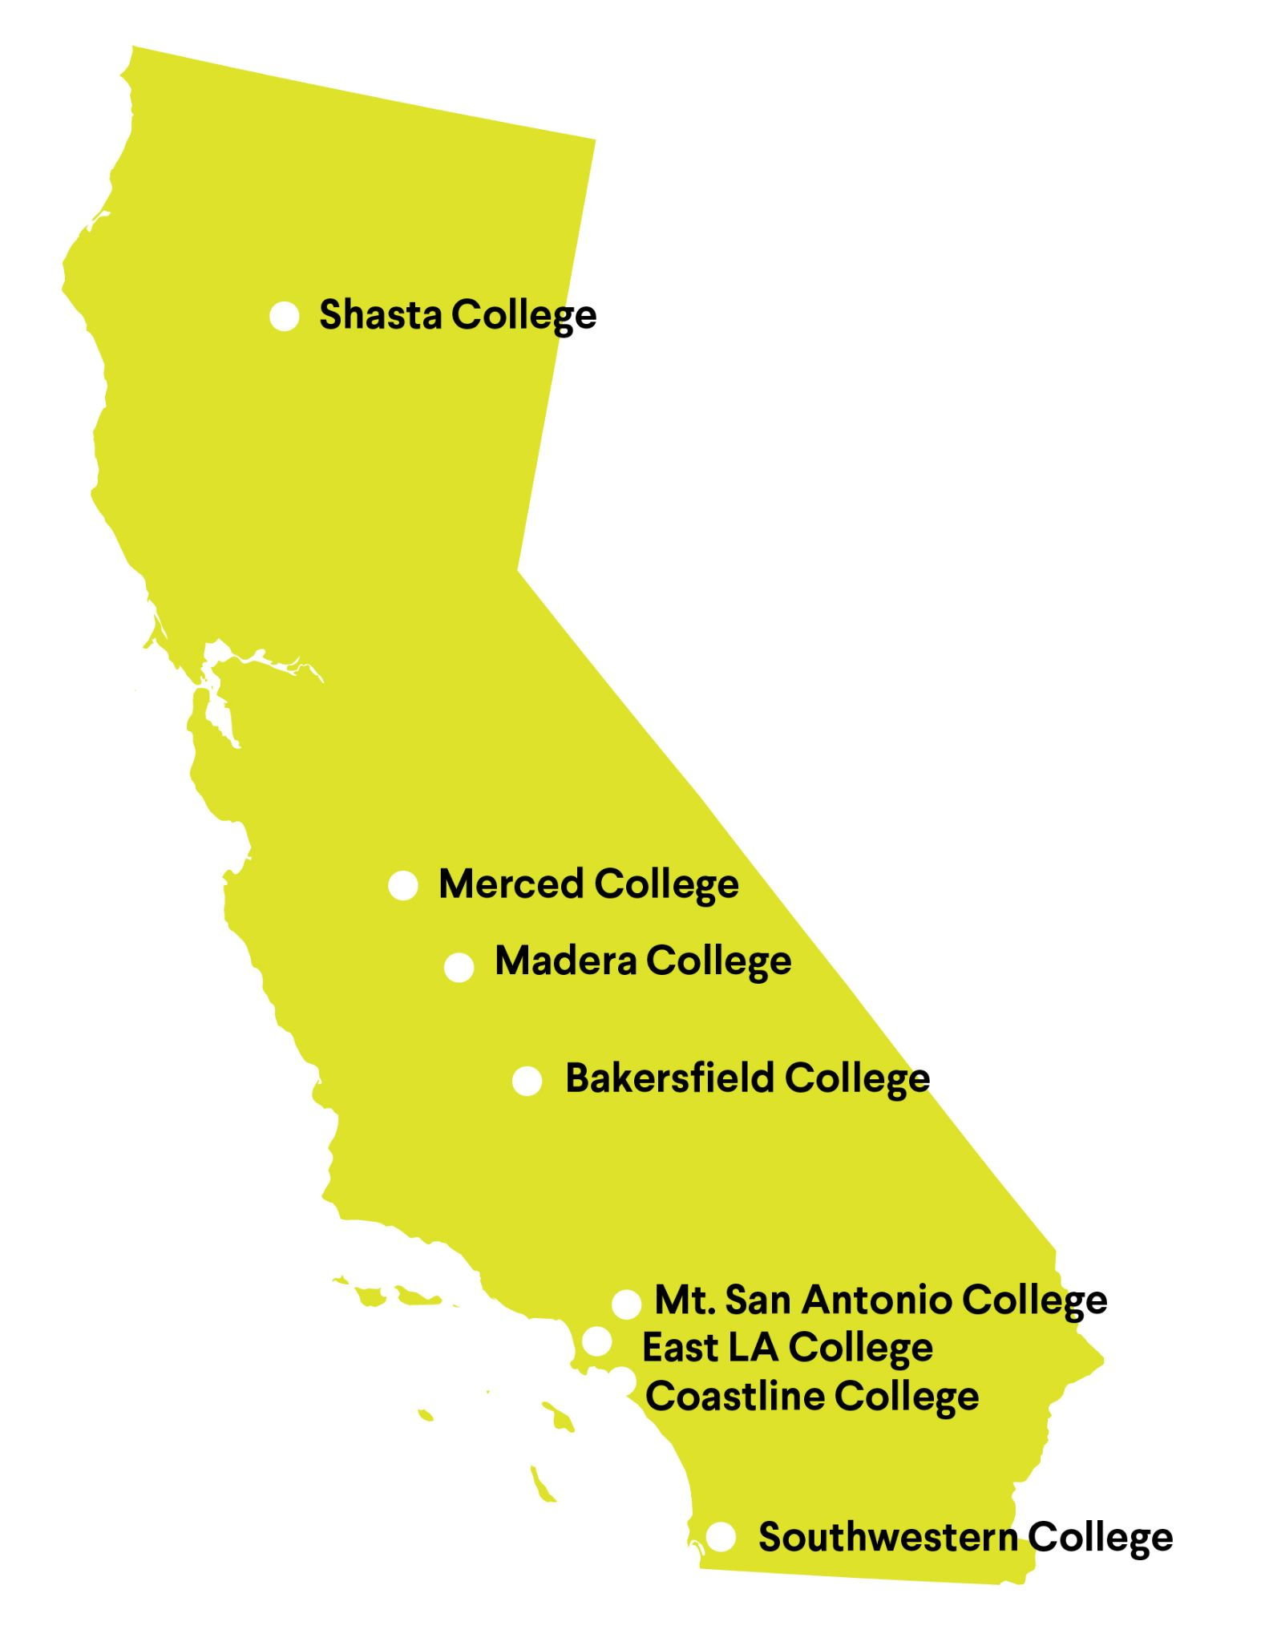
CBE Collaborative Colleges
Eight colleges
175 participants
Monthly learning sessions
Monthly leads’ meetings
Integrated Canvas course
Key Partners: Foundation Success Center, Jobs for the Future (JFF), Competency Based Education Network (CBEN), RAND
Notes:
Business Administration (2)
Early Childhood Education/Child Development (2)
Kinesiology & Wellness (1)
Technology & Logistics (1)
Culinary
Automotive tech

Slide 18
CBE Collaborative Timeline
2022
2023
2024
2025
Notes:
Angela

Slide 19
ACCJC & Department of Education & CCCCO
Required Elements
Planning process
Mission
Expected outcomes
Assessing and validating quality and effectiveness
Definition of clock hour and methods for equating clock to credit
Competency statements
Regular and Substantive Interaction
Resources and Governance
ACCJC Substantive Change
Federal Regulations for Direct Assessment
Title 5 Article 6 Direct Assessment Regulations
Notes:
Randy

Slide 20
Building the Program
Establishing crosswalks between credit courses and competencies
Developing modules based on competencies (determining pacing)
Developing the "Faculty Model" and negotiating compensation
Coordinating assessments and assignment support (AT Lab)
Technology considerations. Can we use Canvas? What about SIS?
Dual Transcripts for transfer (hint: start talking about this ASAP!)
Engagement with stakeholders (advisory committees, transfer institutions, local industry)
Notes:
Randy

Slide 21
Collaborative Activities and Milestones
Institutional Buy-In
Governance and Support
Implementation Team
Program Selection
What do we want to accomplish?
LMI Data
Competency Statements and Methodology
Automotive Tech
General Ed
Assessment Methods and Strategies
Learner Profile and Journey
Faculty Model
The "Unbundled Faculty" Model
Regular and Substantive Interaction

Slide 22
Institutional Redesign
Student Services for CBE Students
Financial Aid Decisions
Terms (standard vs. non-standard)
Start dates
Pacing and Satisfactory Academic Progress
Student Payment Model
Subscription model
Something else?
Academic Calendar
How will CBE be integrated into your academic calendar?

Slide 23
Competency Based Education at Madera Community College
Business Administration
Business Administration, AS-T prepares students for career opportunities and advancements in a dynamic business environment.
​The quality focus of this degree program will require students to demonstrate mastery of all competencies required for the CBE Associate degree such as communication and presentation skills, marketing, etc. ​
Students with leadership and management experience who are self-motivated, goal oriented, and excel at working independently are ideal candidates for the CBE program.
Social Work and Human Services
Social Work and Human Services, AA-T prepares students for a career opportunities and advancements in the field of Social Work and Human Services.​
This competency-based program is designed to provide students with applicable critical thinking skills, case planning, crisis intervention, theory-based assessment, working knowledge of community resources, and experience in a human service agency. Students will be able to become employed in entry-level social work occupations, which offers an occupational career ladder in the field as well as a potential transfer degree to the CSU System.​
Students will be able to demonstrate knowledge and skills in working within the social work and social welfare agencies, be able to address social issues, such as poverty, mental illness, crime, violence, divorce, and drug abuse within the society.​

Slide 24
Lessons Learned at Madera
Time and Resources - leveraging what you have.
Creating the competency sets - working from multiple perspectives.
Title 5 and what this means for local curriculum process.
Current system limitations.
Intentionality with bringing in various constituency groups when needed.

Slide 25
Key Recommendations to Get Started
Asses your own institutional commitment (your WHY?) and capacity for CBE
Learn about CBE...I mean REALLY learn about it
Create the message, and communicate it often
Identify internal and external stakeholders and champions early
Create a work plan and timeline
Don't underestimate the heaviness of "the lift"
Get your funding in order

Slide 27
What next?
What can the ASCCC and CCCCO do to support CBE at the local college/ district?
Help Us, Help You
ACTIVITY

Slide 28
Questions?
Thank you!
Notes:
Additional slides as “appendix”

Slide 29
Why is CBE in Community Colleges Different?
Honor the Past While Moving to the Future
CBE Touches Everything
Scale & Complexity of Change
Mindset Shifts Required

Slide 30
Not just another program
Direct assessment competency-based education is not another program. It is an innovation of teaching and learning leading to campus-wide transformation.
Notes:
Approach to initiatives @ CCC
Approach to initiatives @ local college
What does it take? Lessons learned…

Slide 31
CBE requires we dismantle the status quo
Reliance on time: seat time and out-of-the-classroom time
Reliance on traditional academic calendar: Semesters, Quarters, and Intersession
Limited access to student support services: Mon – Fri, 9 – 5, primarily in-person (pre-COVID)
Traditional grading: Focused on passing and grades, not mastery
Notes:
To highlight those high level barriers

Slide 32
CBE requires we innovate teaching and learning
Program Design:
Modality
Program Selection
Flexibility
Program Standards:
Focus on eliminating opportunity gaps
Student support services
Faculty Roles:
Program design
Unbundled roles
Teaching and mentorship
Academic Grading:
Focus on mastery
Non-punitive
Repetition and Withdrawal:
No failing grades
Redirect to credit programs
Credit Hour Equivalency:
Level of learning
Educational activities
Assessments
Alignment to existing credit courses
Notes:
This is intended to highlight the buckets of policy areas.
Decisions points centered around equity : ​
Program Design
Highlights flexibility
-Online modality
Data informed program selection
Program standards:
-Eliminating opportunity gaps, starting with degree programs
- Student support services
Faculty Role
CBE faculty roles can be unbundled to meet the needs of the program
Faculty work collaboratively to develop comprehensive CBE programs
Faculty have a role in providing mentorship and connecting students to student support services
Grading
Range of Mastery
M + adopted to ensure students can transfer with GPAs above 3.0
No grades that negatively impact GPA
Repetition and withdrawal​
A student cannot fail a CBE program rather they are given a PW
Students are redirected from CBE program to credit programs
Credit hour equivalencies
(1) The level of learning;
(2) The types of educational activities;
(3) The formative assessments;
(4) The complexity and rigor of the summative assessment; and
(5) Alignment to existing credit courses.

Slide 33
Overview of Resources & Supports
College Program Development
Artifacts
Group Resources & Support
Research to Inform the Process
Developmental Evaluation
Collaborative Syllabus
Peer Learning Sessions
Vision Resource Center
Individualized Support
Coaching
Ongoing Feedback
Notes:
Let’s starts with a high-level overview. Here, we’ve broken down resources and supports into four major components.
The first component is group resources and support. A common syllabus will keep us all on track, Peer Learning Sessions will give us a chance to learn together and from outside experts, and the Vision Resource Center will serve as a hub for key information.
The second component is college program development. Within the collaborative, program development will center around the creation of key artifacts. Artifacts include items such as implementation team charters, competency statements, revised policies, onboarding plans, etc.
The third component is individualized support for the college program development process. This will take the form of both coaching and written feedback around artifacts.
The final component of the collaborative is research. Developmental evaluation, conducted by RAND, will help inform the collaborative as we work and inform other colleges in the future. RAND will speak more on their plans soon.
Now that we’ve seen what the whole thing looks like, let’s take a closer look at a few components.

Slide 34
Policy Topics
Policy areas that need to be created, revised or modified to create direct assessment CBE programs for the CCCs:
Establish direct assessment program quality standards and approval process
Establish direct assessment academic standards and course approval process
Define direct assessment academic terms and calendars
Determine credit-hour equivalencies and methodology for a direct assessment program
Establish a competency-based grading system for direct assessment programs
Align direct assessment CBE course criteria with Associate Degree course standards

