Slide 1
Competency Based Education: Follow-up and Facilitated Dialogue

Slide 2
Recap
CBE Definition
Differences between CBE programs and other programs
Student Experience
Equity Imperative
5C Efforts to date

Slide 3
In this session...
Guiding principles and regulations framework
Equity imperative and assessment
Key decisions outlined in draft regulations
  Program Design and Approval
  Faculty Roles
  Grading and Academic Calendar
CBE Collaborative and Discussion

Slide 4
5C Guiding Principles
Maintain equity as a central goal and driver for change
Support college access, persistence, and completion
Prepare students for college, career, and lifelong learning
Intentional, transparent, and meaningful competencies
Design with the student in mind – anytime, anywhere learning
Provide students with timely and accessible support
Empower students to be active learners and faculty to engage in continual and collaborative inquiry processes
Cultural validation (culturally responsive pedagogy) in program design to support diverse learners
Serve populations being left behind with an emphasis on historically underserved students
Equity-minded data collection and evaluation
Notes:
Maintain equity as a central goal and driver for change
Support college access, persistence, and completion
Student outcomes designed to prepare students for college, career, and lifelong learning
Intentional, transparent, and meaningful competencies to facilitate student completion
Design with the student in mind – anytime, anywhere learning
Provide students with timely and accessible support
Teaching and learning at the core – empower students to be active learners and faculty to engage in continual and collaborative inquiry processes that build their professional knowledge and skills.
Cultural validation (culturally responsive pedagogy) in program design that is reflective and meets the academic priorities, needs, and experiences of students.
Serve populations being left behind with an emphasis on historically underserved students, unemployed adults, and adults with some college but no credential
Equity-minded data collection and evaluation

Slide 5
5C Regulatory Workgroup
Purpose
The workgroup was responsible for the review and drafting of regulatory language for statewide implementation of direct assessment competency-based education.
Process
­The workgroup met concurrently to regularly scheduled 5C meetings. In preparation for each CBE meeting, the workgroup provided a set of regulatory changes for the 5C committee to review and discuss.

Slide 6
Regulations Framework
Regulations are needed to enable colleges to maximize state and federal funding support for CBE programs.
The regulations will reside under the Alternative Instructional Methodologies in Subchapter 3 of Title 5 Division 6 Chapter 6.
The student learning journey, with emphasis on equity, is the focus of the design and elements of the program.
Focus on direct assessment competency-based education as a starting point.
Program and module quality standards align with those of degree programs and degree-applicable credit courses.
The implementation of a CBE program will include related professional development.
Chancellor’s Office approval will be required before a college can offer a CBE program for apportionment purposes.
CBE programs will have a separate program approval process, modules are to be adopted as part of a program.
In providing students with the flexibility to learn at their own pace, grading and transcripts systems will align with a national model.
Regulations will allow for greater flexibility and will clearly differentiate between direct assessment CBE and other programs.
Notes:
Regulations only address direct assessment competency-based education in the community college context.
Program and module quality standards are integrated and should align with those of degree programs and degree-applicable credit courses.
The intention is to start with degree programs and overtime phase in other programs (i.e. certificates).
The current streamlined program approval process is not applicable to CBE programs. As such, Chancellor’s Office approval will be required before a college can offer a CBE program for apportionment purposes.
CBE programs will have a separate program approval process. Modules will be approved as a part of a program and will not have a separate approval process.
In providing students with the flexibility to learn at their own pace, grading and transcripts systems will align with a national model to measure and denote mastery and GPA. Transfer credit or credit for prior learning is not permitted in direct assessment programs.
The implementation of a CBE program will include related professional development.
The student learning journey, with emphasis on equity, is the focus of the design and elements of the program.
The regulations will reside under the Alternative Instructional Methodologies in Subchapter 3 of Title 5 Division 6 Chapter 6.
Regulations are needed to enable colleges to maximize state and federal funding support for CBE programs.
Regulations will allow for greater flexibility; not be overly prescriptive; and will clearly differentiate between direct assessment CBE and other programs.
Colleges may not need to go through the CO approval process to implement a direct assessment CBE program and receive Title IV funding. However, to be eligible for state funds colleges will need to adhere to this process.

Slide 7
Ensuring an Equity-minded Approach
Each section of the proposed Title 5 regulations was reviewed using CUE’s policy review framework which includes 6 indicators and related questions to evaluate whether language is maintaining an equity-minded approach.
https://cue.usc.edu/files/2017/02/CUE-Protocol-Workbook-Final_Web.pdf
Equity-mindedness as the guiding paradigm for policy
Equity in language
Data collection and reporting Strategy
Disproportionate Impact
Policy Consistency and Ubiquity
Equity framing

Slide 8
The Equity Imperative - How?
Adopt Culturally Responsive Practices
Utilize culturally responsive learning activities, curricula, and instruction
Support faculty in developing culturally responsive teaching practices
Maintain high academic standards
Utilize Data
What's measured gets noticed
Meet students where they are and continuously support them
Recognize the Importance of Collectivism
The feeling of belonging supports student success
Create learning environments that support peer-to-peer learning

Slide 9
Direct Assessment CBE Title 5 Regulations
Proposed New Regulations
Direct Assessment CBE Definition and Application
Scope and Intent
Definitions
CBE Program Approval
Modality
General Academic Standards and Module approval
Module Quality Standards
Faculty Selection and Workload
Instructor Contact
Instruction
Availability of Instructor
Program and Curriculum Development
Academic Record Symbols and Grade Point Average
Repetition
Evaluation
Academic Calendar
Competency-Based Credit
Eligibility for State Funds
Notes:
Reviewed in Session 1. The Proposed New Regulations for Direct Assessment CBE Consists of:

Slide 10
Program Approval
&
Standards

Slide 11
Program Design
Delivery Model
  ­Fully Online
  ­Blended/Hybrid
Considerations
  ­Range of Learner Experience from fully online to fully on-ground
  ­Range of flexible time from high to low (self-paced to schedule with true start and stop)
Program Selection
  Use data to identify and select a direct assessment CBE program of study
  ­Alignment with the institutions’ mission, vision, and strategic plan
  Meaningful outcomes to students

Slide 12
Program Standards
Based on the guiding principles developed by the 5C, the following was considered and included in regulatory language:
An evaluation plan that focuses on closing historical equity gaps
An explanation of student success support services that will be made available to students
A professional development plan specific for direct assessment CBE faculty and staff
Creating and redesigning instructional content that is culturally responsive

Slide 13
Program Approval
Current System
Program and course are approved separately at the local level
Shift to streamlined approval process
The CO is responsible for chaptering programs and courses
Direct Assessment CBE
Courses, or modules, are bundled and approved at the program level
Final program approval happens at the USDOE/regional accreditors level
Chancellor’s Office approval necessary to earn apportionment

Slide 14
CBE Program Approval
US DEPT of ED
Program is structured
Student support
Credit hour equivalencies and methodology
CCCCO
Catalog description
Equity strategies
Professional development
Process for assessing learning
Module elements
Module elements
Competency statements
Method for substantive interation
Evaluations
Outreach strategies
Learning activities
Summative assessment rubric
List of modules within program
Faculty and staff roles
Student support
Substintive faculty interation
Notes:
This is a summary of the elements.

Slide 15
CBE Program Quality Standards
Draft Language
Direct assessment competency-based education modules are a set of degree-applicable credit modules which have been designated as appropriate to the associate degree in accordance with the requirements for an AA Degree and federal standards.
Decisions points:
CBE Programs are degree programs
Modules are equivalent to degree-applicable courses
Programs will include general education modules

Slide 16
Faculty Roles

Slide 17
Faculty Selection and Workload
Faculty is inseparable from design and implementation of direct assessment CBE programs. However, CBE faculty roles typically differ from traditional roles in order to meet the unique components of the CBE approach and USDOE requirements on faculty-learner interaction.

Slide 18
CBE Faculty Roles
 | Credit Hour Model | CBE Model
Curriculum Design | Faculty create to align with COR May be modified throughout course. Courses adopted into a program Standalone courses | Faculty create in collaboration with industry experts, instructional designers Must be completed before course begins. Modules must be developed as part of a program Modules are bundled and sequential
Instruction | Live, whole group instruction Typically from one faculty member Set office hours Primarily synchronous | Pre-recorded lectures and resources Emphasis on individualized instructor contact Flexible office hours Primarily asynchronous Engaged learning pedagogical approach
Delivery | Typically in person | Typically online
Assessment | Faculty created Graded by instructors | Faculty created in consultation with external experts, May not be graded by instructor
Resources | Office hours, student support services | Flexible office hours, online student support services CBE "coaches" help connect to support services

Slide 19
Program Development, Instruction,
& Student Support
Direct assessment competency-based education faculty shall be responsible for program design and curriculum development, instruction, and integrating student success support. In performing these functions faculty shall adopt an equity mindset aimed at reducing bias and stereotypical assumptions in their design, delivery, and implementation of direct assessment competency-based education... Direct assessment competency-based education program faculty shall take on the following functions:

Slide 20
Faculty Roles Language
Decisions points: ​
CBE faculty roles can be unbundled to meet the needs of the program
Faculty work collaboratively to develop comprehensive CBE programs
Faculty have a role in providing mentorship and connecting students to student support services
Developing direct assessment competency-based education programs
Instruction of direct assessment competency-based education modules. Instruction shall consist of facilitation of learning of culturally responsive instructional content designed by faculty and tracking student progress towards mastery of competencies.
Facilitating student success and support services embedded within the module design in coordination with student support classified staff.

Slide 21
Faculty Roles – Discussion
How does competency-based education (CBE) align with current pedagogical approaches to teaching and learning at the California Community Colleges? How might it differ?

Slide 22
Academic Symbols
&
Grading

Slide 23
Grading in CBE
Under direct assessment CBE programs, mastery or achievement of competencies is not tied to a traditional grading system and a GPA is not automatically calculated.
Students must demonstrate discrete competencies to receive graded marks.

Slide 24
Defining Mastery
“Mastery” means a student has mastered the competency by meeting or exceeding the minimum requirement of 80% or higher on the summative assessment.

Slide 25
Academic Record Symbols &
Grade Point Average
Grading policy:
Symbol | Definition | Grade Equivalency | Grade Point
M | Mastery – obtaining at minimum 80 percent on the summative assessment | B | 3.0
M+ | Mastery with Distinction- obtaining at minimum 90 percent on the summative assessment | A | 4.0
Decisions Points: ​
Range of Mastery
M + adopted to ensure students can transfer with GPAs above 3.0
No grades that negatively impact GPA

Slide 26
Academic Calendar
&
Enrollment Guidelines

Slide 27
Academic Calendar Options
 | Standard Term | Nonstandard Term | Nonterm
Definition | Traditional Semesters and Quarters | Fixed start and end date but not aligned to traditional semesters or quarters | Modules overlap terms with no start and end period
Flexibility | Each semester can include two session or four one-month session | Terms may be unequal in length | Students’ progress is self-paced
Tradeoffs | Administratively easier Familiarity for students Students will need to wait before they can begin the next set of modules | Permits flexibility in length of sessions within a term (e.g. a 4, 10 and 2 week session within a 16 week nonstandard term) Complexity for students and faculty | Students can move through the program at their own pace Administratively complex

Slide 28
Repetition and Withdrawal
Withdrawal Policies:
Repetition Policies:
Students may take attempt a summative assessment a maximum of three times before receiving the non-evaluative symbol “PW”
A district can establish guidelines for when a student can repeat modules for which the non-evaluative symbol “PW” is assigned.
A district policy should include guidelines for redirecting students to credit hour programs when satisfactory academic progress is not achieved.
Symbol | Definition
PW | Progress Withdrawal - demonstration of mastery not met after the maximum number of summative assessments attempted
Decisions points: ​
A student cannot fail a CBE program rather they are given a PW
Students are redirected from CBE program to credit programs

Slide 29
Discussion
The committee wrestled with the elements introduced in this sections (and others not covered here), what comes to mind as we discussed these components of direct assessment CBE?

Slide 30
Direct Assessment CBE
Collaborative

Slide 31
CBE Collaborative
Goals
Objectives
Criteria/Structure
Timeline

Slide 32
Goals for the Collaborative
Adoption and application of direct assessment CBE Title 5 regulations.
The development of an equity-minded direct assessment CBE program framework that will help inform a systemwide toolkit for implementation.
Information sharing to inform Chancellor’s Office planning and state-level infrastructure to support local implementation of direct assessment CBE programs.
The development of best practices and procedures for direct assessment CBE and curriculum design.
The identification of resources needed inclusive of costs, personnel, professional development, and technology needs.
The cultivation of CBE leaders within the system to provide training and technical support to other colleges.

Slide 33
Direct Assessment CBE Collaborative Objectives
Establish a local structure to support the development and implementation of a direct assessment CBE program
Support the development of a direct assessment CBE program framework
To assist with the development and dissemination of direct assessment CBE program framework for system level implementation

Slide 34
Collaborative Criteria
Colleges will be selected based on their ability to demonstrate the following:
A historical commitment to serving adult learners and students from minoritized communities through innovative practices and a proven dedication to eliminating opportunity gaps in their service area.
College-wide and district-level commitment to the implementation of direct assessment CBE that includes a willingness to make financial investments and build capacity for innovation and implementation inclusive of working with college leaders to ensure long-term sustainability of reforms.
A proven ability to bring together cross-departmental teams of faculty, staff, and administrators with shared enthusiasm for change and innovation. This should include a history of working closely with the local Academic Senate and local bargaining units to adopt innovative teaching and learning strategies.
A history of collaborating with external partners and four-year institutions to implement intersegmental efforts with a particular focus on equity. Colleges should also demonstrate a willingness and commitment from four-year partners to implement direct assessment CBE.
Ability to integrate data-informed decisions in the selection of programs by conducting labor market analysis to determine which degrees are in demand and offer the greatest opportunities for students.

Slide 35
Collaborative Structure
The Chancellor's Office is providing seed money to support the implementation of direct assessment CBE among a collaborative of X colleges.
The CBE collaborative will establish a direct assessment CBE learning community with the goal of informing key aspects for systemwide implementation of direct assessment CBE.
Interested districts and/or colleges will apply for funds through an application process established by the Chancellor’s Office.
The collaborative is expected to commence Spring 2021 and end in Fall 2023.

Slide 36
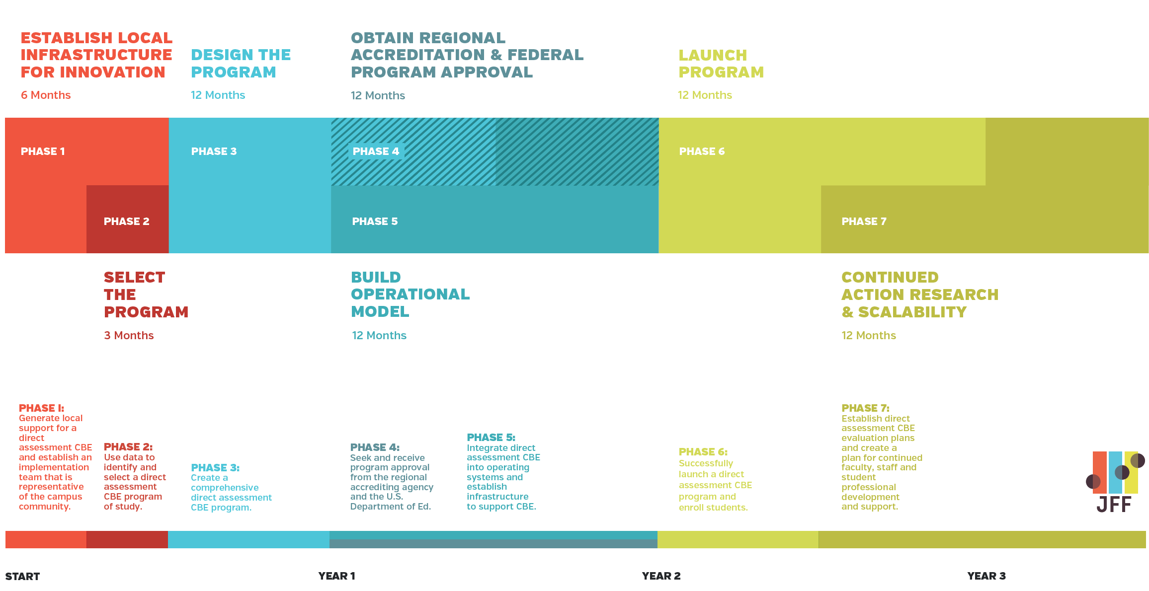
7 Phases for Implementation

Slide 37
CBE Collaborative - Discussion
Timeline
College Selection Criteria
Program Selection Criteria

Slide 38
Q & A

