Slide 1
Curriculum Committee, Planning, and Governance: Integrating Our Guided Pathways Work
Erik Shearer, Napa Valley College
Sarah Harris, College of the Sequoias
Josefina Gomez, San Joaquin Delta College
Notes:
Erik

Slide 2
Housekeeping
Please use the chat feature in Pathable
Use “Raise Hand” feature to speak or ask questions when called
Reminder to please mute mic when not speaking
Pro tip: maneuver your windows to have both Zoom and Pathable visible
Notes:
Erik

Slide 3
Session Description
By clarifying the path, helping students to find the path, supporting students to stay on the path, and ensuring student learning, the Guided Pathways framework serves as an institutional redesign with equity and the student experience at the core. Colleges have completed year four of the five-year grant to design and implement a Guided Pathways framework. Colleges are situated to institutionalize their Guided Pathways frameworks by integrating the guided pathways elements into existing and redefined college structures. Our curriculum committees and academic senates have a central role in leading this next stage of institutional redesign. Join this session to learn and discuss what a Guided Pathways integration looks like across different colleges and how your curriculum committee can play a central role.
Notes:
Erik

Slide 4
Institutionalizing Guided Pathways
Questions to Ask: Has your College . . .
Created a sustainability plan for supporting students and faculty in continuing the framework and addressing equity goals
Changed structures to align with the Guided Pathways framework: governance, planning, budgeting, hiring
Aligned outcome and program review assessments to ensure ongoing assessment of the framework
Identified a continued role for the academic senate and curriculum committees in Guided Pathways re-design
Notes:
Erik

Slide 5
Aligning the Mission and Vision with Equity and Guided Pathways
Ensure your college VISION and MISSION statements are aligned with Guided Pathways efforts
Support faculty in:
leading change
serving students
embracing inclusion
engaging in anti-racism
Curriculum Committee efforts aligned with Mission and Vision through the development criteria
Notes:
Sarah
leading change--ownership of redesign and authentic practices (grassroots efforts and engagement)
serving students--intentional involve and invite student voices (look to left and right of every meeting--if you don’t see a student, ask for one)
embracing inclusion--address and actively discuss practices of inclusion that support all lived experiences
engaging in anti-racism--interrogate systems of status quo that create racial barriers
When colleges actively seek to redesign in a GP framework, the mission and thus outcomes should intentionally work toward these aims.

Slide 6
The 10+1 and Guided Pathways
Curriculum
Educational Programs
Degree and Certificate Requirements
Student Preparation and Success
Accreditation Process
Curriculum
Student Preparation and Success
Educational Programs
Clear pathways and programs
Guided Exploration and Progress
Teaching and Learning
Academic and Student Support
Curriculum
Student Preparation and Success
Educational Programs
Curriculum
Student Preparation and Success
Notes:
Sarah

Slide 7
Guided Pathways Integration into College Structures
Key areas to consider:
Sustaining role of student voice / input
Hand-off to committees and other standing groups
Changes to governance bodies and committees
Institutional Planning: Annual, Educational and other Master Plans, Program Review, etc.
Locating ongoing oversight with structures that provide appropriately high-level, holistic perspective on the institution
Ongoing funding sources / budgets for anything currently funded through GP
Continuing efforts to "de-silo" work
Integration with Equity
Sustaining a Focus on Students
Notes:
Sarah

Slide 8
DEI and Anti-Racism
Major Objectives of Guided Pathways Institutional Redesign:
Close equity, achievement, and opportunity gaps
English, English as a Second Language, and Mathematics Pathways
Streamlined student journey so that financial aid is not wasted on unnecessary course taking
Student Self-Agency: students are provided with clearly defined pathways and program maps to choose their self-determined educational goals
Curriculum that is culturally responsive as well as relevant to students’ career and future educational goals
Consider – where do these goals fit in your institution?
Notes:
Josefina

Slide 9
Reviewing Committee Charges
Take note of the GP activities to be sustained
Discuss how your current or revised curriculum committee structure can support GP improvements
Look at your current committee work and prioritize discussions on how to incorporate the work of GP in your institutional structures
If the work does not fit into current committees perhaps revise committee charges
Make sure to review/address membership to include all constituency groups and highlight student voices
Notes:
Josefina

Slide 10
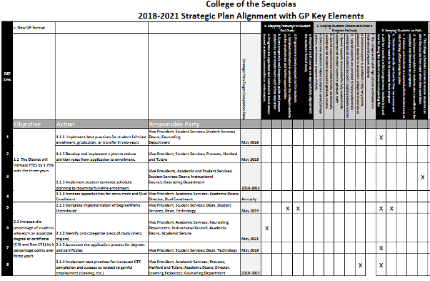
Example: College of the Sequoias
COS uses its integrated planning process to embed various initiatives into ongoing work.
Initiatives referenced in COS Strategic Plans include:
Strong Workforce
Vision for Success
Student Centered Funding Formula
Basic Skills/ AB705
Pathways key elements mapped to Strategic Plan for reporting
Notes:
Sarah

Slide 11
Example: College of the Sequoias (Cont.)
Meta-Majors
Developed and vetted via two District-wide summits
Initial draft reviewed in Curriculum Committee
Work directed by Meta-Majors Taskforce in response to 18 – 21 Strategic Plan action
Final draft approved through Governance process
Taskforce dissolved once draft completed and approved
Giant Pathways
Incorporated in COS Catalog
Ongoing updates/ maintenance reviewed in Curriculum Committee
New goals in 21 – 25 Strategic Plan iterate the work – Program mapping, Success Team development, Career and Transfer resources
Notes:
Sarah

Slide 12
Example: San Joaquin Delta College
Guided Pathways Implementation Team (GPIT)
Faculty member and Administrator Co-Leads
Diverse stakeholder representation including
Institutional Effectiveness Staff
Admissions and Records
Instructional Deans
CTE
Academic Senate
Instructional faculty
Counseling Faculty
Notes:
Josefina

Slide 13
SJDC: Understanding Guided Pathways
Notes:
Josefina

Slide 14
SJDC: What are “Meta-Majors”
Sweet 16 approach to determine the name at Delta College.
Multiple retreats with "post-its" getting disciplines in each
STUDENT PERSPECTIVE
Notes:
Josefina

Slide 15
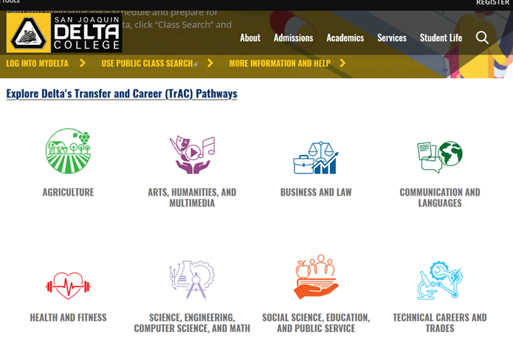
SJDC: Transfer and Career Pathways
Notes:
Josefina

Slide 16
SJDC: Success Teams
Goal – to provide every student with "wrap-around services and support" to keep them "on TrAC"
Composition-
Dean
TrAC Faculty Chair
Resource Specialist(s)
Counselor(s)
Librarian
Notes:
Josefina

Slide 17
SJDC: Pathway Maps
Notes:
Josefina

Slide 18
SJDC: Guided Pathways & The SJDC Curriculum Committee
New and revised courses
stand alone courses = extra scrutiny
Review of offerings and deactivations as necessary
New programs
Guided Pathways analysis included in the proposal
Pathway mapping to be integrated
Notes:
Josefina

Slide 19
Discussion: Your Examples
What are you doing to integrate GP work in your curriculum committee?
Share examples in chat
Notes:
Josefina; All

Slide 20
Sustaining Change and Assessment (Continuous Quality Improvement)
When it has taken root, Guided Pathways redesign results in an organizational structure/culture of ongoing transformative change
Governance structures adopt data-informed decision-making to examine where a current practice is living up to shared values and where it is not.
Pathways (meta-majors) and academic program maps are a source for evaluating the efficacy of scheduling and program offerings
With the help of case management technologies, proactive student support will both serve students and become a source of data for how to better meet student needs
Outcomes assessment can be regularly aligned with real world applications to future careers—directly or following transfer.
With its emphasis of breaking down barriers to student success, Guided Pathways, ultimately, is about advancing student equity.
Notes:
Erik
Guided Pathways helps faculty laser-focus a program’s goal to guide and prepare students to enter further education or employment
Competencies help identify skills needed in similar programs
Skills specific to industry/discipline
Technical knowledge
History of the industry/discipline
Methods and theories
Skills for transition to workforce (Soft skills)
Collaboration
Problem solving
Adaptability
Guided Pathways helps identify extraneous or duplicative programs during mapping, sorting, cross-discipline discussions, including with counseling
In the process, it encourages faculty to talk about their programs with other stakeholders (counselors, students, admin) to understand the bigger picture
GP recognizes milestones, including maximizing the use of “stackable” certifications?
GP looks for “bridges” to facilitate movement between programs for students who change their focus
Considerations for Guided Pathways-Informed Program Review
Are students in “Areas of Interest/Meta Majors” completing at higher rates than prior to guided pathways frameworks?
Are disproportionately impacted students being served by the college’s guided pathways framework?
Has the establishment of “Areas of Interest/Metamajors” contributed to course/program completion rates? How will you tell?
How have changes in counseling and student services contributed to student outcomes?
What resources are needed in order to move towards the achieivement of equitable student outcomes?
professional development of all employees working in a program
faculty hiring
facilities
Does the program review measure intentional equity in student completion and socio-cultural well-being?

Slide 21
Some GP integration considerations for Curriculum Committees

Slide 22
Keeping an Eye on the Big Picture: The Development Criteria
Local curriculum approval assures that each proposal meets five criteria:
•Appropriateness to Mission
•Need
•Curriculum Standards
•Adequate Resources
•Compliance
DC require focus on the Big Picture and alignment with local and system missions, including all aspects of GP work.
Explained in Chapter 1 of the PCAH
Notes:
Erik
Where did they originate?
•Honed over many years of work between the Chancellor’s Office, the ASCCC, Chief Instructional Officers, and local colleges.
•Endorsed by the System Advisory Committee on Curriculum (now the California Community College Curriculum Committee or 5C) as the basic framework for curriculum development and approval processes
•Have been included in every edition of the Program and Course Approval Handbook since the 2nd edition in 2002. However, the basic framework and standards articulated in the criteria date back to earlier guidance for curriculum development in the Community College system.
•Were the basis of the old Chancellor’s Office curriculum forms—such as the CCC-510—that were required for curriculum approval prior to the introduction of the Curriculum Inventory system.
•Elements from the development criteria are still visible today in the narrative used for program approval and, to a lesser extent, in the curriculum inventory submission screens.

Slide 23
Committee Membership
Who is at the table?
Have you included students on your committee or in your curriculum process?
Membership with an eye toward Curriculum as a system, not a product.
In addition to faculty and those directly responsible for managing curriculum, consider other areas of expertise that are part of the curriculum system:
Admissions and Records
Financial Aid
Veterans Support Services and Programs
Disabled Students Programs and Services / Accessibility
Distance Education
Outcomes Assessment
Membership with an eye on Equity and Diversity
Notes:
Erik

Slide 24
Meta Major Development
CC involvement in initial development and ongoing review / maintenance of Meta Majors.
Including Meta Major conversations / considerations as part of curriculum review and approval processes.
Notes:
Erik

Slide 25
Monitoring English and Math Pathways
Sustaining and monitoring AB 705 changes to placement, sequencing, and prerequisites for computation and communication.
Consider role of the committee in ongoing monitoring and discussions about impact of changed practices.
CC a location for ongoing conversations about overall impact of changes across the curriculum and in student progress toward educational goal attainment.
Notes:
Erik

Slide 26
Resources
Survey on Collegial Consultation During Guided Pathways Implementation: An Agenda for Professional Development
GPTF Webinars:
Integrating Guided Pathways to Institutional Structures PPT and Recording
Using the SOAA as a Tool of Guided Pathways Reflection, Planning, and Collaboration PPT and Recording
Integrated Planning, Guided Pathways, and Sustainability PPT and Recording
All GPTF Webinars: https://asccc.org/guided-pathways

Slide 27
Q & A
Thank you for joining us today!
Erik Shearer, Napa Valley College
Sarah Harris, College of the Sequoias
Josefina Gomez, San Joaquin Delta College
Please use chat for questions, or “raise hand” and wait until called on to unmute.

