Slide 1

Submission Requirements
Chancellor’s Office
Vice Chancellor Aisha Lowe
Dean Raul Arambula
Patti Blank
Yvonne Lopez
David Garcia
Rosa Estrada

Slide 2
Session Overview
  Chancellor’s Office 2022 Updates
  COCI Updates / Maintenance Dates
  Resources
  Submission Requirements
    Credit Programs (AA/AS/COA)
    Noncredit
    ADTs
  Common Submission Errors
  Questions

Slide 3
Aisha N. Lowe, Ph.D., Vice Chancellor
Equitable Student Learning, Experience, and Impact Office
Educational Services and Support Division
  Chancellor’s Office
  2022 Updates

Slide 4


Vision for Success Goals
Commitments
Decrease average unit obtainment for a degree to 79
Reduce and erase equity gaps
Focus on students’ goals
Design with the students’
experience in mind
High expectations and high support
Foster use of data and evidence
Own student performance
Thoughtful innovation and action
Cross-system partnership
Reduce regional gaps
Increase transfer by 35% to
UC and CSU
Increase credential obtainment
by 20%
Increase employment for CTE students to 76% in their field of study

Slide 5

The Work Ahead: Roadmap to Equity
Continue to elevate the student voice and experiences. Chancellor’s Office will continue to focus on regional barriers to implement the Vision and prioritize the student experience through campus listening tours.
Advance the Governor’s Roadmap for California Community Colleges
The roadmap makes a state commitment to advance the
Vision for Success goals and commitments. Our colleges
play a critical role in achieving 70% postsecondary
degree and certificate attainment among
working-age Californians by 2030.
Notes:
Summarize bullets in slides
5

Slide 6

Policy Change with Fidelity: Full implementation of policy and fiscal tools that will advance equitable student outcomes and reduce regional gaps (e.g., Equitable Placement, Competency Based Education, and the Student-Centered Funding Formula.)
Structural implementation of the Vision for Success: Continue progress with expanded capacity in the Chancellor’s Office and help colleges advance Diversity Equity, Inclusion and Accessibility competencies, support inclusive and anti-racist campus culture, and continue to lead toward inclusive and flexible teaching modalities.
Notes:
Summarize bullets in slides
6

Slide 7


Intentional Student-
Centered Design for an Equitable Recovery
Student
Centered Funding
Equitable Placement
Financial Stability
Clarify problems
Health/ Mental Health
Support Networks
Maximize resources
Shift structures
Diversity, Equity, Inclusion and Accessibility
Guided
Pathways

Slide 8
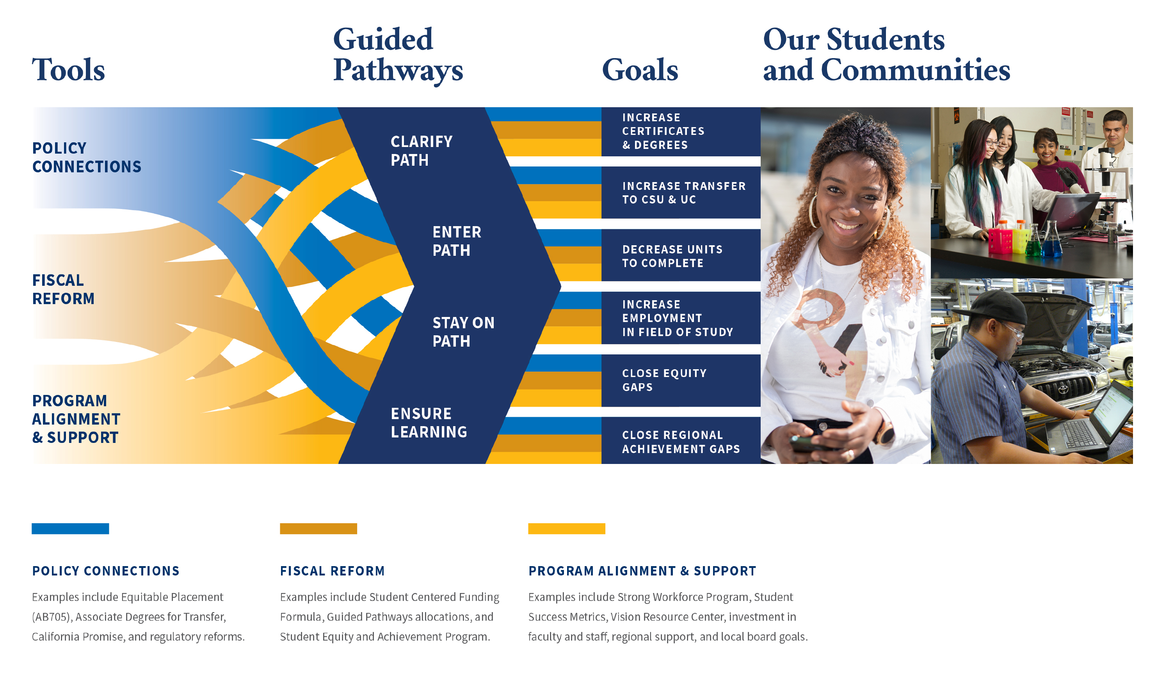
Aligning Resources & Programs to Put Students First

Slide 9

The Innovation Imperative
Teaching and learning must innovate to keep pace with advances in technology, shifting economic paradigms, modern employer demands, students’ evolving needs (psychological, tactical & relational), and an expanding global society.
What’s Blockbuster?

Slide 10

Key Updates
5C Updates
Equitable Placement and Completion
Competency-based education
Credit for Prior Learning
Ethnic Studies Implementation
Baccalaureate Degree Implementation
Legislation Implementation

Slide 11
5C Updates
DEI in Curriculum Framework: Diversity, Equity, and Inclusion in Curriculum: Model Principles and Practices published.
Work Experience Education: Updated regulations went before the BOG for first read in May (2nd read in July).
PCAH: Reviewed and finalizing PCAH revisions
Forthcoming:
  Updates to the AA degree regs and associated sections
  Incorporating DEI in the COR regulations
  Guidance & attendance accounting for Hyflex
  Guidance on cross listing
  Title 5 revisions for AB 705 alignment

Slide 12
Equitable Placement and Completion
(AB 705/1705)
Goal: Maximize student success
Policy Reform: Stipulates the time to enrollment & completion; what information can be used for placement; and the standard of proof for any BTL placements
Implementation: Research to establish standards & best practices; Required adoption plans with a two-year innovation window; Required validation of practices; Enforcement of the law; Improvement plans; Continued evaluation and improvement
AB 705 is a historic reform to dismantle structural racism and classism barriers.

Slide 13
Implementation Progress
October 2017 | Legislation Signed
March/July 2018 | Default Placement Rules Established
March 2019 | English and Math Regulations Approved
July 2019 | English and Math Adoption Plans Submitted
Fall 2019 | Implementation Deadline for English and Math
March 2020 | ESL Regulations Approved
Spring 2020 | ESL Adoption Plan Deadline extended to July 1, 2021 for Fall 2021 Implementation
Spring 2020 | Published Equitable Placement Toolkit
Spring 2021 | English and Math Validation of Practices Data Collected

Slide 14
Implementation Progress
Spring 2021 | Transfer Level Gateway Completion Dashboard Created
Spring 2021 | ESL Data Analysis and Research
July 1, 2021 | ESL Adoption Plans Due
July 2021 | Equitable Placement & Completion BOG Spotlight: Results of Validation of Practices
Fall 2021 | Implementation Deadline for ESL
Fall 2021 | Reconstituted Assessment Committee
Fall 2021 | Assessing ESL Adoption Plans
Fall 2021 | Equitable Placement & Completion Improvement Plans
Results of Improvement Plans analyses will be sent to colleges.
Notes:
ESL Research:
Assess colleges with high populations of international students (assessment, placement & outcome data) to assess correlations and establish criteria (quantitative)
Assess colleges with high throughout for ESL to assess best practices (qualitative)
Assess colleges with promising GSP models (qualitative)

Slide 15

What We Know
Evidence from numerous sources supports one key finding:
When local placement practices require, encourage or allow students to enroll in pre-transfer level coursework, throughput is not being maximized. Students are more likely to complete transfer requirements in math and English when they are placed and enroll in transfer-level coursework.
For all student groups
No matter students’ high school performance
No matter how long students have been out of school
No matter students’ prior math completion
See BOG January & July 2021 digests & spotlights, and memo ESS 21-300-015 (November 18, 2021) for research references.
Notes:
CASAS: Probationary approval for the 80R and 80L tests due to sampling methodology used for the consequential validity data collection and the need to collect data from a sufficient number of community colleges with samples that meet CCC Standards.
CELSA: Not approved for CELSA paper-and-pencil and computer-delivered version due to the missing documentation for logical and empirical fairness reviews of the tests.
Accuplacer:
Not approved for ESL Listening and WritePlacer ESL (Computer-delivered and COMPANION forms) due to the absence of criterion/consequential validity evidence. Probationary approval for ESL Reading Skills, ESL Sentence Meaning, and ESL Language Use (Computer-delivered and COMPANION forms) due to the need for criterion/consequential validity data to be collected from a sufficient number of community colleges with samples that meet CCC Standards.

Slide 16

What We Know
Starting in transfer-level gives students the best chance of successfully completing transfer-level
Overall non-successful completions have declined post-AB 705 (not increased)
Even students who start in and fail transfer-level are more likely to then pass transfer-level than if they had started below transfer-level
Research briefs on these topics are forthcoming.
Notes:
CASAS: Probationary approval for the 80R and 80L tests due to sampling methodology used for the consequential validity data collection and the need to collect data from a sufficient number of community colleges with samples that meet CCC Standards.
CELSA: Not approved for CELSA paper-and-pencil and computer-delivered version due to the missing documentation for logical and empirical fairness reviews of the tests.
Accuplacer:
Not approved for ESL Listening and WritePlacer ESL (Computer-delivered and COMPANION forms) due to the absence of criterion/consequential validity evidence. Probationary approval for ESL Reading Skills, ESL Sentence Meaning, and ESL Language Use (Computer-delivered and COMPANION forms) due to the need for criterion/consequential validity data to be collected from a sufficient number of community colleges with samples that meet CCC Standards.

Slide 17

AB 1705 brings clarity
AB 1705 clarifies vague or confusing aspects of AB 705
The goals and standards of proof remain the same
Important loopholes are closed
Allowances for BTL course work are made clear:
  Non U.S. high school graduates
  Certain certificate programs
  Noncredit ESL
  Students with disabilities
  Adult education
  Dual enrollment
  CTE
  Where there is evidence of benefit to students
See the detailed Assembly and Senate analyses.
Notes:
CASAS: Probationary approval for the 80R and 80L tests due to sampling methodology used for the consequential validity data collection and the need to collect data from a sufficient number of community colleges with samples that meet CCC Standards.
CELSA: Not approved for CELSA paper-and-pencil and computer-delivered version due to the missing documentation for logical and empirical fairness reviews of the tests.
Accuplacer:
Not approved for ESL Listening and WritePlacer ESL (Computer-delivered and COMPANION forms) due to the absence of criterion/consequential validity evidence. Probationary approval for ESL Reading Skills, ESL Sentence Meaning, and ESL Language Use (Computer-delivered and COMPANION forms) due to the need for criterion/consequential validity data to be collected from a sufficient number of community colleges with samples that meet CCC Standards.

Slide 18
From Compliance to Continuous Improvement
Access
Comprehensively informing students
Enrollment
Ensuring students enroll in gateway courses (not simply giving them the option to)
Performance
Investing in concurrent support
Data-driven advising
Defaulting to transfer-level placement
Ensuring equity in classroom curriculum and pedagogy
Let’s work together so that all students and colleges can be successful.
See appendix for research sources.
Notes:
As we continue to implement and evaluate the implementation of this transformational reform, our focus is on shifting from compliance to full implementation, not simply to the letter of the law, but the spirit of the law
The spirit and intent of this reform is not simply that students have the option to enroll in these essential gateway courses, but that our districts and colleges ensure students’ entrance into, support in, and successful completion of these courses is maximized
Maximized, which by definition means to make as large or great as possible, and to make the best use of
The work of implementing AB 705 with fidelity requires that we create the largest opportunities possible for access to gateway courses [slide]
That we ensure the greatest enrollment possible into gateway courses [slide]
And that make the best use of these opportunities for students by providing them the support they need to perform well and be successful in completing gateway courses [slide]
As we review our implementation progress and the work still before us, we want to keep this ecosystem of equitable placement in mind – Access, Enrollment and Performance

Slide 19
ESL Updates
ESL innovation and experimentation should have been planned 2017-2020, and should be evaluated 2020-2023
  There will be a similar validation of practices process in 2023
Current assessments will remain approved through the ESL innovation timeframe (2021-22 and 2022-23)
Assessment Advisory Committee recommendations approved by the BOG January 2022 (see BOG digest & https://assessment.cccco.edu/assessment for the list)
Forthcoming:
  Review and revise standards (spring-fall 2022)
  Review locally developed assessments (fall 2022)
  Establish infrastructure for additional assessment review (i.e. guided/self-placement)
See appendix for ESL research & guides.
Notes:
CASAS English as a Second Language (ESL) Appraisal Tests for Reading (80R) and Listening (80L): Probationary approval
Combined English Language Skill Assessment (CELSA) tests: Not approved
ACCUPLACER ESL Tests:
Sentence Meaning: Probationary approval
Reading Skills: Probationary approval
Language Use: Probationary approval
Listening: Not approved
WritePlacer: Not approved

Slide 20
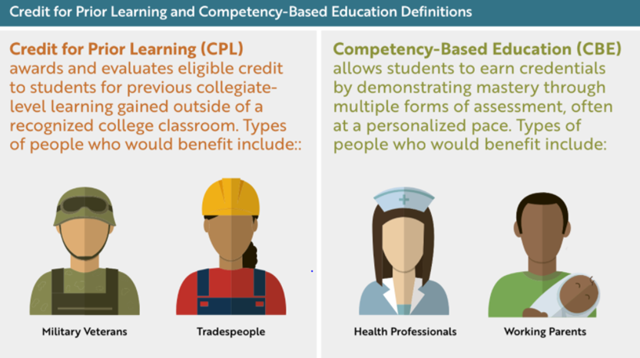
CPL and CBE: Separate but related strategies
to serve working learners
Shared central tenets:
Giving credit where credit is due
Validate learning however it is achieved
Mastery rather than time on task
Flexibility

Slide 21
Competency-based Education
Direct assessment competency-based education is an intentional outcomes-based and equity-minded approach to earning a college degree in which the expectations of learning are held constant, but time is variable through a flexible, self-paced, high-touch and innovative learning practice.
Under Title 5 Regulations Direct Assessment Programs are Associate Degree Programs delivered through direct assessment (as defined by Federal Regulations); Programs are fully online or hybrid
Direct Assessment differs from more generalized competency-based education which can be used for non-credit degree pathways.

Slide 22
CBE requires we dismantle the status quo
Reliance on time: seat time and out-of-the-classroom time
Reliance on traditional academic calendar: Semesters, Quarters, and Intersession
Limited access to student support services: Mon – Fri, 9 – 5, primarily in-person (pre-COVID)
Traditional grading: Focused on passing and grades, not mastery
Notes:
To highlight those high level barriers

Slide 23

CBE Implementation
January 2020 Presentation to Board of Governors
January 2020 – June 2020 Partnered with 5C to Establish Title 5 Regulations
September 2020 Presented Regulations at Sept BOG meeting (1st Reading)
November 2020 Regulations approved by the BOG
December 2020 Collaborative RFA
June 2021 Launched the Direct Assessment CBE Collaborative
Spring/Fall 2022 Seek ACCJC Approval
Spring 2024 CBE Programs Launch

Slide 24
2021-2024 CBE Collaborative Pilot
A collaborative of campuses implementing direct assessment CBE programs
Close coordination with the CCCCO
Seed money to launch programs
Program development support
Research implementation process and program outcomes
Recommendations for improvement
Inform broader system implementation

Slide 25
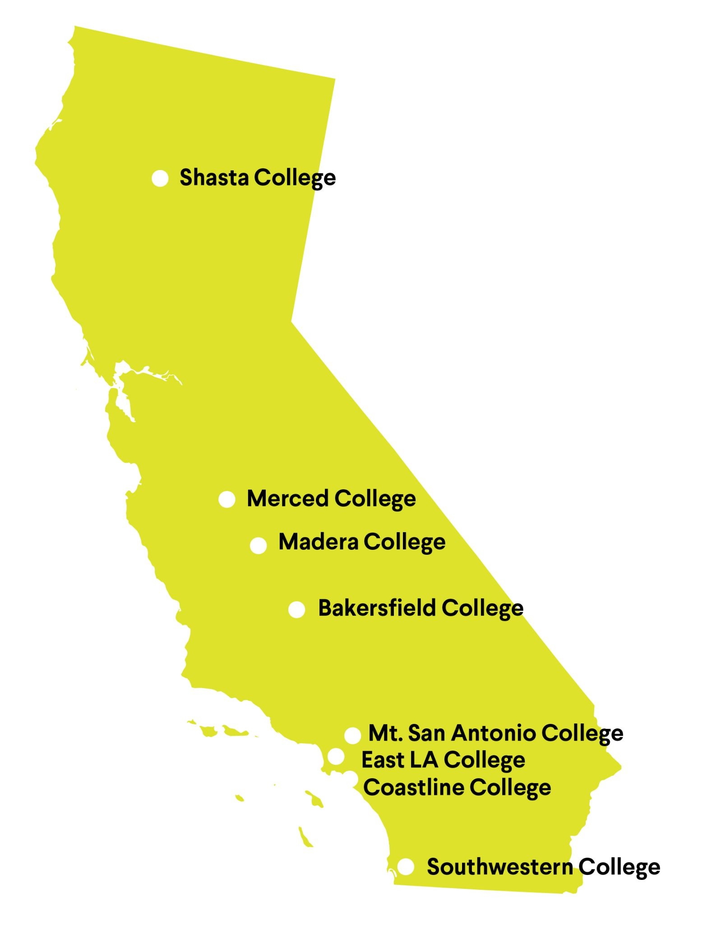
CBE Collaborative Colleges
Eight colleges
175 participants
Monthly learning sessions
Monthly leads’ meetings
Integrated Canvas course
Key Partners: Foundation Success Center, Jobs for the Future (JFF), Competency Based Education Network (CBEN), RAND
Notes:
Business Administration (2)
Early Childhood Education/Child Development (2)
Kinesiology & Wellness (1)
Technology & Logistics (1)
Culinary
Automotive tech

Slide 26
CBE is a tool for campus-wide transformation
Faculty Role, Load and Contracts
District/College Policies
Student Support Services
Dismantling silos to provide a tailored student experience leading to clearly defined competencies students can leverage in industry.
Student
Centered
DA CBE
Self
Directed
Variably
Paced
Institutional Data & Research
Outcomes
Focused
Financial Aid
SIS & LMS
Notes:
To highlight those high level barriers

Slide 27

Credit for Prior Learning (CPL)
California Code of Regulations, Title 5 Section 55050 - Districts must have a policy in place to award CPL by December 2020
  Expansion of prior learning assessment beyond credit by exam
  Automatic referral for assessment for veteran/military and students with industry certifications
  Priority for credits that count towards completion and transfer (not electives)
Code of Federal Regulations, Title 38, Section 21.4253(d)(3) - Colleges receiving federal veteran’s funds must maintain a written record of previous education and training of the veteran or eligible person which clearly indicates that appropriate credit has been given by the school for previous education and training.
-

Slide 28
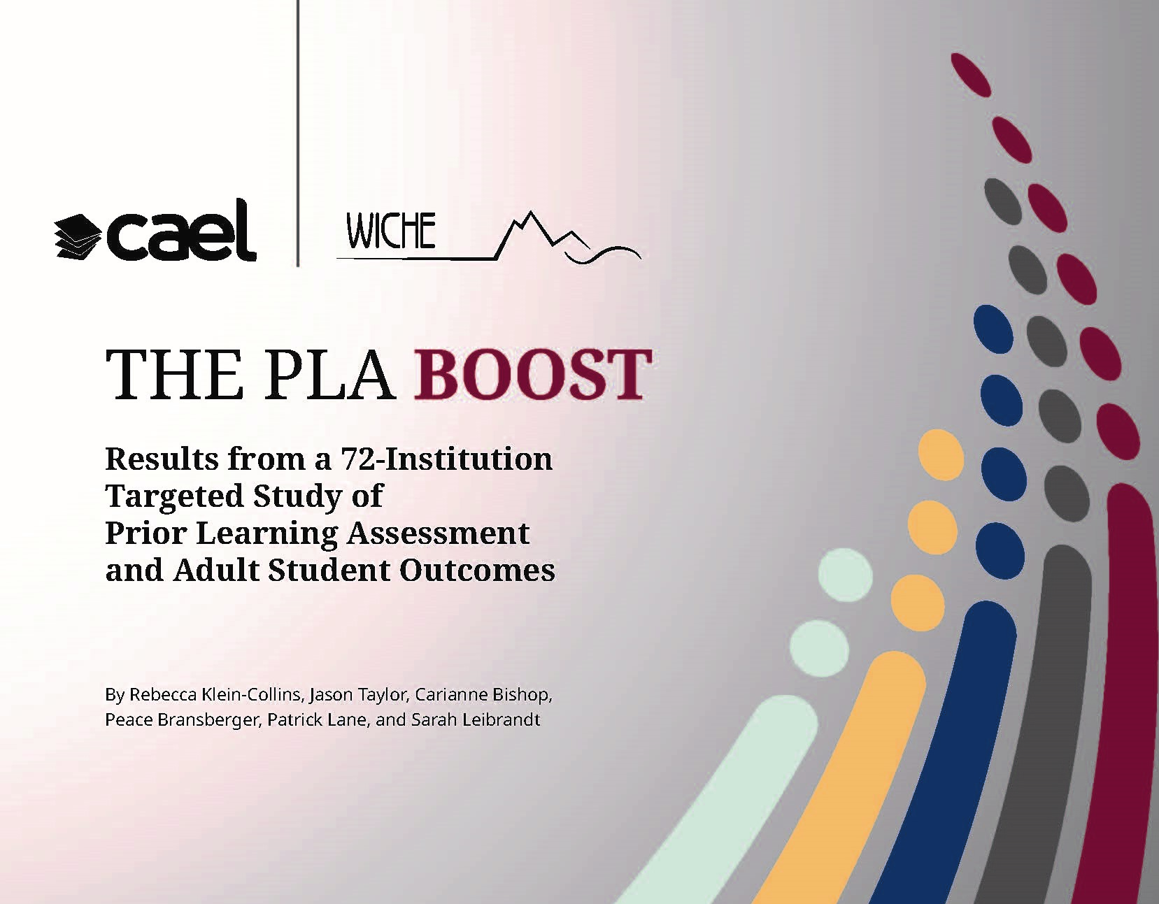
CPL: A credential completion tool
CPL boosts credential completion rates for adult students and has the potential to affect equity in educational attainment.
When controlling for other factors, the boost for adult student completion is 16% for all prior learning assessment (PLA) methods. This includes a boost of 14% for Black adults, 24% for Hispanic adults, 33% for Pell Grant recipients, and 25% for adult students at community colleges.

Slide 29
CPL: Evidence-based Findings
CPL saves adult students both time and money. Average adult student savings at public 2-year colleges is $1,481. At 2-year public institutions, adult students saved an average of 14 months in the earning of an associate degree if they earned at least 12 CPL credits.
There is a strong business case for CPL. On average, adult students that received CPL took 17.6 more credits at their institution than those who did not receive CPL, according to the data.
    Rather than taking revenue away for CPL, colleges get a net tuition gain through continued course enrollment.
  CPL attracts students who might not otherwise enroll.
Uptake remains relatively low. Only about 1 in 10 adult students received credit through CPL, according to the research. And, the rates at which students receive credit through CPL were lowest among Black students, Pell recipients, and those at community colleges.
Source: Klein-Collins, R., Taylor, J.,Bishop, C., Bransberger, P., Lane, P., and Leibrandt, S. (2020). The PLA Boost: Results from a 72-Institution Targeted Study of Prior Learning Assessment and Adult Student Outcomes. CAEL and WICHE. Retrieved from: https://www.wiche.edu/resources/pla-boost-report-updated-12-2020/

Slide 30
Fully implementing CPL is a completion strategy, and there are resources to help:
CCC Vision Resource Center (VRC)
  Policy Guidance Memorandum
  Implementation Toolkit (templates in appendix)
  Community forum
  Presentation archives
Regional Equity and Recovery Partnerships (RERP) grants: for CPL, CBE & work-based learning; awards to be announced this fall
Academic Senate for California Community Colleges CPL Resources:
  Credit for Prior Learning as an Equity Lever [article](November 2020)
  Implementing Credit for Prior Learning webinar [recording] (February 11, 2021)
  CTE Liaison Coffee Hour webinar [slides] (March 18, 2021)
Notes:
The California Labor and Workforce Development Agency in partnership with the California Workforce Development Investment Board announced $24,050,000 in competitive grants to fund Regional Equity and Recovery Partnerships (RERP) between Local Workforce Development Boards and Community College Regional Consortia. Applications have been received, scored, and the Labor agency is in the process of approving awards for public announcement sometime in Sept. Upon confirmation of their award the CO will fund colleges who were part of winning proposals with the $10M funds we were allocated.
The primary objectives of these grants are to create quality jobs, preparing Californians for those jobs, ensuring access for those too often left behind, and supporting employers who are investing in their workforce.
The strategies include, but are not limited to interventions that:
Improve job quality and job access, including for women and people from underserved and underrepresented populations.
Meet the skill and profitability needs of employers.
Meet the economic, social, and environmental needs of the community.
For the community college portion of the grants, districts and colleges will be funded to address the following:
credit for prior learning,
competency-based education, and
work-based learning provisions outlined in Assembly Bill 132 to support the strategies mentioned above in creating access to quality jobs for students.

Slide 31
CPL Rersources, continued:
Palomar College, CPL Resources Web Page
  Innovative local implementation resources [https://www.palomar.edu/cpl/]
Military Articulation Platform (MAP), Norco College
  Community College Voice Podcast: Military Articulation Platform (MAP) at Norco College on Apple Podcasts
  American Association of Community Colleges (AACC): Article on the California MAP Initiative
  Workingnation: Article on the California MAP Initiative
  3-Minute Introductory Video on MAP
  MAP Website
Notes:
The California Labor and Workforce Development Agency in partnership with the California Workforce Development Investment Board announced $24,050,000 in competitive grants to fund Regional Equity and Recovery Partnerships (RERP) between Local Workforce Development Boards and Community College Regional Consortia. Applications have been received, scored, and the Labor agency is in the process of approving awards for public announcement sometime in Sept. Upon confirmation of their award the CO will fund colleges who were part of winning proposals with the $10M funds we were allocated.
The primary objectives of these grants are to create quality jobs, preparing Californians for those jobs, ensuring access for those too often left behind, and supporting employers who are investing in their workforce.
The strategies include, but are not limited to interventions that:
Improve job quality and job access, including for women and people from underserved and underrepresented populations.
Meet the skill and profitability needs of employers.
Meet the economic, social, and environmental needs of the community.
For the community college portion of the grants, districts and colleges will be funded to address the following:
credit for prior learning,
competency-based education, and
work-based learning provisions outlined in Assembly Bill 132 to support the strategies mentioned above in creating access to quality jobs for students.

Slide 32
Ethnic Studies Implementation
  Implementation:
  Define ethnic studies for the CCC System;
  Establish an Ethnic Studies Transfer Model Curriculum;
  Create the needed C-ID course descriptors;
  Examine and update ethnic studies minimum qualifications;
  Update the Program and Course Approval Handbook;
  Provide professional development to ensure ethnic studies is implemented with fidelity; and
  Coordinate with CSU for alignment.
Title 5, §55063
(3) Satisfactory completion of a transfer-level course (minimum of three semester units or four quarter units) in ethnic studies. This requirement may be satisfied by obtaining a satisfactory grade in a course in ethnic studies taught in or on behalf of other departments and disciplines.
Notes:
Consultation Council on March 18, 2021
Board of Governors on May 24, 2021 for a first reading
2nd read at July BOG
September 2019, the Board of Governors adopted the 68 Diversity, Equity and Inclusion Integration Plan recommendations
June 2020, the Chancellor’s Office released the Diversity, Equity and Inclusion (DEI) Call to Action
Historically, ethnic studies is the interdisciplinary and comparative study of race and ethnicity with special focus on four historically defined racialized groups — Native Americans, African Americans, Asian Americans & Pacific Islanders, and Latina/o Americans. As such, instituting ethnic studies as a graduation requirement for the Associate degree is an important step in diversifying curriculum and one important tool for creating anti-racism curriculum
Field advocating in 2020:
ASCCC adopted Resolution 9.03
SSCCC adopted Resolution S21.01.05
California Community Colleges Ethnic Studies Faculty Council (www.cccesfcouncil.org/), consisting of 200 ethnic studies faculty from across the California Community College (CCC) System
Alignment with newly created Area F for CSU general education breadth to implement a lower-division ethnic studies requirement
Governor's Council for Post-Secondary Education report, “Recovery with Equity: Roadmap for Higher Education After the Pandemic”
The Chancellor’s Office will work in collaboration with the ASCCC, the SSCCC, the CCC Ethnic Studies Faculty Council, and the applicable intersegmental groups (i.e. Intersegmental Curriculum Workgroup and Course Identification Numbering System (C-ID)) where appropriate to:
Define ethnic studies for the CCC System;
Establish an Ethnic Studies Transfer Model Curriculum;
Create the needed C-ID course descriptors;
Examine and update ethnic studies minimum qualifications;
Update the Program and Course Approval Handbook;
Provide professional development to ensure ethnic studies is implemented with fidelity; and
Coordinate with CSU for alignment.

Slide 33
CCC Ethnic Studies Implementation Taskforce Updates
Goal 1. To determine an implementation date for the new CCC ethnic studies requirement By fall 2024 Timeline included in recent memo | Goal 2. To establish ethnic studies core competencies for the California Community Colleges Drafting CCC ethnic studies core competencies Will undergo a vetting process through C-ID in fall
Goal 3. To help coordinate professional development and technical assistance for the California Community Colleges to ensure ethnic studies is implemented with fidelity to the disciplines CCC Ethnic Studies Requirement Professional Learning Survey disseminated Vision Resource Center community created FAQ forthcoming | Goal 4. To coordinate with California State University for intersegmental alignment Aligning CCC core competencies with the CSU Area F and the UC IGETC Area 7 Coordinating on potential shared professional development
The taskforce will continue their work in 2022-2023.
Notes:
Consultation Council on March 18, 2021
Board of Governors on May 24, 2021 for a first reading
2nd read at July BOG
September 2019, the Board of Governors adopted the 68 Diversity, Equity and Inclusion Integration Plan recommendations
June 2020, the Chancellor’s Office released the Diversity, Equity and Inclusion (DEI) Call to Action
Historically, ethnic studies is the interdisciplinary and comparative study of race and ethnicity with special focus on four historically defined racialized groups — Native Americans, African Americans, Asian Americans & Pacific Islanders, and Latina/o Americans. As such, instituting ethnic studies as a graduation requirement for the Associate degree is an important step in diversifying curriculum and one important tool for creating anti-racism curriculum
Field advocating in 2020:
ASCCC adopted Resolution 9.03
SSCCC adopted Resolution S21.01.05
California Community Colleges Ethnic Studies Faculty Council (www.cccesfcouncil.org/), consisting of 200 ethnic studies faculty from across the California Community College (CCC) System
Alignment with newly created Area F for CSU general education breadth to implement a lower-division ethnic studies requirement
Governor's Council for Post-Secondary Education report, “Recovery with Equity: Roadmap for Higher Education After the Pandemic”
The Chancellor’s Office will work in collaboration with the ASCCC, the SSCCC, the CCC Ethnic Studies Faculty Council, and the applicable intersegmental groups (i.e. Intersegmental Curriculum Workgroup and Course Identification Numbering System (C-ID)) where appropriate to:
Define ethnic studies for the CCC System;
Establish an Ethnic Studies Transfer Model Curriculum;
Create the needed C-ID course descriptors;
Examine and update ethnic studies minimum qualifications;
Update the Program and Course Approval Handbook;
Provide professional development to ensure ethnic studies is implemented with fidelity; and
Coordinate with CSU for alignment.

Slide 34
Baccalaureate Degree Programs (BDP)
Goal: To increase the number of bachelor’s degrees in high-demand workforce industries.
Effective January 1, 2022 and chaptered into Education Code §78040-78042.
Makes permanent the existing 15 community college pilot sites authorized by SB 850 (2014).
Allows an expansion of up to 30 community college baccalaureate degree programs per year.
Requires two application cycles with very specific timelines
Notes:
AB 927 made the pilot BDP a permanent CCCs offering
The leg stipulates two very specific application and review cycles each year in January and August
Those processes, as well as application review, have to be completed within 6 months

Slide 35
BDP Approval Process
Colleges submit applications
CO validates submissions and commences program review
CO sends proposed BDPs to 4-year segments
CO notifies colleges of final approval decisions
CO analyzes CSU & UC program duplication objections
CO convenes objecting segment(s) and negotiates agreement(s)
CO sends recommended programs for BOG approval
CO informs colleges of provisional program approval decisions & commences appeal process
CO finalizes college appeals process
Notes:
An intersegmental review process on two fronts: 1) CCCs coordinating with CSU & UC on regional workforce needs and 2) the CCCCO establishing a process for CSU, UC and AICCU to provide feedback on CC proposed BDP and for CSU & UC to submit any program duplication objectives.
It’s important to note the CO was not provided any new staff to manage these new requirements or to build the infrastructure needed to support the BDPs (items like implementing the BDPs into the curriculum submission & review process, COCI, MIS, the PCAH, etc.)

Slide 36
December 2021 – June 2022 Implementation Progress
Infrastructure Building | Program Review & Approval | Intersegmental Coordination
Designed and released BDP application and interest survey Created new Chancellor’s Office Management Information System (COMIS) data element Completed preliminary edits to Program Course Approval Handbook (PCAH) Created BDP workgroup charter & convened group | Received and certified 10 BDP applications | Designed intersegmental duplication concerns processes and procedures Convened Intersegmental Coordinating Committee Designed and distributed Intersegmental Consultation Form Distributed applications for intersegmental consultation review
July – December 2022 Implementation Pending Items
Infrastructure Building | Program Review & Approval | Intersegmental Coordination
Establish BDP program review process Design appeal process Revise BDP online application Update BDP Handbook Update PCAH Update Chancellor’s Office Curriculum Inventory system Leverage COMIS data elements and develop a BDP research agenda Create and update resources for colleges (e.g., CCCCO website and Vision Resource Center) | Create and finalize application scoring rubric Review and score January 2022 applications Implement and manage appeal process BOG review and approval of new BDPs Notify colleges of approval decisions | Complete intersegmental duplication objection process for cycle one applications Establish written agreements with segments regarding program duplication objections Review and improve intersegmental review and duplication objection process
Notes:
An intersegmental review process on two fronts: 1) CCCs coordinating with CSU & UC on regional workforce needs and 2) the CCCCO establishing a process for CSU, UC and AICCU to provide feedback on CC proposed BDP and for CSU & UC to submit any program duplication objectives.
It’s important to note the CO was not provided any new staff to manage these new requirements or to build the infrastructure needed to support the BDPs (items like implementing the BDPs into the curriculum submission & review process, COCI, MIS, the PCAH, etc.)

Slide 37
Legislation Implementation
  AB 928
  AB 1111 (Common Course Numbering)

Slide 38
Student Transfer Achievement Reform Act (AB 928)
Requires ICAS to establish a singular lower division general education pathway
  Draft disseminated for feedback
Establishes the ADT Intersegmental Implementation Committee
  Committee will begin this fall and be chaired by the CCCCO
Requires the CCCs to automatically place students on ADT pathways
  TBD
Notes:
There are three portions to the bill:
One component is the requirement that the CSU and UC create a singular lower division general education pathway by fall 2025 that will not lengthen the time-to-degree or include more units than those required under the IGETC
At this time the ICAS Single GE Subcommittee proposal developed Spring 2022 has been accepted by ICAS.
The accepted proposal now enters a vetting phase for the field into fall (all segments)
There is also an inclusion opportunity on the single GE pathway at the summer Curriculum Institute and the fall Senate curriculum regionals and plenary.
The new law requires a solution by May 2023, and application of the solution by the 2025-26 AY
Other components of the bill:
Establishes the Associate Degree for Transfer Intersegmental Implementation Committee to serve as the primary entity charged with the oversight of the ADT. The CCCCO will chair this committee for the first two years, which Dr. Lowe has “volunteered” to do.
16 members of committee as listed in the new law (3 Senate, 3 Student Senate, 3 System Office, 1 K12, 1 AICCU, and 5 appointed by the Gov and Lieutenant Gov)
Look for meetings to begin this summer, with professional facilitation support provided by the State’s Office of Planning and Research.
Like the CCN taskforce meetings, these meetings will also be accessible to the public.
Some responsibilities of this committee are:
To serve as the primary entity charged with the oversight of the associate degree for transfer for the sole purpose of strengthening the pathway for students and to ensure it becomes the primary transfer pathway in California between campuses of the California Community Colleges and the University of California, the California State University. The oversight shall include, but is not limited to, all of the following:
(A) Ensuring a reduction in the number of excess units accumulated by California Community College students before transferring to four-year postsecondary educational institutions.
(B) Eliminating repetition of courses at four-year postsecondary educational institutions taken by California Community College students who successfully transfer into four-year postsecondary educational institutions.
(C) Increasing the number of California Community College students who transfer into a four-year postsecondary educational institution through an ADT pathway.
The third directive of AB 928 is the auto-enrollment of students into an ADT pathway. More specifically…
Where ADTs for major pathways exist, the bill would require the California Community Colleges, on or before August 1, 2024, to place students who declare a goal of transfer on their mandatory education plans on the ADT pathway if the student has not opted out, as specified, and if such a pathway exists for their intended major. More to come on that, the honest answer at this time is that my cup is full.

Slide 39
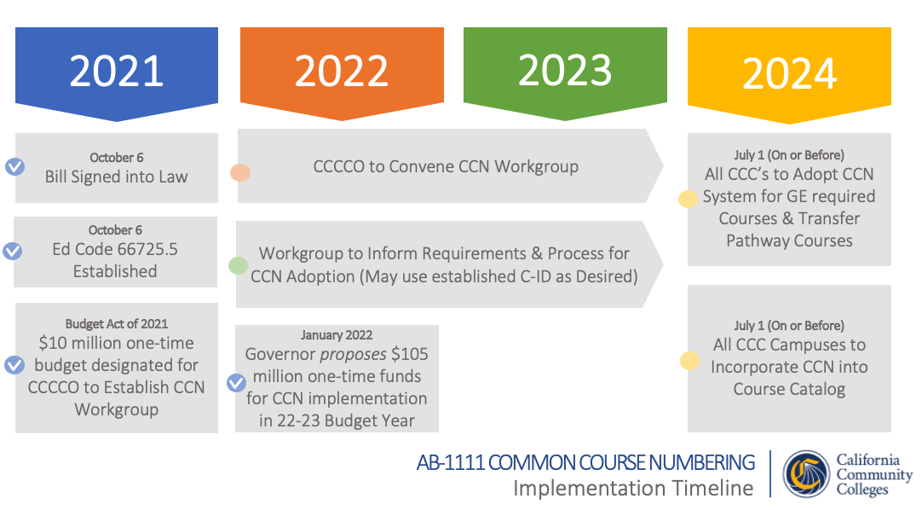
Notes:
AB 1111, known as the common course numbering project. As you can see from the slide, the end goal is a July 2024 implementation.
The project is currently nearing the conclusion of the Landscape Scan phase (June 2022)
That phase included lit review, CCN in 18 states (e.g., NV, FL, TX), 100+ interviews (national, and CA higher-ed experts), and a CCC system survey where several thousand responded representing 112 CCCs.
A final Landscape Scan report is anticipated in late June
The next phase to follow is the Solutioning Phase.
This phase leverages a Risk Mitigation plan developed using information gathered from the landscape scan (such as concerns and challenges) to form a response to how to mitigate each risk identified. This type of plan is considered a living document and will be updated as the project evolves.
As part of the Solutioning Phase, a Task Force, will be convened, supported by a charter outlining the groups charge, members, etc. for the group’s work. The taskforce is called for in the statute concerning common course numbering, and meetings will be accessible to the public.
We anticipate the taskforce convening as soon as September. The taskforce will develop a set of recommendations for the implementation plan.
Financially, $10 million is currently allocated to this project, with an additional $105 million proposed in the 2022-23 state budget.

Slide 40
We are Here to Support You
AB 705 implementation: ab705@cccco.edu
Assessment Advisory Committee: AssessmentAdvisory@cccco.edu
Baccalaureate Degree Program: BDP@cccco.edu
Competency Based Education: CBE@cccco.edu
Ethnic Studies: EthnicStudies@cccco.edu
Articulation: Bob Quinn (bquinn@cccco.edu)
Curriculum: Raul Arambula (rarambula@cccco.edu)
Rising Scholars, Puente, Umoja, HBCU, MESA, or dual enrollment: LeBaron Woodyard (lwoodyar@cccco.edu)
Financial Aid: Gina Browne (gbrowne@cccco.edu)
Apportionment: Wrenna Finche (wfinche@cccco.edu)

Slide 41
Appendix

Slide 42
Equitable Placement and Completion
2021-2022 Learning Series
July 12, 2021: Board of Governor’s Spotlight
August 4, 2021: System Webinar - Leading Courageous Conversations about Equitable Placement (recording in the VRC under the CCC | Webinars, Conferences, and Events community)
September 8, 2021: Transfer Level Gateway Completion Dashboard (recording in the VRC under the Equitable Placement and Completion community)
October 29, 2021 (2:00-3:00pm): RP Group/MMAP webinar - Emerging Practices and Resources to Support ESL Placement and Throughput: Guided Self-Placement (click here to watch)
November 5, 2021 (2:00-3:00pm): RP Group/MMAP webinar - Emerging Practices and Resources to Support ESL Placement and Throughput: Innovations and Practices (click here to watch)
February 14, 2022: Moving from Compliance to Ensuring Learning – Conducting Ongoing Examination, Evaluation and Reflection (recording in the VRC in EP&C community)
March 24, 2022: Equitable and Complete Messaging and Communication to Guide Student Enrollment (recording in the VRC in EP&C community)
May 9, 2022: ESL Adoption Plans & Promising Practices (recording in the VRC in EP&C community)
Notes:
(Aisha)

Slide 43
ESL Implementation Guides
Emerging Practices in ESL Guided Self Placement, January 2022
Guide providing ESL community college stakeholders with key practices and strategies to assist in the development and implementation of a Guided Self Placement (GSP) model to effectively assess English Language Learners.
ESL College Spotlights
College Spotlights feature ESL innovations taking place in California Community Colleges that support ESL student success. This includes an overview of key information relevant to other institutions that may be interested in implementing ESL course transferability practices.
  City College of San Francisco - Steps to Credit Program
  College of San Mateo - Word Jam
  Cypress College - ESL Course Transferability
  Cypress College - ESL Milestone Certificates
  Orange Coast College - SLO Assessments

Slide 44
Equitable Placement and Completion Research Briefs
English Learners: Pathways in California's Community Colleges Under AB 705
Publication in Policy Analysis for California Education (PACE). The brief highlights that ELs who graduated from a US high school and then enrolled in a community college experienced much higher throughput rates when allowed to enroll directly in transferable, college-level English composition than if they were directed to the ESL Pathway. It provides recommendations for community colleges to (a) improve placement for this subgroup of ELs, (b) integrate English support into academic instruction throughout college-level courses, and (c) better track the academic pathways of ELs from high school to college in administrative data sets.
Transition in Math from High School to Community College Before and After
AB 705, January 2022
Statewide analysis comparing high school to community college transitions in California before AB 705 came into effect in 2018 and post-implementation in fall 2019. Fewer students are repeating a math course which they successfully completed post-AB 705; However, many students continue to repeat such courses which requires additional exploration by colleges locally.
Enrollment and Success in Transfer-Level English & Math for Special Populations, July 2021
Statewide analysis of the impact of AB 705 implementation on transfer-level enrollment and throughput rates for special student populations enrolled in either English or math for the first time from fall 2015 to fall 2019. Findings suggest throughput has increased for all special populations within the timeframe tracked.
Assessment Measures for English as a Second Language Students in College: Summary of Relevant Literature, February 2021
Summary featuring recent ESL research on the benefits and challenges of different types of assessments as well as key considerations for colleges seeking to implement one or more of the main ESL assessment and placement strategies.
Notes:
(Aisha)

Slide 45
Equitable Placement and Completion Research Reports
Maximizing Completion of Transfer Level English/ESL for International Students in the California Community College System, Summer 2021; Study updates
Study exploring the evidence regarding which pathways can maximize throughput for international students, including analysis of their country of origin, language group, assessment test scores, placement levels, and beginning pathway (i.e., English or ESL).
Maximizing Math Throughput of Students Who Did Not Complete Algebra 2 in High School, August 2021
Report showing how the one-year math throughput rate of community college students varies according to the highest level of math completed in high school, with a focus on the impact of completing Algebra 2 while in high school. Findings suggest students who did not successfully complete Algebra 2 in high school have higher throughput when beginning at transferable, college-level math than intermediate Algebra.
Enrollment and Success in Transfer-Level English and Math in the California Community Colleges System, Fall 2015 to Fall 2019 Statewide Analysis, January 2021
Analysis of statewide transfer-level English and math enrollment and completion within one year, disaggregated by ethnicity and special populations. One year throughput rates show large improvements in completion of transfer level English and math for all groups.
Maximizing English Language Learner's Completion of Transferable English Composition in Community College: A focus on US High School Graduates, September 2020
Report exploring ESL pathways that maximize throughput with a focus on US high school graduates. Historically, completion of transfer-level English for ELL US high school graduates has been higher for students on the English pathway.
  English or ESL Pathways for English Language Learners Who Are U.S. High School Graduates? Effective Community College Placement Strategies, September 2020
  Infographic exploring ESL pathways that maximize throughput with a focus on US high school graduates.
Notes:
(Aisha)

Slide 46
COCI Updates
Maintenance Schedule

Slide 47
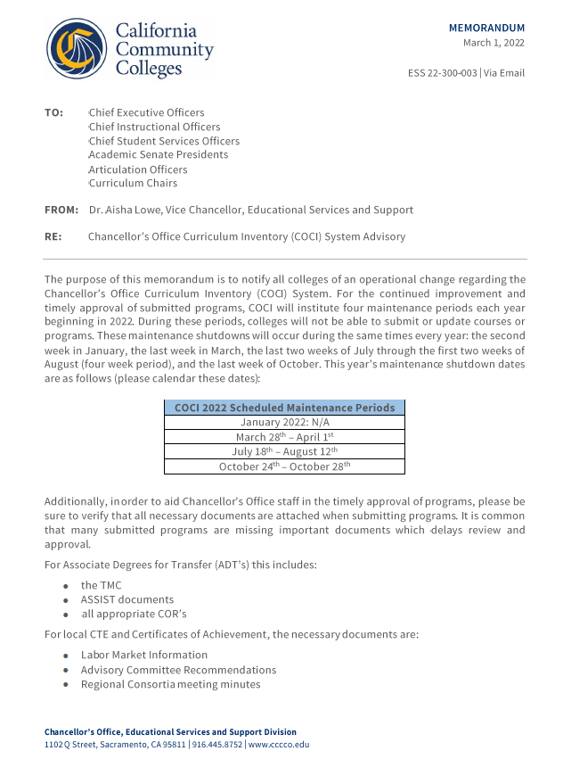

Maintenance Schedule
COCI…

Slide 48

COCI System Updates
April 2022 Release Announcement:
We are pleased to announce COCI was successfully upgraded to version 3.6 on 4/4/2022.
Version 3.6 is a combination of new features, enhancements and bug fixes.
This upgrade introduces the following features:
  UCTP and 4 year program awards with upper/lower division flag for courses
  Course editing (select fields) directly on the Associated Courses table
  Unit validations that support quarter term schools
  Admin access to Create/Edit CIP codes and add/edit/remove TOP | CIP crosswalk.
Several enhancements were also deployed in the areas of:
  Permissions management; select user at login
  Associated Courses table formatting
  Program Report export
  Print Course format

Slide 49

COCI System Updates
COCI 3.7.0 contains: Program Workflows (BA Degrees and UC Pathways awards), TMC Crosswalk, Manage Program Form, Associated Courses Table, Review Program (Change Display), Validation Rules (BA Degrees and UCTP), Program Migration, Update Internal and Public Reports (BA Degrees and UCTP), Existing Program Migration, Upper Division Courses, and C-ID API v2
Next update

Slide 50
Resources

Slide 51



Resources
EDCODE
Title V
PCAH
TOP code manual
The Data Element Dictionary
Guide
https://www.cccco.edu/

Slide 52
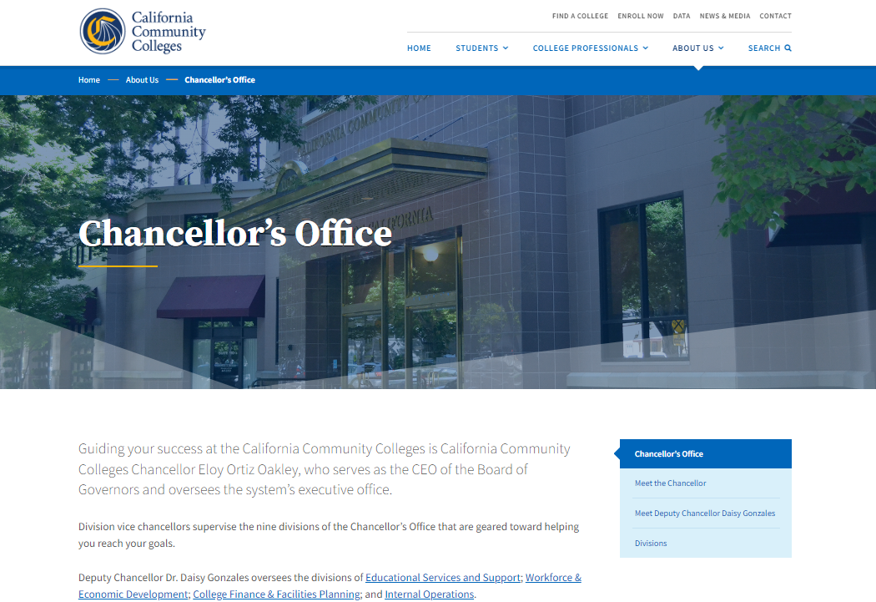
Educational Services and Support

Slide 53
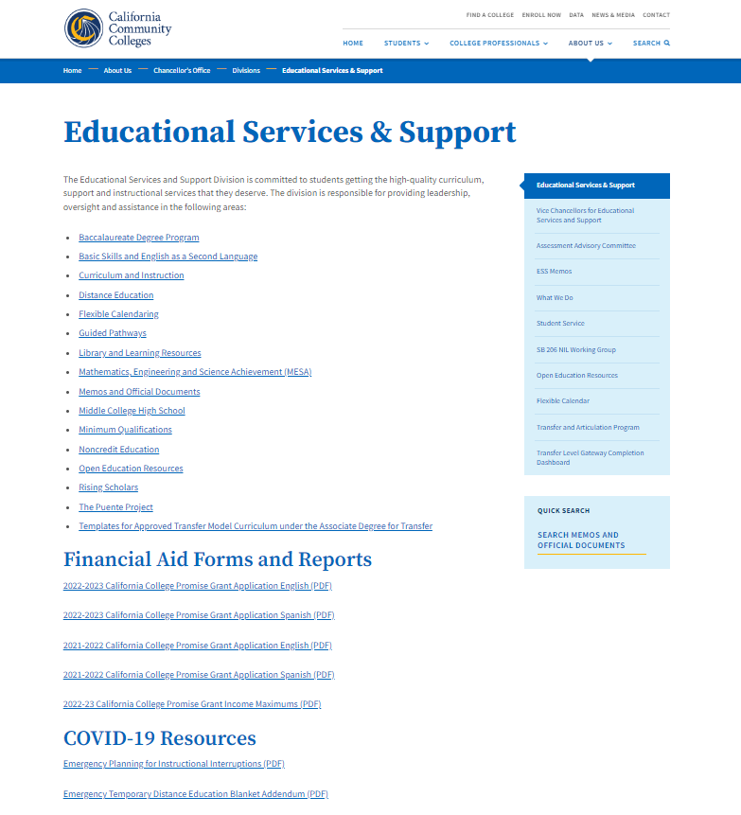


https://www.cccco.edu/About-Us/Chancellors-Office/Divisions/Educational-Services-and-Support/
Curriculum and Instruction

Slide 54
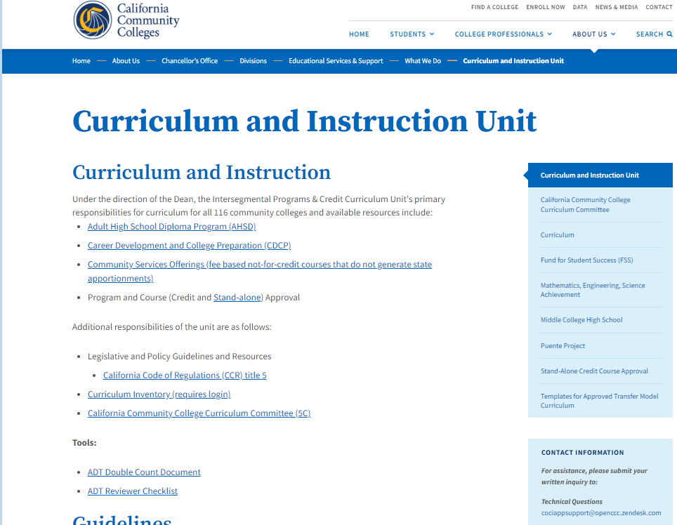
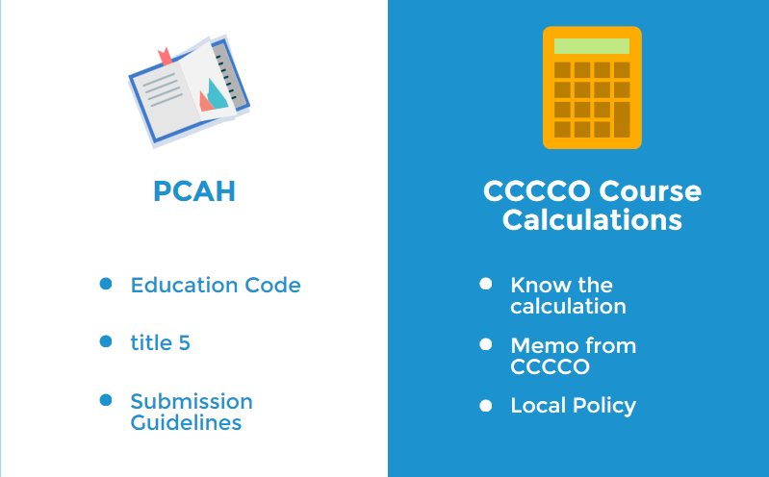
Curriculum and
Instruction Unit webpage
https://www.cccco.edu/About-Us/Chancellors-Office/Divisions/Educational-Services-and-Support/What-we-do/Curriculum-and-Instruction-Unit

Slide 55
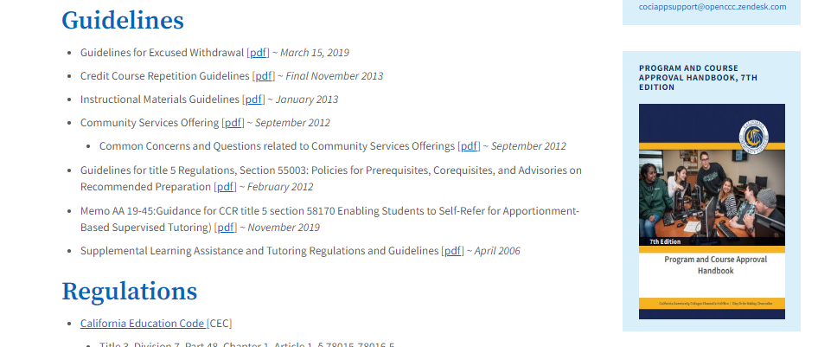
https://www.cccco.edu/About-Us/Chancellors-Office/Divisions/Educational-Services-and-Support/What-we-do/Curriculum-and-Instruction-Unit

Slide 56
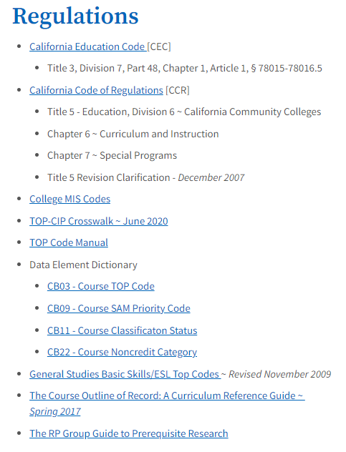
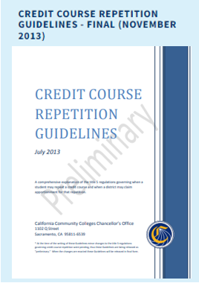
https://www.cccco.edu/About-Us/Chancellors-Office/Divisions/Educational-Services-and-Support/What-we-do/Curriculum-and-Instruction-Unit

Slide 57
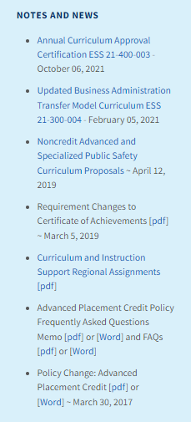
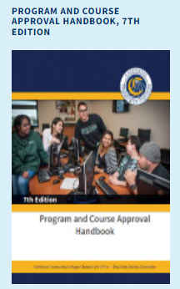
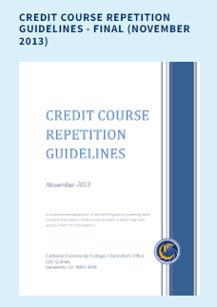
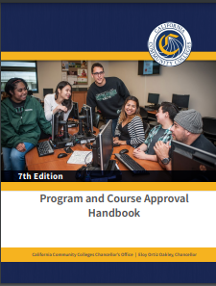
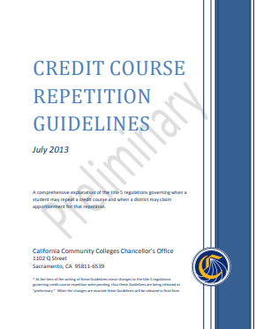
https://www.cccco.edu/About-Us/Chancellors-Office/Divisions/Educational-Services-and-Support/What-we-do/Curriculum-and-Instruction-Unit

Slide 58
Submission Requirements
Credit Programs (AA/AS/COA)
Noncredit
ADTs

Slide 59

With streamlining and auto-approval, the Chancellor’s Office no longer reviews every type of award when it is submitted to COCI.
Awards that are reviewed at submission:*
  New and Revised ADTs
  New CTE Certificates of Achievement
  New CTE AS/AA Degree
  New and Revised CDCP Noncredit (short term vocational)
*Colleges are still responsible for maintaining supporting documents for all awards, as specified in PCAH, even if the Chancellor’s Office does not review them at submission.

Slide 60



Credit Programs
Review of AA/AS Degrees
Compliance standards for associate degrees per title 5, § 55063
All curriculum components will be reviewed
CORs-Course Outline of Record for all courses
Narrative (with all components)
Supporting documentation for CTE associate degrees
For details refer to PCAH (7th ed):
  AA/AS: pp. 79-89

Slide 61


Credit Programs
Review of CTE Programs
Program Narrative and Associated Courses
Labor Market Information (LMI) & Analysis
  Within five years & regional for the college
  Data on Wages should be included
  **Employer survey can be used in lieu of LMI**
Regional Consortia Recommendation for the specific program
Advisory Committee Recommendation for the specific program
Program Review Date: Must be every 2 years (Education Code 78016)

Slide 62

Noncredit Programs
COMPLETION
COMPETENCY
Certificate of Completion
Certificate of Competency
All curriculum components will be reviewed
Narrative (with all components)
CORs-Course Outline of Record for all courses
Appropriate supporting documentation for short-term vocational (“CTE”) certificates
Refer to PCAH 7, Part III, Section 3 for noncredit program criteria and standards
Adult High School Diploma (AHSD) and apprenticeship see PCAH 7, Part III, Section 3 (pp. 135 – 137)
For details refer to PCAH (7th ed):
  Certificates of Achievements: pp. 89-93

Slide 63

Noncredit Programs
Only CDCP Programs in the domain of Short-Term Vocational require Chancellor’s Office approval before chaptering:
  Program is a Certificate of Completion
  Includes New and modified Short-term vocational certificates
  Includes New and modified Apprenticeships
The submission must include all required documentation (PCAH 7th ed, p. 132) including:
  Narrative – 4 items
  CORs-Course Outlines of Record for all associated courses
  Associated courses with predominantly CB11 – K and CB22 - I
  Labor Market Information
All COCI fields must coincide with COR and supporting documentation
For details refer to PCAH (7th ed):
  CDCP certificates: pp. 129-137

Slide 64

Credit Programs
ADT Review: Reminders
Verify the completion of all the proposal fields
Ensure all the required CORs are attached
Match CORs to the courses listed in the Narrative and Course Report Section
Review Narrative for completion and accuracy
Use current version of the TMC template:
https://www.cccco.edu/About-Us/Chancellors-Office/Divisions/Educational-Services-and-Support/What-we-do/Curriculum-and-Instruction-Unit/Templates-For-Approved-Transfer-Model-Curriculum
Verify total units for the major (minimum and maximum) must match the information on COCI and the TMC template.
The college name must be on the template
Verify Double Count calculation
ADT
For details refer to PCAH (7th ed):
  ADTs: pp. 73-79

Slide 65

ASSIST Documentation: AAM, BCT & GECC
AAM
Attach the appropriate ASSIST documentation as follows:
Articulation Agreement by Major (AAM) demonstration lower division preparation in the major at a CSU;
CST Baccalaureate Level Course List by Department (BCT) for the transfer Courses; and /or,
CSU GE Certification Course List by Area (GECC).
BCT
GECC

Slide 66

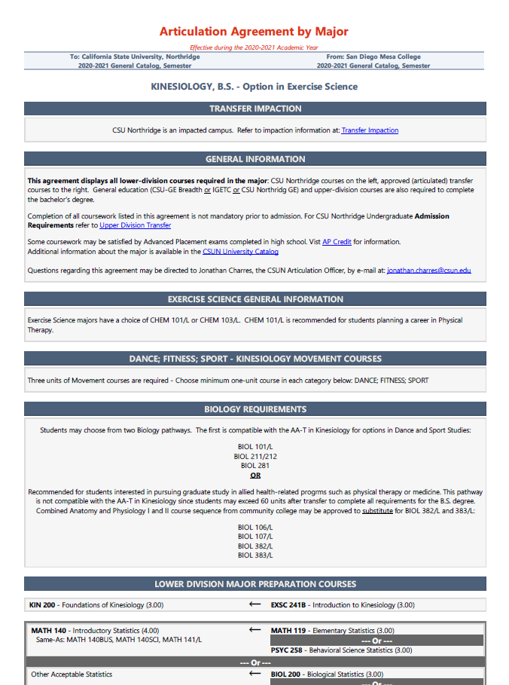
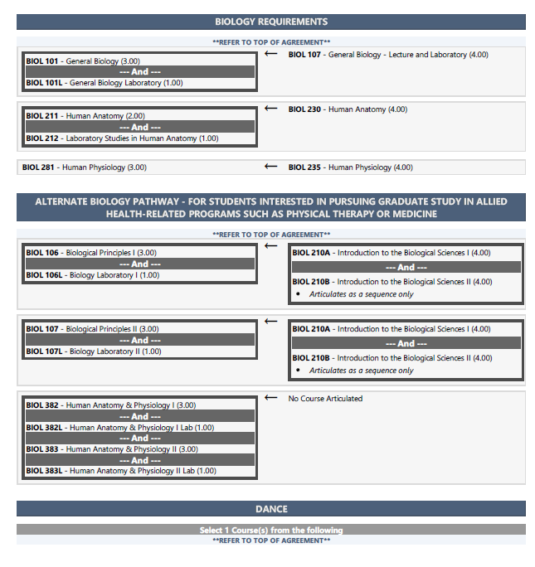
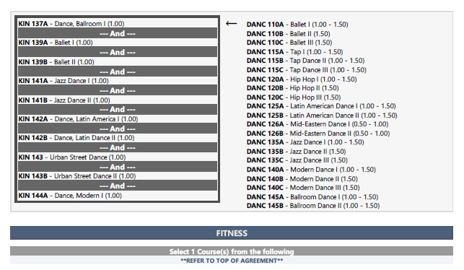
Articulation Agreement By Major (AAM)

Slide 67
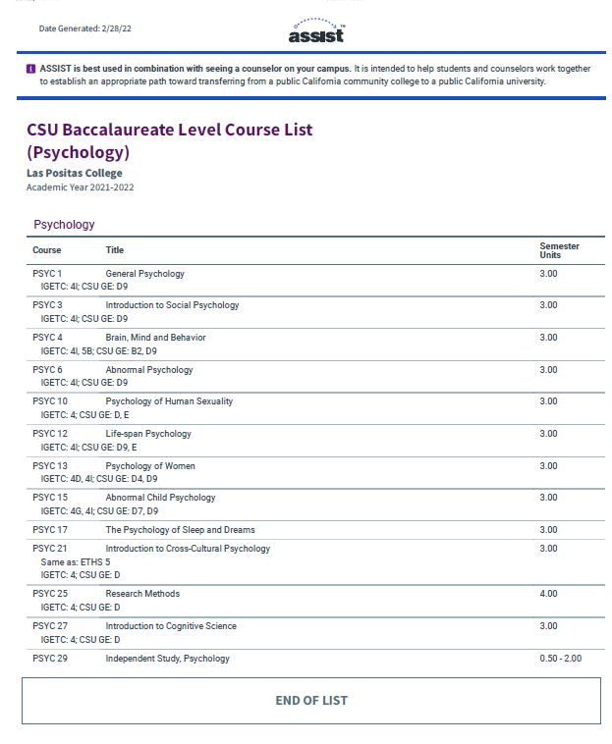
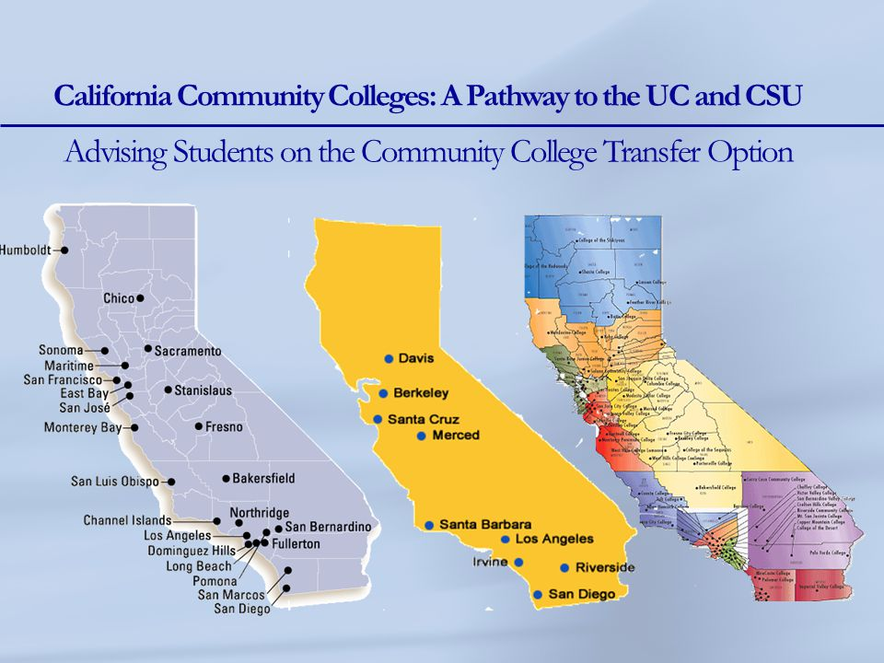

CSU Baccalaureate Level Course List by Department (BCT)

Slide 68
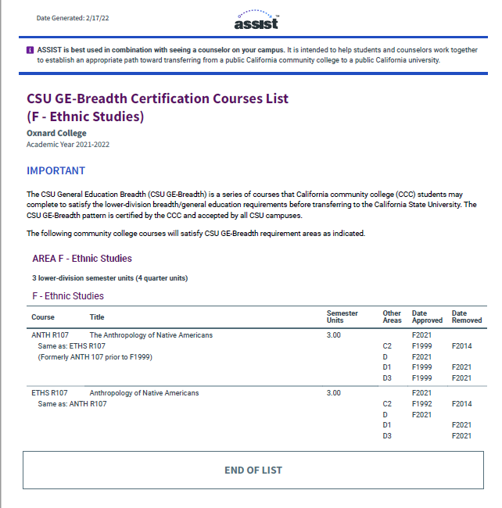
CSU GE-Breadth Certification Course List by Area (GECC)

Slide 69

When…
…Consistent Information!
…Catalog Description on COCI and the Narrative match!
…Minimum grade of “C” (or “P”)!
…Provide articulation!
…Double-counted units and electives are calculated just right!

Slide 70
Common
Submission
Errors

Slide 71

GE Area (both CSU and IGETC) – incorrect or incomplete breadth requirement next to the course
All CORS are not attached
Double count discrepancies
Courses “expired” or not submitted to C-ID
Narrative not updated when TMC is updated
Old template is used
ASSIST Supporting Documents (AAM, BCT, GECC) – incorrect report or not attached at all

Slide 72


Raul Arambula
Dean
Educational Services and Support
rarambula@cccco.edu
David Garcia
dgarcia@cccco.edu
Njeri Griffin
ngriffin@cccco.edu
Yvonne Lopez
ylopez@cccco.edu
Patti Blank
pblank@cccco.edu
Rosa Estrada
restrada@cccco.edu
Chris Graillant
CGraillat@cccco.edu
Curriculum Team

Slide 73

Questions

