Slide 1
PRE-SESSION: NEW/NEWER CURRICULUM SPECIALISTS Lesley Agostino, Diablo Valley College Randy Beach, Southwestern College Stephanie Di Alto, Saddleback College Marwin Luminarias, Fullerton College featuring Raul Arambula & David Garcia, California Community Colleges Chancellor’s Office

Slide 2
Breakout Description
Curriculum specialists play an essential role in the college curriculum process, and the work can be daunting for those new to this role. This workshop is intended for new or newer curriculum specialists and provides the basics of the roles and responsibilities of curriculum specialists, designing your own personal tracking system, best practices for submitting curriculum, and building relationships with faculty and the curriculum chair.

Slide 3
Overview
Roles and Responsibilities
Designing a Personal Tracking System for Courses and Programs
Best Practices for Submitting Curriculum
Building Relationships with Faculty and Curriculum Chair(s)
Keeping Up with Curriculum Developments
Resources
Related Breakout Sessions

Slide 4
Roles and Responsibilities
USUALLY, under the general supervision of the Vice President for Instruction, Curriculum Specialists:
Coordinate the curriculum approval process from the course and program proposal level through local and state approval, including ACCJC (if appropriate)
Oversee/manage the local curriculum management system of record and submit curriculum to the state inventory (COCI)
Validate that codes are aligned/consistent across various curriculum systems - local curriculum management system, scheduling system, COCI, etc.

Slide 5
Roles and Responsibilities, continued
Assure that new and revised curriculum is documented and approved by the district and chaptered with the CCCCO in a timely manner prior to offering
Coordinate with the CCCCO in assuring compliance for program and course approval
Attend technical review committee meetings to provide technical and resource support, especially in the area of coding
Work with faculty to clarify comments and resolve issues prior to local approval

Slide 6
Roles and Responsibilities, continued
Participate in Curriculum Committee meetings and record proceedings (agendas/minutes)
Prepare and maintain documentation related to curriculum approval (the official “historian/archivist”)
Coordinate, edit, and produce content for the college catalog/addenda and schedule of classes
Track completion of new and revised curriculum for publication

Slide 7
Roles and Responsibilities, continued
Coordinate with the Financial Aid office to update the Eligibility and Certification Approval Report (ECAR) and Program Participation Agreement (PPA)
Assist the district in reconciling any course-level referential (misalignment between what is reported and what is in the MIS master course file) or syntactical (rules based) MIS errors for the college during end-of-term reporting

Slide 8
Specialists Sometimes…
Assure compliance of the curriculum with Student Services in the areas of Articulation, Matriculation, and Admissions and Records
Perform a variety of technical duties relative to assigned area

Slide 9
Tasks of Others
Faculty or administrative responsibilities include:
Creating the Course Outline of Record (COR) and Program Narratives
Determining Course Design, including:
Method of instruction (lecture/lab/studio)
Number of course hours and units
Academic discipline
Assigning the TOP Code (CB03), CIP Code, SAM code (CB09), Basic Skills Status (CB08), Special Class Status (CB13), Levels Below Transfer (CB21), and other coding*
Determining the Minimum Qualifications for a course
These elements should be established through collegial consultation with faculty and administration

Slide 10
What is Not Part of the Specialists’ Role
Writing/revising curriculum for the faculty
The 10+1 (Title 5, §53200) gives faculty primary authority over and responsibility for curriculum
Approving curriculum
This is the purview of faculty and administrators
Submitting to ASSIST or C-ID
This is the role of the articulation officer

Slide 11
Designing a Personal Tracking System - Courses
What information is important to track regarding courses?
GE codes - local, CSU-Breadth, IGETC
C-ID descriptor
Repeatability
CB24 status
CB Code changes
Action taken/changes made and potential impact on programs
Approval dates - local, state, UCOP
Approval letters
Substantial changes (resulting in the issuance of a new control number)
Notes
Submission/activation/deactivation dates in COCI
Effective term
Catalog and scheduling deadlines

Slide 12
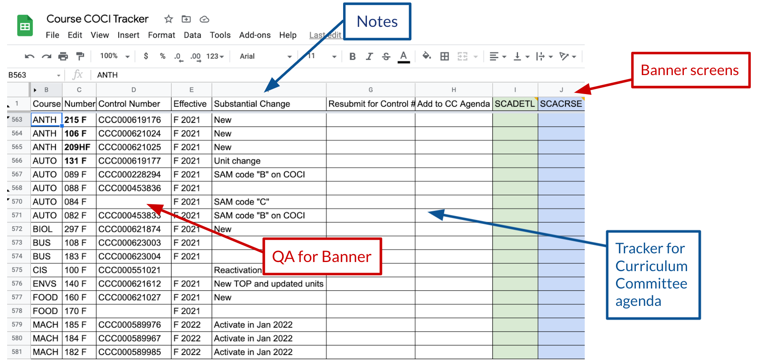

Slide 13
Designing a Personal Tracking System - Programs
What information is important to track regarding programs?
New course approvals & control numbers; inactivated courses
Narrative
Status of supporting documentation
CTE: advisory committee minutes, LMI & analysis, regional consortia recommendation, transfer documentation (if applicable)
Apprenticeship: LMI & analysis, California Division of Apprenticeship Standards approval letter
ADTs: TMC, required transfer documentation (AAM, BCT, GECC), C-ID submission status for courses pending approval
Non-CTE: transfer documentation, if applicable
Alignment of TOP Code to CIP Code

Slide 14
Designing a Personal Tracking System - Programs
What information is important to track regarding programs?
Approval dates - local, state
Approval letters
Linkage between courses and programs - course level control numbers
Certificate units - do they fit within one of the program award types in COCI?
Notes
Submission/activation/deactivation dates in COCI
Effective term
Catalog deadlines

Slide 15
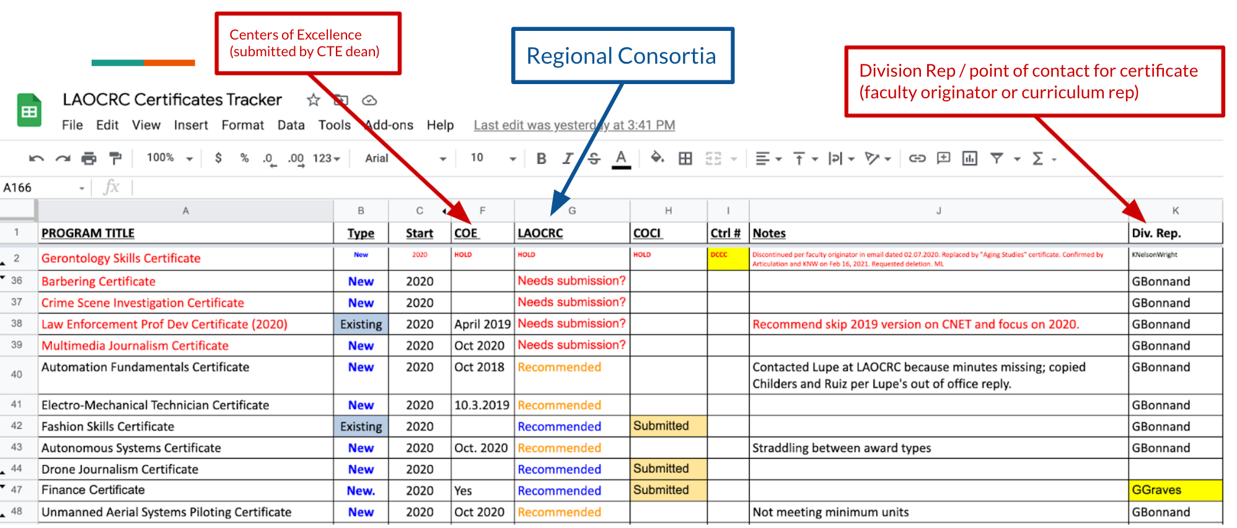

Slide 16
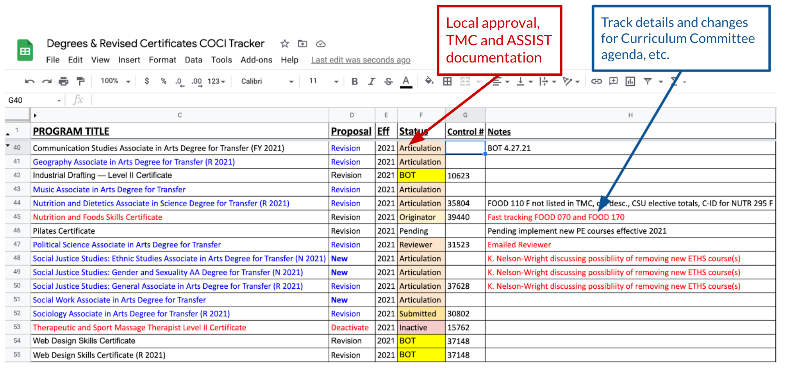

Slide 17
Best Practices for Submitting Curriculum
California Education Code
Statute, determined by legislation
Title 5
Interprets Ed Code into regulations
Defines required elements of the COR
CCCCO Program and Course Approval Handbook (PCAH)
Establishes specific guidelines for implementing Title 5
MIS Data Element Dictionary (DED)
Provides coding rules for individual Course Basic (CB) codes as well as codes that intersect (such as CB03 - TOP code and CB09 - SAM code)
Validate CB codes prior to submitting courses to the state inventory

Slide 18
Best Practices for Submitting Curriculum
The Chancellor's Office Curriculum Inventory System (COCI)
Public Version
College User Version
Review all elements of the submission carefully for accuracy and completeness prior to submitting in COCI
Chancellor's Office Curriculum staff assignments by region [link]

Slide 19
Best Practices for Submitting Curriculum - Courses
Confirm proposal fields completed in COCI match those in the COR
CB Codes
Catalog description
Minimum/maximum contact hours (credit courses), Minimum/maximum course contact hours (noncredit courses)
Minimum/maximum outside of class hours (credit courses)
Confirm only one COR is attached

Slide 20
Best Practices for Submitting Curriculum – All Program Types
Confirm proposal fields are accurate and complete in COCI and match the narrative
Program title
Program goal
Program award type
Catalog description
TOP & CIP codes - validate against crosswalk
Minimum/maximum units (or hours for noncredit CDCP)
Verify that all courses in narrative item 3 have been included in the Associated Courses section
For legacy programs confirm that old/outdated attachments (including CORs) and regenerated/duplicate attachments have been removed

Slide 21
Best Practices for Submitting Curriculum – Certificates and Associate Degrees
Confirm all required elements and supporting documentation (if applicable) is attached
Narrative
Validate double counted values in narrative item 3 for associate degrees are accurate
LMI and analysis (for CTE programs & apprenticeships) - must be current (within 2 years) and focus on local region
Advisory committee minutes (for CTE programs) - including date and location of meeting, list of attendees and job titles, and program recommendations)
If certificate or degree is new confirm the approval action for the new program is highlighted
Regional consortia recommendation (for new CTE programs)
California Division of Apprenticeship Standards Approval Letter (for apprenticeships)
Transfer documentation (if applicable)

Slide 22
Best Practices for Submitting Curriculum – ADTs
Utilize the Chancellor’s Office AA-T/AS-T Review Checklist [link]
Confirm current TMC was used, the college name is included, and the total min/max units are 60
Confirm narrative items 1-2 are attached and that the graduation requirements (completion of 60 semester or 90 quarter units, minimum overall GPA of 2.0, minimum grade of “C” or “P” for each course in the major, completion of the CSU-GE Breadth or IGETC pattern) have been included
Confirm the program goal is “Transfer” and that apprenticeship is coded as “False”
Confirm all CORs are attached and that the course prefix, number, and title for C-ID approved courses matches in both COCI and C-ID’s system
Confirm all supporting documentation (AAM, GECC, BCT) required by the TMC is attached
If a course matched to a C-ID descriptor is pending C-ID approval beyond 45 days attach documentation

Slide 23
Best Practices for Submitting Curriculum – ADTs
Double counting
Develop a basic understanding of the rules for each GE area
Refer to the Chancellor’s Office Double Count for CSU-GE, IGETC, and IGETC for STEM document [link]
Have someone from your campus experienced at double counting (such as an evaluator, counselor, or articulation officer) confirm the values provided in the TMC

Slide 24
Best Practices for Submitting Curriculum –Noncredit Certificates (CDCP)
Confirm proposal fields specific to noncredit programs are accurate and complete in COCI
Noncredit program type
CDCP eligibility criteria
Employment potential
Total core courses/hours and total elective courses/hours
Confirm all required elements and supporting documentation (if applicable) is attached
Narrative (only items 1-4 are required for noncredit programs)
LMI and analysis (only required for Short-Term Vocational programs)

Slide 25
Building Relationships with Faculty & Curriculum Chair(s)
Care and Feeding of the Faculty Curriculum Chair
Promote a team approach that sets aside perceived hierarchies
Formulate a clear understanding of respective responsibilities within the team structure
Develop and maintain regular and open communication with the chair(s)
Collaborate to develop annual curriculum timelines, calendars, goals, and objectives
Be open to ideas for process improvement and innovation wherever they come from
Attend training opportunities together and plan professional development together

Slide 26
Building Relationships with Faculty & Curriculum Chair(s)
Care and Feeding of the Faculty
Sympathize and empathize whenever possible; expect the same in return
Expect technology challenges and distracted faculty (“I never got your email!”)
Reference local documents (e.g. curriculum handbooks, local policies, etc.), Title 5, and Education Code
Communicate timelines, technology updates, support hours, etc. frequently
Provide visual representations of complex submission and approval processes, especially related to technology
Partner with the Curriculum Chair in the stickier situations (or in all situations) that may be challenging

Slide 27
Keeping Up With Curriculum Developments
Academic Senate for California Community Colleges Papers (link)
Academic Senate for California Community Colleges Rostrum (link)
California Community Colleges Board of Governors (link)
California Community Colleges Curriculum & Instruction Unit (link)
California Community Colleges Curriculum Committee (5C) (link)
Chancellor’s Office Curriculum Assistance Listserv (link)
Curriculum Institute and Regional Meetings (link)
Curriculum Specialists Listserv (send email request to join to cacurriculumstaff+owner@groups.io)

Slide 28
Resources
CCCCO MIS Data Mart (link)
Course Data Elements (link)
Credit Course Repetition Guidelines (link)
Common Concerns and Questions for Community Services Offerings (link)
Guidelines for Required Instructional Materials in the California Community Colleges (link)
Noncredit at a Glance (link)

Slide 29
Resources
Policies for Prerequisites, Corequisites, and Advisories on Recommended Preparation (link)
Program and Course Approval Handbook - 7th edition (link)
Taxonomy of Programs (6th edition) (link)
TOP-CIP Crosswalk (2020)
Located Under “Regulations” (link)
The Course Outline of Record: A Curriculum Reference Guide Revisited (Spring 2017) (link)
Supplemental Learning Assistance and Tutoring Regulations and Guidelines (link)

Slide 30
Related Breakout Sessions
Wednesday, July 7
Breakout 1 (2:00-3:15): Curriculum Basics
Breakout 2 (3:45-5:00): Noncredit Curriculum Basics
Thursday, July 8
Networking by Role (8:00-9:00): Curriculum Specialists
Breakout 3 (9:00-10:15): Work Based Learning/Work Experience Education
Breakout 4 (10:45-noon): PCAH
Breakout 5 (3:00-4:30): Navigating Curriculum Technology and Management Systems
Friday, July 9
Breakout 6 (9:00-10:15): Curriculum Committee: Effective Practices & Partnerships or Accreditation/Curriculum

Slide 31
Thank you for joining us today!
Questions?

Slide 32
Presenters’ Contact Information
Lesley Agostino: LAgostino@dvc.edu
Randy Beach: RBeach@swccd.edu
Stephanie Di Alto: sdialto@saddleback.edu
Marwin Luminarias: MLuminarias@fullcoll.edu
Raul Arambula: rarambula@CCCCO.edu
David Garcia: dgarcia@CCCCO.edu

